Slide 1
CSL 554 Text and Web Intelligence Analytics
Anjali Goyal (anjaligoyal@ncuindia.edu)
Lecture 3 – 1st August 2018 (Wednesday 09:30 AM – 10:20 AM)

Slide 2
Can’t build the matrix
Sec. 1.1
500K x 1M matrix has half-a-trillion 0’s and 1’s.
But it has no more than one billion 1’s.
matrix is extremely sparse.
What’s a better representation?
We only record the 1 positions.

Slide 3
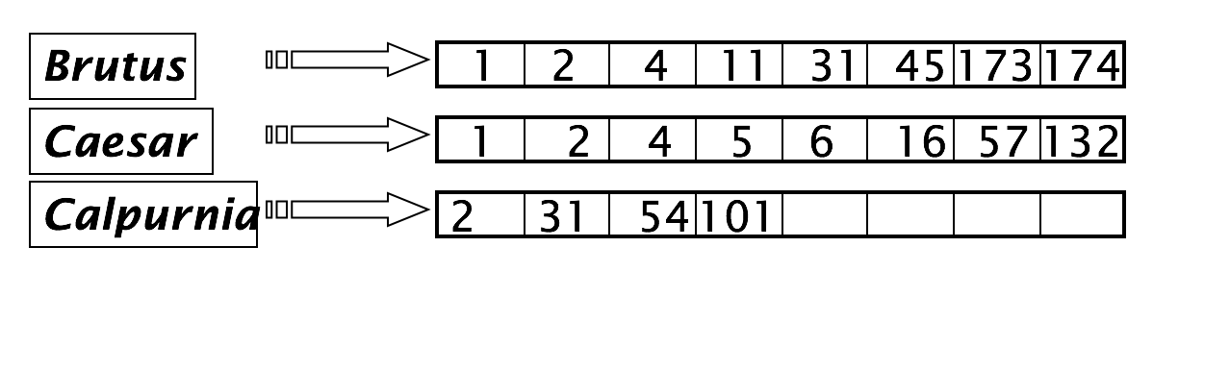
Inverted index
Sec. 1.2
For each term t, we must store a list of all documents that contain t.
Identify each by a docID, a document serial number
Can we used fixed-size arrays for this?

Slide 4
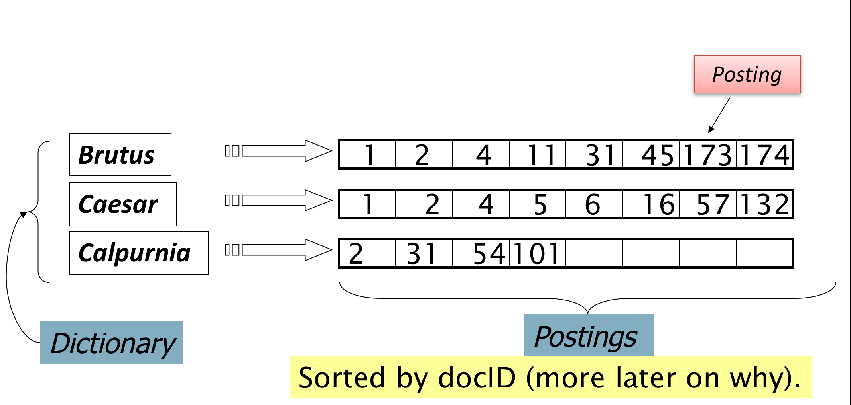
Inverted index
Sec. 1.2
We need variable-size postings lists
Notes:
Linked lists generally preferred to arrays
Dynamic space allocation
Insertion of terms into documents easy
Space overhead of pointers

Slide 5





Inverted index construction
Sec. 1.2
Documents to
be indexed.
Friends, Romans, countrymen.
Tokenizer
Token stream.
Friends
Romans
Countrymen
More on
these later.
Linguistic modules
Modified tokens.
friend
roman
countryman
Indexer
friend
2
4
roman
1
2
Inverted index.
countryman
13
16

Slide 6
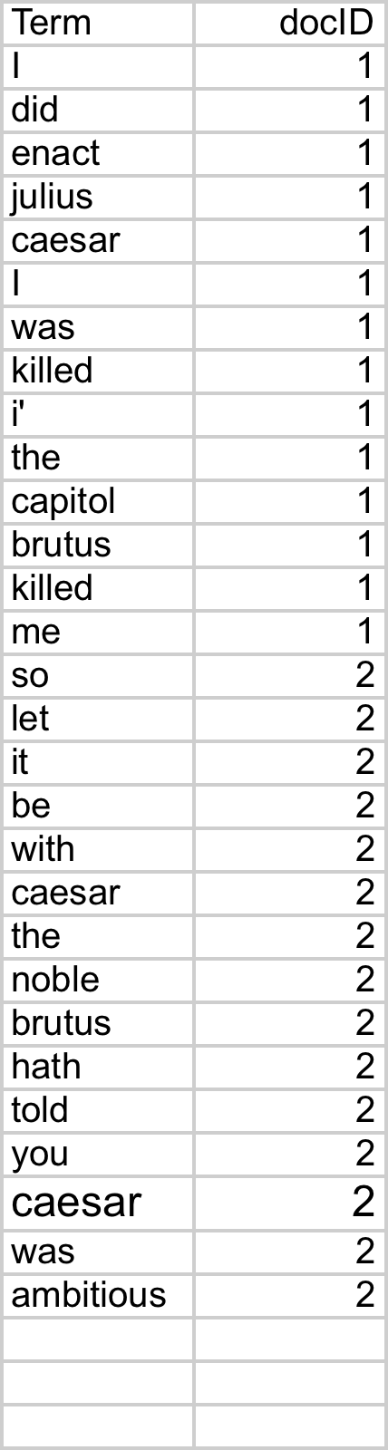
Indexer steps: Token sequence
Sec. 1.2
Sequence of (Modified token, Document ID) pairs.
Doc 1
Doc 2
I did enact Julius
Caesar I was killed
i' the Capitol;
Brutus killed me.
So let it be with
Caesar. The noble
Brutus hath told you
Caesar was ambitious

Slide 7
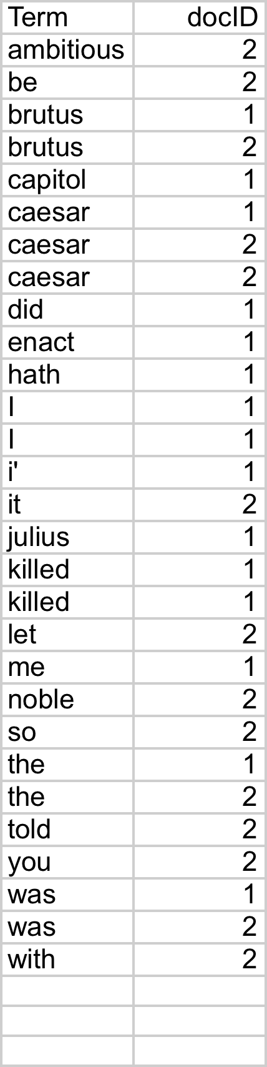
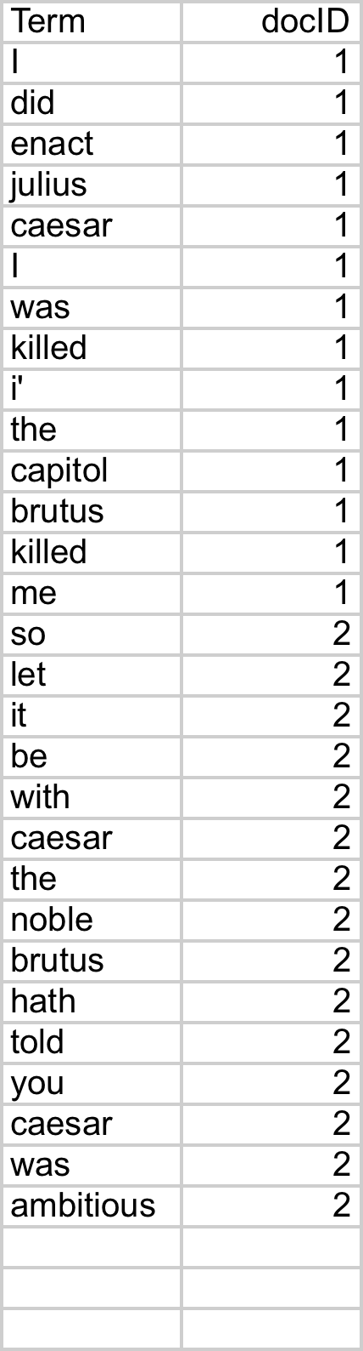
Indexer steps: Sort
Sec. 1.2
Sort by terms
And then docID
Core indexing step

Slide 8
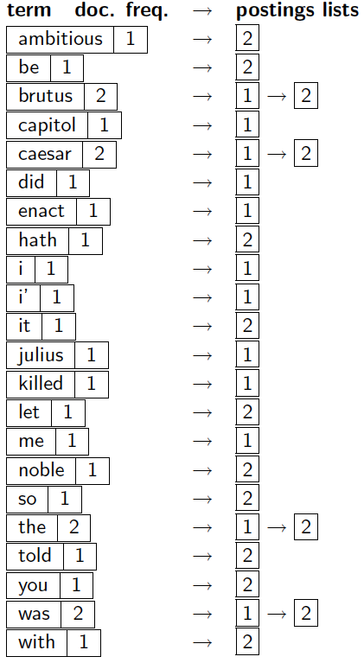
Indexer steps: Dictionary & Postings
Sec. 1.2
Multiple term entries in a single document are merged.
Split into Dictionary and Postings
Doc. frequency information is added.
Why frequency?
Will discuss later.

Slide 9
The index we just built
Sec. 1.3
Today’s focus
How do we process a query?

Slide 10
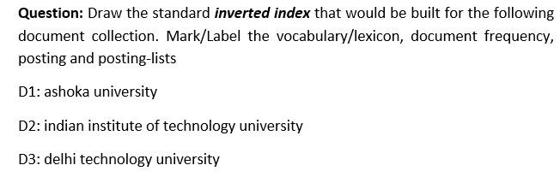
D1: NorthCap University
D2: indian institute of technology university
D3: delhi technology university

Slide 11
Query processing: AND
Sec. 1.3
Consider processing the query:
Brutus AND Caesar
Locate Brutus in the Dictionary;
Retrieve its postings.
Locate Caesar in the Dictionary;
Retrieve its postings.
“Merge” the two postings:
2
4
8
16
32
64
128
Brutus
1
2
3
5
8
13
21
34
Caesar

Slide 12
The Merge
Sec. 1.3
Walk through the two postings simultaneously, in time linear in the total number of postings entries
2
4
8
16
128
2
4
8
16
32
64
128
32
64
Brutus
2
8
1
2
5
8
13
21
34
Caesar
1
2
3
5
8
13
21
34
3
If the list lengths are x and y, the merge takes O(?)
operations.
Crucial: postings sorted by docID.

Slide 13
The Merge
Sec. 1.3
Walk through the two postings simultaneously, in time linear in the total number of postings entries
2
4
8
16
128
2
4
8
16
32
64
128
32
64
Brutus
2
8
1
2
5
8
13
21
34
Caesar
1
2
3
5
8
13
21
34
3
If the list lengths are x and y, the merge takes O(x+y)
operations.
Crucial: postings sorted by docID.

Slide 14
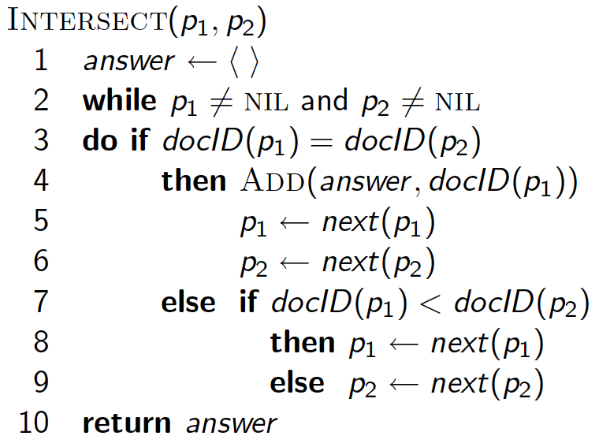
Intersecting two postings lists (a “merge” algorithm)

Slide 15
Question: Write out a postings merge algorithm for an
x OR y query.

Slide 16
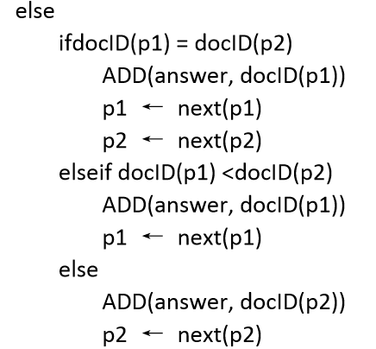
Question: Write out a postings merge algorithm for an
x OR y query.

Slide 17
Question: Write out a postings merge algorithm for an
x AND (NOT y) query.
Left Blank for Students to Solve

Slide 18
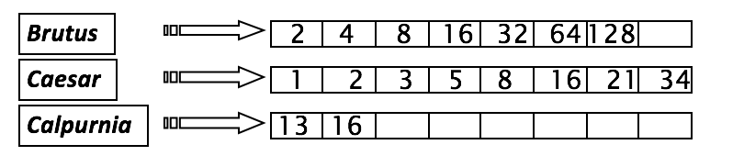
Query optimization
Sec. 1.3
What is the best order for query processing?
Consider a query that is an AND of n terms.
For each of the n terms, get its postings, then AND them together.
Query: Brutus AND Calpurnia AND Caesar
18

Slide 19
Query optimization example
Sec. 1.3
Process in order of increasing freq:
start with smallest set, then keep cutting further.
This is why we kept
document freq. in dictionary
Execute the query as (Calpurnia AND Brutus) AND Caesar.

Slide 20
More general optimization
Sec. 1.3
e.g., (madding OR crowd) AND (ignoble OR strife)

Slide 21
More general optimization
Sec. 1.3
e.g., (madding OR crowd) AND (ignoble OR strife)
Get doc. freq.’s for all terms.
Estimate the size of each OR by the sum of its doc. freq.’s (conservative).
Process in increasing order of OR sizes.

Slide 22
Exercise
Recommend a query processing order for
(tangerine OR trees) AND
(marmalade OR skies) AND
(kaleidoscope OR eyes)

Slide 23
Using the conservative estimate of the length of
unioned postings lists, the recommended order is:
(kaleidoscope OR eyes) AND
(tangerine OR trees) AND
(marmalade OR skies)

Slide 24

Thank You

