Slide 1
Faster postings merges:
Skip pointers/Skip lists

Slide 2
Recall basic merge
Sec. 2.3
Walk through the two postings simultaneously, in time linear in the total number of postings entries
2
4
8
41
48
64
128
Brutus
2
8
1
2
3
8
11
17
21
31
Caesar
If the list lengths are m and n, the merge takes O(m+n)
operations.
Can we do better?
Yes (if index isn’t changing too fast).

Slide 3
Augment postings with skip pointers (at indexing time)
Sec. 2.3
41
128
2
4
8
41
48
64
128
11
31
1
2
3
8
11
17
21
31
Why?
To skip postings that will not figure in the search results.
How?
Where do we place skip pointers?

Slide 4
Query processing with skip pointers
Sec. 2.3
41
128
2
4
8
41
48
64
128
11
31
1
2
3
8
11
17
21
31
Suppose we’ve stepped through the lists until we process 8 on each list. We match it and advance.
We then have 41 and 11 on the lower. 11 is smaller.
But the skip successor of 11 on the lower list is 31, so
we can skip ahead past the intervening postings.

Slide 5
Where do we place skips?
Sec. 2.3
Tradeoff:
  More skips → shorter skip spans ⇒ more likely to skip. But lots of comparisons to skip pointers.
  Fewer skips → few pointer comparison, but then long skip spans ⇒ few successful skips.

Slide 6
Placing skips
Sec. 2.3
Simple heuristic: for postings of length L, use √L evenly-spaced skip pointers.
This ignores the distribution of query terms.
Easy if the index is relatively static; harder if L keeps changing because of updates.

Slide 7
Why are skip pointers not useful for queries of the
form x OR y?

Slide 8
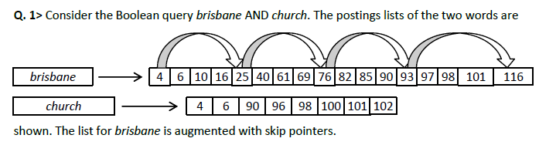
How many comparisons are required in the situation
shown, when brisbane has skips? List the comparisons
sequentially.
How often is a skip pointer used in the above situation?

Slide 9
Comparisons: <4, 4>; <25, 6> (Skip? Check – Fail);
<6, 6>; <10, 90>; <16, 90>; <25, 90>; <76, 90>
(Skip? Check – Success); <93, 90> (Skip? Check – Fail);
<82, 90>; <85, 90>; <90, 90>; <93, 96>; <116, 96>
(Skip? Check – Fail); <97, 96>; <97, 98>; <98, 98>;
<101, 100>; <101, 101>; <116, 102>
Once [25 -> 76]

Slide 10

Consider the following postings list augmented with skip
pointers at a uniform skip size of 4
At some stage in processing an AND query, we need to
merge the entries in this postings list with the entries
in the candidate list (3,5,89,95,97,99,100,101).
We define the following four operations:
Compare(A,B): compare entry A in postings list with entry B in the
candidate list
Output(X): output value X as a result of the merge process
LookAheadTo(X): peek ahead to take a look at the target X of a
skip pointer
SkipTo(X): follow a skip pointer to reach entry X

Slide 11
In performing this merge, list the instances of
Output, LookAheadTo, and SkipTo operations in the
order in which they would be executed.
(Note: Do not list instances of Compare).
You need to follow the rule that the last look ahead
value is discarded. At skip points, lookahead before
operating on the current postings entry
List the Compare operations would be executed

Slide 12
LookAheadTo(24)
Output(3)
Output(5)
LookAheadTo(75)
SkipTo(75)
LookAheadTo(92)
Output(89)
LookAheadTo(115)
Output(97)
Output(100)
there are 19 compares:
3) (3 3) (5 5) (9 89) (15 89) (24 89) (75 89) (92 89)
(81 89) (84 89) (89 89) (115 95) (92 95) (96 95) (96 97)
(97 97) (100 99) (100 100) (115 101)

