Slide 1
Phrase queries and positional indexes

Slide 2
Phrase queries
Sec. 2.4
Want to be able to answer queries such as “stanford university” – as a phrase
Thus the sentence “I went to university at Stanford” is not a match.
The sentence “The inventor Stanford Ovshinsky never went to university” is not a match.
  The concept of phrase queries has proven easily understood by users; one of the few “advanced search” ideas that works
  Many more queries are implicit phrase queries
For this, it no longer suffices to store only
<term : docs> entries

Slide 3
A first attempt: Biword indexes
Sec. 2.4.1
Index every consecutive pair of terms in the text as a phrase
For example the text “Friends, Romans, Countrymen” would generate the biwords
  friends romans
  romans countrymen
Each of these biwords is now a dictionary term
Two-word phrase query-processing is now immediate.

Slide 4
Longer phrase queries
Sec. 2.4.1
:
stanford university palo alto can be broken into the Boolean query on biwords:
stanford university AND university palo AND palo alto
Without the docs, we cannot verify that the docs matching the above Boolean query do contain the phrase.
Can have false positives!

Slide 5
Issues for biword indexes
Sec. 2.4.1
False positives, as noted before
Index blowup due to bigger dictionary
  Infeasible for more biwords
Biword indexes are not the standard solution (for all biwords) but can be part of a compound strategy

Slide 6
Solution 2: Positional indexes
Sec. 2.4.2
In the postings, store, for each term the position(s) in which tokens of it appear:
  <term, number of docs containing term;
  doc1: frequency of the term; position1, position2 … ;
  doc2: frequency of the term; position1, position2 … ;
  etc.>

Slide 7
Positional index example
Sec. 2.4.2
<be: 993427;
1: 6; 7, 18, 33, 72, 86, 231;
2: 2; 3, 149;
4: 5; 17, 191, 291, 430, 434;
5: 11; 363, 367, …>
Which of docs 1,2,4,5
could contain “to be
or not to be”?
For phrase queries, we use a merge algorithm recursively at the document level
But we now need to deal with more than just equality

Slide 8
Processing a phrase query
Sec. 2.4.2
Extract inverted index entries for each distinct term: to, be, or, not.
Merge their doc:position lists to enumerate all positions with “to be or not to be”.
  to:
    2: 5; 1,17,74,222,551; 4: 5; 8,16,190,429,433; 7: 3; 13,23,191; ...
  be:
    1: 2;17,19; 4: 5;17,191,291,430,434; 5: 3; 14,19,101; ...
Same general method for proximity searches

Slide 9
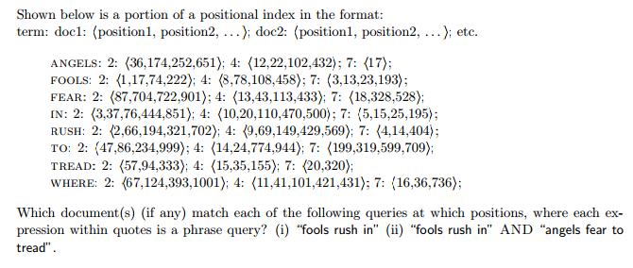

Slide 10
(i) doc2:1, doc4:8, doc7:3,13 (ii) doc4:8 & 12

Slide 11
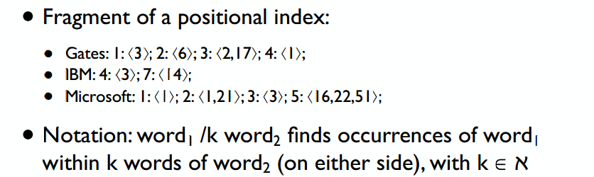
Describe the result for the query «Gates /1 Microsoft»:
Describe the result for the query «Gates /2 Microsoft»:

Slide 12
Describe the result for the query «Gates /1 Microsoft»:
: {k = 1} gives {3};
Describe the result for the query «Gates /2 Microsoft»:
: {k = 2} gives {1};

Slide 13
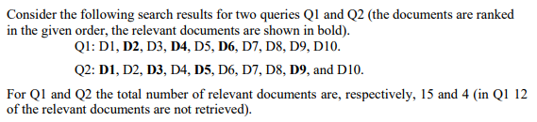

Slide 14
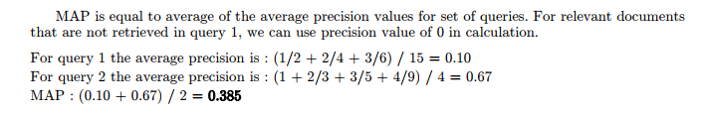

Slide 15
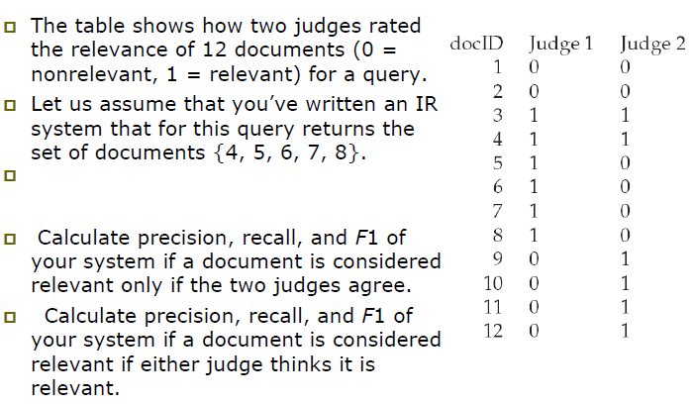
Exercise:

Slide 16
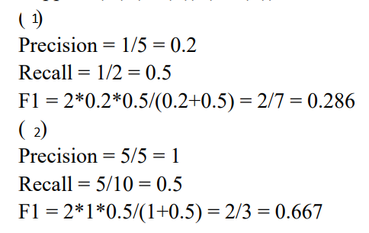

Slide 17
Assume a biword index. Give an example of a document which will be returned for a query of New York University but is actually a false positive which should not be returned.

Slide 18
New York City has Old York University
Located in Manhattan

