Slide 1
Predictive Modeling
Lecture-8 (Tuesday, 21 August 2018)

Slide 2
Supervised vs. Unsupervised Learning
Supervised learning (classification)
  Supervision: The training data (observations, measurements, etc.) are accompanied by labels indicating the class of the observations
  New data is classified based on the training set
Unsupervised learning (clustering)
  The class labels of training data is unknown
  Given a set of measurements, observations, etc. with the aim of establishing the existence of classes or clusters in the data

Slide 3
Classification—A Two-Step Process
Model construction: describing a set of predetermined classes
  Each tuple/sample is assumed to belong to a predefined class, as determined by the class label attribute
  The set of tuples used for model construction is training set
  The model is represented as classification rules, decision trees, or mathematical formulae
Model usage: for classifying future or unknown objects
  Estimate accuracy of the model
    The known label of test sample is compared with the classified result from the model
    Accuracy rate is the percentage of test set samples that are correctly classified by the model
    Test set is independent of training set (otherwise overfitting)
  If the accuracy is acceptable, use the model to classify new data
Note: If the test set is used to select models, it is called validation (test) set

Slide 4



Process (1): Model Construction
Classification
Algorithms
Training
Data
Classifier
(Model)
IF rank = ‘professor’
OR years > 6
THEN tenured = ‘yes’

Slide 5




Process (2): Using the Model in Prediction
Classifier
Testing
Data
Unseen Data
(Jeff, Professor, 4)
Tenured?

Slide 6

Illustrating Classification Task

Slide 7
Classification: Definition
Given a collection of records (training set )
  Each record contains a set of attributes, one of the attributes is the class.
Find a model for class attribute as a function of the values of other attributes.
Goal: previously unseen records should be assigned a class as accurately as possible.
  A test set is used to determine the accuracy of the model. Usually, the given data set is divided into training and test sets, with training set used to build the model and test set used to validate it.

Slide 8




Examples of Classification Task
Predicting tumor cells as benign or malignant
Classifying credit card transactions
as legitimate or fraudulent
Classifying secondary structures of protein
as alpha-helix, beta-sheet, or random
coil
Categorizing news stories as finance,
weather, entertainment, sports, etc

Slide 9
Classification Techniques
Decision Tree based Methods
Rule-based Methods
Memory based reasoning
Neural Networks
Naïve Bayes and Bayesian Belief Networks
Support Vector Machines

Slide 10
Naïve Bayes Classifier

Slide 11
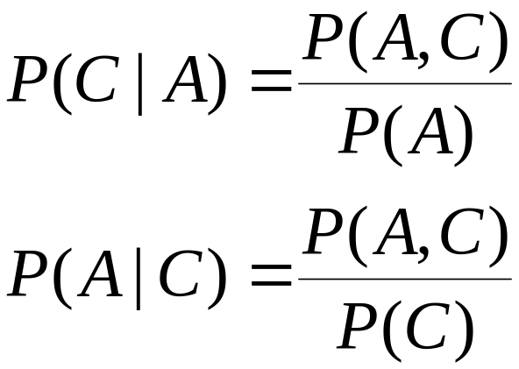
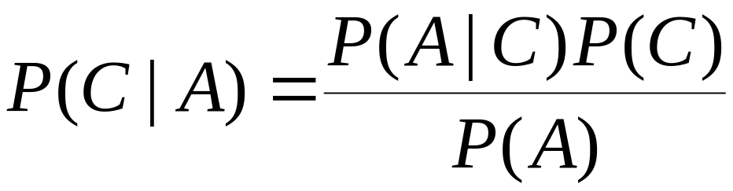
Bayes Classifier
A probabilistic framework for solving classification problems
Conditional Probability:
Bayes theorem:

Slide 12
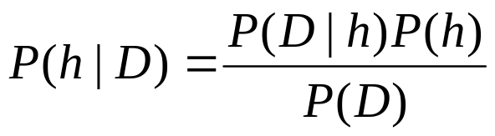
Bayes Theorem
Given a hypothesis h and data D which bears on the hypothesis:
P(h): independent probability of h: prior probability
P(D): independent probability of D
P(D|h): conditional probability of D given h: likelihood
P(h|D): conditional probability of h given D: posterior probability

Slide 13
Example of Bayes Theorem
Given:
  A doctor knows that meningitis causes stiff neck 50% of the time
  Prior probability of any patient having meningitis is 1/50,000
  Prior probability of any patient having stiff neck is 1/20
If a patient has stiff neck, what’s the probability he/she has meningitis?

Slide 14
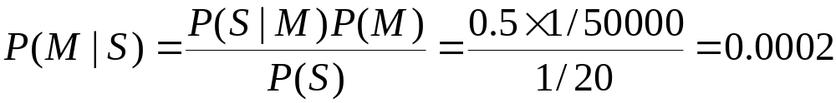
Example of Bayes Theorem
Given:
  A doctor knows that meningitis causes stiff neck 50% of the time
  Prior probability of any patient having meningitis is 1/50,000
  Prior probability of any patient having stiff neck is 1/20
If a patient has stiff neck, what’s the probability he/she has meningitis?

Slide 15
Bayesian Classifiers
Consider each attribute and class label as random variables
Given a record with attributes (A₁, A₂,…,A_{n})
  Goal is to predict class C
  Specifically, we want to find the value of C that maximizes P(C| A₁, A₂,…,A_{n} )

Slide 16
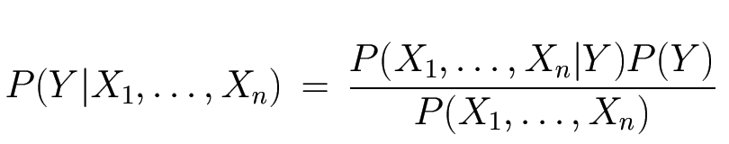
The Bayes Classifier
Likelihood
Prior
Normalization Constant

Slide 17

Example

Slide 18
Example
Learning Phase
Outlook | Play=Yes | Play=No
Sunny | 2/9 | 3/5
Overcast | 4/9 | 0/5
Rain | 3/9 | 2/5
Temperature | Play=Yes | Play=No
Hot | 2/9 | 2/5
Mild | 4/9 | 2/5
Cool | 3/9 | 1/5
Humidity | Play=Yes | Play=No
High | 3/9 | 4/5
Normal | 6/9 | 1/5
Wind | Play=Yes | Play=No
Strong | 3/9 | 3/5
Weak | 6/9 | 2/5
P(Play=Yes) = 9/14
P(Play=No) = 5/14

Slide 19
Example
Test Phase
  New instance
  Outlook=Sunny, Temperature=Cool, Humidity=High,Wind=Strong
  Look up tables
P(Outlook=Sunny|Play=Yes) = 2/9
P(Temperature=Cool|Play=Yes) = 3/9
P(Huminity=High|Play=Yes) = 3/9
P(Wind=Strong|Play=Yes) = 3/9
P(Play=Yes) = 9/14

Slide 20
Example
Test Phase
  New instance
  Outlook=Sunny, Temperature=Cool, Humidity=High, Wind=Strong
  Look up tables
P(Outlook=Sunny|Play=No) = 3/5
P(Temperature=Cool|Play==No) = 1/5
P(Huminity=High|Play=No) = 4/5
P(Wind=Strong|Play=No) = 3/5
P(Play=No) = 5/14

Slide 21
Example
Test Phase
  New instance
  Outlook=Sunny, Temperature=Cool, Humidity=High, Wind=Strong
P(Yes|x’):
[P(Sunny|Yes)P(Cool|Yes)P(High|Yes)P(Strong|Yes)]P(Play=Yes) = 0.0053
P(No|x’):
[P(Sunny|No) P(Cool|No)P(High|No)P(Strong|No)]P(Play=No) = 0.0206

Slide 22
Example
Test Phase
  New instance
  Outlook=Sunny, Temperature=Cool, Humidity=High, Wind=Strong
P(Yes|x’):
[P(Sunny|Yes)P(Cool|Yes)P(High|Yes)P(Strong|Yes)]P(Play=Yes) = 0.0053
P(No|x’):
[P(Sunny|No) P(Cool|No)P(High|No)P(Strong|No)]P(Play=No) = 0.0206
P(Yes|x’) < P(No|x’), we label x’ to be “No”.

Slide 23
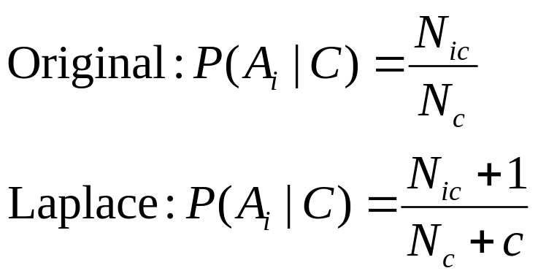
Naïve Bayes Classifier
If one of the conditional probability is zero, then the entire expression becomes zero
Probability estimation:

