Slide 1
Classification
Lecture-09 (23 August 2018, 9:30-10:20am)
6.<number>

Slide 2

Avoiding the Zero-Probability Problem
Naïve Bayesian prediction requires each conditional prob. be non-zero. Otherwise, the predicted prob. will be zero
Ex. Suppose a dataset with 1000 tuples, income=low (0), income= medium (990), and income = high (10)
Use Laplacian correction (or Laplacian estimator)
  Adding 1 to each case
    Prob(income = low) = 1/1003
    Prob(income = medium) = 991/1003
    Prob(income = high) = 11/1003
  The “corrected” prob. estimates are close to their “uncorrected” counterparts

Slide 3
Naïve Bayes Classifier: Comments
Advantages
  Easy to implement
  Good results obtained in most of the cases
Disadvantages
  Assumption: class conditional independence, therefore loss of accuracy
  Practically, dependencies exist among variables
    E.g., hospitals: patients: Profile: age, family history, etc.
      Symptoms: fever, cough etc., Disease: lung cancer, diabetes, etc.
    Dependencies among these cannot be modeled by Naïve Bayes Classifier
How to deal with these dependencies? Bayesian Belief Networks

Slide 4
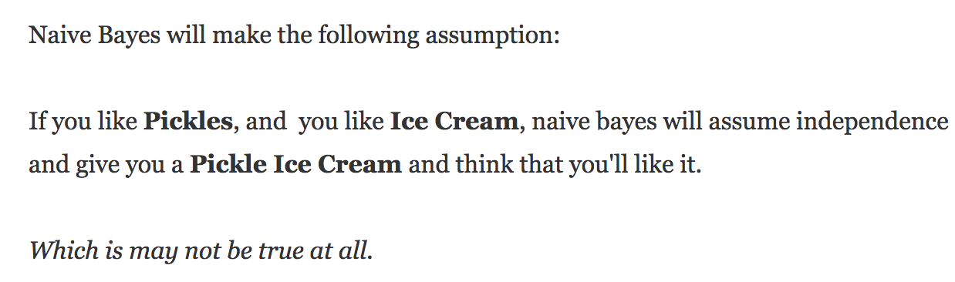
Why naïve in “Naïve Bayes”?
6.<number>

Slide 5
Classifier Evaluation Metrics: Confusion Matrix
Confusion Matrix:
Actual class\Predicted class | C₁ | ¬ C₁
C₁ | True Positives (TP) | False Negatives (FN)
¬ C₁ | False Positives (FP) | True Negatives (TN)
Example of Confusion Matrix:
Actual class\Predicted class | buy_computer = yes | buy_computer = no | Total
buy_computer = yes | 6954 | 46 | 7000
buy_computer = no | 412 | 2588 | 3000
Total | 7366 | 2634 | 10000
Given m classes, an entry, CM_{i,j} in a confusion matrix indicates # of tuples in class i that were labeled by the classifier as class j
May have extra rows/columns to provide totals

Slide 6
Evaluation Metrics: Accuracy, Error Rate, Sensitivity & Specificity
Class Imbalance Problem:
  One class may be rare, e.g. fraud, or HIV-positive
  Significant majority of the negative class and minority of the positive class
  Sensitivity: True Positive recognition rate
    Sensitivity = TP/P
  Specificity: True Negative recognition rate
    Specificity = TN/N
A\P | C | ¬C
C | TP | FN | P
¬C | FP | TN | N
 | P’ | N’ | All
Classifier Accuracy, or recognition rate: percentage of test set tuples that are correctly classified
  Accuracy = (TP + TN)/All
Error rate: 1 – accuracy, or
  Error rate = (FP + FN)/All

Slide 7
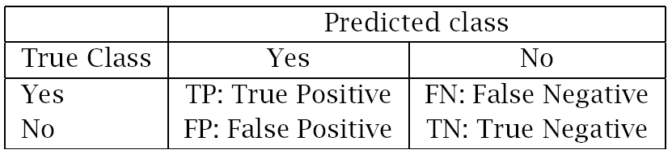
Measuring Error
Error rate = # of errors / # of instances = (FN+FP) / N
Recall = # of found positives / # of positives
= TP / (TP+FN) = sensitivity = hit rate
Precision = # of found positives / # of found
= TP / (TP+FP)
Specificity = TN / (TN+FP)
False alarm rate = FP / (FP+TN) = 1 - Specificity

Slide 8
NEAREST NEIGHBOR
CLASSIFICATION

Slide 9
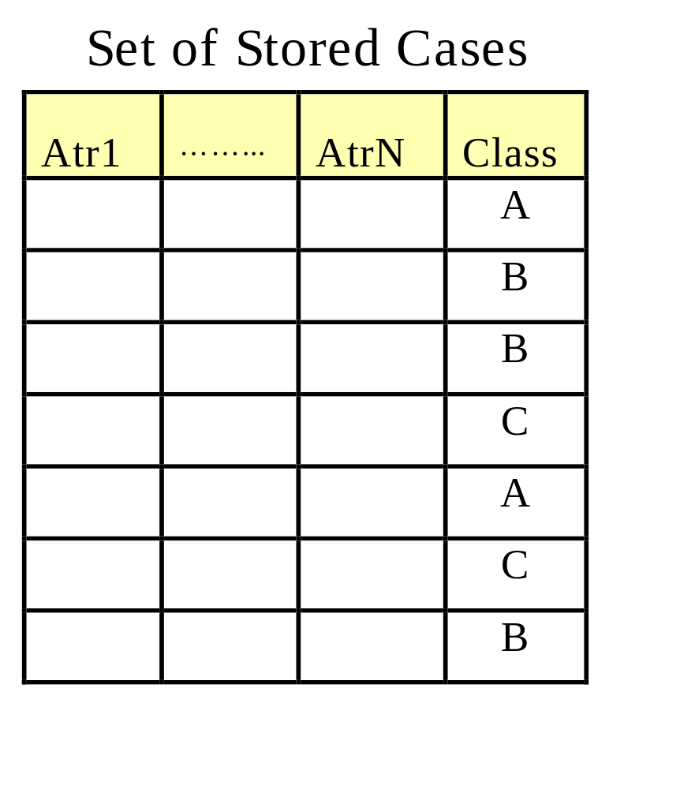
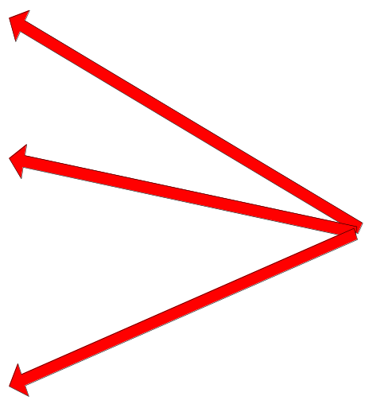
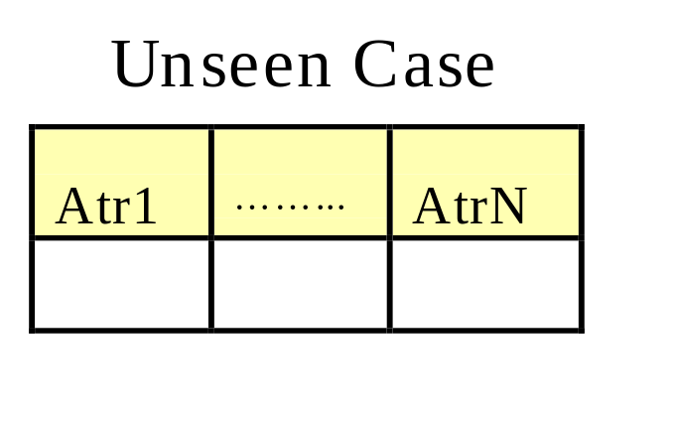
Instance-Based Classifiers
Store the training records
Use training records to
predict the class label of
unseen cases

Slide 10
Instance Based Classifiers
Examples:
  Rote-learner
    Memorizes entire training data and performs classification only if attributes of record match one of the training examples exactly
  Nearest neighbor
    Uses k “closest” points (nearest neighbors) for performing classification

Slide 11






Nearest Neighbor Classifiers
Basic idea:
  If it walks like a duck, quacks like a duck, then it’s probably a duck
Compute Distance
Test Record
Training Records
Choose k of the “nearest” records

Slide 12
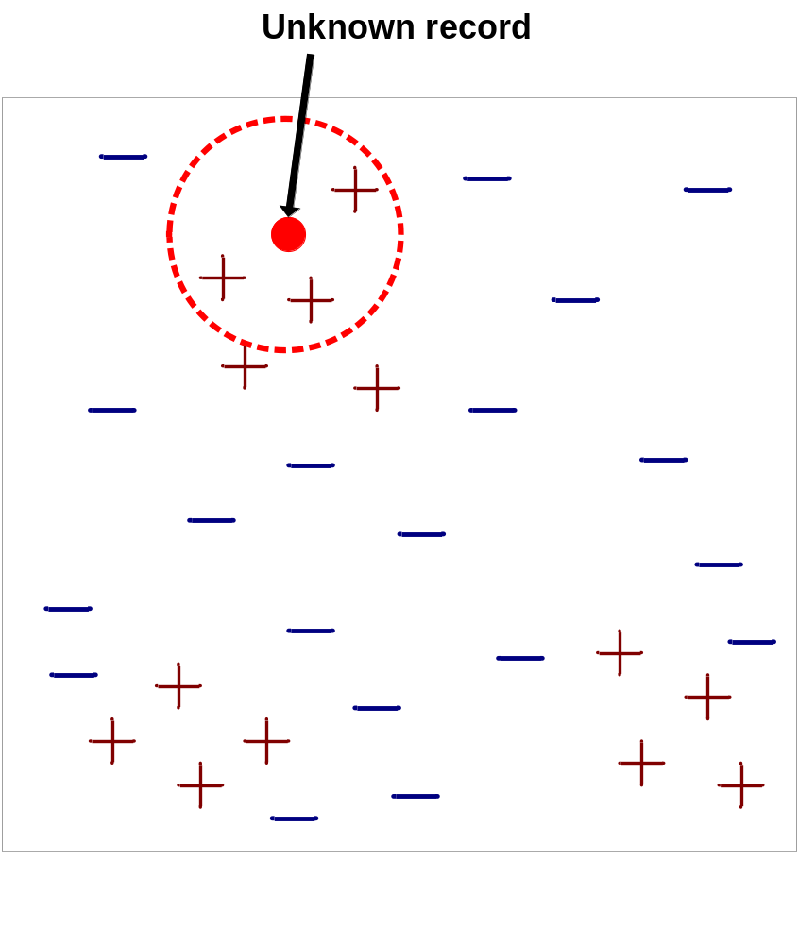
Nearest-Neighbor Classifiers
Requires three things
  The set of stored records
  Distance Metric to compute distance between records
  The value of k, the number of nearest neighbors to retrieve
To classify an unknown record:
  Compute distance to other training records
  Identify k nearest neighbors
  Use class labels of nearest neighbors to determine the class label of unknown record (e.g., by taking majority vote)

Slide 13

Definition of Nearest Neighbor
K-nearest neighbors of a record x are data points that have the k smallest distance to x

Slide 14
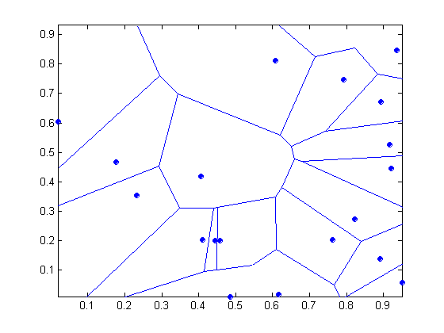
1 nearest-neighbor
Voronoi Diagram defines the classification boundary
The area takes the class of the green point

Slide 15
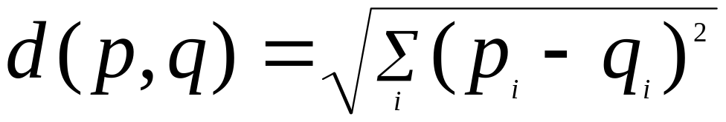
Nearest Neighbor Classification
Compute distance between two points:
  Euclidean distance
Determine the class from nearest neighbor list
  take the majority vote of class labels among the k-nearest neighbors
  Weigh the vote according to distance
    weight factor, w = 1/d²

Slide 16
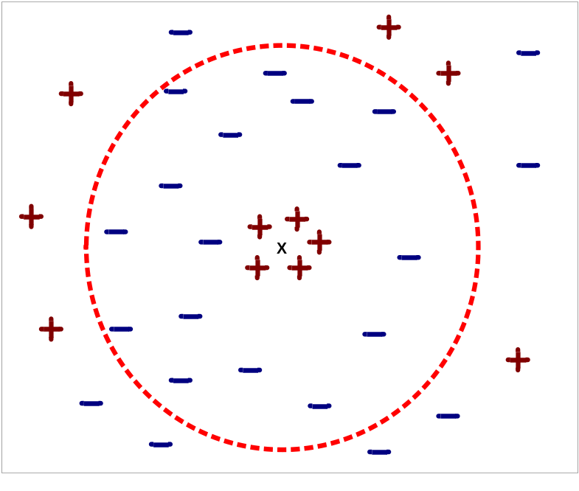
Nearest Neighbor Classification…
Choosing the value of k:
  If k is too small, sensitive to noise points
  If k is too large, neighborhood may include points from other classes

Slide 17






K-Nearest Neighbor Algorithm
To determine the class of a new example E:
  Calculate the distance between E and all examples in the training set
  Select K-nearest examples to E in the training set
  Assign E to the most common class among its K-nearest neighbors
Response
No response
No response
Class: Response
No response
Response

Slide 18
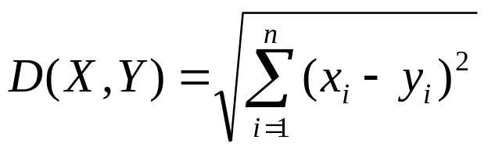
K-Nearest Neighbor Classifier
Distance Between Neighbors
Each example is represented with a set of numerical attributes
“Closeness” is defined in terms of the Euclidean distance between two examples.
  The Euclidean distance between X=(x₁, x₂, x₃,…x_{n}) and Y =(y₁,y₂, y₃,…y_{n}) is defined as:
  Distance (John, Rachel)=sqrt [(35-41)²+(95K-215K)² +(3-2)²]
  John:
  Age=35
  Income=95K
  No. of credit cards=3
  Rachel:
  Age=41
  Income=215K
  No. of credit cards=2

Slide 19
K-Nearest Neighbor: Instance Based Learning
No model is built: Store all training examples
Any processing is delayed until a new instance must be classified.
Response
No response
No response
Class: Respond
No response
Response

Slide 20
Example : 3-Nearest Neighbors
K-Nearest Neighbor Classifier
Customer | Age | Income | No. credit cards | Response
John | 35 | 35K | 3 | No
Rachel | 22 | 50K | 2 | Yes
Hannah | 63 | 200K | 1 | No
Tom | 59 | 170K | 1 | No
Nellie | 25 | 40K | 4 | Yes
David | 37 | 50K | 2 | ?

Slide 21
K-Nearest Neighbor Classifier
Example
Customer | Age | Income (K) | No. cards
John | 35 | 35 | 3
Rachel | 22 | 50 | 2
Hannah | 63 | 200 | 1
Tom | 59 | 170 | 1
Nellie | 25 | 40 | 4
David | 37 | 50 | 2
Response
No
Yes
No
No
Yes
Distance from David
sqrt [(35-37)²+(35-50)² +(3-2)²]=15.16
sqrt [(22-37)²+(50-50)² +(2-2)²]=15
sqrt [(63-37)²+(200-50)² +(1-2)²]=152.23
sqrt [(59-37)²+(170-50)² +(1-2)²]=122
sqrt [(25-37)²+(40-50)² +(4-2)²]=15.74
Yes

