Slide 1
Decision Trees

Slide 2
An example application
An emergency room in a hospital measures 17 variables (e.g., blood pressure, age, etc) of newly admitted patients.
A decision is needed: whether to put a new patient in an intensive-care unit.
Due to the high cost of ICU, those patients who may survive less than a month are given higher priority.
Problem: to predict high-risk patients and discriminate them from low-risk patients.

Slide 3
Machine learning and our focus
Human learns from past experiences.
A computer does not have “experiences”.
A computer system learns from data, which represent some “past experiences” of an application domain.
Our focus: learn a target function that can be used to predict the values of a discrete class attribute, e.g. high-risk or low-risk.
The task is commonly called: Supervised learning, classification, or inductive learning.

Slide 4
The data and the goal
Data: A set of data records (also called examples, instances or cases) described by
  k attributes: A₁, A₂, … A_{k}.
  a class: Each example is labelled with a pre-defined class.
Goal: To learn a classification model from the data that can be used to predict the classes of new (future, or test) cases/instances.
Notes:
Induction is different from deduction and DBMS does not not support induction;
The result of induction is higher-level information or knowledge: general statements about data
There are many approaches. Refer to the lecture notes for CS3244 available at the Co-Op.
We focus on three approaches here, other examples:
Other approaches
Instance-based learning
other neural networks
Concept learning (Version space, Focus, Aq11, …)
Genetic algorithms
Reinforcement learning

Slide 5
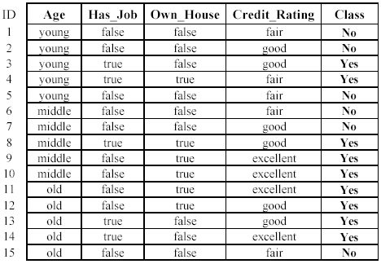
An example: data (loan application)
Approved or not

Slide 6
An example: the learning task
Learn a classification model from the data
Use the model to classify future loan applications into
  Yes (approved) and
  No (not approved)
What is the class for following case/instance?

Slide 7
Decision Tree
Decision tree learning is one of the most widely used techniques for classification.
  Its classification accuracy is competitive with other methods, and
  it is very efficient.
The classification model is a tree, called decision tree.
C4.5 by Ross Quinlan is perhaps the best known system.

Slide 8
The loan data
Approved or not

Slide 9
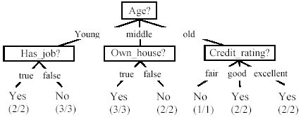
Decision tree from loan data
Decision nodes and leaf nodes (classes)

Slide 10
Use the decision tree
No

Slide 11
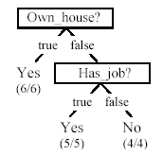
Is the decision tree unique?
No. Here is a simpler tree.
We want smaller tree and accurate tree.
  Easy to understand and perform better.
Finding the best tree is NP-hard.
All current tree building algorithms are heuristic algorithms.

Slide 12
Decision Tree Algorithm
To construct decision tree T from learning set S:
  If all examples in S belong to some class C Then
  make leaf labeled C
  Otherwise
    select the “most informative” attribute A
    partition S according to A’s values
    recursively construct subtrees T1, T2, ..., for the subsets of S

Slide 13

Hunt’s Algorithm
Refund
Don’t
Cheat
Yes
No
Don’t
Cheat
Don’t
Cheat
Refund
Refund
Yes
No
Yes
No
Don’t
Cheat
Marital
Status
Don’t
Cheat
Marital
Status
Single,
Divorced
Single,
Divorced
Married
Married
Cheat
Don’t
Cheat
Taxable
Income
Don’t
Cheat
< 80K
>= 80K
Don’t
Cheat
Cheat

Slide 14
Attribute Selection Criteria
Main principle
  Select attribute which partitions the learning set into subsets as “pure” as possible
Various measures of purity
  Information-theoretic
  Gini index
  X²
  Relief
  ...

Slide 15
Information-Theoretic Approach
To classify an object, a certain information is needed
  I, information
After we have learned the value of attribute A, we only need some remaining amount of information to classify the object
  I_{res}, residual information
Gain
  Gain(A) = I – I_{res(A)}
The most ‘informative’ attribute is the one that minimizes I_{res}, i.e., maximizes Gain

Slide 16

Entropy
The average amount of information I needed to classify an object is given by the entropy measure

Slide 17

Residual Information
After applying attribute A, S is partitioned into subsets according to values v of A
I_{res} is equal to weighted sum of the amounts of information for the subsets

Slide 18
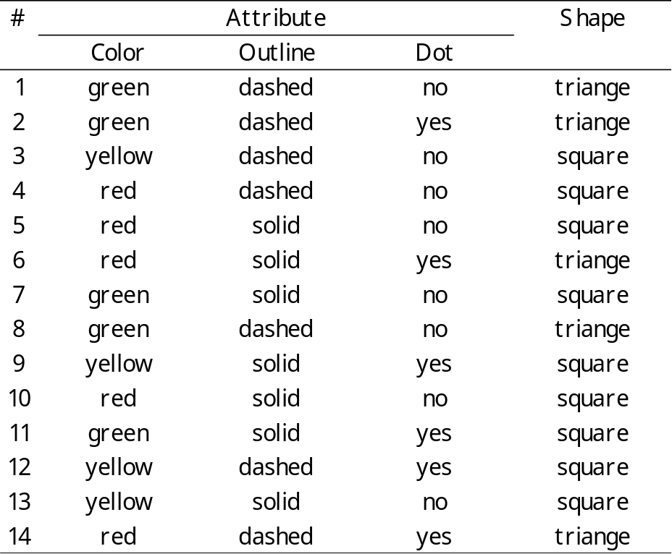
Triangles and Squares
Data Set:
A set of classified objects
.
.
.
.
.
.

Slide 19
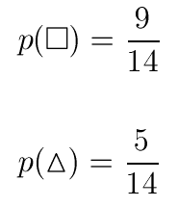

Entropy
5 triangles
9 squares
class probabilities
entropy
.
.
.
.
.
.

Slide 20



Color?
.
.
.
.
.
.
.
.
red
green
.
yellow
.
.
.

Slide 21







.
.
.
.
.
.
.
.
red
Color?
green
.
yellow
.
.
.

Slide 22
Information Gain
.
.
.
.
.
.
.
.
red
Color?
green
.
yellow
.
.
.

Slide 23
Information Gain of Attributes
Attributes
  Gain(Color) = 0.246
  Gain(Outline) = 0.151
  Gain(Dot) = 0.048
Heuristics: attribute with the highest gain is chosen
This heuristics is local (local minimization of impurity)

Slide 24
.
.
.
.
.
.
.
.
red
Color?
green
.
yellow
.
.
.
Gain(Outline) = 0.971 – 0 = 0.971 bits
Gain(Dot) = 0.971 – 0.951 = 0.020 bits

Slide 25
.
.
.
.
.
.
.
.
red
Gain(Outline) = 0.971 – 0.951 = 0.020 bits
Gain(Dot) = 0.971 – 0 = 0.971 bits
Color?
green
.
yellow
.
.
.
solid
.
Outline?
dashed
.

Slide 26
.
.
.
.
.
.
.
.
red
.
yes
Dot?
.
Color?
no
green
.
yellow
.
.
.
solid
.
Outline?
dashed
.

Slide 27
Decision Tree
.
.
.
.
.
.
Color
red
green
yellow
Dot
square
Outline
yes
no
dashed
solid
triangle
square
triangle
square

Slide 28
Add a new feature to existing dataset such that new feature is most beneficial?
Add a feature which has distinct values for all classes.
Add a new feature to existing dataset such that new feature is least beneficial?
Add a feature which has same values for all classes.

