Slide 1
The Bias-Variance Trade-Off

Slide 2
Estimating Generalization Error
The basic problem: Once I’ve built a classifier, how accurate will it be on future test data?
Problem of Induction: It’s hard to make predictions, especially about the future.
Cross-validation: clever computation on the training data to predict test performance.
Other variants: jackknife, bootstrapping.

Slide 3
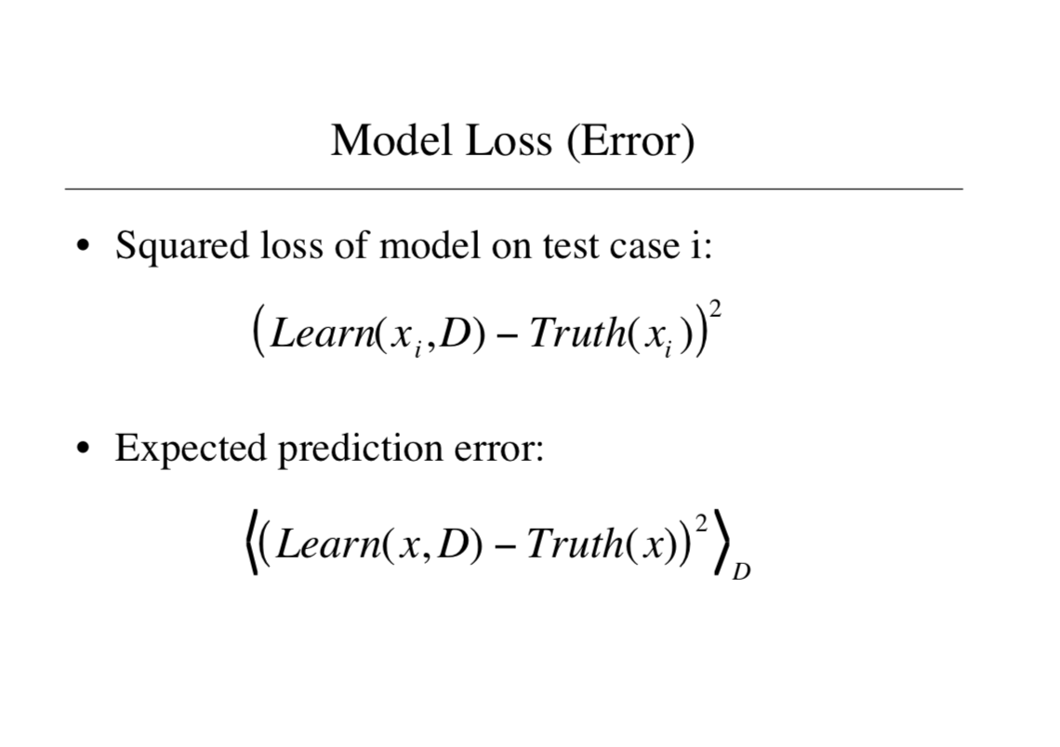

Slide 4
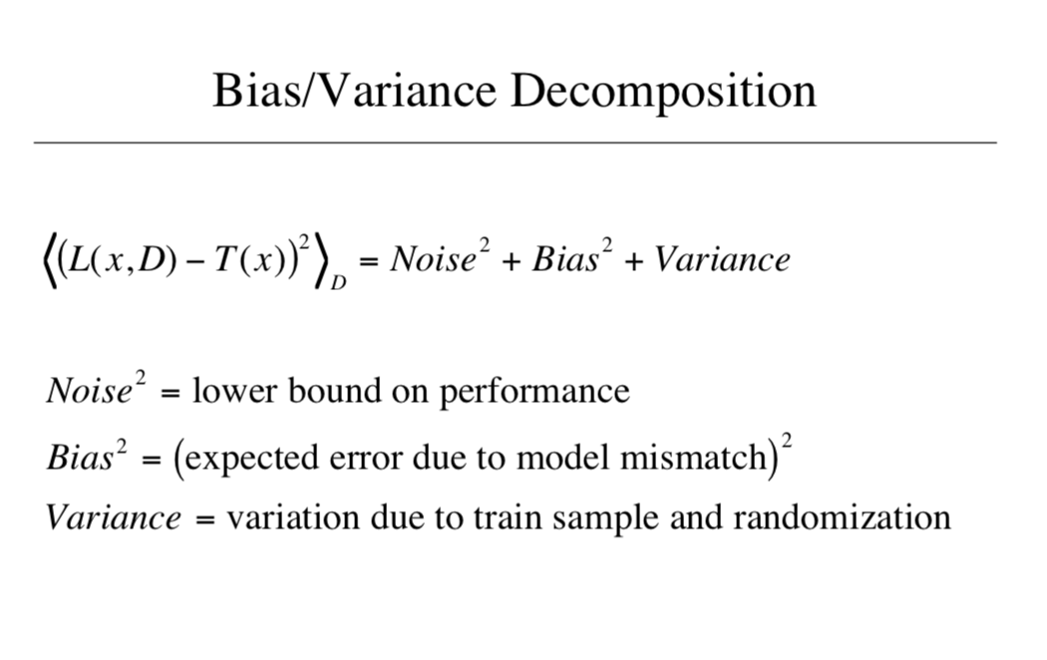

Slide 5
The Bias-Variance Trade-off
The Short Story: generalization error = bias² + variance + noise.
Bias and variance typically trade off in relation to model complexity.
Model complexity
-
+
Bias²
Variance
+
+
Error

Slide 6
Dart Example

Slide 7
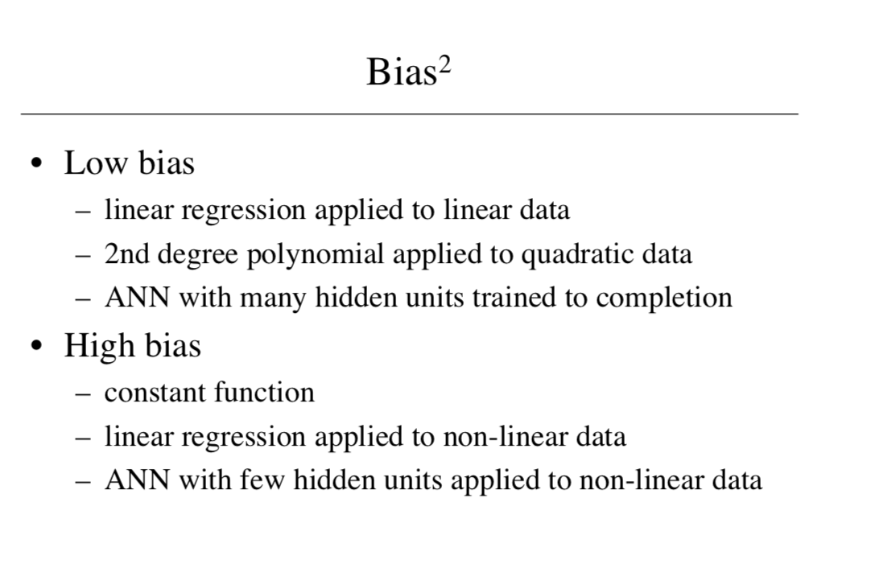

Slide 8
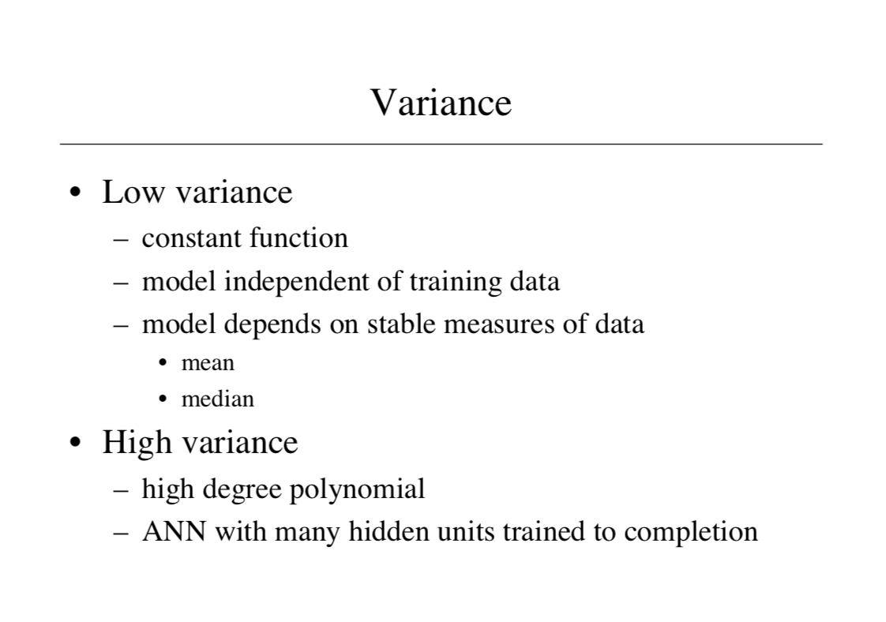

Slide 9
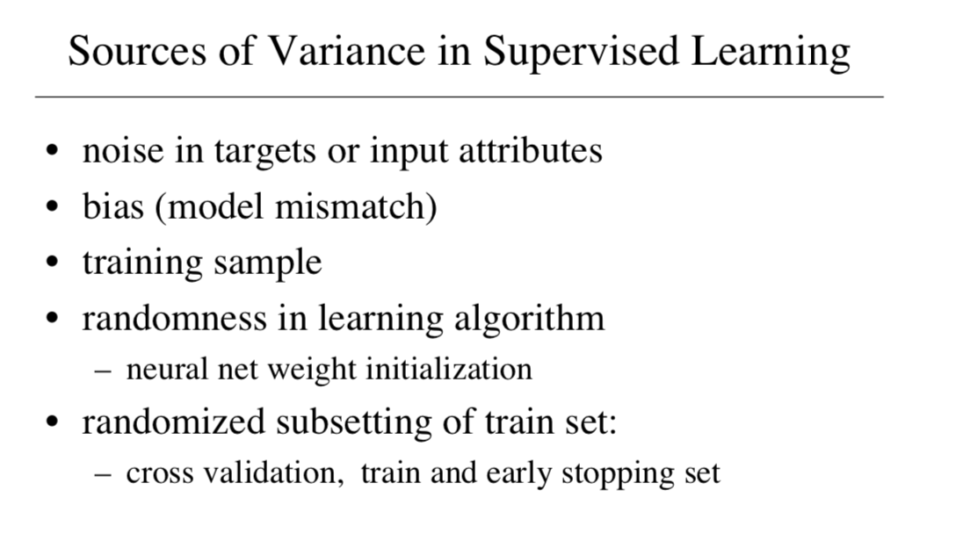

Slide 10
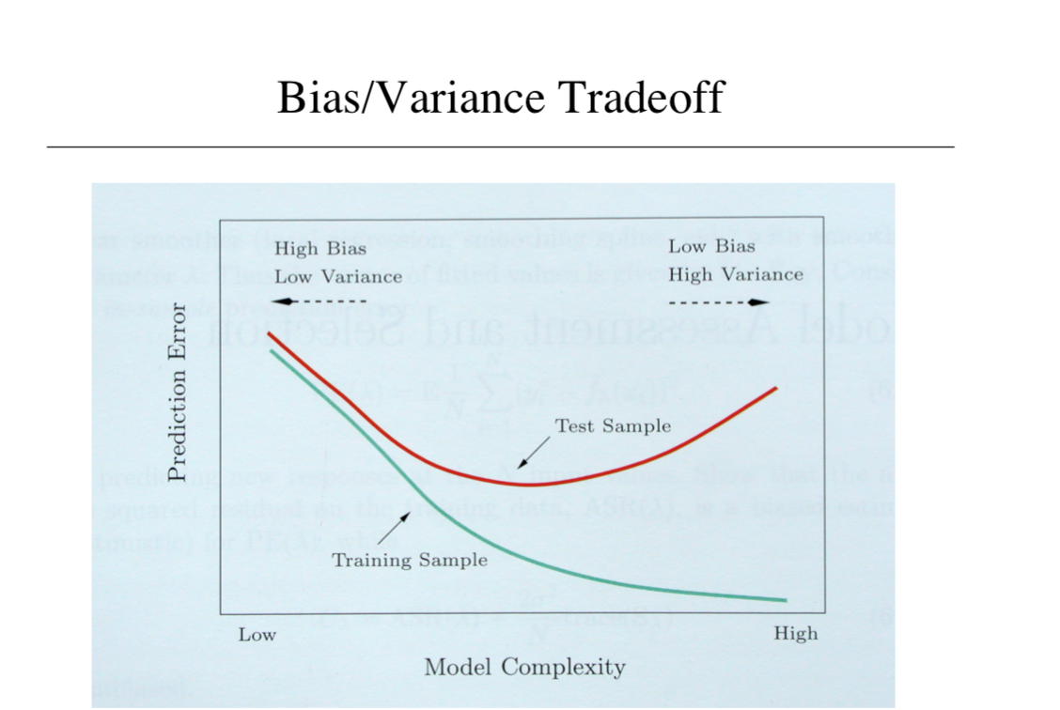

Slide 11
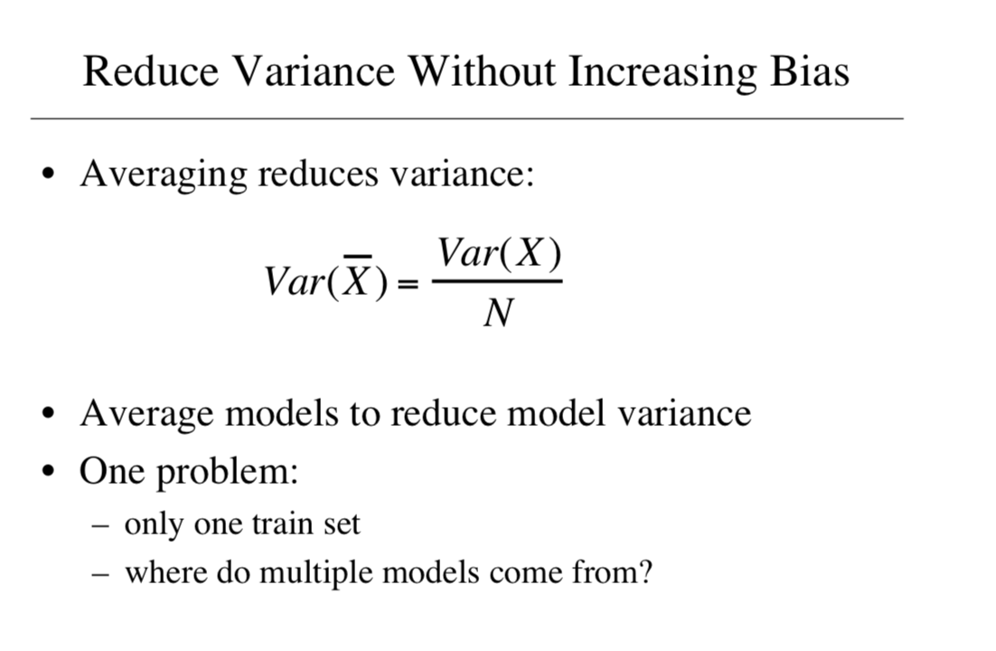

Slide 12
Training Error and Cross-Validation
Suppose we use the training error to estimate the difference between the true model prediction and the learned model prediction.
The training error is downward biased: on average it underestimates the generalization error.
Cross-validation is nearly unbiased; it slightly overestimates the generalization error.

Slide 13
Classification
Can do bias-variance analysis for classifiers as well.
General principle: variance dominates bias.
Very roughly, this is because we only need to make a discrete decision rather than get an exact value.

