Slide 1
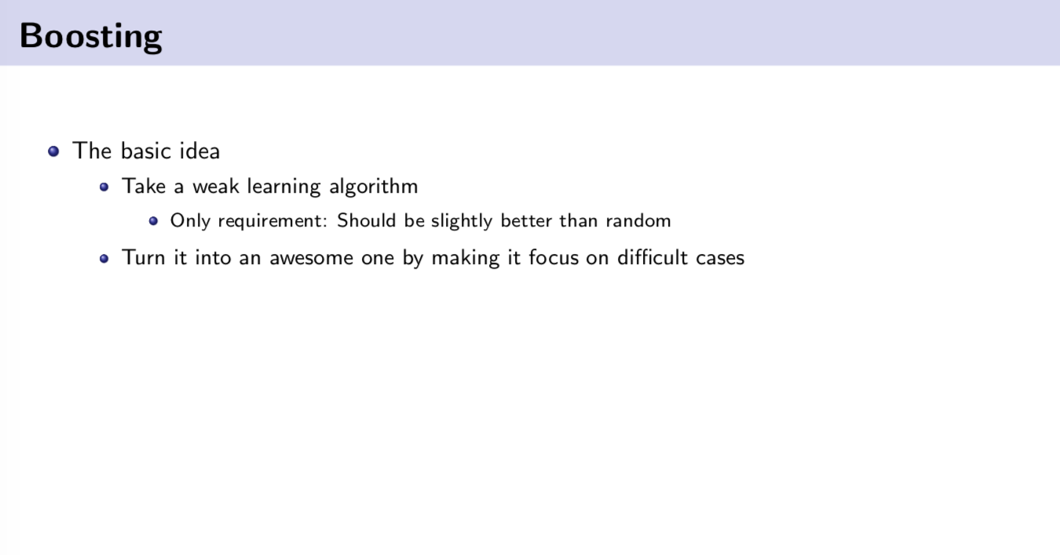

Slide 2
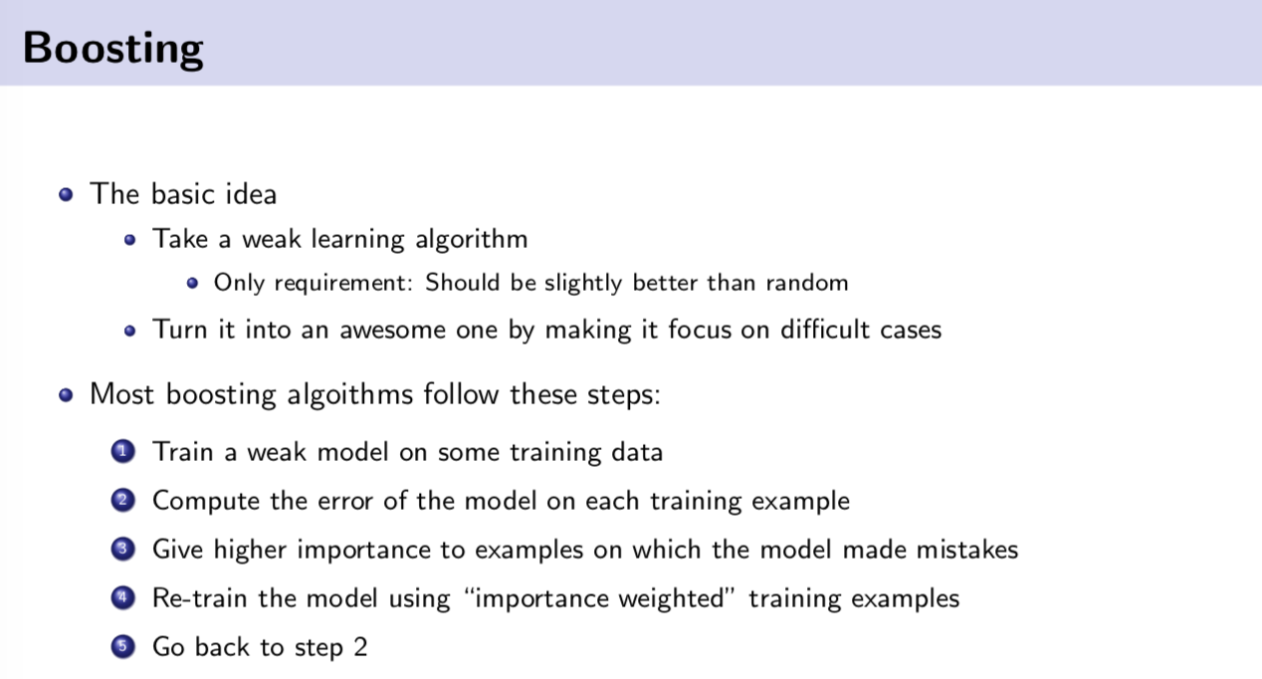

Slide 3
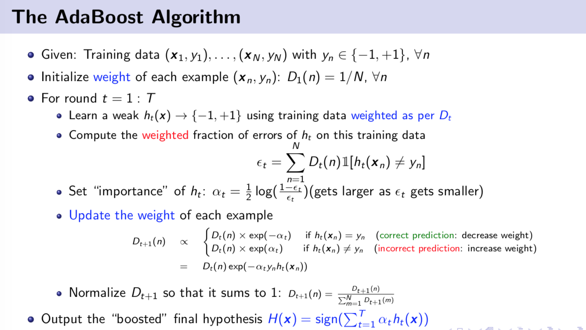

Slide 4
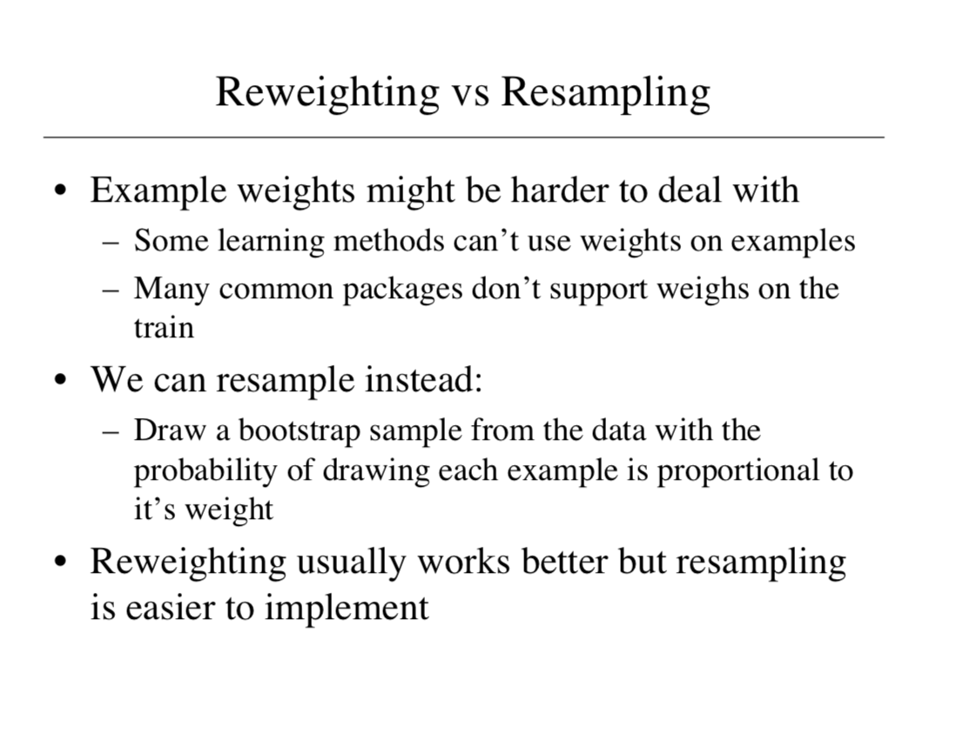

Slide 5
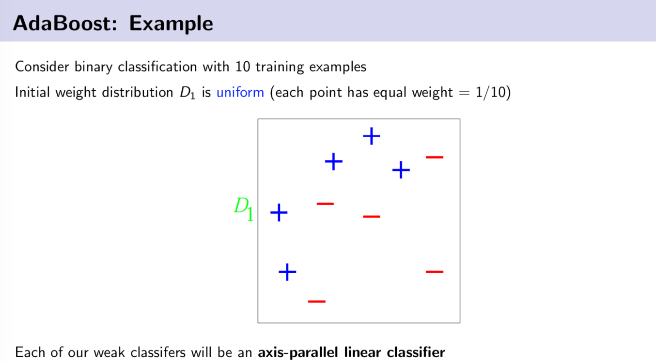

Slide 6
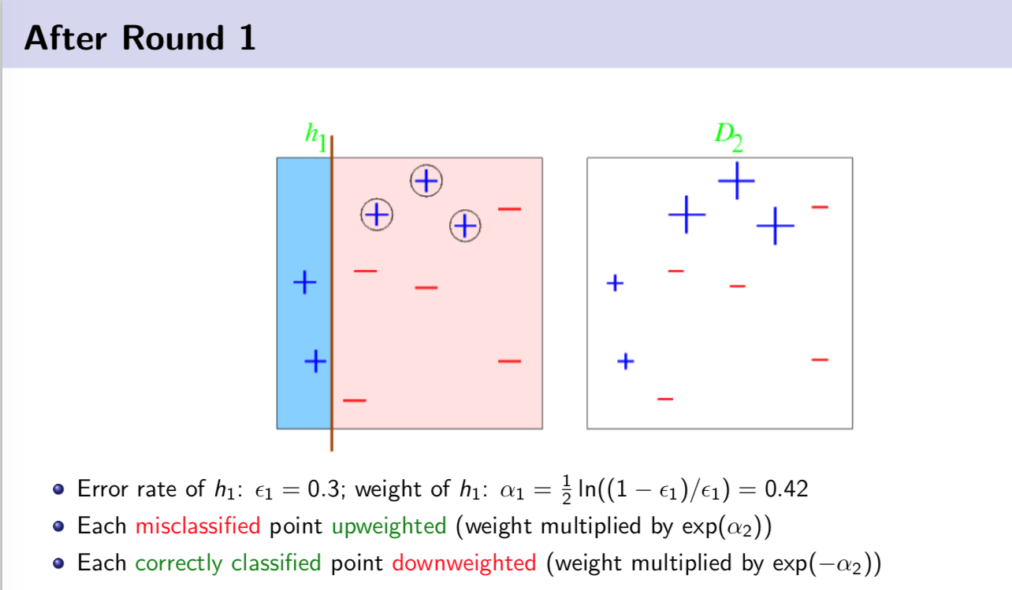

Slide 7
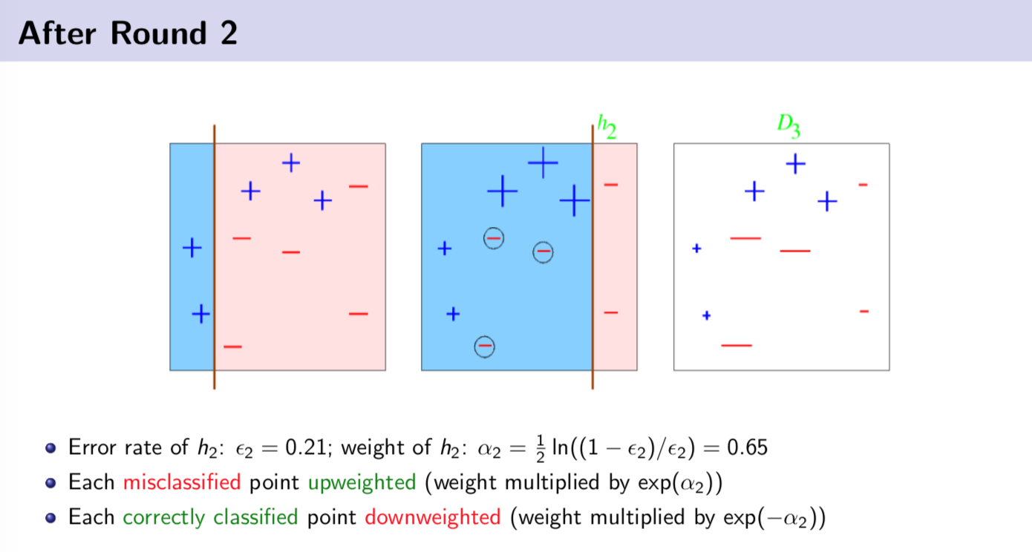

Slide 8
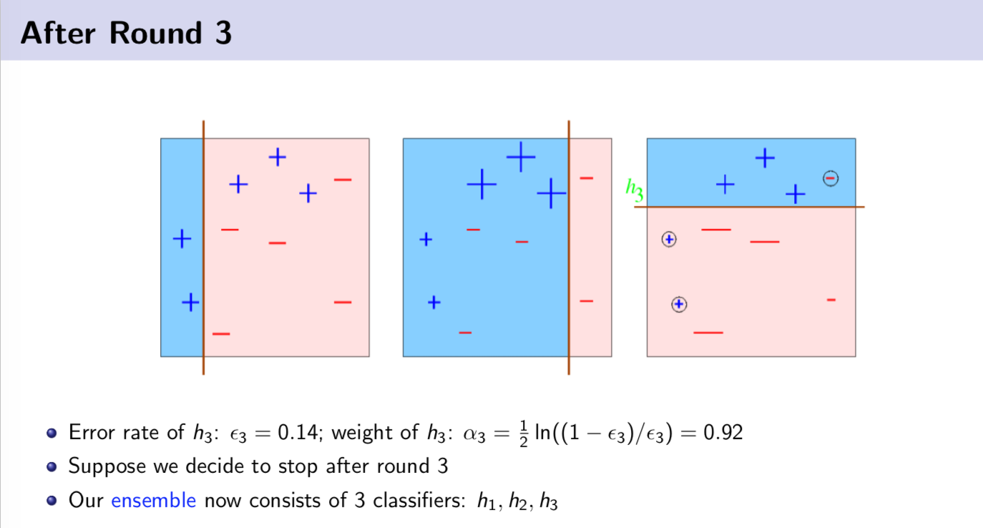

Slide 9
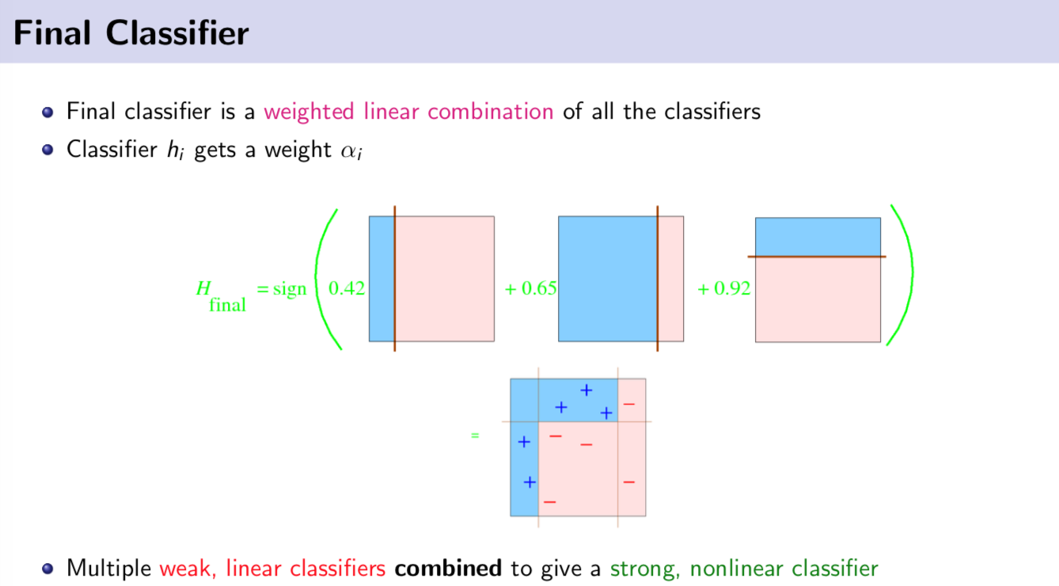

Slide 10
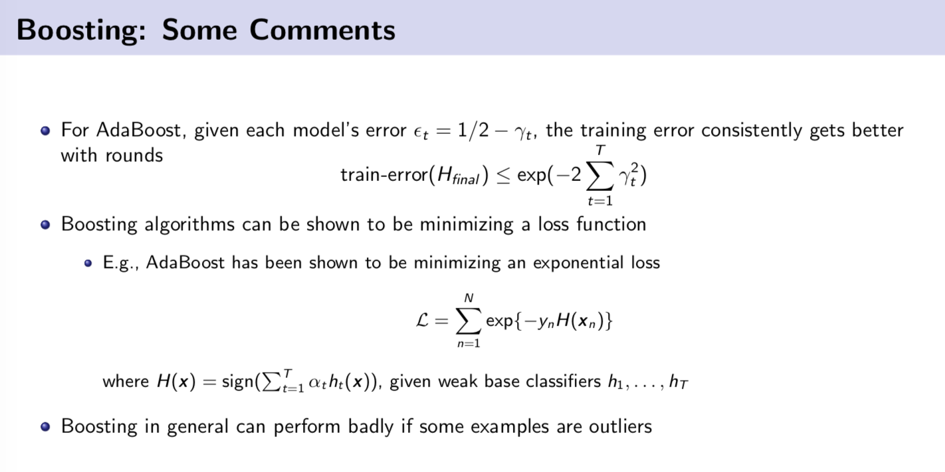

Slide 11
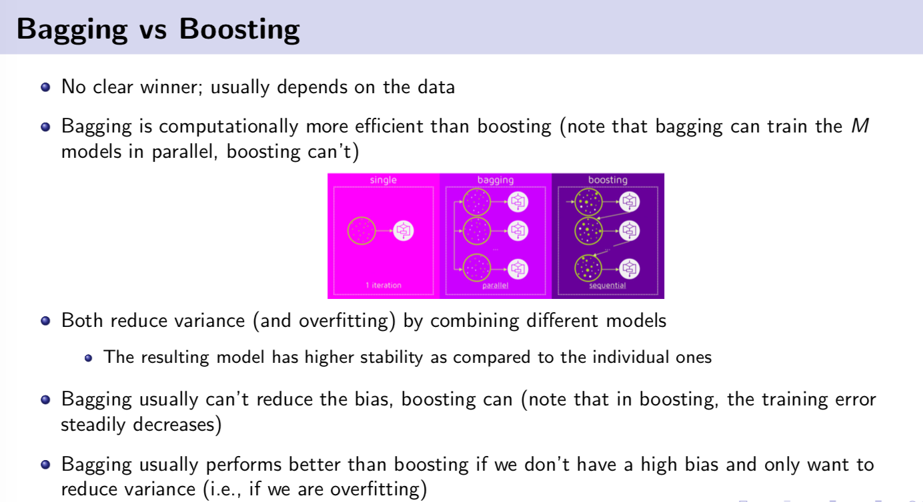

Slide 12
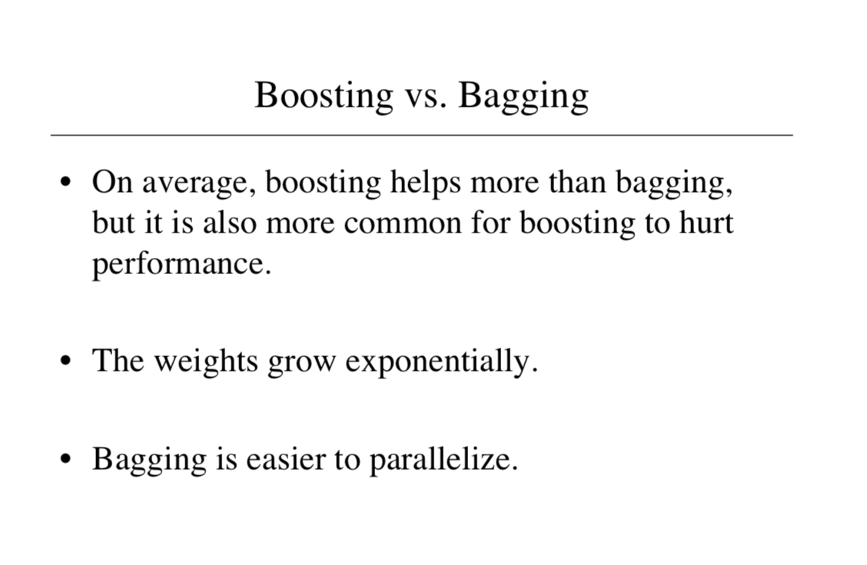

Slide 13
Clustering Techniques

Slide 14
What is clustering?
Ch. 16
Clustering: the process of grouping a set of objects into classes of similar objects
Documents within a cluster should be similar.
Documents from different clusters should be dissimilar.
The commonest form of unsupervised learning
Unsupervised learning = learning from raw data, as opposed to supervised data where a classification of examples is given
A common and important task that finds many applications in IR and other places

Slide 15
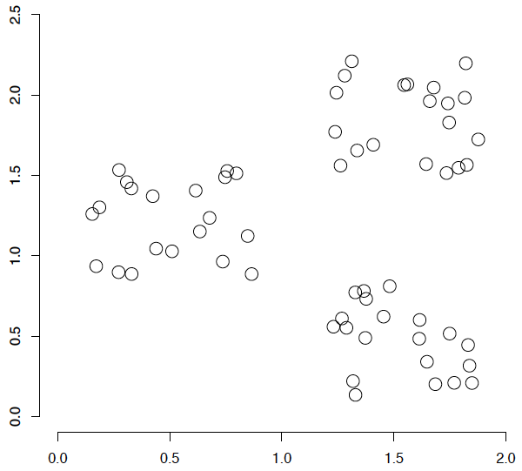
A data set with clear cluster structure
Ch. 16
How would you design an algorithm for finding the three clusters in this case?

Slide 16
Clustering Algorithms
Flat algorithms
Usually start with a random (partial) partitioning
Refine it iteratively
K means clustering
(Model based clustering)
Hierarchical algorithms
Bottom-up, agglomerative
(Top-down, divisive)

Slide 17
Hard vs. soft clustering
Hard clustering: Each document belongs to exactly one cluster
More common and easier to do
Soft clustering: A document can belong to more than one cluster.
Makes more sense for applications like creating browsable hierarchies
You may want to put a pair of sneakers in two clusters: (i) sports apparel and (ii) shoes
You can only do that with a soft clustering approach.
We won’t do soft clustering today. See IIR 16.5, 18

Slide 18
Partitioning Algorithms
Partitioning method: Construct a partition of n documents into a set of K clusters
Given: a set of documents and the number K
Find: a partition of K clusters that optimizes the chosen partitioning criterion
Globally optimal
Intractable for many objective functions
Ergo, exhaustively enumerate all partitions
Effective heuristic methods: K-means and K-medoids algorithms

Slide 19
K-Means
Sec. 16.4
Assumes documents are real-valued vectors.
Clusters based on centroids (aka the center of gravity or mean) of points in a cluster, c:
Reassignment of instances to clusters is based on distance to the current cluster centroids.
(Or one can equivalently phrase it in terms of similarities)

Slide 20
K-Means Algorithm
Sec. 16.4
Select K random docs {s₁, s₂,… s_{K}} as seeds.
Until clustering converges (or other stopping criterion):
For each doc d_{i}:
Assign d_{i} to the cluster c_{j} such that dist(x_{i}, s_{j}) is minimal.
(Next, update the seeds to the centroid of each cluster)
For each cluster c_{j}
s_{j} = μ(c_{j})

Slide 21
Example: Assigning Clusters
x
x
x
x
x
x
x
x
x
x
x
x … data point
… centroid
Clusters after round 1

Slide 22
Example: Assigning Clusters
x
x
x
x
x
x
x
x
x
x
x
x … data point
… centroid
Clusters after round 2

Slide 23
Example: Assigning Clusters
x
x
x
x
x
x
x
x
x
x
x
x … data point
… centroid
Clusters at the end

Slide 24
Getting the k right
How to select k?
Try different k, looking at the change in the average distance to centroid as k increases
Average falls rapidly until right k, then changes little
Best value
of k
Average
distance to
centroid
k

Slide 25
Example: Picking k
x
xx x
x x
x x x
x
x x x
x
Too few;
many long
distances
to centroid.
x
x x
x x x x
x x x x
x x x
x x
x x
x x x x
x x x
x
x

Slide 26
Example: Picking k
x
xx x
x x
x x x
x
x x x
x
x
Just right;
distances
rather short.
x x
x x x x
x x x x
x x x
x x
x x
x x x x
x x x
x
x

Slide 27
Example: Picking k
Too many;
little improvement
in average
distance.
x
xx x
x x
x x x
x
x x x
x
x
x x
x x x x
x x x x
x x x
x x
x x
x x x x
x x x
x
x

Slide 28
Termination conditions
Sec. 16.4
Several possibilities, e.g.,
A fixed number of iterations.
Doc partition unchanged.
Centroid positions don’t change.

Slide 29
Time Complexity
Sec. 16.4
Computing distance between two docs is O(M) where M is the dimensionality of the vectors.
Reassigning clusters: O(KN) distance computations, or O(KNM).
Computing centroids: Each doc gets added once to some centroid: O(NM).
Assume these two steps are each done once for I iterations: O(IKNM).

Slide 30

Seed Choice
Sec. 16.4
Results can vary based on random seed selection.
Some seeds can result in poor convergence rate, or convergence to sub-optimal clusterings.
Select good seeds using a heuristic (e.g., doc least similar to any existing mean)
Try out multiple starting points
Initialize with the results of another method.
Example showing
sensitivity to seeds
In the above, if you start
with B and E as centroids
you converge to {A,B,C}
and {D,E,F}
If you start with D and F
you converge to
{A,B,D,E} {C,F}

Slide 31
K-means issues, variations, etc.
Sec. 16.4
Recomputing the centroid after every assignment (rather than after all points are re-assigned) can improve speed of convergence of K-means
Assumes clusters are spherical in vector space
Sensitive to coordinate changes, weighting etc.
Disjoint and exhaustive
Doesn’t have a notion of “outliers” by default
But can add outlier filtering

Slide 32
How Many Clusters?
Number of clusters K is given
Partition n docs into predetermined number of clusters
Finding the “right” number of clusters is part of the problem
Given docs, partition into an “appropriate” number of subsets.
E.g., for query results - ideal value of K not known up front - though UI may impose limits.
Can usually take an algorithm for one flavor and convert to the other.

Slide 33
K not specified in advance
Say, the results of a query.
Solve an optimization problem: penalize having lots of clusters
application dependent, e.g., compressed summary of search results list.
Tradeoff between having more clusters (better focus within each cluster) and having too many clusters

Slide 34
K not specified in advance
Given a clustering, define the Benefit for a doc to be the cosine similarity to its centroid
Define the Total Benefit to be the sum of the individual doc Benefits.
Why is there always a clustering of Total Benefit n?

Slide 35
Penalize lots of clusters
For each cluster, we have a Cost C.
Thus for a clustering with K clusters, the Total Cost is KC.
Define the Value of a clustering to be =
Total Benefit - Total Cost.
Find the clustering of highest value, over all choices of K.
Total benefit increases with increasing K. But can stop when it doesn’t increase by “much”. The Cost term enforces this.

