Slide 1
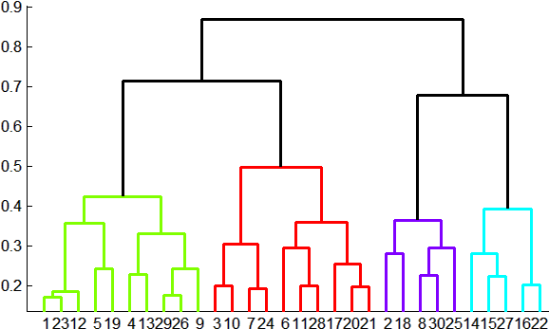
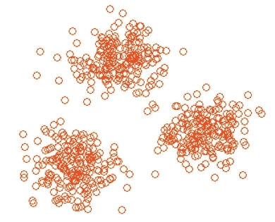
Overview: Methods of Clustering
Hierarchical:
Agglomerative (bottom up):
Initially, each point is a cluster
Repeatedly combine the two “nearest” clusters into one
Divisive (top down):
Start with one cluster and recursively split it
Point assignment:
Maintain a set of clusters
Points belong to “nearest” cluster

Slide 2
Hierarchical Clustering
Key operation: Repeatedly combine two nearest clusters
Three important questions:
1) How do you represent a cluster of more than one point?
2) How do you determine the “nearness” of clusters?
3) When to stop combining clusters?

Slide 3
Hierarchical Clustering
Key operation: Repeatedly combine two nearest clusters
(1) How to represent a cluster of many points?
Key problem: As you merge clusters, how do you represent the “location” of each cluster, to tell which pair of clusters is closest?
Euclidean case: each cluster has a centroid = average of its (data)points
(2) How to determine “nearness” of clusters?
Measure cluster distances by distances of centroids

Slide 4
Example: Hierarchical clustering
(5,3)
o
(1,2)
o
o (2,1) o (4,1)
o (0,0) o (5,0)
x (1.5,1.5)
x (4.7,1.3)
x (1,1)
x (4.5,0.5)
Data:
o … data point
x … centroid
Dendrogram

Slide 5
Implementation
Naïve implementation of hierarchical clustering:
At each step, compute pairwise distances between all pairs of clusters, then merge
O(N³)
Careful implementation using priority queue can reduce time to O(N² log N)
Still too expensive for really big datasets that do not fit in memory

Slide 6
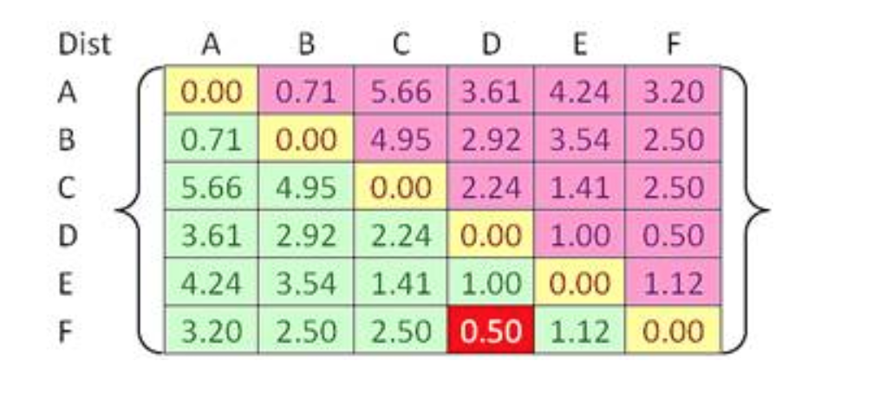
Example

Slide 7
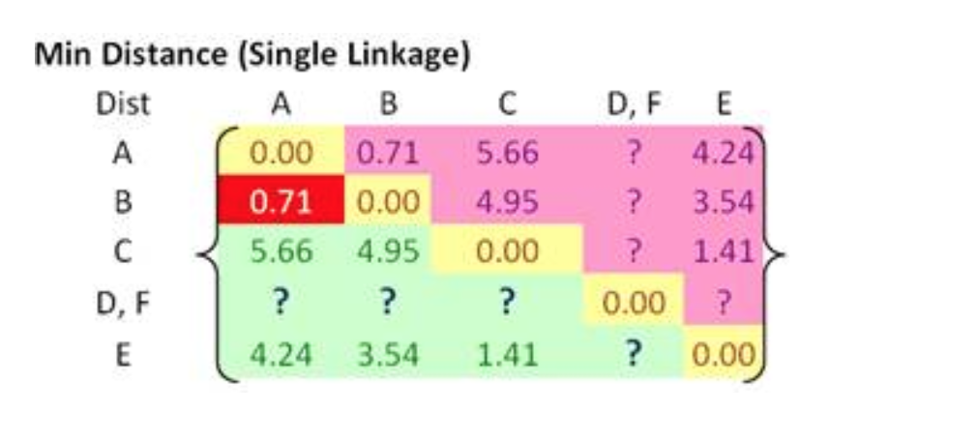
Example

Slide 8
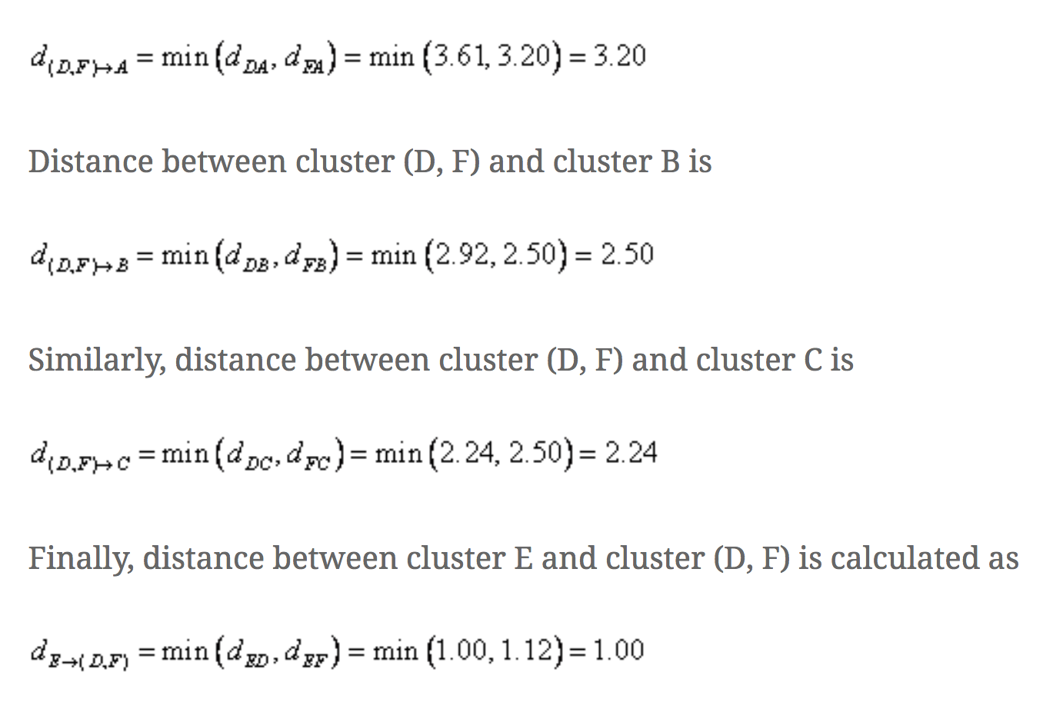

Slide 9
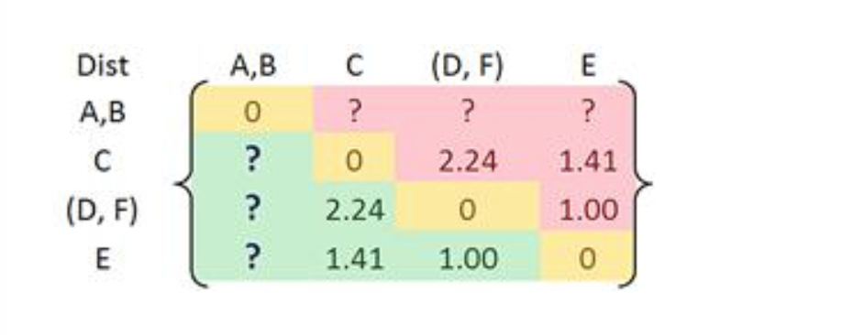
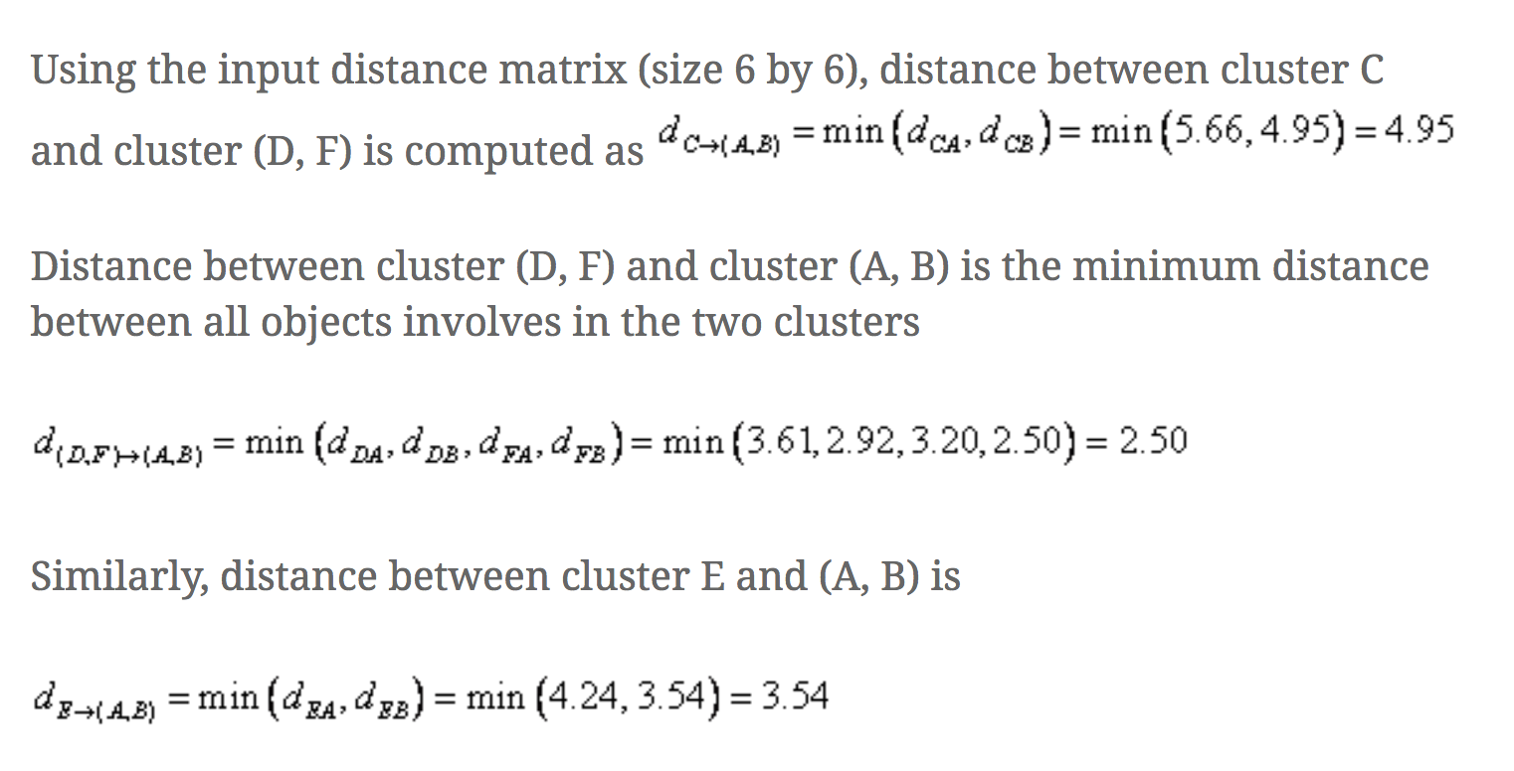

Slide 10
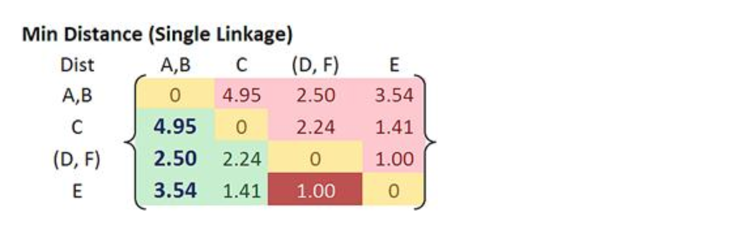

Slide 11
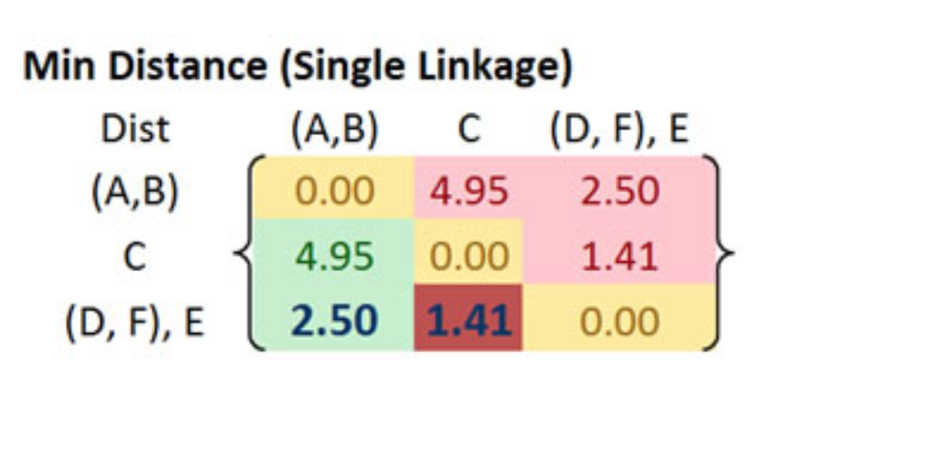

Slide 12
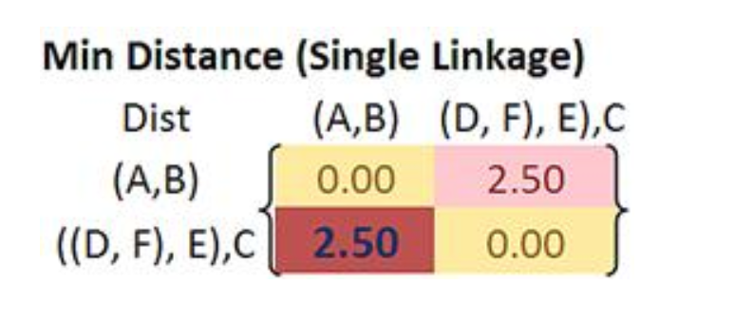

Slide 13
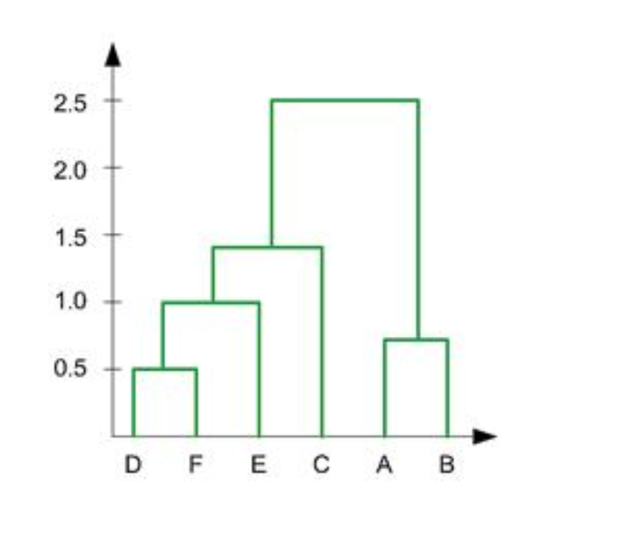

Slide 14
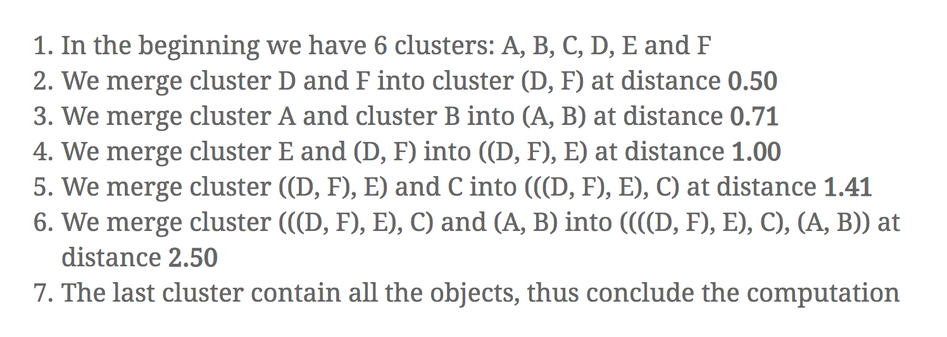

Slide 15
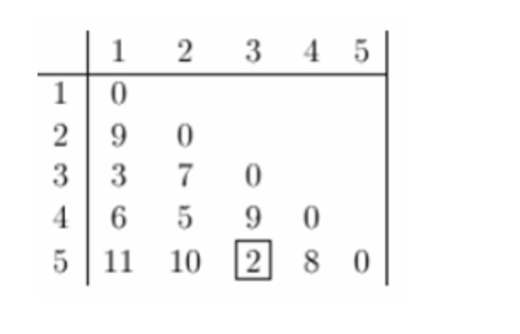
Example 2:

Slide 16
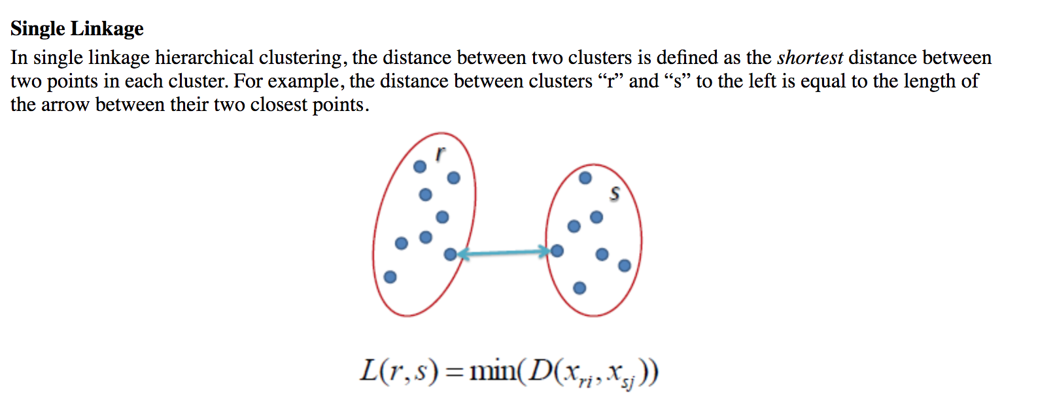

Slide 17
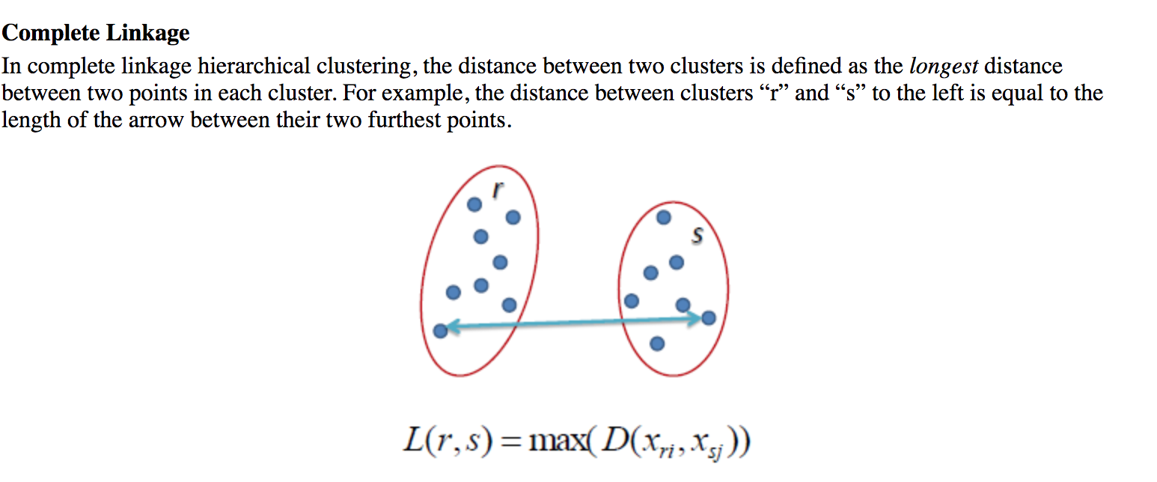

Slide 18
