Slide 1
Sentiment Analysis
What is Sentiment Analysis?

Slide 2
“Process of determining whether a piece of writing is positive, negative or neutral”
It’s also known as opinion mining, deriving the opinion or attitude of a speaker.

Slide 3
Sentiment Analysis is a field within Natural Language Processing (NLP) that builds systems that try to identify and extract opinions within text.
Usually, besides identifying the opinion, these systems extract attributes of the expression e.g.:
Polarity: if the speaker express a positive or negative opinion,
Subject: the thing that is being talked about,
Opinion holder: the person, or entity that expresses the opinion.

Slide 4


Positive or negative movie review?
unbelievably disappointing
Full of zany characters and richly applied satire, and some great plot twists
this is the greatest screwball comedy ever filmed
It was pathetic. The worst part about it was the boxing scenes.

Slide 5
Google Product Search
a

Slide 6
Bing Shopping
a

Slide 7
Sentiment analysis has many other names
Opinion extraction
Opinion mining
Sentiment mining
Subjectivity analysis

Slide 8
Why sentiment analysis?
Movie: is this review positive or negative?
Products: what do people think about the new iPhone?
Public sentiment: how is consumer confidence? Is despair increasing?
Politics: what do people think about this candidate or issue?
Prediction: predict election outcomes or market trends from sentiment

Slide 9
Scherer Typology of Affective States
Emotion: brief organically synchronized … evaluation of a major event
angry, sad, joyful, fearful, ashamed, proud, elated
Mood: diffuse non-caused low-intensity long-duration change in subjective feeling
cheerful, gloomy, irritable, listless, depressed, buoyant
Interpersonal stances: affective stance toward another person in a specific interaction
friendly, flirtatious, distant, cold, warm, supportive, contemptuous
Attitudes: enduring, affectively colored beliefs, dispositions towards objects or persons
liking, loving, hating, valuing, desiring
Personality traits: stable personality dispositions and typical behavior tendencies
nervous, anxious, reckless, morose, hostile, jealous

Slide 10
Scherer Typology of Affective States
Emotion: brief organically synchronized … evaluation of a major event
angry, sad, joyful, fearful, ashamed, proud, elated
Mood: diffuse non-caused low-intensity long-duration change in subjective feeling
cheerful, gloomy, irritable, listless, depressed, buoyant
Interpersonal stances: affective stance toward another person in a specific interaction
friendly, flirtatious, distant, cold, warm, supportive, contemptuous
Attitudes: enduring, affectively colored beliefs, dispositions towards objects or persons
liking, loving, hating, valuing, desiring
Personality traits: stable personality dispositions and typical behavior tendencies
nervous, anxious, reckless, morose, hostile, jealous

Slide 11
Sentiment Analysis
Sentiment analysis is the detection of attitudes
“enduring, affectively colored beliefs, dispositions towards objects or persons”
Holder (source) of attitude
Target (aspect) of attitude
Type of attitude
From a set of types
Like, love, hate, value, desire, etc.
Or (more commonly) simple weighted polarity:
positive, negative, neutral, together with strength
Text containing the attitude
Sentence or entire document

Slide 12
Sentiment Analysis
Simplest task:
Is the attitude of this text positive or negative?
More complex:
Rank the attitude of this text from 1 to 5
Advanced:
Detect the target, source, or complex attitude types

Slide 13
Sentiment Analysis Scope
Sentiment analysis can be applied at different levels of scope:
Document level sentiment analysis obtains the sentiment of a complete document or paragraph.
Sentence level sentiment analysis obtains the sentiment of a single sentence.
Sub-sentence level sentiment analysis obtains the sentiment of sub-expressions within a sentence.

Slide 14
Types of Sentiment Analysis
Fine Grained Sentiment Analysis
level of polarity of the opinion:
Very positive
Positive
Neutral
Negative
Very negative
Emotion detection
happiness, frustration, anger, sadness

Slide 15
Types of Sentiment Analysis
Aspect-based Sentiment Analysis
particular aspects or features of the product people talk about.
"The battery life of this camera is too short."
The sentence is expressing a negative opinion about the camera, but more precisely, about the battery life, which is a particular feature of the camera.
Multilingual sentiment analysis

Slide 16
Types of Sentiment Analysis
Intent analysis
detects what people want to do with a text rather than what people say with that text.
“Your customer support is a disaster. I’ve been on hold for 20 minutes”.
“I would like to know how to replace the cartridge”.
“Can you help me fill out this form?”
Human has no problems detecting the complaint in the first text, the question in the second text, and the request in the third text.
However, machines can have some problems to identify those. Sometimes, the intended action can be inferred from the text, but sometimes, inferring it requires some contextual knowledge.

Slide 17
Sentiment Analysis Algorithms
Rule-based systems that perform sentiment analysis based on a set of manually crafted rules.
Automatic systems that rely on machine learning techniques to learn from data.
Hybrid systems that combine both rule based and automatic approaches.

Slide 18
Sentiment Analysis
Lexicon Based Approaches

Slide 19
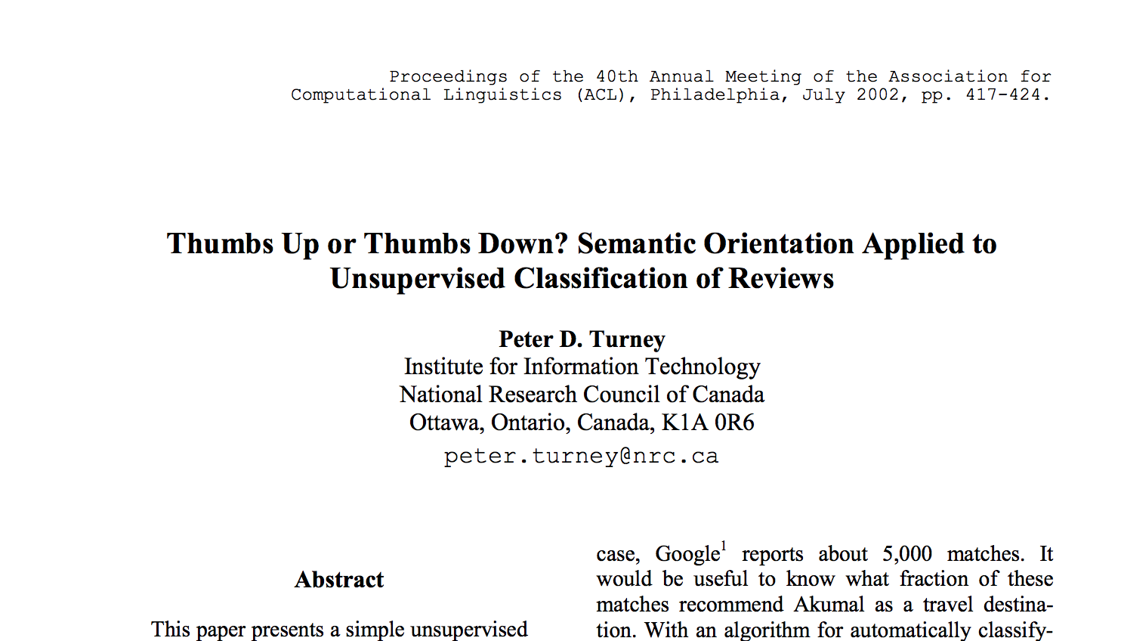
Turney Algorithm

Slide 20
Turney Algorithm
The classification of a review is predicted by the average semantic orientation of the phrases in the review that contain adjectives or adverbs.
A phrase has a positive semantic orientation when it has good associations and a negative semantic orientation when it has bad associations.
In this paper, the semantic orientation of a phrase is calculated as the mutual information.

Slide 21
Turney Algorithm
Extract a phrasal lexicon from reviews
Learn polarity of each phrase
Rate a review by the average polarity of its phrases

Slide 22
How to measure polarity of a phrase?
Positive phrases co-occur more with “excellent”
Negative phrases co-occur more with “poor”
But how to measure co-occurrence?

Slide 23

Mutual Information (MI) (1/2)
MI measures the mutual dependence of two random variables.
The higher it is, the more dependent the two random variables are with each other.
Its value is always positive.
The equation of MI:

Slide 24
Mutual Information (MI) (2/2)
For example, say a discrete random variable X represents visibility at a certain moment in time and random variable Y represents wind speed at that moment.
The mutual information between X and Y:

Slide 25
Mutual Information and Pointwise Mutual Information:
Discrete random variable X: (visibility)
X=Good
X=Bad

Slide 26
Discrete random variable Y: (wind speed)
Y=High
Y=Low

Slide 27
Mutual Information and Pointwise Mutual Information:
Mutual Information of X and Y:
0.05
0.35
0.5
X=Good
X=Bad
Y=High
Y=Low
0.1

Slide 28
Mutual Information and Pointwise Mutual Information:
Mutual Information of X and Y:
0.01
0.39
0.49
0.01

Slide 29
Mutual Information and Pointwise Mutual Information:
Mutual Information of X and Y:
0.15
0.35
0.25
0.25

