Slide 1

Pointwise Mutual Information (PMI)
PMI measures the mutual dependence of between two instances or realizations of random variables.
Positive => high correlated
Zeros => no information (independence)
Negative => opposite correlated
The equation of PMI:

Slide 2
Pointwise Mutual Information
Pointwise mutual information:
PMI between two words:

Slide 3
Does phrase appear more with “poor” or “excellent”?
How much more the word is like “excellent” than it is like “poor”.

Slide 4
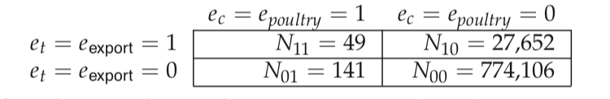
Question:
Consider the class poultry and the term export. The counts of the number of documents with four possible combinations are indicated as follows:
Calculate mutual information?

Slide 6
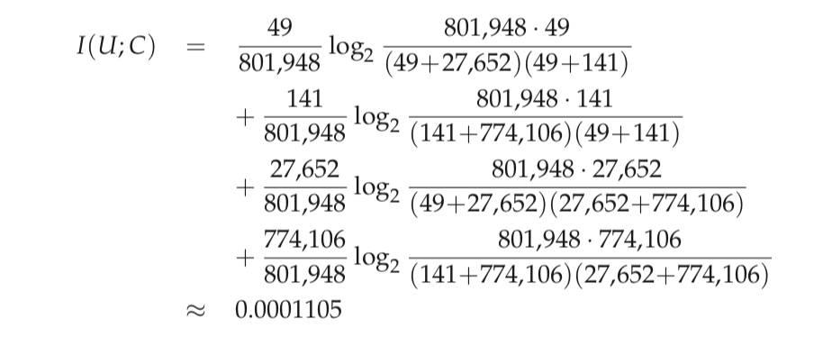

Slide 7
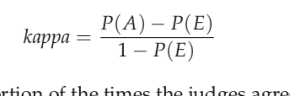
Kappa Statistic
where P(A) is the proportion of the times the judges agreed,
and,
P(E) is the proportion of the times they would be expected to agree
by chance.

Slide 8
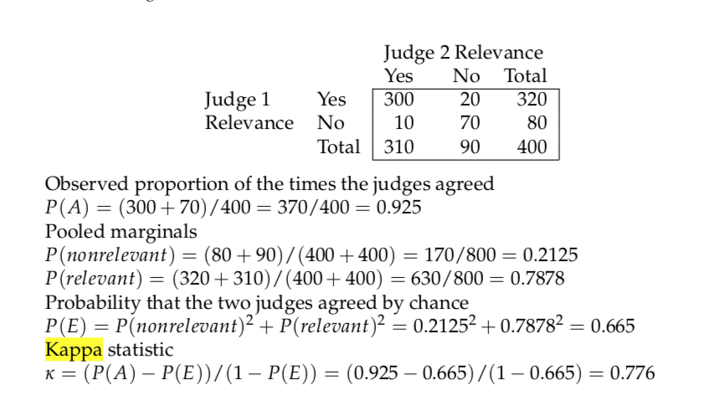
Kappa Statistic

Slide 9
Range of Kappa | Interpretation
> .75 | Excellent agreement
.40 to .75 | Good agreement
< .40 | Poor agreement

Slide 10
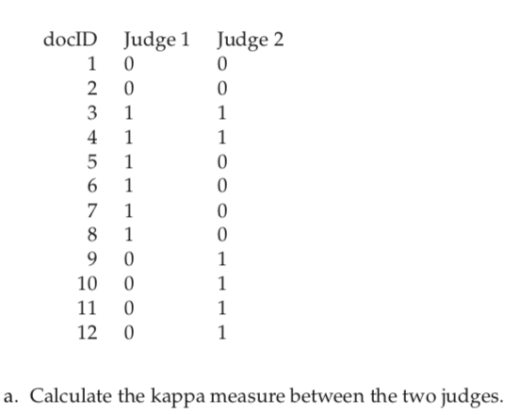
Below is a table showing how two human judges rated the relevance 12 documents. (0 = negative, 1 = positive).

Slide 11
