Slide 1
Take 1: Jaccard coefficient
Ch. 6
A commonly used measure of overlap of two sets A and B
What is jaccard(A,B) =
jaccard(A,B) = |A ∩ B| / |A ∪ B|
jaccard(A,A) = 1
jaccard(A,B) = 0 if A ∩ B = 0
A and B don’t have to be the same size.
Always assigns a number between 0 and 1 because
at most the intersection can be as large as the union.

Slide 2
Jaccard coefficient: Scoring example
Ch. 6
What is the query-document match score that the Jaccard coefficient computes for each of the two documents below?
Query: ides of march
Document 1: caesar died in march
Document 2: the long march

Slide 3
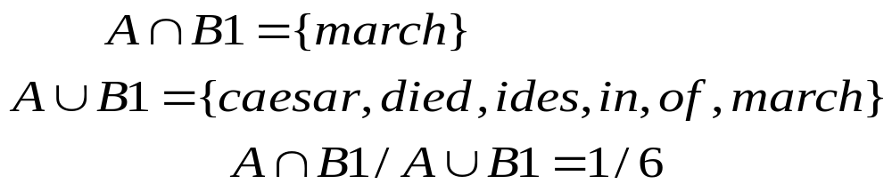
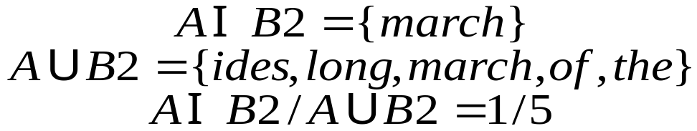
Jaccard Example
Query: ides of march
Document 1: caesar died in march
Document 2: the long march
A = {ides, of, march}
B1 = {caesar, died, in, march}
B2 = {the, long, march}

Slide 4
Issues with Jaccard for scoring
Ch. 6
It doesn’t consider term frequency (how many times a term occurs in a document)

Slide 5
Bag of words model

Slide 6
Term frequency tf
The term frequency tf_{t,d} of term t in document d is defined as the number of times that t occurs in d.
We want to use tf when computing query-document match scores. But how?
Raw term frequency is not what we want
  A document with 10 occurrences of the term is more relevant than a document with 1 occurrence of the term.
  But not 10 times more relevant.
Relevance does not increase proportionally with term frequency.

Slide 7
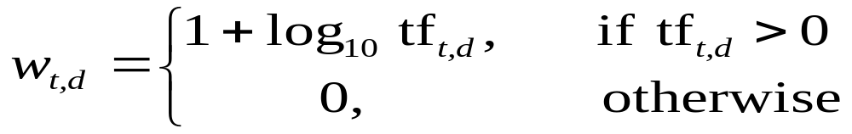

Log-frequency weighting
Sec. 6.2
The log frequency weight of term t in d is
0 → 0, 1 → 1, 2 → 1.3, 10 → 2, 1000 → 4, etc.
How will you compute Score for a document-query pair:
sum over terms t in both q and d:
score
The score is 0 if none of the query terms is present in the document.

Slide 8
Document frequency
Sec. 6.2.1
Rare terms are more informative than frequent terms
  Recall stop words
Consider a term in the query that is rare in the collection (e.g., arachnocentric)
A document containing this term is very likely to be relevant to the query arachnocentric
→ We want a high weight for rare terms like arachnocentric.

Slide 9
Document frequency, continued
Sec. 6.2.1
Frequent terms are less informative than rare terms
Consider a query term that is frequent in the collection (e.g., high, increase, line)
A document containing such a term is more likely to be relevant than a document that doesn’t
But it’s not a sure indicator of relevance.
→ For frequent terms, we want high positive weights for words like high, increase, and line
But lower weights than for rare terms.
We will use document frequency (df) to capture this.

Slide 10
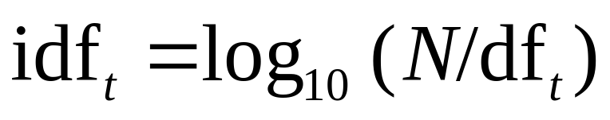
idf weight
Sec. 6.2.1
df_{t} is the document frequency of t: the number of documents that contain t
  df_{t} is an inverse measure of the informativeness of t
  What can be the max value of df_{t}
  df_{t} ≤ N
We define the idf (inverse document frequency) of t by
  Why We use log (N/df_{t}) instead of N/df_{t}
  to “dampen” the effect of idf.
Will turn out the base of the log is immaterial.

Slide 11

Mathematically the base of the log function does not
matter and constitutes a constant multiplicative factor
towards the overall result.

Slide 12
idf example, suppose N = 1 million
Sec. 6.2.1
term | df_{t} | idf_{t}
calpurnia | 1 | ?
animal | 100 | ?
sunday | 1,000 | ?
fly | 10,000 | ?
under | 100,000 | ?
the | 1,000,000 | ?
There is one idf value for each term t in a collection.
Notes:
6 4 3 2 1 0

Slide 13
idf example, suppose N = 1 million
Sec. 6.2.1
term | df_{t} | idf_{t}
calpurnia | 1 | 6
animal | 100 | 4
sunday | 1,000 | 3
fly | 10,000 | 2
under | 100,000 | 1
the | 1,000,000 | 0
There is one idf value for each term t in a collection.
Notes:
6 4 3 2 1 0

Slide 14
Collection vs. Document frequency
Sec. 6.2.1
The collection frequency of t is the number of occurrences of t in the collection, counting multiple occurrences.
Example:
Which word is a better search term (and should get a higher weight)?
What does it mean
Word | Collection frequency | Document frequency
insurance | 10440 | 3997
try | 10422 | 8760
Notes:
Why do you get these numbers?
Suggests df is better.

