Slide 1
Graph Data!
High dim. data
Locality sensitive hashing
Clustering
Graph data
PageRank, SimRank
Community Detection
Infinite data
Filtering data streams
Web advertising
Dimensionality reduction
Spam Detection
Queries on streams
Machine learning
SVM
Decision Trees
Perceptron, kNN
Apps
Recommender systems
Association Rules
Duplicate document detection

Slide 2
Web as a Graph
Web as a directed graph:
Nodes: Webpages
Edges: Hyperlinks
I teach a class on Networks.
CS224W: Classes are in the Gates building
Computer Science Department at Stanford
Stanford University

Slide 3
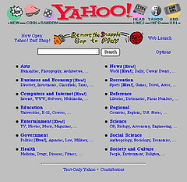
Broad Question
How to organize the Web?
First try: Human curated Web directories
Yahoo, DMOZ, LookSmart
Second try: Web Search
Information Retrieval investigates: Find relevant docs in a small and trusted set
Newspaper articles, Patents, etc.
But: Web is huge, full of untrusted documents, random things, web spam, etc.

Slide 4
Web Search: 2 Challenges
2 challenges of web search:
(1) Web contains many sources of information Who to “trust”?
Trick: Trustworthy pages may point to each other!
(2) What is the “best” answer to query “newspaper”?
No single right answer
Trick: Pages that actually know about newspapers might all be pointing to many newspapers

Slide 5
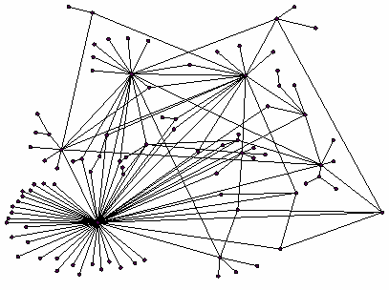
Ranking Nodes on the Graph
All web pages are not equally “important”
There is large diversity in the web-graph node connectivity. Let’s rank the pages by the link structure!

Slide 6
Link Analysis Algorithms
Link Analysis approaches for computing importance of nodes in a graph:
Page Rank
Topic-Specific (Personalized) Page Rank
Web Spam Detection Algorithms

Slide 7
PageRank: The “Flow” Formulation

Slide 8
Links as Votes
Idea: Links as votes
Page is more important if it has more links
In-coming links? Out-going links?
Think of in-links as votes:
www.ncuindia.edu has 23,400 in-links
www.anjaligoyal.com has 1 in-link
Are all in-links are equal?
Links from important pages count more
Recursive question!

Slide 9
Example: PageRank Scores
B
38.4
C
34.3
A
3.3
D
3.9
E
8.1
F
3.9
1.6
1.6
1.6
1.6
1.6

Slide 10
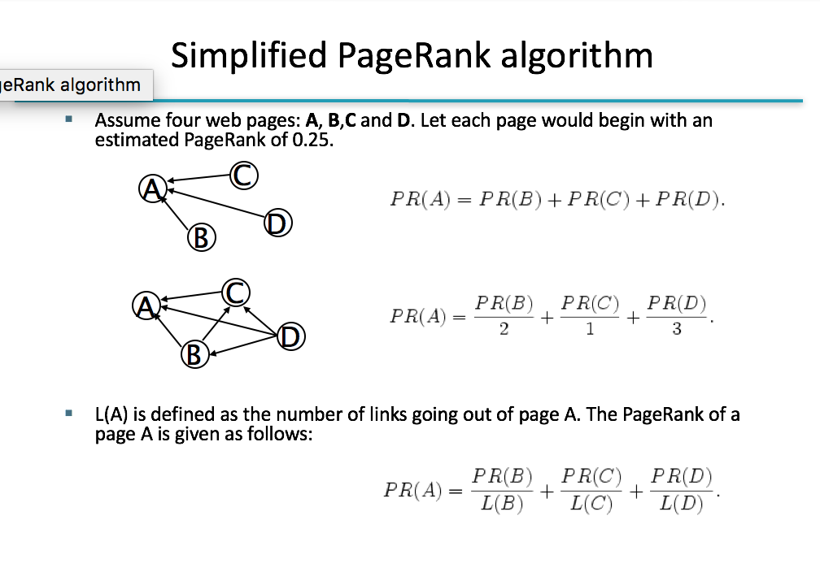

Slide 11
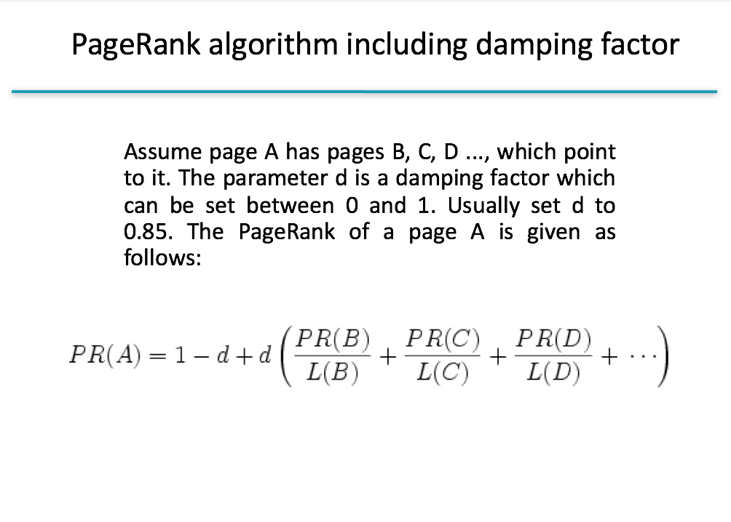

Slide 12
