Slide 1
Power Iteration Method
Given a web graph with n nodes, where the nodes are pages and edges are hyperlinks
Power iteration: a simple iterative scheme
Suppose there are N web pages
Initialize: r⁽⁰⁾ = [1/N,….,1/N]^{T}
Iterate: r^{(t+1)} = M ∙ r^{(t)}
Stop when |r^{(t+1)} – r^{(t)}|₁ < ε
d_{i} …. out-degree of node i

Slide 2
PageRank – Power Iteration Method
1
1
1.83
1.325
1.27
1
1.83
1.325
1.27
0.33
1.522
0.33
0.61
0.442
1
1.83
1.325
1.27
 | P1 | P2 | P3 | P4
I1 | 1 | 1 | 1 | 1
I2
I3
I4
I5
 | P1 | P2 | P3 | P4
I1 | 1 | 1 | 1 | 1
I2 | 1 | 1.83 | 0.33 | 0.83
I3
I4
I5
 | P1 | P2 | P3 | P4
I1 | 1 | 1 | 1 | 1
I2 | 1 | 1.83 | 0.33 | 0.83
I3 | 1.83 | 1.325 | 0.33 | 0.495
I4
I5
 | P1 | P2 | P3 | P4
I1 | 1 | 1 | 1 | 1
I2 | 1 | 1.83 | 0.33 | 0.83
I3 | 1.83 | 1.325 | 0.33 | 0.495
I4 | 1.325 | 1.27 | 0.61 | 0.775
I5
 | P1 | P2 | P3 | P4
I1 | 1 | 1 | 1 | 1
I2 | 1 | 1.83 | 0.33 | 0.83
I3 | 1.83 | 1.325 | 0.33 | 0.495
I4 | 1.325 | 1.27 | 0.61 | 0.775
I5 | 1.27 | 1.522 | 0.442 | 0.747
0.33
0.33
0.61
0.442
0.33
0.33
0.61
0.442
1
0.83
0.495
0.775
0.5
0.165
0.165
0.305
0.5
0.165
0.165
0.305
Converges to steady state probabilities
1
0.33
0.33
0.61
0.442
1
0.83
0.495
0.775
0.747

Slide 3
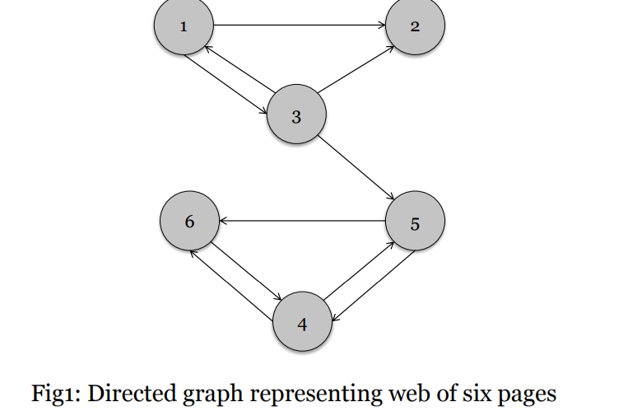

Slide 4
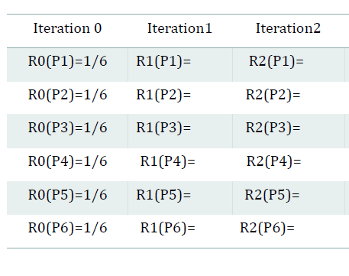

Slide 5
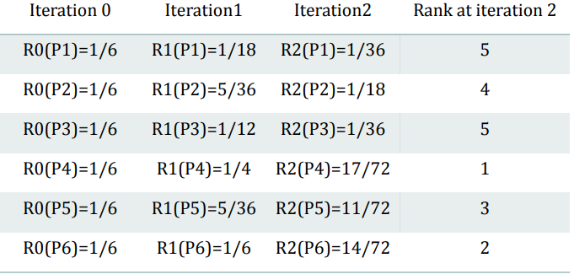

Slide 6
PageRank: Problems
Dead end
2 problems:
(1) Some pages are dead ends (have no out-links)
Random walk has “nowhere” to go to
Such pages cause importance to “leak out”
(2) Spider traps: (all out-links are within the group)
Random walked gets “stuck” in a trap
And eventually spider traps absorb all importance
Spider trap

Slide 7
Problem: Spider Traps
Example:
r_{y} 1/3 2/6 3/12 5/24 0
r_{a} = 1/3 1/6 2/12 3/24 … 0
r_{m} 1/3 3/6 7/12 16/24 1
y
a
m
m is a spider trap
r_{y} = r_{y} /2 + r_{a} /2
r_{a} = r_{y} /2
r_{m} = r_{a} /2 + r_{m}
Iteration 0, 1, 2, …
All the PageRank score gets “trapped” in node m.

Slide 8
Solution: Teleports!
The Google solution for spider traps: At each time step, the random surfer has two options
With prob. β, follow a link at random
With prob. 1-β, jump to some random page
Common values for β are in the range 0.8 to 0.9
Surfer will teleport out of spider trap within a few time steps
y
y
a
m
a
m

Slide 9
Problem: Dead Ends
Example:
r_{y} 1/3 2/6 3/12 5/24 0
r_{a} = 1/3 1/6 2/12 3/24 … 0
r_{m} 1/3 1/6 1/12 2/24 0
y
a
m
r_{y} = r_{y} /2 + r_{a} /2
r_{a} = r_{y} /2
r_{m} = r_{a} /2
Iteration 0, 1, 2, …
Here the PageRank “leaks” out since the matrix is not stochastic.

Slide 10
Solution: Always Teleport!
Teleports: Follow random teleport links with probability 1.0 from dead-ends
Adjust matrix accordingly
y
y
a
m
a
m
 | y | a | m
y | ½ | ½ | 0
a | ½ | 0 | 0
m | 0 | ½ | 0
 | y | a | m
y | ½ | ½ | ⅓
a | ½ | 0 | ⅓
m | 0 | ½ | ⅓

Slide 11
Why Teleports Solve the Problem?
Why are dead-ends and spider traps a problem and why do teleports solve the problem?
Spider-traps are not a problem, but with traps PageRank scores are not what we want
Solution: Never get stuck in a spider trap by teleporting out of it in a finite number of steps
Dead-ends are a problem
The matrix is not column stochastic so our initial assumptions are not met
Solution: Make matrix column stochastic by always teleporting when there is nowhere else to go

Slide 12
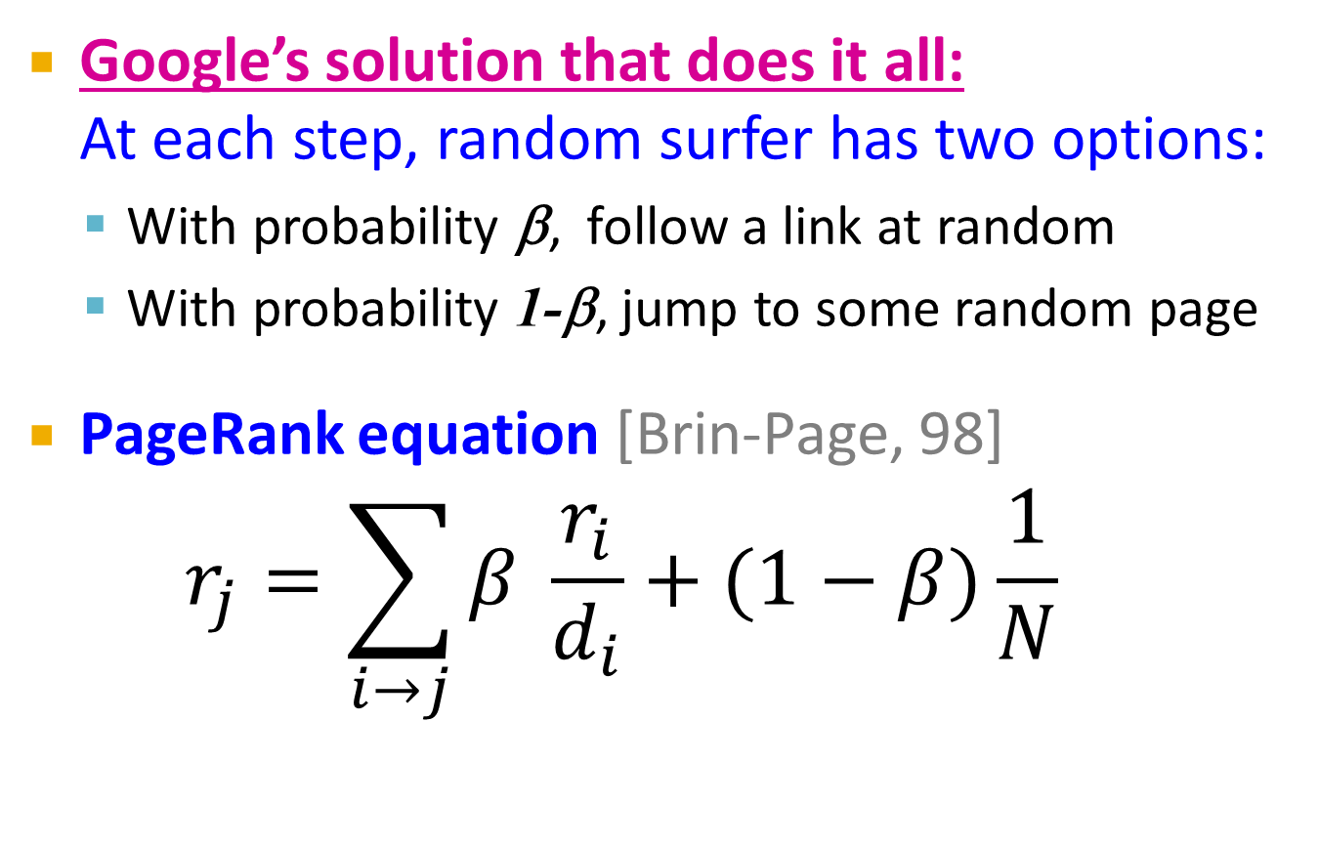
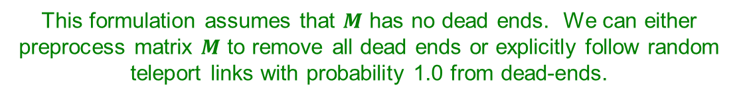
Solution: Random Teleports
Google’s solution that does it all: At each step, random surfer has two options:
With probability β, follow a link at random
With probability 1-β, jump to some random page
PageRank equation [Brin-Page, 98] $r_{j}=\sum_{i→j}{β \frac{r_{i}}{d_{i}}}+(1−β)\frac{1}{N}$
d_{i} … out-degree of node i
This formulation assumes that $M$ has no dead ends. We can either preprocess matrix $M$ to remove all dead ends or explicitly follow random teleport links with probability 1.0 from dead-ends.

Slide 13
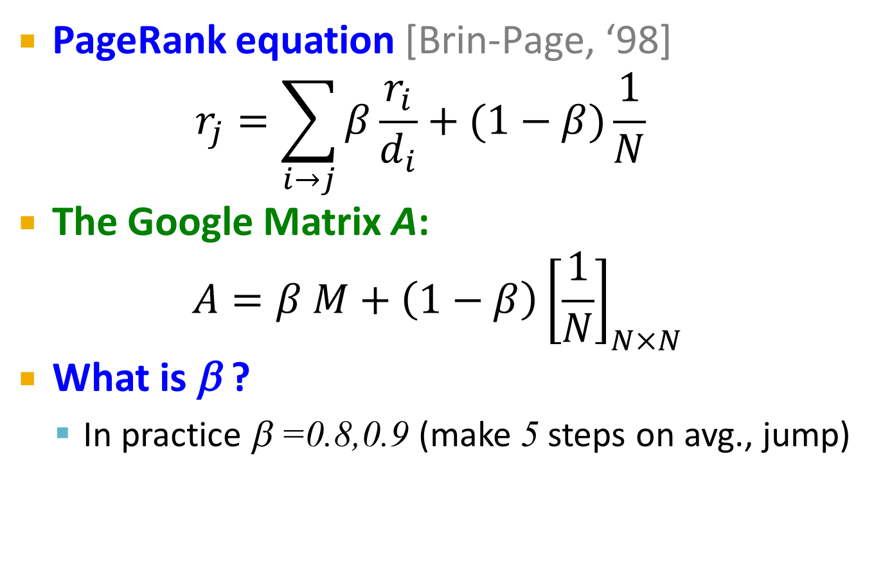
The Google Matrix
PageRank equation [Brin-Page, ‘98] $r_{j}=\sum_{i→j}{β\frac{r_{i}}{d_{i}}}+(1−β)\frac{1}{N}$
The Google Matrix A:
$$A=β M+\left(1−β\right){\left[\frac{1}{N}\right]}_{N×N}$$
What is β ?
In practice β =0.8,0.9 (make 5 steps on avg., jump)
[1/N]_{NxN}…N by N matrix where all entries are 1/N

Slide 14
Random Teleports (β = 0.8)
M
[1/N]_{NxN}
7/15
y
1/2 1/2 0
1/2 0 0
0 1/2 1
1/3 1/3 1/3
1/3 1/3 1/3
1/3 1/3 1/3
0.8
+ 0.2
7/15
1/15
7/15
1/15
y 7/15 7/15 1/15
a 7/15 1/15 1/15
m 1/15 7/15 13/15
13/15
a
7/15
m
1/15
1/15
A
y
a =
m
1/3
1/3
1/3
0.33
0.20
0.46
0.24
0.20
0.52
0.26
0.18
0.56
7/33
5/33
21/33
. . .

Slide 15
Some Problems with Page Rank
Measures generic popularity of a page
Biased against topic-specific authorities
Solution: Topic-Specific PageRank (next)
Uses a single measure of importance
Other models of importance
Solution: Hubs-and-Authorities
Susceptible to Link spam
Artificial link topographies created in order to boost page rank
Solution: TrustRank

