Slide 1
HITS: Hubs and Authorities

Slide 2
Hubs and Authorities
HITS (Hypertext-Induced Topic Selection)
Is a measure of importance of pages or documents, similar to PageRank
Proposed at around same time as PageRank (‘98)
Goal: Say we want to find good newspapers
Don’t just find newspapers. Find “experts” – people who link in a coordinated way to good newspapers
Idea: Links as votes
Page is more important if it has more links
In-coming links? Out-going links?

Slide 3
Finding newspapers
Hubs and Authorities Each page has 2 scores:
Quality as an expert (hub):
Total sum of votes of authorities pointed to
Quality as a content (authority):
Total sum of votes coming from experts
Principle of repeated improvement
NYT: 10
Ebay: 3
Yahoo: 3
CNN: 8
WSJ: 9

Slide 4
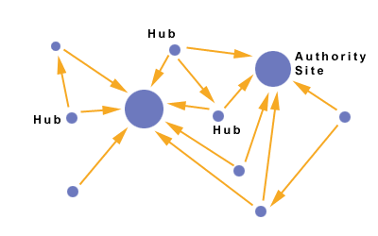
Hubs and Authorities
Interesting pages fall into two classes:
Authorities are pages containing useful information
Newspaper home pages
Course home pages
Home pages of auto manufacturers
Hubs are pages that link to authorities
List of newspapers
Course bulletin
List of US auto manufacturers

Slide 5
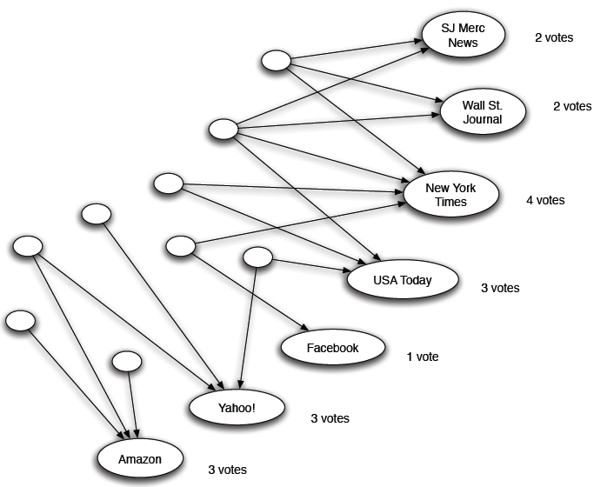
Counting in-links: Authority
Each page starts with hub score 1. Authorities collect their votes
(Note this is idealized example. In reality graph is not bipartite and each page has both the hub and authority score)

Slide 6
Counting in-links: Authority
Sum of hub scores of nodes pointing to NYT.
Each page starts with hub score 1. Authorities collect their votes
(Note this is idealized example. In reality graph is not bipartite and each page has both the hub and authority score)

Slide 7
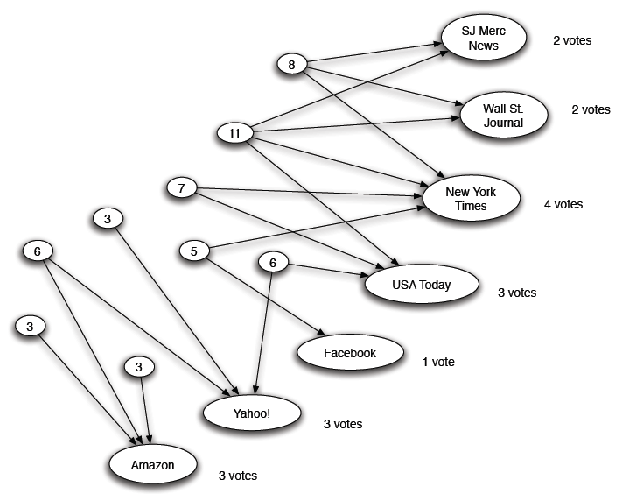
Expert Quality: Hub
Sum of authority scores of nodes that the node points to.
Hubs collect authority scores
(Note this is idealized example. In reality graph is not bipartite and each page has both the hub and authority score)

Slide 8
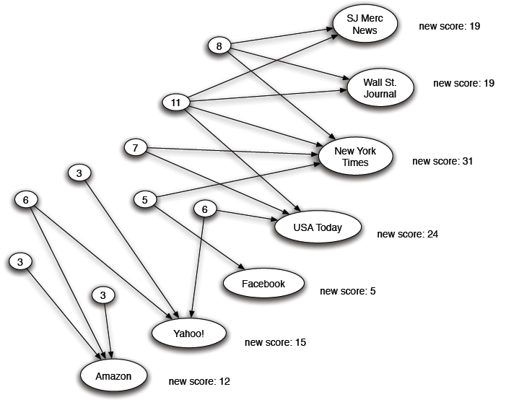
Reweighting
Authorities again collect the hub scores
(Note this is idealized example. In reality graph is not bipartite and each page has both the hub and authority score)

Slide 9
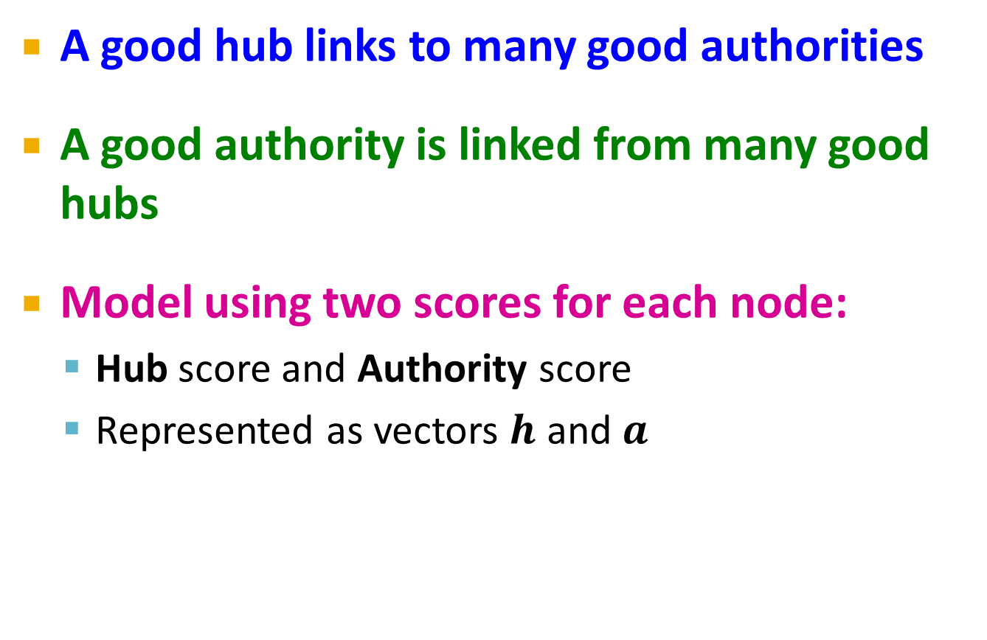
Mutually Recursive Definition
A good hub links to many good authorities
A good authority is linked from many good hubs
Model using two scores for each node:
Hub score and Authority score
Represented as vectors $h$ and $a$

Slide 10

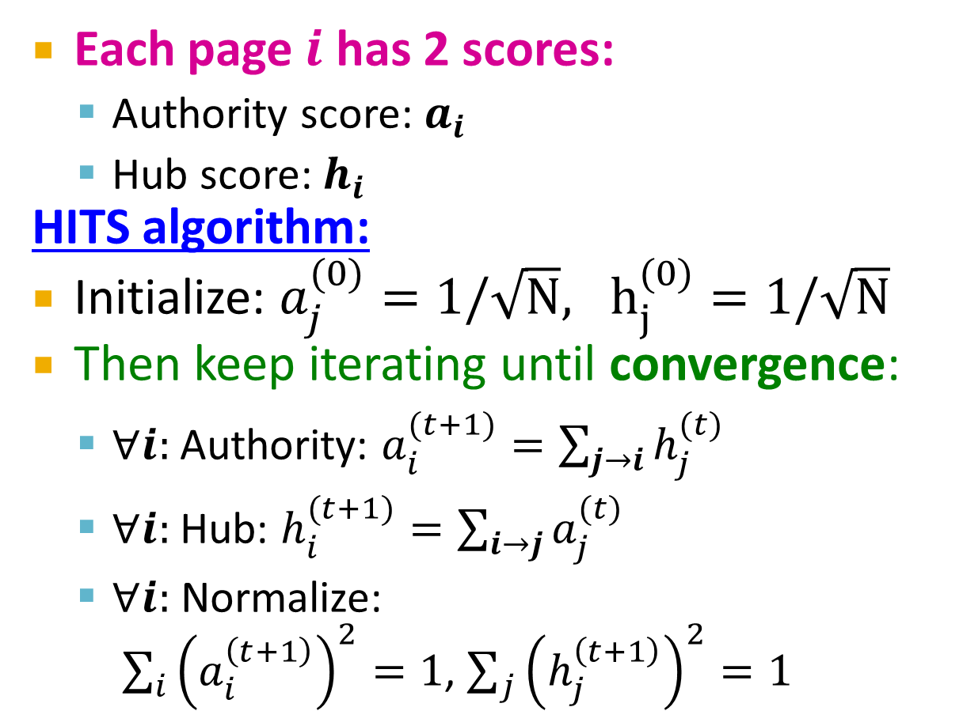

Hubs and Authorities
[Kleinberg ‘98]
j₁
j₂
j₃
j₄
Each page $i$ has 2 scores:
Authority score: $a_{i}$
Hub score: $h_{i}$
HITS algorithm:
Initialize: $a_{j}^{(0)}=1/\sqrt{N}, h_{j}^{(0)}=1/\sqrt{N}$
Then keep iterating until convergence:
$∀i:$Authority: $a_{i}^{(t+1)}=\sum_{j→i}{h_{j}^{(t)}}$
$∀i:$Hub: $h_{i}^{(t+1)}=\sum_{i→j}{a_{j}^{(t)}}$
$∀i:$ Normalize: $\sum_{i}{{\left(a_{i}^{\left(t+1\right)}\right)}^{2}}=1$, $\sum_{j}{{\left(h_{j}^{\left(t+1\right)}\right)}^{2}}=1$
i
$$a_{i}=\sum_{j→i}{h_{j}}$$
i
j₁
j₂
j₃
j₄
$$h_{i}=\sum_{i→j}{a_{j}}$$

Slide 11
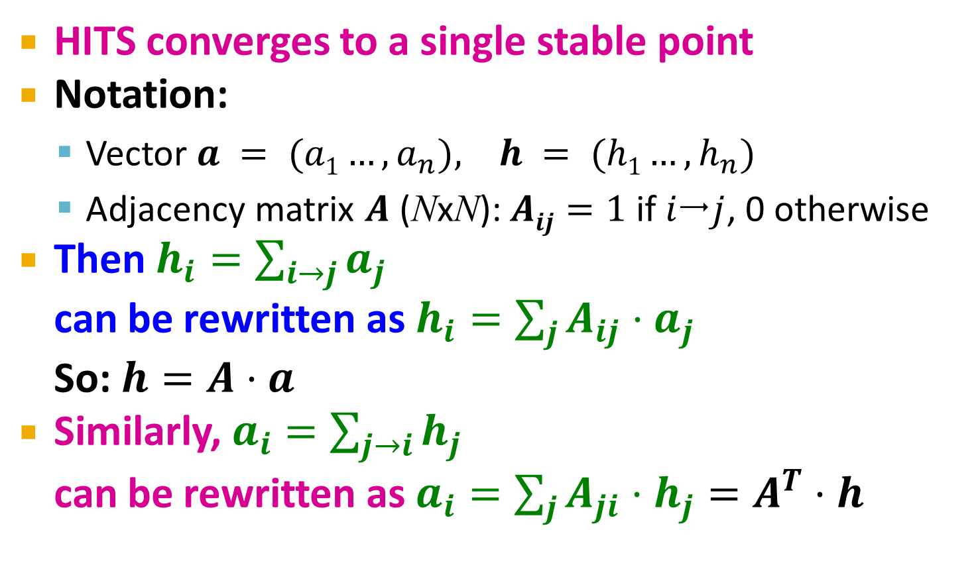
Hubs and Authorities
[Kleinberg ‘98]
HITS converges to a single stable point
Notation:
Vector $a = (a1…,a_{n}), h = (h1…,h_{n})$
Adjacency matrix $A$ (NxN): $Aij=1$ if $ij$, 0 otherwise
Then $h_{i}=\sum_{i→j}{a_{j}}$ can be rewritten as $h_{i}=\sum_{j}{A_{ij}⋅a_{j}}$ So: $h=A⋅a$
Similarly, $a_{i}=\sum_{j→i}{h_{j}}$ can be rewritten as $a_{i}=\sum_{j}{A_{ji}⋅h_{j}}=A^{T}⋅h$

Slide 12

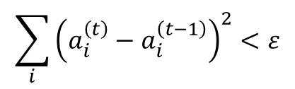
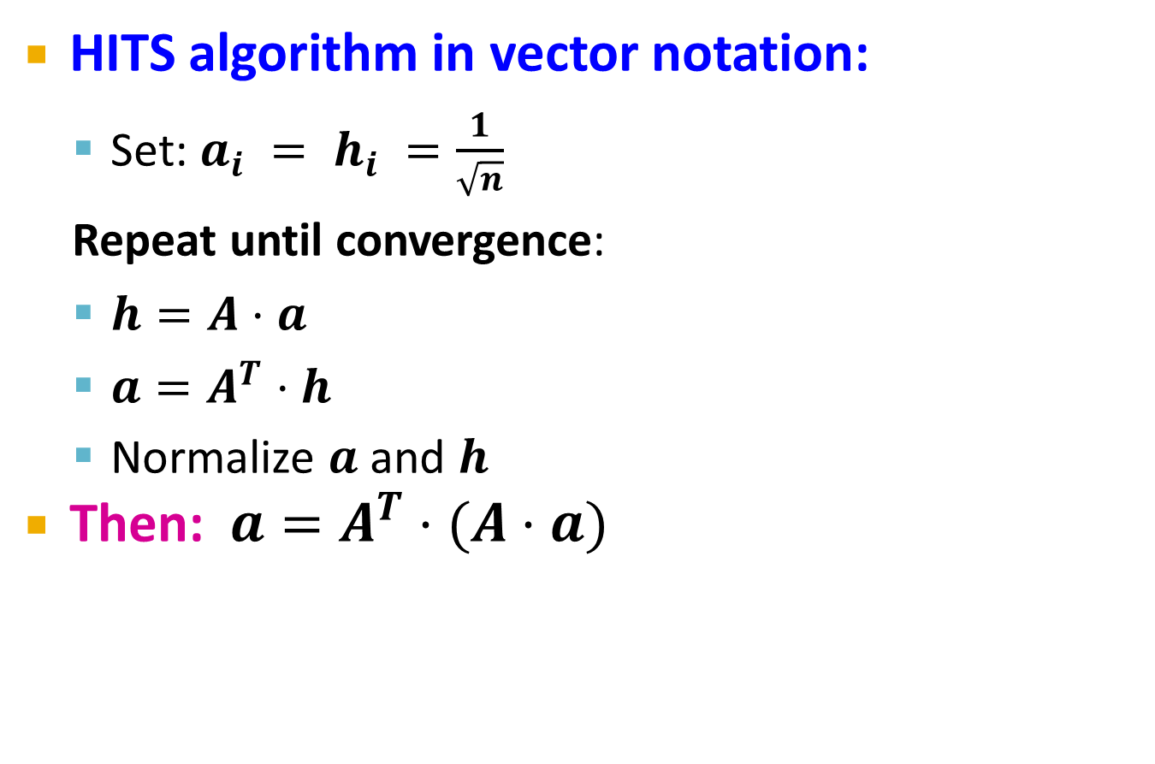
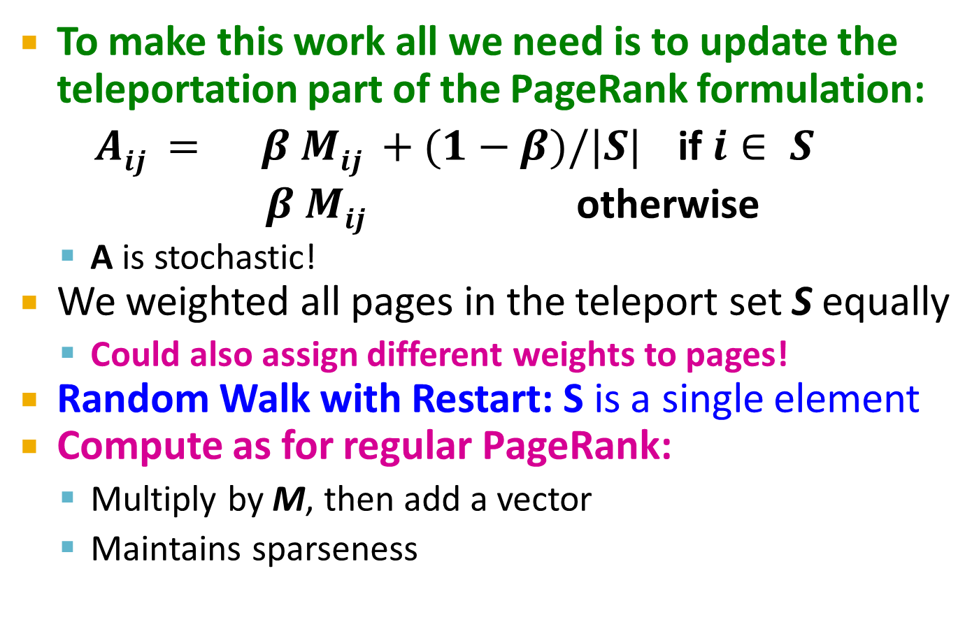


Hubs and Authorities
HITS algorithm in vector notation:
Set: $a_{i} = h_{i} =\frac{1}{\sqrt{n}}$
Repeat until convergence:
$h=A⋅a$
$a=A^{T}⋅h$
Normalize $a$ and $h$
Then: $a=A^{T}⋅(A⋅a)$
Convergence criterion:
$$\sum_{i}{{\left(h_{i}^{\left(t\right)}−h_{i}^{\left(t−1\right)}\right)}^{2}}<ε$$
$$\sum_{i}{{\left(a_{i}^{\left(t\right)}−a_{i}^{\left(t−1\right)}\right)}^{2}}<ε$$
$a$ is updated (in 2 steps):
$a=A^{T}(A a)=(A^{T}A) a$
h is updated (in 2 steps):
$$h=A (A^{T}h)=(A{ A}^{T}) h$$
new $h$
new $a$
Repeated matrix powering

Slide 13
Example of HITS
1 1 1
A = 1 0 1
0 1 0
1 1 0
A^{T} = 1 0 1
1 1 0
Yahoo
Amazon
M’soft

Slide 14
PageRank and HITS
PageRank and HITS are two solutions to the same problem:
What is the value of an in-link from u to v?
In the PageRank model, the value of the link depends on the links into u
In the HITS model, it depends on the value of the other links out of u

