Slide 1

Recommendation Systems

Slide 2
Recommendation System
A subclass of information filtering system that seeks to predict the "rating" or "preference" a user would give to an item.
Utilized in a variety of areas including movies, music, news, books, research articles, search queries, social tags, and products in general.

Slide 3
Recommendation System: Types
Recommender systems typically produce a list of recommendations in one of two ways –
Collaborative Filtering
Content Based Filtering
Hybrid Systems

Slide 4
Collaborative Filtering (CF)
The most prominent approach to generate recommendations
used by large, commercial e-commerce sites
well-understood, various algorithms and variations exist
applicable in many domains (book, movies, DVDs, ..)
Approach
use the "wisdom of the crowd" to recommend items
Basic assumption and idea
Users give ratings to catalog items (implicitly or explicitly)
Customers who had similar tastes in the past, will have similar tastes in the future

Slide 5
Content Based Filtering (CBF)
Utilize a series of discrete characteristics of an item in order to recommend additional items with similar properties.
Difference:
Last.fm creates a "station" of recommended songs by observing what bands and individual tracks the user has listened to on a regular basis and comparing those against the listening behavior of other users. Last.fm will play tracks that do not appear in the user's library, but are often played by other users with similar interests. As this approach leverages the behavior of users, it is an example of a collaborative filtering technique. – Cold Start Problem
Pandora uses the properties of a song or artist (a subset of the 400 attributes provided by the Music Genome Project) to seed a "station" that plays music with similar properties. User feedback is used to refine the station's results, deemphasizing certain attributes when a user "dislikes" a particular song and emphasizing other attributes when a user "likes" a song. This is an example of a content-based approach.

Slide 6
CF Approaches
Based on collecting and analyzing a large amount of information on users’ behaviors, activities or preferences and predicting what users will like based on their similarity to other users.
A key advantage of the collaborative filtering approach is that it does not rely on machine analyzable content and therefore it is capable of accurately recommending complex items such as movies without requiring an "understanding" of the item itself.
Algorithms
KNN
Pearson Correlation

Slide 7
Pure CF Approaches
Input
Only a matrix of given user–item ratings
Output types
A (numerical) prediction indicating to what degree the current user will like or dislike a certain item
A top-N list of recommended items

Slide 8
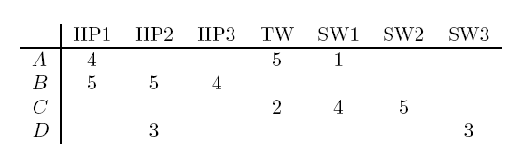
Jaccard Distance
Cosine Distance
Rounding the Data
Normalising Rating

Slide 9
Algorithms
User-based nearest neighbor
Non-probabilistic Algorithms
Item-based nearest neighbor
Collaborative Filtering
Reducing dimensionality
Bayesian-network models
EM algorithm
Probabilistic Algorithms

Slide 10
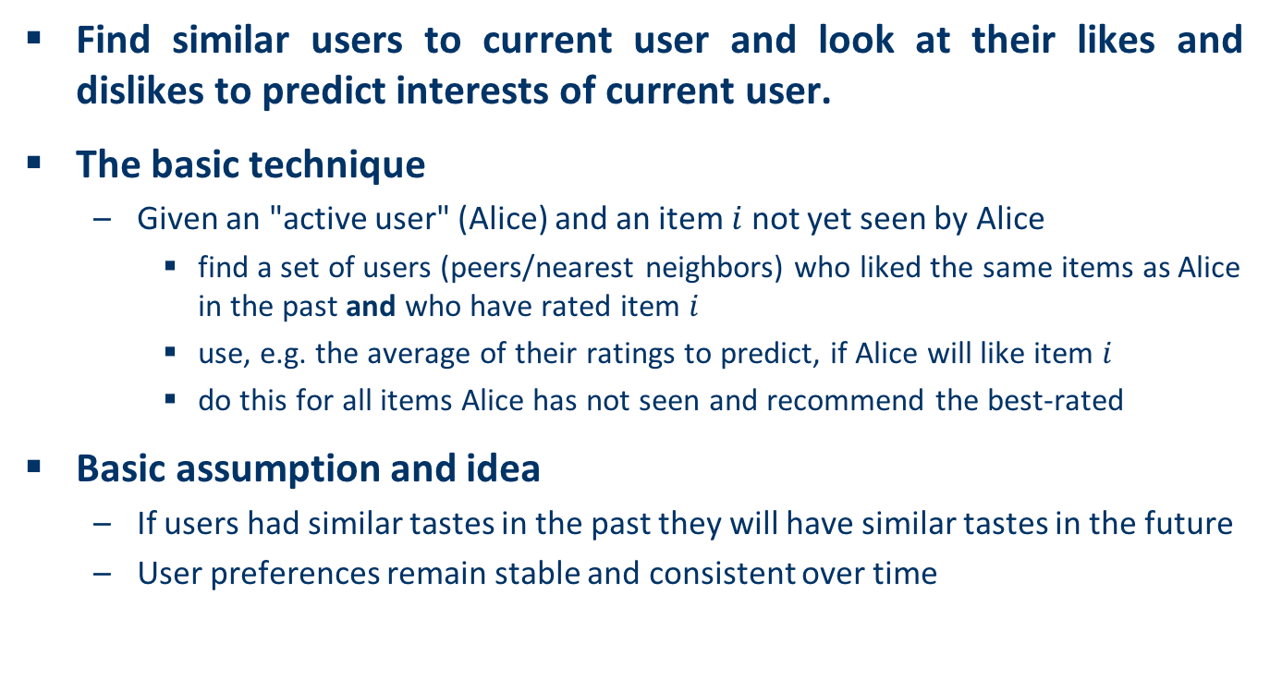
User-based nearest-neighbor collaborative filtering (1)
Find similar users to current user and look at their likes and dislikes to predict interests of current user.
The basic technique
Given an "active user" (Alice) and an item $i$ not yet seen by Alice
find a set of users (peers/nearest neighbors) who liked the same items as Alice in the past and who have rated item $i$
use, e.g. the average of their ratings to predict, if Alice will like item $i$
do this for all items Alice has not seen and recommend the best-rated
Basic assumption and idea
If users had similar tastes in the past they will have similar tastes in the future
User preferences remain stable and consistent over time

Slide 11
User-based nearest-neighbor collaborative filtering (2)
Example
A database of ratings of the current user, Alice, and some other users is given:
Determine whether Alice will like or dislike Item5, which Alice has not yet rated or seen
 | Item1 | Item2 | Item3 | Item4 | Item5
Alice | 5 | 3 | 4 | 4 | ?
User1 | 3 | 1 | 2 | 3 | 3
User2 | 4 | 3 | 4 | 3 | 5
User3 | 3 | 3 | 1 | 5 | 4
User4 | 1 | 5 | 5 | 2 | 1

Slide 12

User-based nearest-neighbor collaborative filtering (3)
Some first questions
How do we measure similarity?
How many neighbors should we consider?
How do we generate a prediction from the neighbors' ratings?
 | Item1 | Item2 | Item3 | Item4 | Item5
Alice | 5 | 3 | 4 | 4 | ?
User1 | 3 | 1 | 2 | 3 | 3
User2 | 4 | 3 | 4 | 3 | 5
User3 | 3 | 3 | 1 | 5 | 4
User4 | 1 | 5 | 5 | 2 | 1

Slide 13

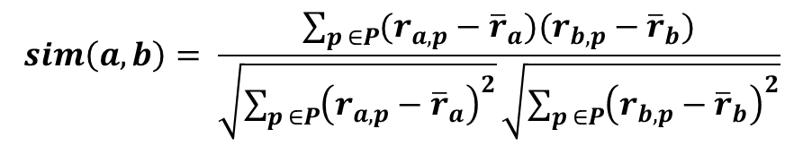
Measuring user similarity (1)
A popular similarity measure in user-based CF: Pearson correlation
$a$, $b$ : users
$r_{a,p}$: rating of user $a$ for item $p$
$P$ : set of items, rated both by $a$ and $b$
Possible similarity values between $−1$ and $1$
$$sim\left(a,b\right)= \frac{\sum_{p ∈P}{(r_{a,p}−{\overline{r}}_{a})(r_{b,p}−{\overline{r}}_{b})}}{\sqrt{\sum_{p ∈P}{{\left(r_{a,p}−{\overline{r}}_{a}\right)}^{2}}}\sqrt{\sum_{p ∈P}{{\left(r_{b,p}−{\overline{r}}_{b}\right)}^{2}}}}$$

Slide 14
Measuring user similarity (2)
A popular similarity measure in user-based CF: Pearson correlation
$a$, $b$ : users
$r_{a,p}$: rating of user $a$ for item $p$
$P$ : set of items, rated both by $a$ and $b$
Possible similarity values between $−1$ and $1$
 | Item1 | Item2 | Item3 | Item4 | Item5
Alice | 5 | 3 | 4 | 4 | ?
User1 | 3 | 1 | 2 | 3 | 3
User2 | 4 | 3 | 4 | 3 | 5
User3 | 3 | 3 | 1 | 5 | 4
User4 | 1 | 5 | 5 | 2 | 1
sim = 0,85
sim = 0,00
sim = 0,70
sim = -0,79

Slide 15
Item-based collaborative filtering
Basic idea:
Use the similarity between items (and not users) to make predictions
Example:
Look for items that are similar to Item5
Take Alice's ratings for these items to predict the rating for Item5
 | Item1 | Item2 | Item3 | Item4 | Item5
Alice | 5 | 3 | 4 | 4 | ?
User1 | 3 | 1 | 2 | 3 | 3
User2 | 4 | 3 | 4 | 3 | 5
User3 | 3 | 3 | 1 | 5 | 4
User4 | 1 | 5 | 5 | 2 | 1

Slide 16
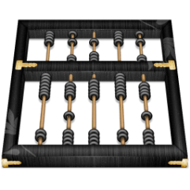
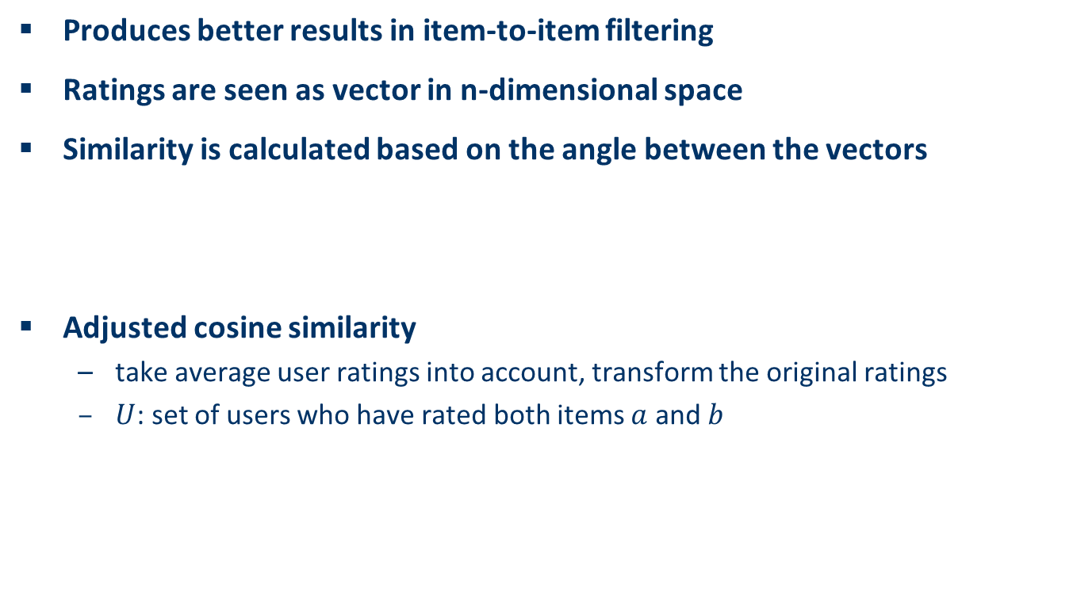
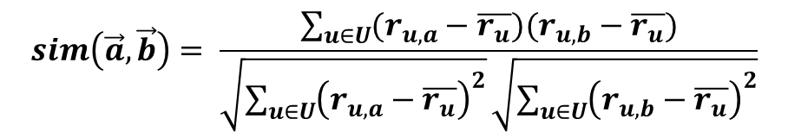

The cosine similarity measure
Produces better results in item-to-item filtering
Ratings are seen as vector in n-dimensional space
Similarity is calculated based on the angle between the vectors
Adjusted cosine similarity
take average user ratings into account, transform the original ratings
$U$: set of users who have rated both items $a$ and $b$
$$sim\left(\vec{a},\vec{b}\right)=\frac{\vec{a}∙\vec{b}}{\left|\vec{a}\right|∗|\vec{b}|}$$
$$sim\left(\vec{a},\vec{b}\right)= \frac{\sum_{u∈U}{(r_{u,a}−\overline{r_{u}})(r_{u,b}−\overline{r_{u}})}}{\sqrt{\sum_{u∈U}{{\left(r_{u,a}−\overline{r_{u}}\right)}^{2}}}\sqrt{\sum_{u∈U}{{\left(r_{u,b}−\overline{r_{u}}\right)}^{2}}}}$$

Slide 17
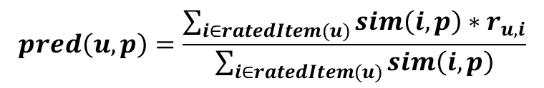
Making predictions
A common prediction function:
Neighborhood size is typically also limited to a specific size
Not all neighbors are taken into account for the prediction
An analysis of the MovieLens dataset indicates that "in most real-world situations, a neighborhood of 20 to 50 neighbors seems reasonable" (Herlocker et al. 2002)
$$pred\left(u,p\right)=\frac{\sum_{i∈ratedItem(u)}{sim\left(i,p\right)∗r_{u,i}}}{\sum_{i∈ratedItem(u)}{sim\left(i,p\right)}}$$

Slide 18



