Slide 1

UCS503
Netra
Team Netra
Ragini Kalra 1024030139
Jatin Goyal 1024030137
Vaishnavi Singh 1024030130
Madhav 1024030134

Slide 2
Introduction
01
Project scope
02
TABLE OF CONTENTS
Proposed functions
03
Target users
04
Features and interfaces
05
Architecture
06
The gap no scanner sees
Server, workers, storage
Data and sampling
07
Three classes, frozen
Ground truth and frame
Performance and security
08
Capture, detect, gate, report
Budgets and controls
Quality and risks
09
Who carries the problem
Attributes and register
Planning and close
10
System and external
Gantt, milestones, references

Slide 3
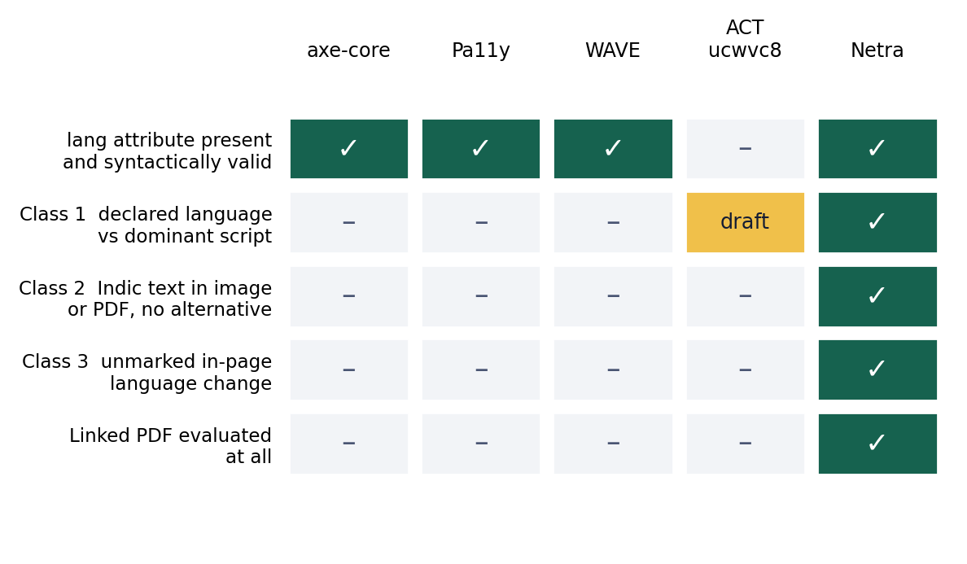
Introduction
Overview: Three accessibility defects on Indian institutional websites that no shipping scanner detects.
The gap: Language rules check that the attribute exists. None check it against the text on the page.
Why now: GIGW 3.0 and IS 17802 make these compliance failures, not preferences.
Aim: Build the labelled Indic-script dataset that makes them measurable.

Slide 4
Project Scope
Class 1: Declared language against the dominant script on the page.
Class 2: Indic text in an image or PDF with no adequate alternative.
Class 3: Unmarked language change inside a page.
Deliverables: Labelled dataset, codebook, hosted audit service, per-class precision and recall against axe-core and Pa11y.
Not in scope: Glyph rendering is a stretch item. English, Hindi, Punjabi only. Public pages only.

Slide 5
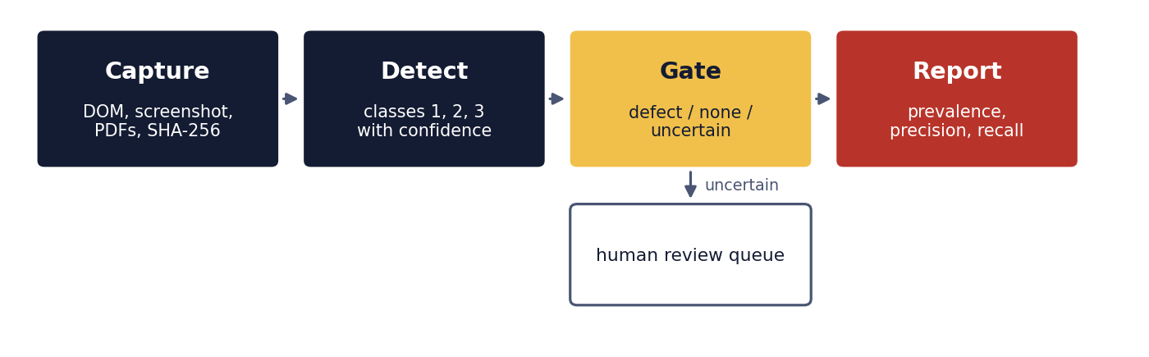
Proposed Functions
Capture: Render the page. Archive DOM, screenshot and every linked PDF with a SHA-256 hash, so a finding survives the next site update.
Detect: Dominant script against declared lang. Run segmentation for language of parts. Indic OCR on images. Unicode test on PDF text layers.
Gate: Uncertain findings go to a human, never into a report. The queue rate is published as a result in its own right.

Slide 6
Target Users
Affected: Blind and low-vision students and staff. They carry the defect and never touch the tool.
Operators: Institutional web teams. They hold the obligation and are not accessibility specialists, so findings name a page and a fix, not a rule number.
Annotators: Our own team. Time is the constraint, so minutes per page is measured, not assumed.
Contacts: Patiala School for the Blind, about sixty students, in our own city. Equal Opportunity Cell, Panjab University.

Slide 7
System Features and Interfaces
Core: Page inventory, capture and archive, three detection modules, axe-core and Pa11y baseline harness.
Human loop: Review queue, blind double annotation, adjudication record published with the dataset.
Output: Prevalence, per-class precision and recall, per-institution export ordered by reach.
User interface: Public site, finding view with the archived screenshot beside the markup, annotation view, admin upload and publish.
External: Tesseract Indic, PDF text extraction, NVDA with Hindi and Punjabi voices, AWS S3. HTTPS at nginx, crawler capped at one request per second per host.

Slide 8
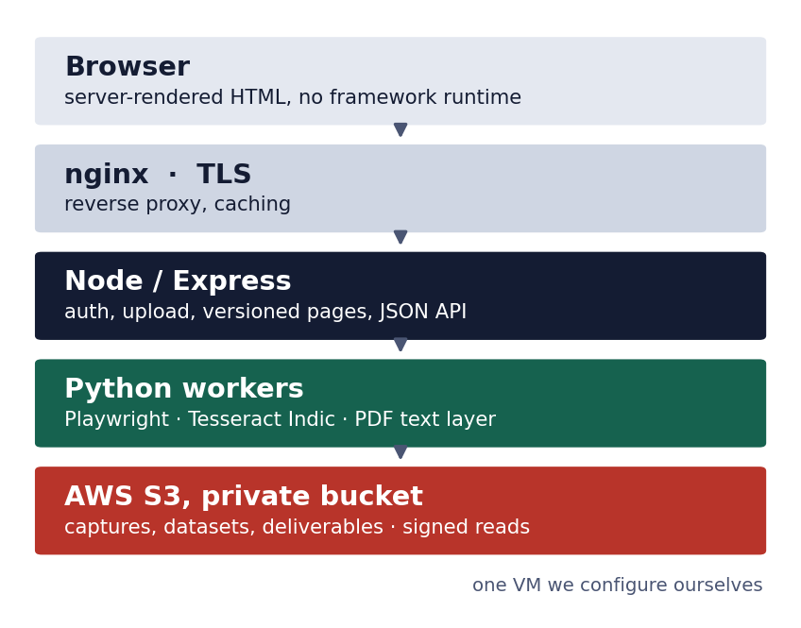
Architecture and Deployment
Our own server: Node and Express on a VM we configure ourselves. No platform that hides the setup.
Workers: Playwright, OCR and PDF work run on a schedule, off the request path.
Storage: Private S3 bucket. Signed reads. Credential limited to put and get.
Records: Append-only metadata. Every published version keeps its address.

Slide 9
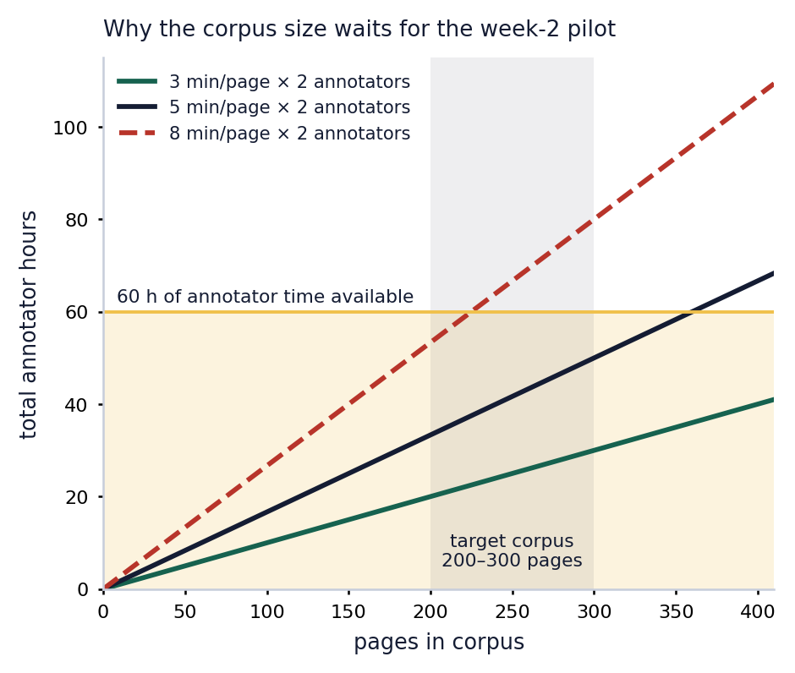
Data and Sampling
Frame: Ten institutions balanced by script region, with Thapar included as an expected-clean control.
Institutions: Punjabi University, Panjab University, GNDU, PAU, NIEPVD Dehradun, Delhi, BHU, Kurukshetra, Lucknow.
Pilot: Thirty pages in week 2. Three per institution, chosen by a fixed rule, never by preference.
Sizing: Corpus set from measured minutes per page, not decided in advance.
Freeze: Blind double annotation, kappa per script, evaluation set hashed before any tuning.

Slide 10
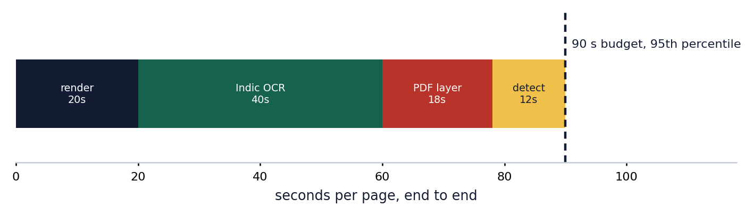
Performance and Security
Page: Published page under 500 ms at the 95th percentile. No JavaScript needed to read the text.
Analysis: One page end to end under 90 seconds. A 300-page corpus re-run in under four hours. Crawler capped at one request per second per institution.
Security: Private bucket, signed reads, SHA-256 on every file. Admin is the only authenticated surface, on eight-hour tokens.
By design: No delete route. A published version cannot be removed, even by us.

Slide 11
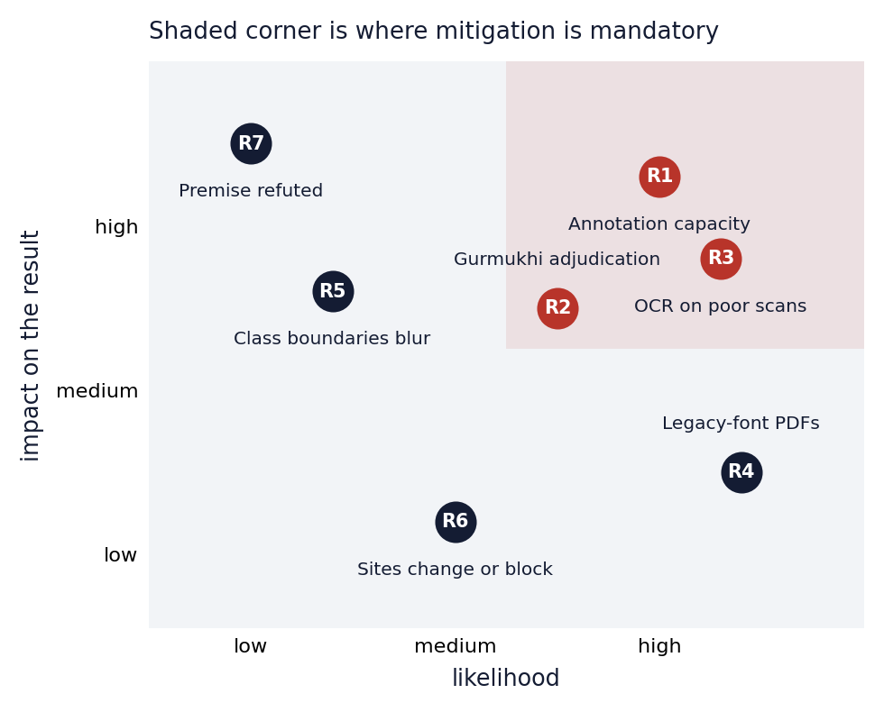
Quality Attributes and Risks
Reliability: Idempotent analysis over immutable, hashed captures. Same capture, same finding.
Usability: Our own site has to pass the audit we run on others.
Maintainability: One module per class behind a shared interface. Named owner and second reader per component.
Top risks: R1 annotation capacity and R3 OCR accuracy. Both mitigated by measurement, not optimism.
Kill switch: R7 if week 1 shows the defect is rare, we stop and report that.

Slide 12
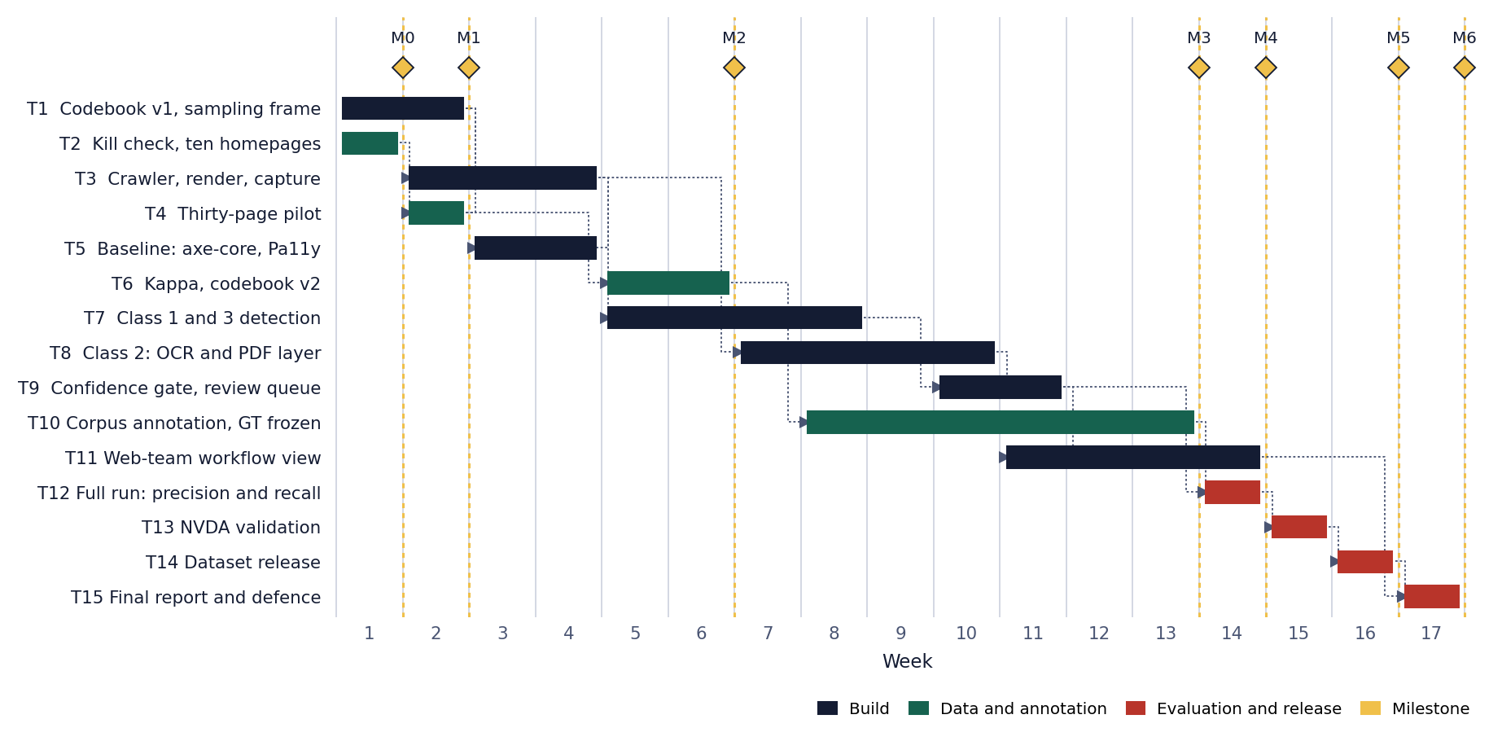
Initial Planning
Seventeen weeks. Bars are tasks, dotted lines are dependencies, diamonds are milestones.
M0 kill check w1 | M1 pilot w2 | M2 kappa w6 | M3 ground truth frozen w13 | M4 results w14 | M5 dataset w16 | M6 defence w17

Slide 13
Conclusion and References
Summary: Three classes nobody detects, on portals where accessibility is law. The labelled dataset is the artefact.
Feasibility: Components are mature; annotation is the binding constraint. Fieldline was dropped on implementation risk.
Next steps: Week 1: kill check and codebook v1. Week 2: the pilot, then the corpus size is fixed.
Two questions for you: Is the class 2 ground-truth rule decidable as written, and is the Gurmukhi protocol acceptable with two in-team readers?
References: W3C ACT ucwvc8; WCAG 2.2; GIGW 3.0; IS 17802; axe-core; Pa11y; Tesseract Indic; NVDA; Playwright; Kaur and Dani 2016; arXiv:1710.07899; arXiv:2009.06526; ACM DGOV 2024.

