Slide 1


FinalSay
Cross-Institution Notice Verification & Temporal Reliability Platform
UCS503 · Software Engineering Lab — Team FinalSay

Slide 2

FinalSay
Introduction
1
PROBLEM
2
INSIGHT
3
SOLUTION
Notices reach students through forwards, screenshots and group-chat messages. A stale or edited version looks identical to the current one, so nobody can confirm what still holds.
This is not a distribution problem — it is a trust problem. The notice already reached the student; what is missing is confirmation that it matches the official record and visibility into how it changed.
A verification layer that redacts personal data, matches a submitted notice against the official record, and classifies the relationship — consistent, contradictory, superseded or unresolved.
Forwards spread the notice. FinalSay verifies it.
SAMPLE SUBMISSION
WHAT THE SYSTEM RETURNS
“Mid-term exam moved to 15 Sep — is this notice genuine?”
The matching official notice, a relationship label with a confidence score, and a verifiable evidence trail.
HOW IT FLOWS
Notice in
Match + compare
Classify
Verified result
1

Slide 3
FinalSay
Feasibility Study — Implementation
FEASIBILITY
Answering the six feasibility questions for the proposed FinalSay system
1
What if the system wasn’t implemented?
4
What will be the integration problems?
→ Students keep relying on forwarded screenshots with no way to confirm authenticity or catch a stale or edited notice.
→ Ingestion, OCR/LLM extraction, comparison engine and hash-anchoring must interoperate; a typed schema and clear API boundaries handle this.
2
What are the current process problems?
5
Is new technology needed? What skills?
→ Notices are cross-checked by word of mouth, if at all; corrections and cancellations rarely reach everyone who saw the original.
→ No custom hardware; FastAPI + PostgreSQL, OCR/LLM extraction, SHA-256 hashing. Skills: backend/API, NLP/ML, applied cryptography.
3
How will the proposed system help?
6
What facilities must be supported?
→ One submission drives extraction → matching → classification → reviewer-confirmed verdict, backed by a hash evidence trail.
→ PDF/webpage/email ingestion, PostgreSQL storage, public website + installable PWA, and a lightweight on-chain anchoring service.
Feasibility verdict → technically viable with standard components (FastAPI, PostgreSQL, OCR/LLM extraction, lightweight on-chain hash anchoring), scoped to a public verification layer that needs no institutional partnership to launch.
2

Slide 4
FinalSay
Requirements Engineering
RE PROCESS
STAKEHOLDERS
Inception
Primary Actor
Secondary Actor
Secondary Actor
Student
Reviewer
Admin (Issuer)
Elicitation
FUNCTIONAL REQUIREMENTS
Elaboration
Notice submission with automatic PII redaction
Reviewer queue for low-confidence / unresolved cases
Typed-field extraction (issuer, audience, date, deadline)
Hash-based evidence trail & audit export
Negotiation
Matching against the official notice record
Verification links + subscriptions/alerts
Confidence-scored relationship classification
Issuer console for official notices (Tier 2)
Specification
NON-FUNCTIONAL REQUIREMENTS
Validation
Trust & Provenance
every verdict traces to a source hash, retrieval date and issuer identity
Management
Security
personal data redacted before storage; role-gated issuer / reviewer access
Reliability
an unresolved conflict stays unresolved — never auto-decided
Usability
one submission flow, a plain-language verdict
Scalability
multi-institution, multi-tenant data model
Privacy
retention & redaction policy for scraped documents
3

Slide 5

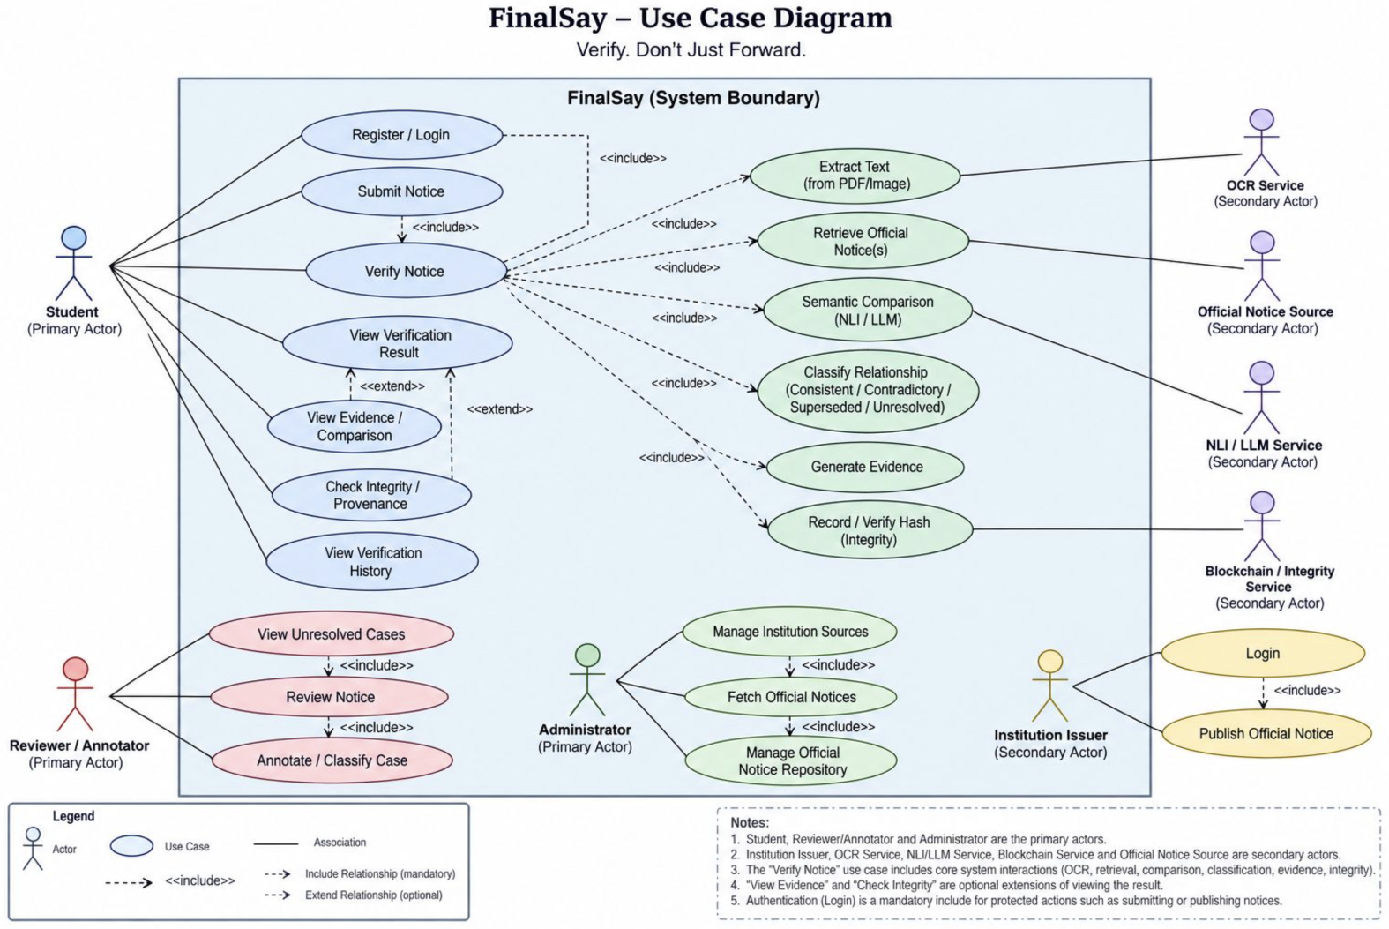
FinalSay
Use Case Diagram
UML — USE CASE
System Design · UML
ACTORS
Primary: Student, Reviewer / Annotator, Administrator. Secondary: OCR, NLI / LLM, Blockchain integrity, Official Notice Source and Institution Issuer.
INCLUDE vs EXTEND
Verify Notice «includes» extraction, retrieval, comparison, classification, evidence and hashing — all mandatory. «extend» covers the optional evidence and integrity views.
Fig. 1 — Verify Notice is the central use case; every supporting service is a mandatory «include», and login gates all protected actions.
4

Slide 6
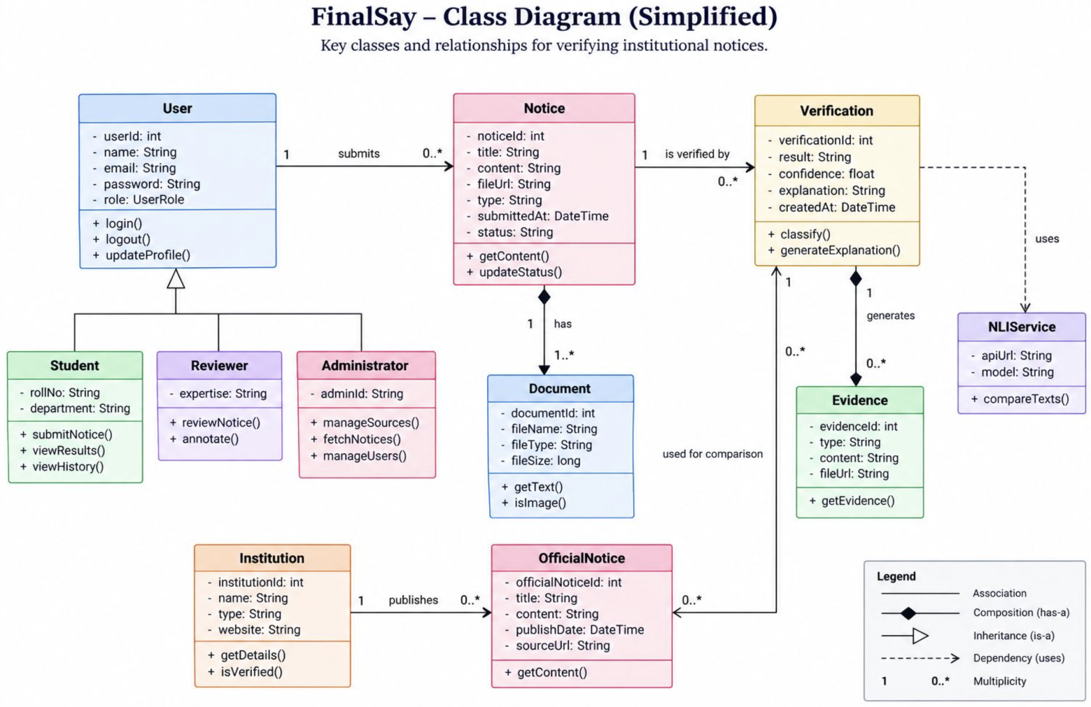
FinalSay
Class Diagram
UML — CLASS
System Design · UML
ONE USER, THREE ROLES
Student, Reviewer and Administrator all inherit from User, so login and profile logic is written once and each role only adds the operations it actually needs.
VERDICT CARRIES EVIDENCE
A Verification is never just a label — it holds result, confidence and explanation, and generates Evidence records that point back to the OfficialNotice used for comparison.
Fig. 2 — A Notice is composed of Documents, verified against an OfficialNotice, and every Verification generates Evidence; NLIService is a dependency, not a stored entity.
5

Slide 7
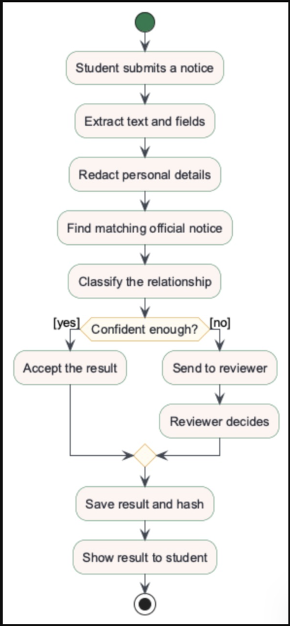
FinalSay
Activity Diagram
CONTROL FLOW
System Design · UML
SCOPE
Covers submission through classification and, when confident, an accepted result. Institutional issuer authoring is a planned extension, kept out of scope for this evaluation.
REVIEW GATE
Every low-confidence branch routes to a human reviewer before a result is saved — the system never silently resolves an unclear case.
Fig. 3 — Only a confident match is auto-accepted; everything else is reviewer-gated.
6

Slide 8
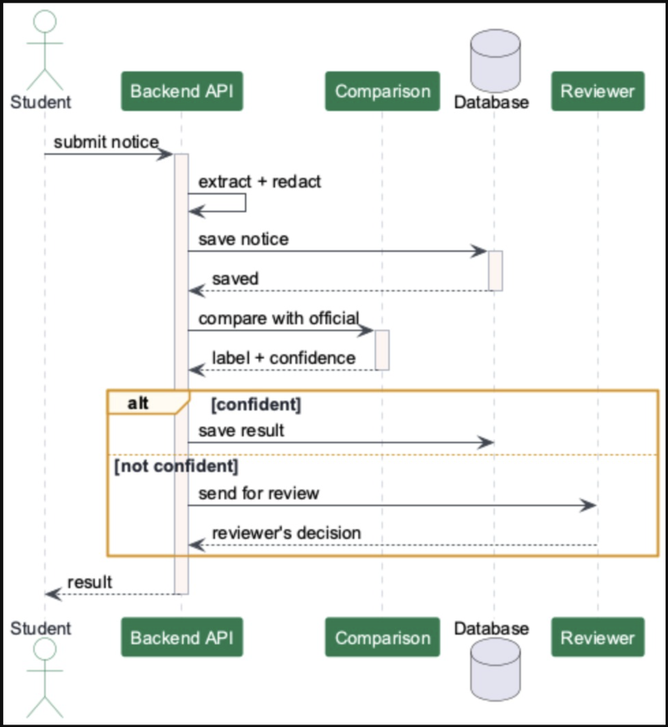
FinalSay
Sequence Diagram
TEMPORAL INTERACTION
System Design · UML
ALT PATH
The alt block is the whole point of the diagram: confident matches save directly, everything else detours through the Reviewer before a result exists.
ONE ROUND TRIP
A single submission drives extraction, comparison and (conditionally) review — the Backend API stays the sole caller the Database and Reviewer ever answer to.
Fig. 4 — Activation bars mark exactly when each component is doing work.
7

Slide 9
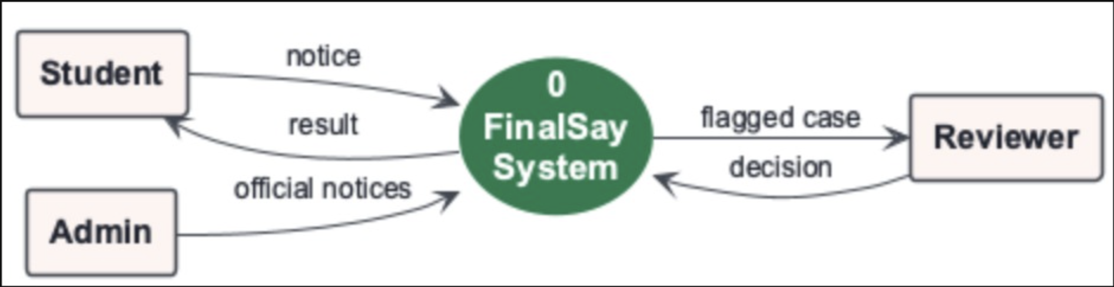
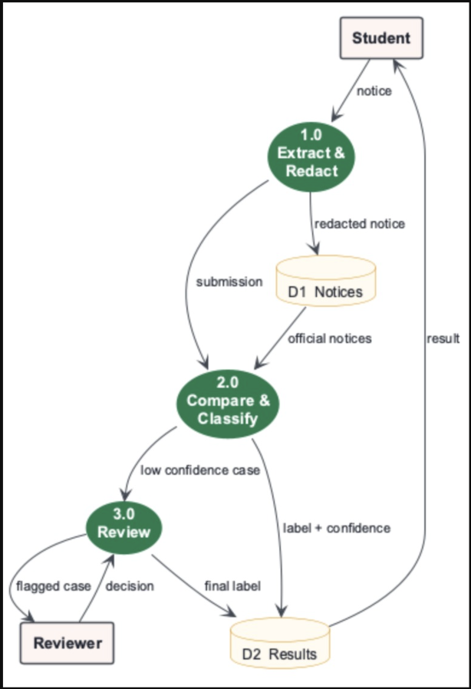
FinalSay
Data Flow Diagram — Level 0 & Level 1
System Design · Process modelling
LEVEL 0 — SYSTEM CONTEXT
LEVEL 1 — PROCESS DECOMPOSITION
LEVEL 0 → LEVEL 1
Level 0 collapses the platform to a single process — Student and Admin feed it, Reviewer is the one actor it hands work back to.
Level 1 opens that box into 1.0 Extract & Redact, 2.0 Compare & Classify and 3.0 Review, with D1 Notices and D2 Results as the two stores. Every flow crossing the Level 0 boundary reappears at Level 1 — the diagram balances.
Fig. 5 — Processes 1.0 and 2.0 are single shared blocks; neither is ever duplicated across the diagram.
8

Slide 10
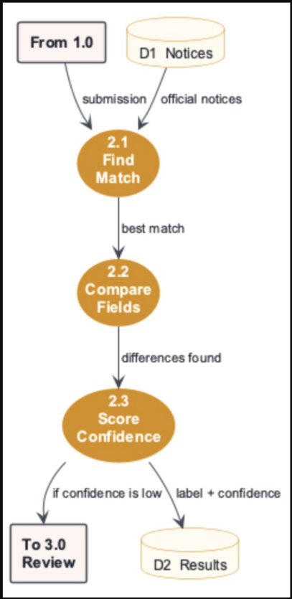
FinalSay
Data Flow Diagram — Level 2
LEVEL 2 — AGENT INTERNALS
System Design · Decomposition of Process 2.0 — Compare & Classify
BALANCING
2.1 Find Match, 2.2 Compare Fields and 2.3 Score Confidence together decompose Process 2.0, matching its Level-1 parent exactly.
UNRESOLVED STAYS UNRESOLVED
A low-confidence match is never force-labelled — it is always handed to Process 3.0 Review rather than silently accepted.
Fig. 6 — Level 2 decomposes only Process 2.0; every child balances against its Level 1 parent.
9

Slide 11
FinalSay
SDLC Model Selection
Why iterative and incremental development fits FinalSay
MODELS CONSIDERED
Waterfall
Prototyping
Spiral
Iterative + Incremental
Rigid sequential phases; no room for scope that changed after every instructor review.
Strong on UI feedback, weak on the architectural rigour a provenance-anchored system needs.
Suited to high-risk, high-cost projects; heavier process than a two-tier scoped evaluation needs.
Working increments validated each sprint, refined as scope and instructor feedback evolved.
SELECTED
WHY IT FITS FINALSAY
Scope kept changing through three instructor review rounds
Cross-institution ingestion can be added one institution at a time
Each sprint yields a testable extraction / comparison increment
Evaluation metrics (F1, agreement) are measured every sprint
Classification thresholds genuinely need tuning against the benchmark
Reviewer workflow and unresolved-case handling validated continuously
SPRINT PROGRESSION
Sprint 0
Sprint 1
Sprint 2
Sprint 3
Sprint 4
Sprint 5+
Architecture
Ingestion / Extraction
Comparison Engine
Reviewer & Evidence Trail
Public Site & PWA
Cross-Inst. Evaluation
“Build a working increment, validate it, learn from feedback, refine the next.”
10

Slide 12
Thank you!
Questions on scope, architecture, or the evidence model — happy to dig in.

