Slide 1
Face Mask Detector
Mayank - 18100031
CSE (6th sem)
Under Guidance of -
Dr. Muneendra Ojha, Asstt. Prof. (Comp. Sci. & Engg.)
Innovate. Achieve. Lead
International Institute of Information Technology, Naya Raipur

Slide 2
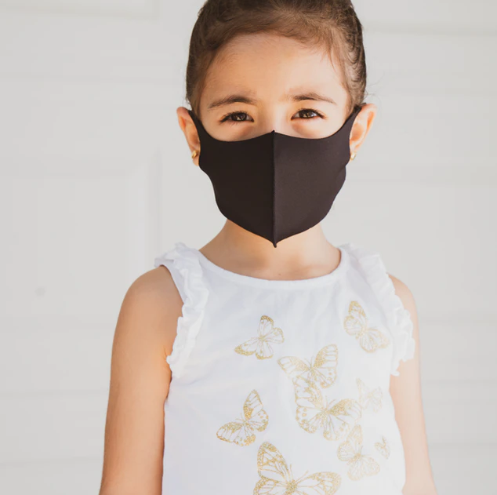
CONTENTS
Introduction
Motivation
About the Dataset
Implementation
Results
Limitations
Dataset & Code link
References

Slide 3
INTRODUCTION
Coronavirus disease is the latest epidemic that forced an international health emergency. It spreads mainly from person to person through respiratory droplets.
According to the latest WHO report, there are around 149M confirmed cases across 192 countries, which has led to around 3M deaths.
Around 1M new cases are reporting each day worldwide.
Thus, wearing a face mask slows the community transmission of this disease.
*
International Institute of Information Technology, Naya Raipur
3

Slide 4
MOTIVATION
Mask is a simple barrier to help prevent your respiratory droplets from reaching others.
When you wear a mask, you protect others as well as yourself. Masks work best when everyone wears one.
The majority of the countries have enforced compulsory face mask policies in public areas and the manual observation of the face mask is a tedious work especially in crowded places.
So, the automation in face mask detection by using latest deep learning techniques motivates the development of this project.

Slide 5
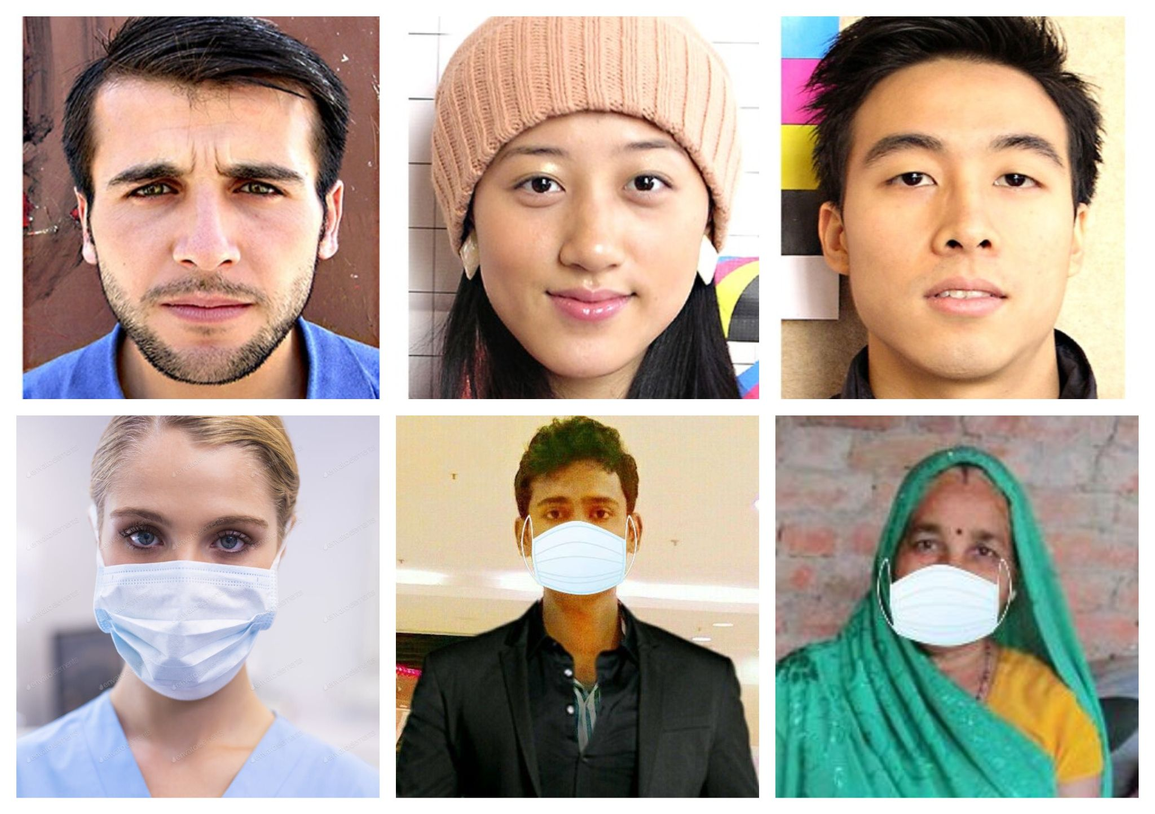
ABOUT THE DATASET
The dataset is created artificially using facial landmarks & downloaded from a open source website.
The dataset has two classes:
with_Mask
without_Mask
Each Image has a dimension of 150×150×3
Fig1. Sample of the dataset

Slide 6
CONTD...
Total training Images: 1315
with_Mask: 658 images
without_mask: 657 images
Total testing Images: 194
with_Mask: 97 images
without_mask: 97 images
As both classes have equal number of images, so the dataset has no class imbalance problem.

Slide 7
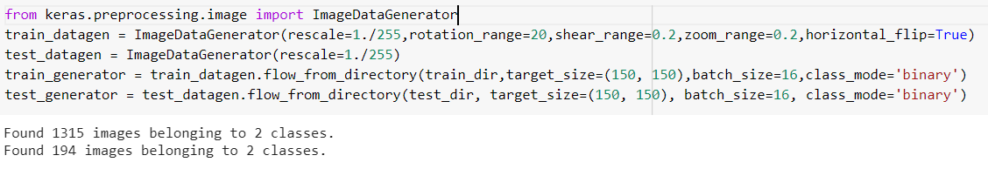
IMPLEMENTATION
ImageDataGenerator: It generates tensor image data with real-time augmentation. So, we used this for preparing the train, test images using the following commands -
As the training dataset is small, so real-time image augmentation is performed on images during the training with train dataset to reduce the chance of overfitting.

Slide 8
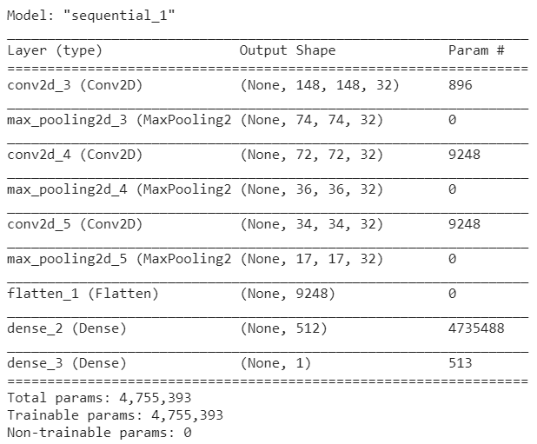
CONTD...
Now, created a sequential model for classifying the masked & unmasked persons. The overview of the layers of the model are -
The Relu (Rectified Linear) & Sigmoid activation functions are used.
Adam is used as an optimizer.
Training & Validation Batch size : 16

Slide 9
CONTD...
The description of the layers are -
Conv2D layer: It has a filter or a kernel which “slides” over the 2D input data, performing an elementwise multiplication which results as a single output pixel.
MaxPooling2D layer: It downsamples the input representation by taking the maximum value over the window defined by pool_size for each dimension along the feature axis & the window is shifted by strides in each dimension.
Flatten layer: It converts the pooled feature map to a single column that is passed to the fully connected layer.
Dense layer: It is a fully connected layer in which all the neurons in a layer are connected to those in the next layer.

Slide 10
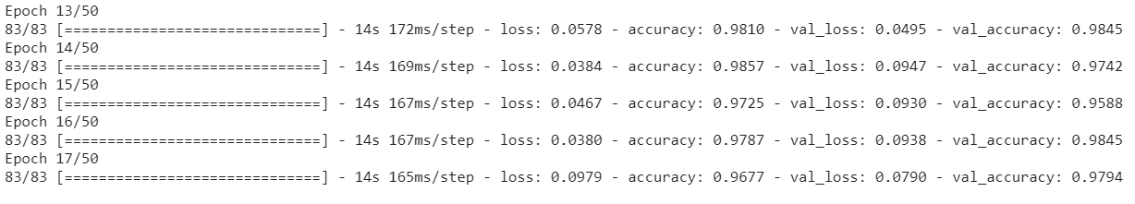
RESULTS
Total epochs on which model is trained : 17 epochs
The last five epochs result are shown in the below figure -

Slide 11
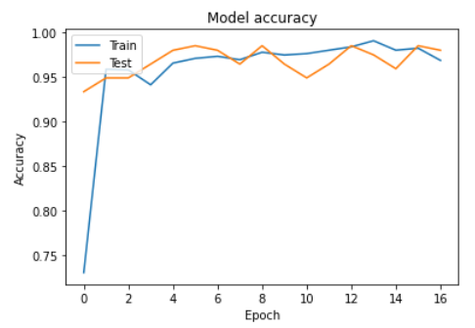
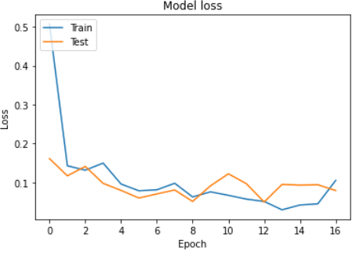
CONTD...
 | Training | Validation
Accuracy | 98.4% | 97.9%
Loss | 0.04 | 0.07
Fig2. This table shows the final obtained results

Slide 12
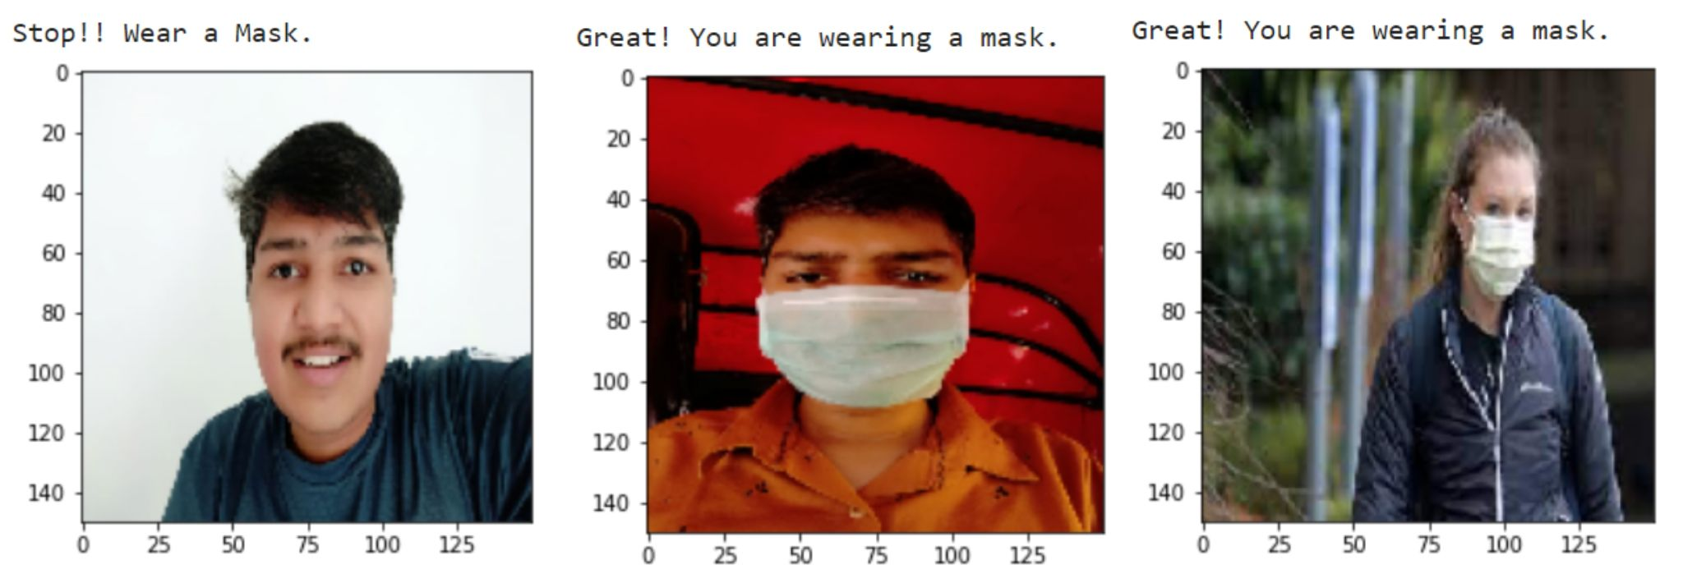
FOR INDIVIDUAL IMAGES...
I randomly selected some pictures from internet for the model testing and the result is shown in the below images:

Slide 13
FOR GROUP IMAGES...
Firstly, all the faces (present in image) coordinates are extracted from the input group image using the OpenCV inbuilt CascadeClassifier.
Then, the each face is passed through the trained model to predict whether the face is masked or not.
Finally, a bounding box is created around each face according to the prediction made.

Slide 14
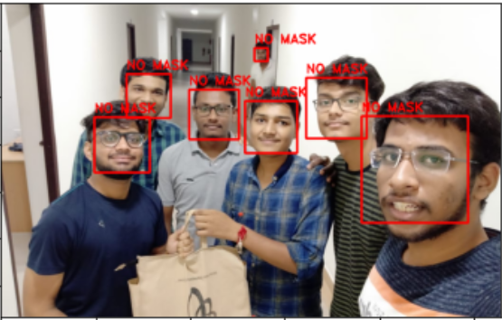
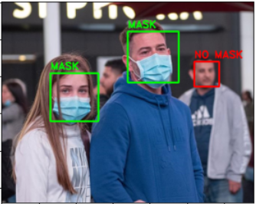
CONTD...
These images shows the testing on some random group images -
Fig3. The prediction shows that the peoples are unmasked.
Fig4. Among all 3 persons, 2 are masked & 1 is unmasked.

Slide 15
LIMITATIONS
The person should be front facing because the model is trained on such image dataset.
In group images, the model sometimes fail to detect the masked person because -
If the image is too obscured by the mask.
The dataset used to train the face detector didn’t contain example images of people wearing face masks.

Slide 16
DATASET & CODE LINK
Dataset link :
Check in Github
Code link :
Check in Github

Slide 17
REFERENCES
A. Das, M. Wasif Ansari and R. Basak, "Covid-19 Face Mask Detection Using TensorFlow, Keras and OpenCV," 2020 IEEE 17th India Council International Conference (INDICON), 2020, pp. 1-5, doi: 10.1109/INDICON49873.2020.9342585
M. M. Rahman, M. M. H. Manik, M. M. Islam, S. Mahmud and J. -H. Kim, "An Automated System to Limit COVID-19 Using Facial Mask Detection in Smart City Network," 2020 IEEE International IOT, Electronics and Mechatronics Conference (IEMTRONICS), 2020, pp. 1-5, doi: 10.1109/IEMTRONICS51293.2020.9216386
S. Ge, J. Li, Q. Ye and Z. Luo, "Detecting Masked Faces in the Wild with LLE-CNNs", 2017 IEEE Conference on Computer Vision and Pattern Recognition (CVPR), pp. 426-434, 2017
M. Z. Islam, M. M. Islam and A. Asraf, "A Combined Deep CNN-LSTM Network for the Detection of Novel Coronavirus (COVID-19) Using X-ray Images", Informatics in Medicine Unlocked, vol. 20, pp. 100412, Aug. 2020

Slide 18

THANK YOU
..
Dr. Shyama Prasad Mukherjee International Institute of Information Technology, Naya Raipur
*
International Institute of Information Technology, Naya Raipur
18

