Slide 1

(OpenMP)
Team No : 11
Team Members :
1) Neelesh Bhakt – 2018201022
2) Souparno Das – 2018201010
3) Nishant Goyal - 2018201038

Slide 2
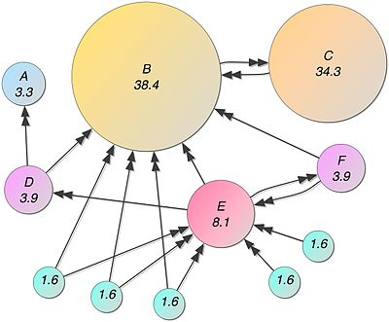
Description
PageRank (PR) is an algorithm used by Google Search to rank web pages in their search engine results. PageRank was named after Larry Page, one of the founders of Google. PageRank is a way of measuring the importance of website pages.

Slide 3
Algorithm Proposed
The algorithm is an implementation of the paper “STIC-D : Algorithmic Techniques For Efficient Parallel Pagerank Computation on Real-World Graphs“
The algorithm proposes two kind of comparisons which are as follows:
1.Comparison based on a baseline page rank code vs the open mp version of the baseline code.
2.Comparison based on an efficient optimized code vs the open mp version of the optimized code.
These two phases are discussed in upcoming slides.

Slide 4
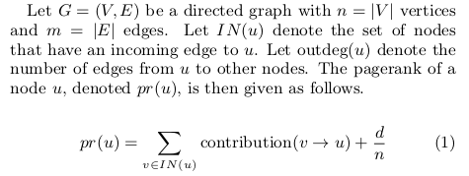
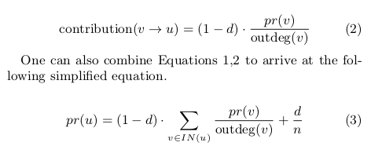
Baseline algorithm

Slide 5
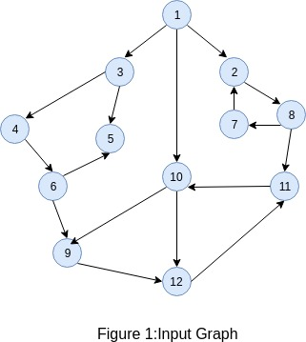
Baseline algorithm
Taking the example of graph G as given below:
Applying the baseline page rank algorithm on the above graph we get,

Slide 6
Baseline Steps
Step-1:In first iteration initialize all nodes with page rank d/n where d is damping factor and n=no.of nodes.Here d=0.15 and n=12
Node | Iteration-1 | Iteration-2 | Final Result
1 | 0.0125
2 | 0.0125
3 | 0.0125
4 | 0.0125
5 | 0.0125
6 | 0.0125
7 | 0.0125
8 | 0.0125
9 | 0.0125
10 | 0.0125
11 | 0.0125
12 | 0.0125

Slide 7
Baseline Steps
Further steps:
Node0 | Iteration-1 | Iteration-2 | Final Result
1 | 0.0125 | 0.0125 | 0.0125
2 | 0.0125 | 0.0213542 | 0.0278947
3 | 0.0125 | 0.0266667 | 0.0473893
4 | 0.0125 | 0.023125 | 0.0527809
5 | 0.0125 | 0.0178125 | 0.0368796
6 | 0.0125 | 0.023125 | 0.0573638
7 | 0.0125 | 0.0178125 | 0.0278895
8 | 0.0125 | 0.023125 | 0.0362105
9 | 0.0125 | 0.023125 | 0.118823
10 | 0.0125 | 0.0319792 | 0.192809
11 | 0.0125 | 0.0284375 | 0.194016
12 | 0.0125 | 0.0284375 | 0.195443

Slide 8
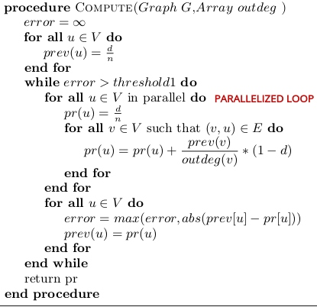
Baseline OpenMp version

Slide 9
Observations:
The algorithm was tested on web-Stanford dataset and following results were obtained:
Sequential Algorithm | No.of Nodes in a graph | Time taken to compute page rank
Baseline algorithm | 281903 | 17.9233 sec
Parallel OpenMP version
No. of threads used | Time taken to compute page rank
2 | 9.02756 sec
3 | 7.53381 sec
4 | 7.17177 sec
5 | 6.64329 sec

Slide 10
Optimized Algorithm
In brief, the SCCs and Topological Ordering breaks the pagerank computation into computations on smaller subgraphs that are strongly connected and processed in a particular order.
The Identical Nodes optimization refers to eliminating the redundant computation for nodes with an identical incoming neighborhood.
The Chain Nodes optimization shortcuts directed paths by a directed edge that connects the end points of the path.
The Optimized Algorithm can be explained in the following steps.

Slide 11
Example-Optimized Algo

Slide 12
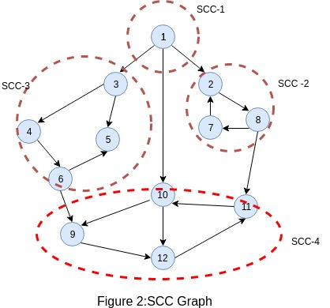
Step-1:Strongly Connected Components(SCC)

Slide 13
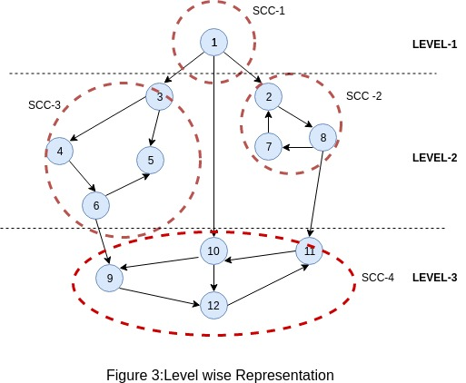
Step-2:Topo-Sorting & Level Ordering

Slide 14
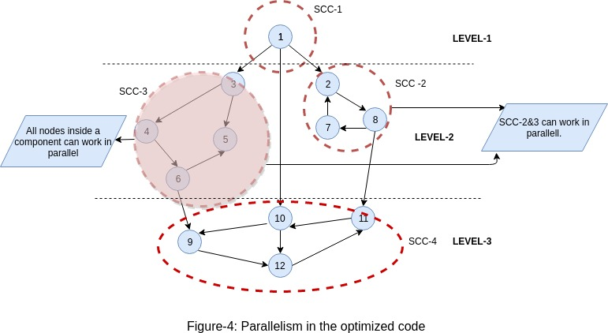
Step-3:Parallelized Algo:

Slide 15
Observations:
The algorithm was tested on web-Stanford dataset and following results were obtained:
Sequential Algorithm | No.of Nodes in a graph | Time taken to compute page rank
Optimized Baseline algorithm | 281903 | 7.32361 sec
Parallel OpenMP version
No. of threads used | Time taken to compute page rank
2 | 6.05546 sec
3 | 5.53381 sec
4 | 5.17177 sec
5 | 5.04329 sec

Slide 16
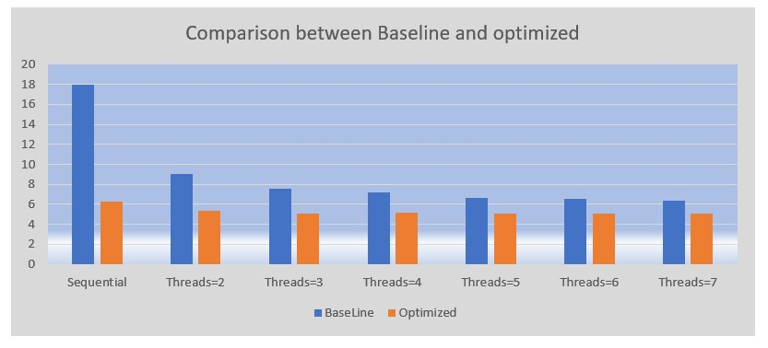

Slide 17


