Slide 1








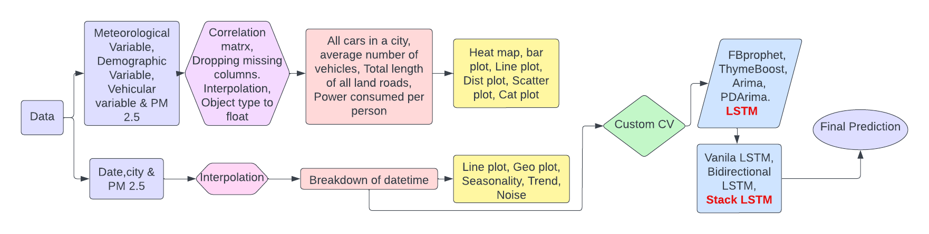
Navigating the Problem
Solution Impact
Rapid economic, and industrial growth caused complex
& extensive air pollution problems.
India became the world’s 8th most polluted country with an annual average PM2.5 concentration 10 times more than the WHO’s recommended level.
PM2.5 has been linked to the development of chronic respiratory, cardiovascular, cerebrovascular diseases, and lung cancer.
Helping the Government to plan and allocate resources accordingly to the most affected areas.
Helping industries regulate the emission of the pollutant causing the highest increase in PM2.5 value.
Helping us identify the most vulnerable cities so we can, control/prevent emissions from the combustion of diesel, fuel, wood.
Solution Overview
Data Treatment
Feature Engineering & Visualization
Modeling
Case Unravellers
1

Slide 2



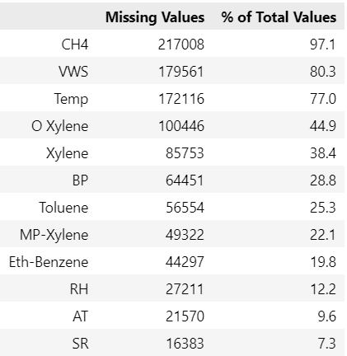
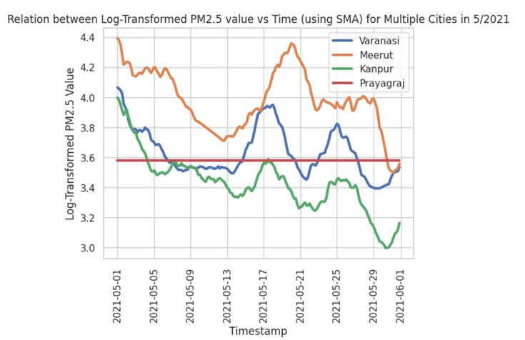


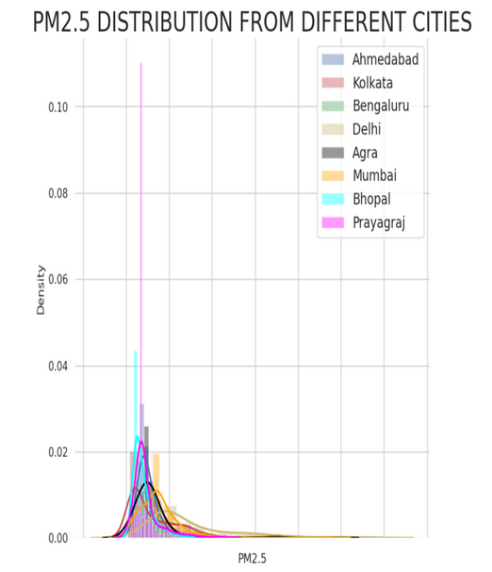
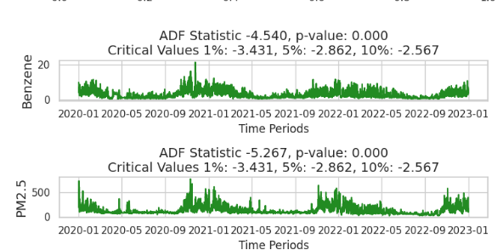
Data Analysis & Treatment
Missing value
Corrupted data
Removed columns having > 25% of their values missing.
For other columns, used simple linear interpolation instead of any other form of interpolation because it presented the best result.
Mean or other forms of imputation weren't used as we had sequential data
Plotted PM2.5 value of each city against time and observed multiple anomalies in multiple cities
Each city with corrupted value presented different challenge, eg. prayagraj had a constant value for 2 years then different values for the subsequent days. Almost 11 cities with anomalies were found.
Outliers
Stationary test & Normalization
We did Augmented Dickey-Fuller (ADF) test to check whether the data was stationary or not, Fortunately, the data turned out to be stationary, in the exceptional cases where such was not the case we did first order differencing
Min Max scaling on the PM2.5 values so we could use our LSTM model
Outliers were detected using data visualization.
Removed outliers and replaced it with simple interpolation
For cities with a higher percentage of outliers, we set a top 2% threshold and removed it, replacing it with simple interpolation
Case Unravellers
2

Slide 3

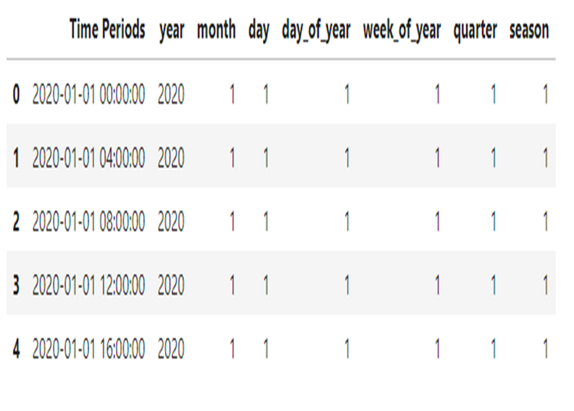
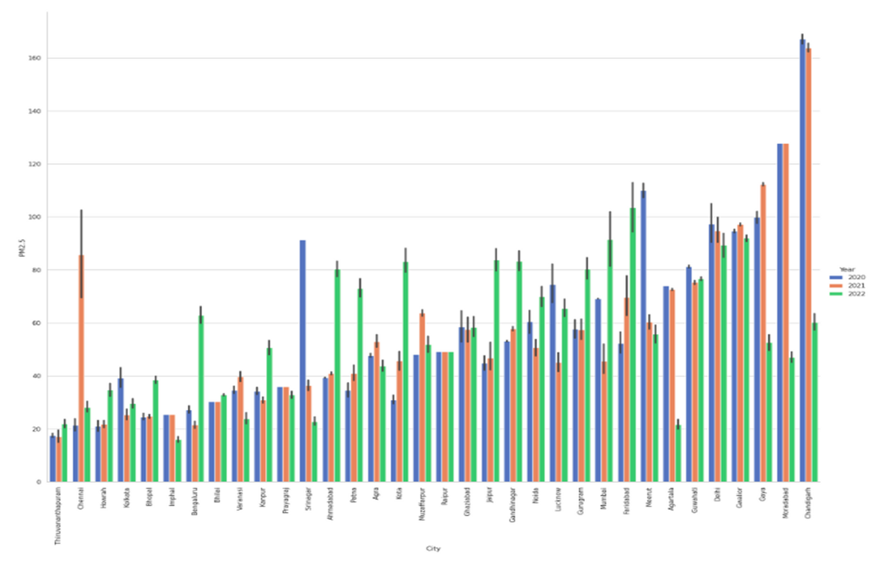
Feature Engineering & Data Visualization
Feature Selection: During submission, we only had the value of datetime and location, so we used a univariate time series model, Hence we only chose datetime as the feature and PM2.5 as the label, so we divided the dataset into 34 datasets of each city
Feature Engineering: Broke down the datetime into day, week, month, hour, week of the month, etc to train the model. We also applied log transformation and a simple moving average (SMA) method for better visualization of the dense dataset
We are able to see from the above bar plot that in most of the cities PM2.5 value increased with time, such cities were Delhi, Ahmedabad, Gandhinagar, Gurugram, and Patna. And in some cities, the PM2.5 value stayed almost the same such as Imphal, Bhilai, Chennai, and Raipur. But In cities like Guwahati, Agartala, Srinagar, and Chandigarh the PM2.5 value decreased over the years.
According to the 2023 report: India's annual average PM2. 5 levels in 2022 was 53.3 μg/m3, slightly lower than the 2021 average of 58.1. However, it was several times higher than the annual PM2. 5 concentrations of 5 μg/m3 limit under World Health Organization (WHO) guidelines.
Case Unravellers
3

Slide 4

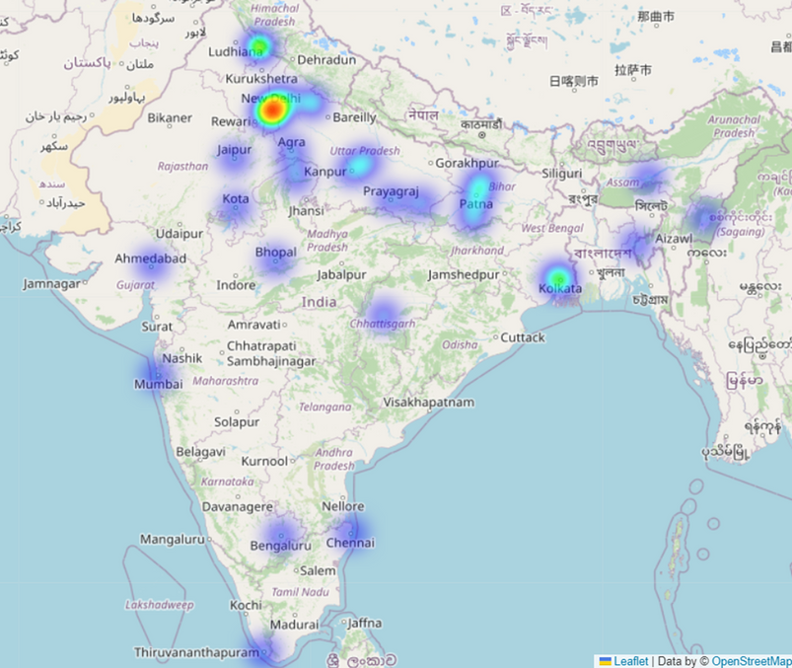
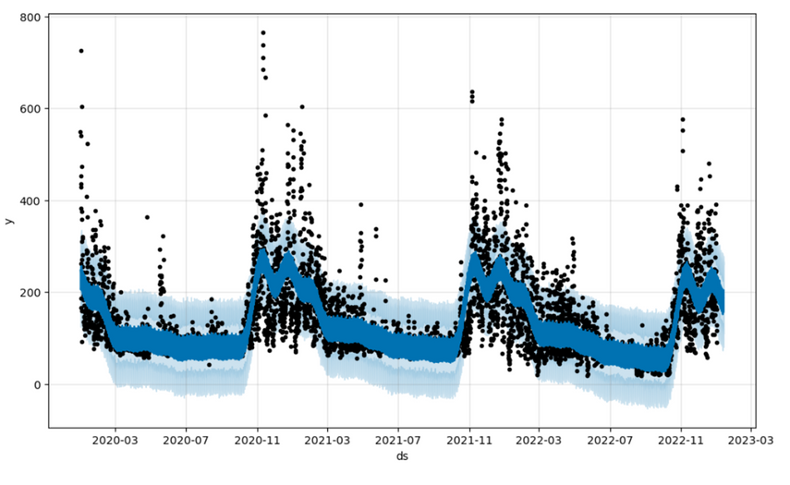


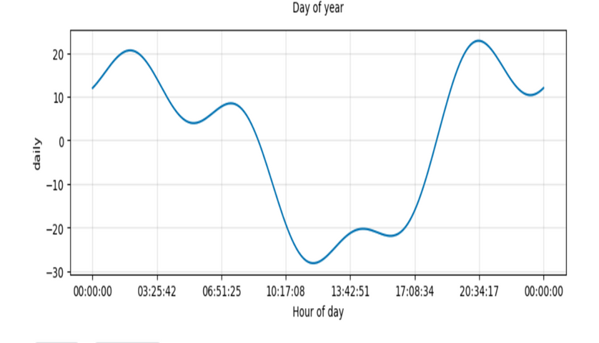
Patterns observed from visualizations
During the working hour of the day, the Planetary Boundary Layer is large and there is more space for these pollution particles to move around, causing the concentrations to get diluted but in the early morning & at night as the temperature is less the atmosphere traps car emissions, CO2, and other pollutants in the house and down near the ground and the effect is much worse.
We can observe that Lockdown did not have a significant decrease in the decomposition of PM2.5 value.
The Data clearly shows the seasonal trend being high from the months of December to March and gradually decreasing over the next months
This observation was made on Delhi as it is generally considered for having the most polluted air, but similar results were obtained for other cities, with few exceptions overall.
High concentrations of PM2.5 values in the northern part of India due to Temperature inversions and stable wind conditions which are meteorological phenomena. Calm wind conditions prevent the dissipation of pollutant emission, and the temperature inversion layer tends to trap pollution, thereby increasing the observed pollutant concentrations.
The measured cause of these high PM2.5 concentrations is primarily due to Vehicular & Industrial emission.
Case Unravellers
4

Slide 5

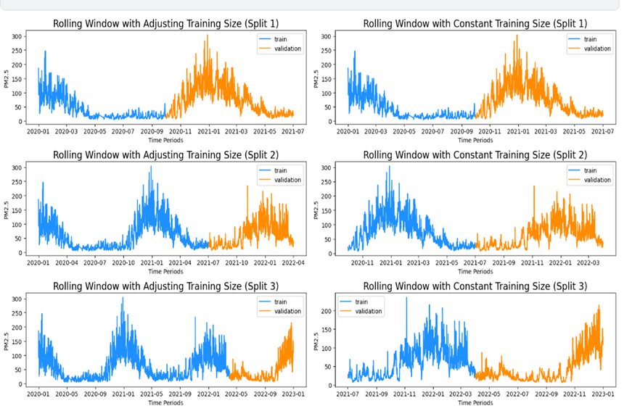
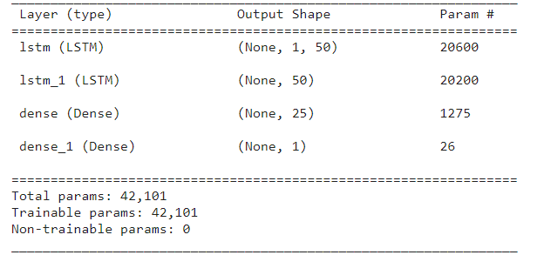

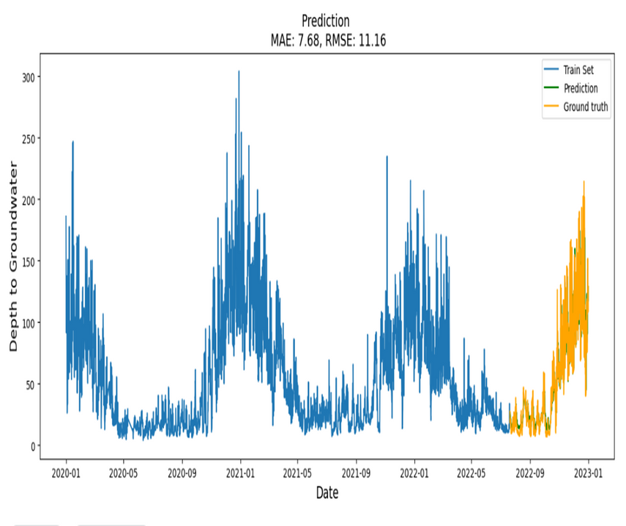
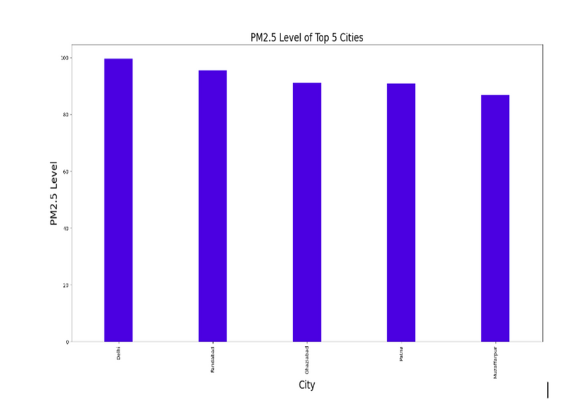

Modeling, Results & Inferences
The top predictors for pollution were found to be PM2.5 value, CO value, & NO value
The northern states had the highest levels of pollution
Used rolling window with adjusting training size for cross-validation, as this was sequential data we could not randomize it. First, take the first n sequence then predict the output of the next stamp, then append this to the n sequence then predict the next time stamp. Cross-validated it with the data of the particular timestamp
Models
FbProphet RMSE: 334.2
ARIMA RMSE: 99.2
PMDARIMA RMSE: 45.6
ThymeBoost RMSE: 44.2
LSTM RMSE: 11.16
Case Unravellers
5

Slide 6











Business Model
Data Sales: Selling the predicted data through one-time sales or subscription-based models.
Consulting Services: Providing consultation services on AQI management strategies, policy development, and infrastructure planning.
Partnerships and Contracts: Collaborating on projects and initiatives can lead to contract opportunities.
Urban Planners: Urban planners can make informed decisions about infrastructure development, traffic management, & green spaces based on the predictive model.
Data Products: The predicted PM2.5 values can be packaged into data products & sold or licensed to various entities, such as government agencies, research institutions, or private companies.
Health Organizations: Health organizations can leverage accurate PM2.5 forecasts to anticipate periods of poor air quality, issue health advisories, & educate vulnerable populations about potential health risks.
Government Agencies: Government agencies can utilize PM2.5 predictions to monitor pollution levels, identify high-risk areas, & implement targeted interventions to mitigate pollution.
Market Size and Growth:
The global air quality monitoring system market is projected to grow from USD 5.02 billion in 2021 to USD 8.33 billion in 2028 at a CAGR of 7.5%.
Revenue Streams
Market share:
The Asia pacific dominatied the market share in 2020 with 1.54 Billion USD
Driving Factor:
Continuous technological advancements, public awareness, favorable public & private initiatives, and upcoming smart cities projects drive the market.
Profitability Analysis
Target Audience
MODEL
Case Unravellers
6

