Slide 1
JOB-A-THAN
CREDIT CARD LEAD PREDICTION

Slide 2
ABOUT PROJECT
Happy Customer Bank is a mid-sized private bank that deals in all kinds of banking products, like Savings accounts, Current accounts, investment products, credit products, among other offerings.
The bank also cross-sells products to its existing customers and to do so they use different kinds of communication like tele-calling, e-mails, recommendations on net banking, mobile banking, etc.
In this case, the Happy Customer Bank wants to cross sell its credit cards to its existing customers. The bank has identified a set of customers that are eligible for taking these credit cards.
Now, the bank is looking for your help in identifying customers that could show higher intent towards a recommended credit card, given:
Customer details (gender, age, region etc.) Details of his/her relationship with the bank (Channel_Code,Vintage, 'Avg_Asset_Value etc.)
WRITE SOMETHING HERE

Slide 3
TABLE OF CONTENT
MY APPROACH
Data Inspection
Exploratory Data Analysis
Checking shape, information of train and test data and finding out Null values
Visualizing all the data in the form of box plot, count plot to get better analysis of features we are going to select.
STEP 1
STEP 2
STEP 3
STEP 4
Importing Relevant Library
Data Cleaning
Started the project with importing libraries like NumPy, pandas, seaborn, matplotlib, Scikit-Learn and etc.
Filling all the Null values with mode values.

Slide 4
TABLE OF CONTENT
MY APPROACH
Validation Strategy
Final Submission
Validation Strategy is the important step towards getting better results. We will use different models to validate.
Predicting Test Dataset and Submitting for final scores.
STEP 7
STEP 6
STEP 5
STEP 8
Building Model
Feature Selection
Building Best Model Obtained. Here we are building XGBClassifier Model
Label Encoding all non – numeric features and drop all unnecessary features.
WRITE SOMETHING HERE

Slide 5
EXPLORATORY DATA ANALYSIS
WRITE SOMETHING HERE

Slide 6
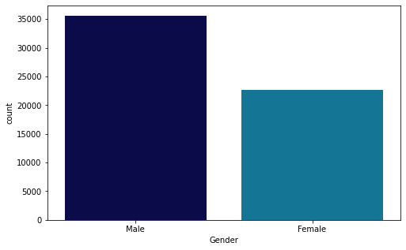
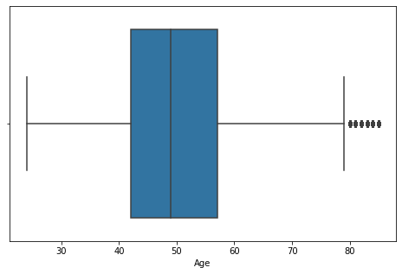
AGE & GENDER ANALYSIS
First we need to analyze what is the age and gender group which is more likely to buy credit card
EXPLORATORY DATA ANALYSIS
AGE & GENDER

Slide 7
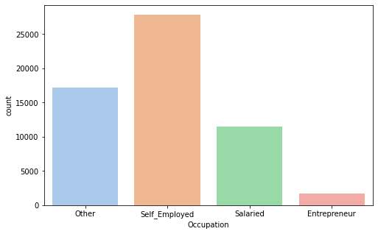
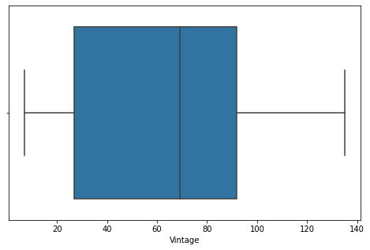
Occupation
Vintage
By Looking into bar charts we can say that Self Employed are more likely to buy credit card. On the other hand Entrepreneur are least interested in buying credit card.
This Box Plot Shows Customer’s age in company which majorly lies between the range of 30 months to 90 months. And the Median Vintage is 70 Months.
EXPLORATORY DATA ANALYSIS
OCCUPATION & VINTAGE

Slide 8
Label Encoder
First step is to convert categorical data into numerical data. We can achieve this by various method but we choose Label encoder to deliver this job.
FEATURE SELECTION
PRE PROCESSING
Standard Scaler
Data Pre Processing before building model. Categorical values needs to be converted into numerical values to build effect model.
Scaling Data is the most crucial part of Data Pre Processing as it will ease out the process model building as well as it helps in improving the accuracy scores.
Data Split
Train Data is then Split into Two parts, one is Training(80%) and another is validation(20%). To validate the model before final submit.

Slide 9
VALIDATION STRATEGY
COMPARING DIFFERENT MODELS
Comparing Different Models on the basis of accuracy score and ROC AUC Score to get the final model. By Using RandomizedSearchCV best parameters suitable for the final model are obtained.
01
K Nearest Neighbor
02
Logistic Regression
Accuracy : 76.5% & ROC : 71.04%
03
Random Forest
Accuracy : 75.4% & ROC: 71.56%
Accuracy : 77.75% & ROC : 75.6%
04
XGB Classifier
Accuracy : 79.15% & ROC : 78.56%

Slide 10
BUILDING MODEL
After Comparing all the model I built my model with XGBoost Classifer and Got 78% ROC Score.
WRITE SOMETHING HERE

Slide 11
THANK YOU
SHASHANK GOYAL - 9782066441

