Slide 1
Assignment # 5

Slide 2
Exercise 1
In this exercise, you will work with any three gray level images, I1, I2, and I3 of your choice. For each image, obtain their normalized histograms, h(I1), h(I2) and h(I3). {Normalized histogram means each bin is represented as a fraction of total pixels}.
Using the cross-entropy measure, determine whether I2 is more similar to I1 or I3 is more similar to I1
Repeat using KL-divergence measure

Slide 3
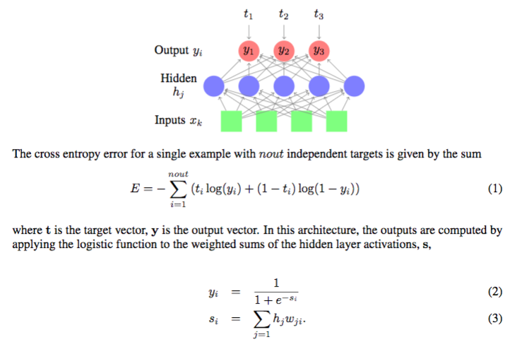
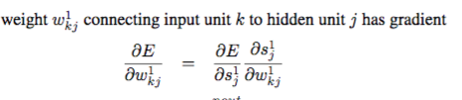
Exercise # 2
Consider the above net with a single hidden layer and cross entropy loss function. Determine the gradient expression for the
?

Slide 4
Exercise # 3
Consider a linear autoencoder that has 4 inputs, 2 hidden layer neurons, and 4 outputs. There are no bias weights. The 4 x 2 weight matrix connecting input to hidden neurons is given by the following weight values
1.2 -0.5
0.75 0.5
0.2 -1.2
-0.5 1.2
The 2 x 4 weight matrix for hidden to output neurons is
0.2 1.5 -0.5 -0.2
-0.4 0.6 1.2 -0.5
The input of [0.5 0.25 0.25 0.5] is presented to the network. Determine the squared error for this input and the weight change for hidden to output layer weights due to the error at the output.

Slide 5
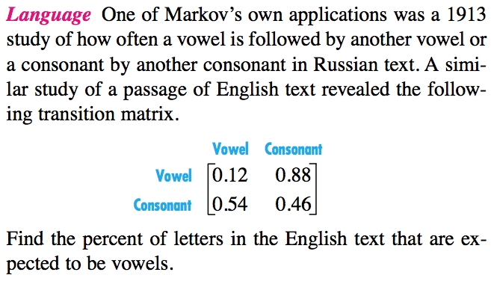
Exercise # 4

Slide 6
Exercise # 5
Consider a RNN with single input, single output and two hidden neurons. The input weights to the hidden neurons are 1 and -0.5. The weights for the recurrent connections are -0.5 and 0.5. The output layer weights are 0.25 and 0.75. The network is fed a sequence of 0.1 0.25 0.35 0.25 0.1. The hidden states are initialized to 0. Determine the output sequence of the network.

Slide 7
Exercise # 6
Train a RNN to perform time series prediction. The task is to build a model for predicting S&P index for day “t” using the closing prices of Dow Jones index and Nasdaq for day “t-1”. You can use data for any 6 months period and test the performance for the following one-month period. Yahoo Finance is an excellent source for data for this project.

