Slide 1
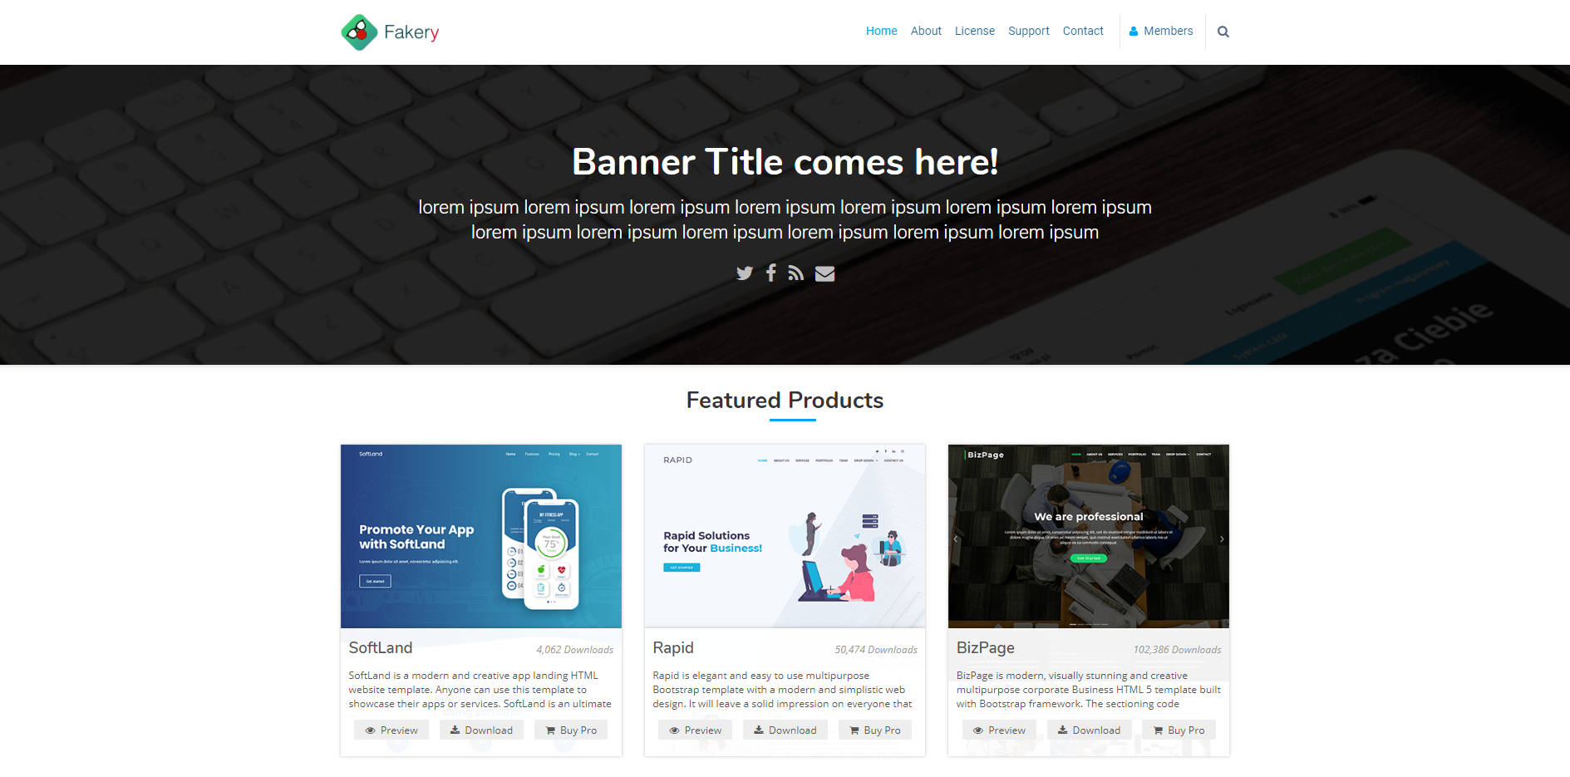
Desktop Layout

Slide 2

Tablet Layout

Slide 3

Mobile Layout

