Slide 1
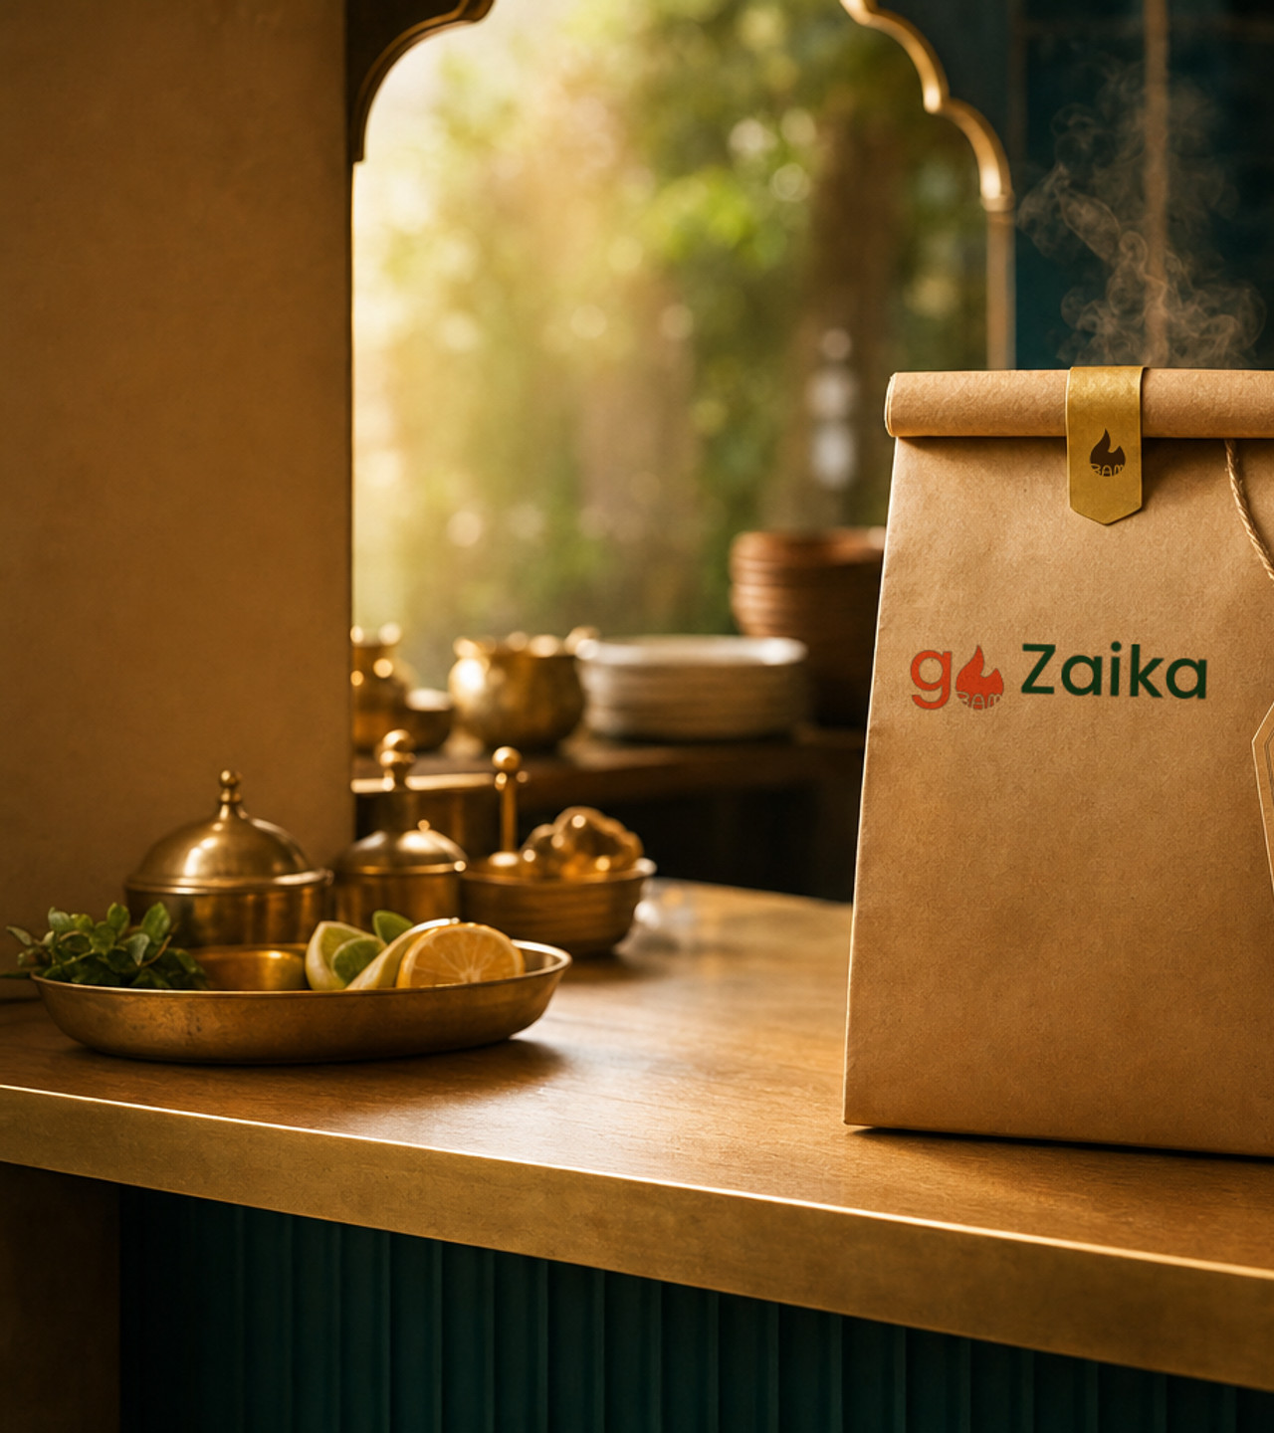

Bring new guests
to your counter.
A curated pickup discovery channel for distinctive food drops.
Restaurant partner introduction
English sales deck • v1.0

Slide 2

THE PROPOSITION
Curated discovery.
Operational control.
IS
IS NOT
Pickup-first discovery
Restaurant-defined drops
Direct counter collection
A leftovers marketplace
A delivery fleet
A promise of guaranteed demand
goZaika helps diners discover limited food drops, reserve a pickup, and collect directly from the restaurant.
The BAM flavor drop marks the moment a distinctive drop becomes discoverable.
gozaika.in • partners@gozaika.in
02

Slide 3

DINER EXPERIENCE
Three clear moments from interest to pickup.
01
02
03
Discover
Reserve
Collect
→
→
See a curated drop and its pickup details.
Choose an available pickup window and quantity.
Pick up directly at the restaurant counter.
Pickup only
No delivery handoff
gozaika.in • partners@gozaika.in
03

Slide 4
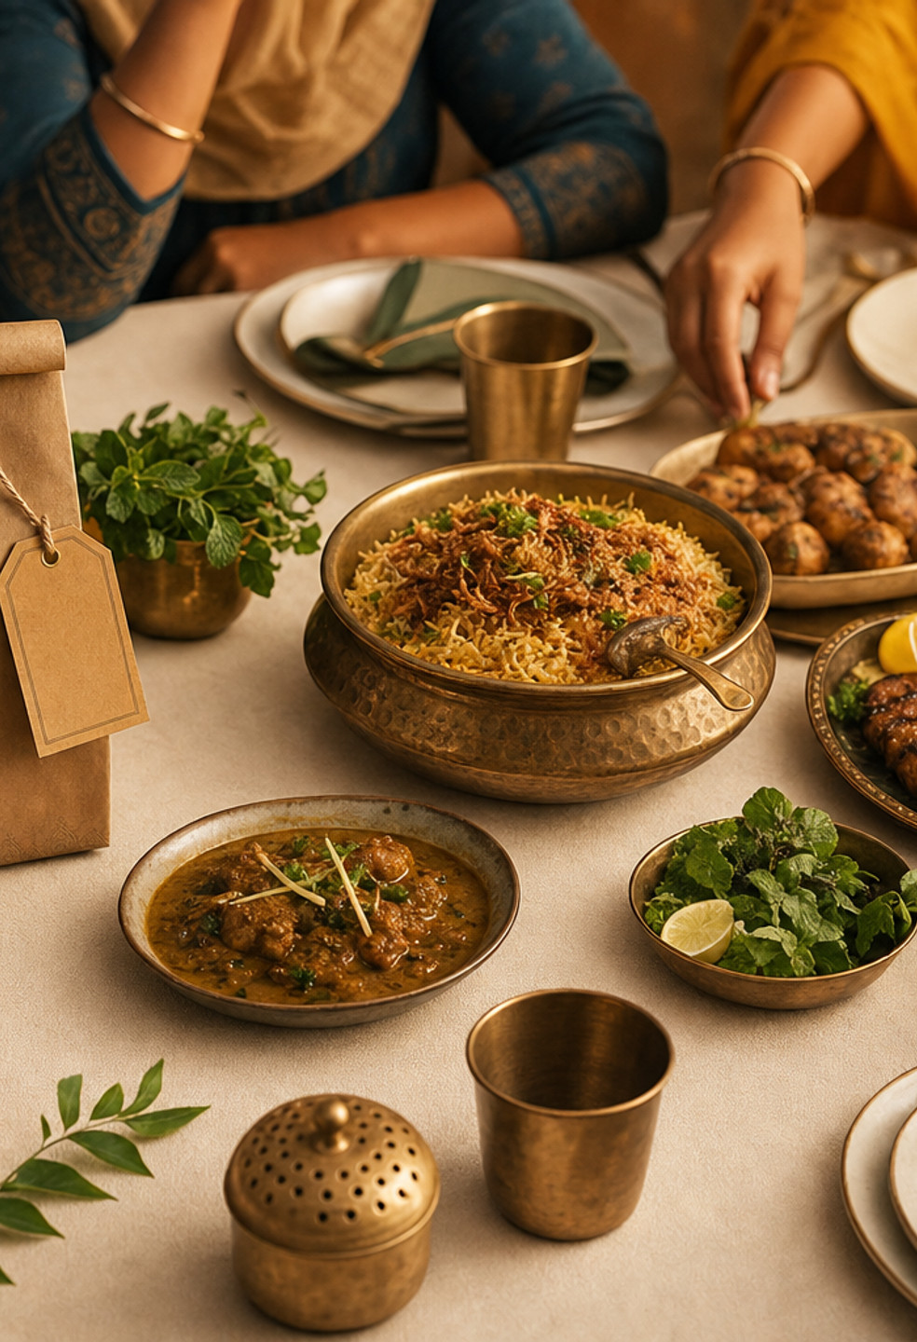
RESTAURANT WORKFLOW
You define the drop.
We structure discovery.
SET
Choose the item, available quantity, pickup window, and disclosures.
REVIEW
Confirm the listing details before the drop is published.
FULFIL
Prepare confirmed reservations for direct counter collection.
No POS replacement required initially
gozaika.in • partners@gozaika.in
04

Slide 5
PARTNER CONTROLS
Built around the realities of a live kitchen.
1
Quantity
2
Timing
Set the number available for each drop.
Define pickup windows your team can support.
3
Disclosure
4
Readiness
Provide accurate ingredients and allergen information.
Publish only when the team and counter are prepared.
Operational details are agreed during onboarding; restaurants remain responsible for food safety and listing accuracy.
gozaika.in • partners@gozaika.in
05

Slide 6
PILOT READINESS
A useful first conversation starts here.
✓
A distinctive item suited to scheduled pickup
COMMERCIAL NOTE
✓
A realistic quantity and pickup window
Commercial terms are discussed during partner qualification.
✓
Clear ingredient and allergen disclosures
No numeric pricing, revenue, demand, or conversion promise is implied in this deck.
✓
A counter workflow for confirmed reservations
Clear before clever
Specific before sweeping
gozaika.in • partners@gozaika.in
06

Slide 7

Let’s see whether your next drop belongs on goZaika.
Start with one item, one pickup window, and an honest operational conversation.
partners@gozaika.in
gozaika.in/for-restaurants
Restaurant partner introduction • English v1.0

