Slide 1

PROJECT 3
Eniac

Slide 2
PROJECT OVERVIEW
ENIAC:
E-commerce tech company
Various technology products, especially compatible with Apple
Data Analysis:
Is it beneficial or not to discount products?

Slide 3
RECOMMENDATION
As a result of our analysis, discounts…
Should be continued, but with a hard cap at 30%
Should concentrate on special (holi)days
In the Storage & Memory category are beneficial
In the Accessories category are not really beneficial

Slide 4
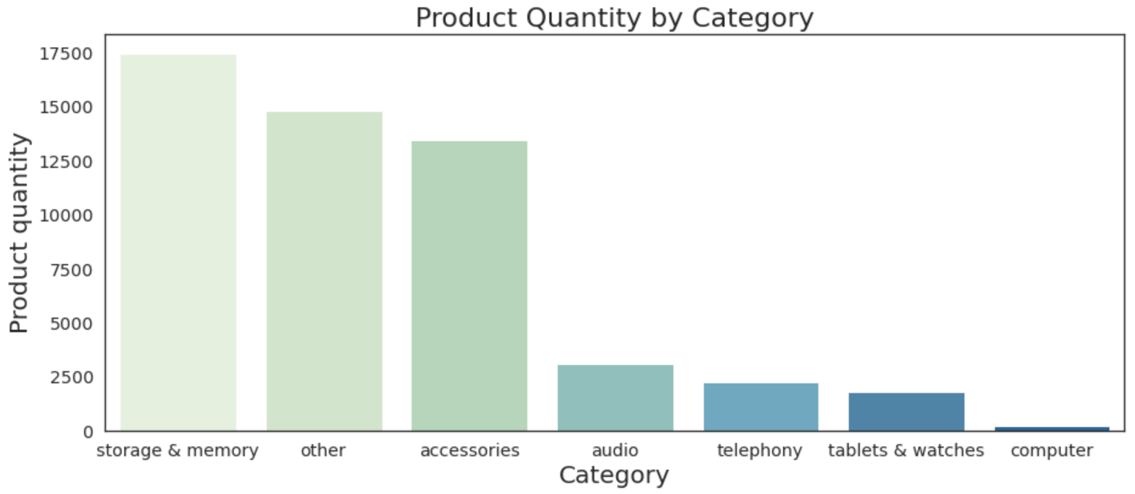
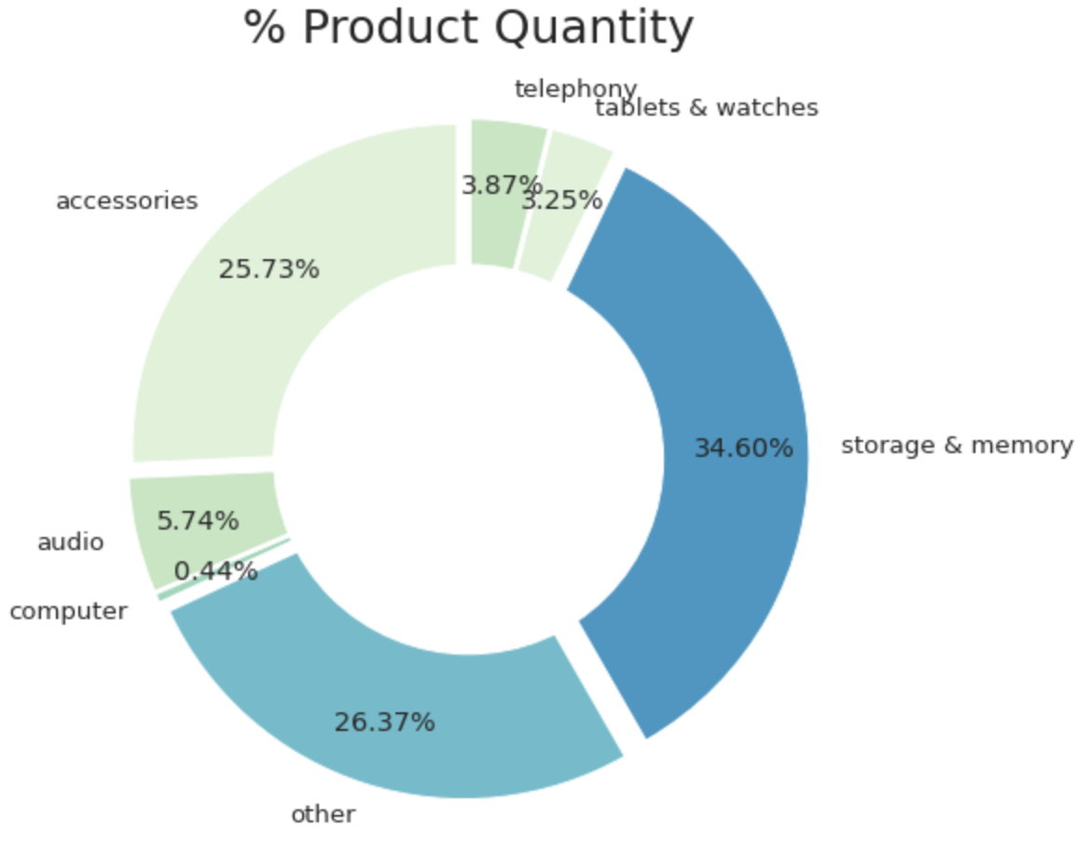
DATASET
There are many different technology products in the Eniac's dataset.
In our analysis, the products were collected in 7 main categories:
Telephony
Computers
Audio
Accessories
Storage & Memory
Tablets & Watches
Other
(iPhone, Smartphone) (Macbook, iMac…) (Headphone, Speaker, iPod) (Case, Screensaver, Charger, Adapter…) (Server, Storage, Hard Drive, Memory…) (iPad, Tablet, Watches) (Battery, Kits, Warranty, Repair Service…)

Slide 5
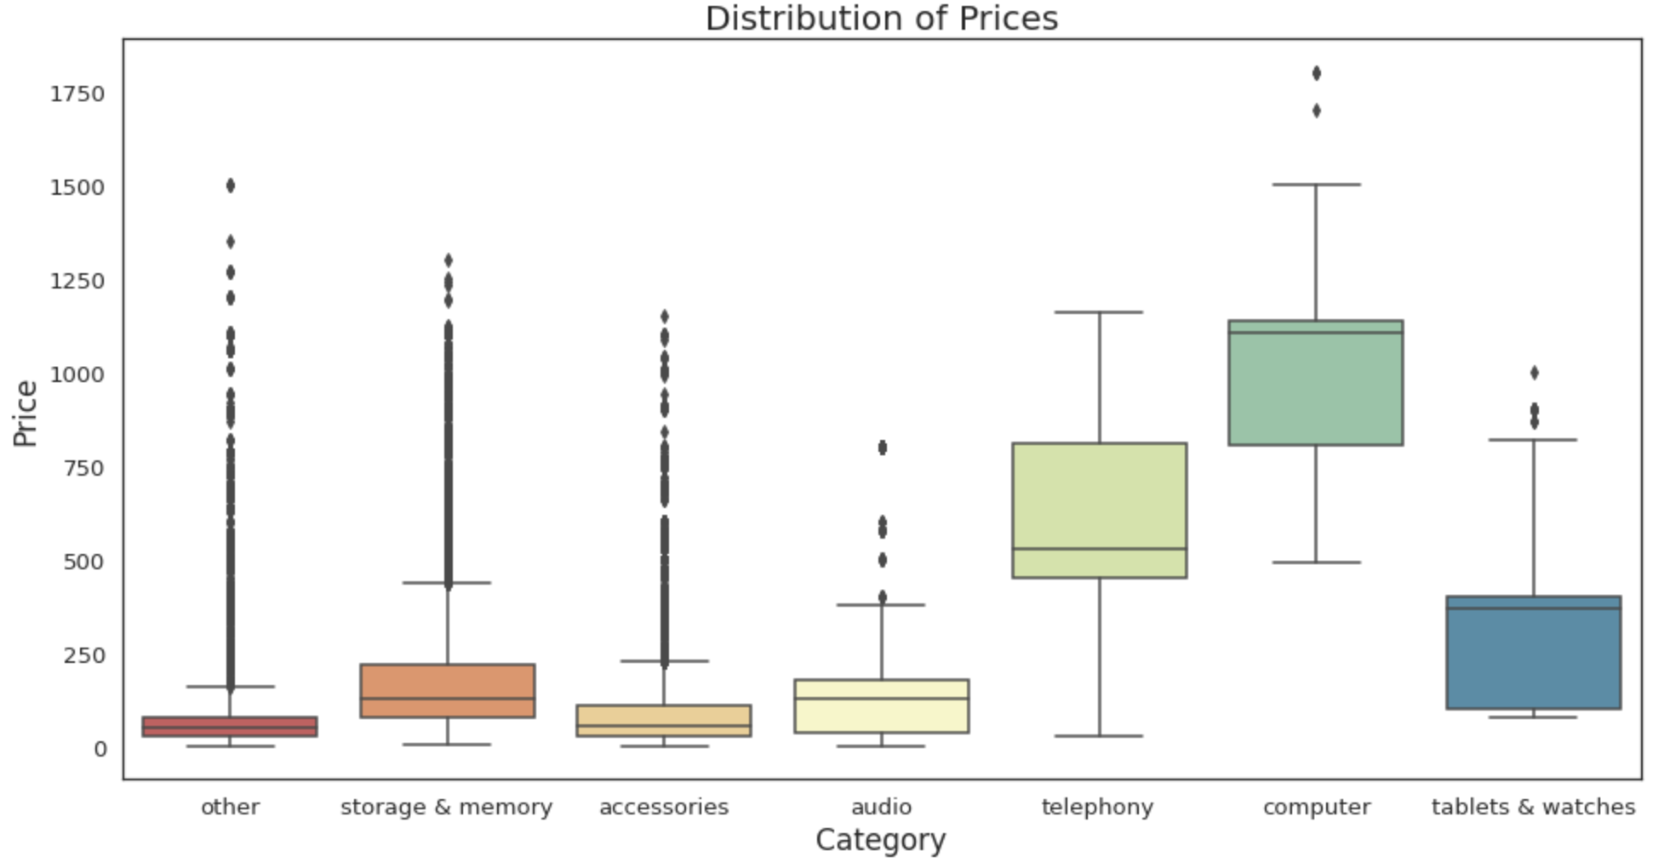
PRODUCT PRICING
ARCHITECTURE
Computers and Telephony categories make up the most expensive products.
More affordable products:
especially in the Accessories, Other categories

Slide 6
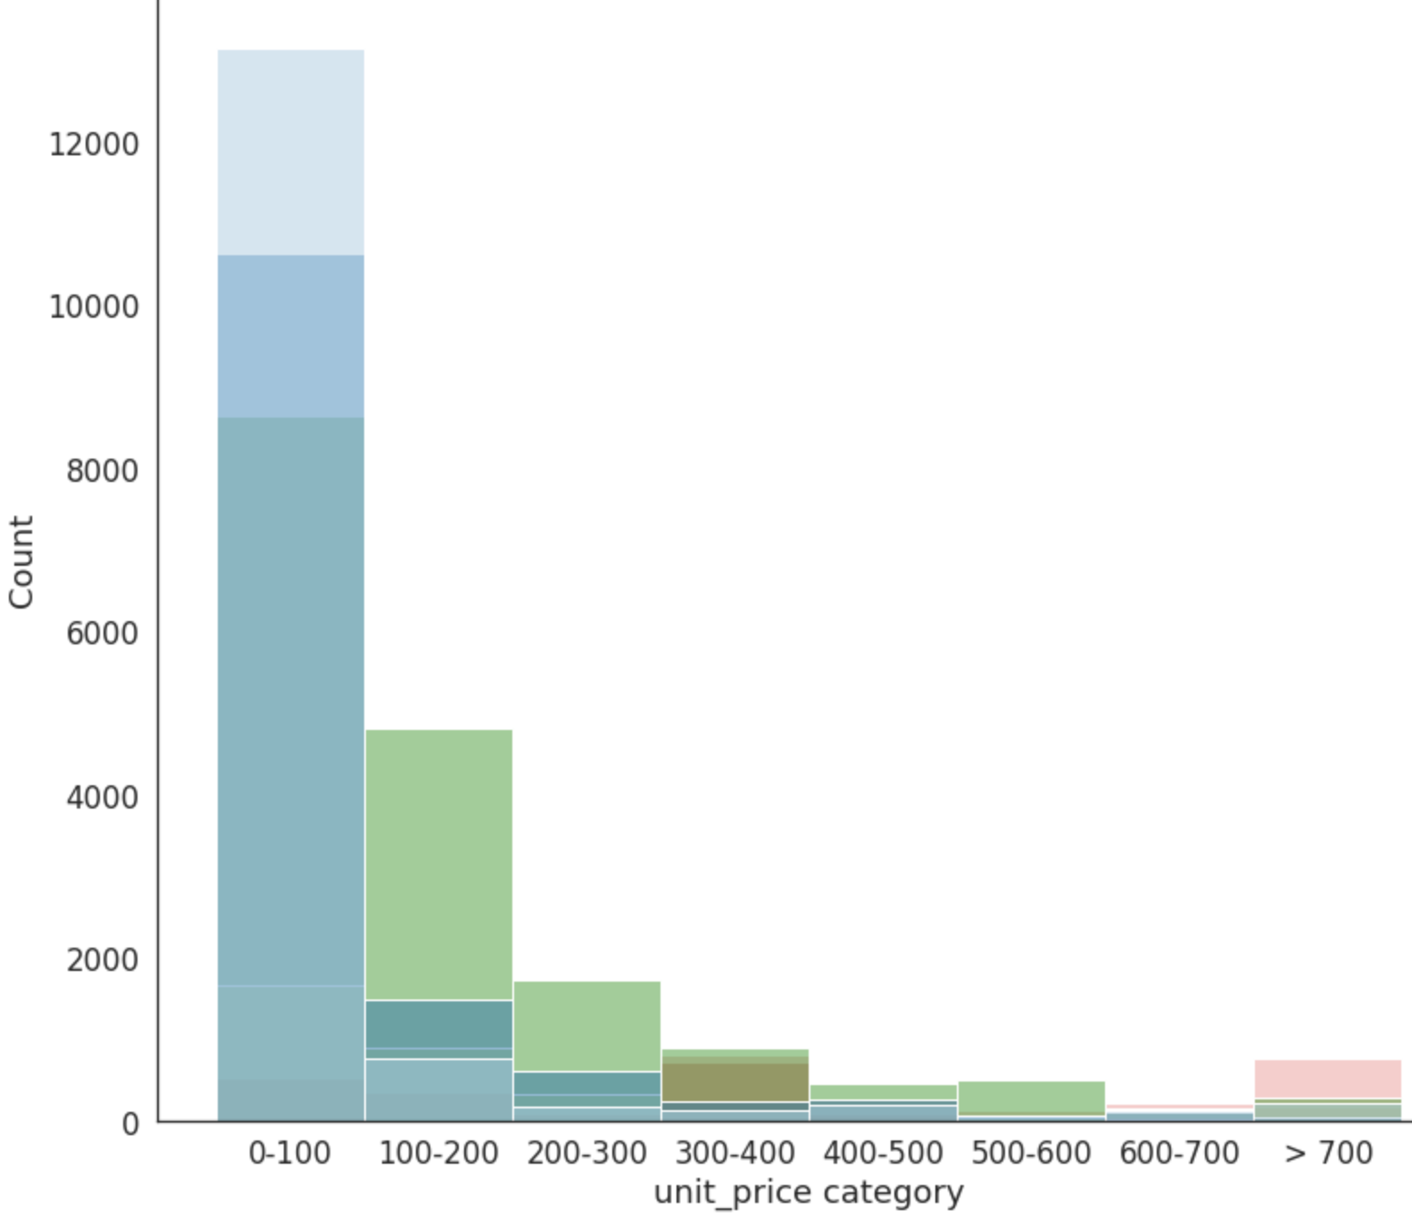
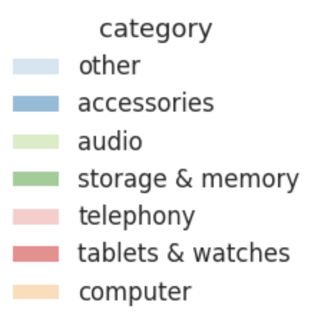
DISTRIBUTION OF
PRODUCT PRICES
other
Products up to € 200 make up 80% of all products.
accessories
audio
quantity
More affordable products:
storage & memory
in the range of € 0-100
especially in the Accessories, Audio categories
price category

Slide 7
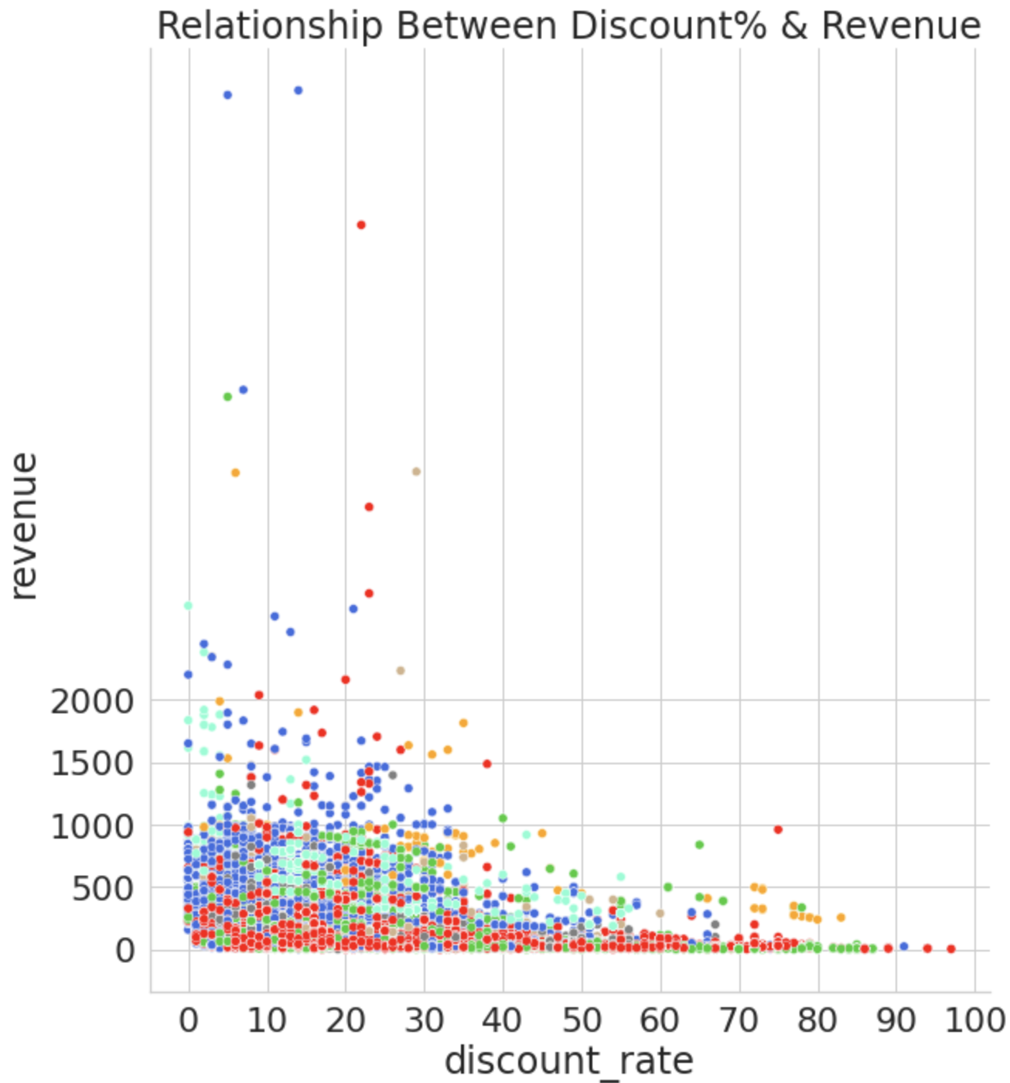
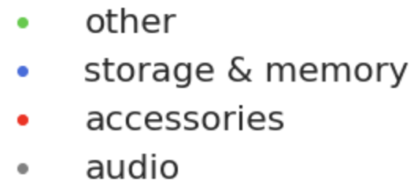
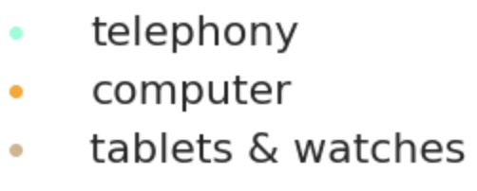
DISCOUNT RATE
& REVENUE
More revenue is provided with discounts up to 30%
The most revenue: Provided by discounts on Storage & Memory and Telephony
The least revenue: Provided by discounts on Accessories

Slide 8
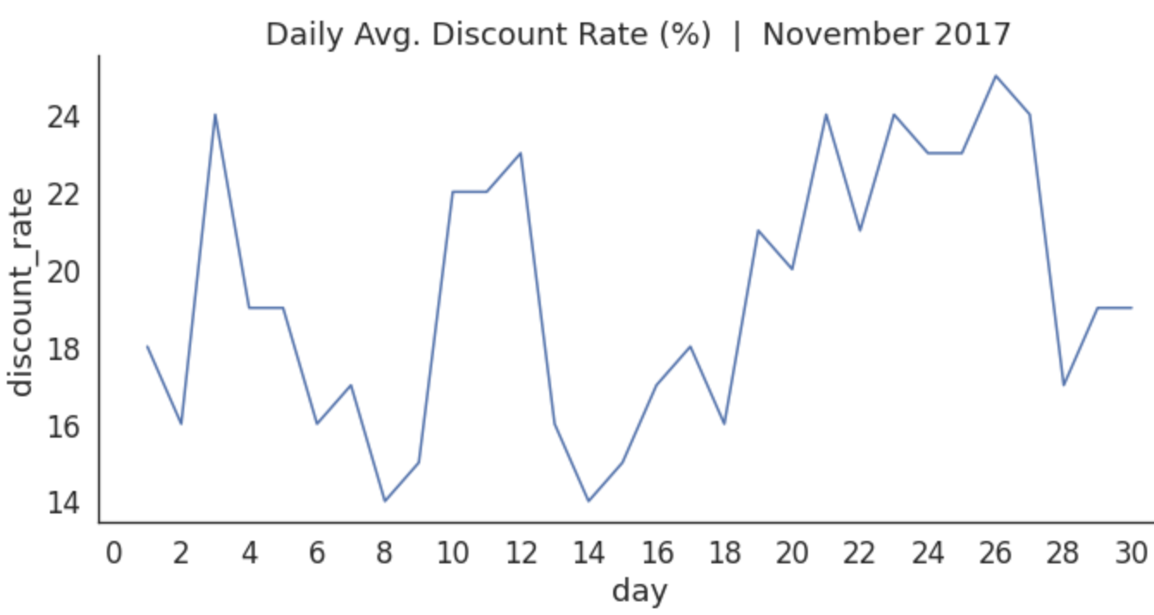
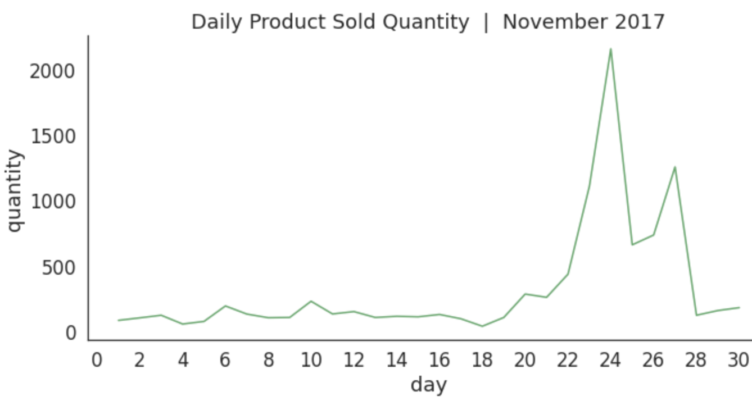
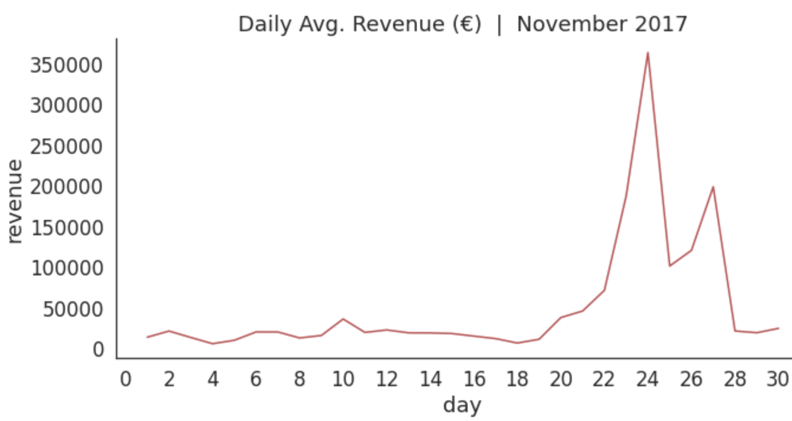
November 2017
Black Friday: 24 November Cyber Monday: 27 November
Average daily values ​​in the last week of November: Sales Quantity and Revenue increased
There was a similar discount rate on other days in November, but Sales Quantity and Revenue did not increase these days

Slide 9
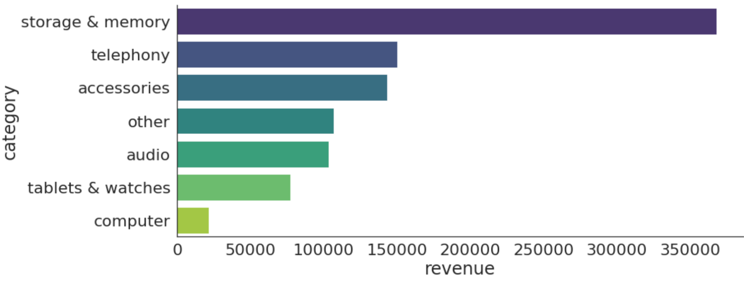
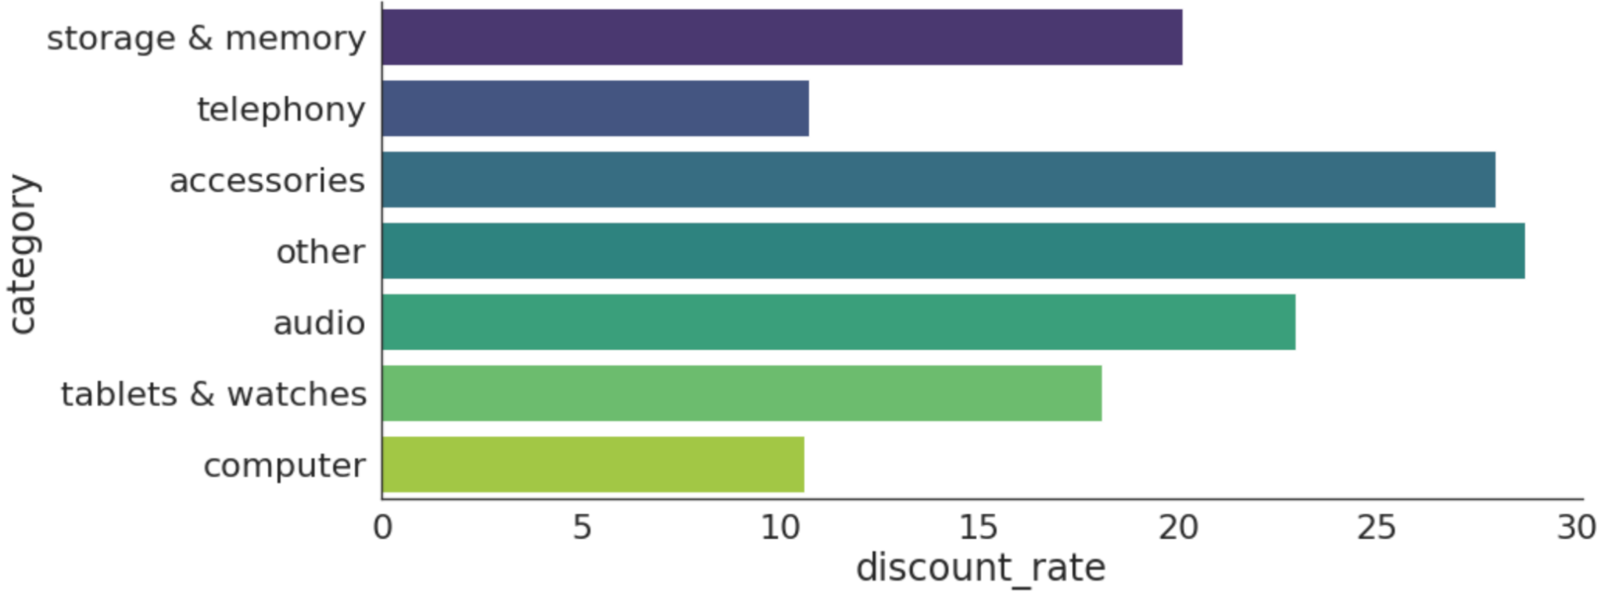
23-28 November 2017
Black Friday: 24 November Cyber Monday: 27 November
Revenue in November 23-28
The most revenue: Provided by Storage & Memory and Telephony
A lot of discounts were made in the Accessories category, but Revenue did not increase much.
Discount Rate in November 23-28

Slide 10
LACK OF INFORMATION
Question 6) How could data collection be improved?
We have no infos about (net) profit!
We should know how the individual orders proceeded (put in basket, shopping cart, placed the order)
We should know way more details about the discounts:
General discounts on the website vs. only partially granted coupons -> look at individual days / weeks!
How were they marketed: Email funnel? Given to people with shopping cart orders?

Slide 11
IMPROVE
DATA QUALITY
Approx. 72% of Data had to be discarded* because of missing values and mismatches
Standardize the formatting of price
Collect all data regarding orders in one data frame
Keep and share (net) profit information
Share specific details about the discounts like: general vs. individualised, promoted using various funnels etc.
Notes:
*based on the number of rows, comparison between original data frames and cleaned data.

Slide 12
THANK YOU
ANY QUESTIONS?

