Slide 1
Multi-Label Classification Implementation
Gözde merve demırcı

Slide 2
Introduction
Multi-label classification study was carried out.
For the study, keras framework was used, RNN application was processed.
At the end of the application, it is aimed to show which or which of the 6 different tags that sentence covers in any sentence.
There is a "Jupyter Notebook" showing the application steps.
The dataset and GloVe word file will be shared with the notebook.

Slide 3
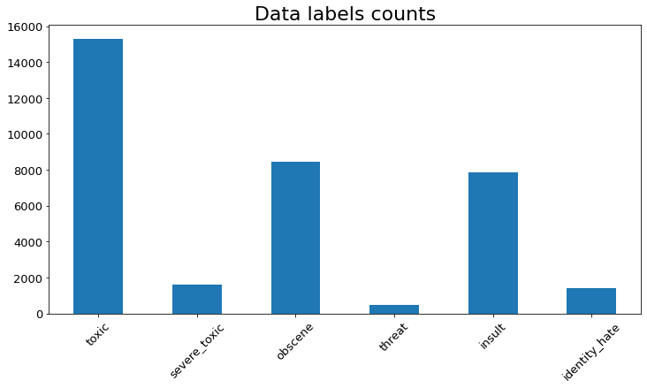
Data EDA & Pre-Processing
Although there is not much focus on EDA and preprocessing;
visualization of labels,
Whether there are NaN values,
The main items from preprocessing techniques (lowercase, deleting unnecessary words, removing special characters, numbers, etc.)
By looking at the label distribution, we can talk about the existence of an unbalanced data set. Labels are not evenly distributed in the data set.

Slide 4
Implementation
Prior to implementation, word embedding was done to prepare the X data for calculation.
For this, GloVe pre-trained dataset was used. However, the keras tokenizer was used. After the words were vectorized, they were converted into a matrix of the same length with the "padding" function.
However, multi-label prediction was performed with “sigmoid” activation using bidirectional RNN. In addition, a two-way layer was created with “Bidirectional”.

Slide 5
Implementation
While preparing the model, an attention mechanism was created for the inputs and it was ensured that the input and layers were created by considering the relations between words.
After the model fit, the attention mechanism was established and put into practice. "Hierarchial Attention Network" was used to find important words affecting the label. In this way, important words in the text have become to be identified.
Model fit is 99%, test accuracy is still 99%. 1 epoch was used for model fit. It is acceptable for both test and train datasets to be high. However, we could comment on a possible overfitting with the epoch-accuracy and epoc-loss figure.

Slide 6
Implementation
The created model and desired values were calculated with the "comparison(test_no, n)" function.
Here:
Test_no: A random number of rows we can look at in the X_test dataset
N: Number of words to be “highlighted”
The function includes creating the padding and word vector for the new text, calling the word attention mechanism, generating the predictive model.

Slide 7
References
https://www.cs.toronto.edu/~lczhang/360/lec/w06/w2v.html
https://www.artiwise.com/2020/06/14/makine-ogrenmesi-ve-derin-ogrenme-ile-coklu-etiket-metin-siniflandirma/
https://androidkt.com/multi-label-text-classification-in-tensorflow-keras/
https://humboldt-wi.github.io/blog/research/information_systems_1819/group5_han/
https://buomsoo-kim.github.io/attention/2020/01/01/Attention-mechanism-1.md/

Slide 8
Thank you.

