Slide 1
Benchmarking Tool for Sorting and Searching Algorithms
1701246, Necip Gözüaçık
1806392, Okan Büyüktepe
Course: CMP5151 Software Design Patterns
Lecturer: Ph.D. Emre Kaplan

Slide 2
AGENDA
DESCRIPTION
FEATURES
DESIGN PATTERNS
RESULTS
REFERENCES

Slide 3
DESCRIPTION
This project aims to run sorting and searching algorithms and provide some statistics such as execution time and applied number of steps. These statistics help us to make a comparison between the algorithms from the point of time complexity level.
The project calculates execution time results and applied number of steps per sorting and searching with using built-in array structures corresponding to use cases (Best, Worst and Average).
User can be able to display the performance results as a figure for the selected algorithm type.

Slide 4
FEATURES
Following Core features are contracted about
Supported Sorting Algorithms: Selection, Bubble, Merge, Quick
Supported Searching Algorithms: Linear, Binary, Jump, Interpolation
Supported Complexity Use Cases: Best, Average, Worst
Complexity level (Best/Average/Worst) and Algorithm (Sorting/Searching) can be selected from GUI.
Comparison results are displayed as plot on GUI.

Slide 5
DESIGN PATTERNS
Following design patterns are used during implementation. Python programming language with QT framework is used.
Simple Factory
Iterator
Template
Visitor

Slide 6
DESIGN PATTERNS
Simple Factory
Iterator
class CaseFactory(): def buildCase(self,type): if type == "Best": return BestCase() elif type =="Worst": return WorstCase() elif type == "Average": return AverageCase()
class SortIterator(object): "An iterator." def __init__(self, container): self.container = container self.n = -1 def __next__(self): self.n += 1 if self.n >= self.container.sortMax: raise StopIteration return self.container.sortTypes[self.n],self.n def __iter__(self): return self

Slide 7
DESIGN PATTERNS
Template
class PerformanceSort(Common.Performance): def __init__(self,title): self.timeStart = 0 self.timeStop = 0 self.title = title self.elapsedTime = 0 self.numberofSteps = 0 def startTime(self): #tempTime = datetime.time(datetime.now()) self.timeStart = timer() #self.timeStart = (tempTime.second*1000) + (tempTime.microsecond/1000) # self.timeStart = float(datetime.time(datetime.now()).microsecond) print("Start Time: ",datetime.datetime.now()) def sort(self,arr): return list def measurePerformance(self,arr): self.startTime() self.sort(arr) self.stopTime() self.calcTime() return self.elapsedTime, self.numberofSteps
class BubbleSort(PerformanceSort): def sort(self,arr): #start_time=float(datetime.time(datetime.now()).microsecond) #print(start_time) n = len(arr) for i in range(n): self.numberofSteps = self.numberofSteps + 1 swapped = False for j in range(0, n - i - 1): self.numberofSteps = self.numberofSteps + 1 if arr[j] > arr[j + 1]: arr[j], arr[j + 1] = arr[j + 1], arr[j] swapped = True if swapped == False: break # stop_time = float(datetime.time(datetime.now()).microsecond) # print(stop_time) # self.elapsedTime = float(stop_time - start_time) return arr

Slide 8
DESIGN PATTERNS
Visitor
class Visitor(): def visitSearch(self):pass def visitSort(self):pass class SearchVisit(object): def accept(self, visitor): visitor.visitSearch() class SortVisit(object): def accept(self, visitor): visitor.visitSort() class AlgVisitor(Visitor): def __init__(self,type,case): self.type = type self.case = case def visitSearch(self): print("1") if self.type == 'All': Search.runAll(self.type, self.case) else: Search.runSearch(self.type, self.case) def visitSort(self): print("2") if self.type == 'All': Sorting.runAll(self.type, self.case) else: Sorting.runSort(self.type, self.case)

Slide 9
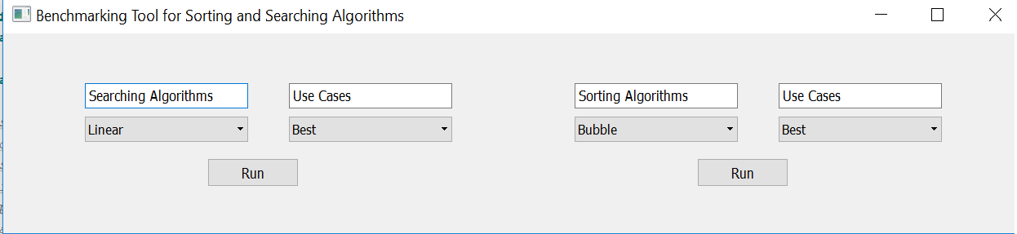
RESULTS

Slide 10
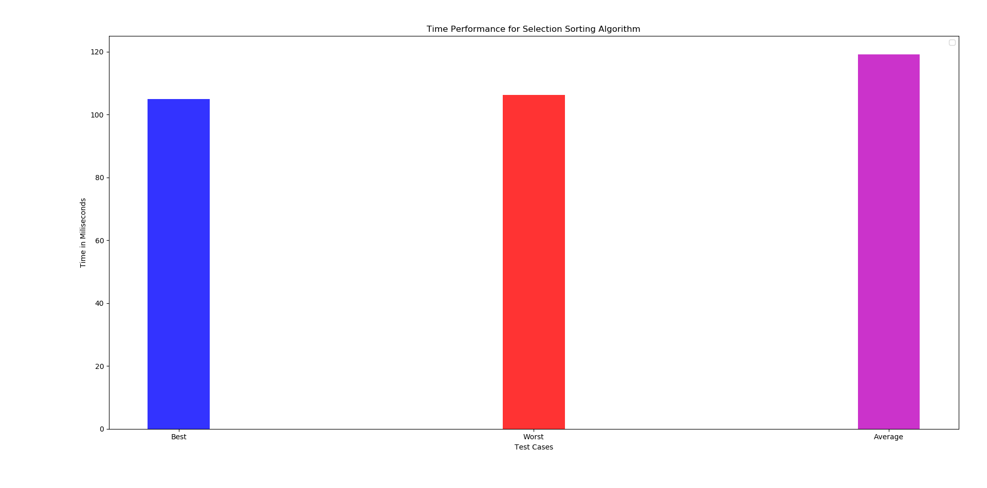
RESULTS

Slide 11
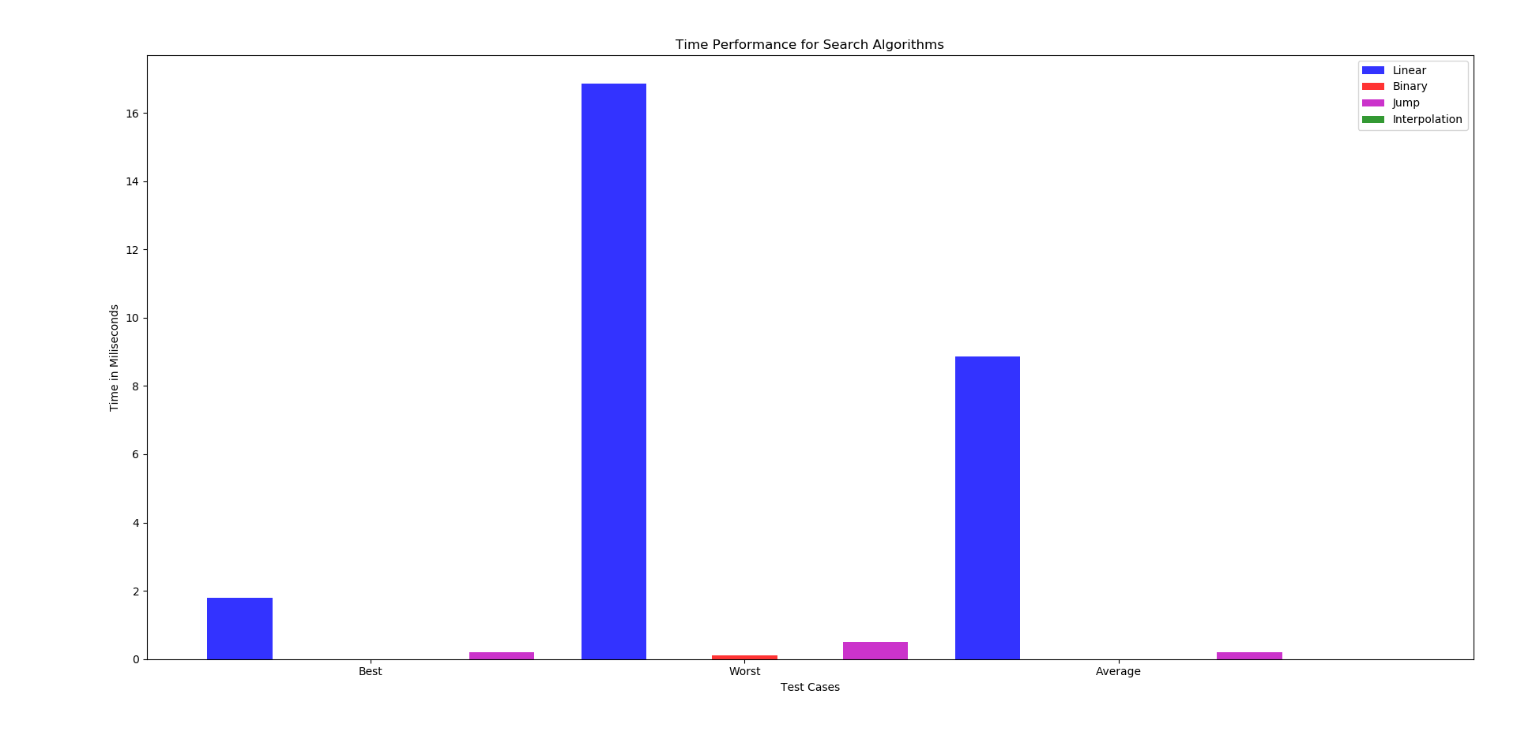
RESULTS

Slide 12
REFERENCES
[1] https://www.geeksforgeeks.org/linear-search/
[2] https://www.geeksforgeeks.org/binary-search/
[3] https://www.geeksforgeeks.org/jump-search/
[4] https://www.geeksforgeeks.org/interpolation-search/
[5] https://www.geeksforgeeks.org/selection-sort/
[6] https://www.geeksforgeeks.org/quick-sort/
[7] https://www.geeksforgeeks.org/merge-sort/
[8] https://www.geeksforgeeks.org/bubble-sort/
[9} https://github.com/gozuacik/cmp5151

Slide 13


