Slide 1

Internet Of Things Project Presentation

Slide 2
Home Security System With RFID Card
Home security system; It is a system in which the alarm system is activated when the motion sensor detects motion.

Slide 3
How ıt Works?
Initially, the alarm is inactive.
The user presses the button to activate the alarm.
It is waited for 10 seconds for the user to go away and then the alarm is activated.
When the alarm is active, when motion is detected by the sensor, it takes 10 seconds for the user to read the correct card.
If the correct card is read within this time, the alarm will become passive, otherwise the buzzer will start to sound.

Slide 4
Metarials That ı used.
Arduino Uno Card •
Breadboard
Jumper Wires Pack M/M
Jumper wires pack M/F
RFID Card
PIR (motion) sensor
Buzzer
Push Button
10k ohm resistor

Slide 5
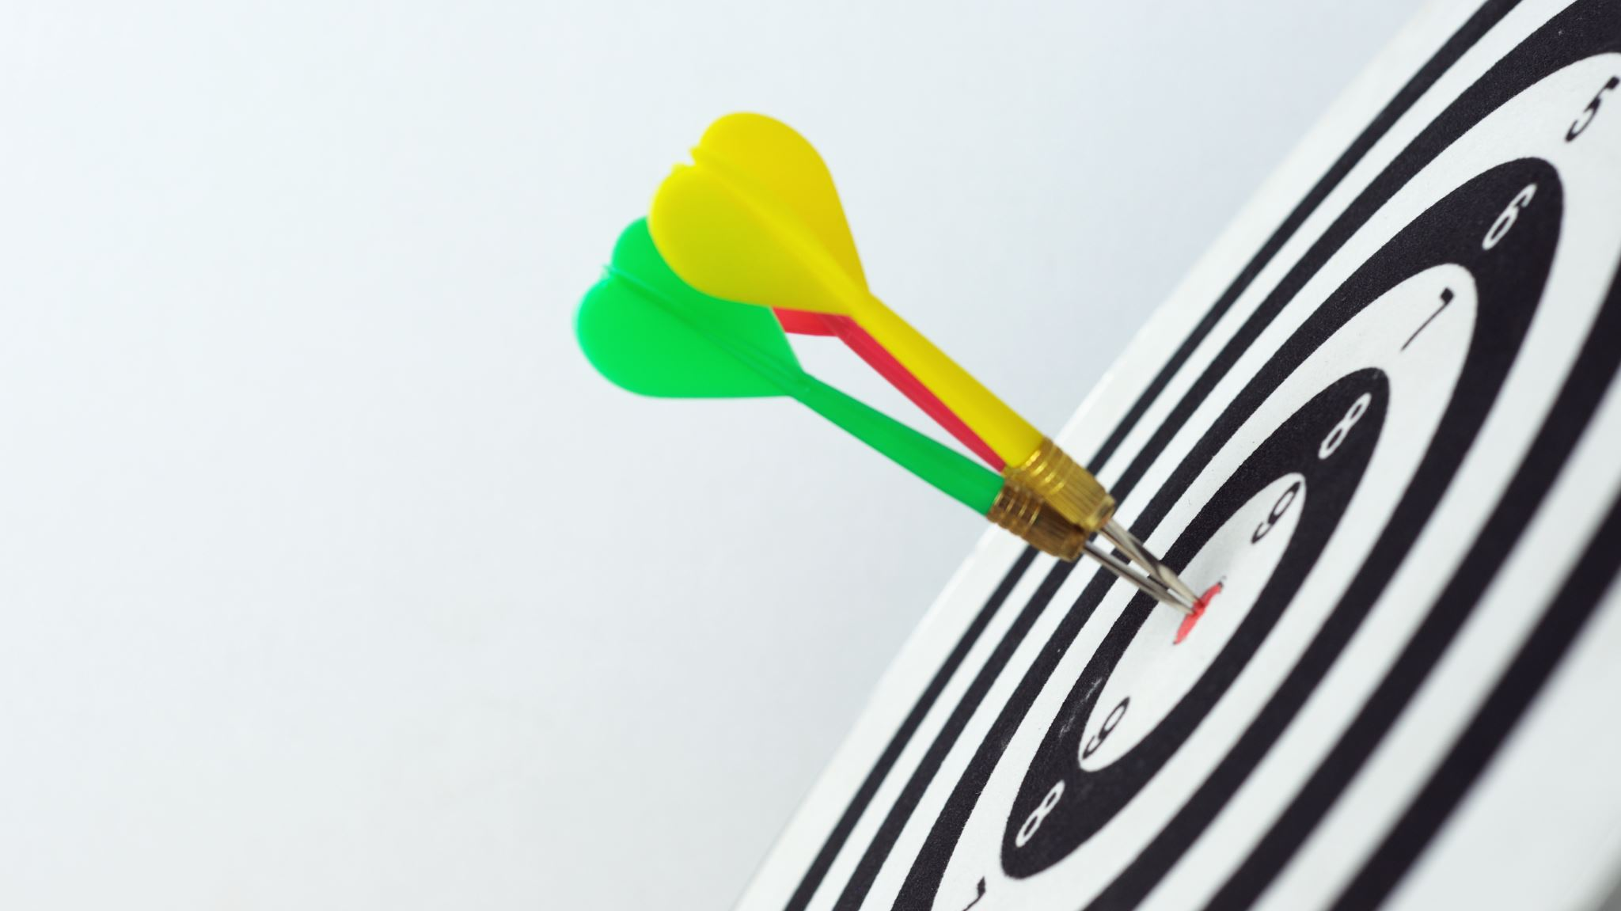
geneRal ınformatıon about metarıals

Slide 6
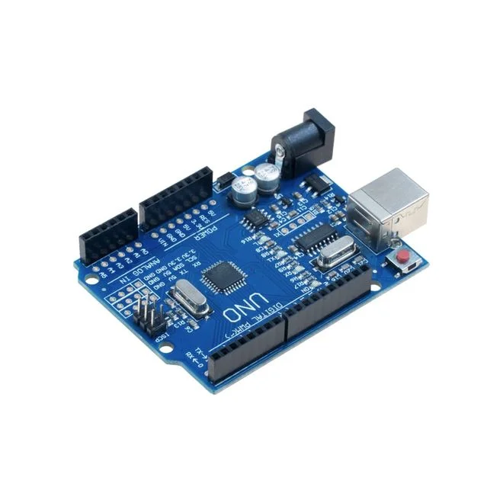
Arduino Uno
Ardunio uno is an open source microcontroller board.

Slide 7
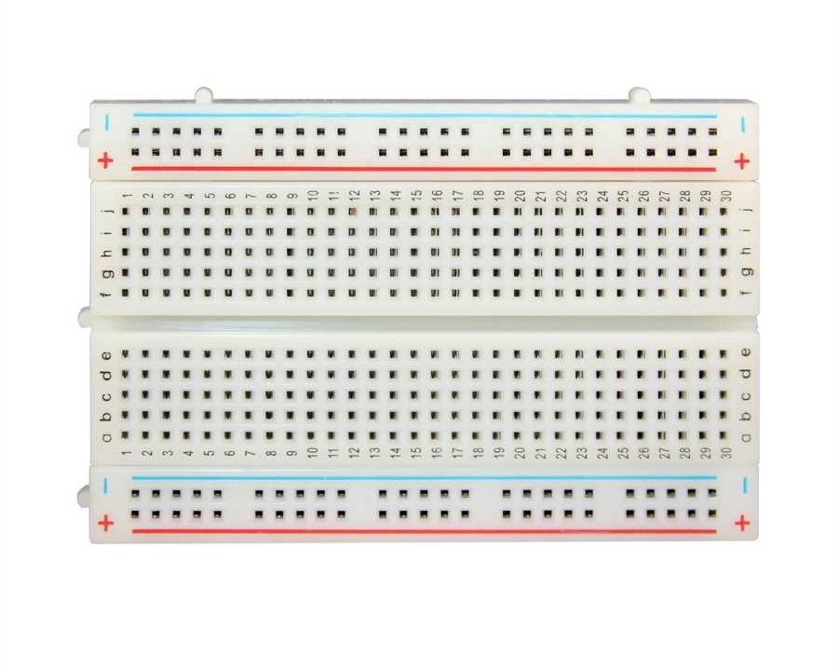
Breadboard
The purpose of the breadboard is to make quick electrical connections between components like resistors, LEDs,

Slide 8
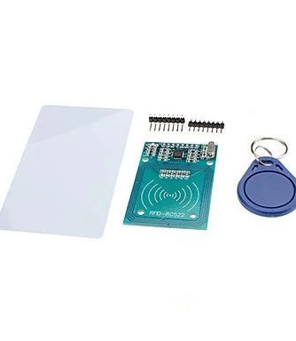
RFID Card
RFID Smart Cards store information on a chip embedded in the smart card. The chip contains an embedded secure microprocessor or equivalent intelligence and internal memory.

Slide 9
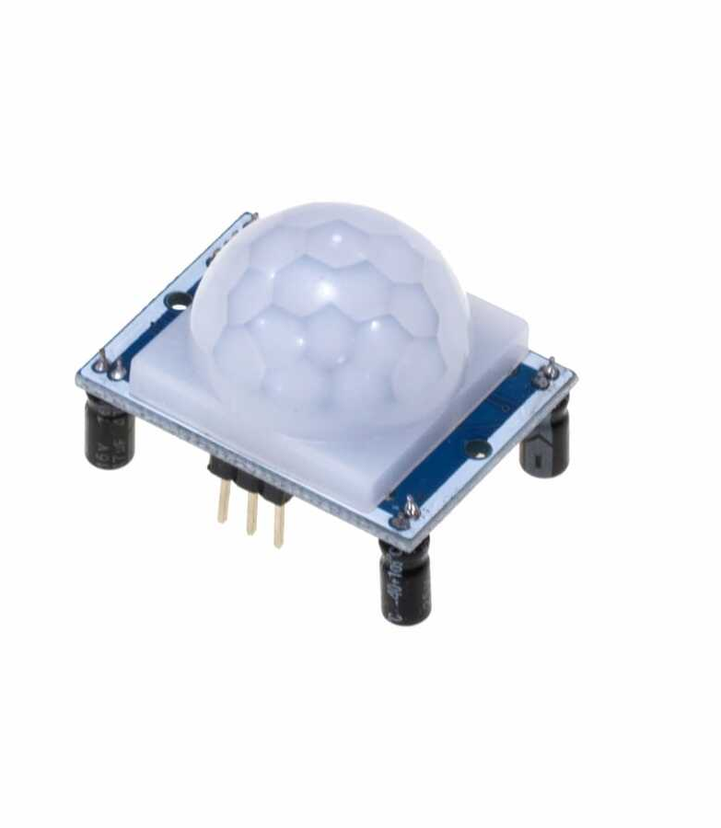
HC-SR501 PIR Motion Detector
HC-SR501 PIR Sensor detects motion by measuring changes in the infrared (heat) levels emitted by surrounding objects.

Slide 10
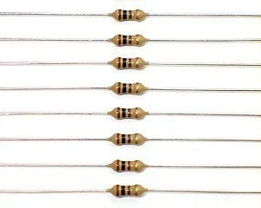
10K ohm Resistor
A 10k resistor is a passive resistor but is a great help in controlling the flow of electric current in the circuit.

Slide 11
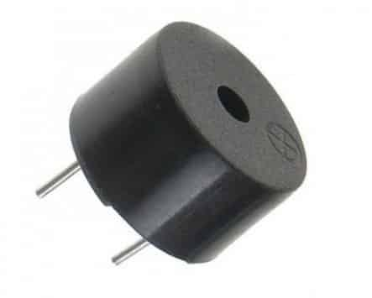
Buzzer
An Arduino Buzzer is basically a beeper

Slide 12
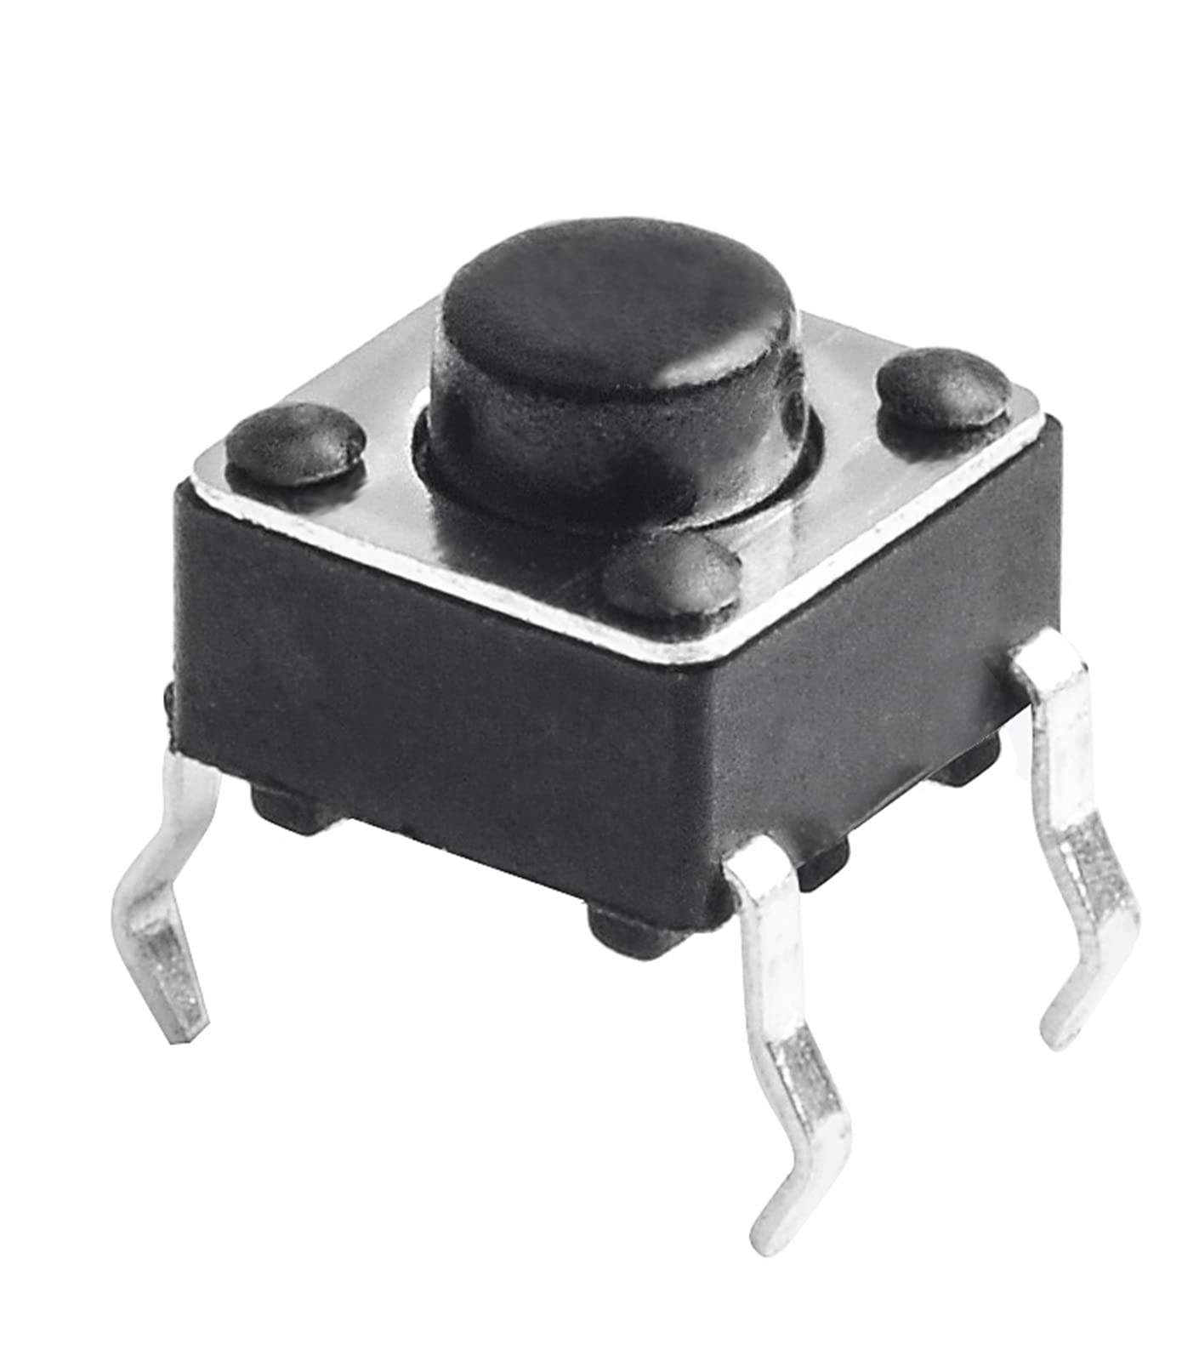
Push Button four pin
Push buttons or switches connect two points in a circuit when you press them. This example the button will start our system.

Slide 13
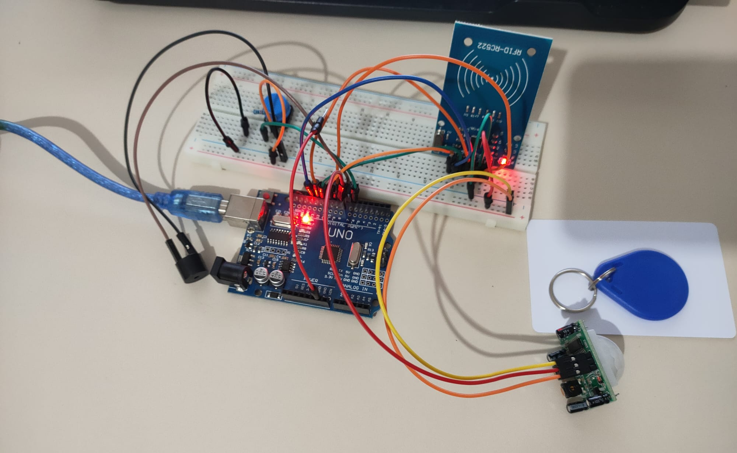
Circuit Design
Circuit design

Slide 14
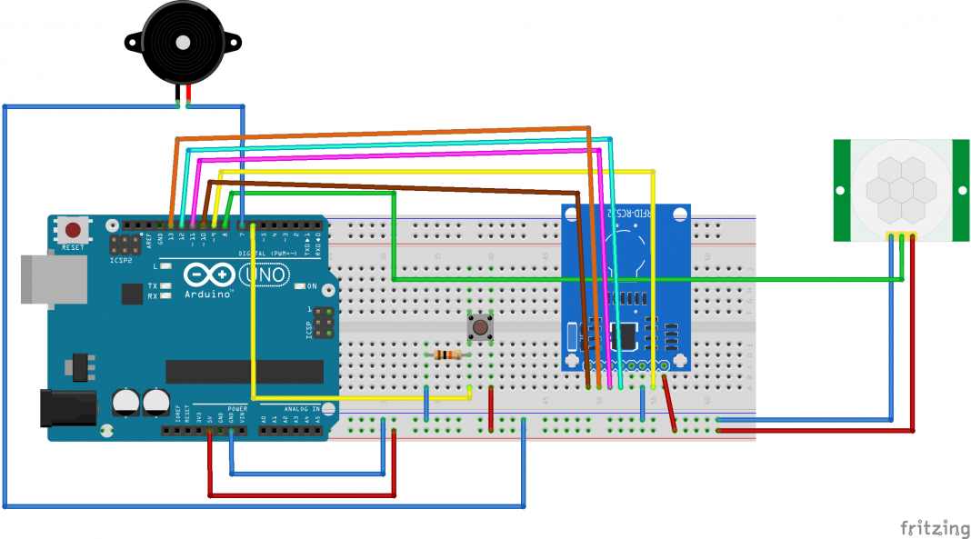
Vıtrual cırcuıt

Slide 15

Thank you for listening… Gorkem ozyurt 218mı1034

