Slide 1
Glucose Forecasting from Wearables
Goal: predict glucose 30 minutes ahead using wearable signals + self-logged data

Slide 2
~1GB XML file on Apple Watch. Didn’t know what to do with it….
Realized that wearables have a TON of health data
Tracking glucose is an important issue for a lot of people
Can you predict glucose with just your wearable data?
Why I chased this question

Slide 3
Background (quick, non-specialist)
Glucose = blood sugar. Going too low or too high can be dangerous
CGM (continuous glucose monitor) = sensor that measures glucose every few minutes
Problem: CGMs can be expensive, inconsistently worn, or not always available

Slide 4
Question 1: If someone has a wearable, can we forecast glucose without using CGM at prediction time?
Question 2: Does learning from someone’s own history (personalization) help?
Research question

Slide 5
Dataset snapshot
Participants: 25 people
Sampling: 5-minute intervals
Test size: 61,858 test points (across 25 users)
Inputs: heart rate, steps, calories, time; plus self-logged meals (carbs) and insulin (basal/bolus)
Label: CGM glucose 30 minutes in the future

Slide 6
What was compared (3 model setups)
1) General model: “can I predict you on day 1”
2) Personalized model: “can I learn you over time”
3) Personalized + CGM history: “I already have CGM data, can I forecast 30 mins in the future”

Slide 7
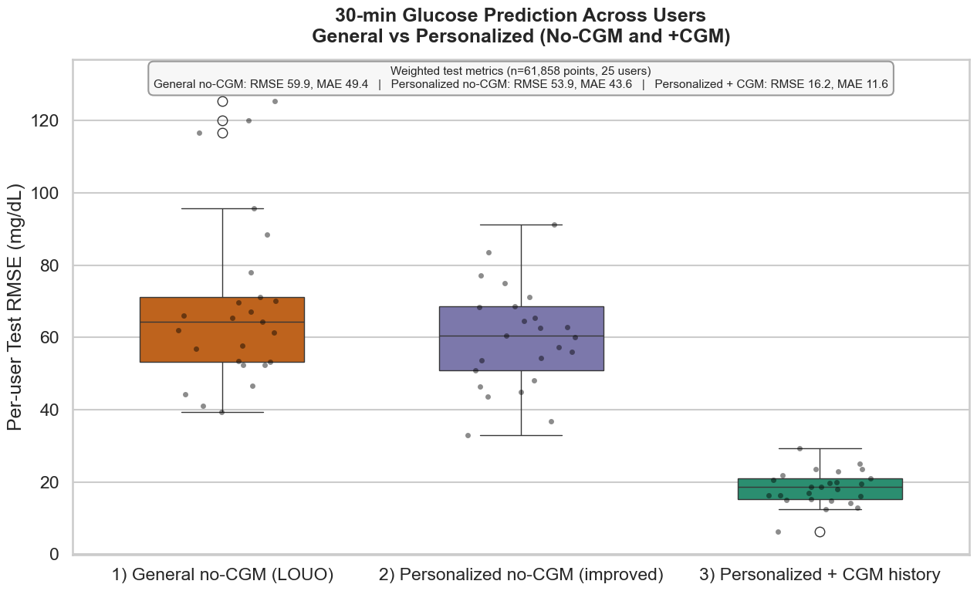
Results (lower error is better)

Slide 8
What the results mean
1. Wearables alone aren’t reliable for exact glucose numbers
2. Personalization helps a bit, but barely

Slide 9
Limitations: meal/insulin log timing errors; missing biology signals (stress, hormones, sleep quality); individual drift over time
Next: add better features (sleep/HRV, exercise intensity, meal composition) and test longer CGM-off gaps
Limitations + what I’d try next

