Slide 1
BudgetApp
A Budget Management System
Giorgio Plescia, Oleksii Redko

Slide 2
A Personal Budget Application
Keep Track Of Spending
Manage a better Income
Plan out investments
Cut out useless funds
Create a better future

Slide 3
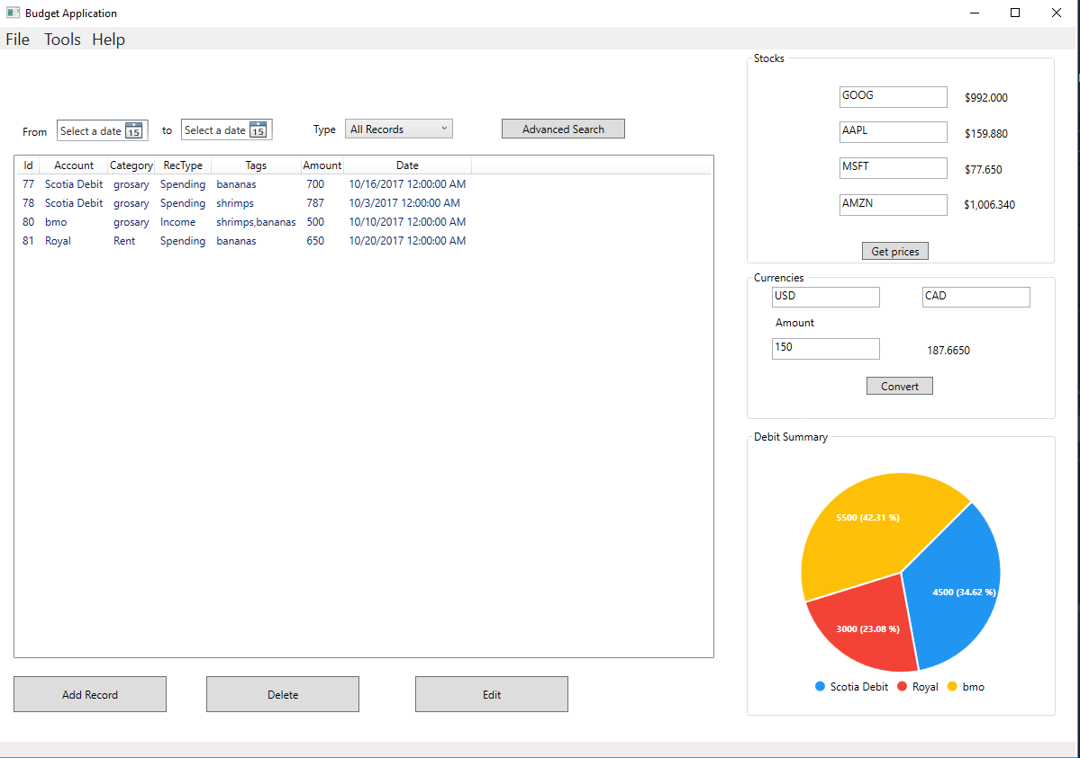
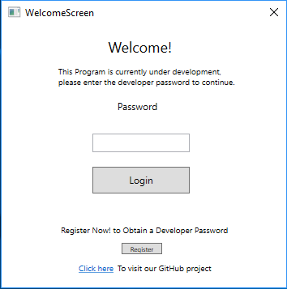
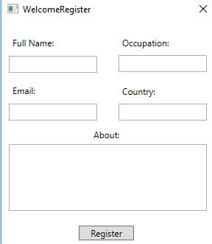
Project Overview

Slide 4
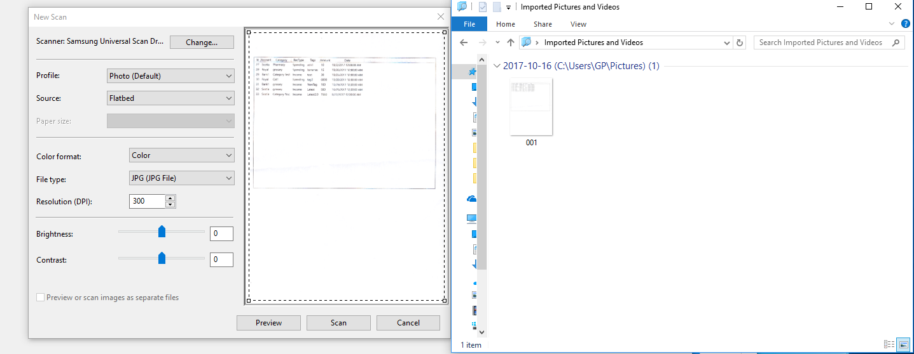
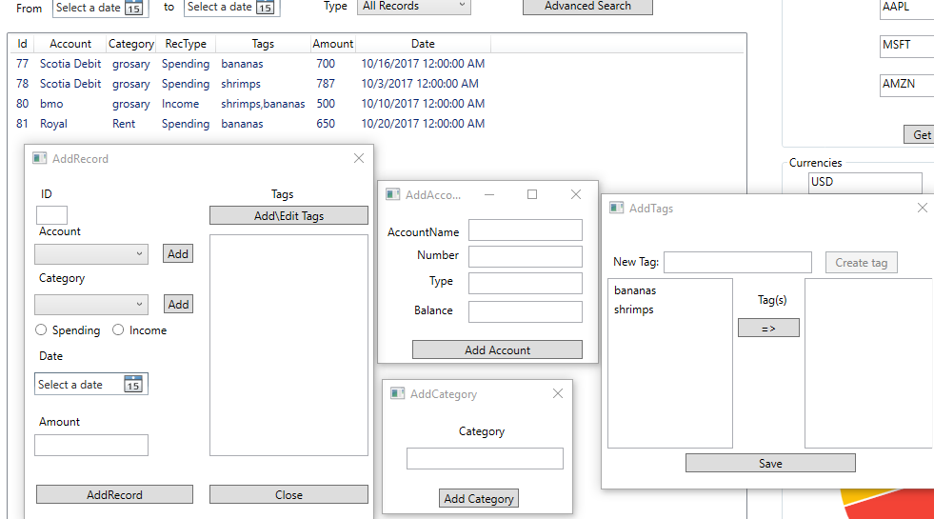
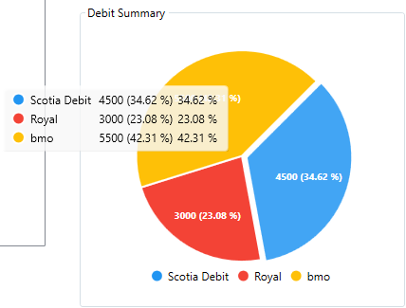
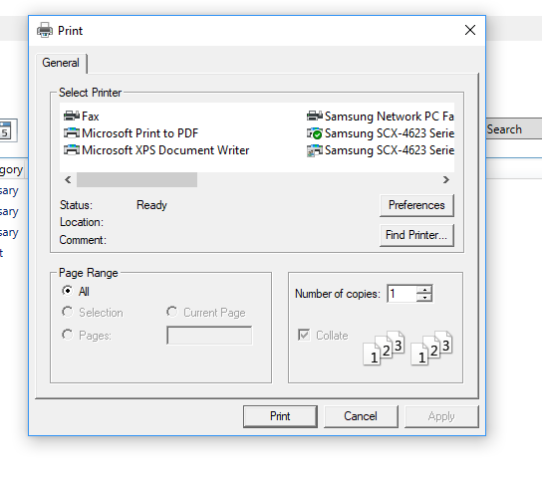
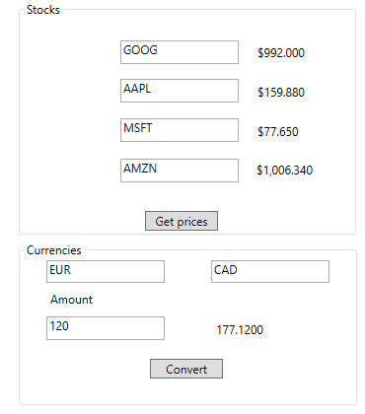
In Depth Features

Slide 5
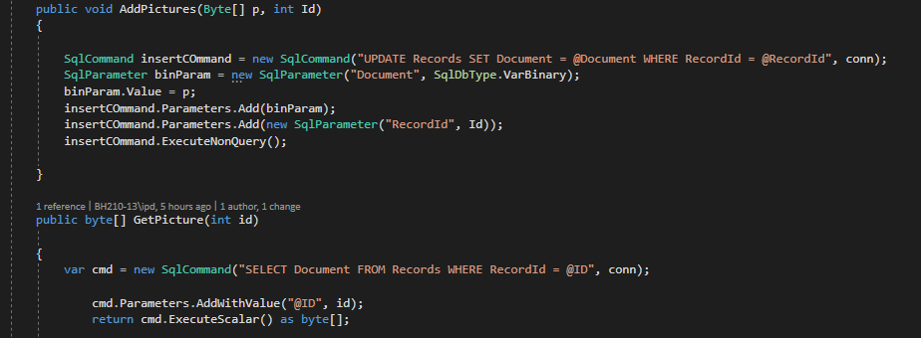
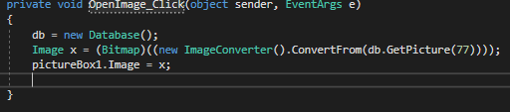
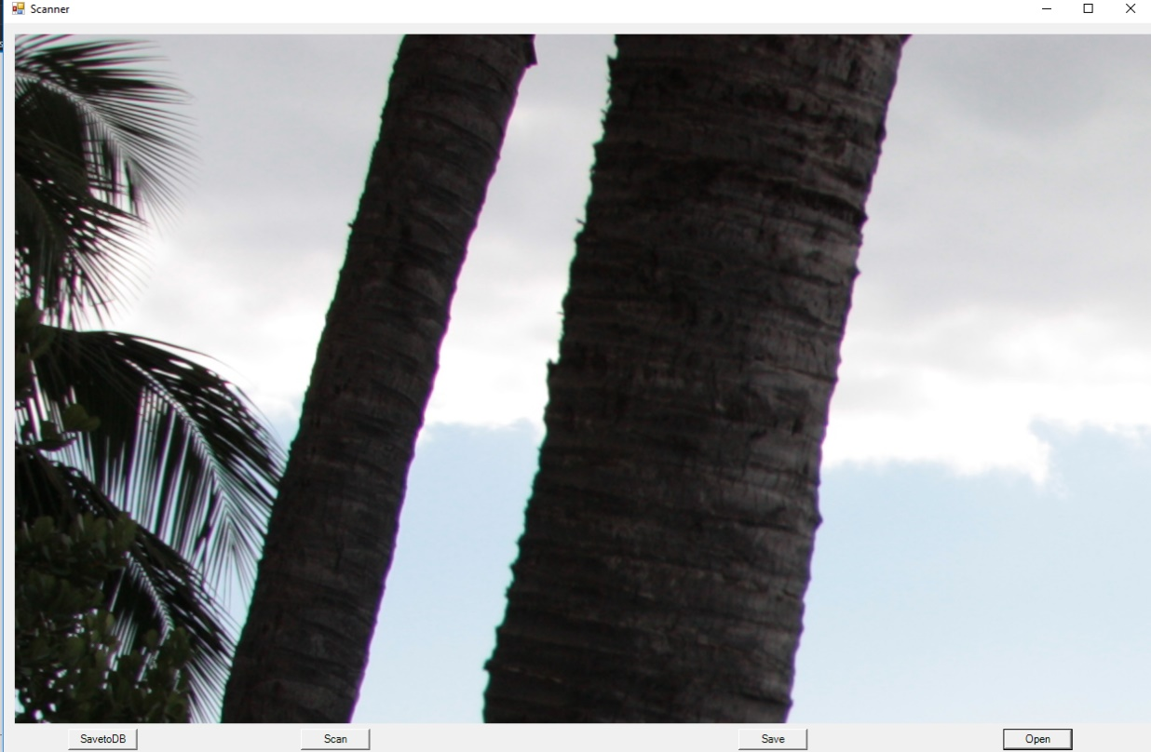
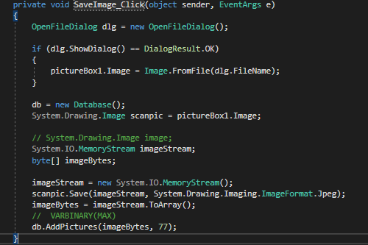
Challenges and Solutions
Import Scanner Image to DB
Export Scanner Image from DB

Slide 6
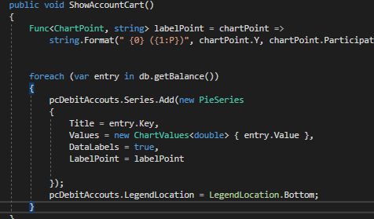
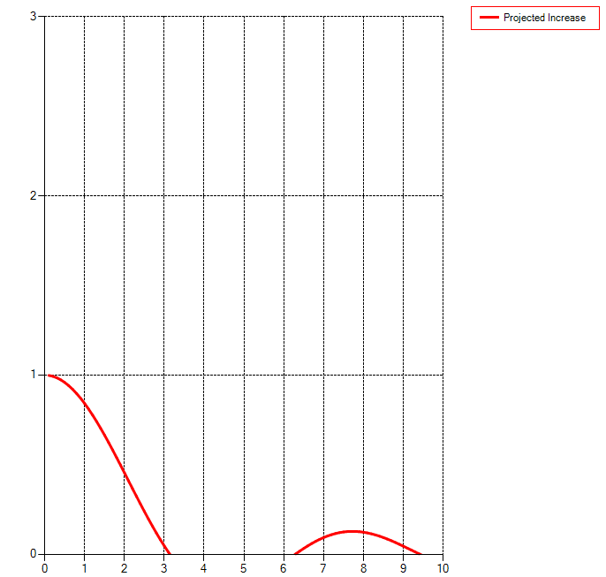
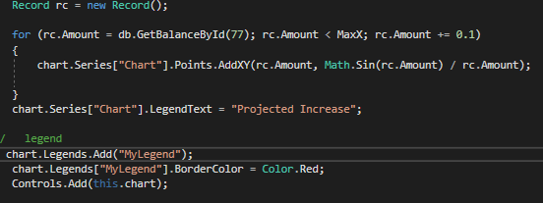
Challenges and Solutions
Chart creation and Linking

Slide 7
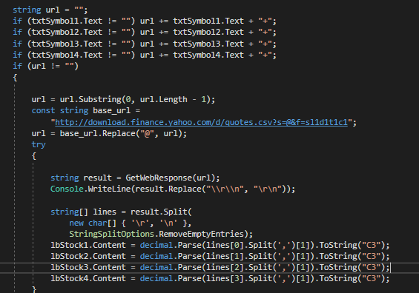
Challenges and Solutions
Functional Api’s

Slide 8
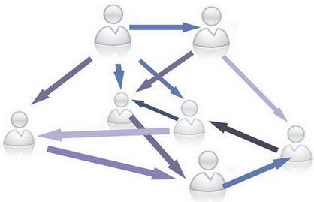
Challenges and Solutions
SQL Many to Many Implementation

Slide 9
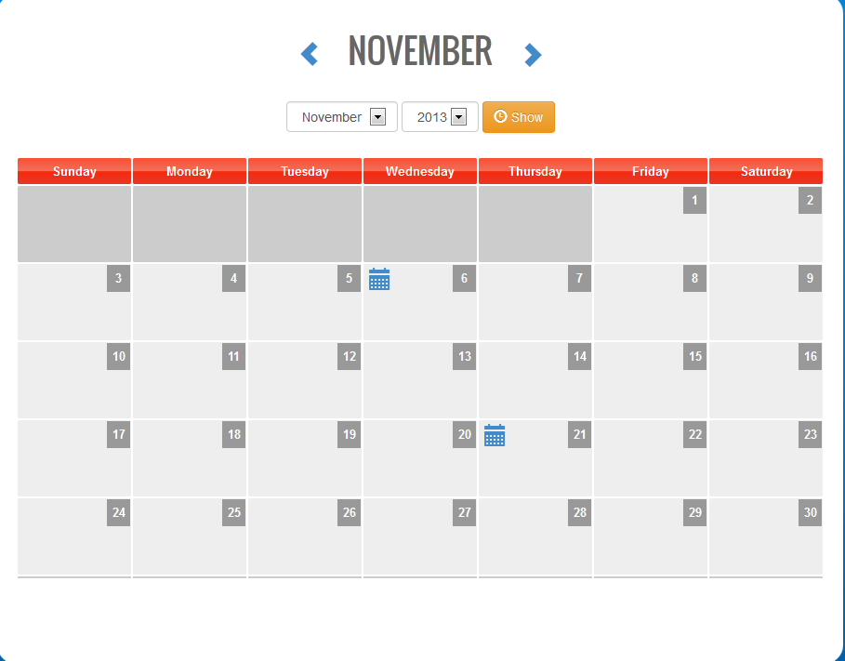
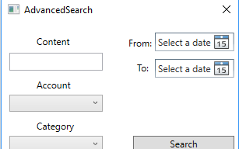
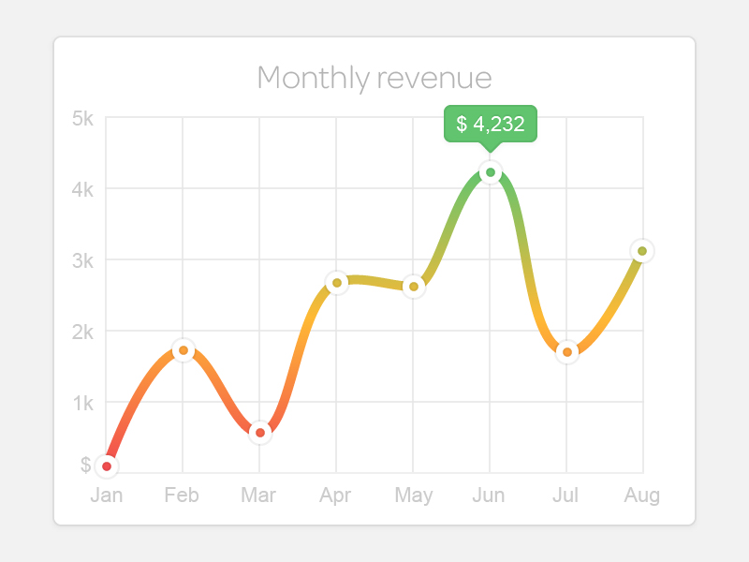
Future Work
Advanced Search
ASP.NET Event Calendar
Improved Charts
Nicer User Interface

Slide 10
Summary
Our Completed Goals
Our Experience
Conclusion
Thank you!

