Slide 1
Datenator
A state of the art Dating Website
Giorgio Plescia, Oleksii Redko

Slide 2
A Social Dating Site
Live Chat with New People
Customize your own profile
filter search for better matches
Create tickets and speak with admins
Gain access to the Admin panel

Slide 3
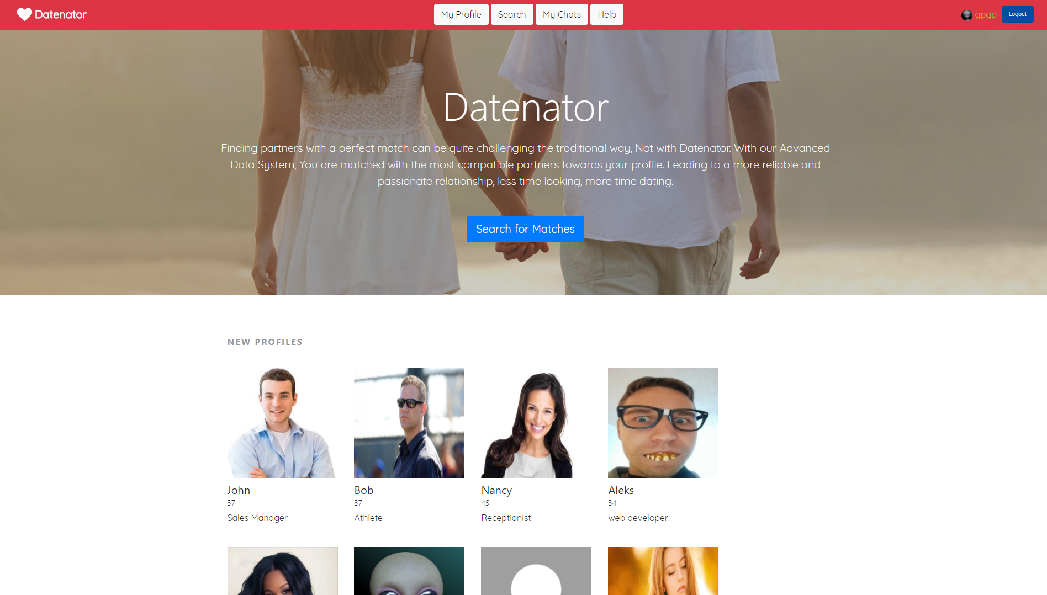
Website Overview

Slide 4
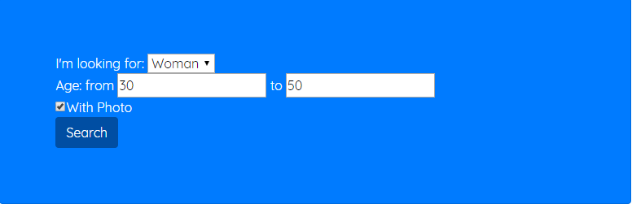
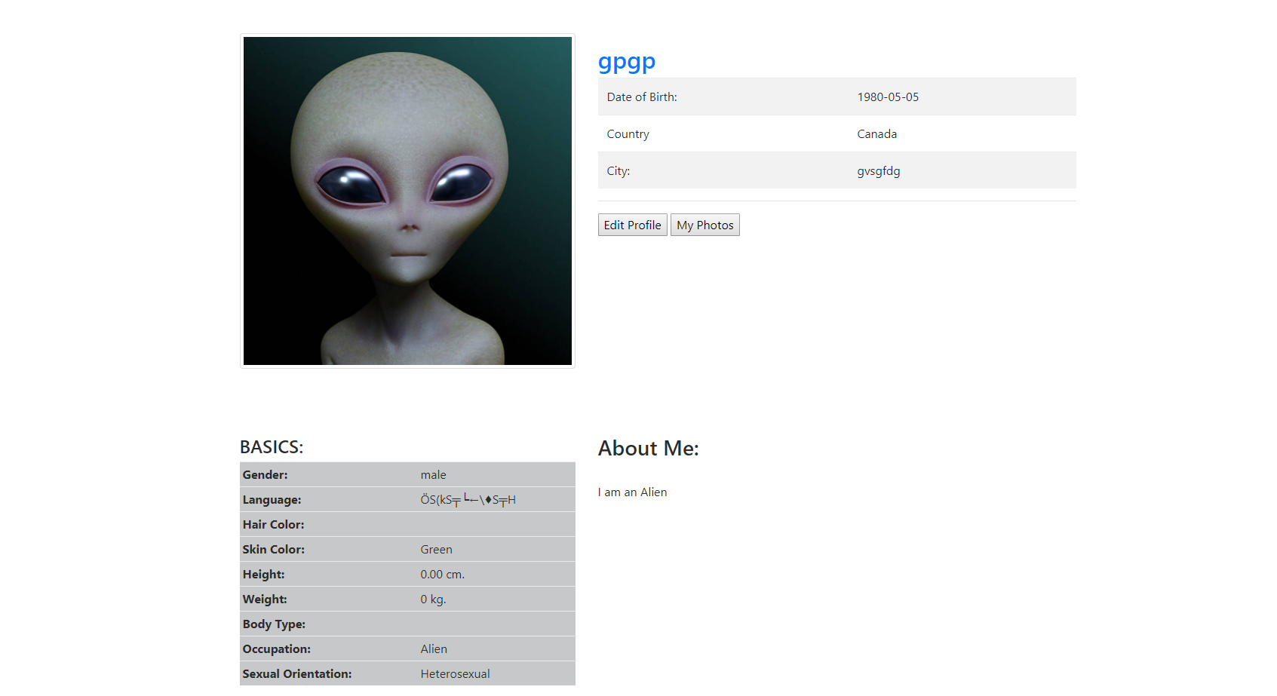
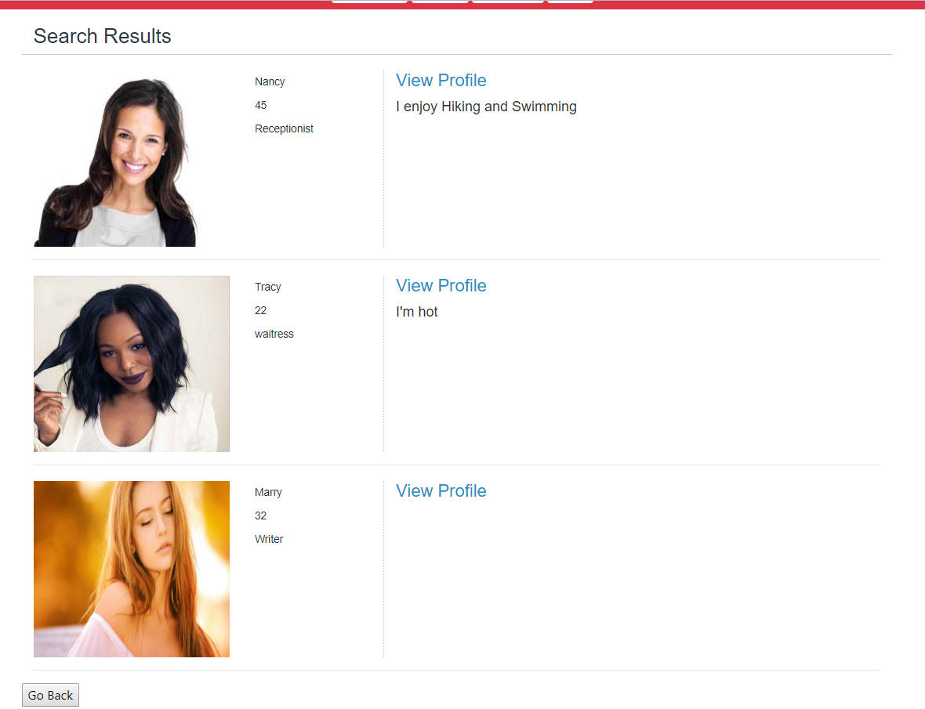
Website Features

Slide 5
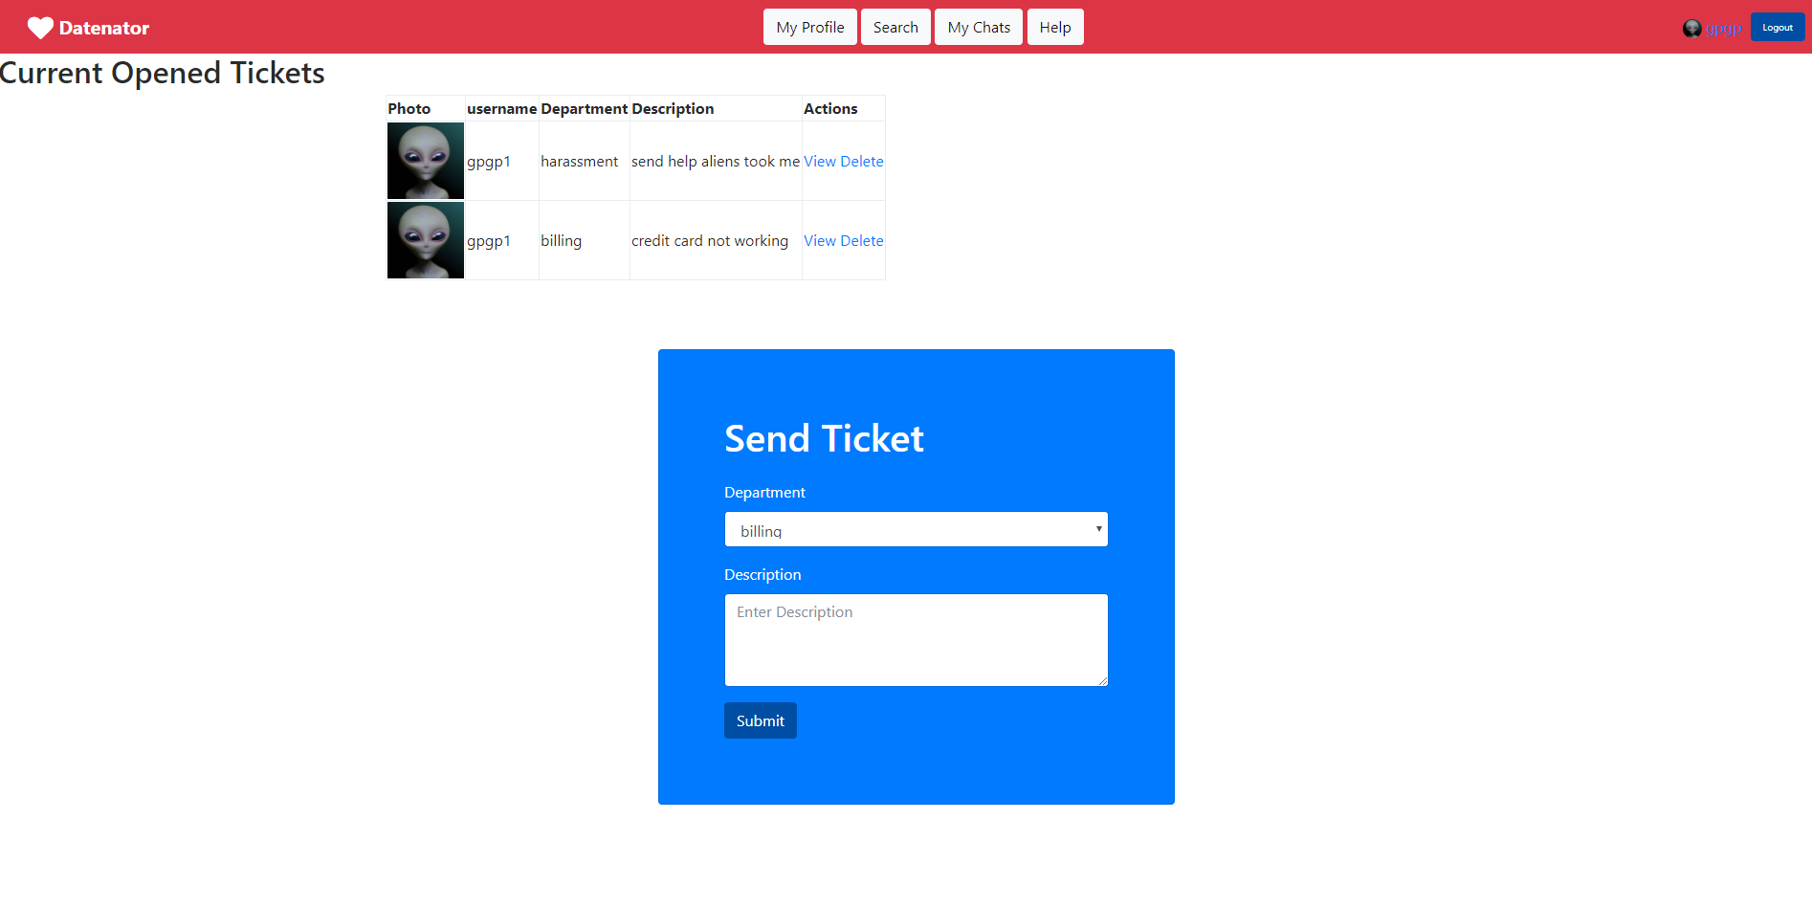
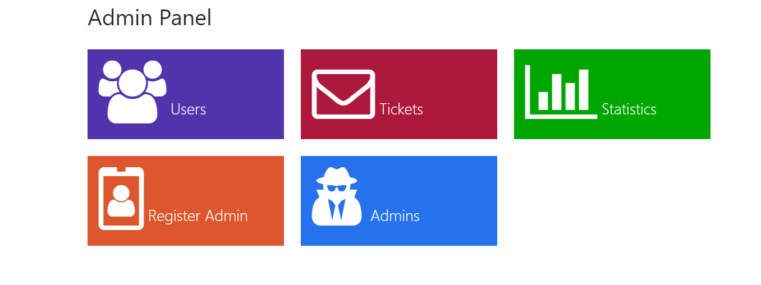
Admin Overview

Slide 6
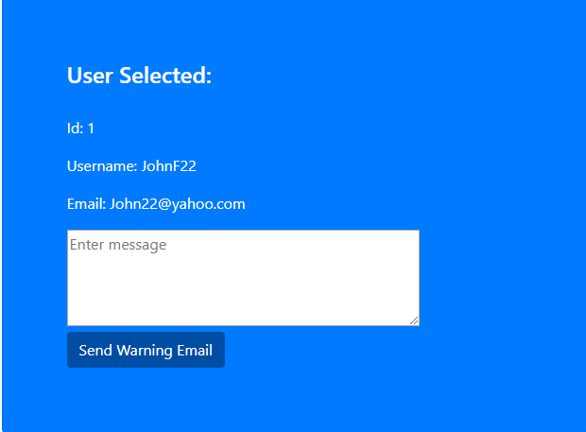
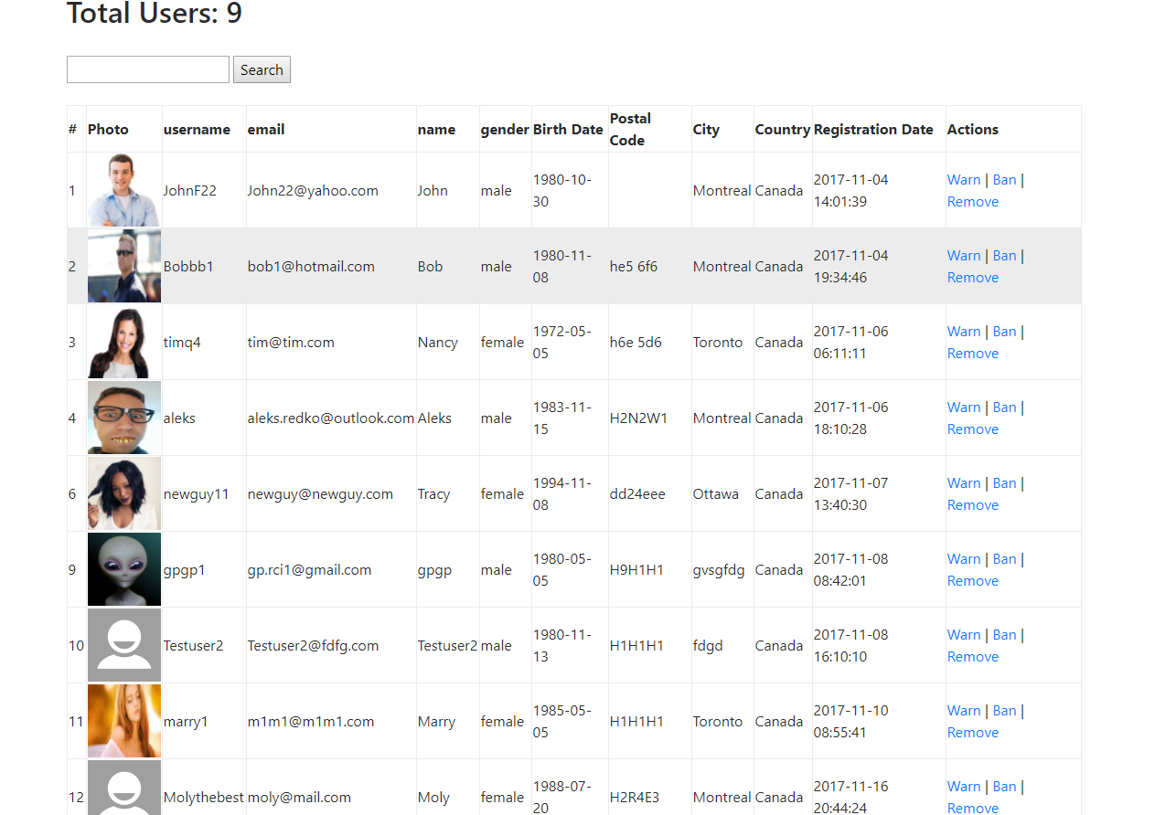
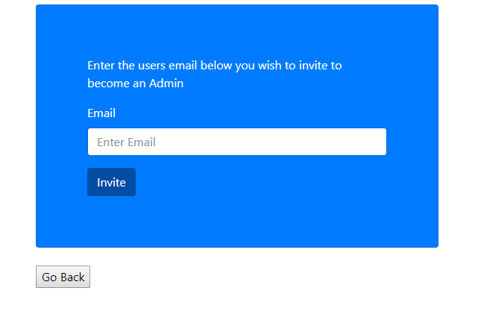
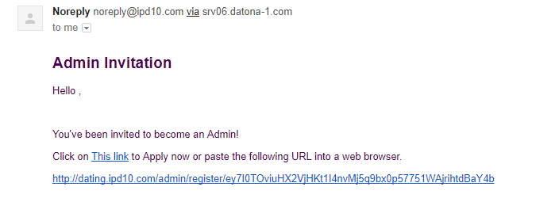
Admin Overview

Slide 7
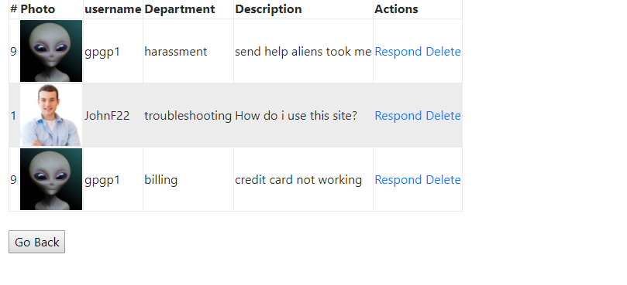
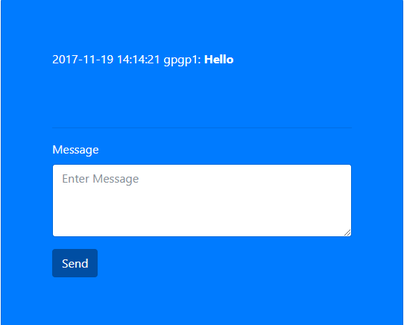
Challenges and Solutions

Slide 8
Challenges and Solutions
Insert User live chatting images here

Slide 9


Future Work
Complete Statistics
Implement Payment System
User/admin notifications
More profile customization
Nicer design

Slide 10
Our Summary
Overall Experience
Thoughts on Website
Conclusion
Thank you!

