Slide 1
TRAINING SESSION — 2025
Introduction to
Generative AI
Unlocking the Power of AI for Everyone
Facilitator: Your Name | Duration: 3 Hours | Level: Beginner–Intermediate

Slide 2
SESSION AGENDA
What We'll Cover Today
What is Generative AI?
Key Techniques
01
02
Core concepts, history & how it works
LLMs, diffusion models, transformers
Real-World Applications
Popular Tools & Platforms
03
04
Industry use cases & live demos
ChatGPT, Copilot, Midjourney & more
Responsible AI & Ethics
Hands-On Practice
05
06
Bias, hallucinations & best practices
Prompt engineering exercises & Q&A

Slide 3
MODULE 01
What is Generative AI?
Generative AI refers to artificial intelligence systems that can create new content — text, images, code, audio, and video — by learning patterns from vast amounts of training data.
Learns Patterns
Generates Content
Adapts & Improves
Trained on billions of examples to understand language, images, and code structures.
Produces original, human-like outputs from simple text prompts and instructions.
Fine-tuned using feedback to align outputs with human intent and accuracy.

Slide 4
MODULE 01
How Generative AI Works
Data
Ingestion
Model
Training
Fine-
Tuning
User
Prompt
AI
Output
◉
⚡
◎
▶
✦
Massive datasets of text, images & code
Neural networks learn patterns & relationships
RLHF aligns outputs with human preferences
You provide natural language instructions
Relevant, coherent content is generated

Slide 5
MODULE 02
Key Techniques & Architectures
Large Language Models (LLMs)
Diffusion Models
GPT, Llama, Gemini
Stable Diffusion, DALL·E
Transformer-based models trained on massive text corpora. Power ChatGPT, Copilot and more.
Learn to reverse noise to generate photorealistic images from text prompts.
GANs
Multimodal AI
Generative Adversarial Networks
GPT-4o, Gemini Ultra
Two networks compete — a generator creates content, a discriminator critiques it.
Process and generate across text, images, audio & video in a single model.

Slide 6
MODULE 03
Real-World Applications
Healthcare
Finance
Education
Medical imaging analysis · Clinical note generation · Drug discovery · Patient Q&A chatbots
Fraud detection · Report generation · Risk analysis · Personalized financial advice
Intelligent tutoring · Auto-grading · Content generation · Personalized learning paths
Engineering
Marketing
Legal
Code generation · Bug fixing · Documentation · Architecture design assistance
Copy writing · Ad creative · SEO content · Email personalization campaigns
Contract review · Case research · Summary drafting · Compliance checking

Slide 7
MODULE 04
Popular Generative AI Tools
ChatGPT
Conversational AI for writing, analysis, coding & brainstorming.
Claude
Long-context AI known for safety, nuanced reasoning & document analysis.
Text / Chat
Text / Research
Copilot
Embedded AI in Microsoft 365 & GitHub for code and document generation.
Gemini
Google's multimodal AI integrated into Search, Docs & Android.
Coding / Productivity
Multimodal
Midjourney
High-quality AI art generation via Discord prompts.
DALL·E 3
Text-to-image AI with precise prompt-following & creative styles.
Image Generation
Image Generation
Runway ML
AI video editing and generation for creatives and filmmakers.
Sora
Generate cinematic video from text prompts up to 60 seconds.
Video Generation
Video Generation
Perplexity AI
AI-powered search that cites real-time web sources accurately.
GitHub Copilot
AI pair programmer in VS Code that autocompletes entire functions.
Search / Research
Developer

Slide 8
MODULE 04
Prompt Engineering Basics
What is Prompt Engineering?
EXAMPLE PROMPT
ROLE:
The skill of crafting clear, precise instructions that guide AI models to produce accurate, useful, and relevant outputs.
Key principles:
→ Be specific and clear
→ Provide context & examples
→ Set role / persona
→ Define output format
→ Iterate and refine
→ Use system-level instructions
You are a senior product manager at a SaaS company.
CONTEXT:
We are launching a new AI feature for HR teams.
TASK:
Write a 3-paragraph announcement email for our
internal newsletter. Keep it under 200 words.
FORMAT:
Subject line, greeting, body, call-to-action.

Slide 9
MODULE 05
Responsible AI & Ethics
⚠
Hallucinations
⚖
Bias & Fairness
🔒
Privacy & Data
AI can generate false information confidently. Always verify critical facts from authoritative sources.
Models reflect biases in training data. Audit outputs for discriminatory patterns in hiring, lending, healthcare.
Avoid sharing personal, confidential, or proprietary data in public AI tools. Check your org's AI usage policy.
©
Copyright & IP
◎
Transparency
🌿
Environmental Impact
AI-generated content may raise IP questions. Understand legal frameworks before publishing AI outputs.
Always disclose AI assistance in work products when required. Maintain human oversight of key decisions.
Training large AI models consumes significant energy. Consider efficiency and sustainable AI practices.

Slide 10
You're Ready to
Start Using AI!
YOUR NEXT STEPS
RESOURCES
01
Experiment with ChatGPT / Claude today — try prompts for your daily tasks
→ promptingguide.ai
02
Complete the hands-on lab exercises in your workbook
→ learnprompting.org
→ huggingface.co/learn
03
Join our internal AI Community of Practice channel
→ openai.com/research
04
Attend the advanced session: AI Agents & Automation (next month)
→ anthropic.com/research
Thank you for attending · Questions welcome · Let's build the future together!

Slide 11
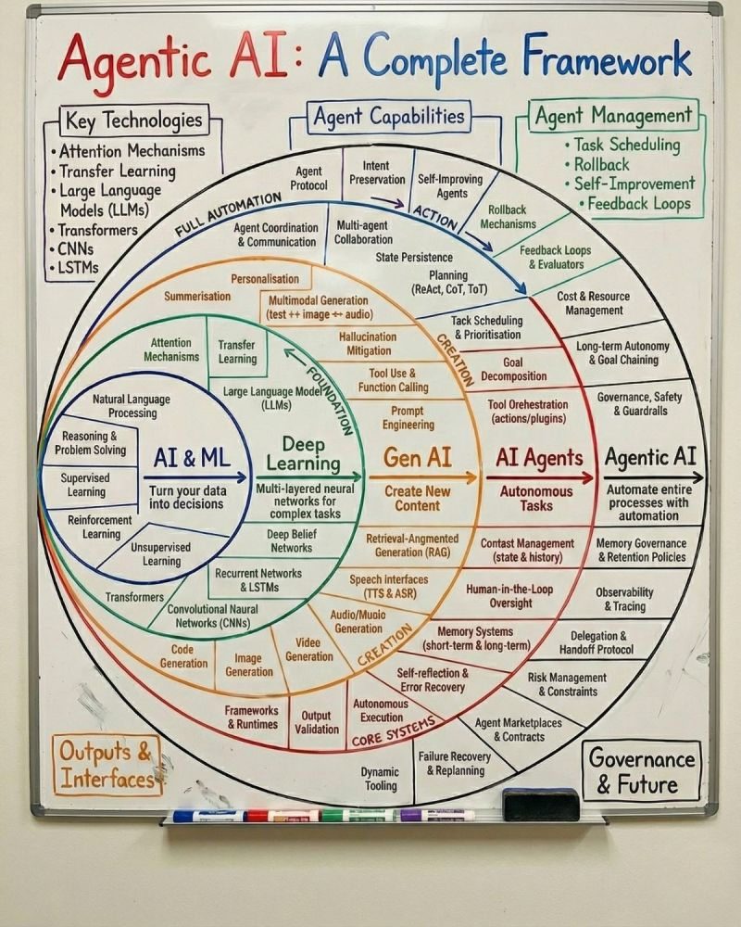
MODULE 02 — FRAMEWORK
Agentic AI: A Complete Framework
AI & ML Foundation
Supervised, Unsupervised & Reinforcement Learning · NLP · Reasoning & Problem Solving
Deep Learning
Multi-layered Neural Networks · CNNs · Transformers · RNNs · Deep Belief Networks
Generative AI
Prompt Engineering · RAG · Tool Use & Function Calling · Multimodal Generation · Hallucination Mitigation
AI Agents
Autonomous Tasks · Goal Decomposition · Memory Systems · Human-in-the-Loop · Tool Orchestration
Agentic AI (Full Automation)
Process Automation · Task Scheduling · Governance & Guardrails · Observability & Self-Improvement

Slide 12
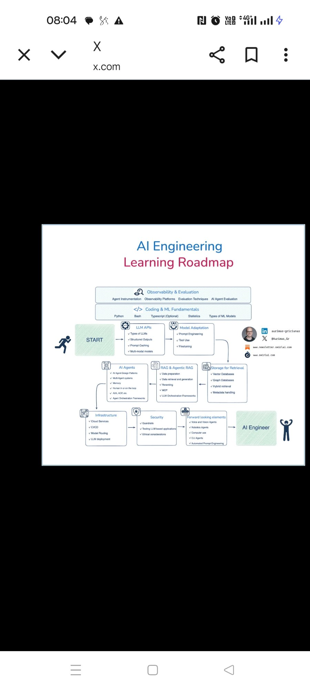
MODULE 01 — ARCHITECTURE
Layers of AI: From Classical to Agentic
Classical AI
1
Foundation Layer · Symbolic AI · Expert Systems · Knowledge Representation · Logic & Reasoning
Machine Learning
2
Learning Layer · Supervised · Unsupervised · Reinforcement Learning · Regression · Classification
Neural Networks
3
Network Layer · Perceptrons · Cost Functions · Backpropagation · Activation Functions · Hidden Layers
Deep Learning
4
Modeling Layer · Transformers · LSTMs · RNNs · CNNs · Autoencoders
Generative AI
5
Creation Layer · LLMs · Diffusion Models · VAEs · Multimodal Models
Agentic AI
6
Autonomy Layer · Memory · Planning · Tool Use · Autonomous Execution

Slide 13
MODULE 02 — HISTORY
The Journey of Large Language Models
2017
2018
2020
2023
2025
Transformer
BERT
GPT-3
GPT-4 / Gemini
Agentic Era
Google Brain
Google
OpenAI
OpenAI / Google
Industry-wide
"Attention Is All You Need" — architecture powering all modern LLMs
Bidirectional encoder. Dominated NLU tasks. Masked language modelling
175B params. Few-shot learning. Powered first wave of AI apps via API
Multimodal, 1T+ params est. Professional-level reasoning & vision
AI Agents, reasoning models (o1/o3), multimodal & autonomous workflows
2018
2019
2022
2024
GPT-1
GPT-2
ChatGPT
Llama 3 / Claude 3
OpenAI
OpenAI
OpenAI
Meta / Anthropic
1st generative pre-trained transformer. 117M params, unsupervised pre-training
1.5B params. Zero-shot tasks. "Too dangerous to release" initially
RLHF fine-tuned GPT. 100M users in 60 days. GenAI goes mainstream
Open-source competition heats up. Long context, tool use, safety focus
Pre-Transformer Era: RNNs, LSTMs (2014–2016) → Word2Vec, GloVe embeddings laid the groundwork

Slide 14
MODULE 06 — ROADMAP
Generative AI Learning Path
Foundations
▸ Python basics & data structures
▸ Math: Linear algebra, probability, statistics
1
⏱ 2–4 weeks
▸ Intro to ML concepts & terminology
▸ Jupyter notebooks & cloud environments
Machine Learning & Neural Networks
▸ Supervised & unsupervised learning
▸ Neural network architecture & backpropagation
2
⏱ 4–6 weeks
▸ Key frameworks: TensorFlow / PyTorch
▸ Model evaluation, overfitting, regularisation
Deep Learning & Transformers
▸ CNNs, RNNs, LSTMs
▸ Attention mechanism & Transformer architecture
3
⏱ 4–6 weeks
▸ Hugging Face ecosystem & pre-trained models
▸ Fine-tuning & transfer learning
Generative AI & LLMs
▸ LLM internals: tokenisation, embeddings, inference
▸ Prompt engineering & advanced techniques (CoT, RAG)
4
⏱ 4–8 weeks
▸ APIs: OpenAI, Anthropic, Gemini
▸ Building AI-powered applications
Agentic AI & Deployment
▸ AI Agents: LangChain, AutoGen, CrewAI
▸ Tool use, function calling & memory systems
5
⏱ 4–8 weeks
▸ MLOps: deployment, monitoring, evaluation
▸ Responsible AI, safety & governance
Estimated Total: 18–32 weeks · Resources: fast.ai · deeplearning.ai · Hugging Face · Coursera · YouTube

Slide 15
MODULE 03 — ARCHITECTURE
Gen AI Project: Solution Flow Diagram
INPUT LAYER
PROCESSING CORE
OUTPUT LAYER
User Query
Orchestrator / Agent
Chat Response
▶
▶
Natural language prompt
LangChain · AutoGen · CrewAI
Streaming text answer
Retrieval (RAG)
Documents / Files
▶
▶
Generated Document
Embeddings → Vector DB → Top-K chunks
PDF, DOCX, CSV, URLs
Report / Summary / Email
Database
LLM Engine
Code / Data
▶
▶
GPT-4o · Claude · Gemini · Llama 3
Structured data source
Scripts, SQL, analysis output
Memory & Context
APIs / Tools
▶
Action / API Call
▶
Short-term chat + Long-term knowledge
External integrations
Booking, CRM update, webhook
Safety & Guardrails
Content filtering · PII redaction
◀ Feedback Loop: User rating & corrections → Fine-tuning / RLHF pipeline → Improved model
Vector DB: Pinecone · Weaviate · ChromaDB · Observability: LangSmith · Weights & Biases

