Slide 1

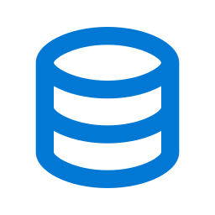








TECHNICAL ARCHITECTURE ON AZURE
Microsoft Azure
Ingestion
Storage
Data Platform
AI Platform
Consumption
File Upload
Azure OpenAI Service
App Service (Deployment)
PDF
👤
PDF
XLS
Azure Synapse Analytics
Embeddings Model
Azure App Service
10
End
User
XLS
Pipeline / Compute
text-embedding-ada-002
Streamlit UI
💻📱
1
4
process
9
2
3
Final Output
6
Azure Data Factory
ADLS Gen2
Document Intelligence
8
Text Generation
QA → Embedding
Ingestion Pipeline
Data Lake Storage
Chunking / Splitting
Similarity Search
GPT-4o / GPT-4 Turbo
Azure OpenAI
5
store vectors
Azure AI Search
Azure AI Foundry
7
Prompt Engineering
Vector Index (HNSW)
Prompt Flow
+ Context Retrieval
Data Flow: ① File Upload → ② ADF Ingestion → ③ ADLS Gen2 → ④ Synapse Analytics → ⑤ Vector Store → ⑧ Similarity Search → ⑨ GPT-4o → ⑩ App Service → End User

Slide 2


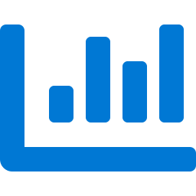
AZURE SERVICES REQUIRED
AWS → Azure Mapping
Storage & Ingestion
Data Processing
AI / ML Platform
Deployment & Security
Azure Data Lake Storage Gen2
Azure Synapse Analytics
Azure OpenAI – Ada Embeddings
Azure App Service
≡ AWS S3
≡ LangChain + Python
≡ Bedrock Embeddings
≡ EC2 (Streamlit app)
Primary data lake for raw files, chunks and vector data. Hierarchical namespace with enterprise-grade security.
Spark-based pipeline for data transformation, chunking orchestration and embedding batch processing.
Generates dense vector embeddings (text-embedding-ada-002) for document chunks stored in AI Search.
Hosts the Streamlit front-end application with auto-scaling and managed TLS certificates.
Azure Data Factory
Azure Document Intelligence
Azure OpenAI – GPT-4o
Azure AD + VNet + Private Endpoints
≡ Custom Python Scripts
≡ LangChain Chunking
≡ Bedrock Text Gen
≡ IAM / VPC
Orchestrates file ingestion pipelines from upload sources into ADLS Gen2. Replaces LangChain pipeline triggers.
AI-powered document parsing, text extraction and intelligent chunking from PDF and Excel files.
Large language model for RAG-based answer generation from retrieved context and user queries.
Unified identity, RBAC access control and private network isolation for all services.
Azure Event Grid
Azure AI Search
Azure AI Foundry / Prompt Flow
Azure Monitor + Application Insights
≡ Amazon EventBridge
≡ Amazon OpenSearch
≡ Bedrock Orchestration
≡ CloudWatch / Logs
Event-driven triggers on new file arrival in ADLS Gen2 to kick off ingestion workflows automatically.
Managed vector search engine with HNSW index for semantic and hybrid similarity search.
Visual prompt engineering, LLM chaining and evaluation platform for production AI workflows.
Full observability stack: metrics, distributed tracing, log analytics and alerting dashboards.
All services deployable inside Azure Virtual Network with Private Endpoints · ADLS Gen2 replaces AWS S3 as the primary data lake · ADF handles file ingestion into the lake

