Slide 1


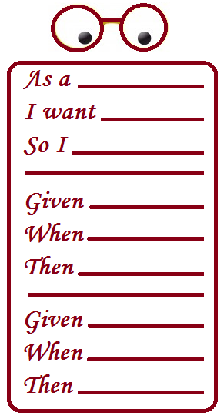
QUALITY INSPECTION TO EVALUATE BDD SCENARIOS
PONTIFICAL CATHOLIC UNIVERSITY OF RIO GRANDE DO SUL
FACULTY OF INFORMATICS
COMPUTER SCIENCE GRADUATE PROGRAM
Student: Gabriel P. A. de Oliveira
Supervisor: Sabrina Marczak, PhD

Slide 2
Agenda
Writing is hard – writing requirements too
What could help on writing requirements?
Behavior Driven Development (BDD) scenarios
Research Proposal
Questions
Objectives
Plan
Timetable

Slide 3
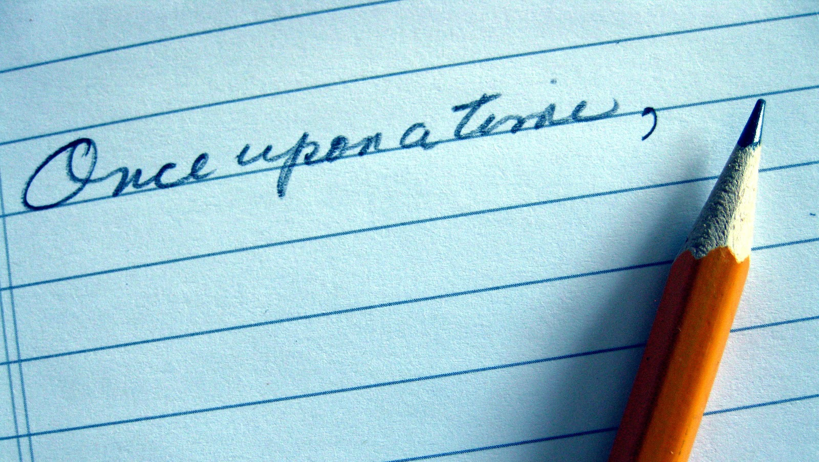
Notes:
Antes de tudo, vou focar no ato da escrita de uma narrativa ou um documento, com o intuito de preserver informações

Slide 4
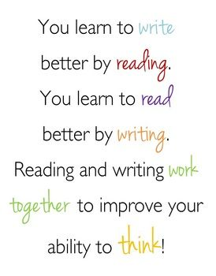
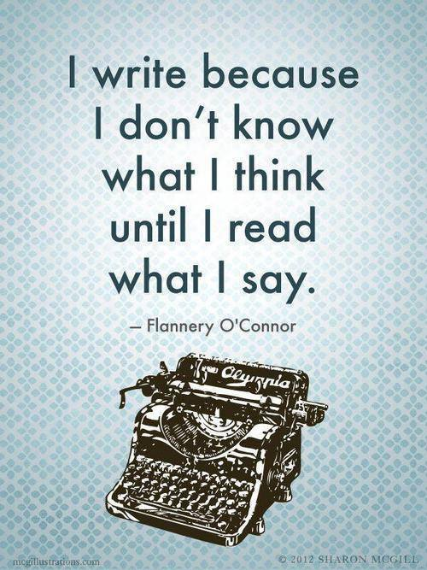
https://www.teacherspayteachers.com/Product/
You-Learn-to-Write-by-Reading-Quote-Poster-201191
https://gunroswell.files.wordpress.com/2016/05/write-think-read.jpg
Notes:
Ler ajuda a Escrever melhor.
Por no papel ajuda a pensar no que foi escrito

Slide 5
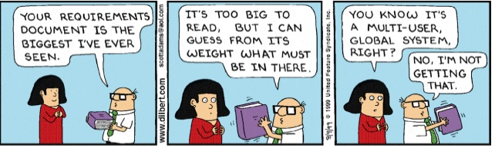
Requirements documents are difficult to write too…
http://dilbert.com/strip/1999-08-09
Notes:
O mesmo se aplica a requisitos – mas nem sempre o mesmo cuidado é tomado

Slide 6
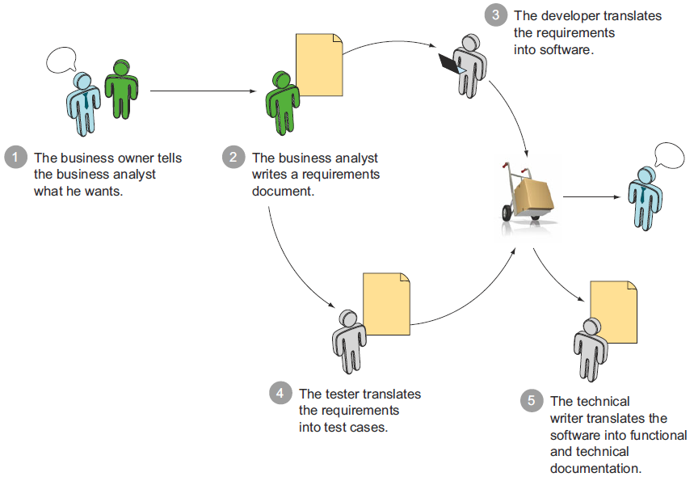
Many requirements documents…
2014, John Ferguson Smart, BDD in Action
Notes:
O problema só se acentua quando pensamos que muitos documentos de requisites circulam dentro da equipe

Slide 7
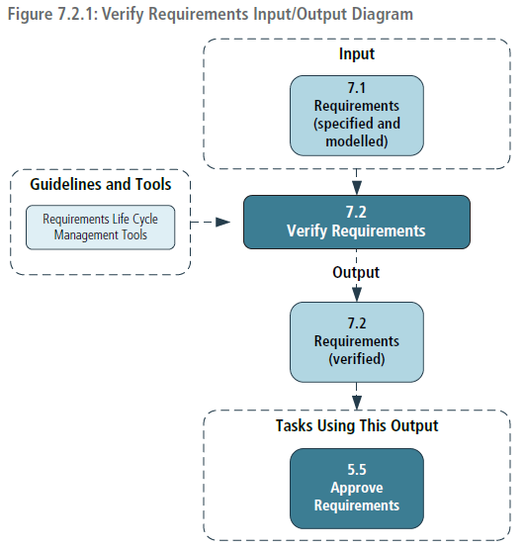
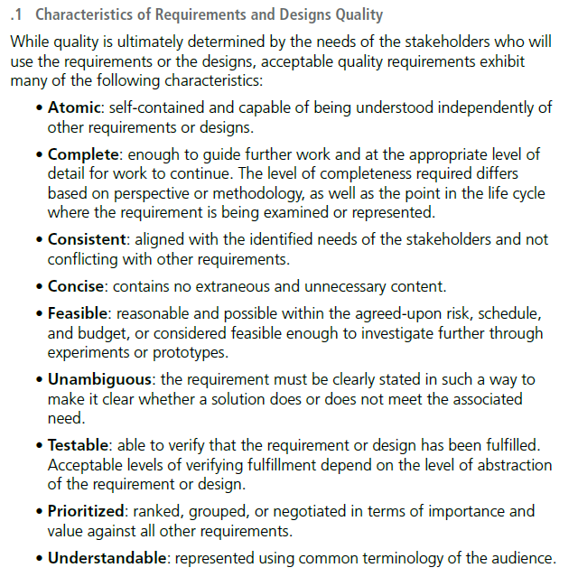
… and validations were always desirable
2015, International Institute of Business Analysis, A Guide to the Business Analysis Body of Knowledge v3
Notes:
O problema só se acentua quando pensamos que muitos documentos de requisites circulam dentro da equipe

Slide 8
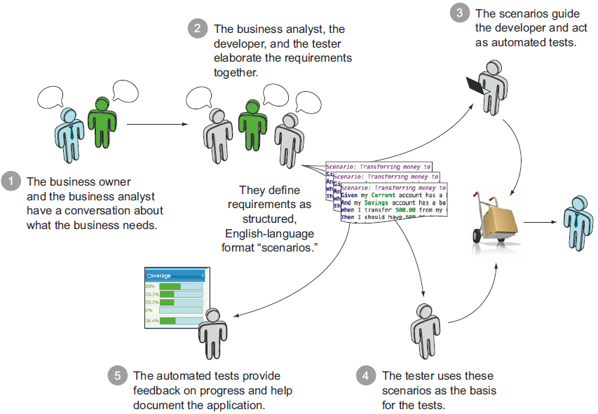
BDD: single executable documentation
2014, John Ferguson Smart, BDD in Action
Notes:
BDD vem para unificar esses muitos documentos… mas carece do mesmo cuidado na escrita que os requisites tradicionais tinham

Slide 9
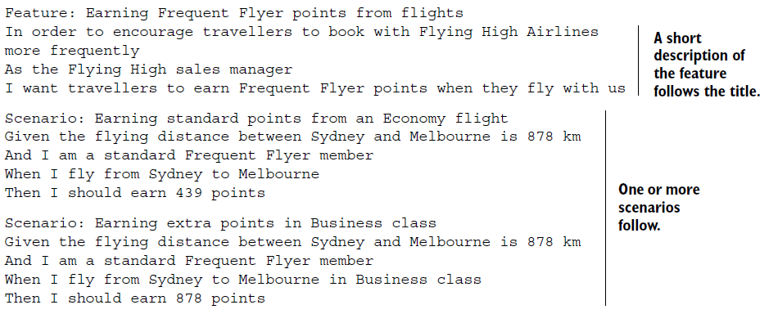
BDD: documentation formatted as stories and scenarios
2014, John Ferguson Smart, BDD in Action
Notes:
Detalham User Stories

Slide 10
It's difficult to write a really good short story because it must be a complete and finished reflection of life with only a few words to use as tools. There isn't time for bad writing in a short story. (Edna Ferber)
Notes:
BDD should have validation tool as well !

Slide 11

BDD: difficulties
What scenarios are worthy to be described?
How to break features and
requirements into scenarios?
How to write scenarios that
are easy to automate ?
What other characteristics should a writer worry about ?
2016, Lauriane Correa, Um estudo empírico sobre o uso do bdd e seu apoio a engenharia de requisitos

Slide 12
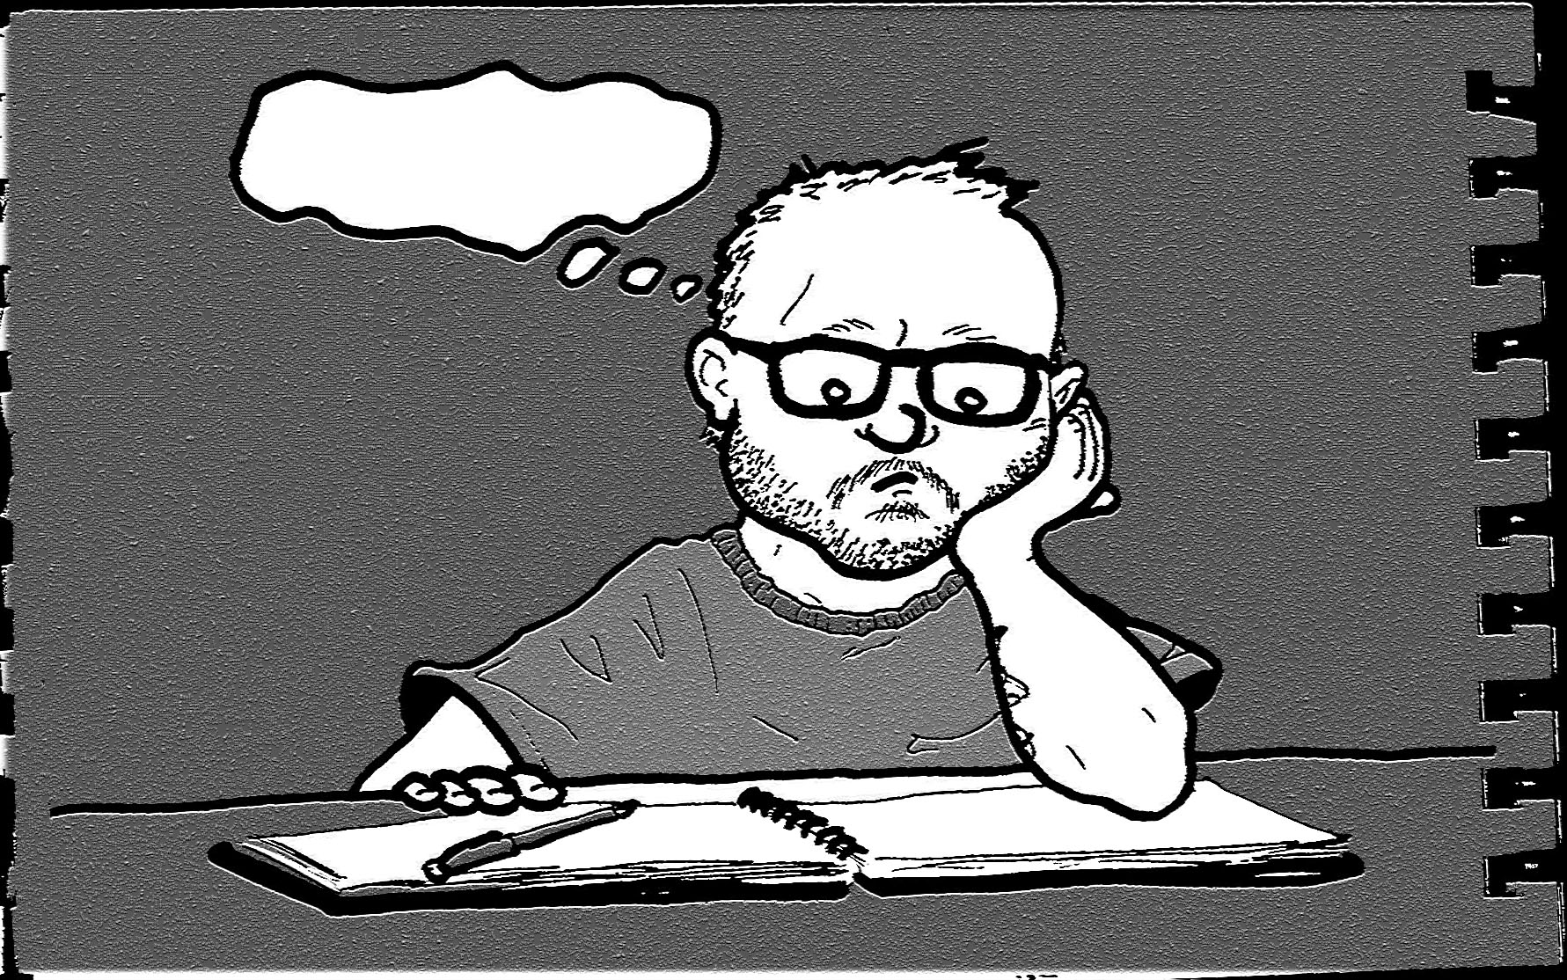
Where to begin with ?
How to evaluate my work ?

Slide 13

What could help?
Quality criteria
What to pay attention when reading ?
Questionnaire
Good/Bad examples

Slide 14

What to pay attention when reading
A reading technique increases the effectiveness of individual reviewers by providing guidelines that they can use to examine (or “read”) a given software document and identify defects during an inspection process.
2001, Walcélio Melo, Forrest Shull, Guilherme H. Travassos, Software Review Guidelines

Slide 15
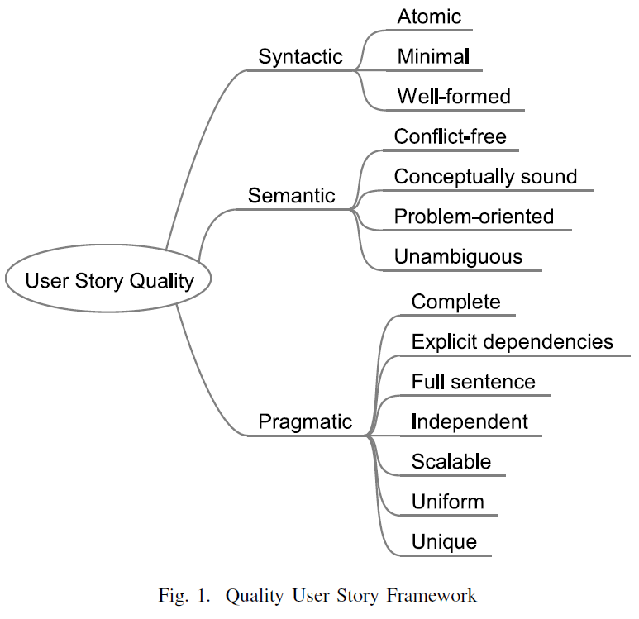
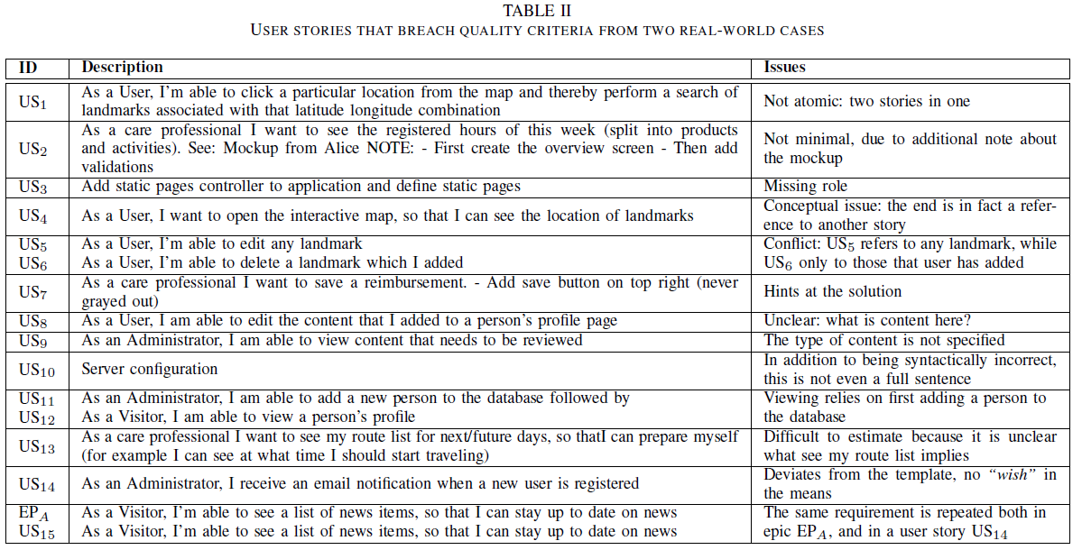
User Stories quality criteria
2015, Garm Lucassen et al., Forging High-Quality User Stories: Towards a Discipline for Agile Requirements

Slide 16
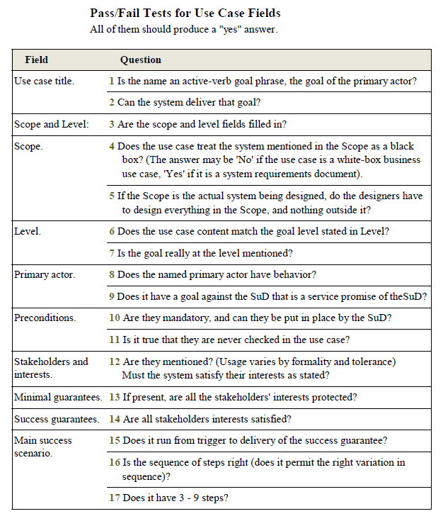
Questionnaire on Use Cases
2000, Alistair Cockburn, Writing Effective Use Cases

Slide 17
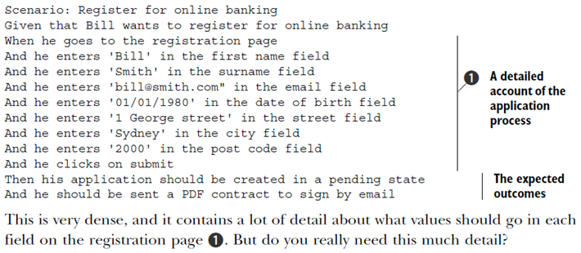
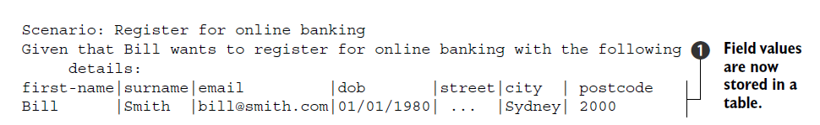
Good/bad examples on BDD
2014, John Ferguson Smart, BDD in Action
Notes:
Porém, BDD só tem exemplos…

Slide 18
Problem
BDD writers only have good/bad examples to rely upon
Specific Problems:
Lack of quality attributes that would be applicable to this format;
Lack of “good” scenario definition;
Incomplete quality review of user stories without the verification of the written details of them;
Learning through experience only.

Slide 19


Slide 20
Research Questions
What is a "good" BDD scenario, in terms of the quality attributes it demonstrates, for a member of a software development team ?
How are the quality attributes used during the evaluation of a single BDD scenario by a member from a software development team ?

Slide 21
Research Objective
Create a new (or adapt an existing one) reading technique that would guide the reader during an inspection process to evaluate the quality of BDD scenarios.
Specific Objectives:
Summarize the existent quality attributes applicable to acceptance tests, on the BDD scenario format;
Summarize the problems that the written form of BDD scenarios may have, according to the experience of its practitioners;
Propose a new reading technique, that would guide the reader during an inspection process, that uses the quality attributes during the evaluation of BDD scenarios
Validate the effectiveness and usefulness of the proposed reading technique with practitioners;
Notes:
Quality attributes applicable to acceptance tests
Problems that the written form of BDD scenarios may have
Reading technique
Validate

Slide 22
Research Plan: Summary
Ad-hoc exploration on quality atributes and BDD scenarios
Reading technique draft based on literature
Inspection technique refinement based on BDD practitioners opinions
Phase 1
Phase 2
Phase 3

Slide 23
Research Plan: detailed phase 1
(A) Literature review on requirements quality
(B) Literature review on inspection reading techniques
(C) Literature review on acceptance tests formats
(D) Empirical study focuses on how novices analyze and validate use cases and BDD scenarios

Slide 24
Research Plan: detailed phase 2
(A) Literature review on requirements quality
(C) Literature review on acceptance tests formats
(D) Empirical study comparing how novices analyze and validate use cases and BDD scenarios
Phase 1
(E) Systematic Literature Review on Acceptance Tests Quality attributes
(F) Reading technique for BDD scenarios proposal
Phase 2

Slide 25
Research Plan: detailed phase 3
(E) Systematic Literature Review on Acceptance Tests Quality attributes
(F) Reading technique for BDD scenarios proposal
Phase 2
(G) Practitioners interviews about missing quality atributes on “bad” handcrafted BDD scenarios and how they evaluate those attributes
(H) Improved reading technique for BDD scenarios
Phase 3
(I) Practitioners interviews to validate the proposed reading technique
(J) Quality inspection for BDD scenarios

Slide 26
Research Timetable

Slide 27
Questions ?
PONTIFICAL CATHOLIC UNIVERSITY OF RIO GRANDE DO SUL
FACULTY OF INFORMATICS
COMPUTER SCIENCE GRADUATE PROGRAM

Slide 28
Research Timetable – short, no animations

Slide 29
Research Timetable – full, no animations

