Slide 1
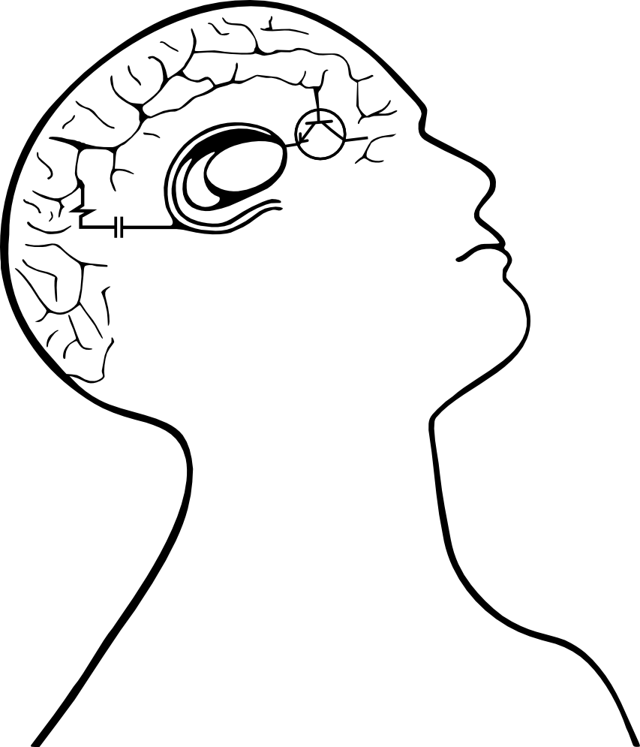

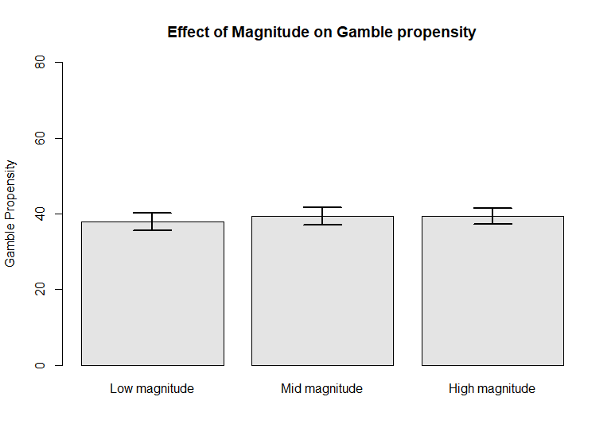
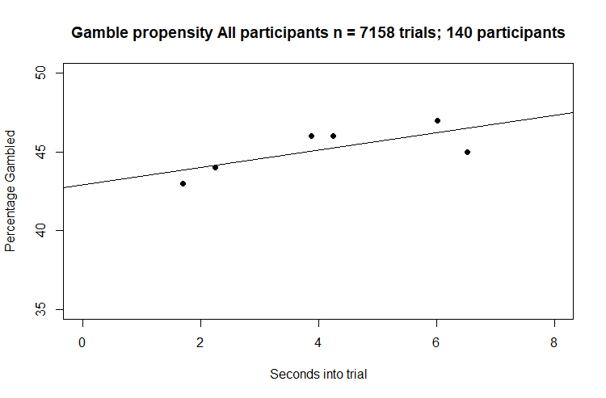
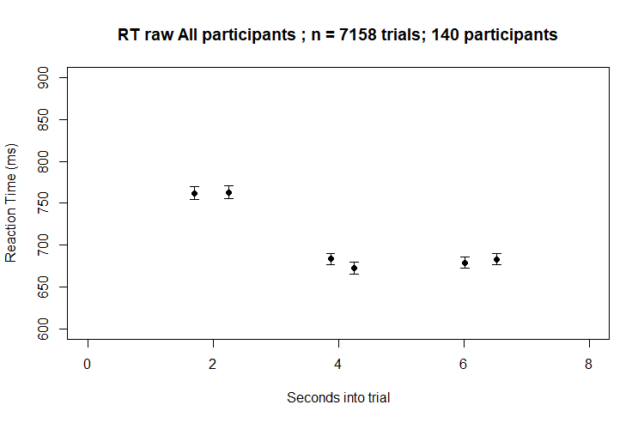
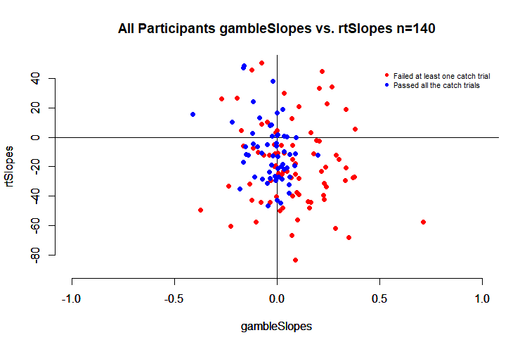
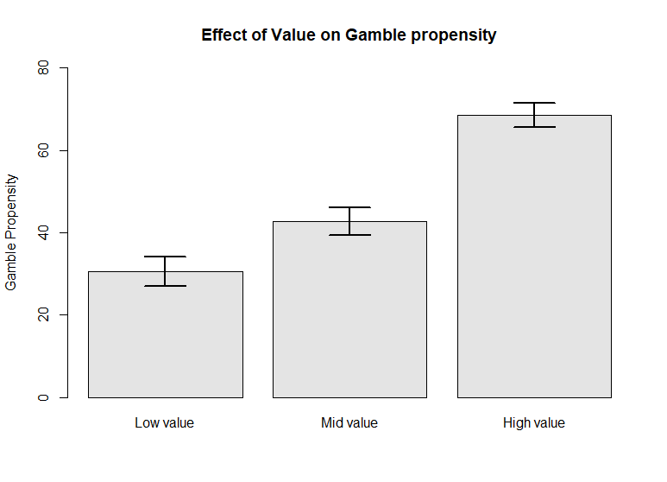
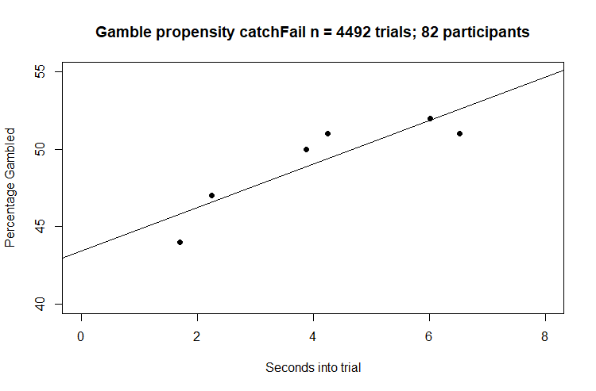
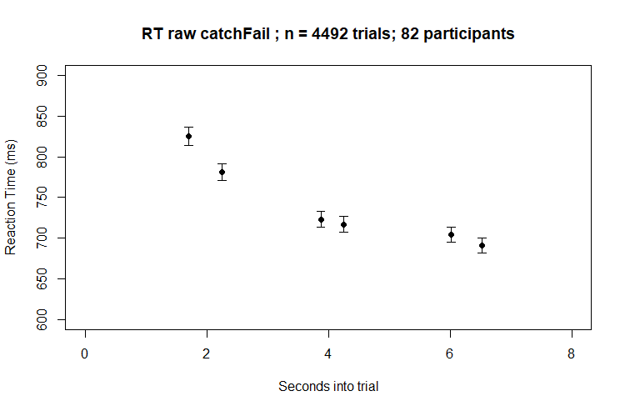
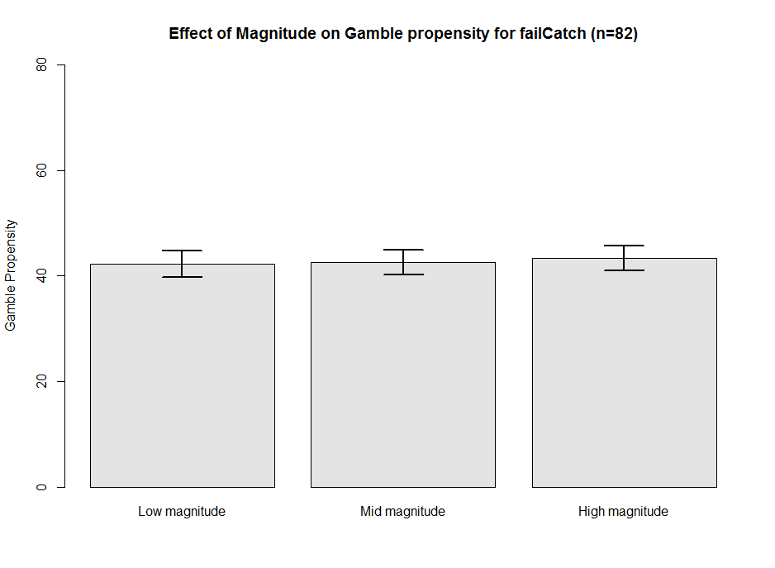
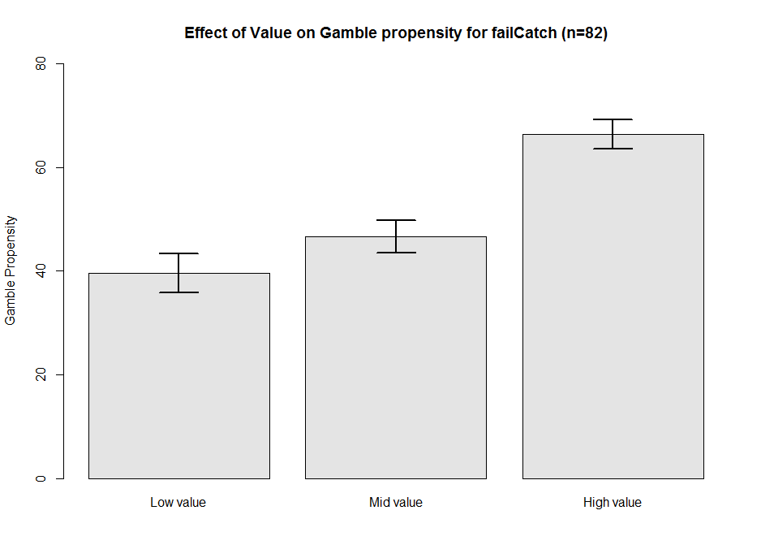
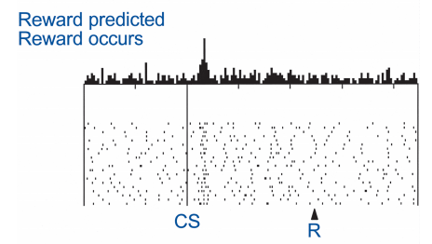
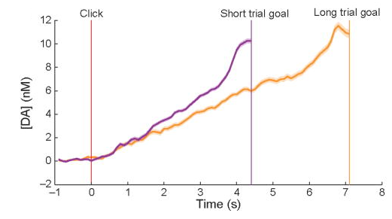
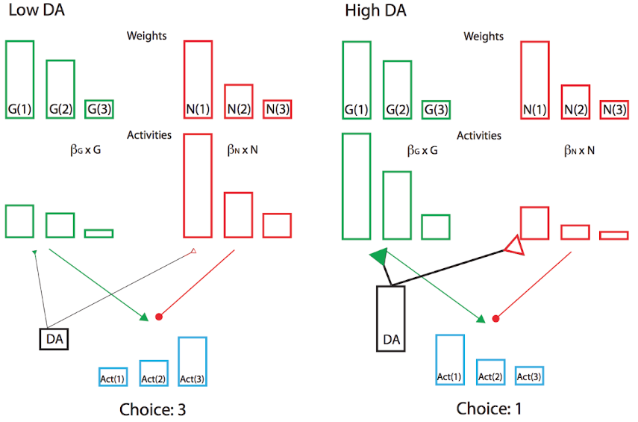
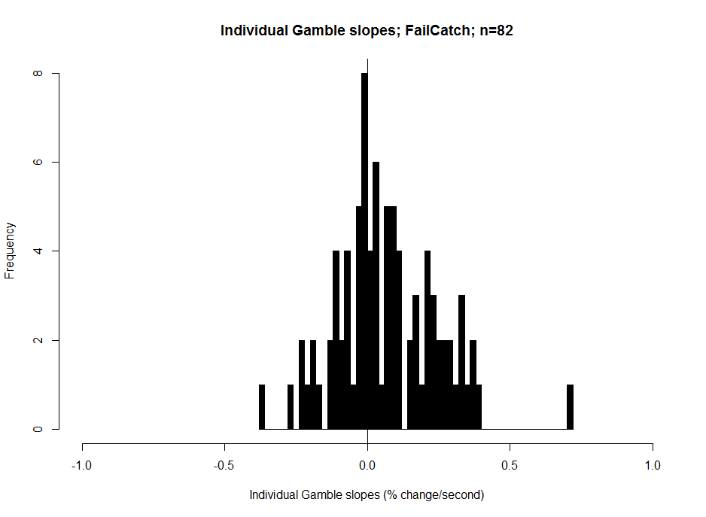
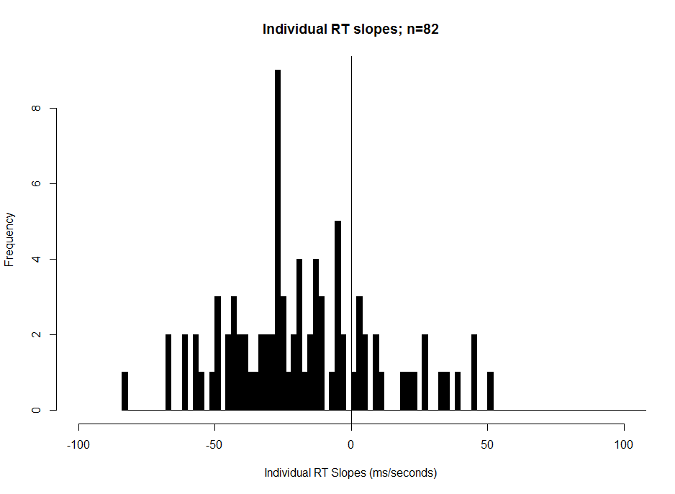
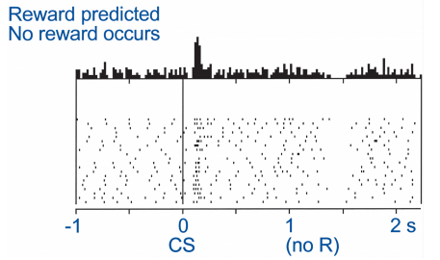
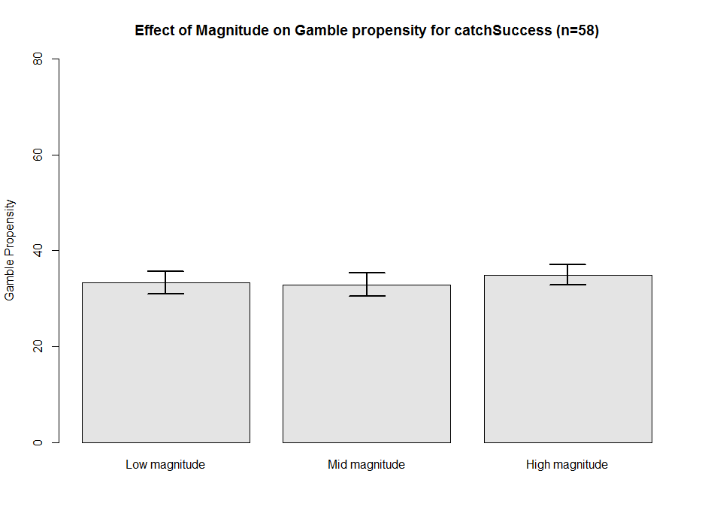
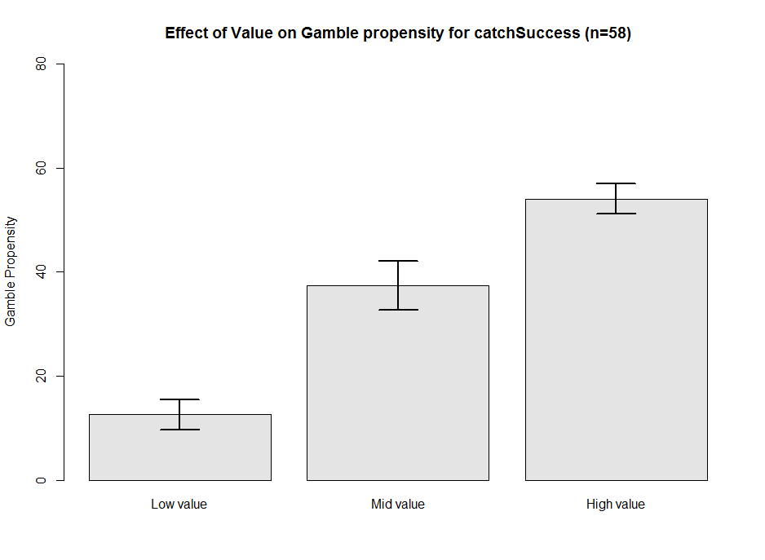
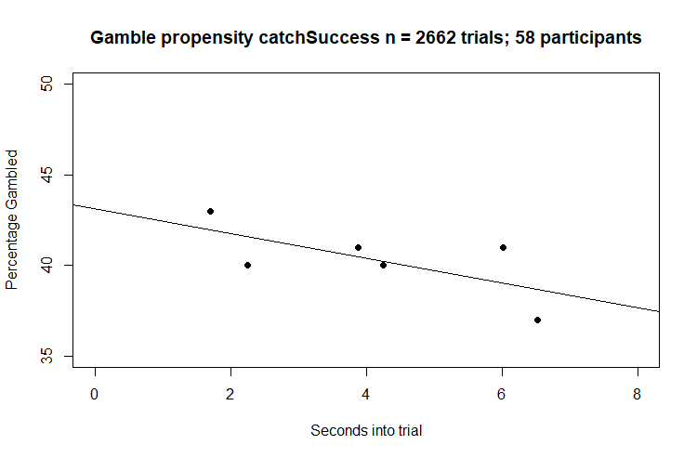
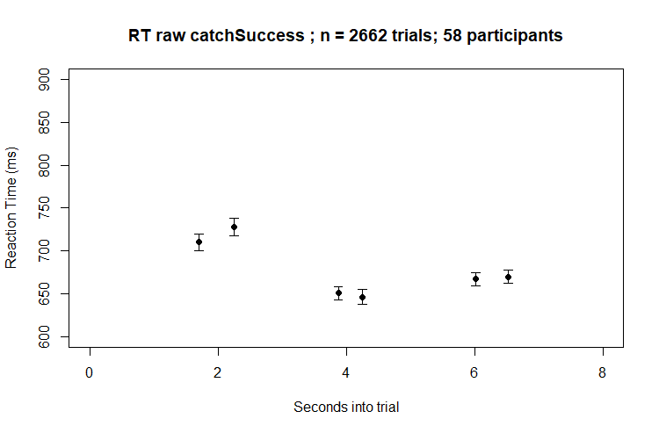
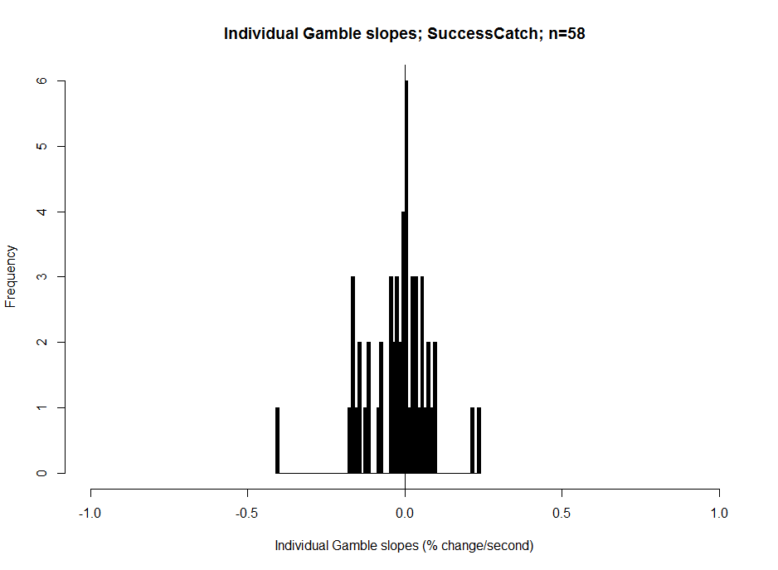
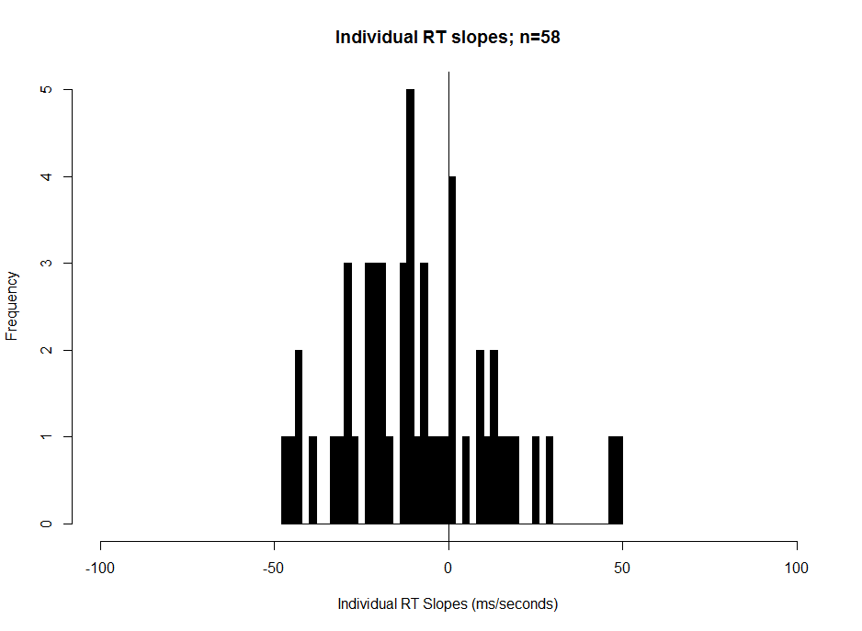
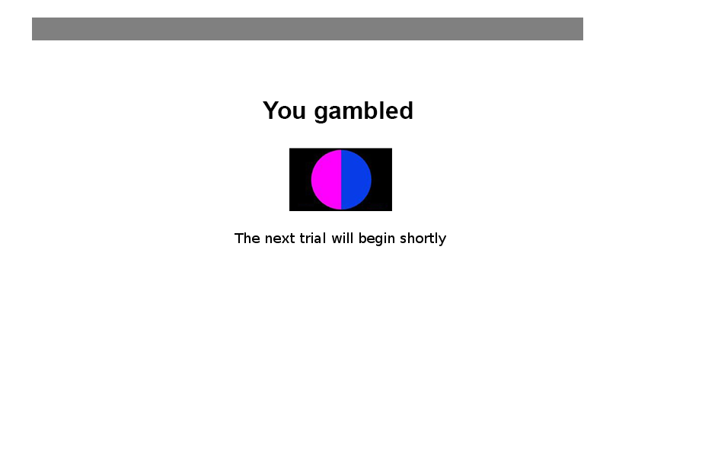
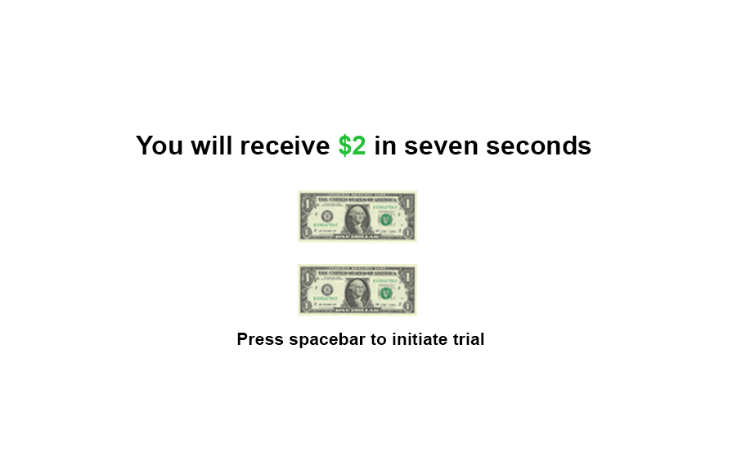
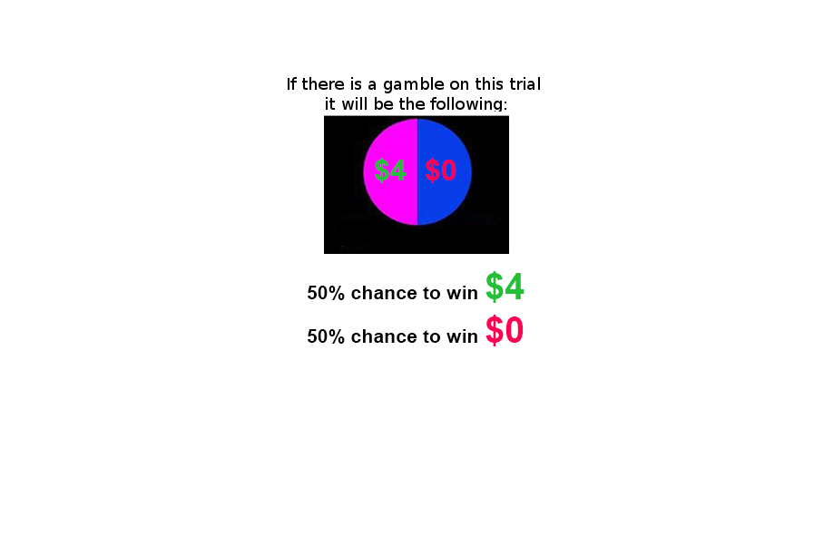

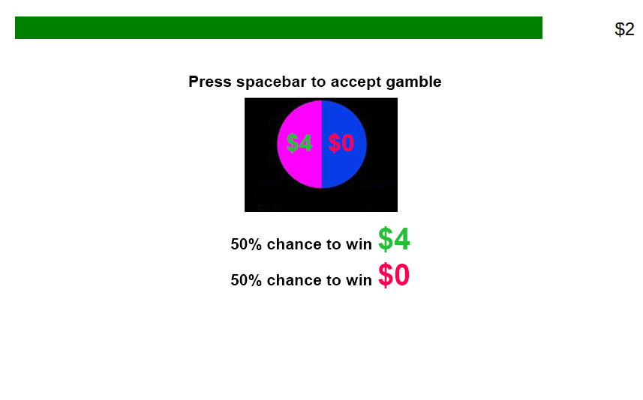
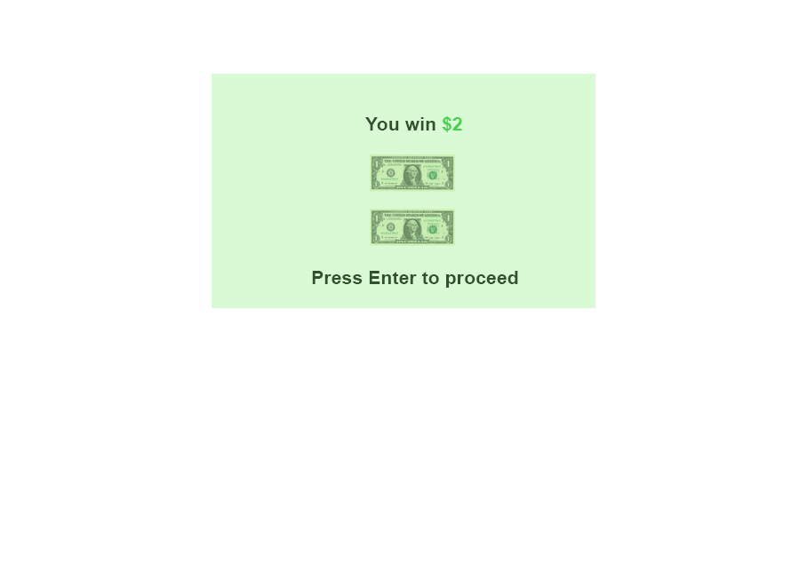
Ramping risk-taking: Progressing value function increases gambling in humans Guillaume J. Pagnier^{1,2}, Andrew Westbrook² & Michael J. Frank^{1,2} ¹Department of Neuroscience, Brown University ²Department of Cognitive, Linguistic and Psychological Sciences, Brown University
Background
Results
Phasic dopamine (DA) spikes in the striatum occur when agents experience an unexpected reward. These fast DA spikes, called Reward Prediction Errors, (RPEs) are instrumental in learning how to maximize reward (Fig 1A).
Aside from providing phasic RPEs that drive learning, DA may also organize motivated behavior at the time of action selection. Striatal DA may generally promote vigor in responding (Niv et al., 2007), and/or affect an agent’s instantaneous willingness to work for reward (Hamid et al., 2016).
Recent work has shown that striatal DA ramps as animals progress through a series of states towards an anticipated reward. The magnitude of this dopaminergic ramp is independent of the overall number of states (Fig. 1B).
Dopamine agonists have been shown to increase gambling propensity in humans (Rigoli et al., 2016). More generally, increasing striatal DA tone is hypothesized to bias the expression of the benefits of actions relative to their costs (value) (Fig 1C). Thus, we hypothesize that agents will become increasingly sensitive to benefits versus costs as they approach an anticipated reward.
To test the hypothesis that humans’ value calculations should change as a function of proximity to reward, we offered risky gambles to test the specific prediction that human participants will become increasingly likely to gamble as gambles are offered closer in time to an anticipated reward.
All participants (n=140)
Participants who failed at least one catch trial (n=82)
A
B
C
Participants who passed all the catch trials (n=58)
Adapted from Schultz, W. (2001). Book review: Reward signaling by dopamine neurons. The Neuroscientist, 7(4), 293-302
Adapted from Fig. 2e Howe, M. W., Tierney, P. L., Sandberg, S. G., Phillips, P. E., & Graybiel, A. M. (2013). Prolonged dopamine signalling in striatum signals proximity and value of distant rewards. Nature, 500(7464), 575.
Adapted from Fig. 1B Collins, A. G., & Frank, M. J. (2014). Opponent actor learning (OpAL): Modeling interactive effects of striatal dopamine on reinforcement learning and choice incentive. Psychological review, 121(3), 337.
Question
As the distance to a reward decreases does a participant’s propensity to gamble (via an adjusting value function) change?
Methods
Conclusions
The later the gamble interrupted the progress bar (i.e. the closer the participant was to the reward), the more likely a participant gambled and the lower their RT tended to be.
These effects were specifically robust to participants who failed at least one catch trial. In fact, participants who passed all catch trials tended to exhibit a negative relationship between gambling propensity and interruption time. These data are indicative of a possible link between impulsivity and dopaminergic release (Buckholtz et al., 2010).
Magnitude had no effect on driving the propensity to gamble but a higher value gamble increased a participant’s propensity to gamble. This effect was strongest in individuals who passed all catch trials.
Future versions will investigate the effect of the progress bar pausing, an instrumental choice being made at the time of the gamble, and removing the gamble preview.
These pilot data are consistent with the theory that DA dynamics affect how humans calculate the value of an acion and that the value of such a calculation may shift as a promixity to a reward.
Magnitude
Value
Subjects
207 Participants were recruited via Amazon’s mechanical turk; (127 male; 76 female; 4 declined to answer) and were between the age of 18-40.
Participants underwent 133 trials (~45 minutes) and were given $3 base pay plus whatever they won on a chosen trial (0$ - $4 bonus).
There was the option to gamble on 86.39 % of trials.
Each trial had a value attribute (low/mid/high) and a magnitude attribute (low/mid/high).
Low
Guaranteed amount = $1 or $2 | Gamble = 1.5 x guaranteed amount
Guaranteed amount = $3 or $4 | Gamble = 2 x guaranteed amount
Guaranteed amount = $5 or $6 | Gamble = 3 x guaranteed amount
Mid
High
References:
Schultz, W. (2001). Book review: Reward signaling by dopamine neurons. The Neuroscientist, 7(4), 293-302
Niv, Y., Daw, N. D., Joel, D., & Dayan, P. (2007). Tonic dopamine: opportunity costs and the control of response vigor. Psychopharmacology, 191(3), 507-520.
Hamid, A. A., Pettibone, J. R., Mabrouk, O. S., Hetrick, V. L., Schmidt, R., Vander Weele, C. M., ... & Berke, J. D. (2016). Mesolimbic dopamine signals the value of work. Nature neuroscience, 19(1), 117.
Collins, A. G., & Frank, M. J. (2014). Opponent actor learning (OpAL): Modeling interactive effects of striatal dopamine on reinforcement learning and choice incentive. Psychological review, 121(3), 337.
Howe, M. W., Tierney, P. L., Sandberg, S. G., Phillips, P. E., & Graybiel, A. M. (2013). Prolonged dopamine signalling in striatum signals proximity and value of distant rewards. Nature, 500(7464), 575.
Buckholtz, J. W., Treadway, M. T., Cowan, R. L., Woodward, N. D., Li, R., Ansari, M. S., ... & Kessler, R. M. (2010). Dopaminergic network differences in human impulsivity. Science, 329(5991), 532-532.
Catch Trials
6 catch trials were included in the task design.
In 3 catch trials, the reward of the gamble matched the sure amount (offering no incentive to gamble).
In the other 3 catch trials, the possible loss of the gamble matched the sure amount (offering no incentive to accept the sure thing).

