Slide 1
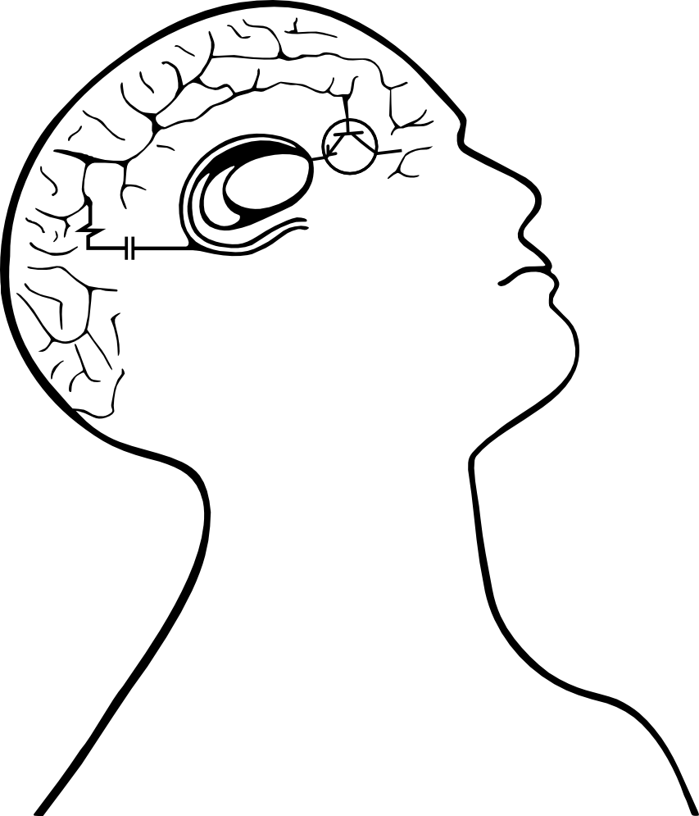


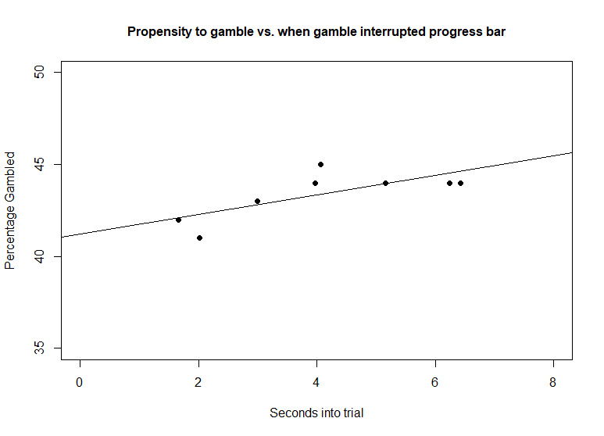
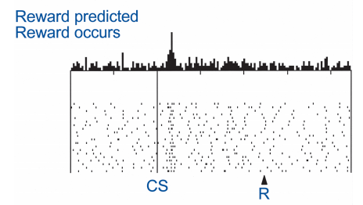
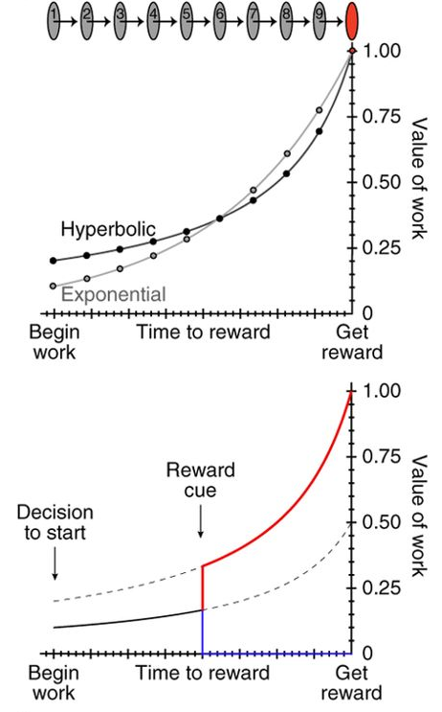
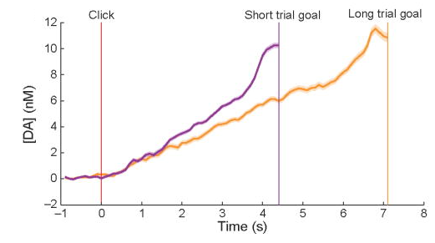
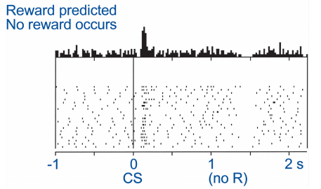
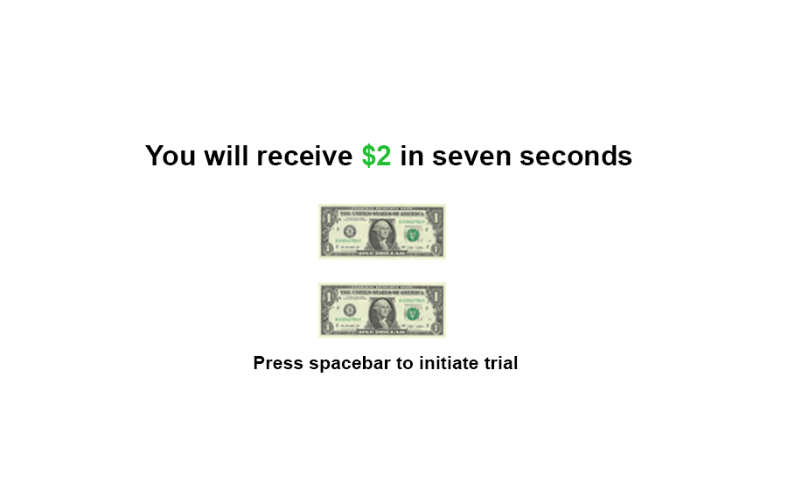
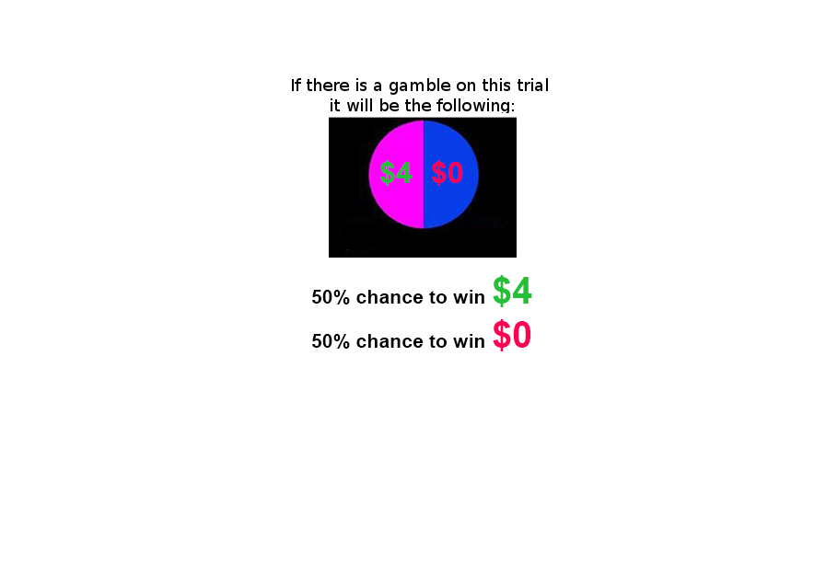

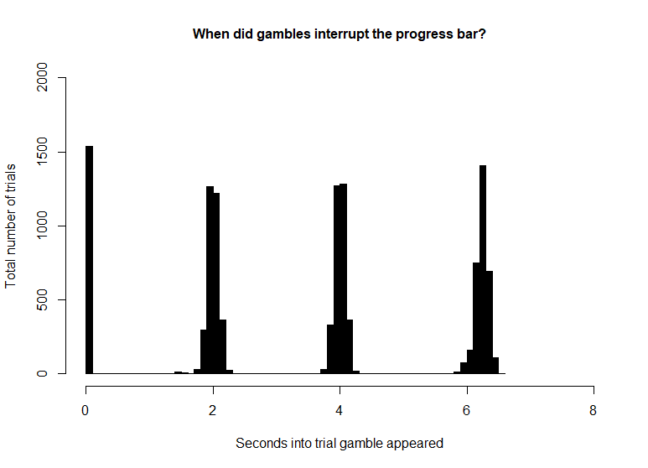
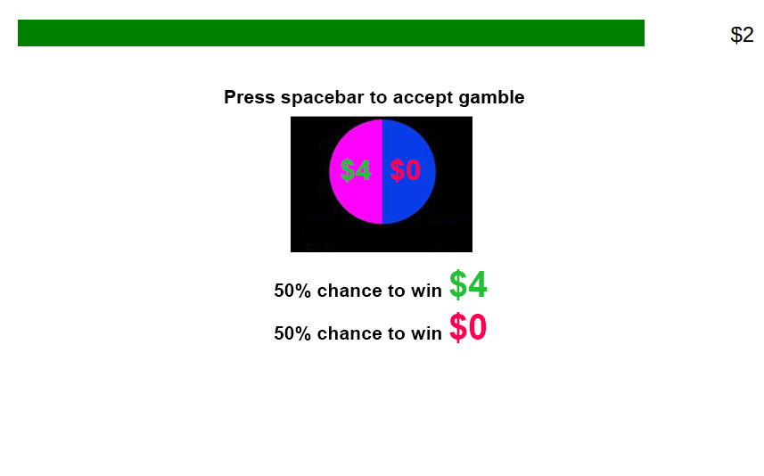
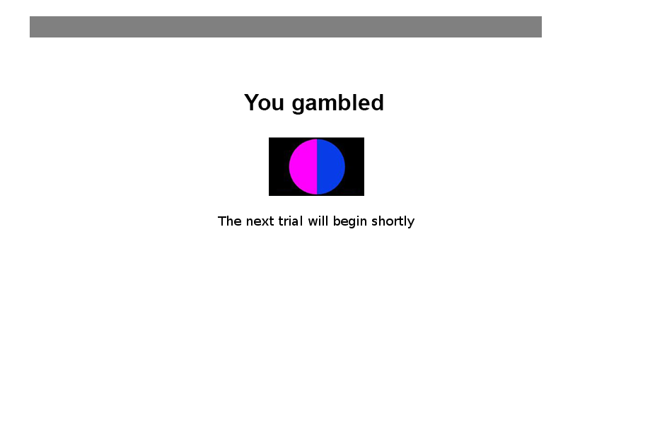

Ramping risk-taking: Progressing value function increases gambling in humans Guillaume J. Pagnier^{1,2}, Andrew Westbrook² & Michael J. Frank^{1,2} ¹Department of Neuroscience, Brown University ²Department of Cognitive, Linguistic and Psychological Sciences, Brown University
Background
Results
Phasic dopamine (DA) spikes in the striatum occur when participants experience reward, effectively reinforcing rewarding actions. This DA spike is called a positive Reward Prediction Error (RPE). Phasic RPEs are key to learning, evidenced in rodents and in humans (Fig 1A).
Seperately from providing RPEs, DA also encodes motivation and vigor. Slowly changing levels of striatal DA (tonic) corresponds to opportunity cost.
Hamid et al., 2015 unified the concepts of tonic (motivation) and phasic (learning) DA, showing that dynamically evolving levels of striatal DA signal cost/benefit (a value signal) in rodents (Fig 1B).
Extending this idea of DA’s purpose, other work has been done showing that pharmacologically manipulating DA affects humans’ cost/benefit risky decision making.
There is also evidence that rodents experience striatal DA ramping as they approach a reward. This striatal DA ramp scales to the distance to the reward (Fig. 1C).
If humans and rodents striatal DA dynamics are similar, than humans’ cost/benefit calculations should change as a function of proximity to reward.
A
B
C
A
B
C
v
Decision threshold
Adapted from Hamid, A. A., Pettibone, J. R., Mabrouk, O. S., Hetrick, V. L., Schmidt, R., Vander Weele, C. M., ... & Berke
, J. D. (2016). Mesolimbic dopamine signals the value of work. Nature neuroscience, 19(1), 117.
Question
Fig. Effect of medication on model parameters and posterior predicitive checks. A. Error bars represent 95% highest density intervals (HDI). B. Density plots are posterior distributions of medication response x session interaction effects, and horizontal bars show the 95% HDI. C. Quantile probability plot and density plot for observed and predicted accuracy and response time across conditions.
As the distance to a reward decreases does a participant’s propensity to gamble (via an adjusting value function) change?
Conclusions and future directions
Methods
Computational modeling identified improved performance for responders compared to non-responders after 6 weeks of medication treatment. Specifically, responders showed increased rate of evidence accumulation and extended decision thresholds compared to non-responders. The results show promise for using individual model parameters in combination with clinical assessment measures and demographic variables for earlier prediction of medication response in ADHD. Future directions are to use measures for classification of medication response with machine learning-algorithms.
Task
Subjects
207 Participants were recruited via Amazon’s mechanical turk; (127 male; 76 female; 4 declined to answer) and were between the age of 18-40.
Participants underwent 133 trials (~45 minutes) and were given $3 base pay plus whatever they won on a chosen trial (0$ - $4 extra).
There was the option to gamble on 86.39 % of trials.
Trials were broken down into low/mid/high value and low/mid/high mag
References:
Retz, W., & Retz-Junginger, P. (2014). Prediction of methylphenidate treatment outcome in adults with attention-deficit/hyperactivity disorder (ADHD). European Archives of Psychiatry and Clinical Neuroscience, 264(S1), 35–43
Wiecki, T. V., Poland, J., & Frank, M. J. (2015). Model-Based Cognitive Neuroscience Approaches to Computational Psychiatry: Clustering and Classification. Clinical Psychological Science, 3(3), 378–399.
Ratcliff, R., Huang-Pollock, C. L., & McKoon, G. (2016). Modeling Individual Differences in the Go/No-Go Task With a Diffusion Model. Decision, 1–22.
Fredriksen, M., Dahl, A. A., Martinsen, E. W., Klungsøyr, O., Haavik, J., & Peleikis, D. E. (2014). Effectiveness of one-year pharmacological treatment of adult attention-deficit/ hyperactivity disorder (ADHD): An open-label prospective study of time in treatment, dose, side-effects and comorbidity. European Neuropsychopharmacology, 24(12), 1873–1884.

