Slide 1
Ramping V03
88 useable participants

Slide 2
Facts about V03
8 second progress bar
Gamble is previewed for 3 seconds before each trial
Gamble is offered for a 1200 ms window sometime during the progress bar (up from 1000 ms)
About 133 trials per participant (before was about 100)
Progress bar does NOT pause during gamble

Slide 3
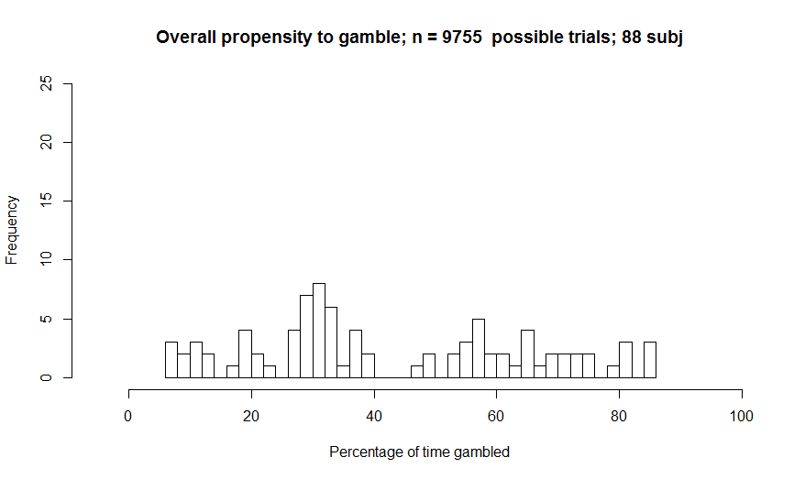
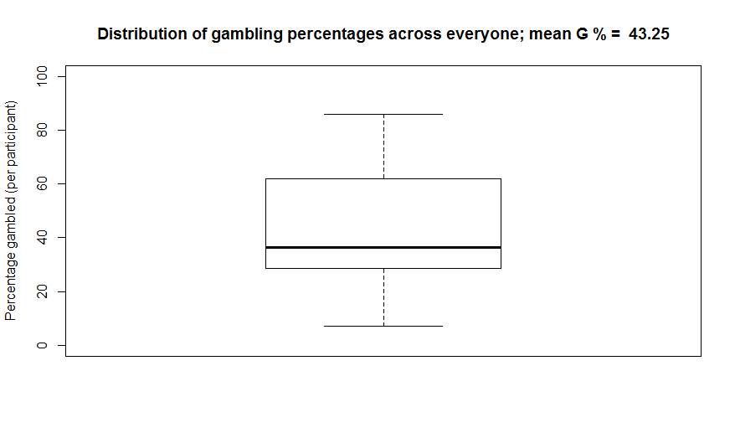
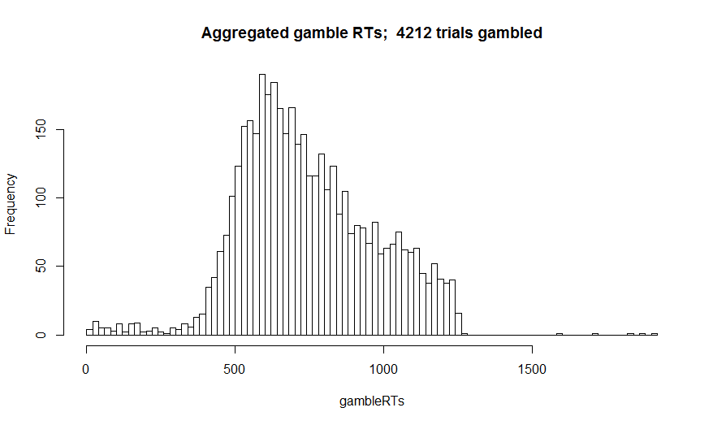
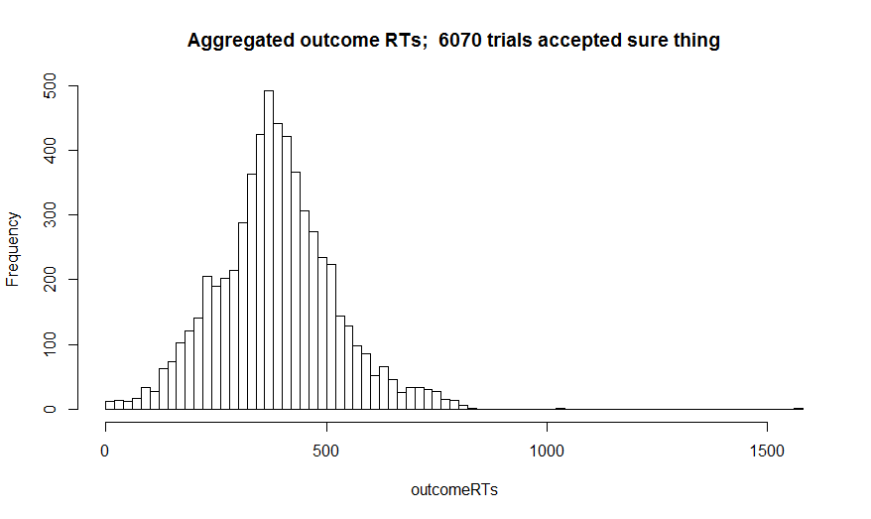
First order characteristics of entire data set

Slide 4
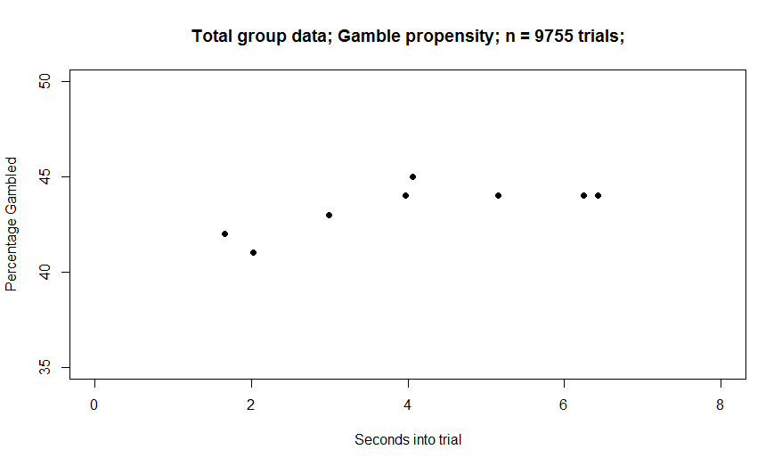
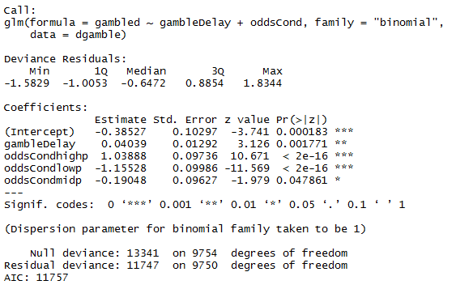
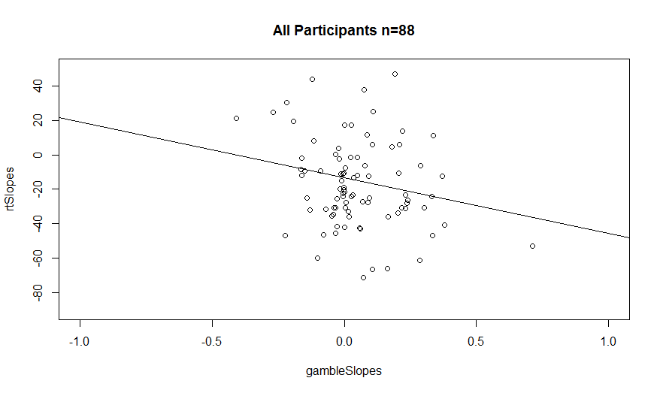
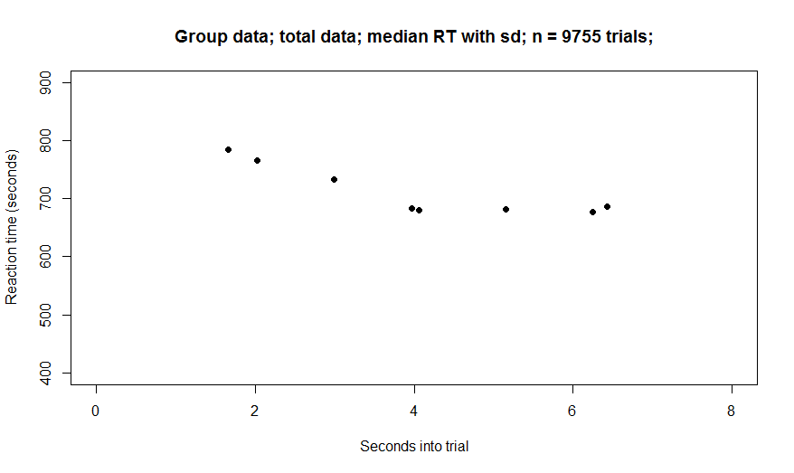
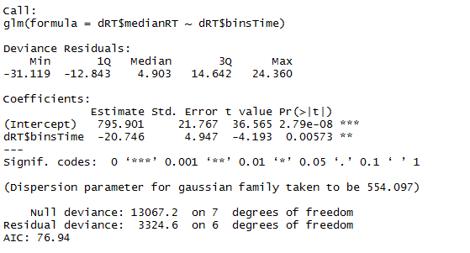
All data
Gamble vs RT slopes
Note: t test of gamble slopes
shows sig. different than 0 (p<.01).
The relationship between gamble slopes
And rtSlopes doesn’t seem to be sig though

Slide 5
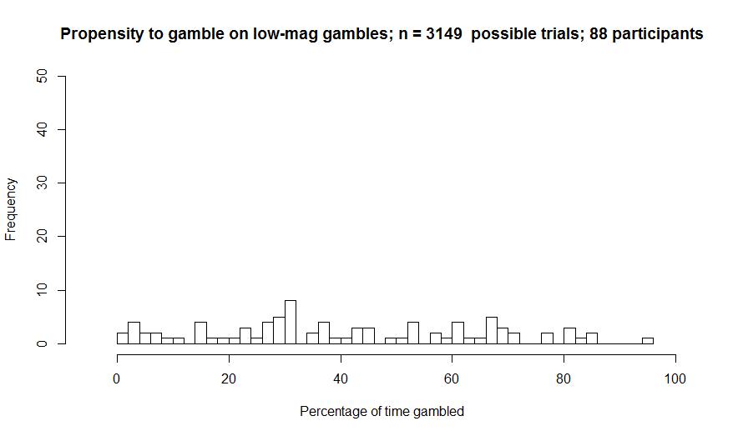
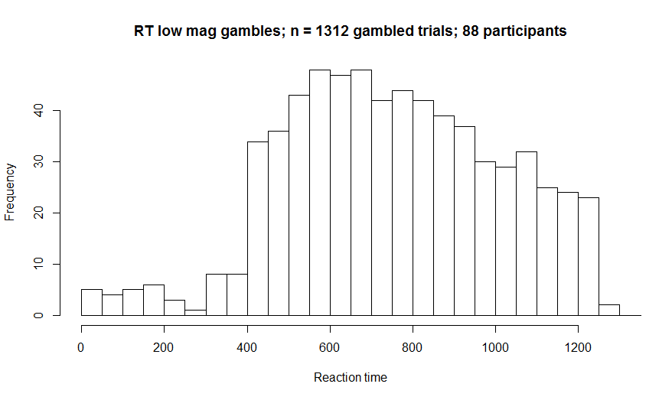
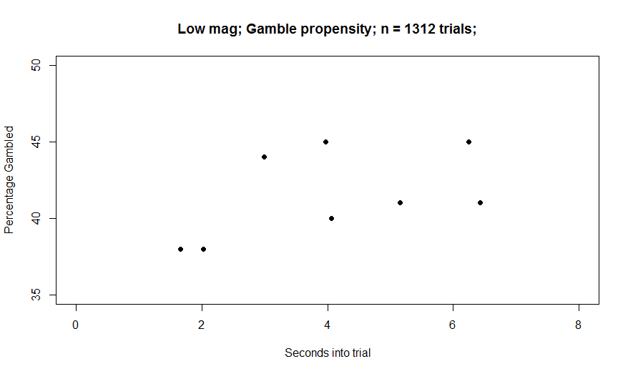
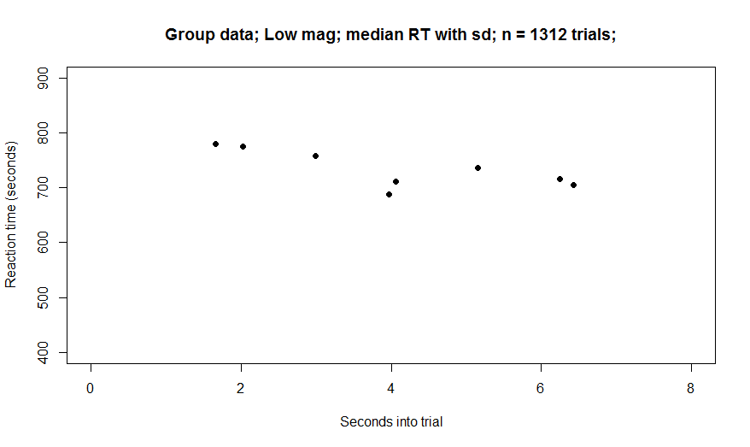
Low Mag

Slide 6
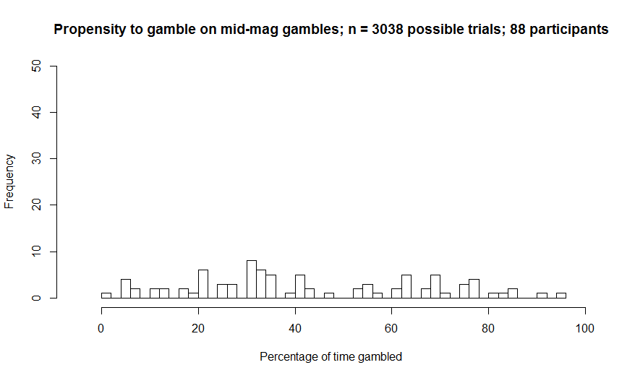
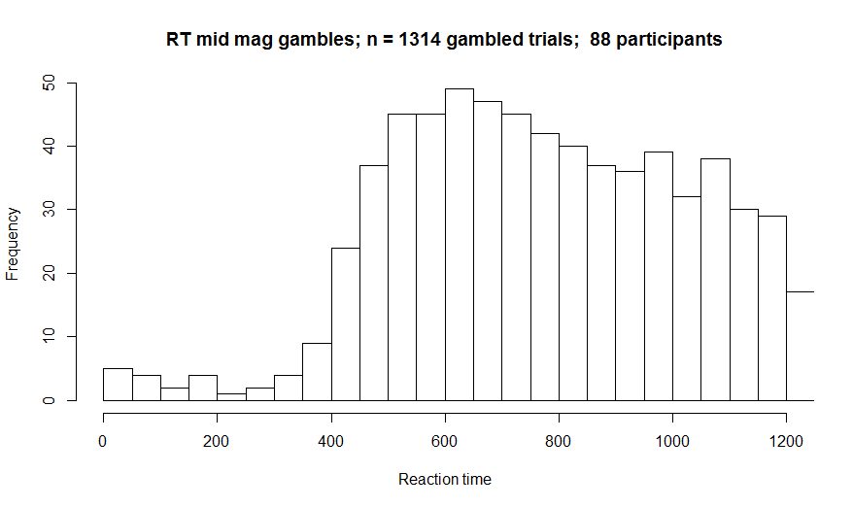
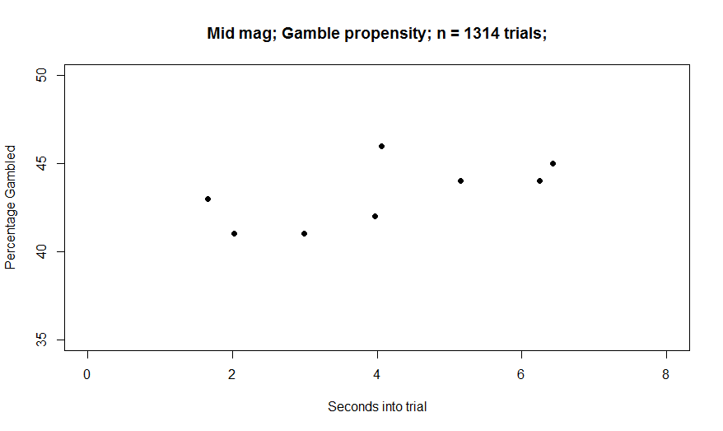
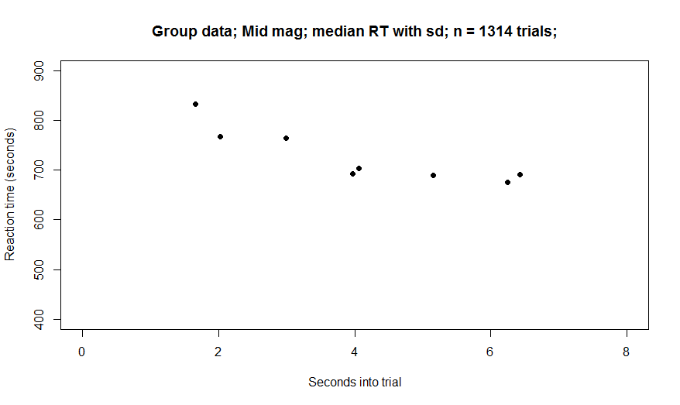
Mid Mag

Slide 7
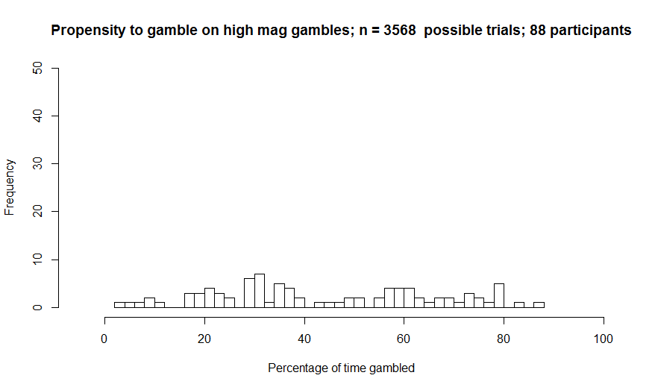
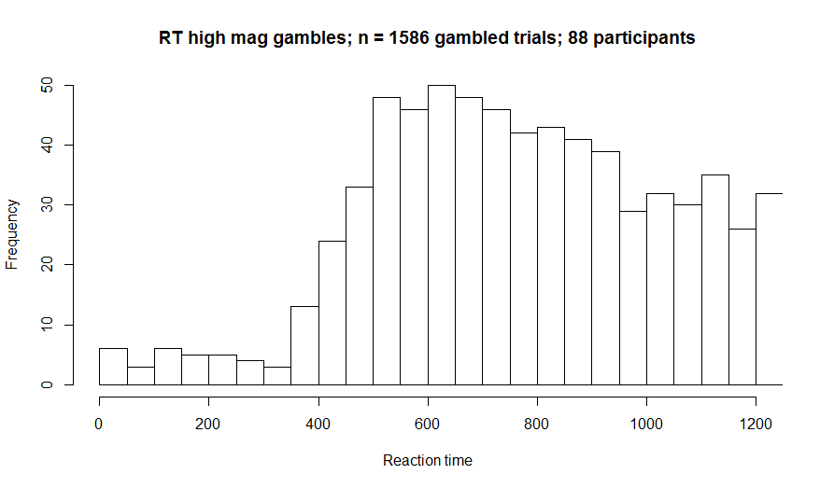
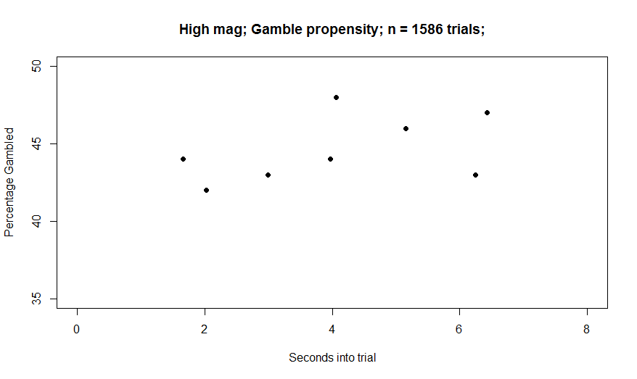

High Mag

Slide 8
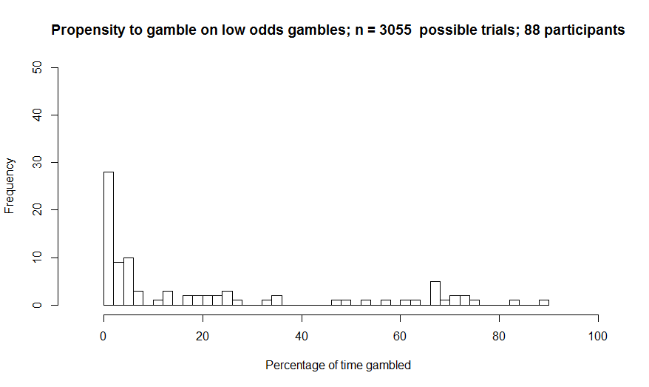
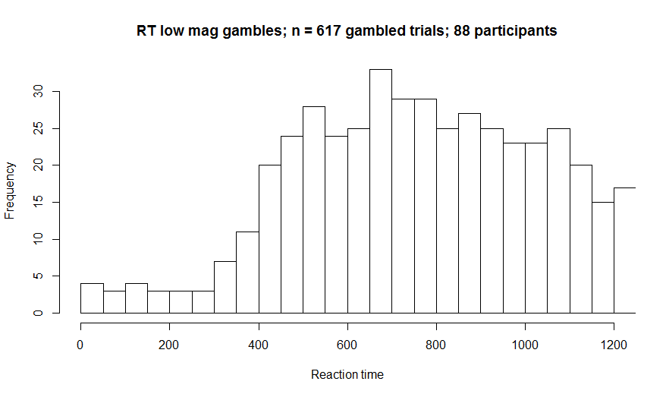
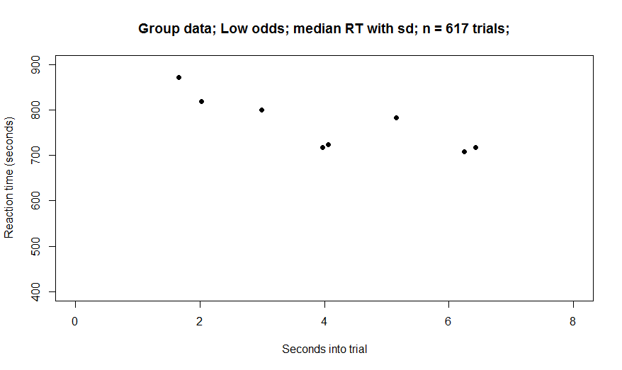
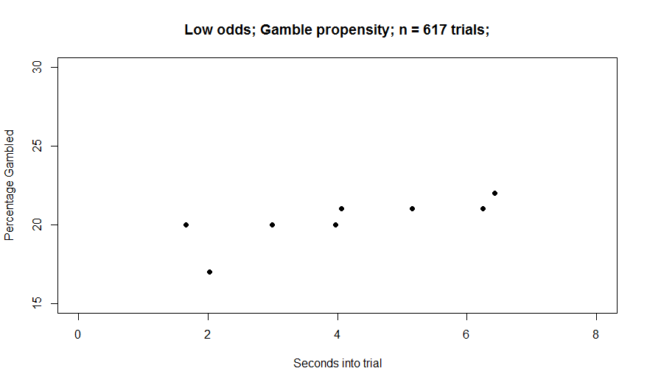
Low value (previously called odds)

Slide 9
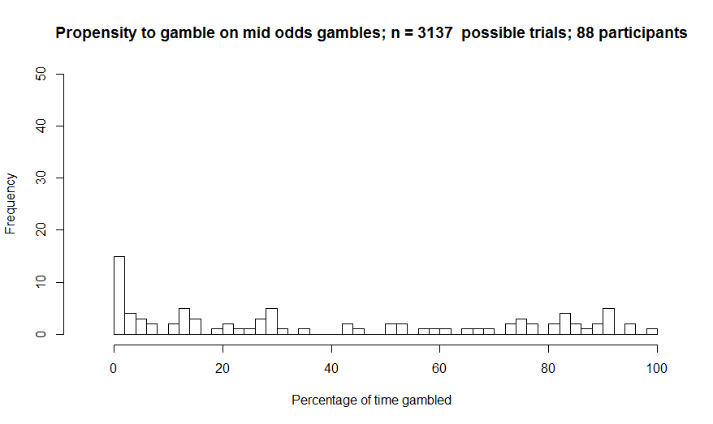
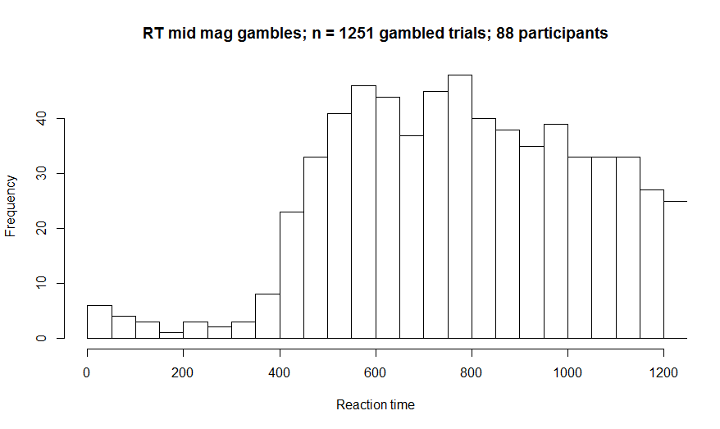
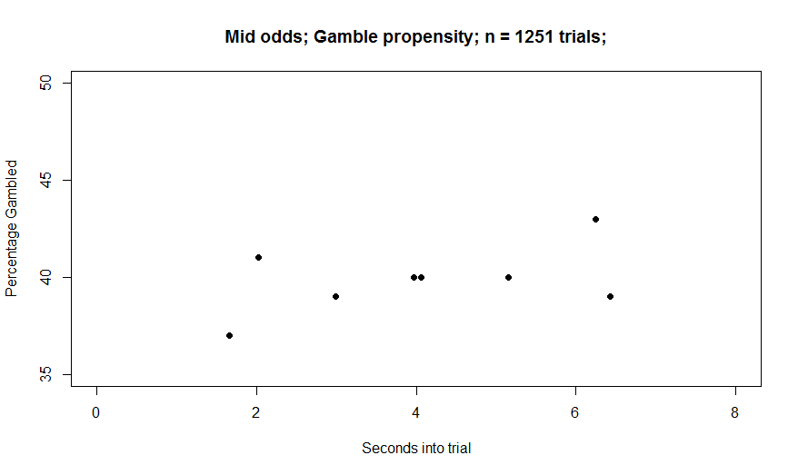
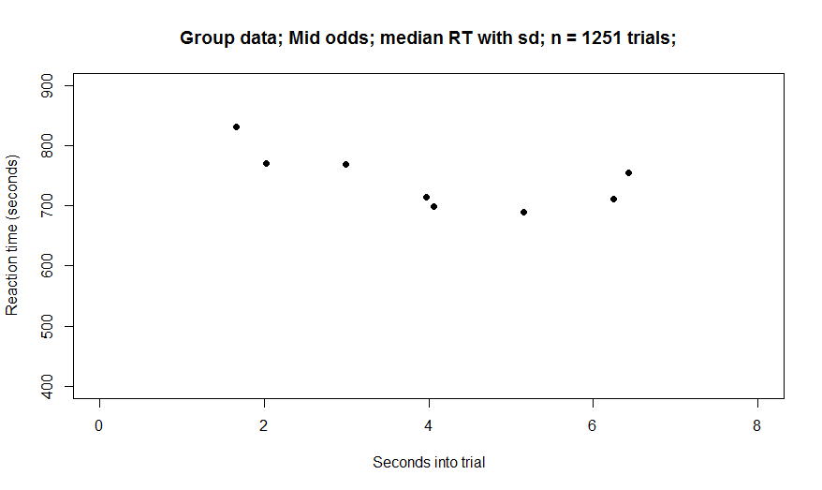
Mid value (odds)

Slide 10
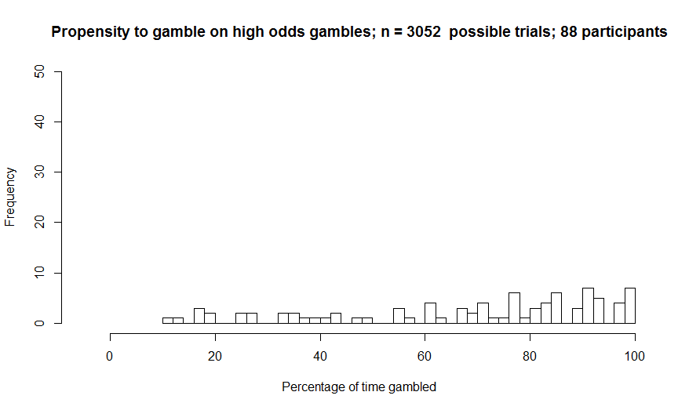
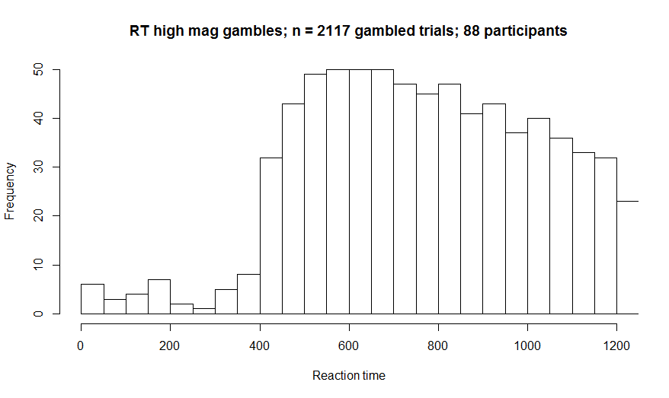
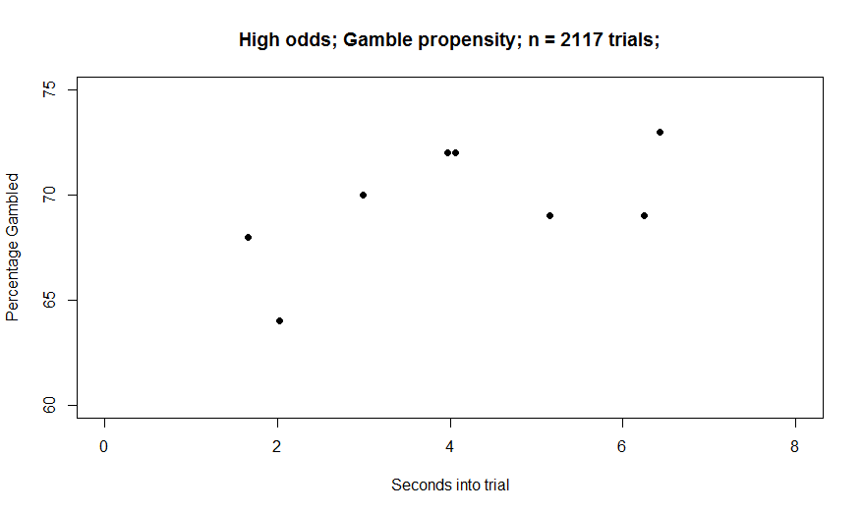
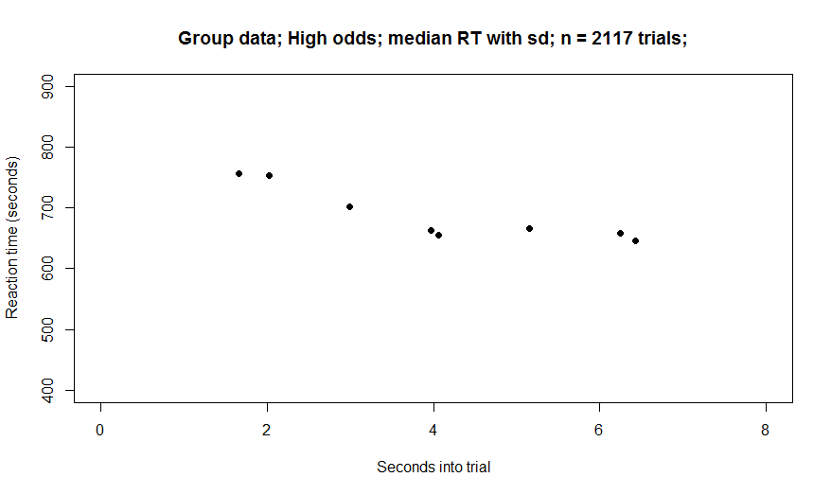
High odds

Slide 11
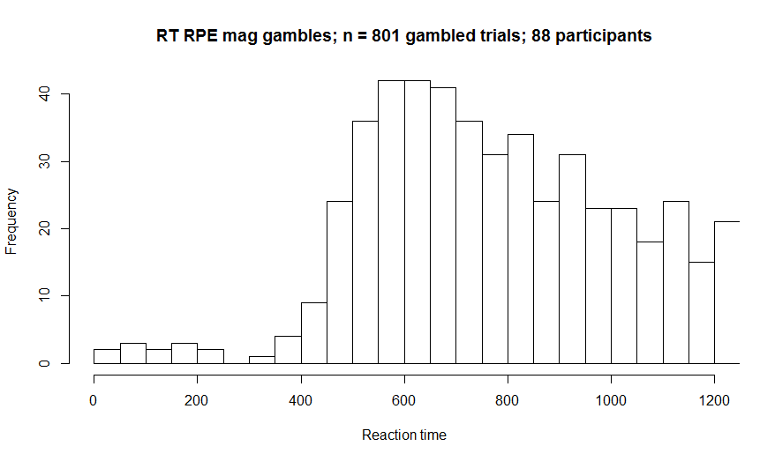
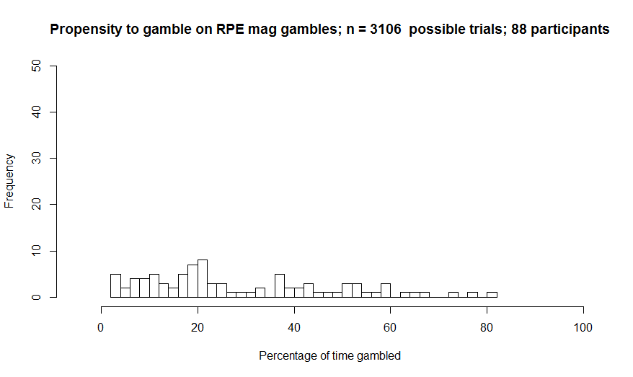
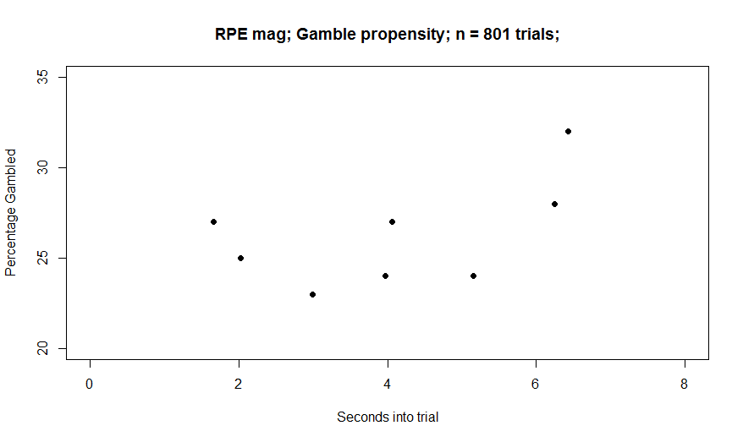
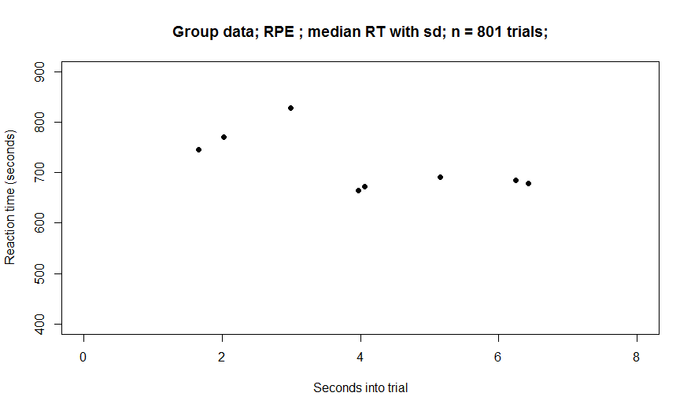
High RPE trials only

Slide 12
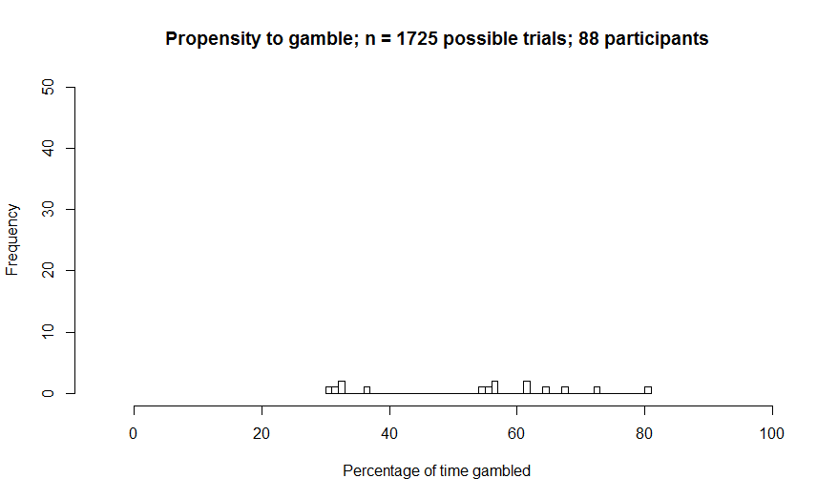
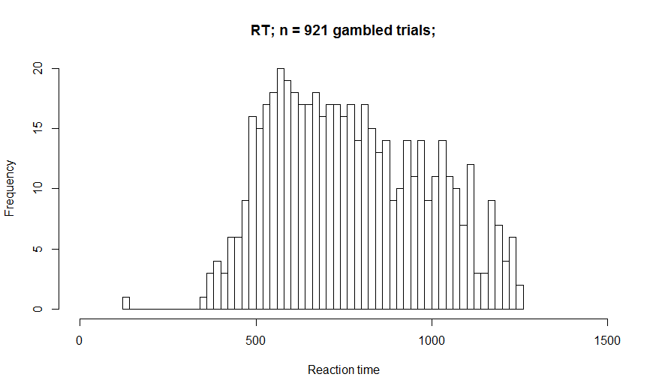

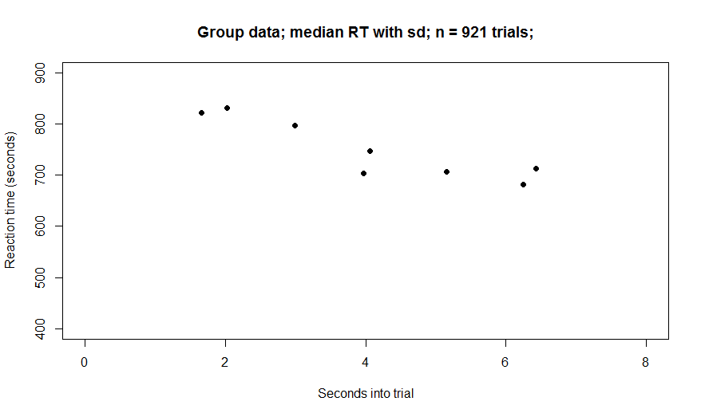
Participants who showed downwards decreasing RT slope (n= 15)

Slide 13
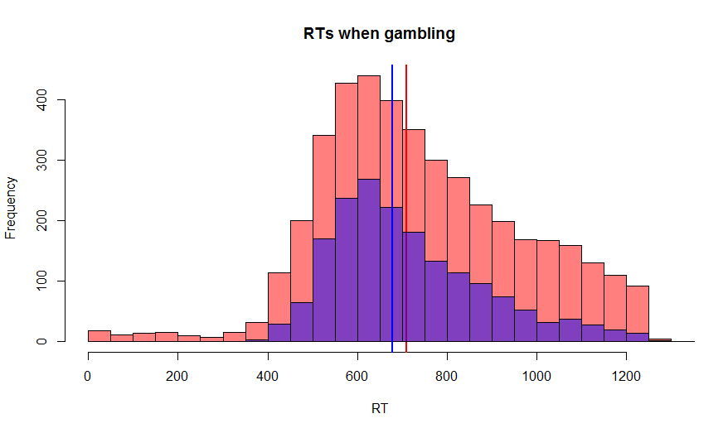
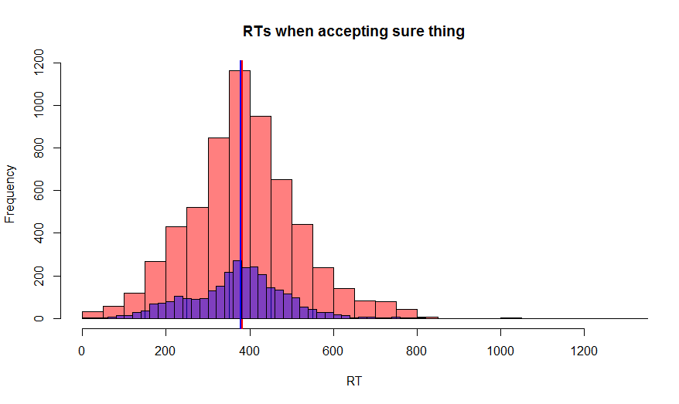
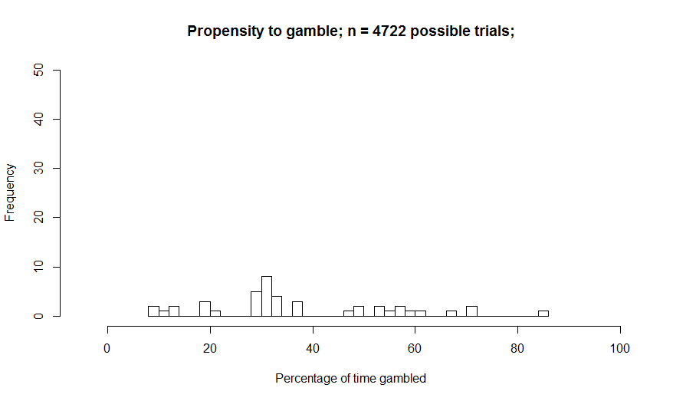
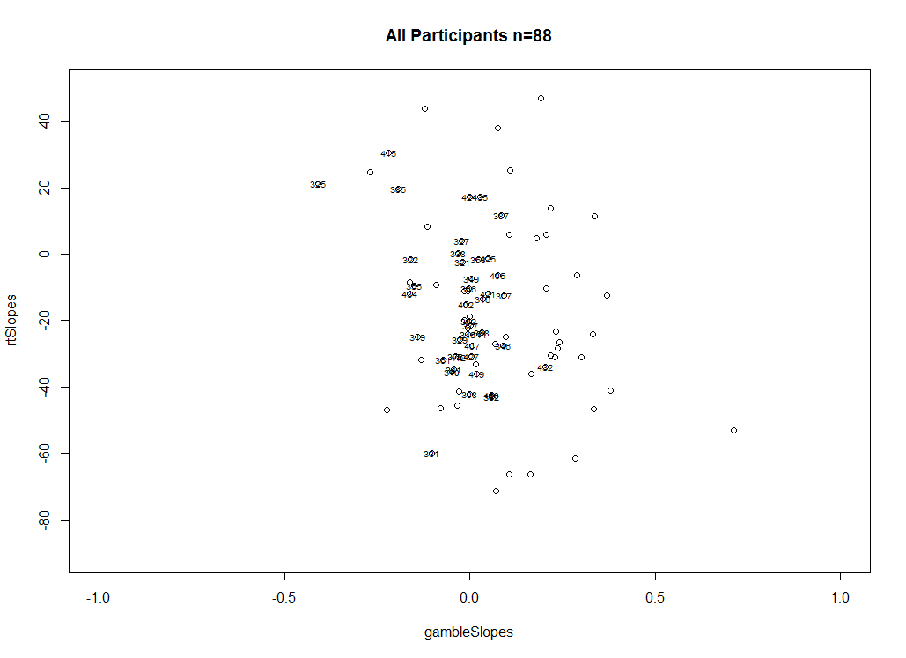
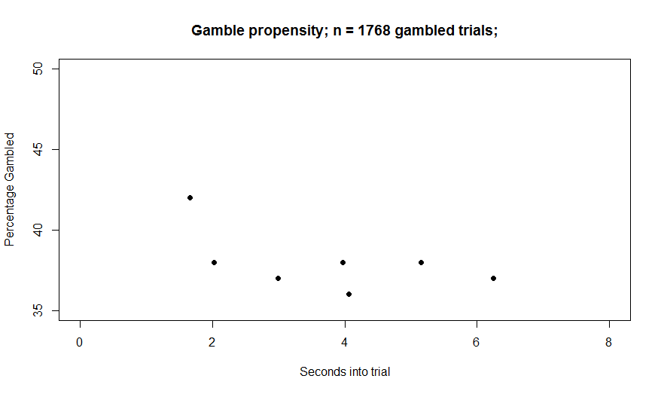

Participants who passed all the catch trials (n=64)
Blue = subgroup; red= all participants

Slide 14
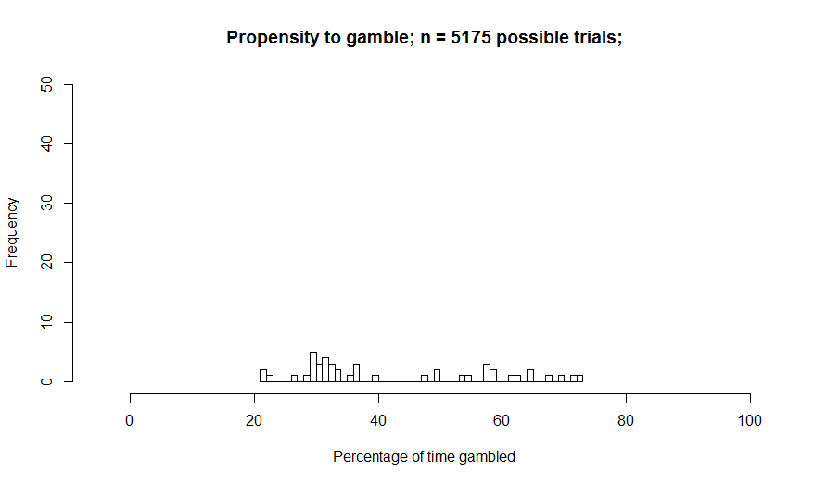
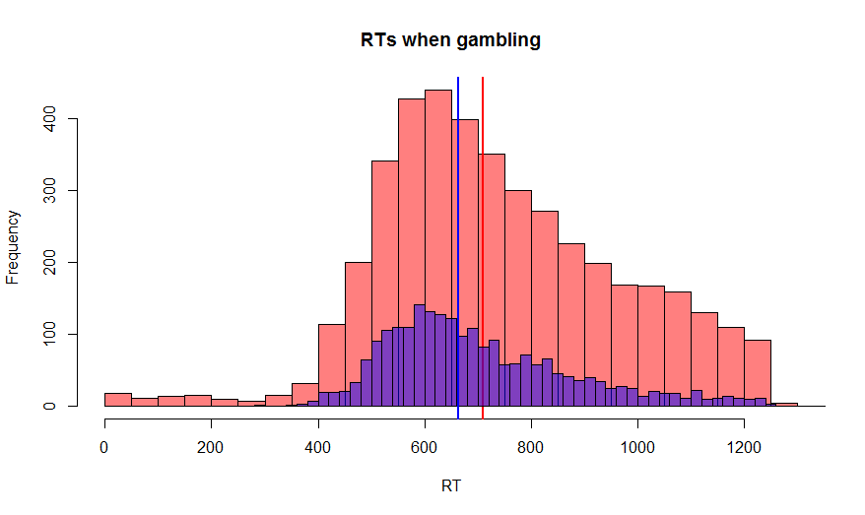
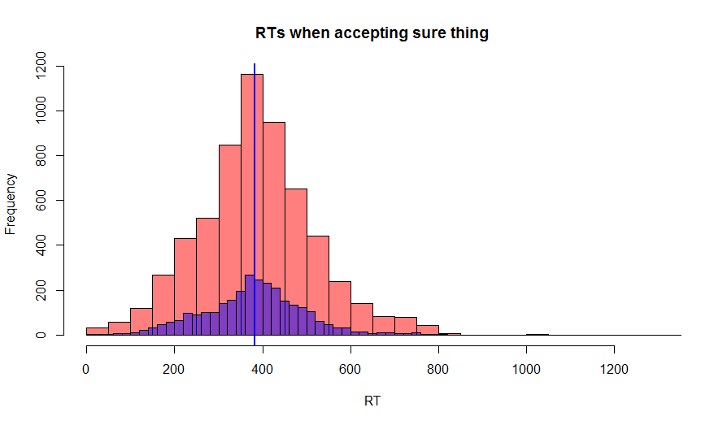
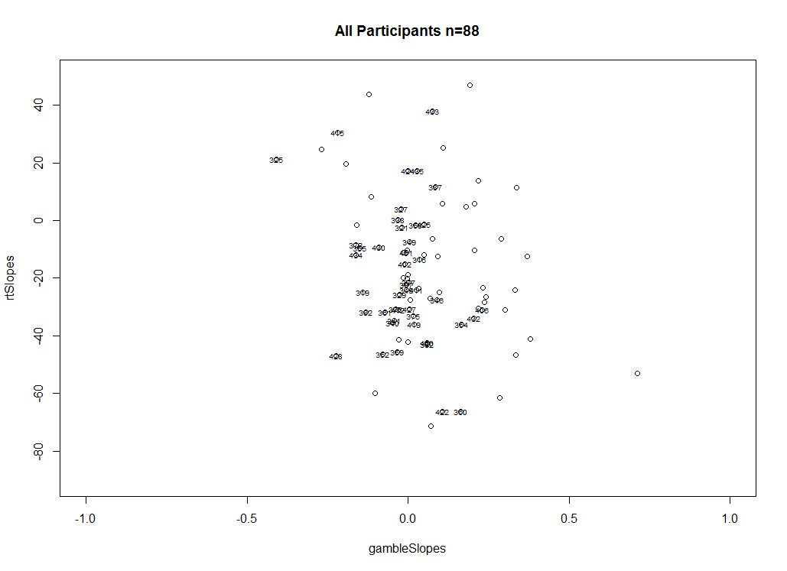
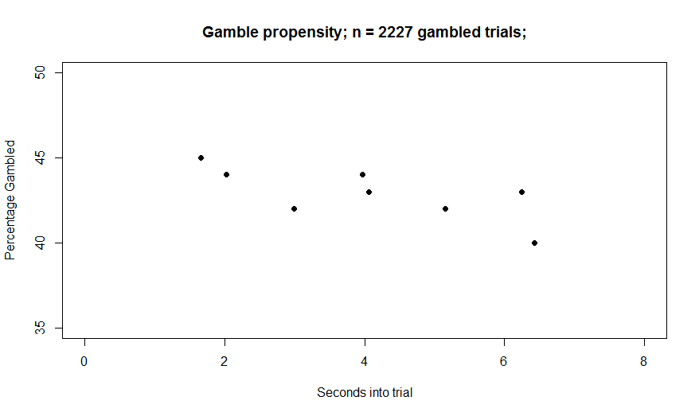
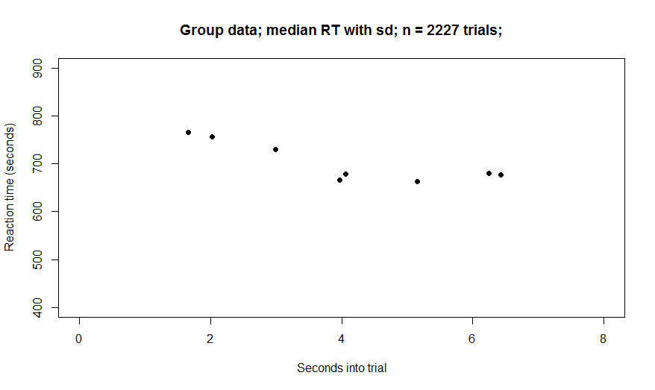
Participants who tended to choose to gamble on high value vs. low value (n=45)
Blue = subgroup; red= all participants

Slide 15






Participants who showed downwards increasing gambling slope (n= 14)
Blue = subgroup; red= all participants
Note: about half of the participants in this subgroup are also in the decreasing RT subgroup

Slide 16



Participants who showed downwards decreasing RT slope (n= 15)
Blue = subgroup; red= all participants

Slide 17






Participants who frequently gambled >60% (n=23)
Blue = subgroup; red= all participants

Slide 18
Plots to do for poster
Bar graphs of slopes for different magnitude/value trials
Violin plots of gamble propensity graphs to indicate spread.
Standard error of RT graphs

Slide 19






Gamble
Ignore

Slide 20






Slide 21







Mag
Value
Low
Mid
EveryTrial
High

Slide 22












Does the number of failed catch trials dictate gambling, RT ramps?
Fail any number of catch trials
Fail 3 catch trials
Fail 1 catch trial
Fail 4 catch trials
Fail 2 catch trials
Fail 5 catch trials

Slide 23


