Slide 1
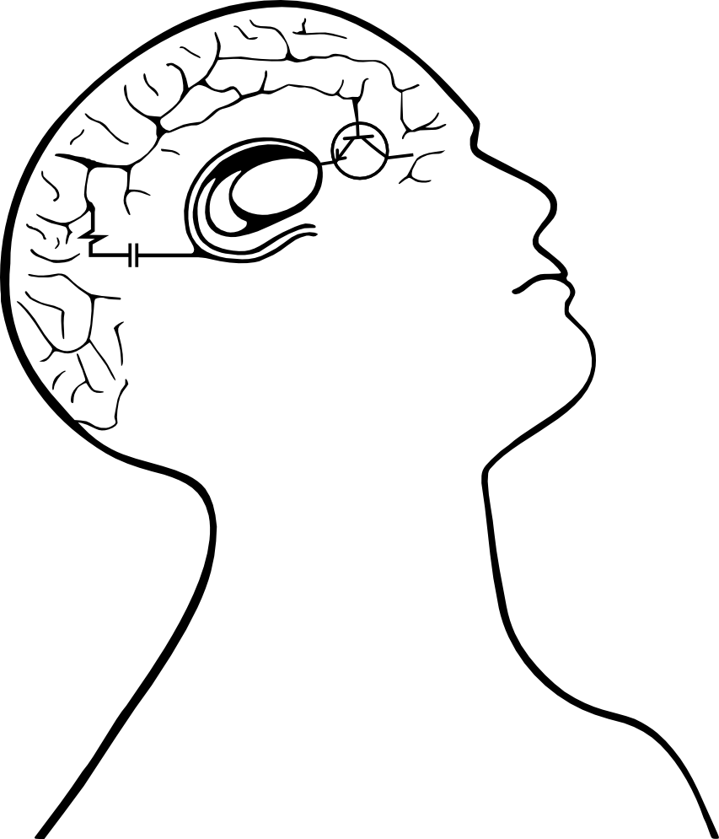

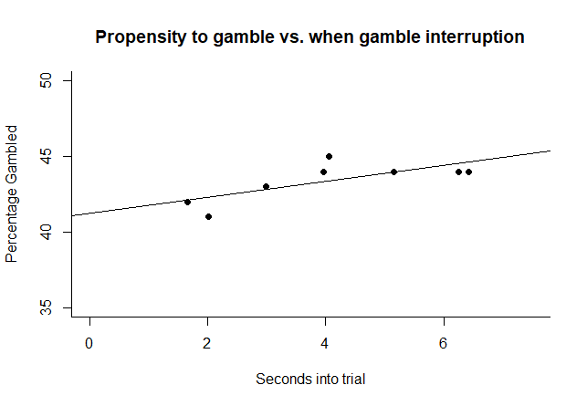
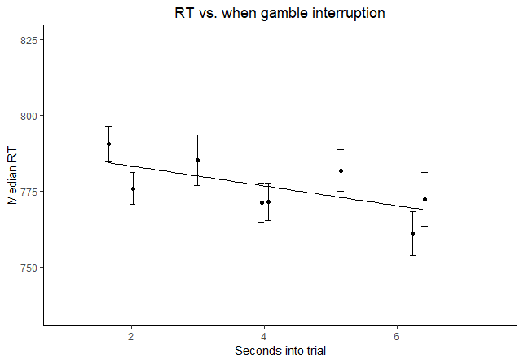
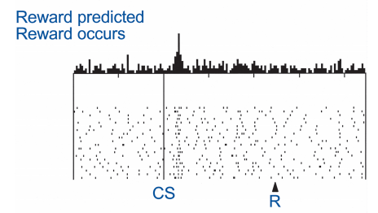
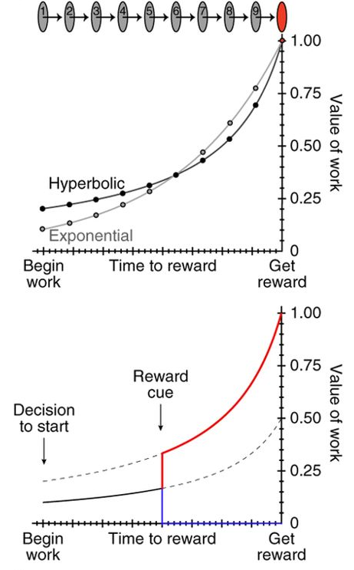
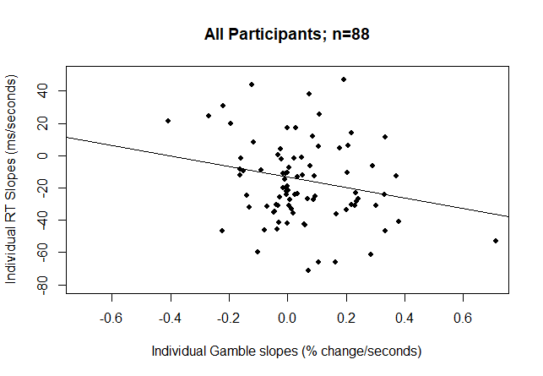
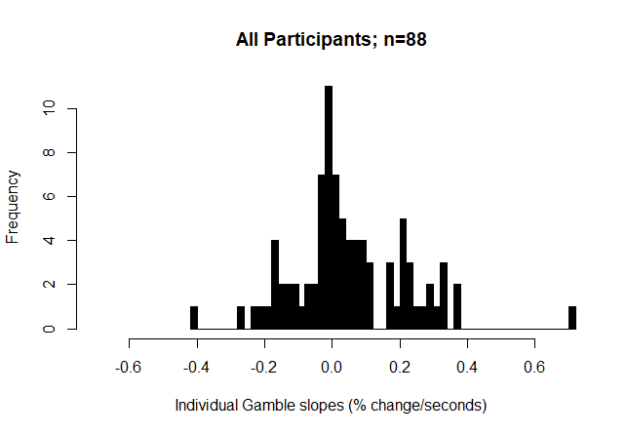
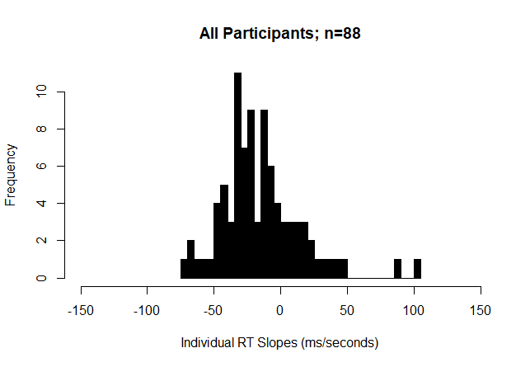
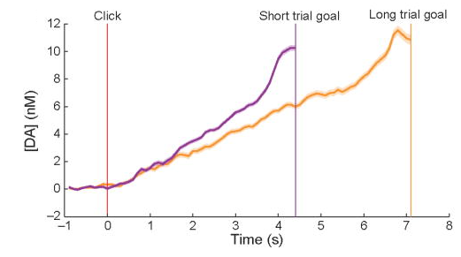
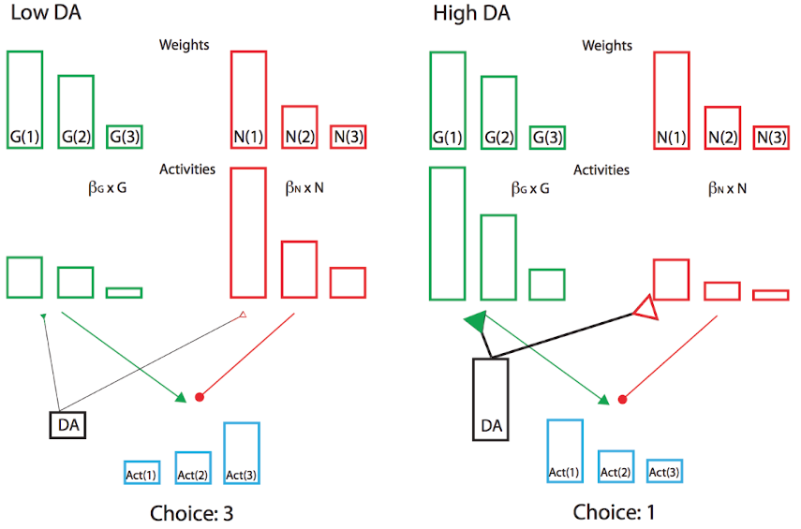
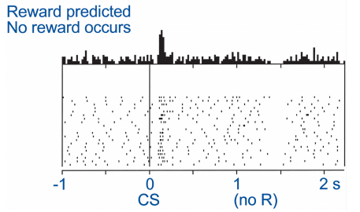
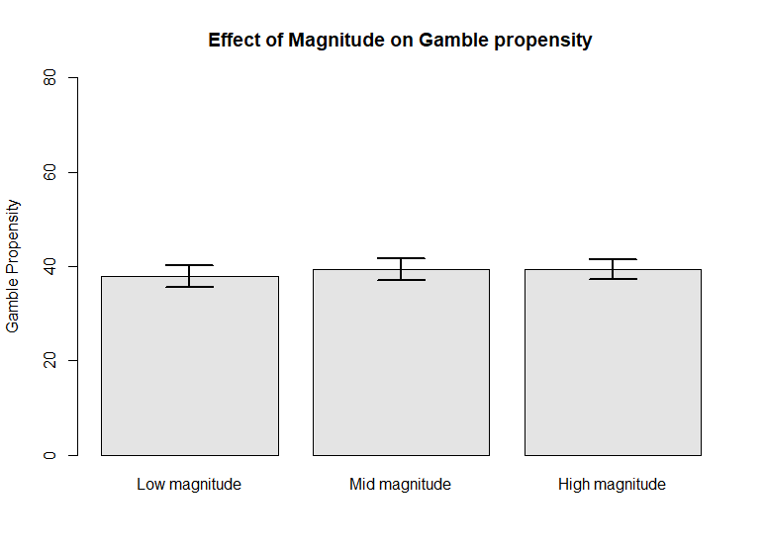
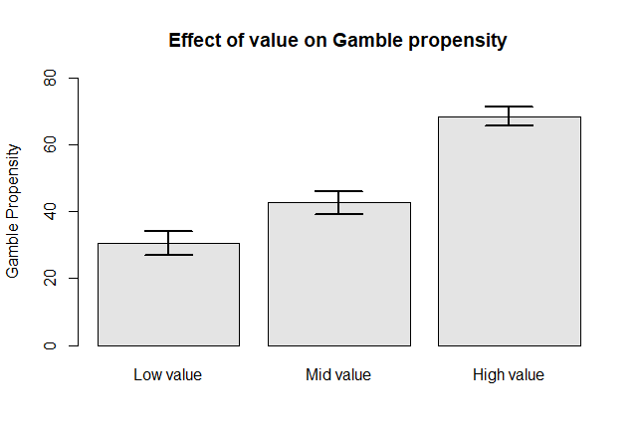
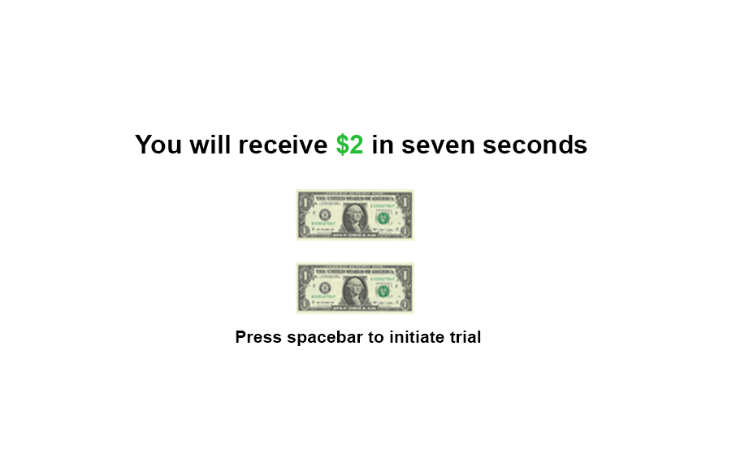
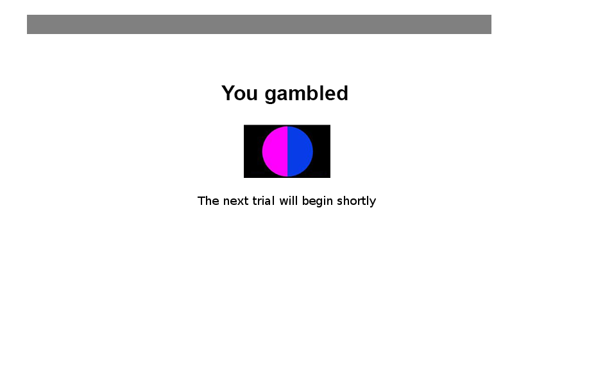
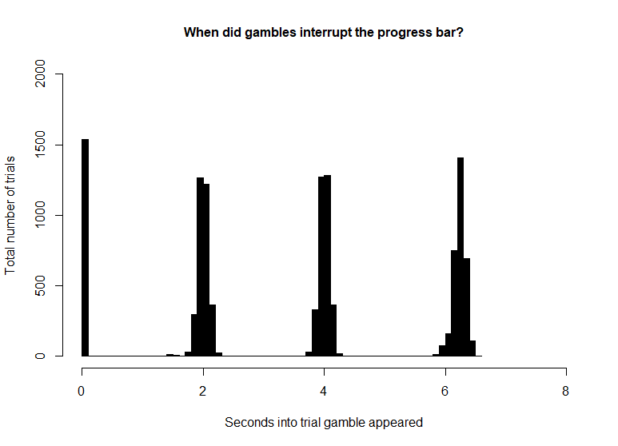
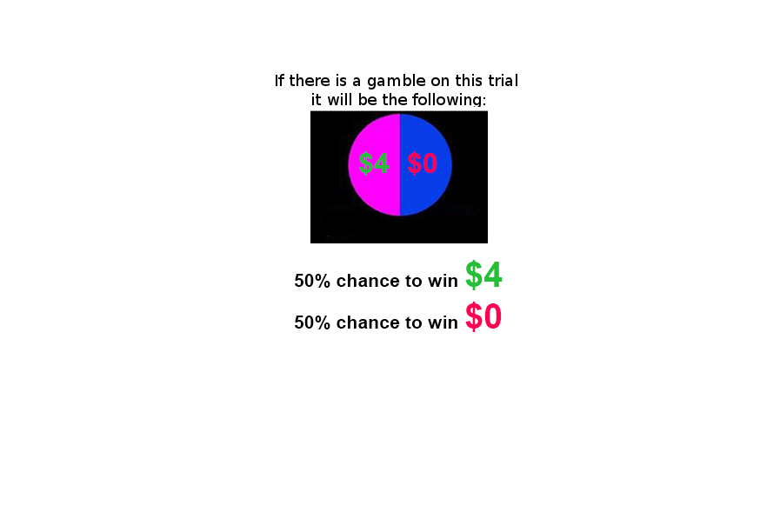

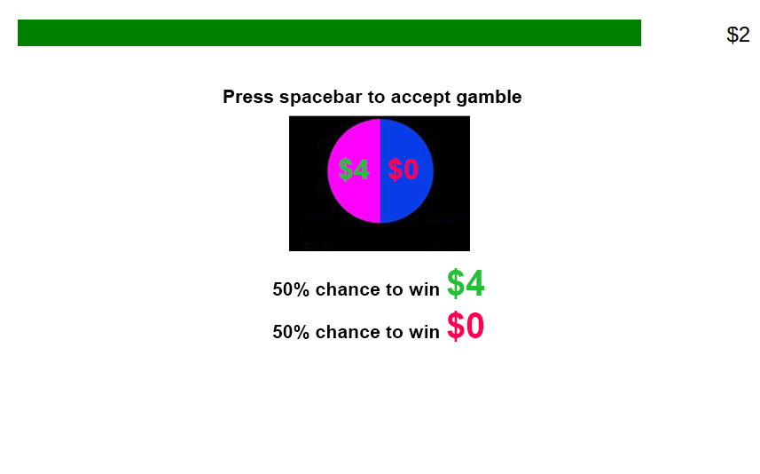

Ramping risk-taking: Progressing value function increases gambling in humans Guillaume J. Pagnier^{1,2}, Andrew Westbrook² & Michael J. Frank^{1,2} ¹Department of Neuroscience, Brown University ²Department of Cognitive, Linguistic and Psychological Sciences, Brown University
Background
Results
Phasic dopamine (DA) spikes in the striatum occur when participants experience reward, effectively reinforcing rewarding actions. This DA spike is called a positive Reward Prediction Error (RPE). Phasic RPEs are key to learning, evidenced in rodents and in humans (Fig 1A).
There is also evidence that rodents experience striatal DA ramping as they approach an anticipated reward. This striatal DA ramp scales to the distance to the reward (Fig. 1B).
It is unclear how striatal DA affects performance. Striatal DA may be affecting general vigor, speeding up all actions indiscriminately. However, recent work suggests that striatal DA also affects cost/benefit weighting (i.e. a value) (Fig. 1C). There has been recent evidence that rodents’ striatal DA concentrations encode such a value function (Fig. 1D).
If humans and rodents striatal DA dynamics are similar and DA modulates value calculation, than humans’ cost/benefit calculations should change as a function of proximity to a reward. More precisely, people should become increasingly risk-seeking the closer they are to an anticipated reward.
A
B
A
B
C
D
C
D
E
Adapted from Fig. 2e Howe, M. W., Tierney, P. L., Sandberg, S. G., Phillips, P. E., & Graybiel, A. M. (2013). Prolonged dopamine signalling in striatum signals proximity and value of distant rewards. Nature, 500(7464), 575.
F
G
Adapted from Schultz, W. (2001). Book review: Reward signaling by dopamine neurons. The Neuroscientist, 7(4), 293-302
Adapted from Fig. 4a Hamid, A. A., Pettibone, J. R., Mabrouk, O. S., Hetrick, V. L., Schmidt, R., Vander Weele, C. M., ... & Berke, J. D. (2016). Mesolimbic dopamine signals the value of work. Nature neuroscience, 19(1), 117.
Question
As the distance to a reward decreases does a participant’s propensity to gamble (via an adjusting value function) change?
Methods
Fig.2A. Overall propensity to gamble increases as a function of when the gamble was introduced (p<.01) B. Overall RT decreases as a function of when the gamble was introduced (p<.001) C. Each participant’s gamble slope is plotted against their RT slope (remove line, it’s meaningful) D. Histogram of all individual gamble slopes. Mean of distribution is sig. more than 0 (p<.01) E. Histogram of all individual RT slopes. Mean of distribution is sig. less than than 0 (p<.01). F. Magnitude has no effect on participants’ decision to gamble (n.s.). G. A trial’s value significantly increases a participant’s propensity to gamble (p<.001).
Task
Gamble
Conclusions
Ignore
The later the gamble interrupted in the progress bar (i.e. the closer the participant was to the reward), the more likely a participant gambled and the lower their RT tended to be.
The more pronounced a participant’s gamble ramp was, the more negative their RT ramp tended to be.
Magnitude had no effect on driving the decision to gamble but a higher value gamble increased a participant’s propensity to gamble.
These pilot data are consistent with the theory that DA dynamics affect how humans calculate the value of a reward.
Magnitude
Value
Subjects
207 Participants were recruited via Amazon’s mechanical turk; (127 male; 76 female; 4 declined to answer) and were between the age of 18-40.
Participants underwent 133 trials (~45 minutes) and were given $3 base pay plus whatever they won on a chosen trial (0$ - $4 extra).
There was the option to gamble on 86.39 % of trials.
Each trial had a value attribute (low/mid/high) and a magnitude attribute (low/mid/high)
Low
Guaranteed amount = $1 or $2 | Gamble = 1.5 x guaranteed amount
Guaranteed amount = $3 or $4 | Gamble = 2 x guaranteed amount
Guaranteed amount = $5 or $6 | Gamble = 3 x guaranteed amount
References:
Schultz, W. (2001). Book review: Reward signaling by dopamine neurons. The Neuroscientist, 7(4), 293-302
Howe, M. W., Tierney, P. L., Sandberg, S. G., Phillips, P. E., & Graybiel, A. M. (2013). Prolonged dopamine signalling in striatum signals proximity and value of distant rewards. Nature, 500(7464), 575.
Hamid, A. A., Pettibone, J. R., Mabrouk, O. S., Hetrick, V. L., Schmidt, R., Vander Weele, C. M., ... & Berke, J. D. (2016). Mesolimbic dopamine signals the value of work. Nature neuroscience, 19(1), 117.
Collins, A. G., & Frank, M. J. (2014). Opponent actor learning (OpAL): Modeling interactive effects of striatal dopamine on reinforcement learning and choice incentive. Psychological review, 121(3), 337.
Mid
High

