Slide 1
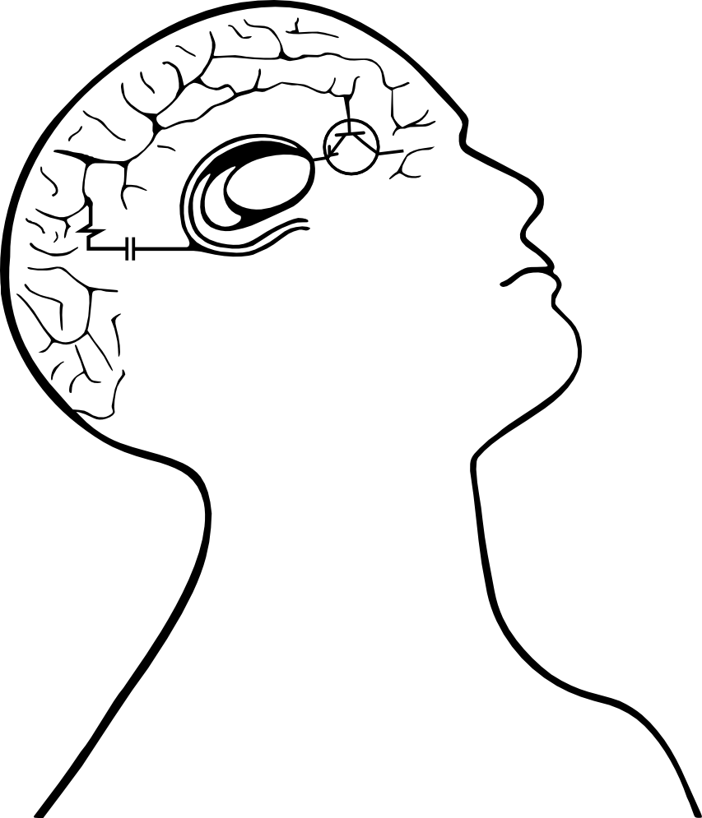

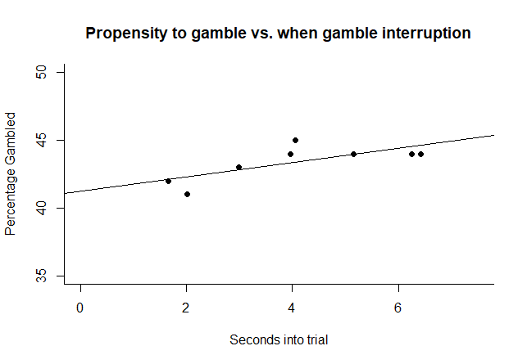
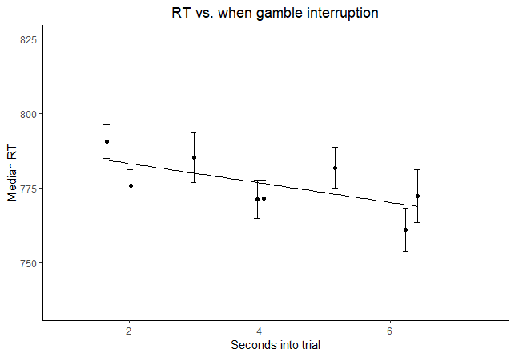
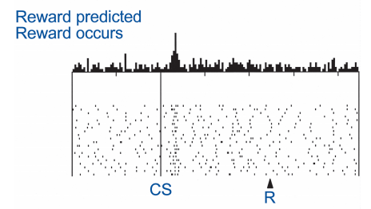
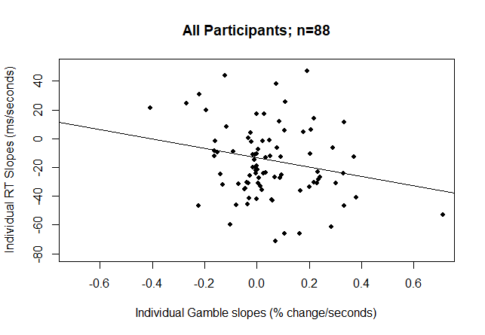
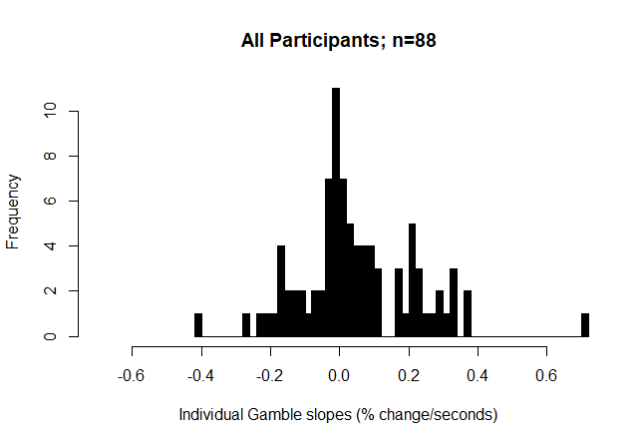
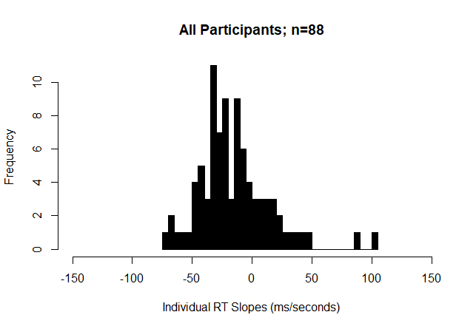
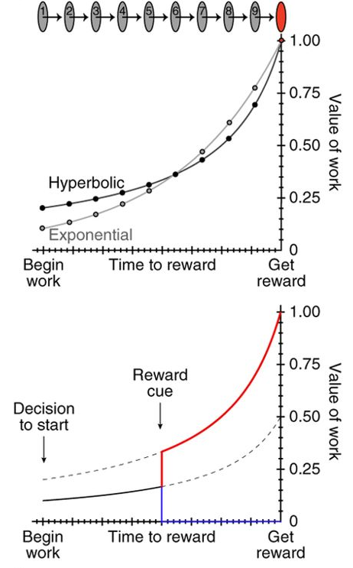
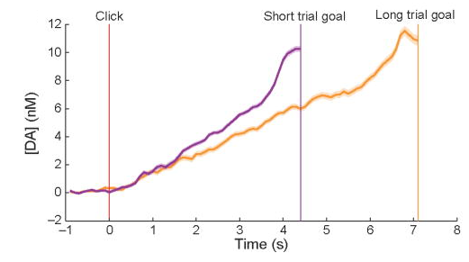
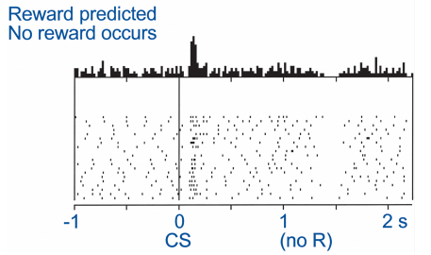
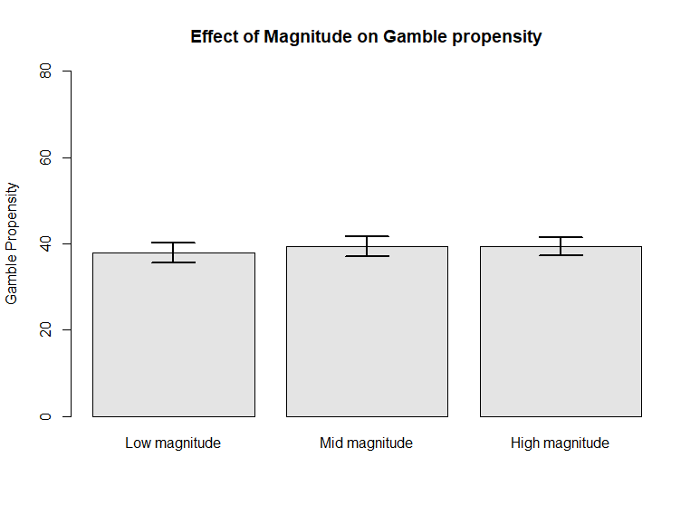
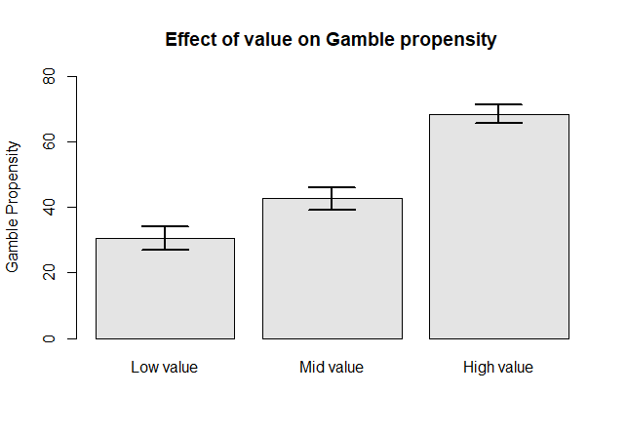
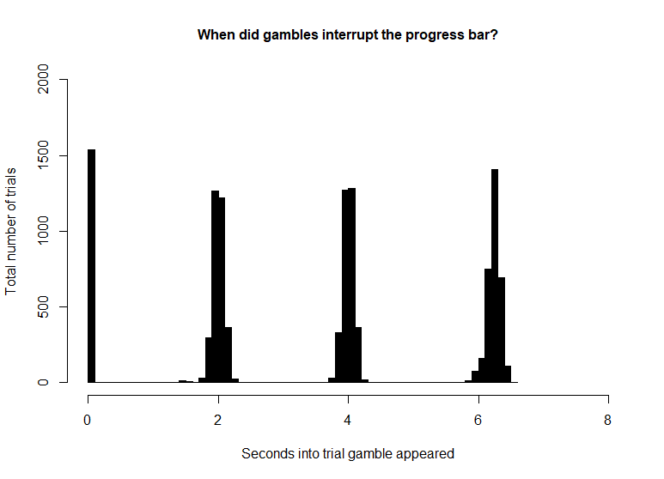
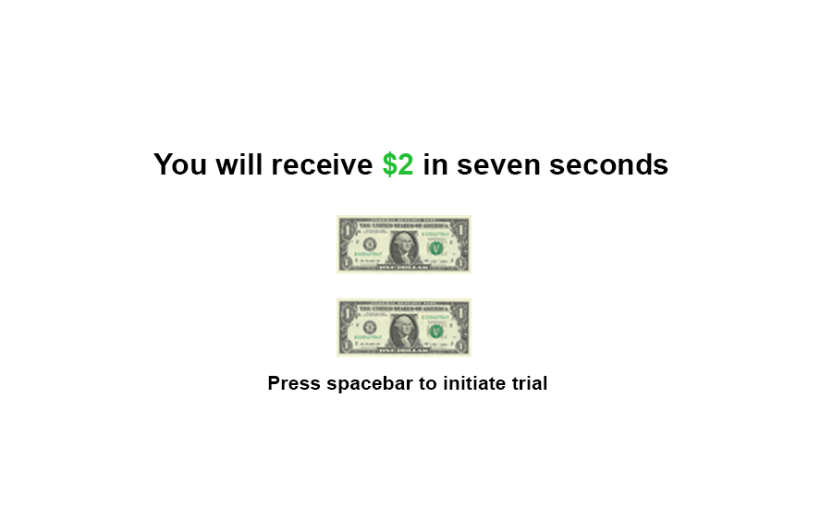
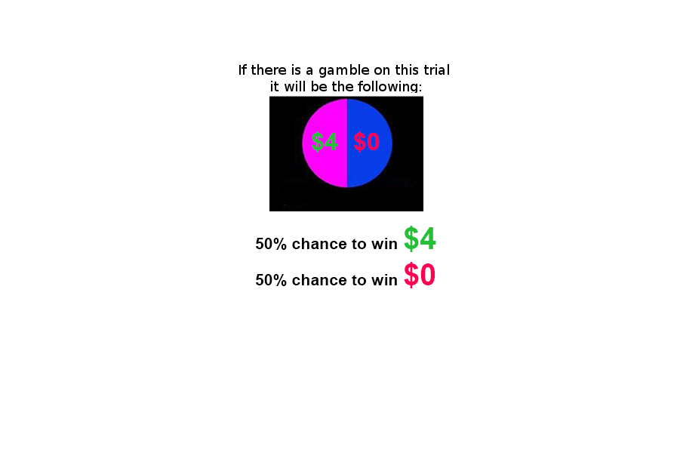

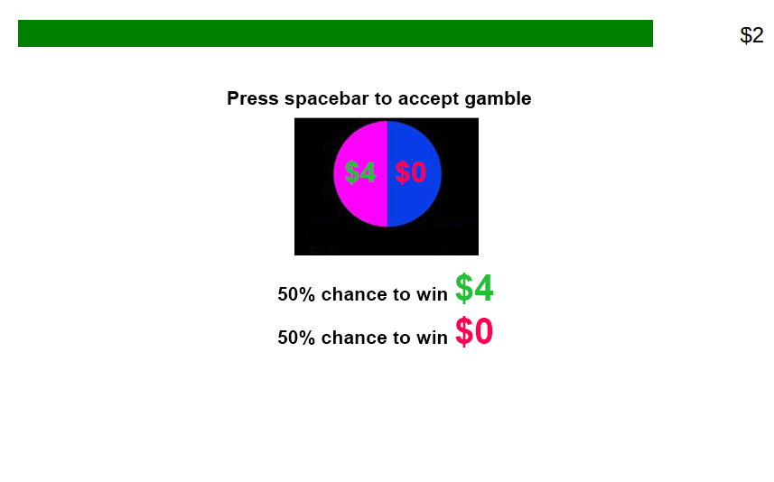
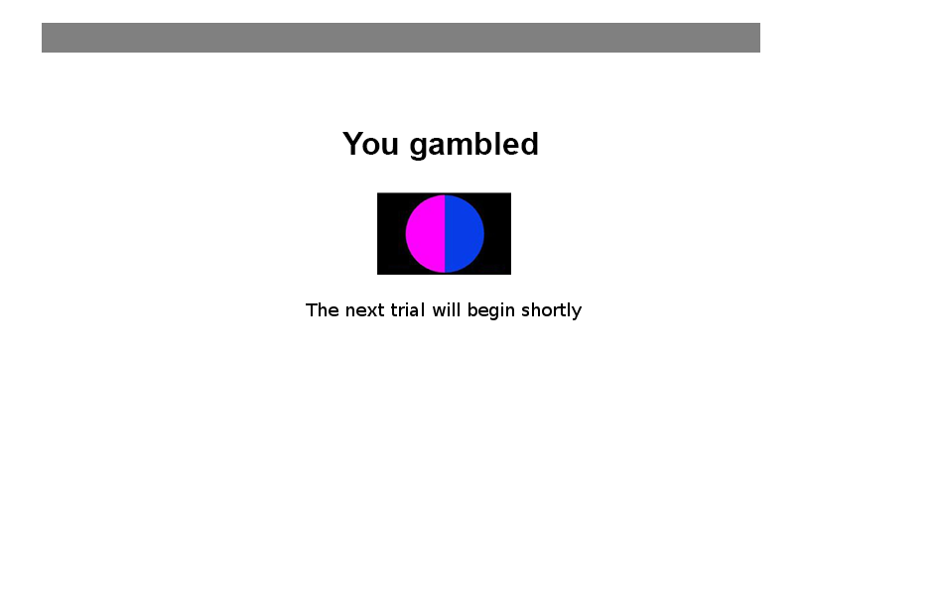

Ramping risk-taking: Progressing value function increases gambling in humans Guillaume J. Pagnier^{1,2}, Andrew Westbrook² & Michael J. Frank^{1,2} ¹Department of Neuroscience, Brown University ²Department of Cognitive, Linguistic and Psychological Sciences, Brown University
Background
Results
Phasic dopamine (DA) spikes in the striatum occur when participants experience reward, effectively reinforcing rewarding actions. This DA spike is called a positive Reward Prediction Error (RPE). Phasic RPEs are key to learning, evidenced in rodents and in humans (Fig 1A).
Seperately from providing RPEs, DA also encodes motivation and vigor. Slowly changing levels of striatal DA (tonic) corresponds to opportunity cost.
Hamid et al., 2015 unified the concepts of tonic (motivation) and phasic (learning) DA, showing that dynamically evolving levels of striatal DA signal cost/benefit (a value signal) in rodents (Fig 1B).
Extending this idea of DA’s purpose, other work has been done showing that pharmacologically manipulating DA affects humans’ cost/benefit risky decision making.
There is also evidence that rodents experience striatal DA ramping as they approach a reward. This striatal DA ramp scales to the distance to the reward (Fig. 1C).
If humans and rodents striatal DA dynamics are similar, than humans’ cost/benefit calculations should change as a function of proximity to reward.
B
C
A
A
B
C
Adapted from Fig. 2e Howe, M. W., Tierney, P. L., Sandberg, S. G., Phillips, P. E., & Graybiel, A. M. (2013). Prolonged dopamine signalling in striatum signals proximity and value of distant rewards. Nature, 500(7464), 575.
Adapted from Schultz, W. (2001). Book review: Reward signaling by dopamine neurons. The Neuroscientist, 7(4), 293-302
Adapted from Fig. 4a Hamid, A. A., Pettibone, J. R., Mabrouk, O. S., Hetrick, V. L., Schmidt, R., Vander Weele, C. M., ... & Berke, J. D. (2016). Mesolimbic dopamine signals the value of work. Nature neuroscience, 19(1), 117.
Question
As the distance to a reward decreases does a participant’s propensity to gamble (via an adjusting value function) change?
Methods
Fig 1. A. Error bars represent 95% highest density intervals (HDI). B. Density plots are posterior distributions of medication response x session interaction effects, and horizontal bars show the 95% HDI. C. Quantile probability plot and density plot for observed and predicted accuracy and response time across conditions.
Task
Subjects
207 Participants were recruited via Amazon’s mechanical turk; (127 male; 76 female; 4 declined to answer) and were between the age of 18-40.
Participants underwent 133 trials (~45 minutes) and were given $3 base pay plus whatever they won on a chosen trial (0$ - $4 extra).
There was the option to gamble on 86.39 % of trials.
Trials were broken down into low/mid/high value and low/mid/high mag
Conclusions
The later the gamble interrupted in the progress bar (i.e. the closer the participant was to the reward), the more likely a participant gambled and the lower their RT tended to be.
The more pronounced a participant’s gamble ramp was, the more negative their RT ramp tended to be.
Magnitude had no effect on driving the decision to gamble. Value did.
These pilot data are consistent with the theory that DA dynamics modulate a value function in humans.
Magnitude
Value
Low
Guaranteed amount = $1 or $2 | Gamble = 1.5 x guaranteed amount
Guaranteed amount = $3 or $4 | Gamble = 2 x guaranteed amount
Guaranteed amount = $5 or $6 | Gamble = 3 x guaranteed amount
References:
Schultz, W. (2001). Book review: Reward signaling by dopamine neurons. The Neuroscientist, 7(4), 293-302
Howe, M. W., Tierney, P. L., Sandberg, S. G., Phillips, P. E., & Graybiel, A. M. (2013). Prolonged dopamine signalling in striatum signals proximity and value of distant rewards. Nature, 500(7464), 575.
Hamid, A. A., Pettibone, J. R., Mabrouk, O. S., Hetrick, V. L., Schmidt, R., Vander Weele, C. M., ... & Berke, J. D. (2016). Mesolimbic dopamine signals the value of work. Nature neuroscience, 19(1), 117.
Collins, A. G., & Frank, M. J. (2014). Opponent actor learning (OpAL): Modeling interactive effects of striatal dopamine on reinforcement learning and choice incentive. Psychological review, 121(3), 337.
Mid
High

