Slide 1
Ramping data V02
112 subjects
10378 total trials
8367 trials with option to gamble
Gambled on 3235 of those trials

Slide 2
V02 task specifications
8 second progress bar
Progress bar does not pause for gamble
Gamble is previewed before each trial
Participants only have 1 second to ‘decide’ whether to gamble or not

Slide 3
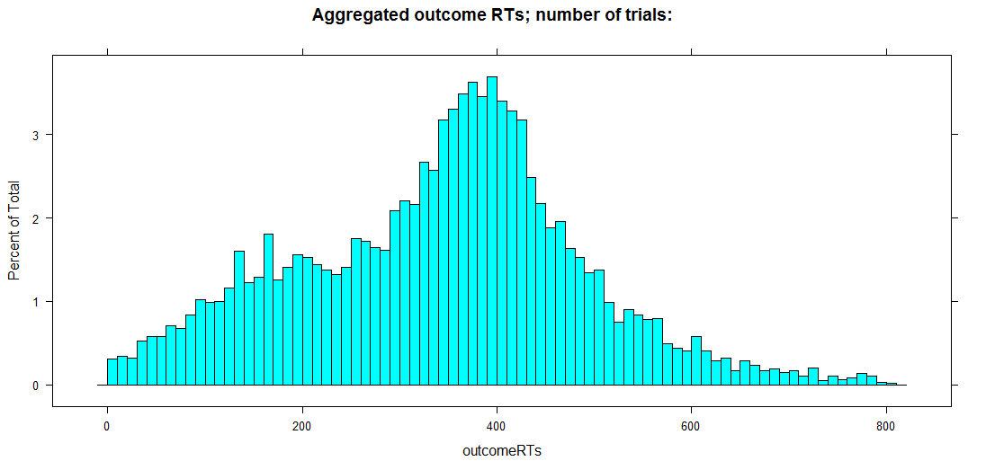

Slide 4
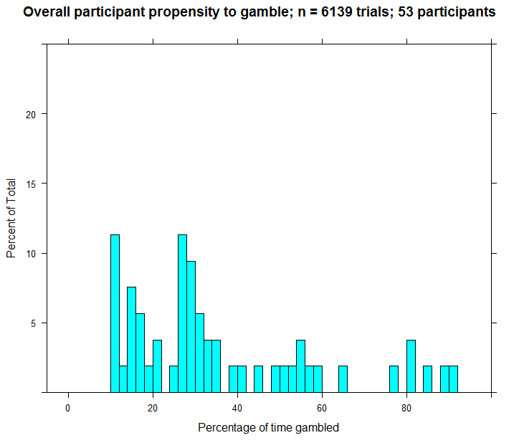

Slide 5
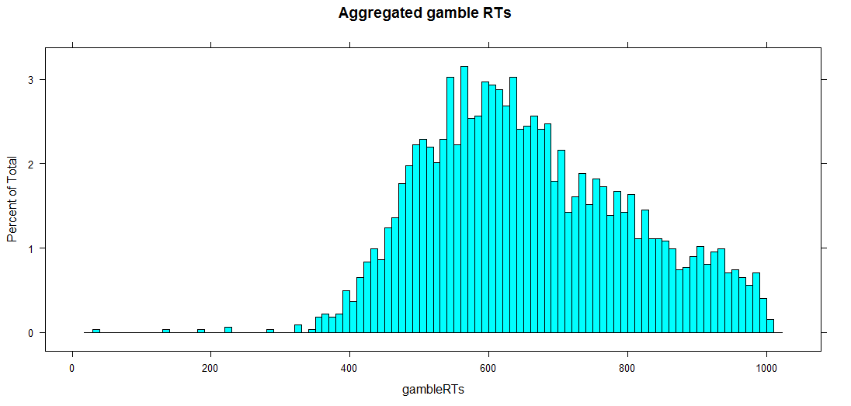
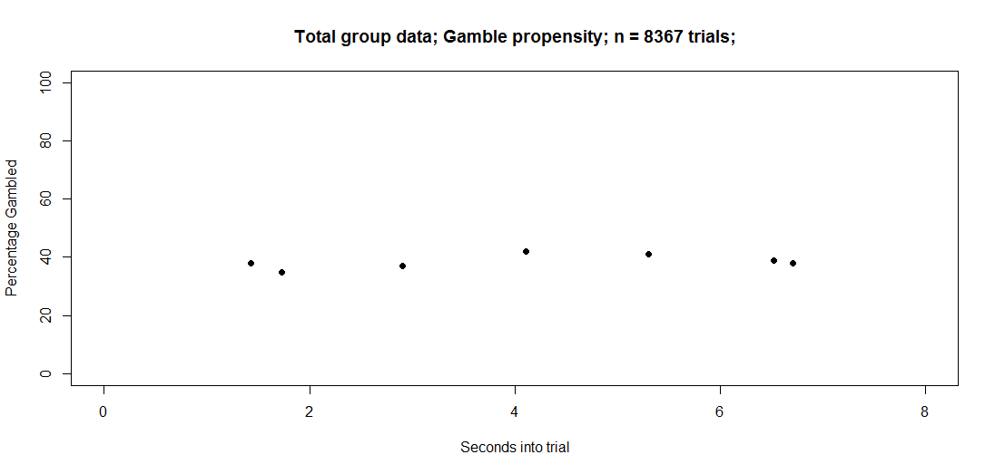
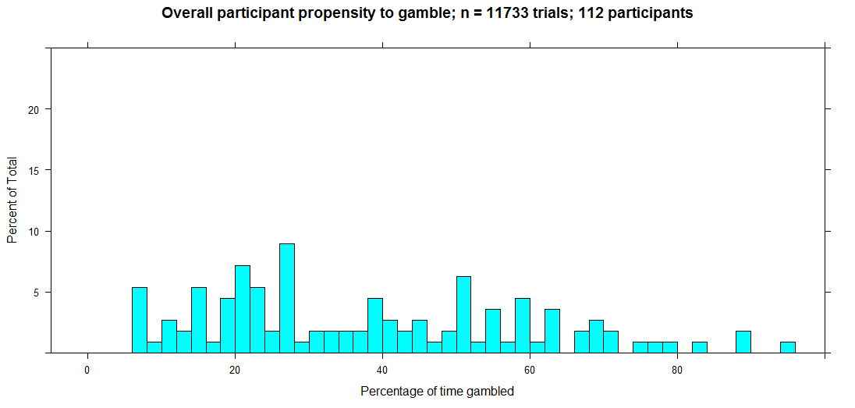
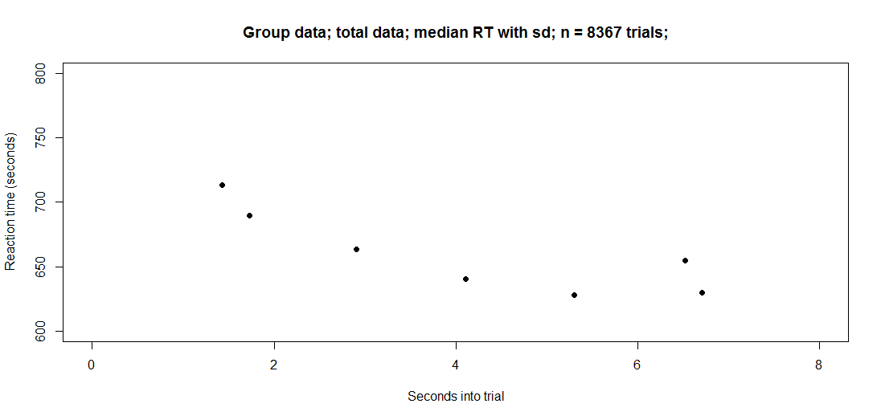
TotalData

Slide 6
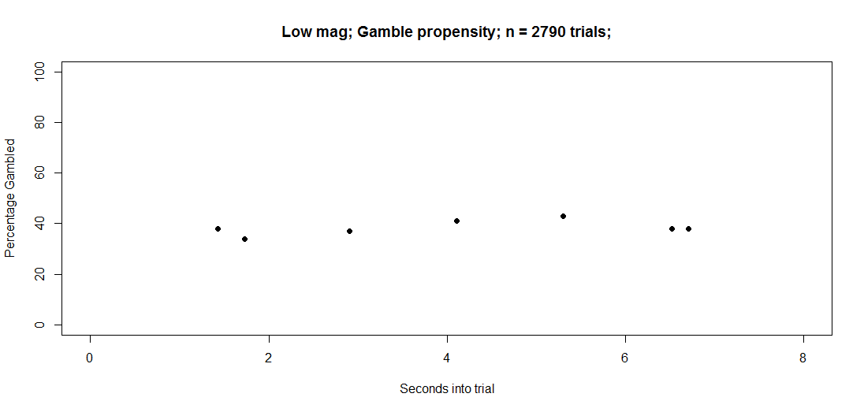
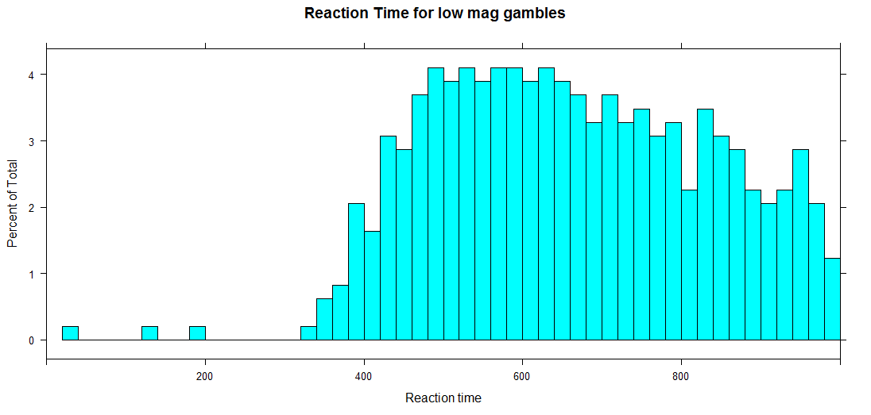
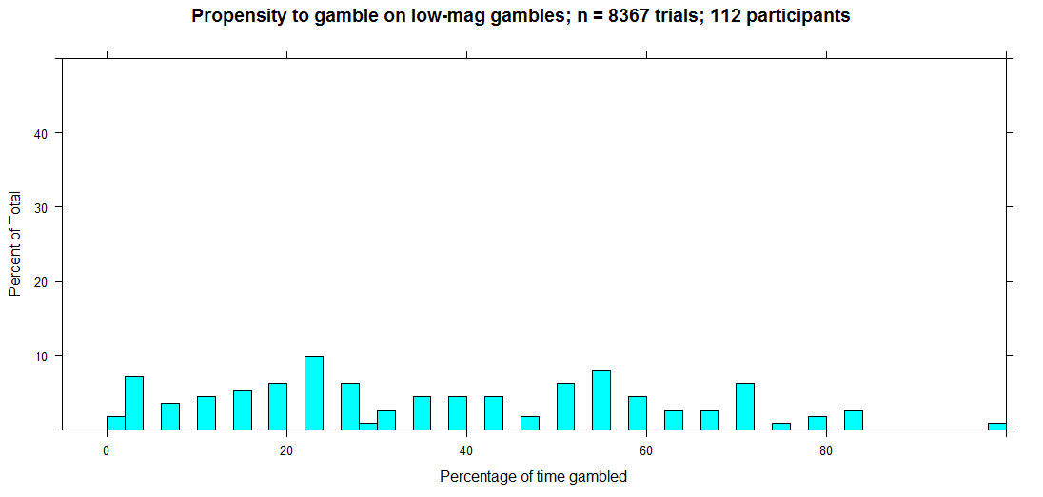
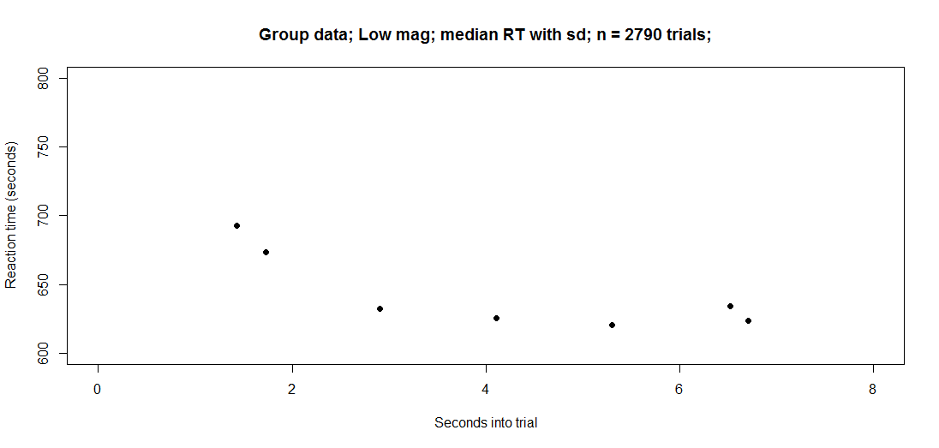
LowMag

Slide 7
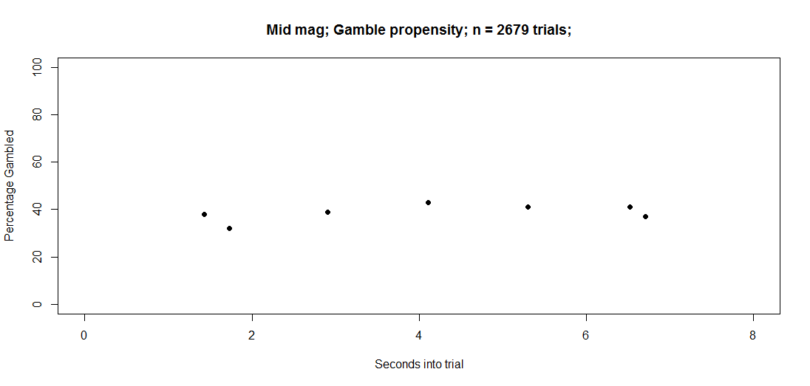
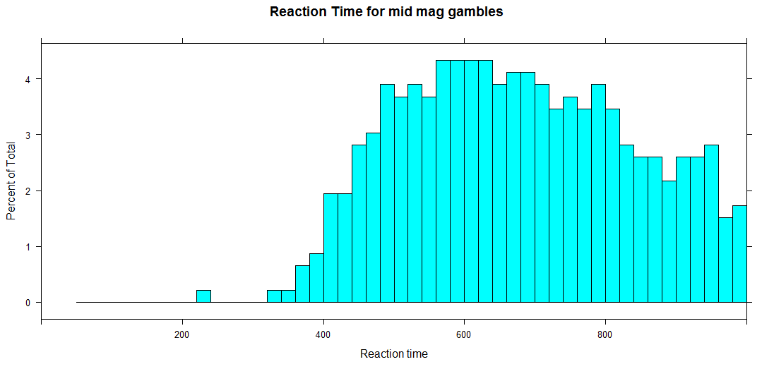
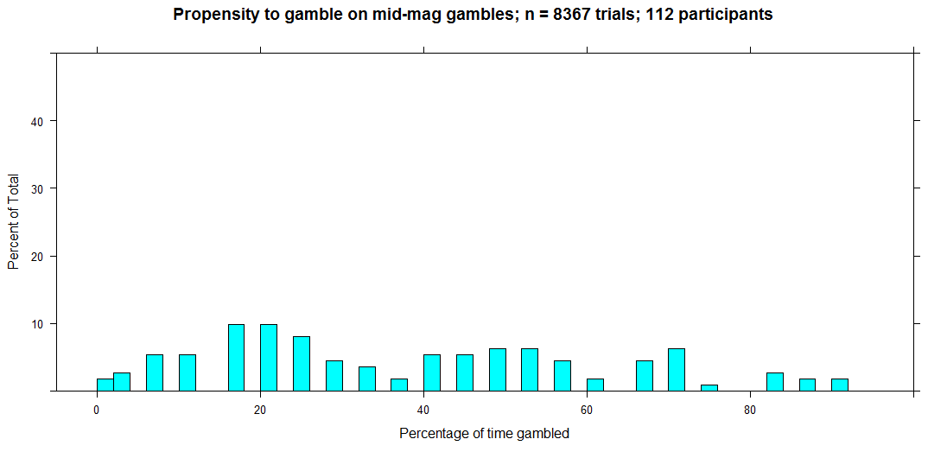
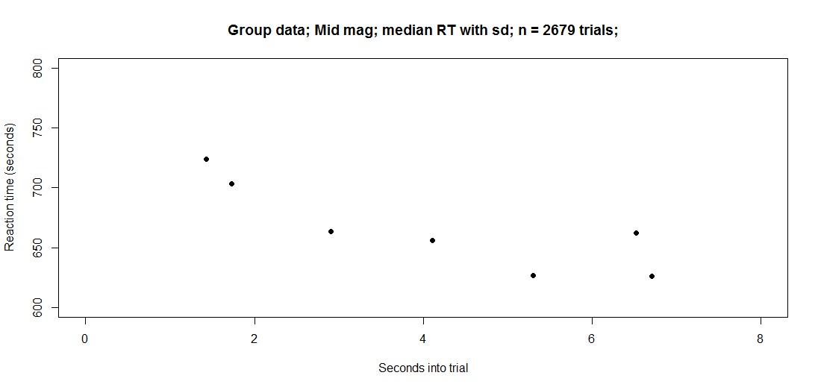
MidMag

Slide 8

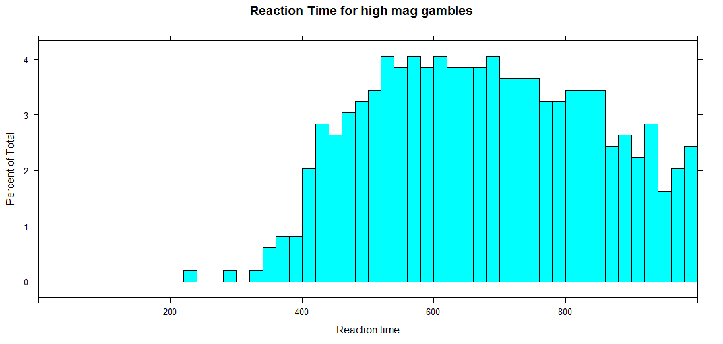
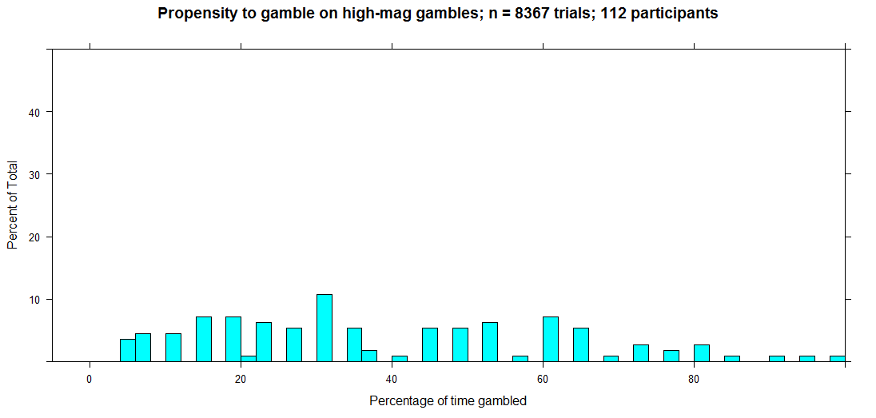
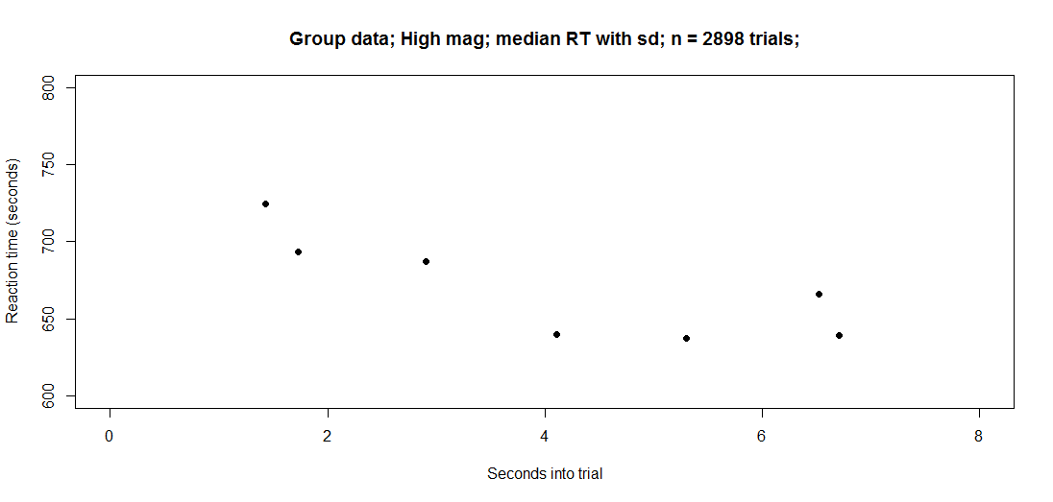
HighMag

Slide 9
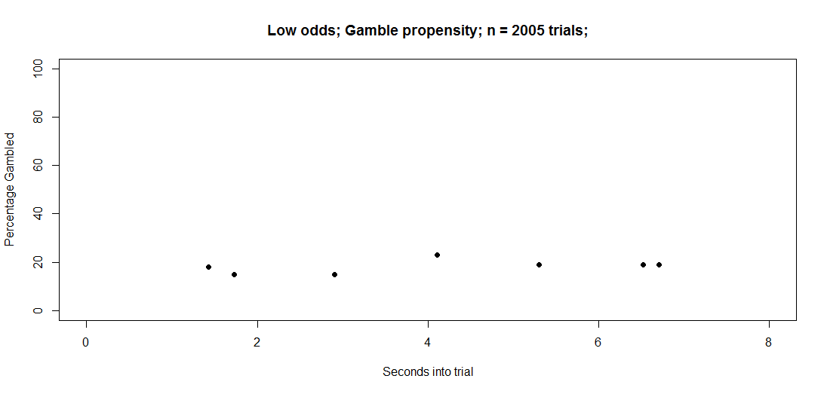
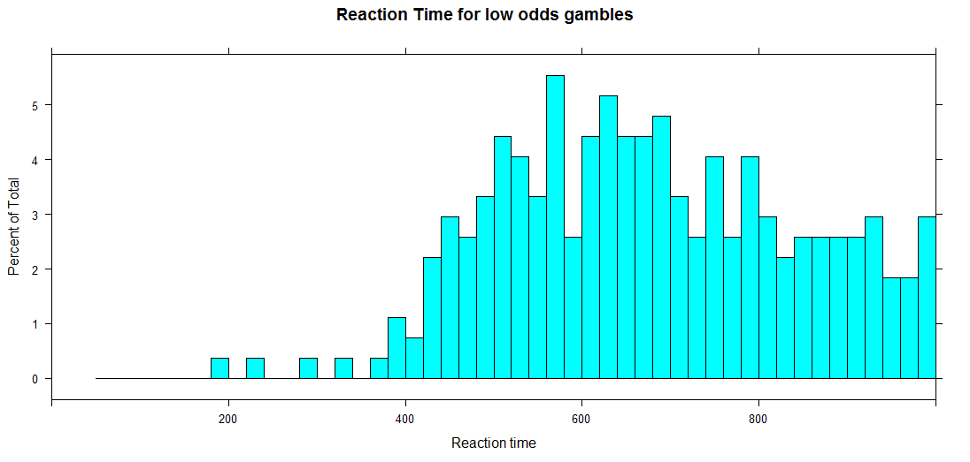
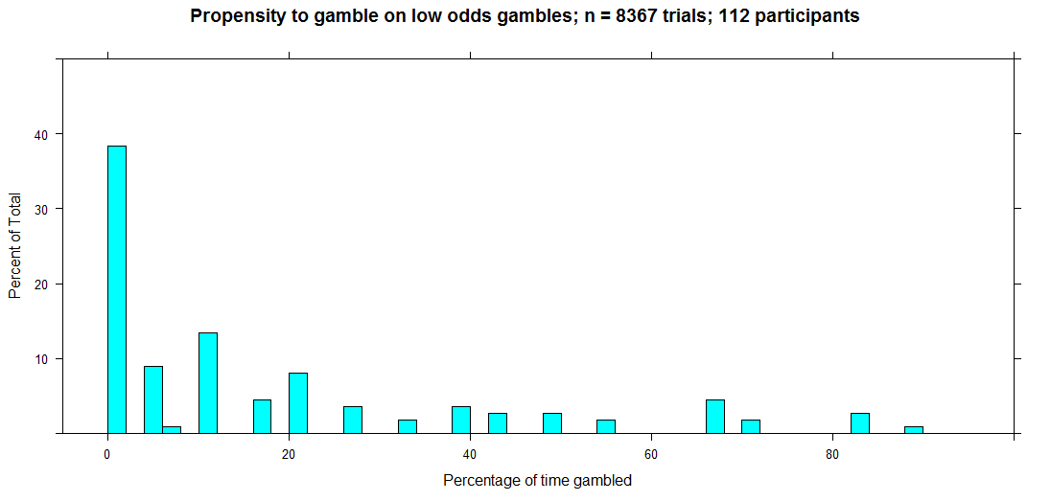
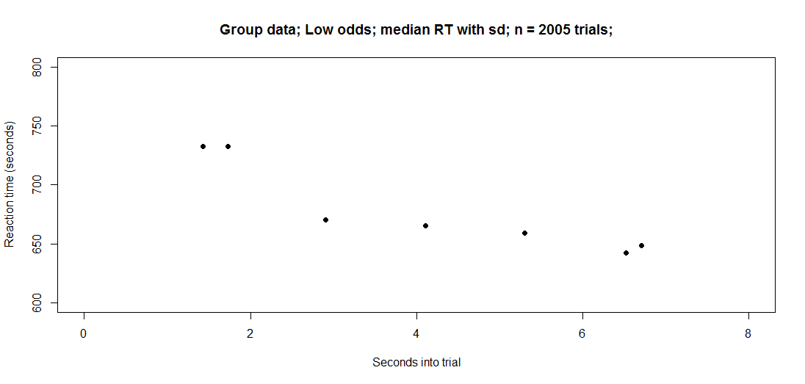
LowOdds

Slide 10

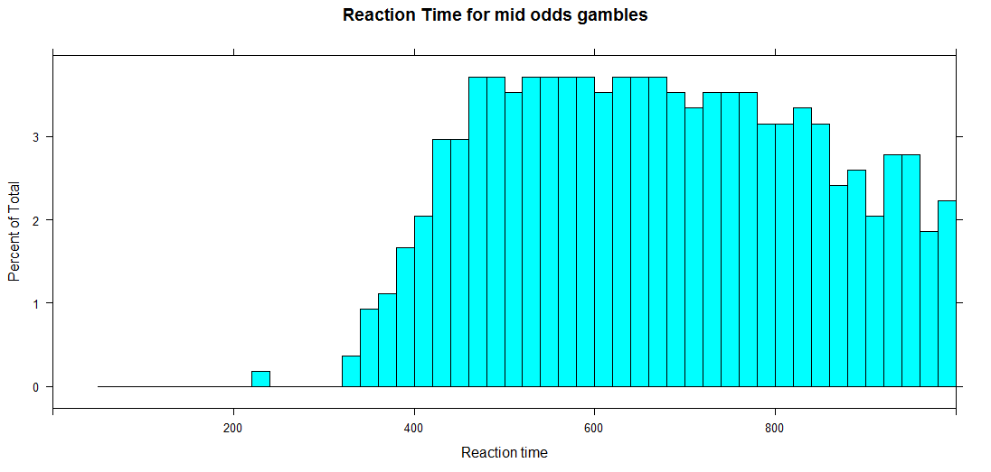
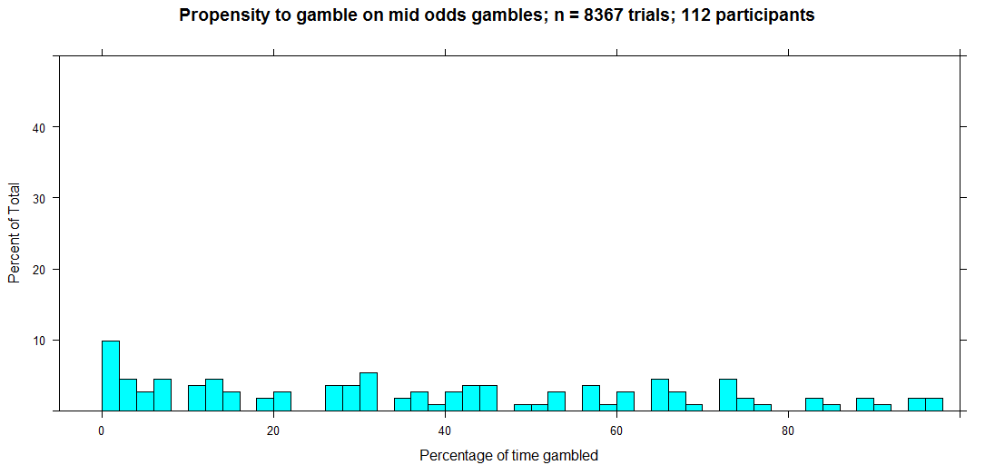
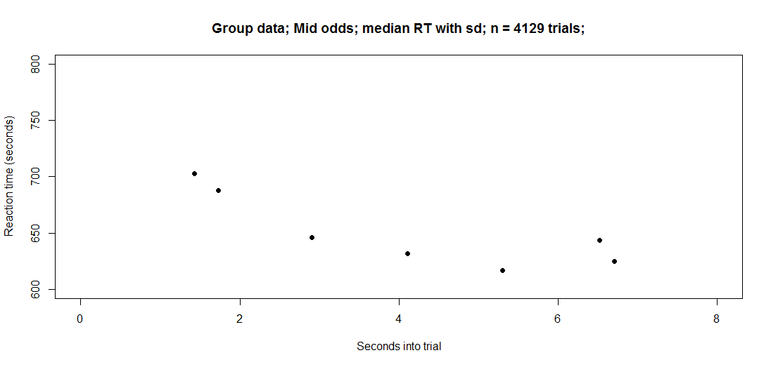
MidOdds

Slide 11
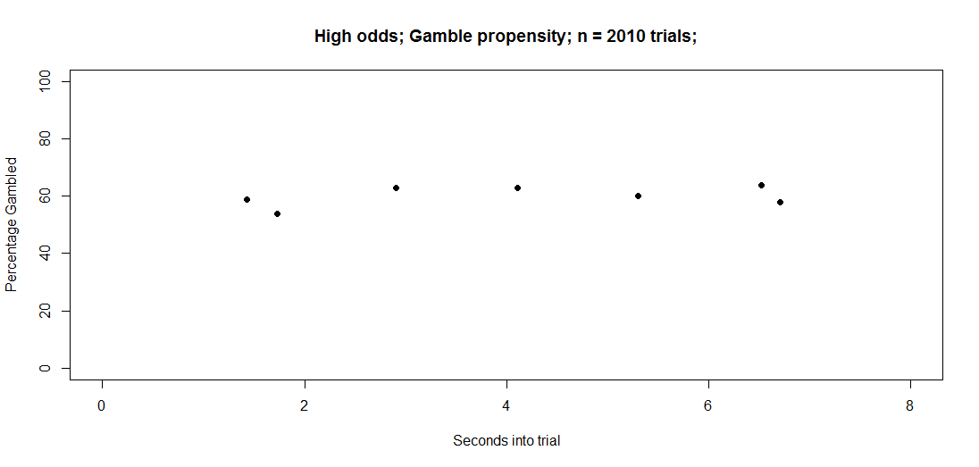
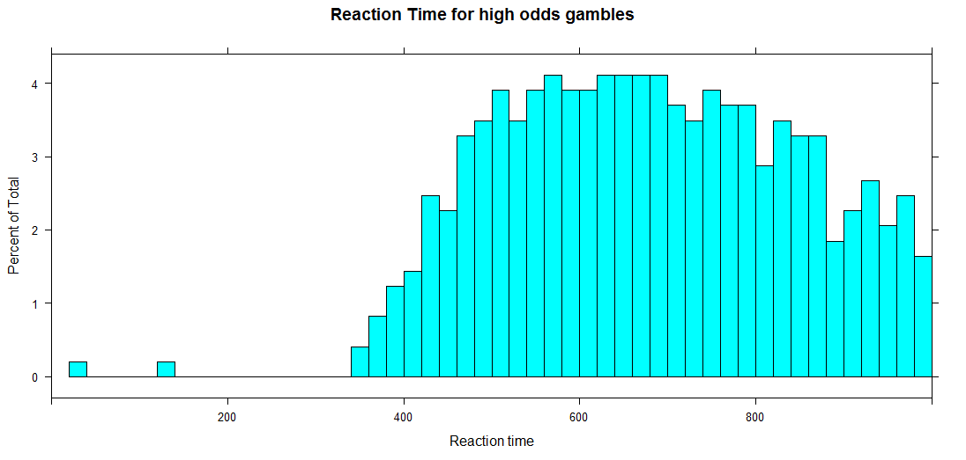
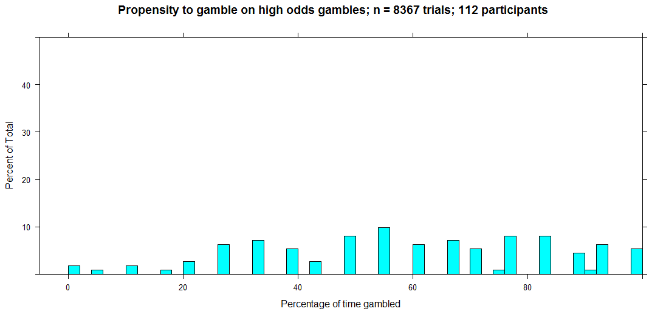
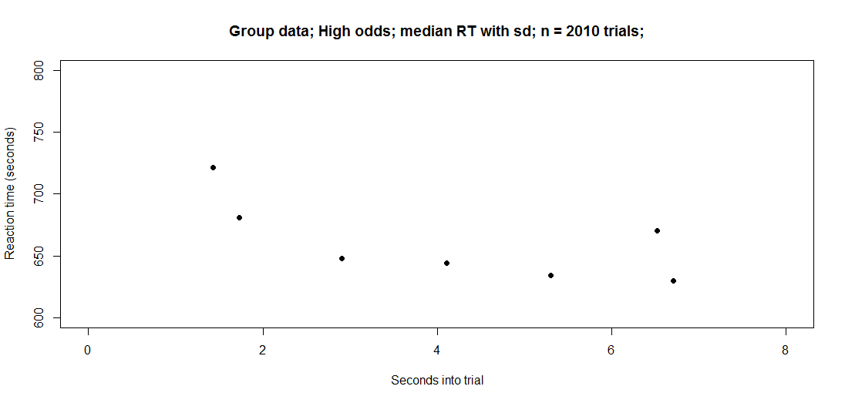
HighOdds

Slide 12
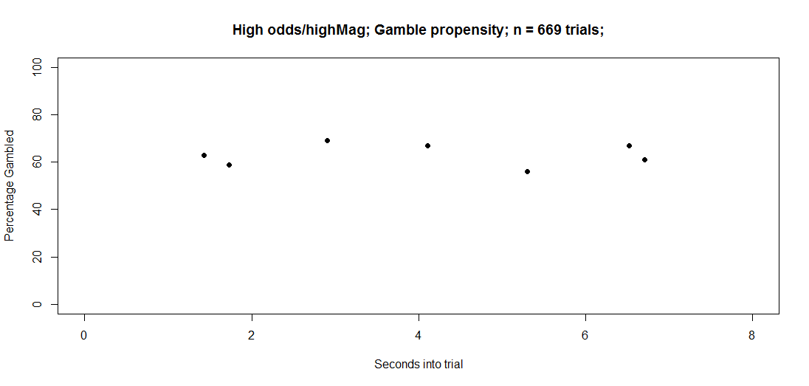
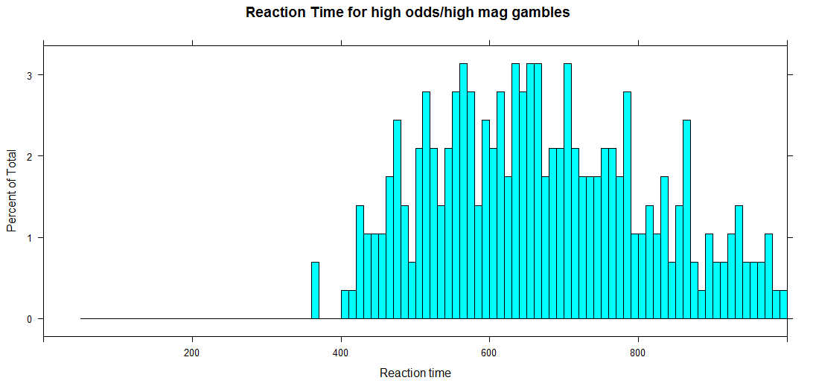
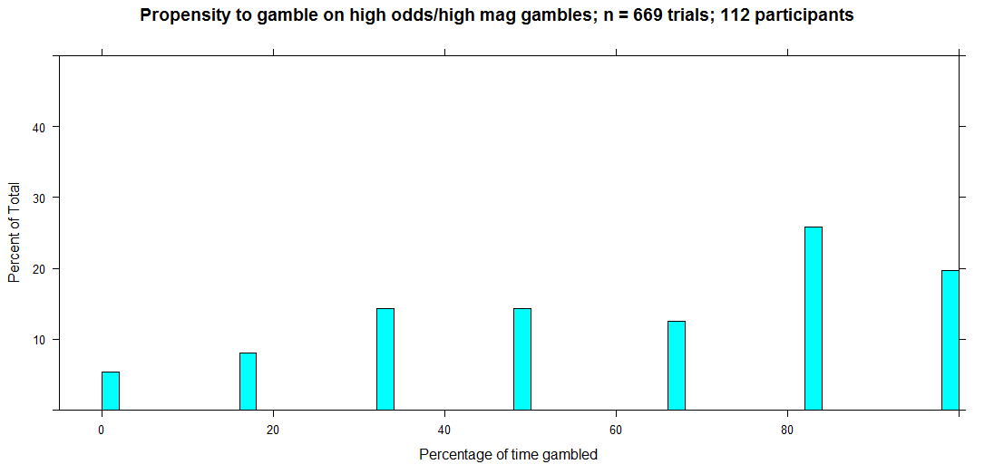

HighOdds/HighMag

Slide 13
RPEs and odds/mag preferences
RPE was calculated three separate ways
Rpe1 for trial t is the amount promised on trial t – the amount previewed on trial t-1
Rpe2 for trial t is the amount promised on trial t – x. x=the amount of whatever they chose on t-1. If they gambled on t-1, x= potential gamble winnings/2. If they didn’t gamble on t-1, x=the amount promised on trial t-1 (note: this is identical to how rpe1 was calculated).
Rpe3 is the same as rpe 2 but with a bigger gain. If they gambled, x=potential gambling winnings (The rationale behind doing this was maybe some participants experienced RPEs by only focusing on the positive amounts and ignoring the potential losses).
A oddsGamblingScore was calculated per participant by taking the percentage of trials gambled in high odds condition and subtracting percentage of trials gambled in low odds condition.
Note: Descriptive stats for RPE2 are not included in this ppt as it contains nearly the same trials as rpe1 (the exact RPE values change a little bit which is why the statistics differ)

Slide 14
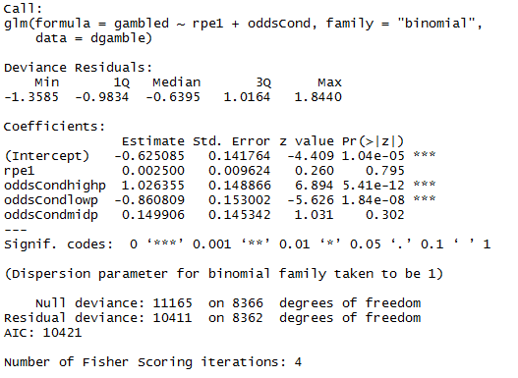
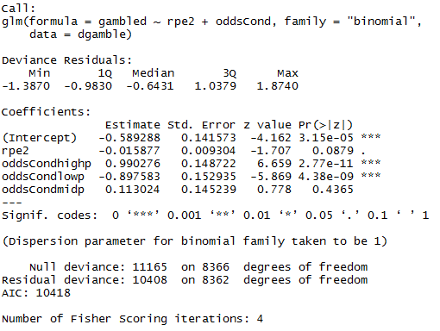
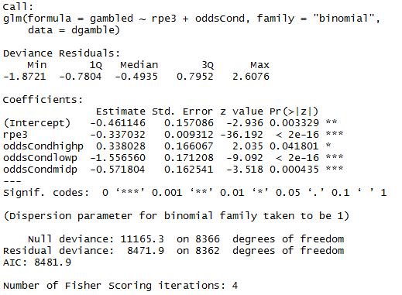
RPE statistics
Logistic regression using rpe1, rpe2, rpe3, and odds to account for propensity to gamble?
RPE1
RPE2
RPE3

Slide 15
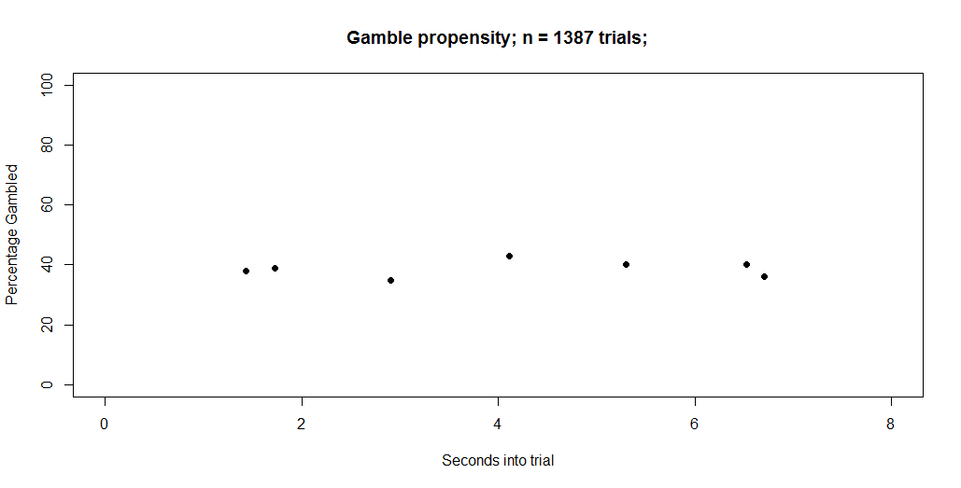
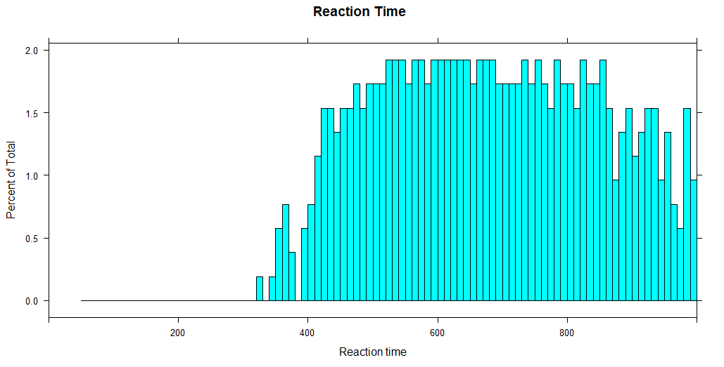
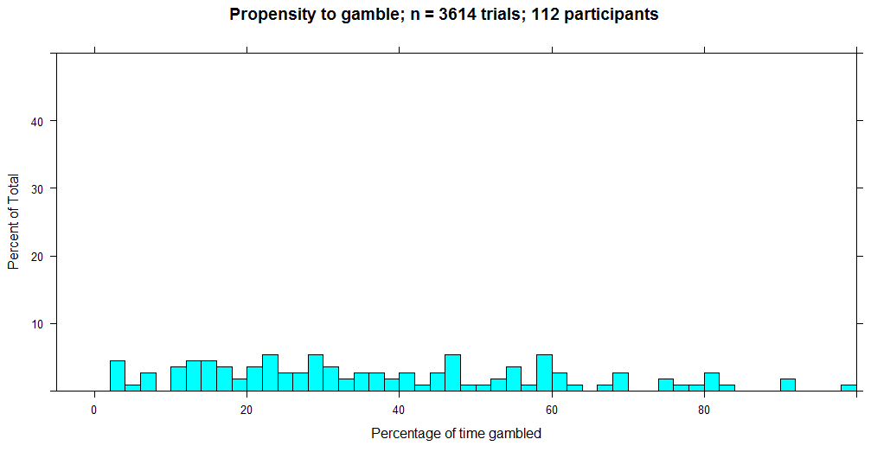
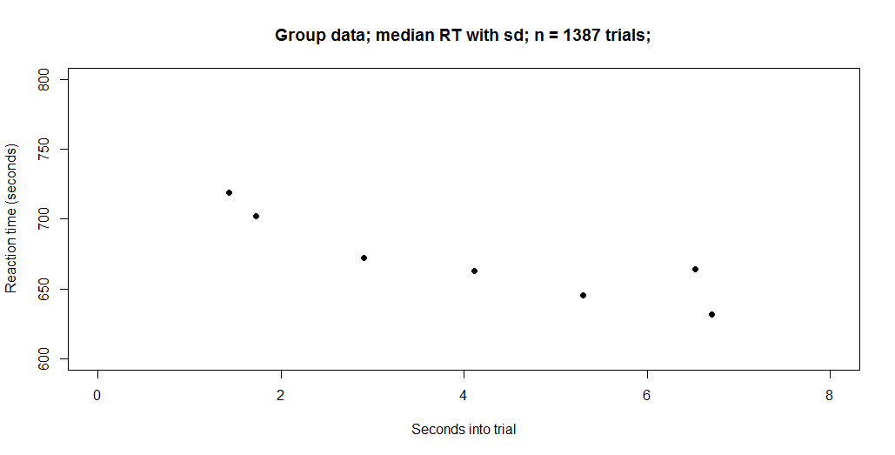
All participants filtered by trials that have a positive RPE1
oddsScore=44.53 (the higher it is, the more they gambled on high odds trials relative to low odds,
Ranges from -100 to 100).

Slide 16
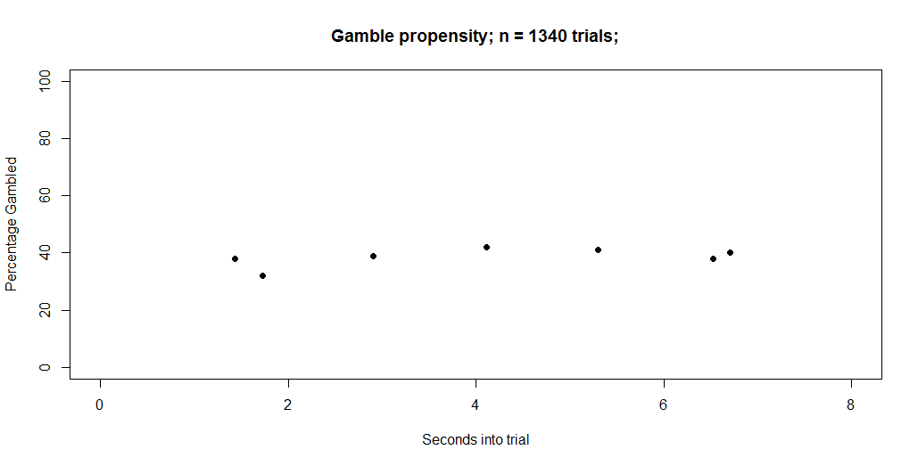
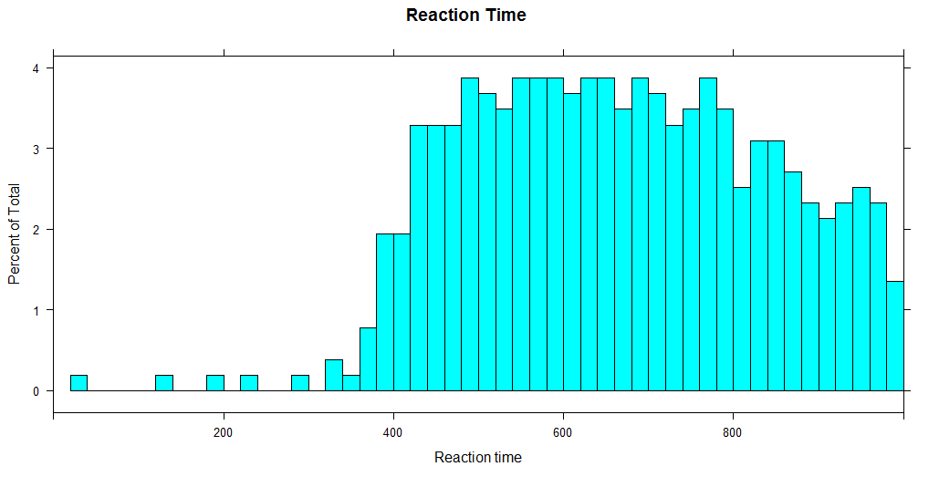
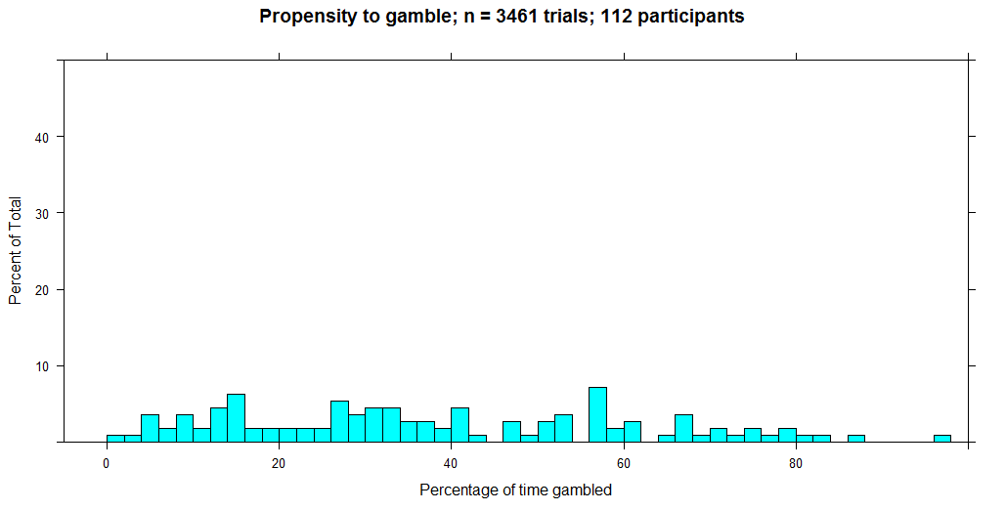
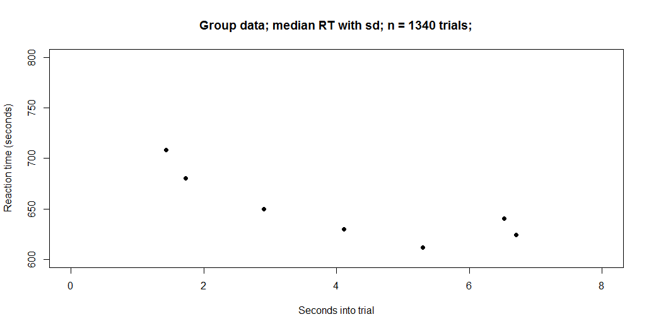
All participants filtered by trials that have a negative RPE1
oddsScore=40.11

Slide 17
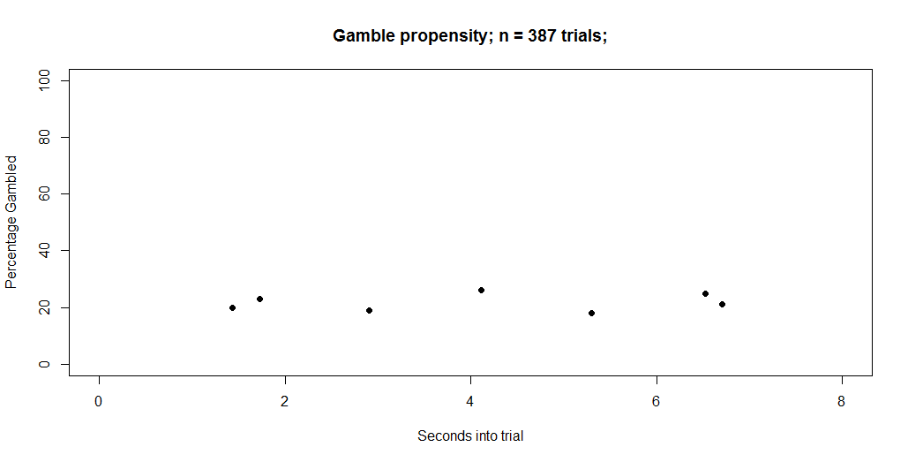
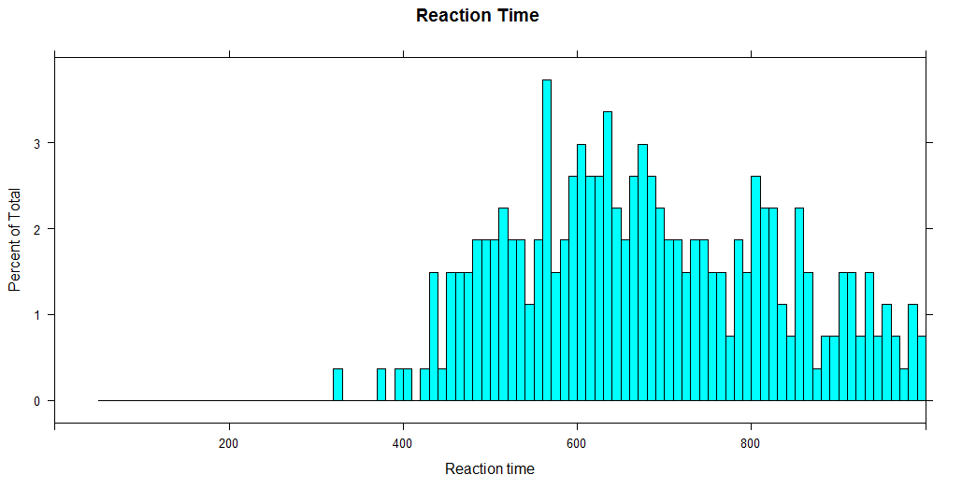
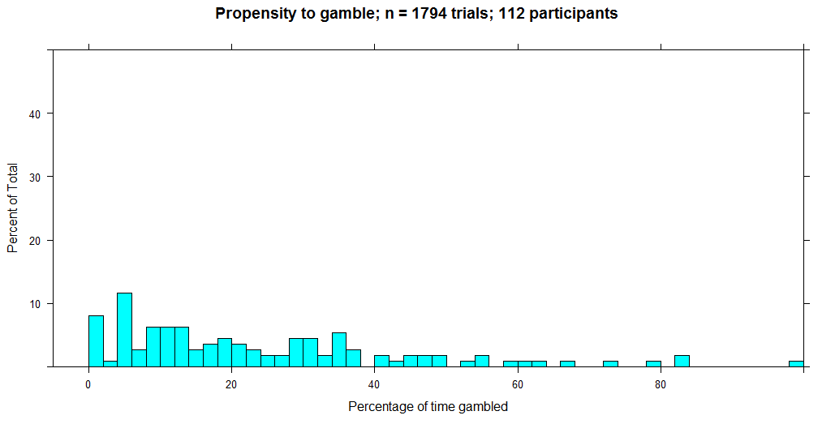
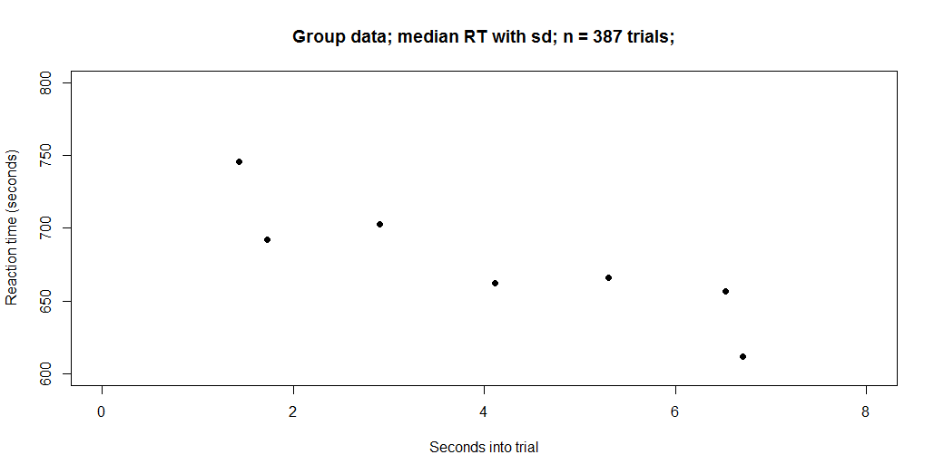
All participants filtered by trials that have a positive RPE3
oddsScore=36

Slide 18
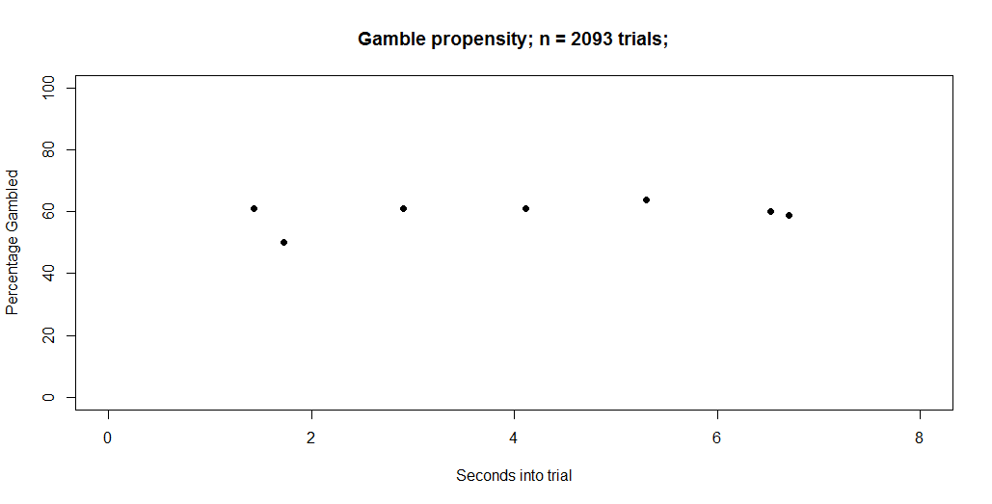
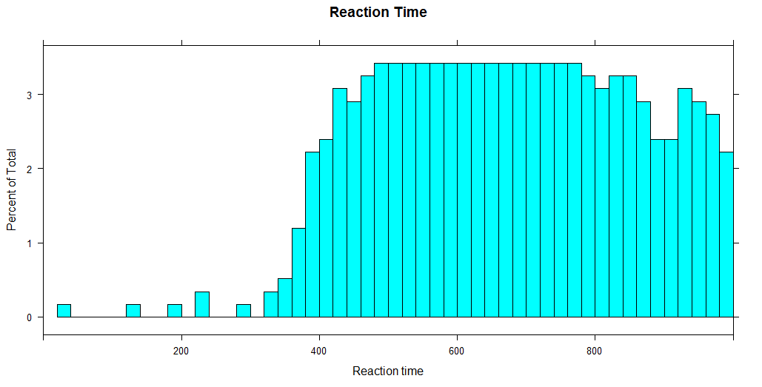
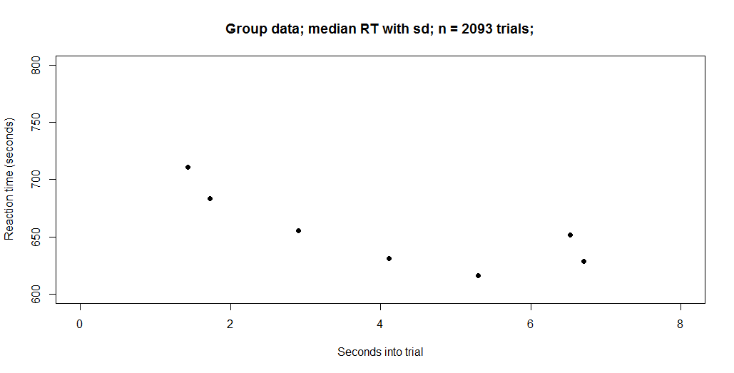
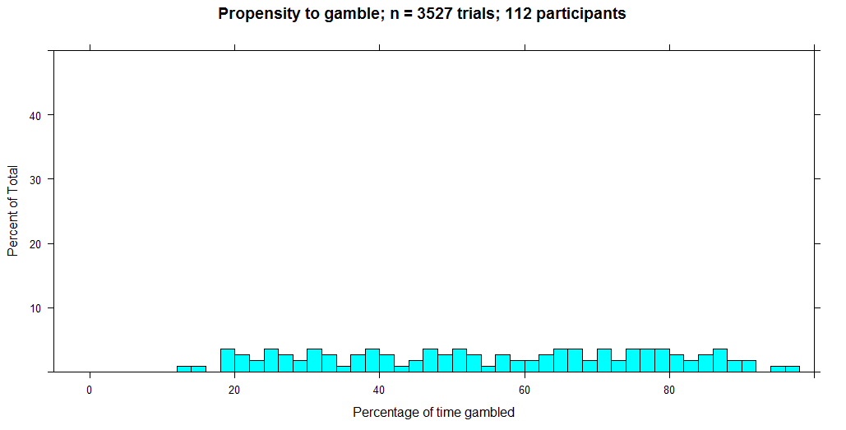
All participants filtered by trials that have a negative RPE3
oddsScore=43.92

Slide 19
Breaking down sub groups of participants who fulfill certain conditions
Subset (n=16) of participants who ‘logically gamble’
Participants who show positive ramp for propensity to gamble vs. gambleDelay
Participants who show negative ramp for RT vs. gambleDelay

Slide 20




Participants who gambled more often on high odds vs. low odds; ‘logical’ gambling; n=16. oddsScore is 94.12

Slide 21




Participants who gambled more often on high odds vs. low odds; ‘logical’ gambling
Low Odds
Mid Odds
High Odds
Behavior (how
much did EACH
participant
gamble)
No data (logical participants
don’t gamble on low odds trials)
Behavior (how
much did EACH
participant
gamble as a
function of
gambleDelay)

Slide 22




Participants who show ramping n=15 (i.e. gamble propensity is affected by gambleDelay

Slide 23






Participants who show ramping n=15 (i.e. gamble propensity is affected by gambleDelay)
Low Odds
Mid Odds
High Odds
Behavior (how
much did EACH
participant
gamble)
Behavior (how
much did EACH
participant
gamble as a
function of
gambleDelay)

Slide 24




Participants who show RT ramping n=13 (i.e. RT is affected by gambleDelay)

Slide 25






Participants who show RT ramping n=13 (i.e. RT is affected by gambleDelay)
Low Odds
Mid Odds
High Odds
Behavior (how
much did EACH
participant
gamble over
gambleDelay)
How often did
they choose
to gamble

Slide 26



Participants who show RT ramping n=13 (i.e. RT is affected by gambleDelay)
Low Odds
Mid Odds
High Odds
Behavior (This
row is same
as last page)
Behavior RT

Slide 27




Bigger subgroup of participants who show rtRAMP (p<.1; n=33)

Slide 28






How did rtRAMP subgroup (n=33 participants) respond to odds
OddsScore=28.23
Behavior (how
much did EACH
participant
gamble over
gambleDelay)
How often did
they choose
to gamble

Slide 29



How did rtRAMP subgroup (n=33 participants) respond to odds
OddsScore=28.23
Behavior (how
much did EACH
participant
gamble over
gambleDelay)
Behavior RT

Slide 30








Comparing overall RTs between groups
When gambling
Red=AllParticipants
Blue=RT rampers (n=33)
When accepting sure thing
Red=AllParticipants
Blue=RT rampers (n=33)
When gambling
Red=AllParticipants
Blue=gamble rampers (n=33)
When accepting sure thing
Red=AllParticipants
Blue=gamblerampers (n=33)
When gambling
Red=AllParticipants
Blue=logical Gamblers (n=33)
When accepting sure thing
Red=AllParticipants
Blue=logical Gamblers (n=33)
When gambling
Red=AllParticipants
Blue=atn gamblers(n=54)
When accepting sure thing
Red=AllParticipants
Blue=atn gamblers(n=54)

Slide 31



Atn gamblers (participants who passed both catch trials (n=54 participants)

Slide 32




Past data set of all participants who showed decreasing RT ramp

Slide 33
Future steps?
Need to determine best way to correlate gambling ramp slope with rt ramp slope in meaningful way.
See how odds modulates this relationship in different subgroups.
Increase trials per participant?
Increase number of trials that don’t have a gamble?

Slide 34




Correlating gambleSlopes with rtSlopes
R2=.022
p=0.13
R2=.019

Slide 35



Correlating gambleSlopes with rtSlopes in different oddsConditions for RT rampers
Low odds
High odds
Mid odds

Slide 36



Correlating gambleSlopes with rtSlopes in different oddsConditions for everyone
Low odds
High odds
Mid odds

