Slide 1
Ramping risk-taking
Examining the dynamics of how a progressing value function changes gambling behavior in humans
Desrochers Lab meeting 8.31.18
Guillaume Pagnier

Slide 2
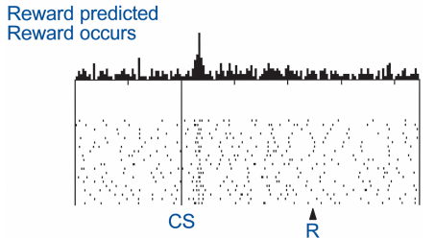
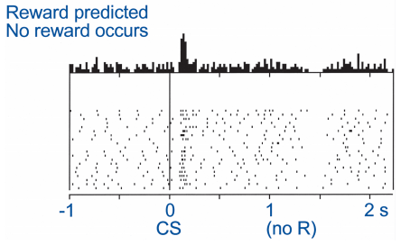
Reward Prediction Errors (RPEs) guide reward learning
Fast, phasic dopamine (DA) spikes in the striatum occur when participants experience reward, effectively reinforcing positive actions.
Phasic DA = RPEs
Schultz, W. (2001). Book review: Reward signaling by dopamine neurons. The Neuroscientist, 7(4), 293-302.

Slide 3
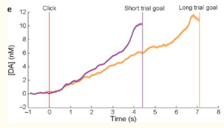
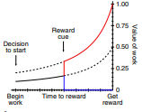
Separately from RPEs, DA encodes motivation and decreases RT
Slower, ramping DA also increases up until a goal in rats during an instrumental task. Thought to encode the value of work.
Howe, M. W., Tierney, P. L., Sandberg, S. G., Phillips, P. E., & Graybiel, A. M. (2013). Prolonged dopamine signalling in striatum signals proximity and value of distant rewards. Nature, 500(7464), 575. Figure 2e.
Hamid, A. A., Pettibone, J. R., Mabrouk, O. S., Hetrick, V. L., Schmidt, R., Vander Weele, C. M., ... & Berke
, J. D. (2016). Mesolimbic dopamine signals the value of work. Nature neuroscience, 19(1), 117.

Slide 4
Does DA affect the value of a gamble?
Altering DA affects risk taking behavior in rats and humans.
Anticipation of a reward increases striatal activity via BOLD in humans.
Theoretical models of DA (Collins & Frank, 2014) predict that DA changes value of a reward (see below).
↑DA = increased activation of D1 pathway.
Increased activation of D1 pathway = rewards are more important than punishments (per Collins & Frank model).
Rewards are more important = more likely to gamble?

Slide 5
Does proximity to a reward affect an individual’s propensity to gamble?

Slide 6
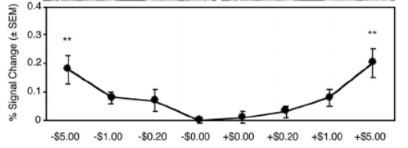
Interesting figure from 2001 paper
This was the most interesting human finding I found that looked at NA activation during anticipation.
NA activation during anticipation of gain/loss of money; Knutson et al., 2001

Slide 7
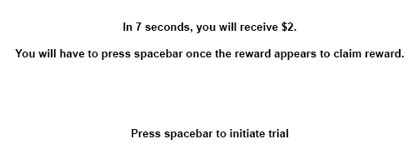

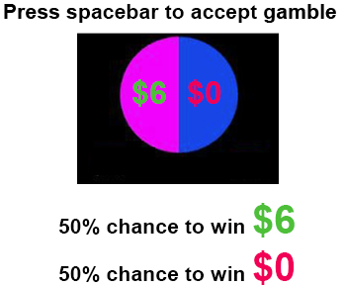

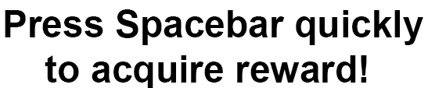
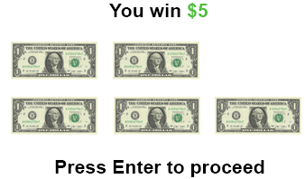
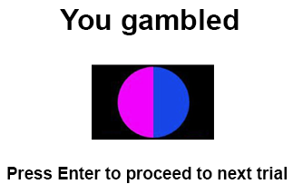
Task
Ignore
Yes

Slide 8
Conditions
Magnitude
Low
Trials that offer $1 or $2
Mid
Trials that offer $3 or $4
High
Trials that offer $5 or $6
Conditions
Low
Gambles that offer 1.5* guaranteed amount
Mid
Gambles that offer 2* guaranteed amount
High
Gambles that offer 3* guaranteed amount
Prediction Error
Low
RPE<0
High
RPE>0

Slide 9
Version 1
-Lasts 8 seconds
-Does not pause during gamble
-Gamble is present for 3.5 seconds
Results
N=120 usable participants
-Did not see any effect of gamble delay.
-Saw a small effect of RT decreasing as gamble interrupted later in the progress bar.
Version 2
-Lasts 8 seconds
-Does not pause during gamble
-Gamble is previewed before progress bar starts for 3 seconds.
-Gamble is present for 1 second during progress bar.
Results
N=40 usable participants.

Slide 10
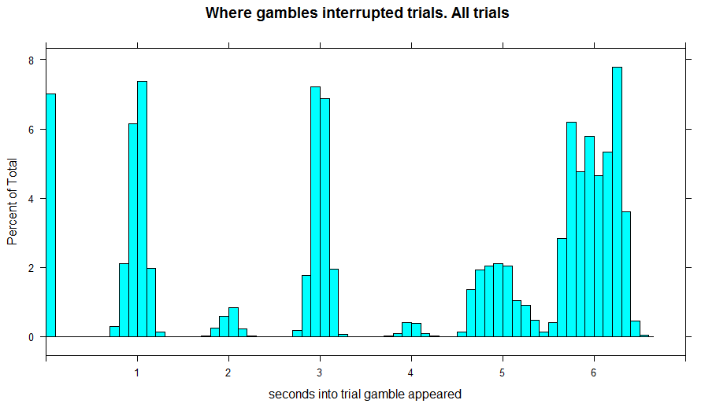
Results V02

Slide 11
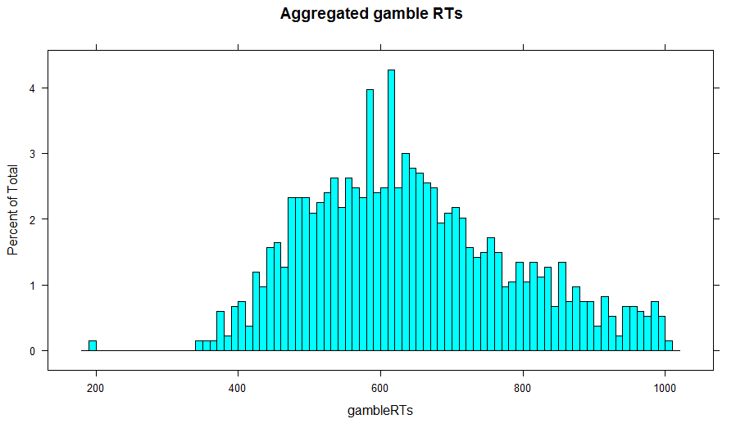
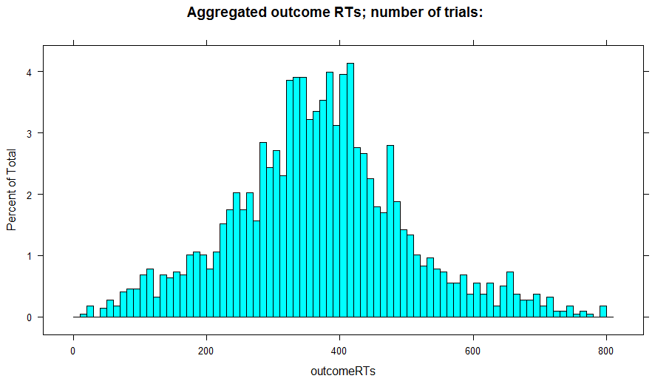
Aggregated RTs
N=1336 trials
N=2117 trials
3522 opportunities to gamble
Gambled on 37.9% of opportunities

Slide 12
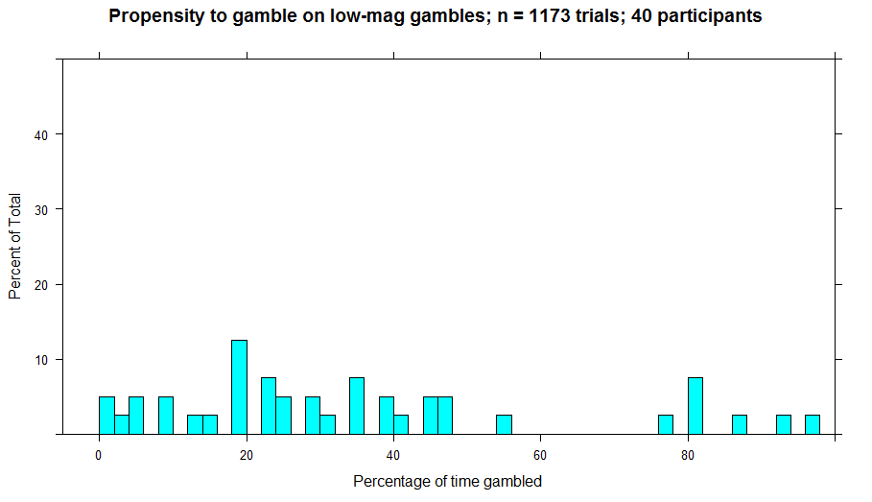
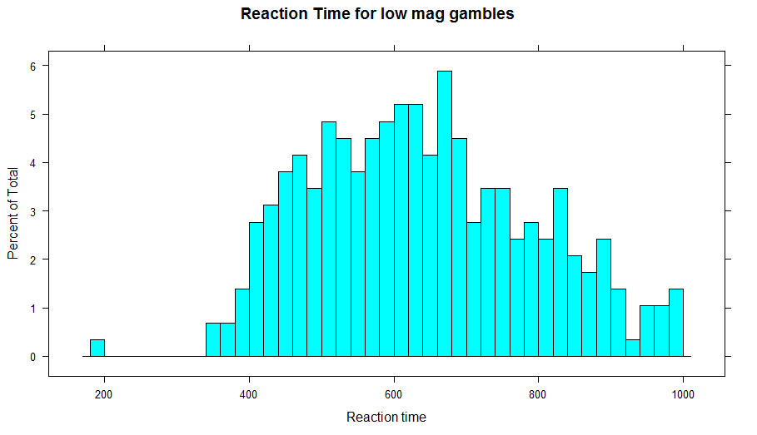
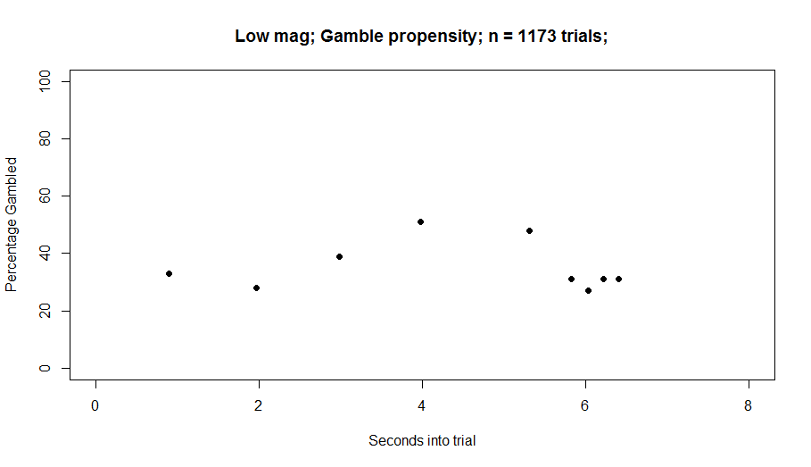
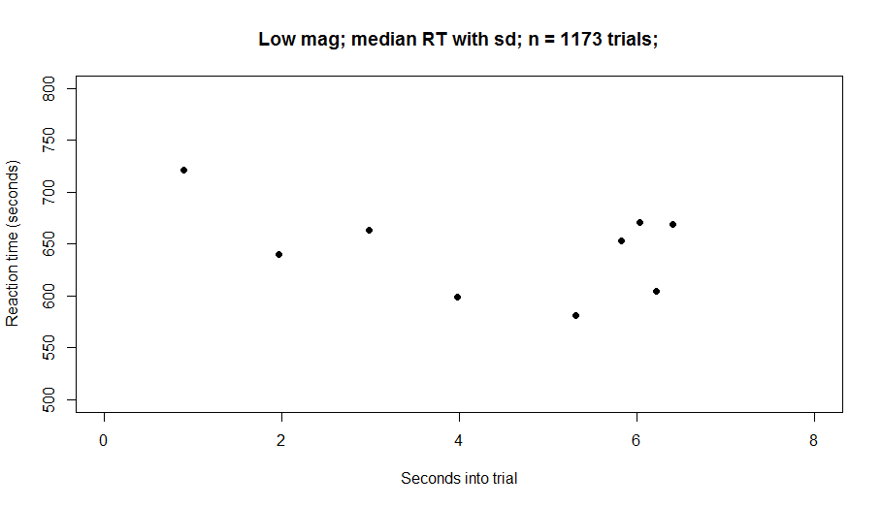
LowMag: Gambled 430 out of 1173 chances or 36.67%

Slide 13
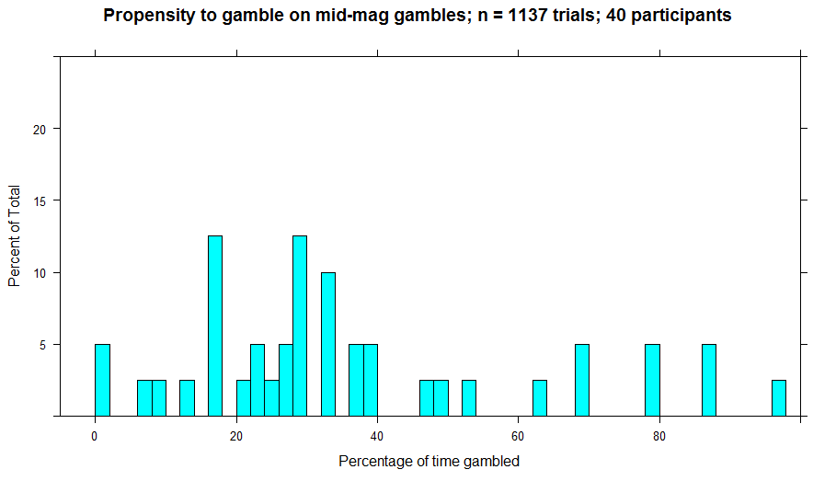
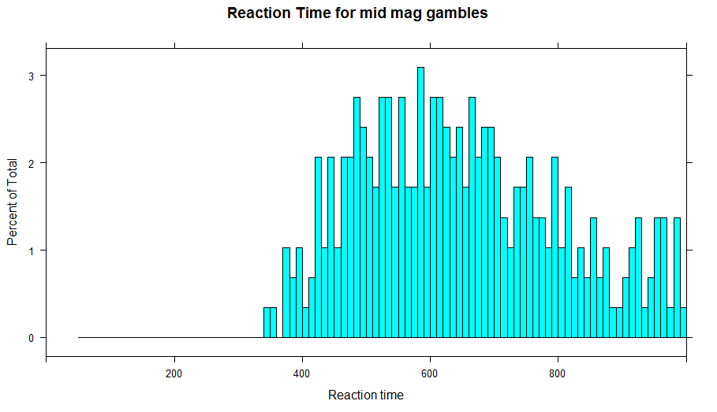
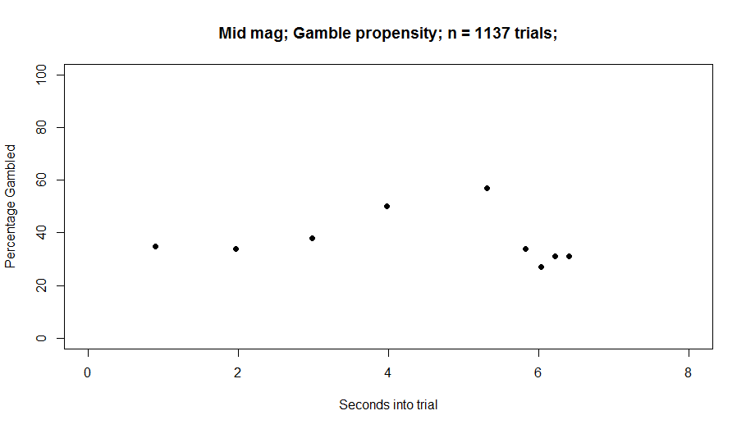
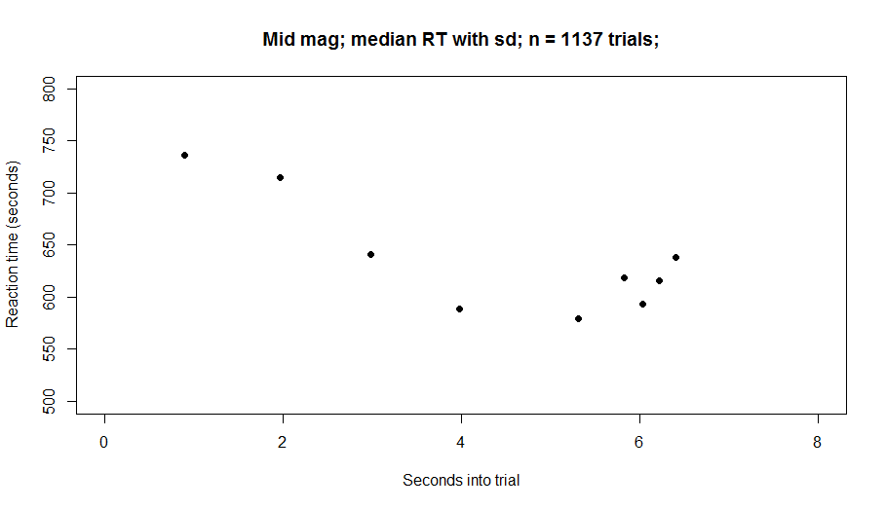
MidMag : Gambled 424 out of 1137 chances or 37.2%

Slide 14
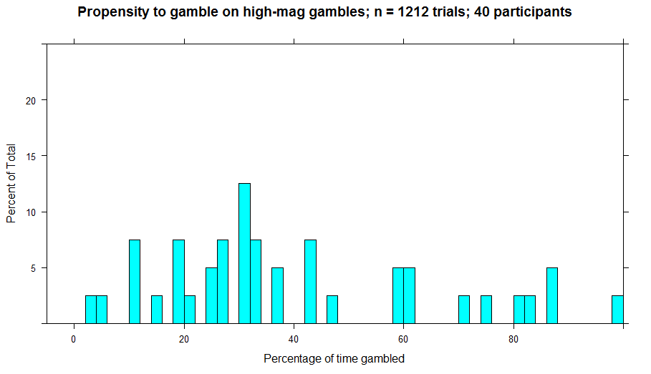
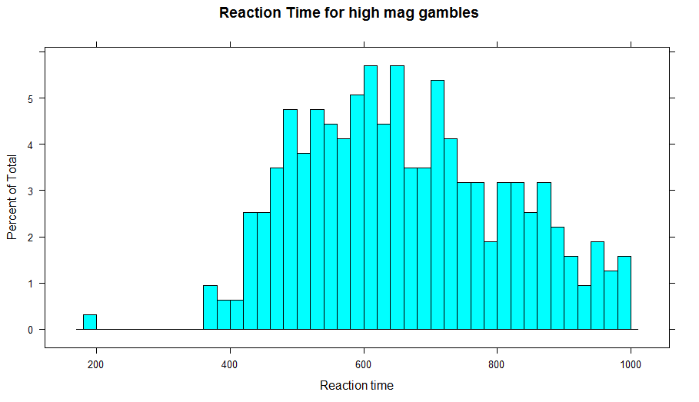
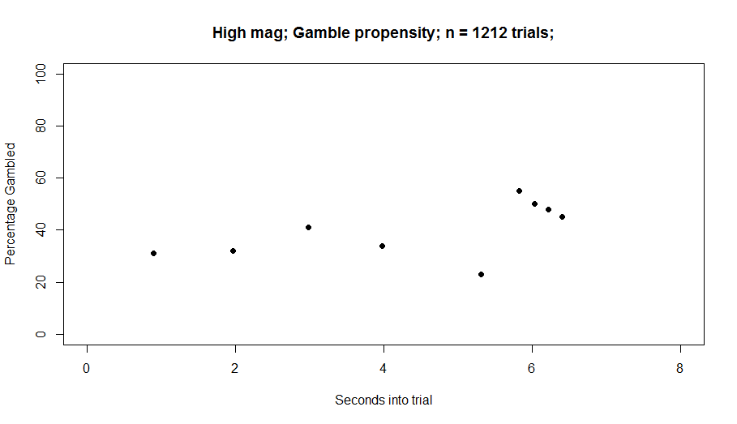
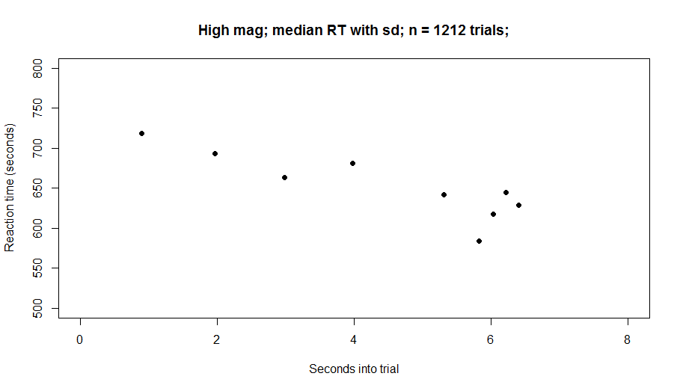
HighMag: Gambled 445 out of 1212 chances or 36.7%

Slide 15
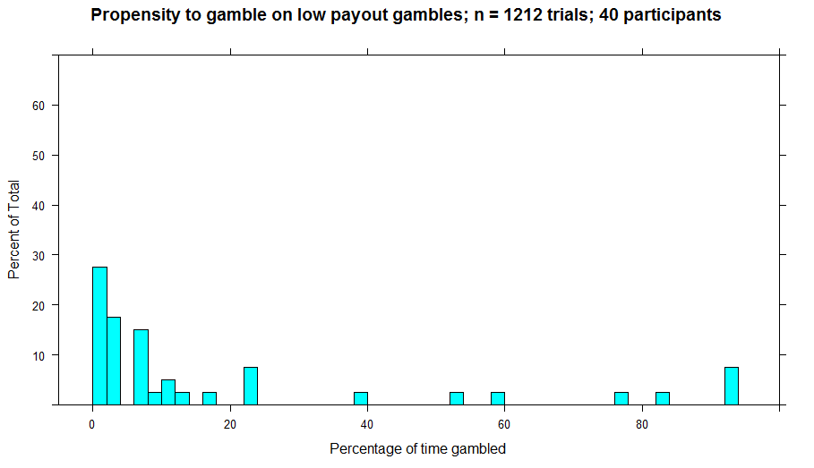
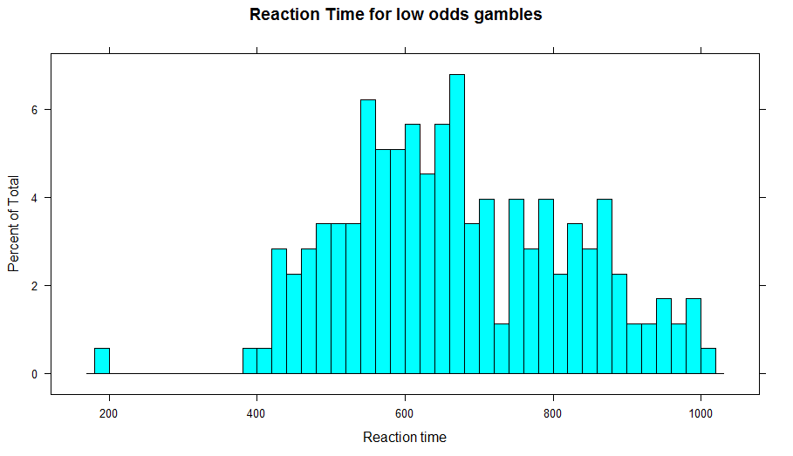
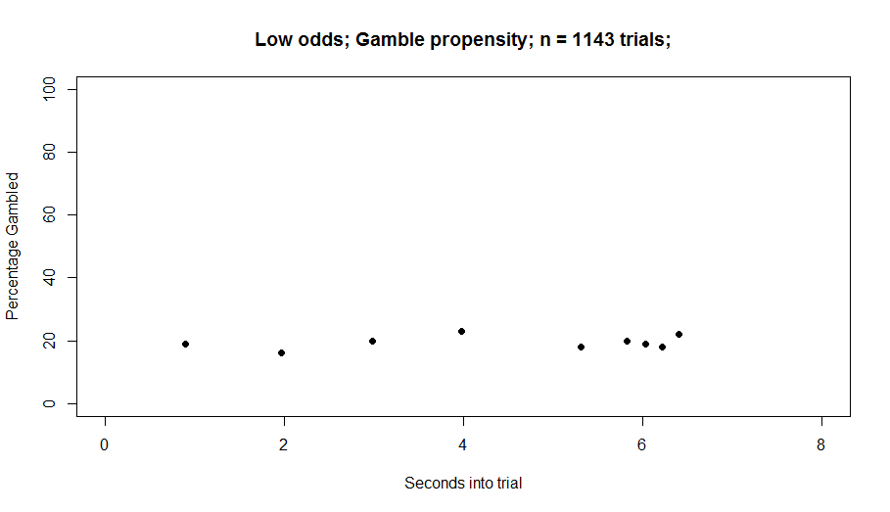
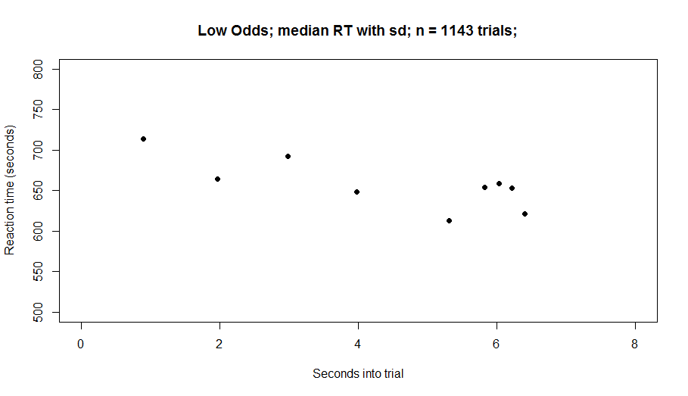
LowOdds: Gambled 219 out of 1143 chances or 19.1%

Slide 16
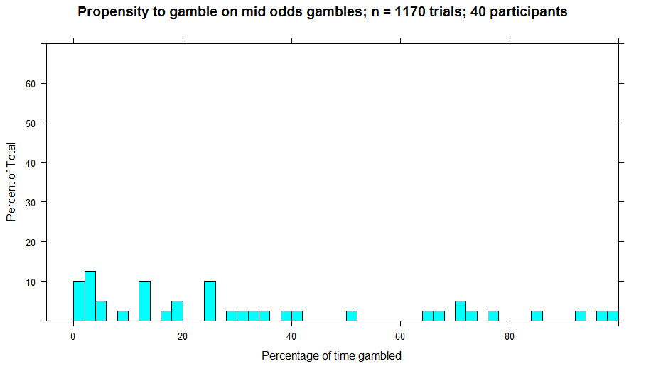
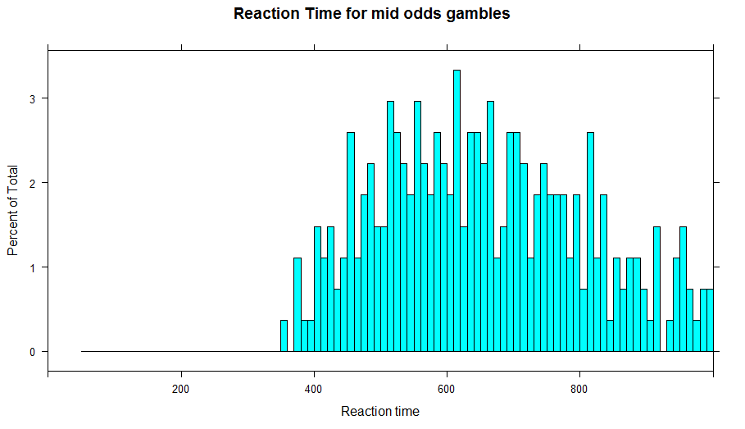
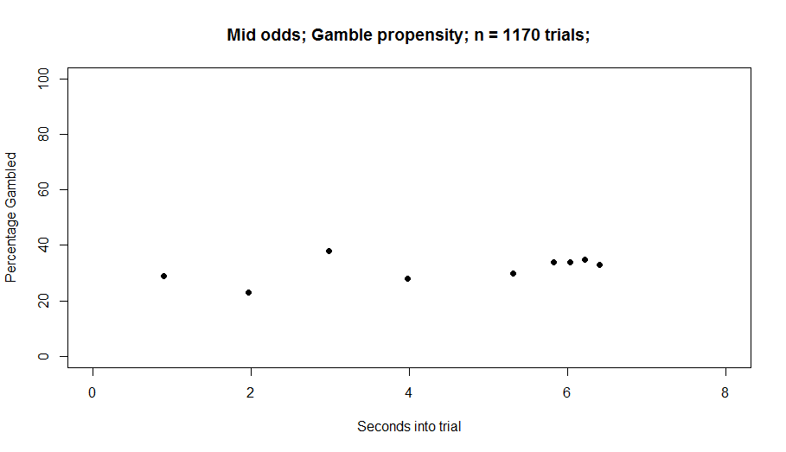
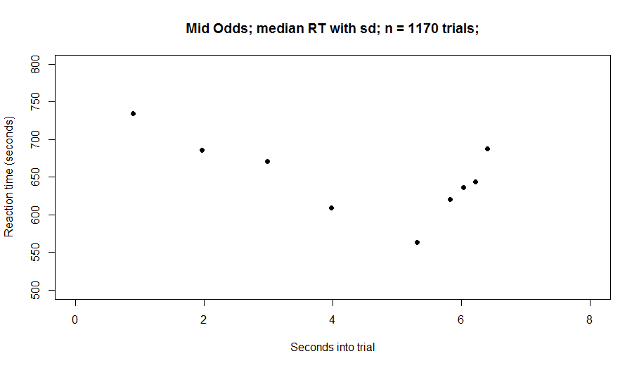
MidOdds: Gambled 378 out of 1170 chances or 32.3%

Slide 17
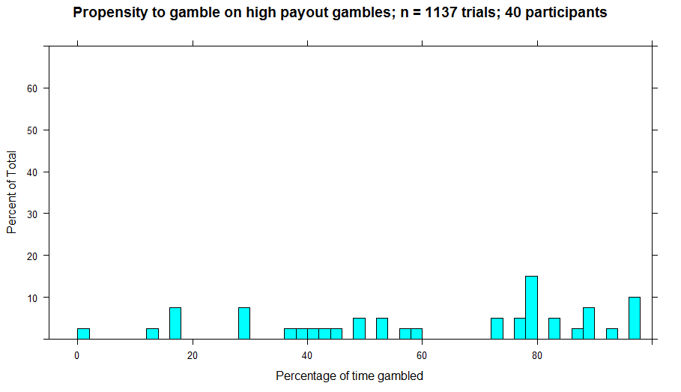
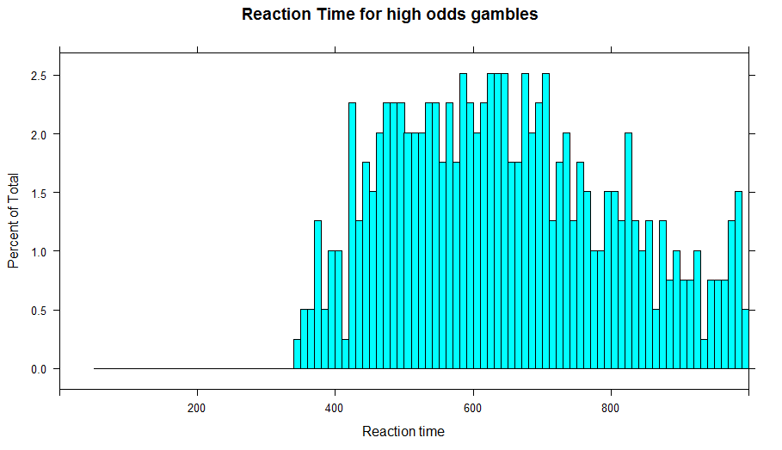
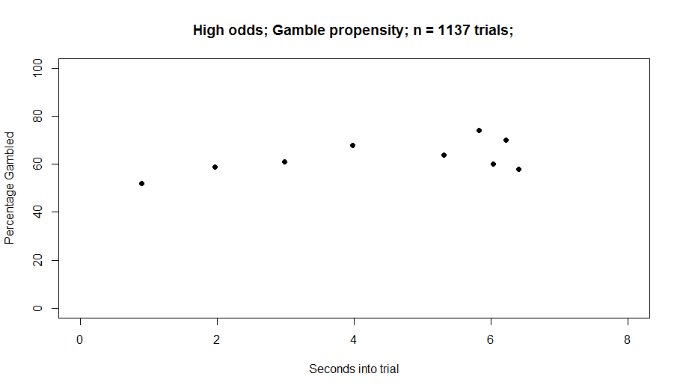

HighOdds: Gambled 718 out of 1137 chances or 63.8%

Slide 18
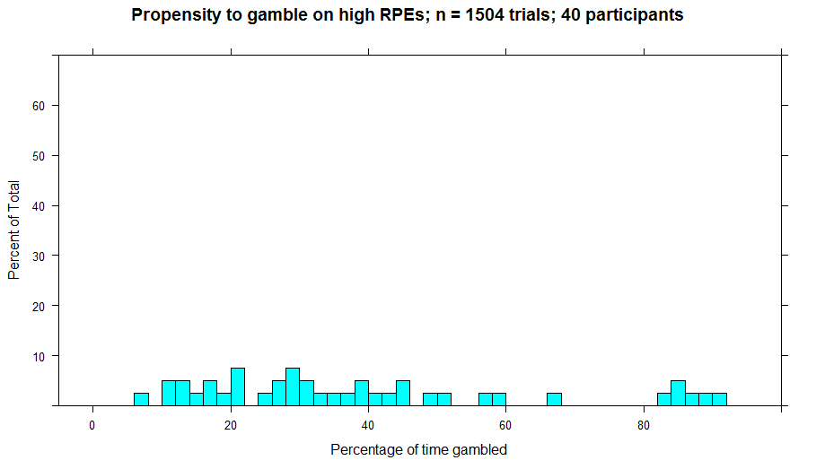
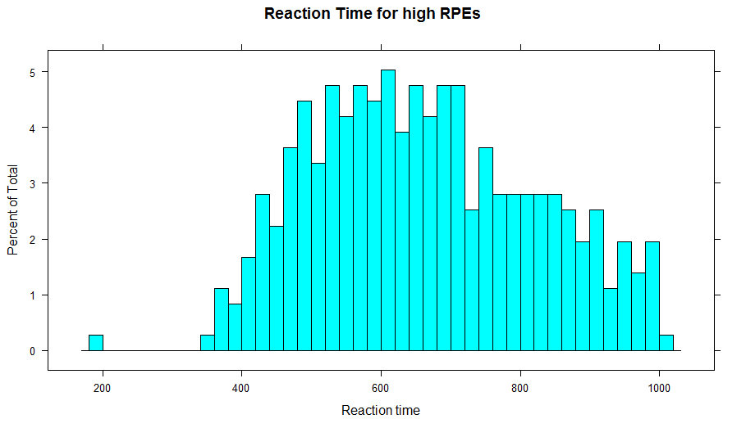
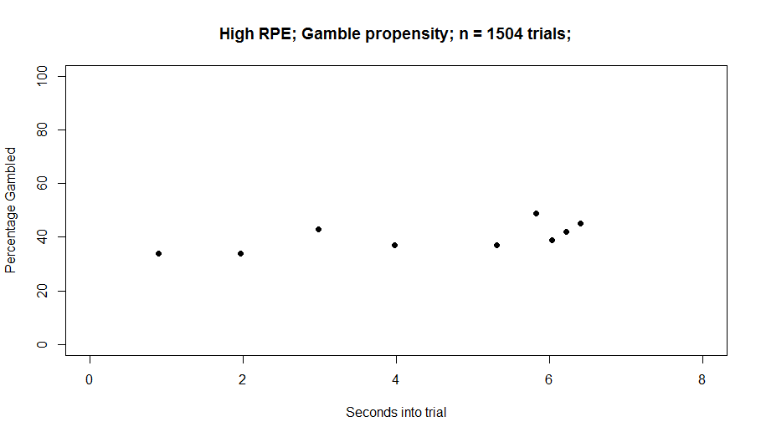
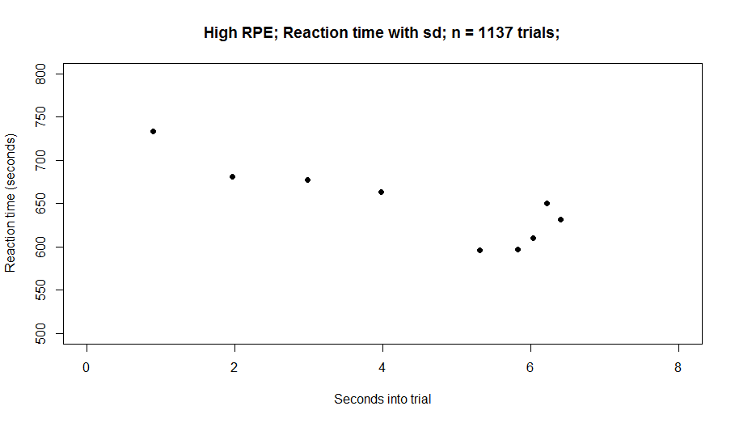
HighRPE: Gambled 597 out of 1504 chances 39.6%

Slide 19
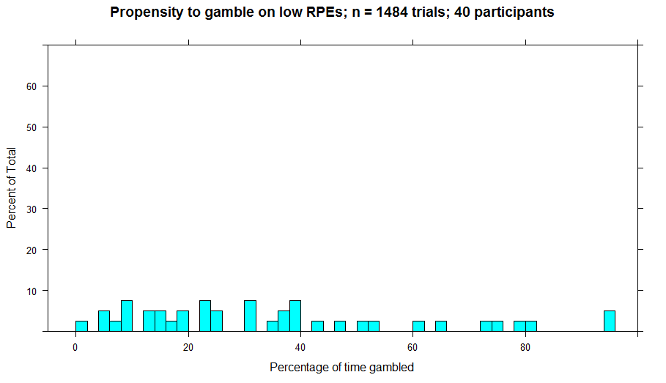
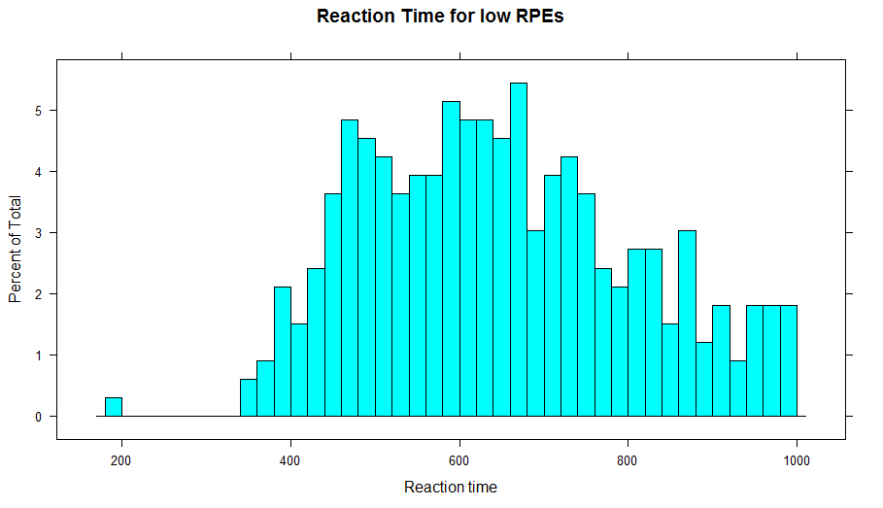
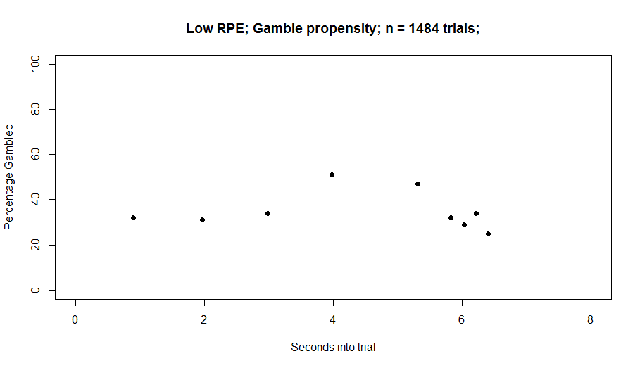
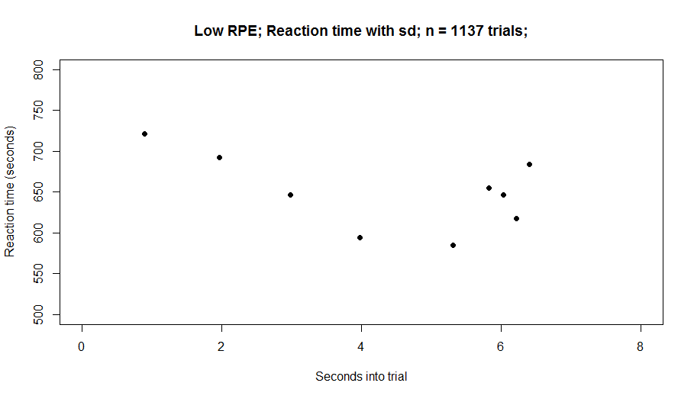
LowRPE: Gambled 533 out of 1484 chances or 35.9 %

Slide 20
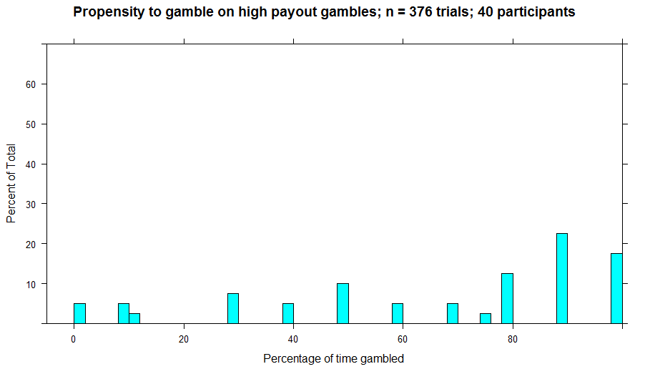
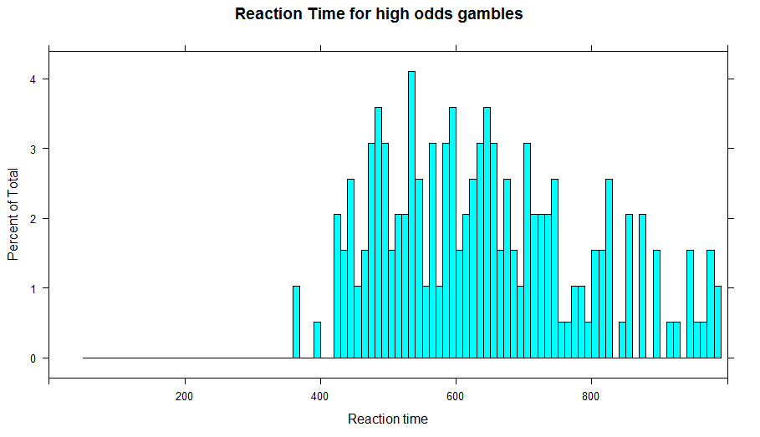
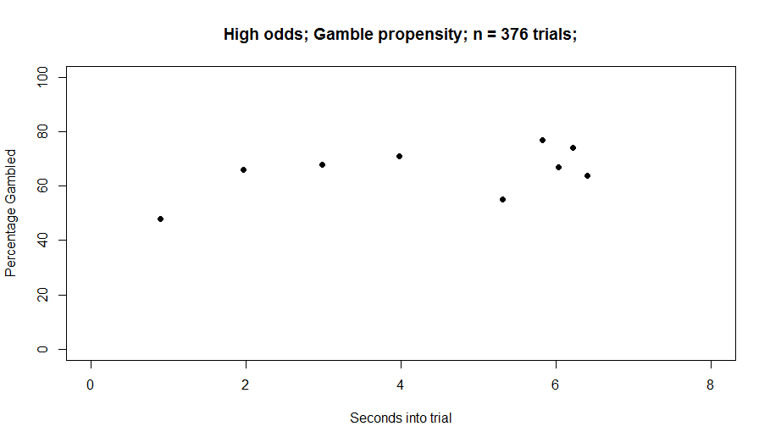
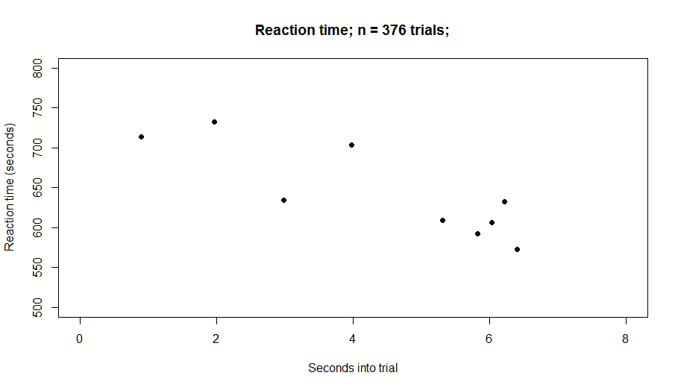
High odds and high mag: Gambled on 66.7%, out of 376 trials

Slide 21
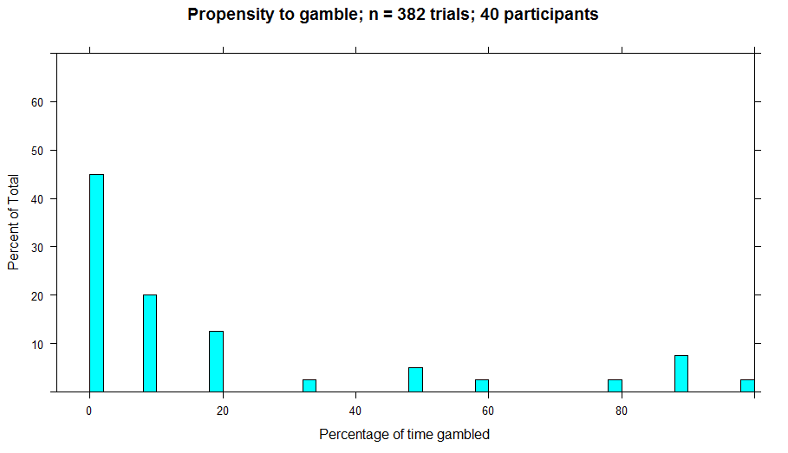
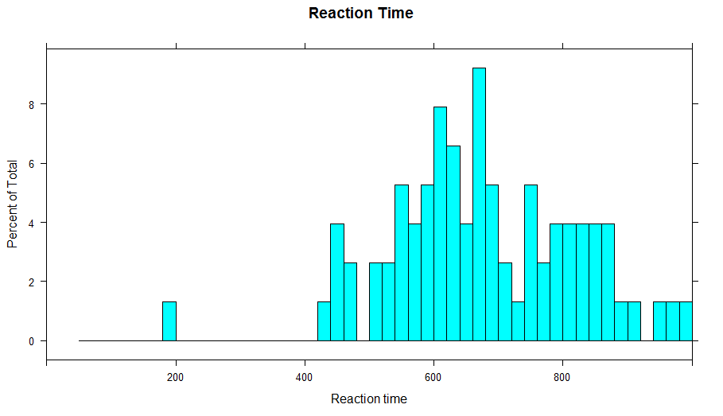


Low odds and Low mag: Gambled on 66.7%, out of 376 trials

Slide 22


Summary of all data

Slide 23






Individual participants that show ramping n=3 and behavioral info.
Conclusion: The three participants who showed the most ramping all
gambled frequently (among the top 5 most among non-excluded participants)

Slide 24

Relationship between gamble percentage and slope coefficient of ramp?
All data

Slide 25
To do list
Run more participants in V02
V03 – Instrumental yes/no
Gamble pauses
Changing length of progress bar?
Tweaking odds/mag parameters?

Slide 26
Looking ahead…

Slide 27
modelling
addiction
sequences
choice
RAMP
Compulsive behavior
habits
two-step task
risk
gambling
model-free habitual dm
RL
explore/exploit
probability
working memory
reward
model-based goal-directed dm
anticipation
DA
Individual differences

Slide 28
modelling
addiction
sequences
choice
RAMP
Compulsive behavior
habits
two-step task
risk
gambling
model-free habitual dm
RL
PhD?
explore/exploit
probability
working memory
reward
model-based goal-directed dm
anticipation
DA
Individual differences

Slide 29
Examining the interaction between habit and reward in influencing choice, anticipation, and learning.

Slide 30
Background
Instrumental actions can be either goal-directed or habitual. Possible that habits are ‘action sequences’ i.e. sequences of actions that become chunked together.
Habits formation involves, to some degree, the striatum.
Optogenetically manipulating the striatum affects compulsive behavior in mice.
Addiction/compulsive behavior has been framed as ‘habit dysfunction’.
Burguière, E., Monteiro, P., Feng, G., & Graybiel, A. M. (2013). Optogenetic stimulation of lateral orbitofronto-striatal pathway suppresses compulsive behaviors. Science, 340(6137), 1243-1246.
Everitt, B. J., & Robbins, T. W. (2005). Neural systems of reinforcement for drug addiction: from actions to habits to compulsion. Nature neuroscience, 8(11), 1481.
Desrochers, T. M., Amemori, K. I., & Graybiel, A. M. (2015). Habit learning by naive macaques is marked by response sharpening of striatal neurons representing the cost and outcome of acquired action sequences. Neuron, 87(4), 853-868.
Dezfouli, A., & Balleine, B. W. (2012). Habits, action sequences and reinforcement learning. European Journal of Neuroscience, 35(7), 1036-1051.

Slide 31
Sequence A
Delay?
Low Reward
Training of sequence A
Choice
Sequence B
Delay?
High Reward
No sequence
Reward?
Delay?
Notes:
Skeleton task. TONS of manipulations.
Once you hit a benchmark RT after some criteria, what choices do you make?

Slide 32

Does variable reward promote learning during the training phase? Is there an interaction with the type of sequence learned?
How often do people even prefer the practice’ sequence? How comfortable does someone have to be to reliably choose practiced sequence? Is there a novelty bonus?
Does the type of sequence (CSS-cognitive vs. SRTT-motor) affect choice inflection point?
Individual differences in choice?
Does adding delay interfere with choice?
What’s going on in the brain???

Slide 33
Thoughts?

