Slide 1
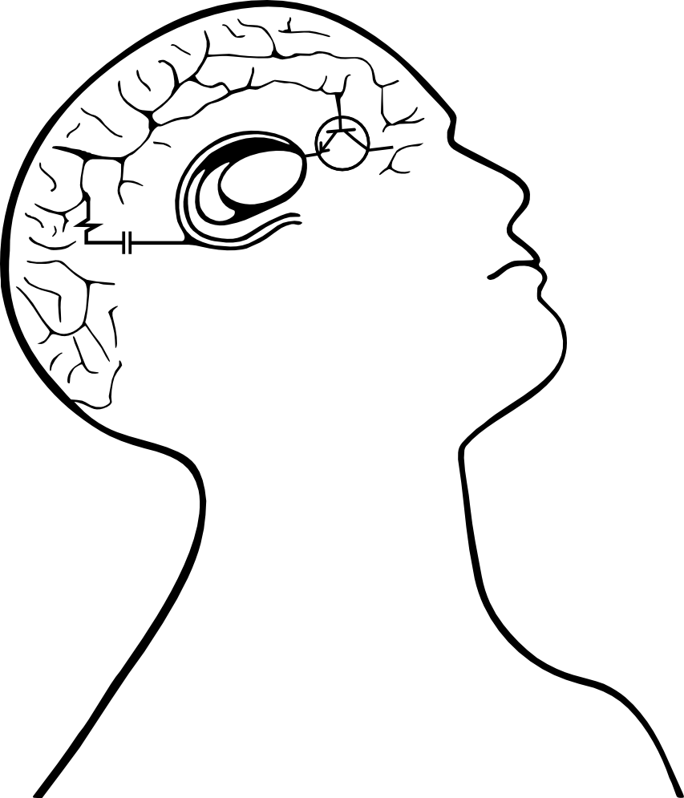


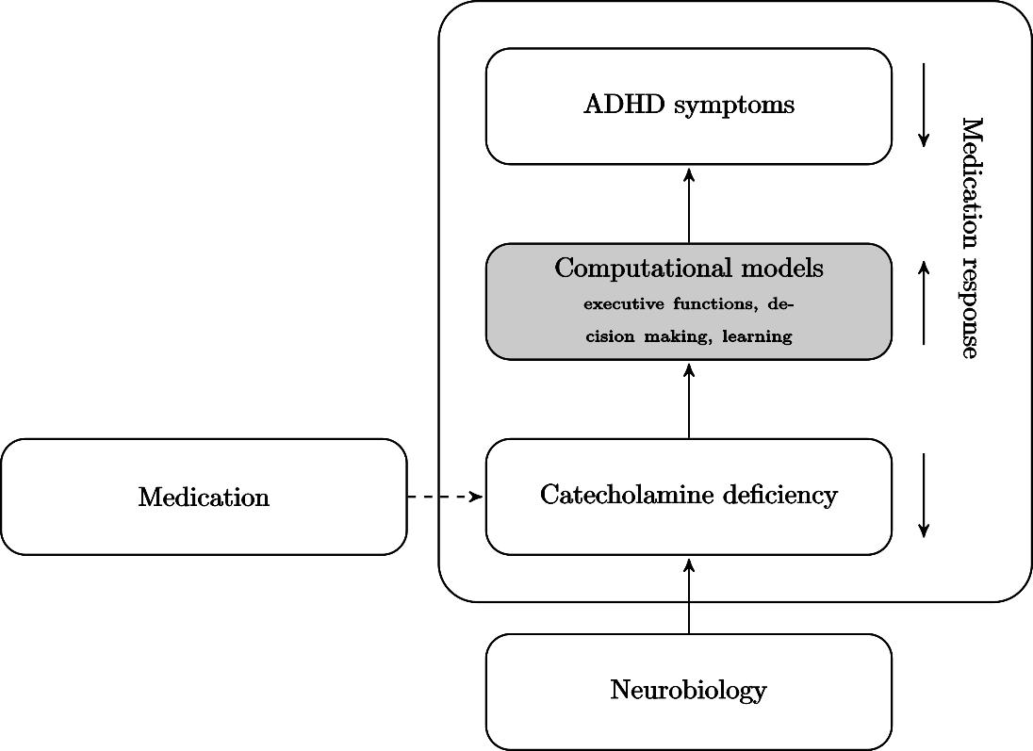
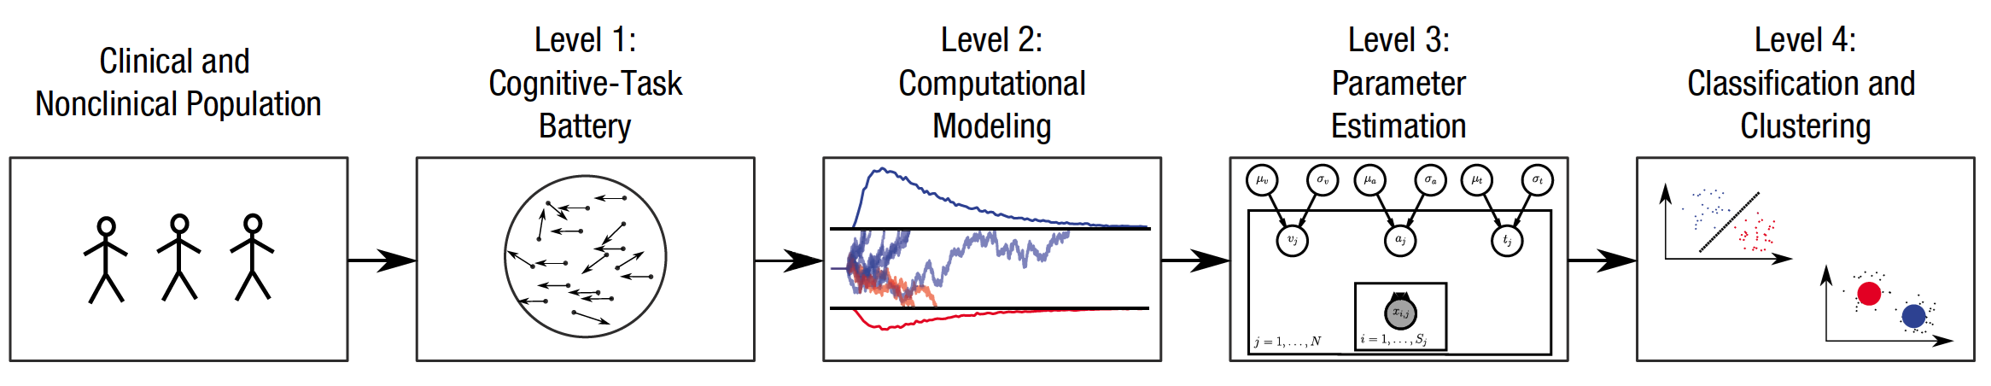
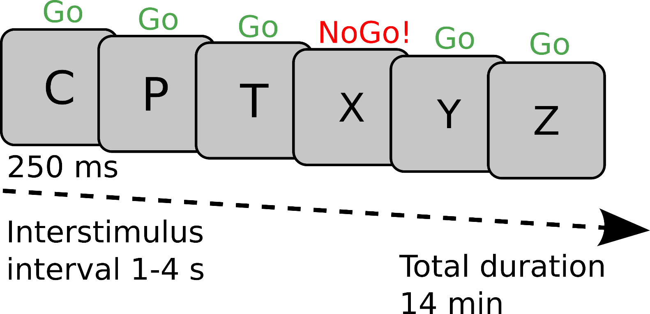
Ramping risk-taking: Progressing value function increases gambling in humans Guillaume J. Pagnier^{1,2}, Andrew Westbrook² & Michael J. Frank^{1,2} ¹Department of Neuroscience, Brown University ²Department of Cognitive, Linguistic and Psychological Sciences, Brown University
Background
Results
Phasic dopamine (DA) spikes in the striatum occur when participants experience reward, effectively reinforcing rewarding actions. This DA spike is called a positive Reward Prediction Error (RPE). RPEs are key to learning, evidenced in rodents and in humans.
Seperately from providing RPEs, DA also encodes motivation and subsequently decreases reaction time. The closer a rodent is to a reward, the faster they will respond.
DA also affects risky decision making.
Fig. Computational models mediate between neurobiological and functional levels. A. In a simplified model of ADHD and its medication, a patient’s neurobiology results in catecholamine deficiency, which impairs neurobiological processes underlying e.g. decision making. These impairments in turn manifest as ADHD symptoms. Medication response can be explained by higher catecholamine levels, which improve impaired processes, which in turn reduces symptoms. B. Computational psychiatry pipeline for approach to classification of clinical groups. B adapted from^{2.}
Performance on the CPT modeled with a modified drift diffusion model. Adult patients with ADHD were tested before onset of medication treatment and after 6 weeks of treatment. Baseline performance did not differ substantially between responders and non-responders on any of the parameters.
Effects of 6 weeks medication treatment:
Drift rate (v) improved more for responders than non-responders.
Decision threshold (a) increased more for responders than non-responders.
A
Drift rate
B
C
A
B
v
Decision threshold
Methods
Fig. Effect of medication on model parameters and posterior predicitive checks. A. Error bars represent 95% highest density intervals (HDI). B. Density plots are posterior distributions of medication response x session interaction effects, and horizontal bars show the 95% HDI. C. Quantile probability plot and density plot for observed and predicted accuracy and response time across conditions.
Data
Patients retrospectively grouped by medication response at one-year endpoint. Performance on CPT compared between groups before medication start and after 6 weeks of medication.
Task
CPT: 360 trials, 90% go-trials, 10% no-go trials. 14 minutes test session.
Model
To better capture response times and choices from the CPT we made two modifications to the DDM:
1. Modified the DDM to capture non-response³ :
p(go|a,z,v).
2. Mixture model to capture fast commission errors:
V_{i,j,nogo} = cat(p(V_{go}),p(V_{nogo})),
i=trial, j=subject.
Conclusions and future directions
Computational modeling identified improved performance for responders compared to non-responders after 6 weeks of medication treatment. Specifically, responders showed increased rate of evidence accumulation and extended decision thresholds compared to non-responders. The results show promise for using individual model parameters in combination with clinical assessment measures and demographic variables for earlier prediction of medication response in ADHD. Future directions are to use measures for classification of medication response with machine learning-algorithms.
References:
Retz, W., & Retz-Junginger, P. (2014). Prediction of methylphenidate treatment outcome in adults with attention-deficit/hyperactivity disorder (ADHD). European Archives of Psychiatry and Clinical Neuroscience, 264(S1), 35–43
Wiecki, T. V., Poland, J., & Frank, M. J. (2015). Model-Based Cognitive Neuroscience Approaches to Computational Psychiatry: Clustering and Classification. Clinical Psychological Science, 3(3), 378–399.
Ratcliff, R., Huang-Pollock, C. L., & McKoon, G. (2016). Modeling Individual Differences in the Go/No-Go Task With a Diffusion Model. Decision, 1–22.
Fredriksen, M., Dahl, A. A., Martinsen, E. W., Klungsøyr, O., Haavik, J., & Peleikis, D. E. (2014). Effectiveness of one-year pharmacological treatment of adult attention-deficit/ hyperactivity disorder (ADHD): An open-label prospective study of time in treatment, dose, side-effects and comorbidity. European Neuropsychopharmacology, 24(12), 1873–1884.
Notes:
After 6 weeks of treatment responders were shown to have greater improvement compared to non-responders on accumulation of evidence (drift rate: v) and response caution (boundary separation: a).
Twelve of 42 non-responders remained on medication after 1 year.
, such as the adult ADHD self-report scale (ASRS) and Global Assessment of Functioning (GAF),
If shown to be helpful, computational modeling of commonly used neuropsychological tests, such as the CPT, can be used as a tool for earlier detection of medication response.
across condition

