Slide 1
Ramping V04
10.22.18
201 participants – 131 useable

Slide 2
Facts about V04 – same as V03
8 second progress bar
Gamble is previewed for 3 seconds before each trial
Gamble is offered for a 1200 ms window sometime during the progress bar (
About 133 trials per participant
Progress bar does NOT pause during gamble

Slide 3
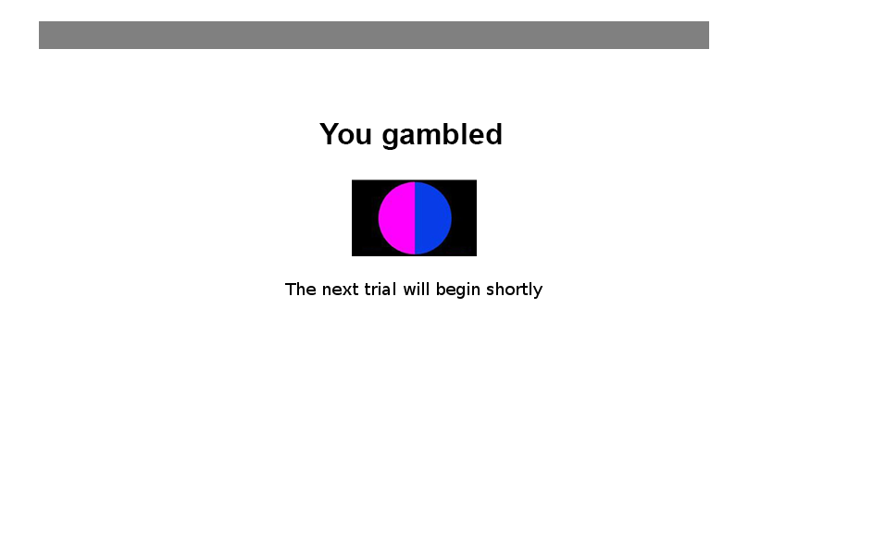
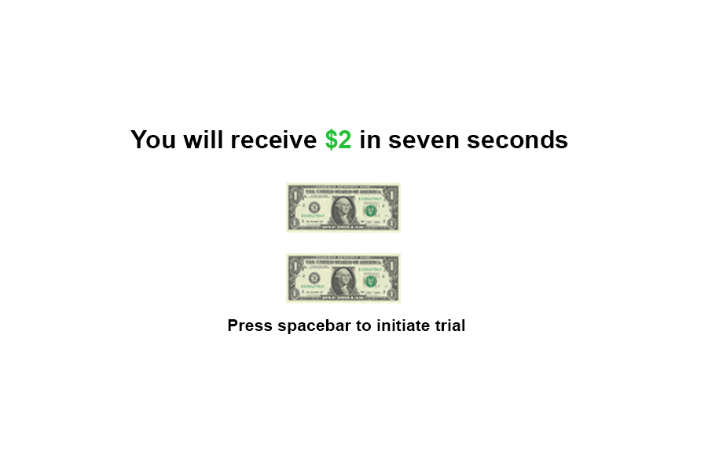
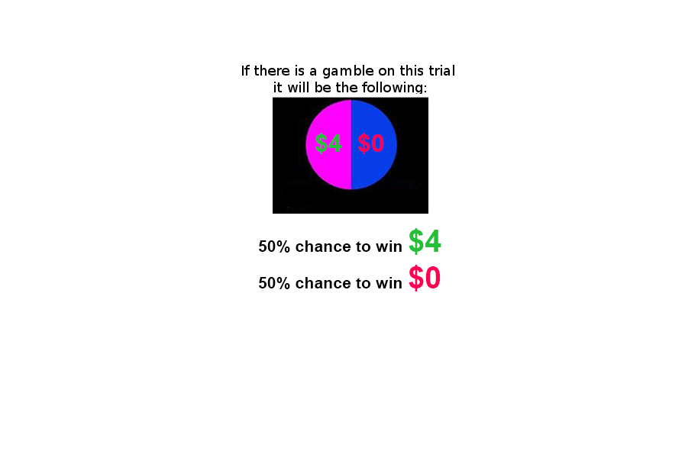

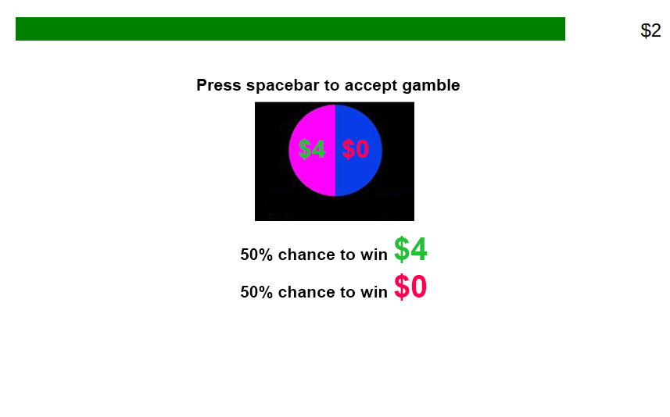
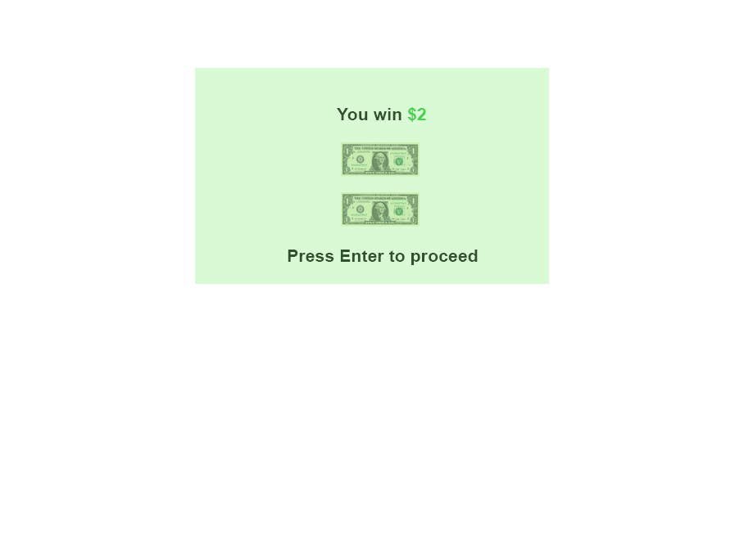
Gamble
Ignore

Slide 4
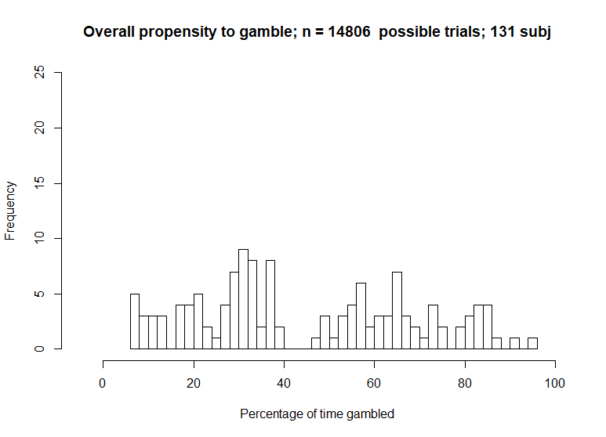
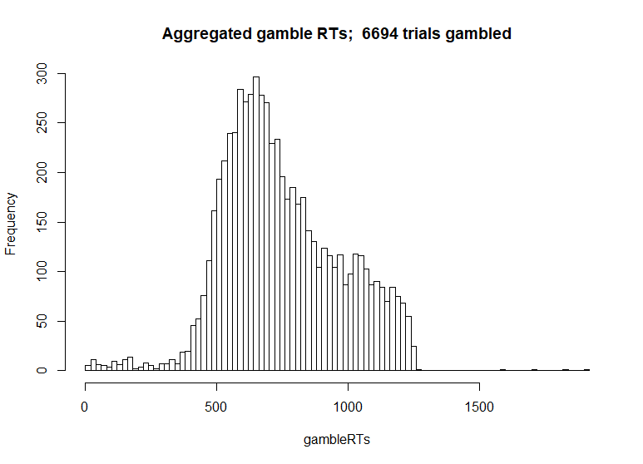
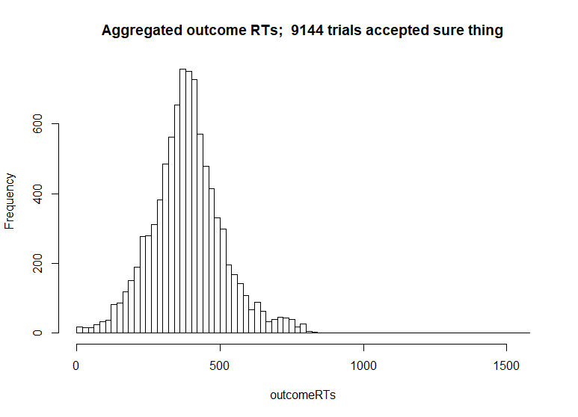
First order characteristics of 131 subj.

Slide 5
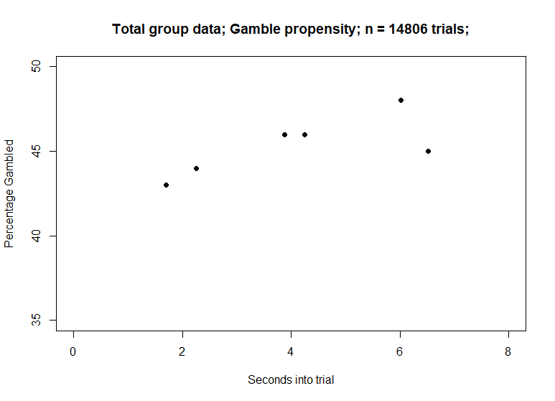
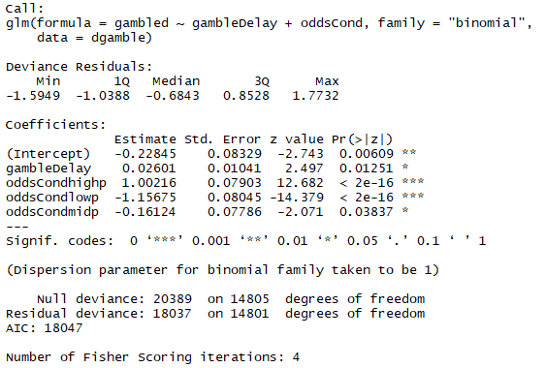
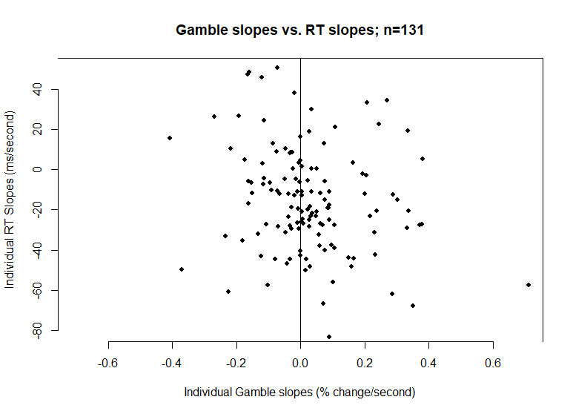
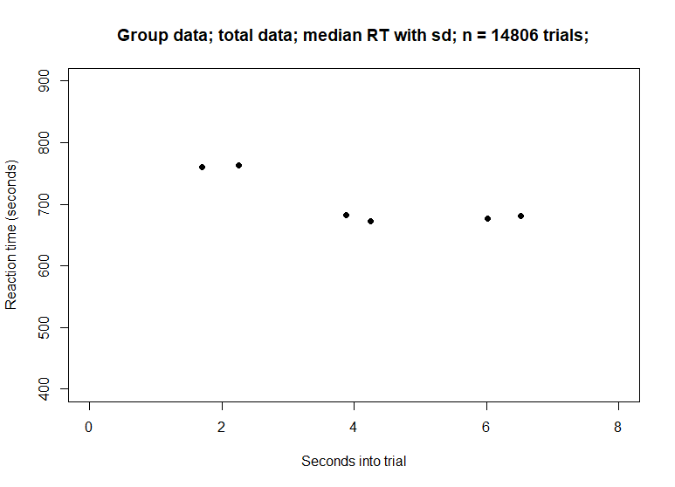
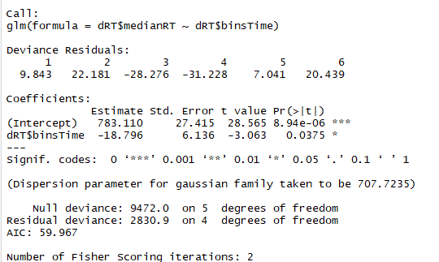
All data
Gamble vs RT slopes
Note: t test of gamble slopes
shows sig. different than 0 (p<.05).

Slide 6
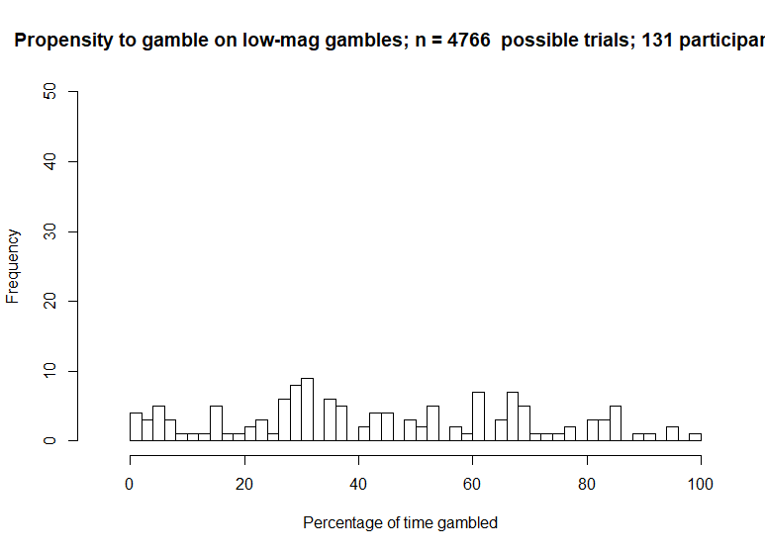
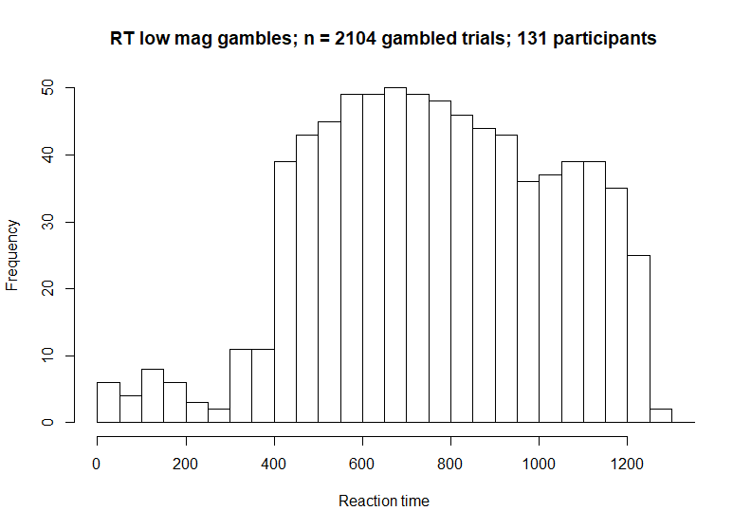
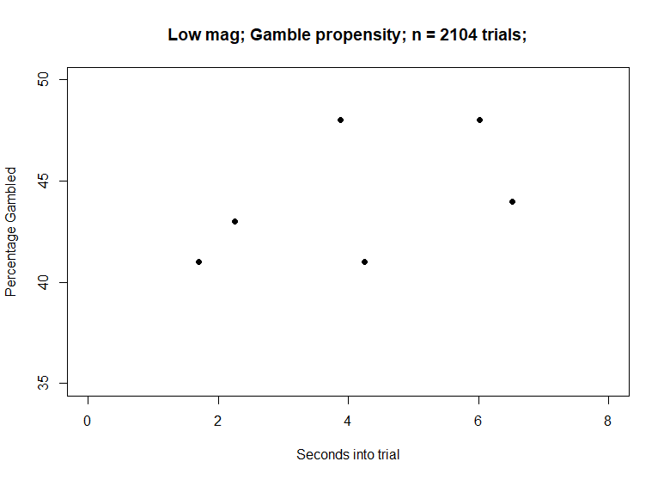
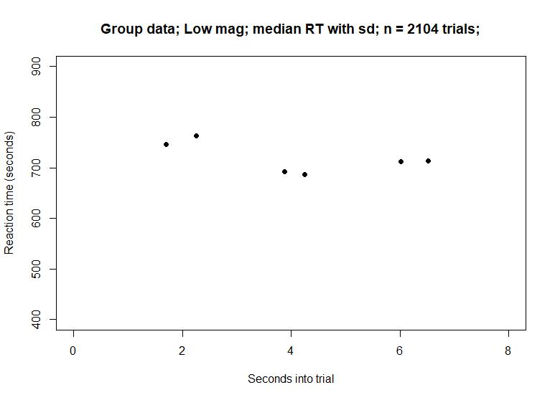
Low Mag

Slide 7

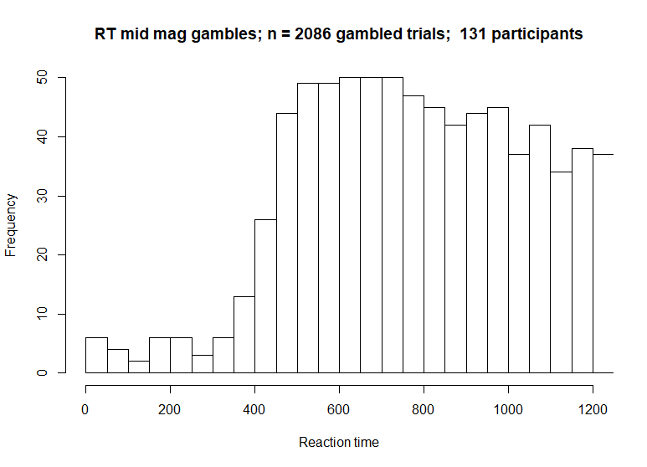
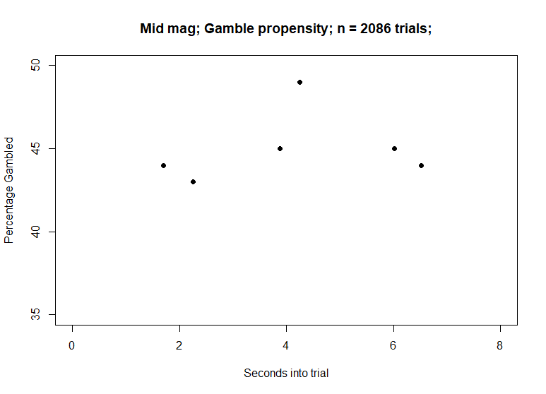
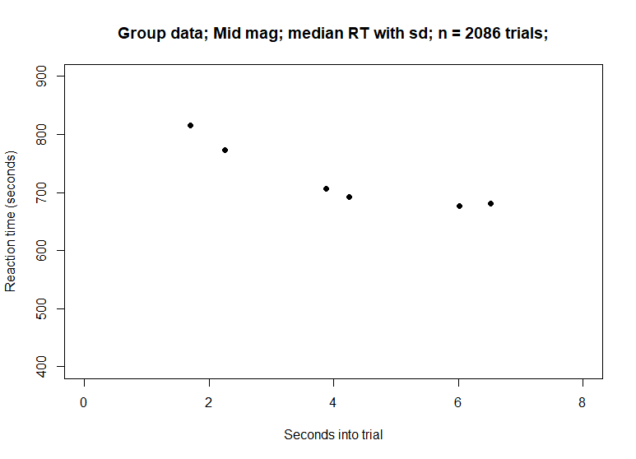
Mid Mag

Slide 8
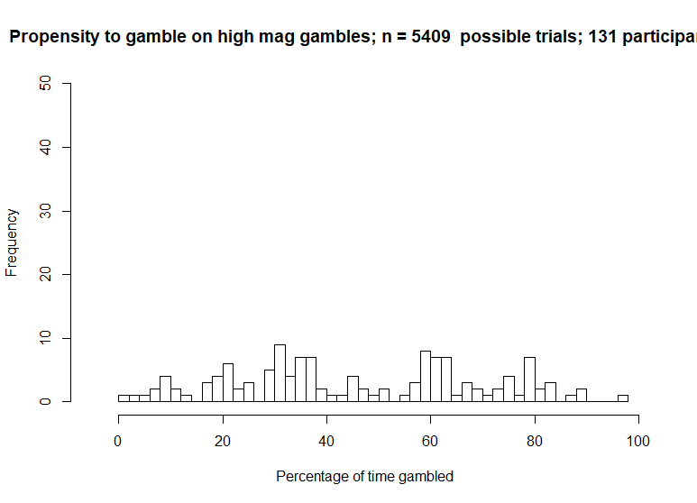
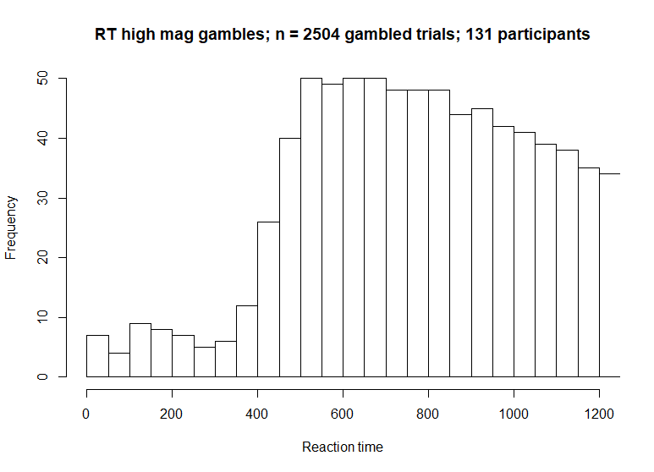
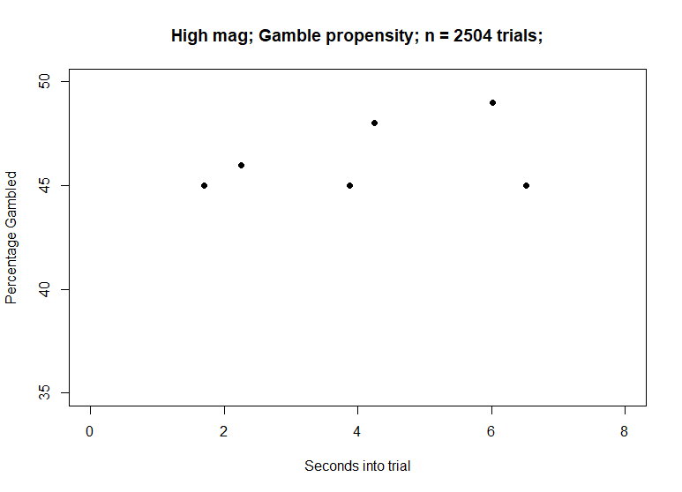
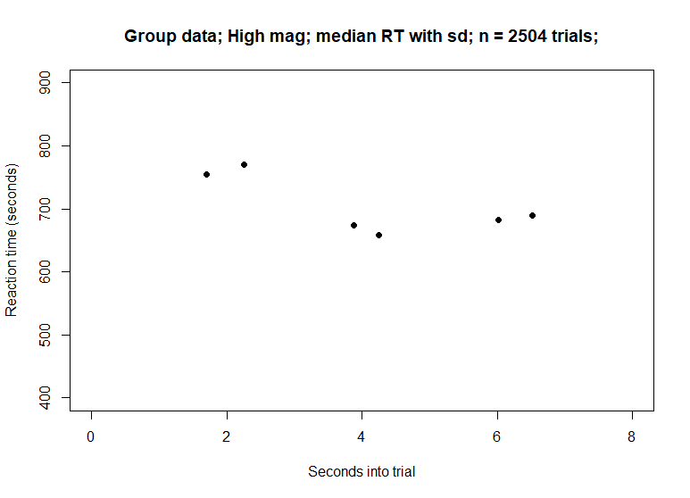
High Mag

Slide 9
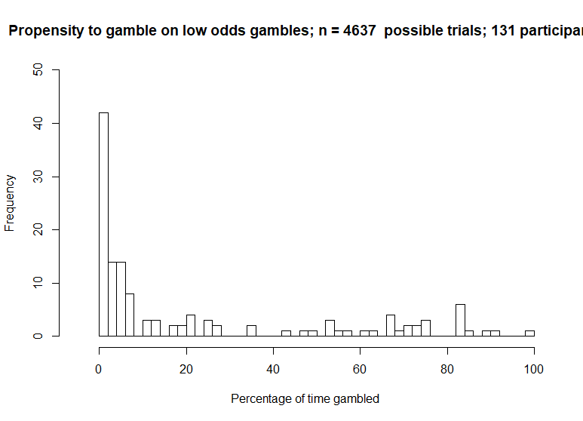
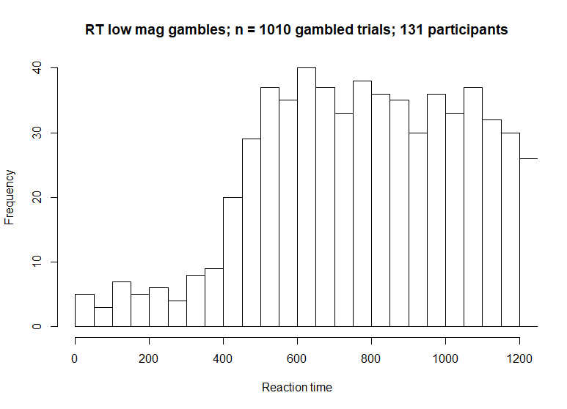
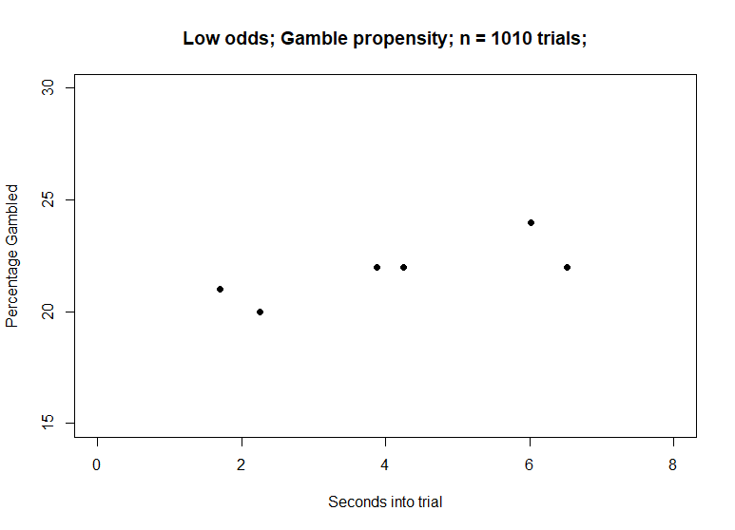
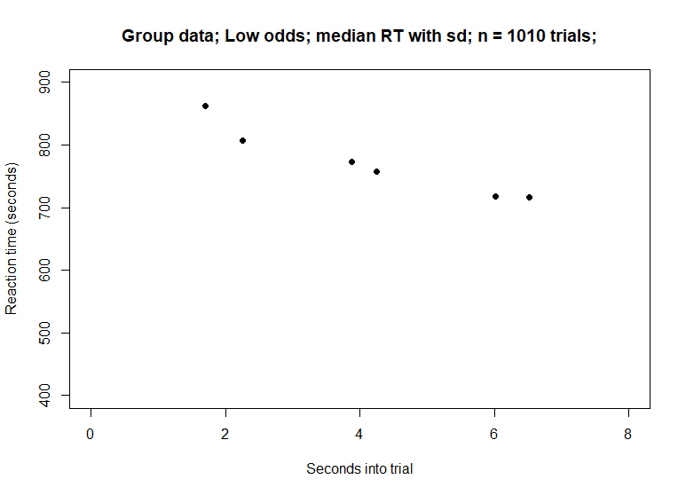
Low value (previously called odds)

Slide 10
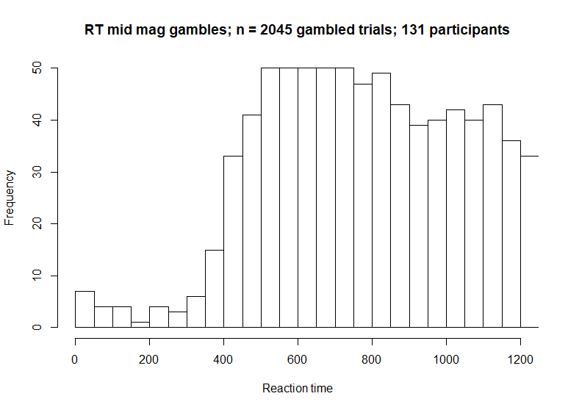
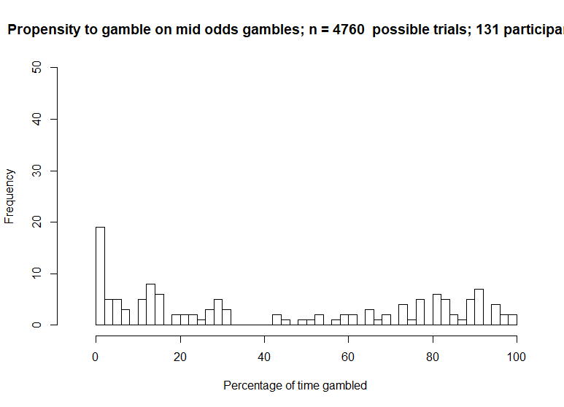
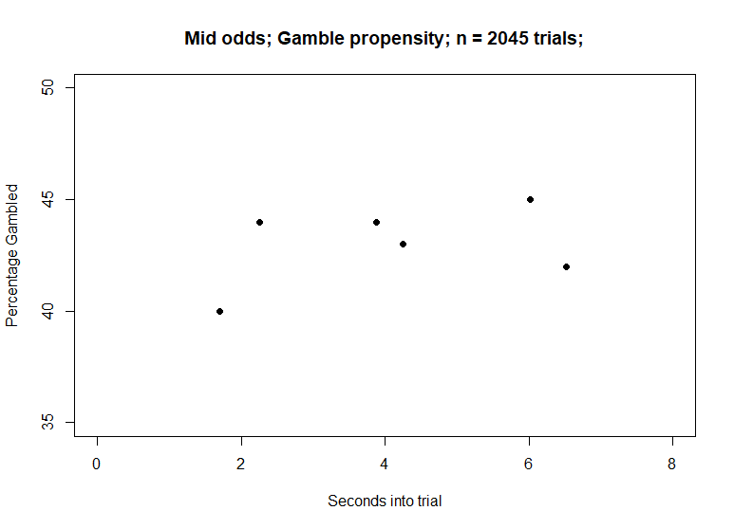

Mid value (odds)

Slide 11
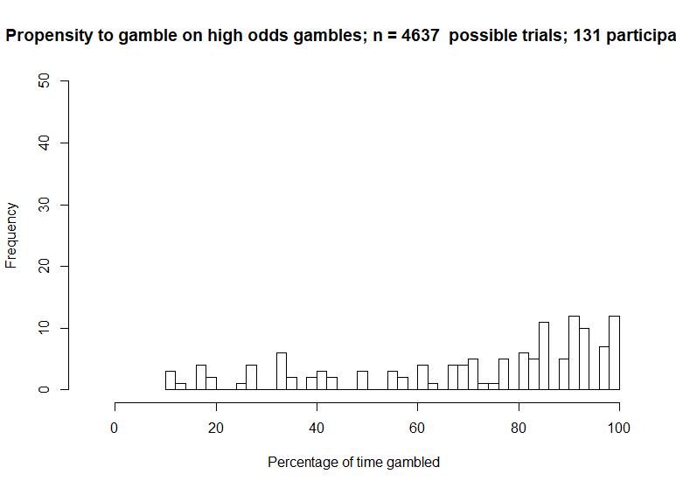
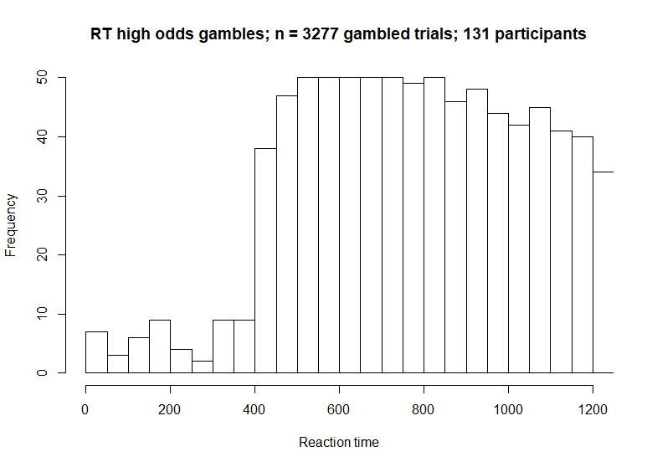
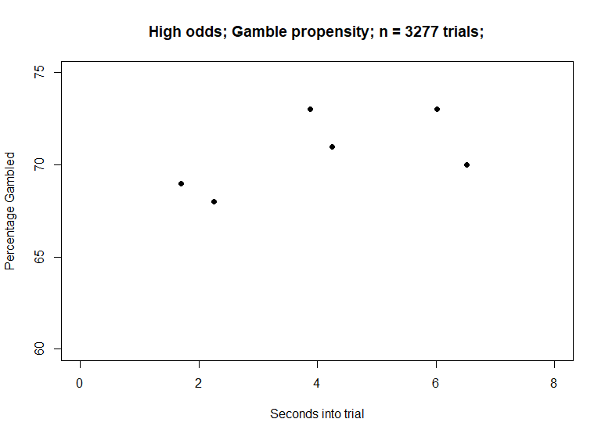

High odds

Slide 12
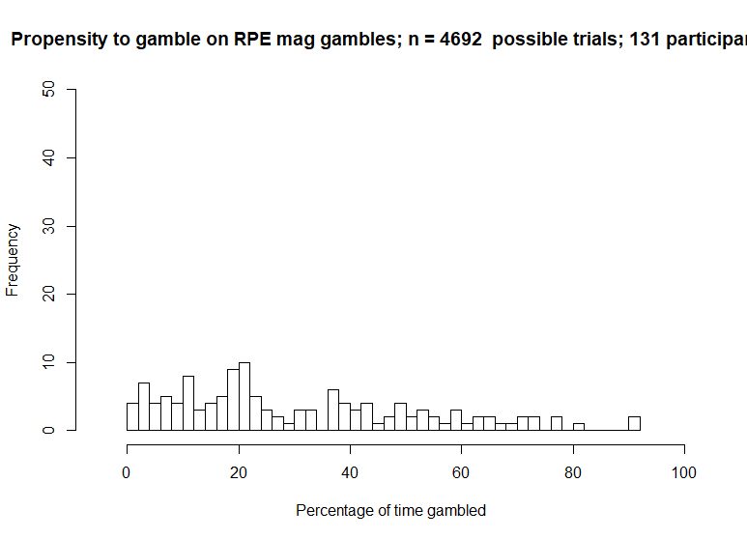
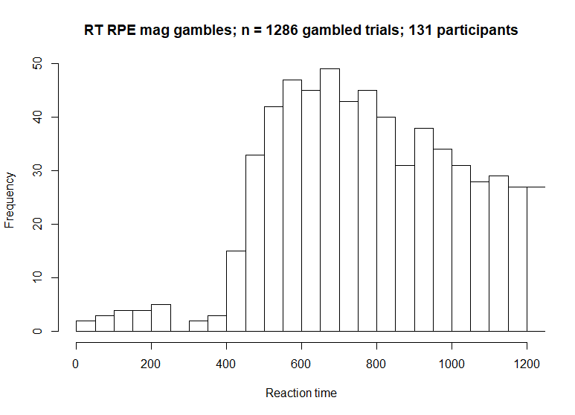
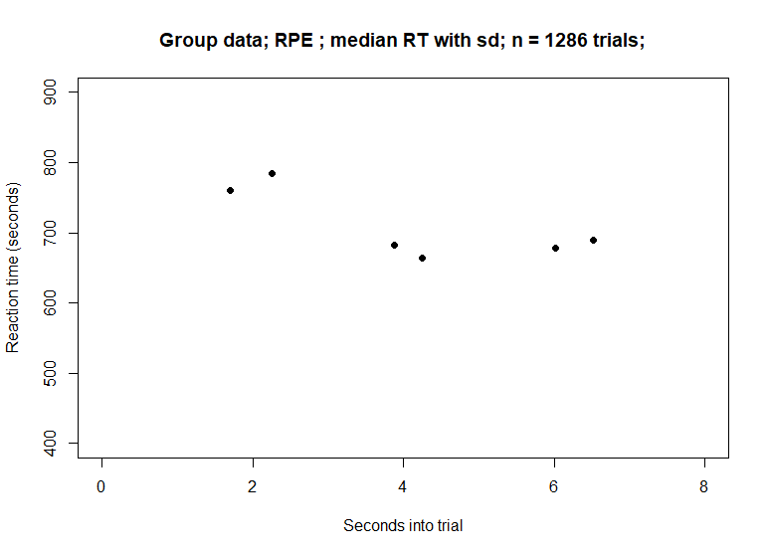
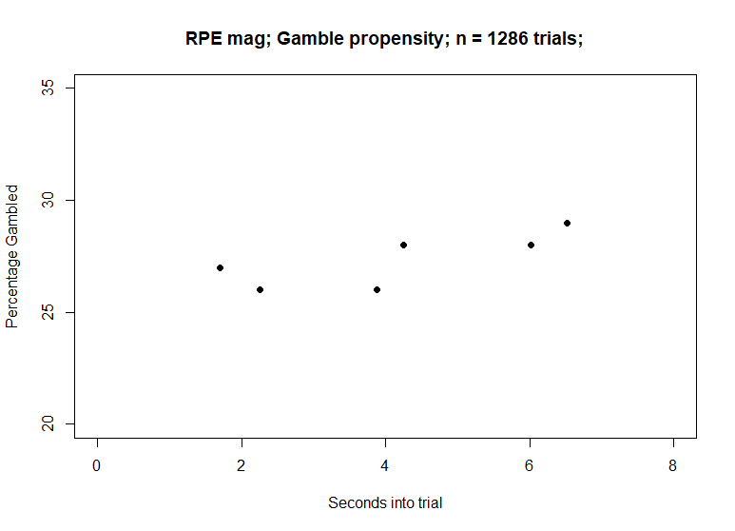
High RPE trials only

Slide 13
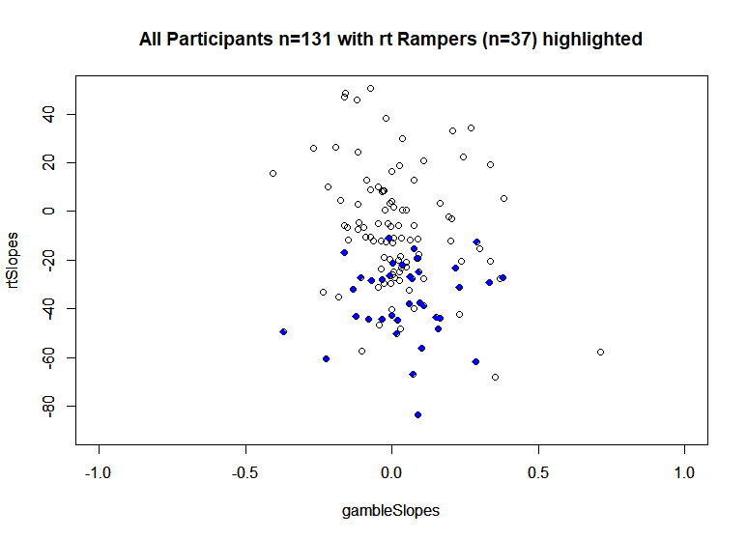
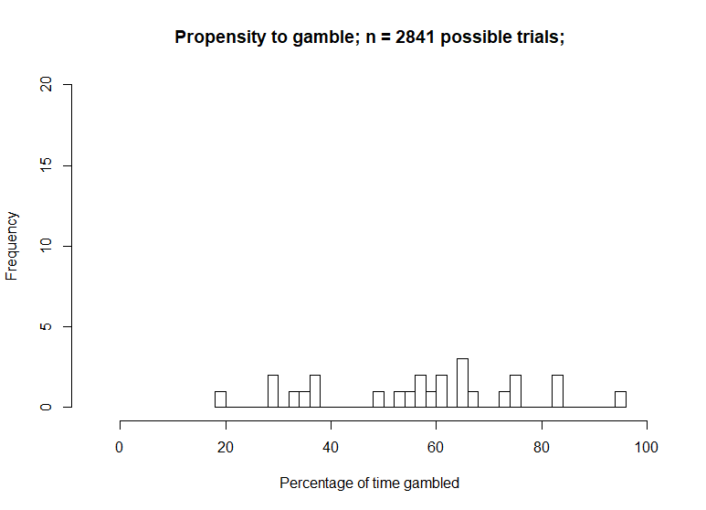
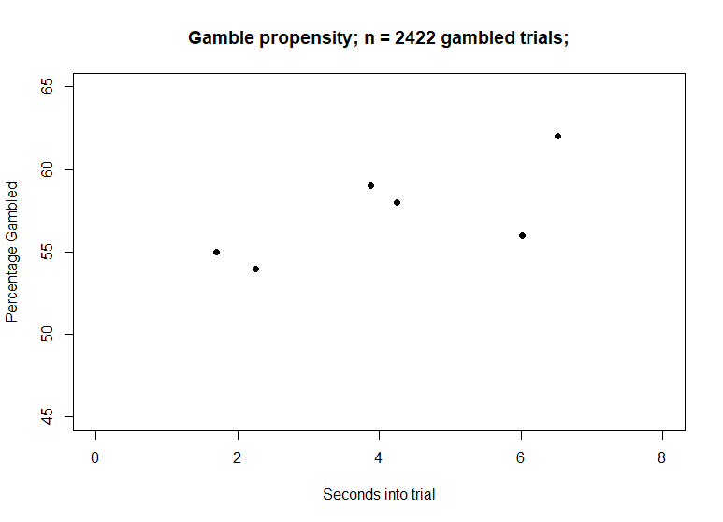
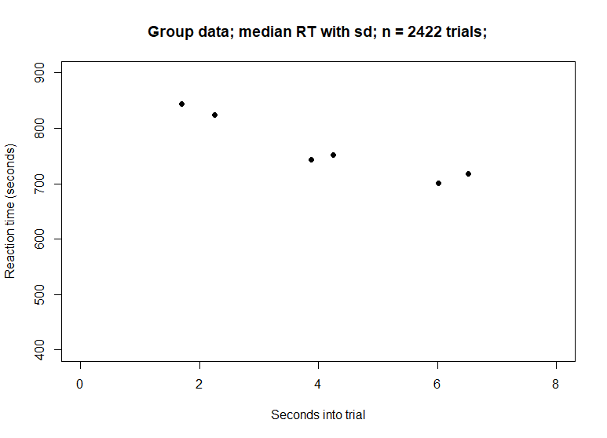
Participants who showed downwards decreasing RT slope, p< .1 (n= 37)
*
*
*
*

Slide 14
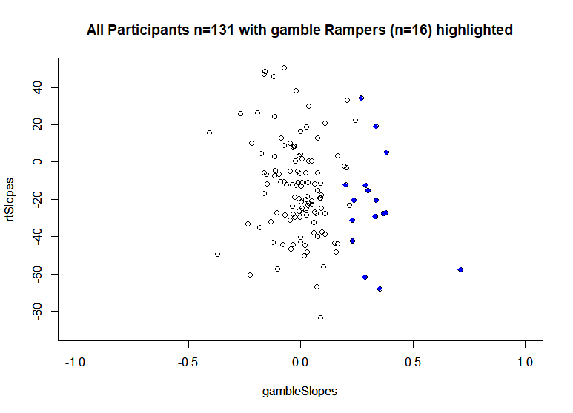
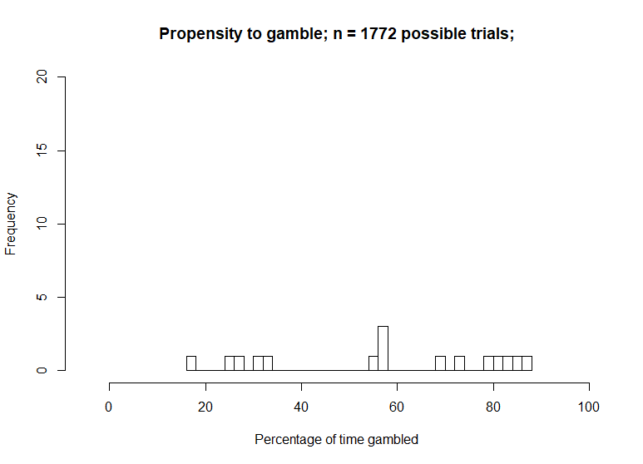
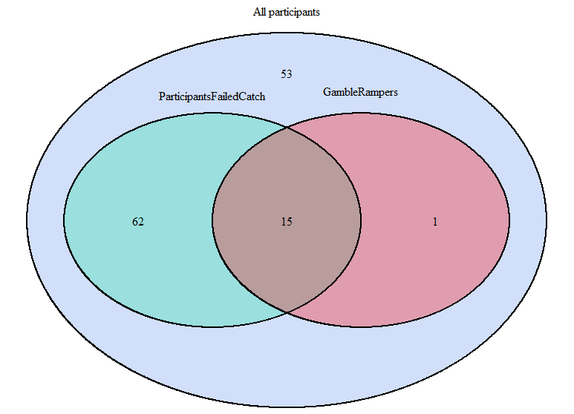
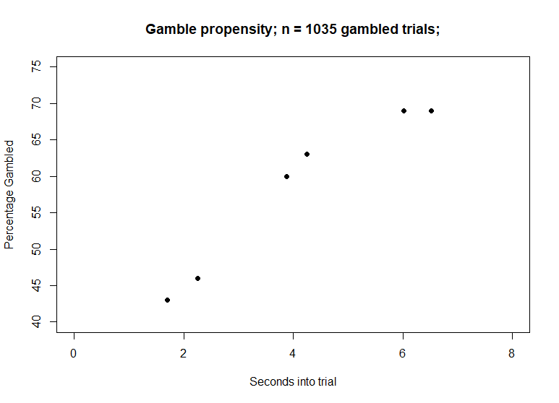
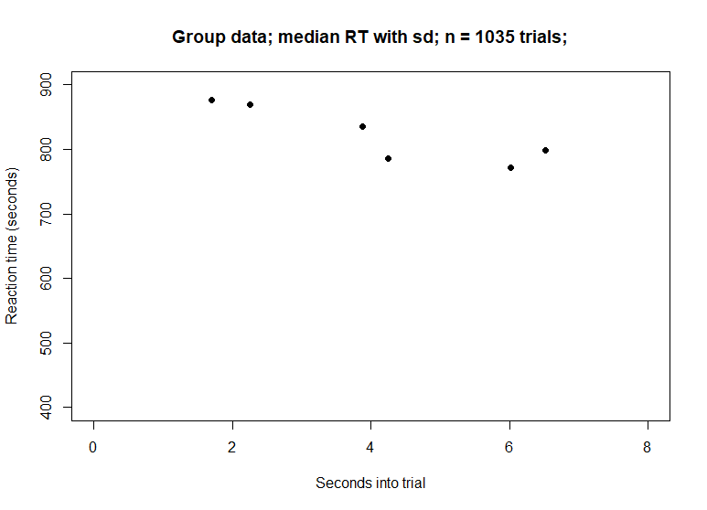
Participants who showed gambleRamp p<.1 (n=16)
*
*
*
*
*

Slide 15
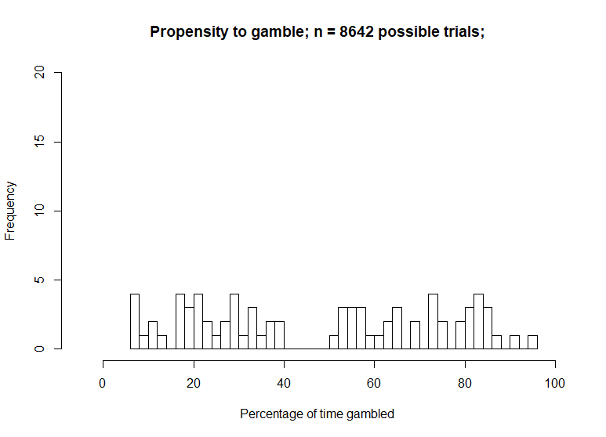
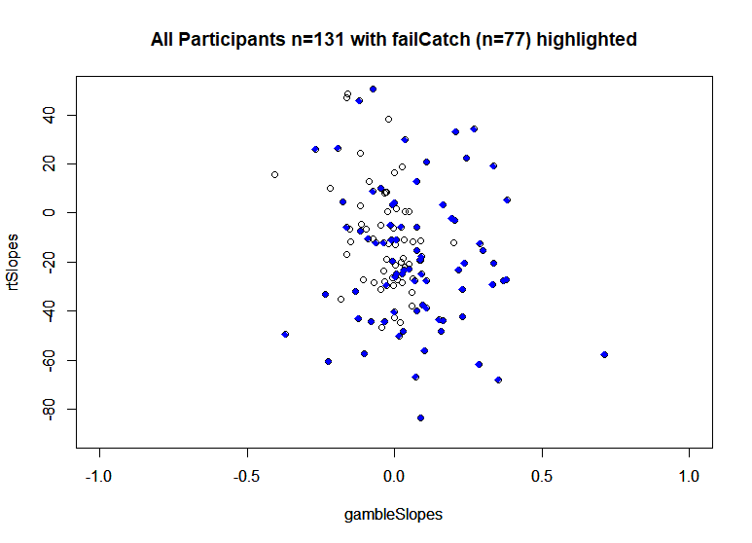
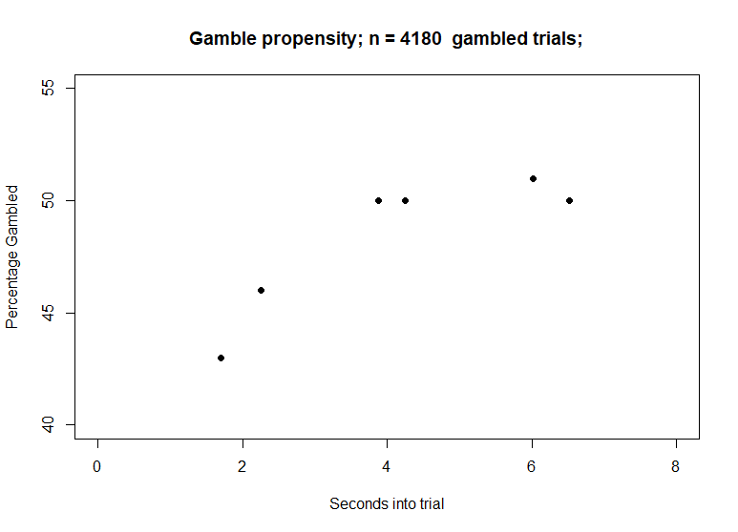

Participants who failed any number of catch trials (n= 77)
*
*
*
*
*
*
*
*
*

Slide 16




Participants who passed all catch trials (n= 53)
*
*
*

Slide 17






Participants who passed all the catch trials (n=64)
Blue = subgroup; red= all participants

Slide 18






Participants who tended to choose to gamble on high value vs. low value (n=45)
Blue = subgroup; red= all participants

Slide 19






Participants who showed downwards increasing gambling slope (n= 14)
Blue = subgroup; red= all participants
Note: about half of the participants in this subgroup are also in the decreasing RT subgroup

Slide 20






Participants who showed downwards decreasing RT slope (n= 15)
Blue = subgroup; red= all participants

Slide 21






Participants who frequently gambled >60% (n=23)
Blue = subgroup; red= all participants

Slide 22
Plots to do for poster
Bar graphs of slopes for different magnitude/value trials
Violin plots of gamble propensity graphs to indicate spread.
Standard error of RT graphs

Slide 23
Gamble
Ignore

Slide 24






Slide 25







Mag
Value
Low
Mid
EveryTrial
High

Slide 26












Does the number of failed catch trials dictate gambling, RT ramps?
Fail any number of catch trials
Fail 3 catch trials
Fail 1 catch trial
Fail 4 catch trials
Fail 2 catch trials
Fail 5 catch trials

Slide 27


