Slide 1
Studying dopamine: a risky proposal?
Exploring the dynamics of dopamine, compulsions, and ventral striatal activity
Guillaume Pagnier
Borton lab meeting 12.7.18

Slide 2
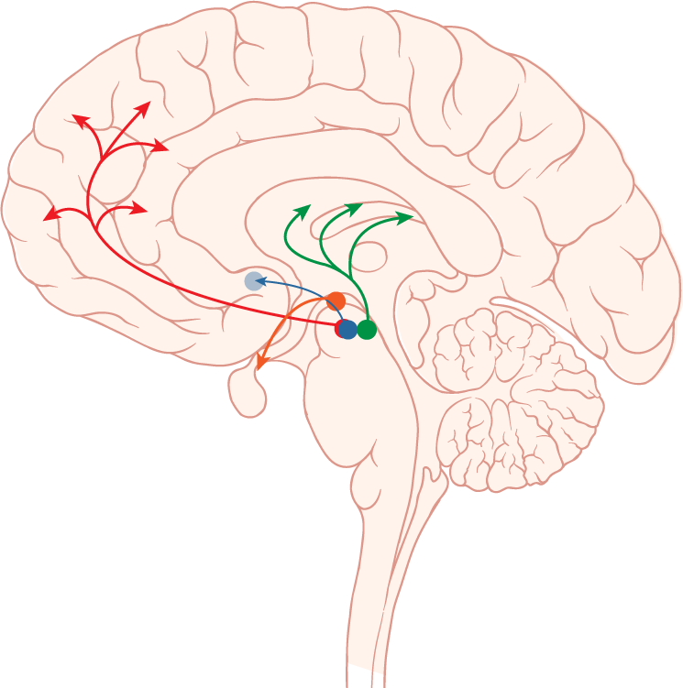
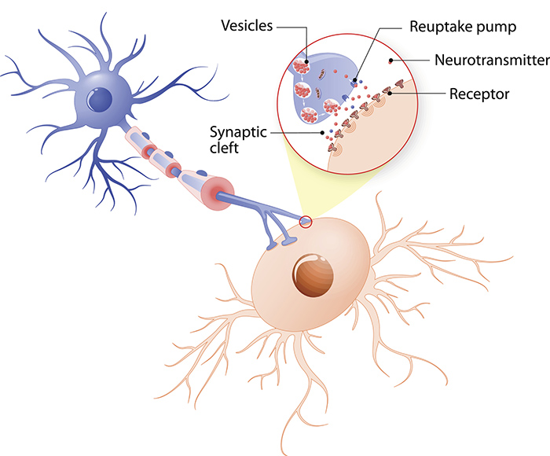
What is dopamine (DA)?
Neurotransmitter
Rest of Basal Ganglia (BG)
Dorsal Striatum
(Caudate and Putamen)
Ventral Striatum (NAc)
DA
DA
Striatum
SNpc
Ventral Tegmental Area (VTA)
Credit: Getty Images/iStockphoto
Notes:
Parkinsons

Slide 3
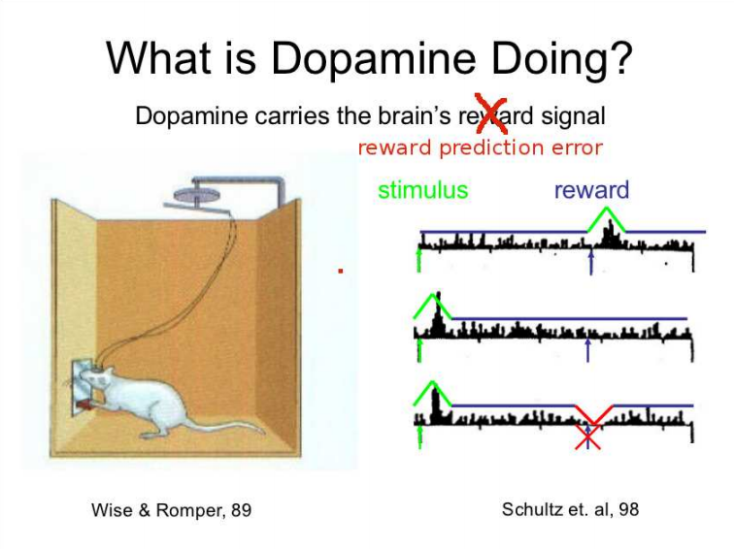
Credit: Michael Frank
Notes:
Similar to gambling via anticipation of reward though unsure about what gambling really does
Dopamine selectively recuits NaC (Kuntson, 2001)

Slide 4
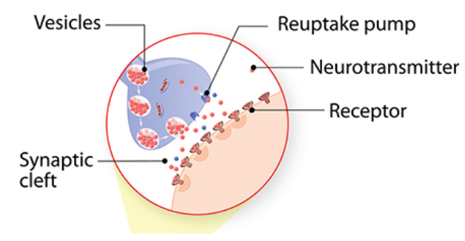
Exploiting dopamine via drugs
Notes:
Cocaine: blocks reuptake transmission. Physiologically addictive via fewer transporters
Amphetamines: DA agonist

Slide 5
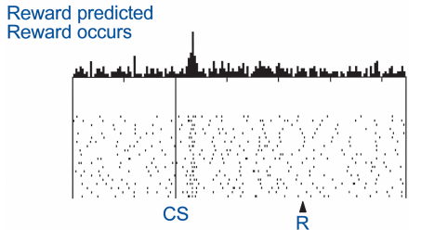
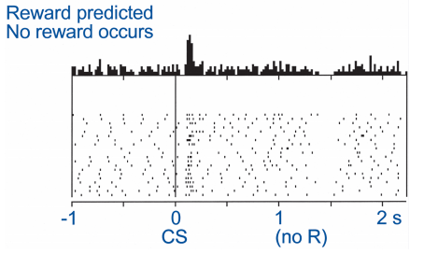
So, what does dopamine (DA) do?
Lots of things
Future behavior (learning)
Current behavior (performance)
Reward Prediction Errors guide learning
DA lesions leads to choice to not pursue rewards

Slide 6
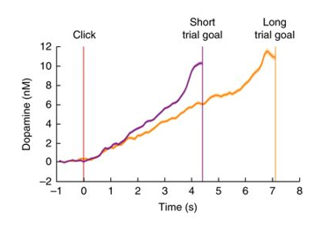
Striatal DA encodes the value of work and ramps up to an expected reward
Reflects state value of a reward
Notes:
Howe, M. W., Tierney, P. L., Sandberg, S. G., Phillips, P. E. & Graybiel, A. M. Prolonged dopamine signalling in striatum signals proximity and value of distant rewards. Nature 500, 575–579 (2013).
Wassum, K. M., Ostlund, S. B. & Maidment, N. T. Phasic mesolimbic dopamine signaling precedes and predicts performance of a self-initiated action sequence task. Biol. Psychiatry 71, 846–854 (2012).
Hamid, A. A. et al. Mesolimbic dopamine signals the value of work. Nat. Neurosci. 19, 117–126 (2016).
Only true in instrumental case

Slide 7
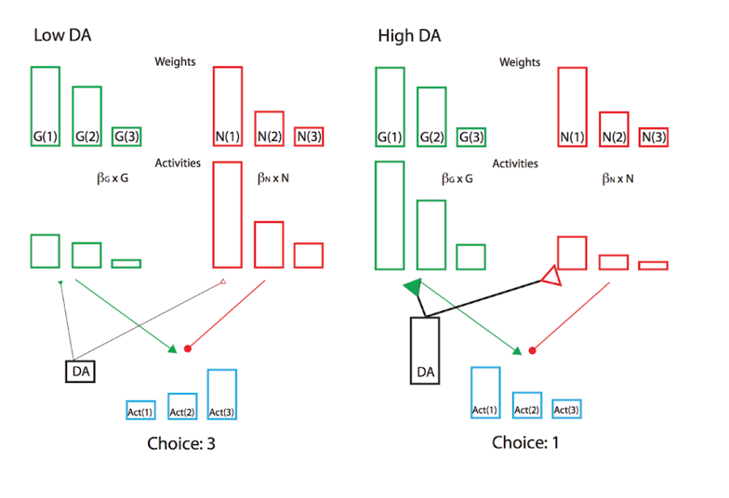
Do fluctuating levels of DA bias value perception?
At different levels of DA, participants may be perceiving value differently.
Specifically when experiencing high levels of DA, participants should focus on rewards.
i.e. participants should prefer risky gambles as the potential reward is higher

Slide 8
Task
Designed to elicit DA ramping in humans online via mTurk
Gamble?
Gamble?
Gamble?

Slide 9
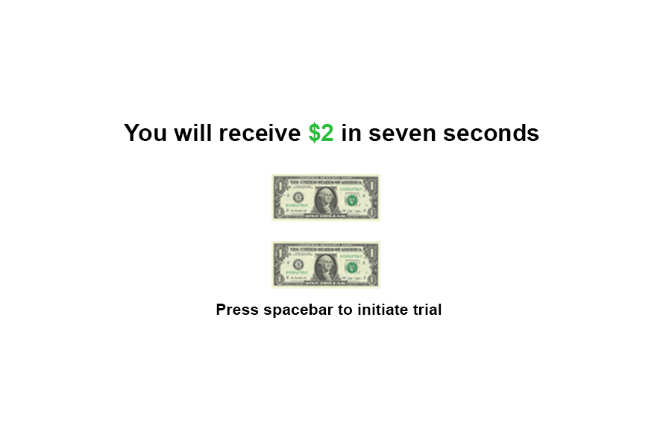
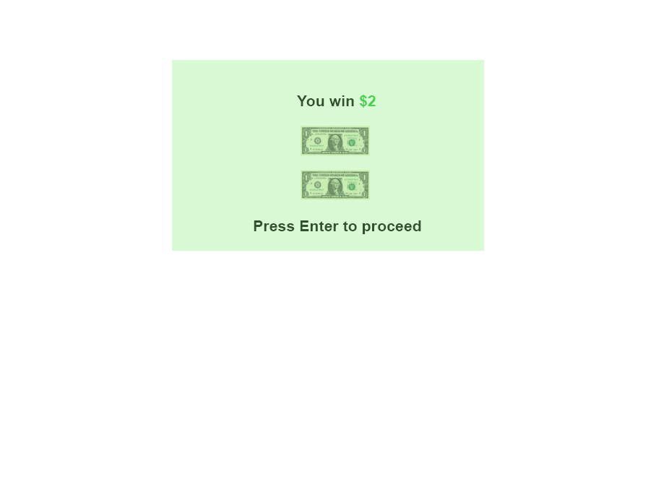

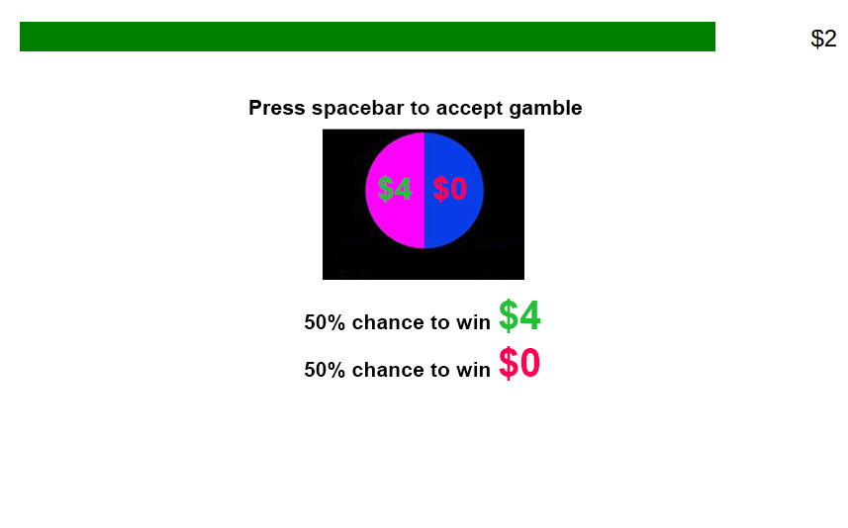
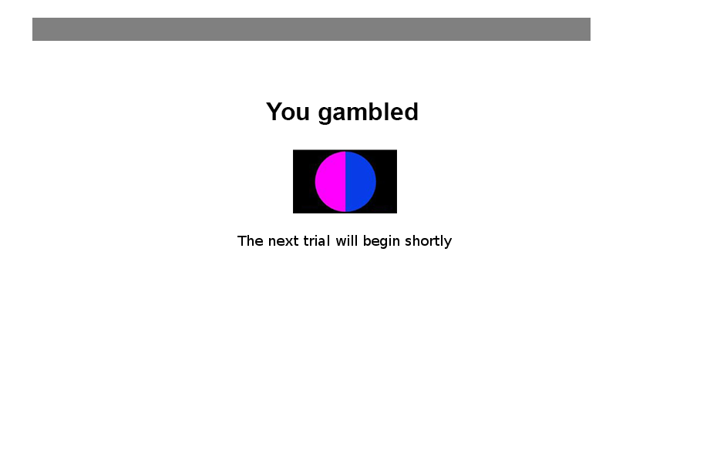

Slide 10
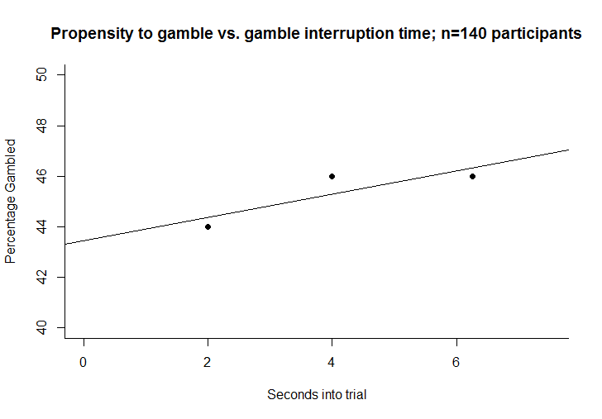
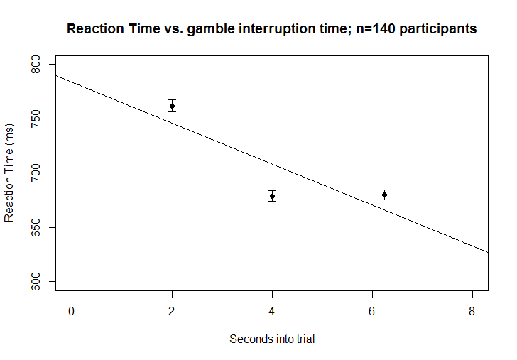
Gamble propensity vs. gamble interruption time
Reaction Time vs. gamble interruption time

Slide 11
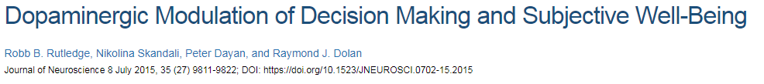
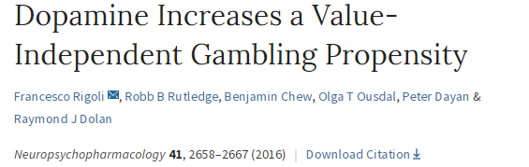
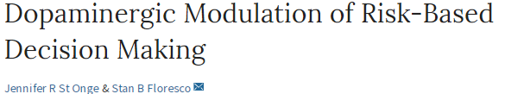



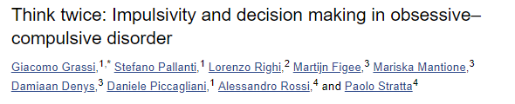
DA affects choice behavior and potentially impulsivity
Notes:
Ramping task
Increases gambling behavior
Impulsive individuals have different DA networks
Sometimes Parkinsons patients have impulse control disorders
Risky choice increased in boosting DA but only relative to wins
Phenotypic and genotypic overlap between OCD and PG

Slide 12
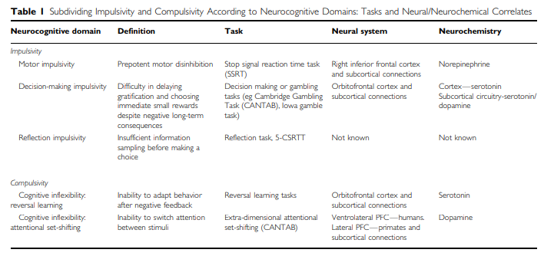
Impulsivity and compulsivity
2 types of gamblers
Impulsive –higher sensation seekers/DA mediated
Compulsive- Time on Device players, more related to OCD
Impulsive Behavior
OCD
NAc and dopamine?
Gambling
Compulsive Behavior

Slide 13
Increased dopamine = NAc stimulation?
We don’t know
Revisiting the Ventral Striatum (NAc)
95% Medium spiny neurons (D1 and D2 etc.)
5% Excitatory and inhibitory interneurons
It’s complex
Rest of basal ganglia
D1 receptor –
containing neurons
D2 receptor –
containing neurons
Ventral Striatum (NAc)
Dopamine
Ventral Tegmental Area (VTA)
Notes:
Unsure what general NAc stimulation is doing. Possible for increased ICD behavior

Slide 14
What does NAc stimulation do?
Affect impulsivity?
Affect compulsivity?
Affect risky decision making via benefits/costs?
Goal
Stimulation
Activity
Impulsive and compulsive behavior
Notes:
I hope to answer this question. Using the tasks, possible to compare OCD NAc ON, NAc off, OCD no-stim, and HC. Presents a unique opportunity to study how NAc stimulation affects these results in a causal way

Slide 15
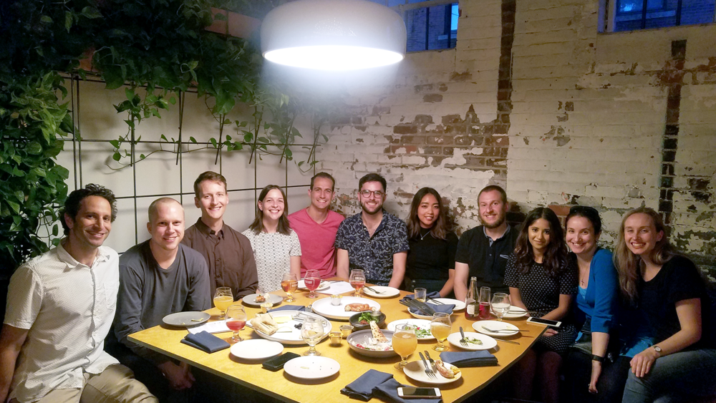
Acknowledgements
LNCC
Special thanks to Andrew, Carolyn, Dan, Andrea, Wasita, and Michael

