Slide 1
Ramp ResponseMappingV3
2.13.19
75 participants total– 26 useable

Slide 2
Facts about ResponseMapping
5 second progress bar
Gamble is not previewed
Gamble is offered for a 1500 ms window sometime during the progress bar
Gamble can show up either on LEFT or RIGHT side of the screen. If participant wants to gamble, they have to press the key that is closest to the gamble (f for when gamble is on left side j when gamble is on right side).
Instrumental condition, participant HAS to choose in 1700 ms otherwise trial is failed
Progress bar does NOT pause during gamble
If participant makes it to end of progress bar (either because they ignored the gamble or there wasn’t one), press spacebar to accept sure thing.
Gambles can be offered at ANY point throughout the progress bar (not binned like any previous experiment)

Slide 3
Reason for attrition
75 completed participants
  25 participants failed > 60/150 trials
  9 participants ignored < 10 trials (so they almost always gambled) + 13
  14 participants gambled <10 trials (so they almost always ignored gamble and they accepted sure thing) +27
Attrition seems to hold steady at about 3/5…
The later the gamble interrupted, the faster they responded
Participants got a little faster throughout the whole session but mostly they
got better at detecting ‘good’ gambles (that’s why the green is much taller)

Slide 5
All data
All data
When gamble is
On left side (gambleLeft)
When gamble is
On right side (gambleRight)

Slide 6
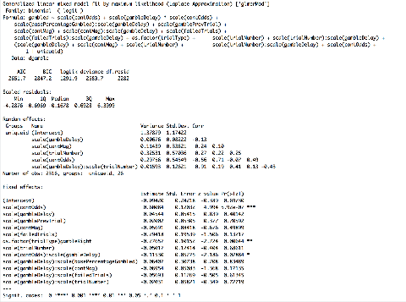
EV sensitivity and stats
Participants learn the EV structure
throughout task

Slide 7
Low Mag

Slide 8
Mid Mag

Slide 9
High Mag

Slide 10
Low value

Slide 11
Mid Value

Slide 12
High Value

Slide 13
Participants w/ sig. rtRamp-
As expected, the faster the RT, the least sensitive to value

Slide 14
Participants who are gambled>40% & <60%; n=9

Slide 15
Participants who are sensitive to value

Slide 16
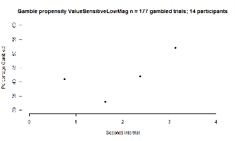
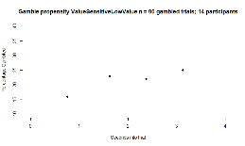
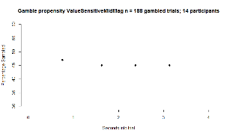
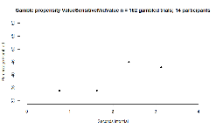
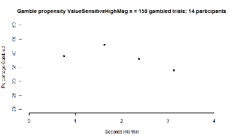
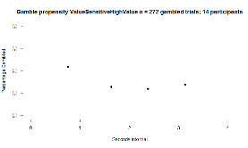
Participants who are sensitive to value breakdown by condition
Mag
Value
Low
Mid
High

Slide 17
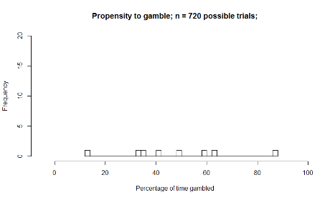
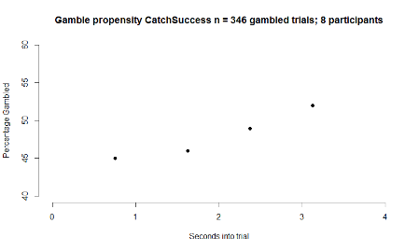
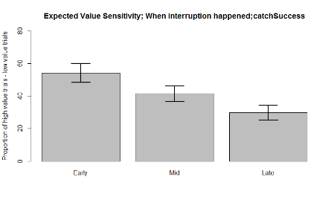
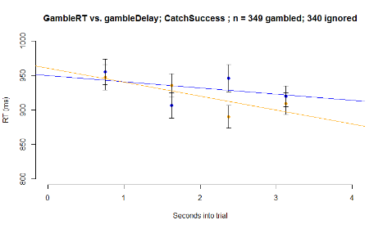
People who failed 0 or 1 catch trials i.e. CatchSuccess

Slide 18
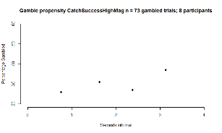
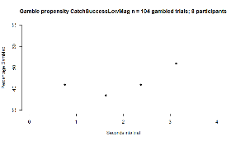
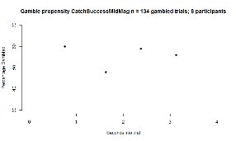
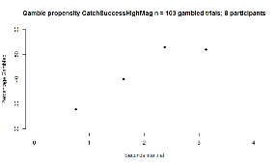
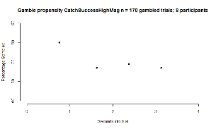
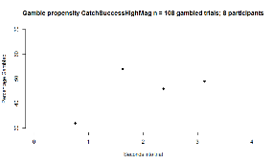
CatchSuccess breakdown by condition
Value
Mag
Low
Mid
High

