Slide 1
Ramp v06
11.13.18
56 participants – 29 useable

Slide 2
Facts about V06
8 second progress bar
Gamble is previewed for 3 seconds before each trial
Gamble is offered for a 1200 ms window sometime during the progress bar
About 133 trials per participant
Progress bar does NOT pause during gamble
Key difference: active button press (spacebar) AVOIDS gambling

Slide 3
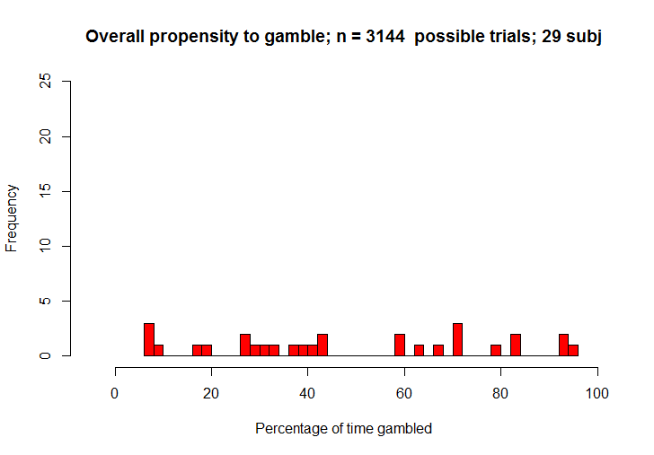
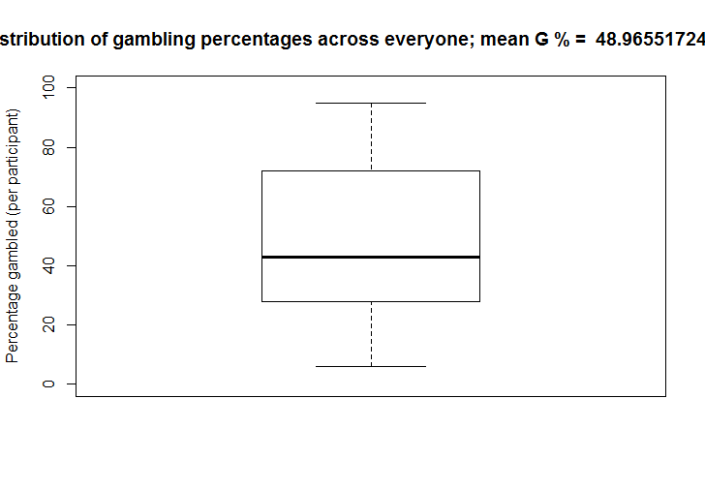
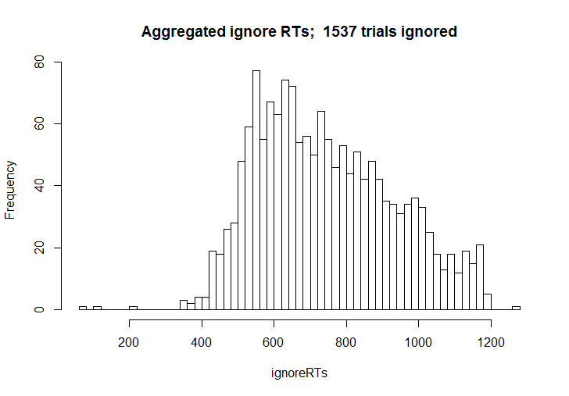
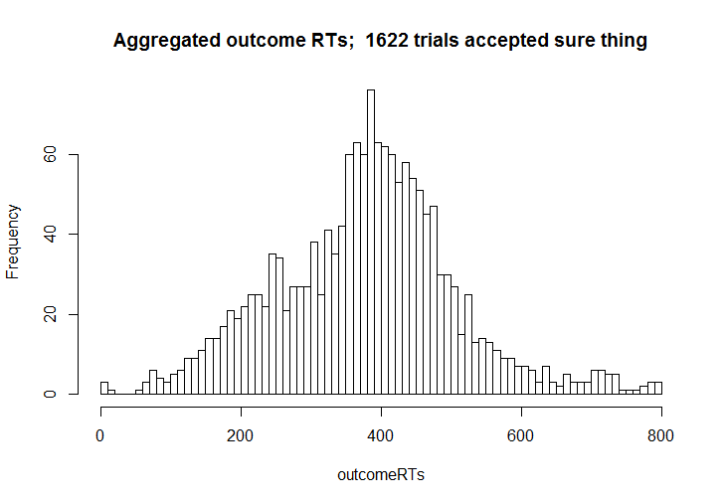
First order characteristics of 29 subj.

Slide 4
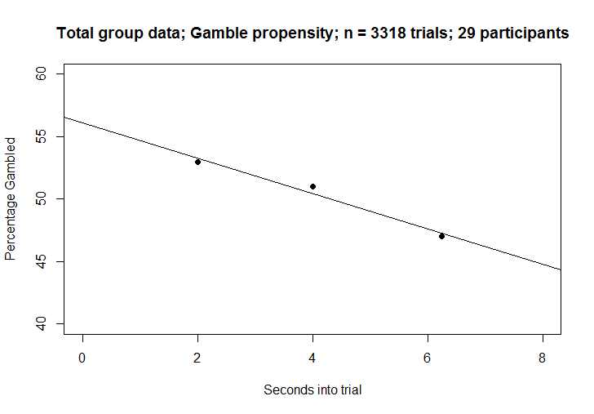
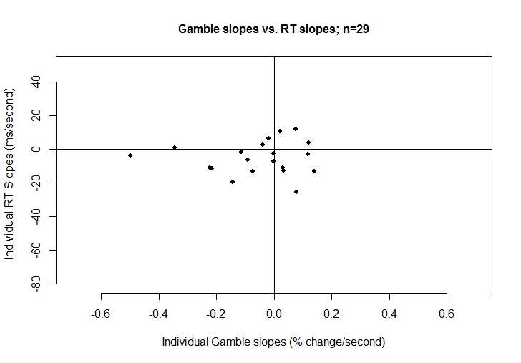
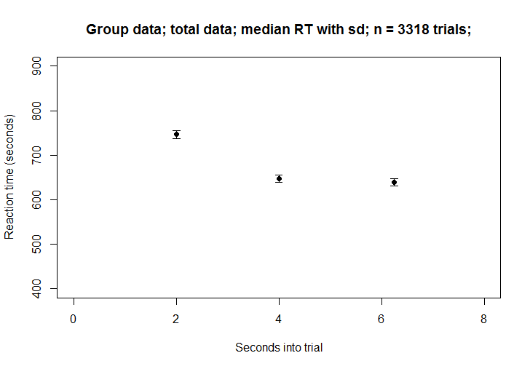
All data

