Slide 1
Ramping risk-taking
Examining the dynamics of how a progressing value function changes gambling behavior in humans
Shenhav lab meeting 10.29.18

Slide 2
Motivation
Task
Breakdown of conditions
Breakdown of participants
Conclusion and future directions

Slide 3
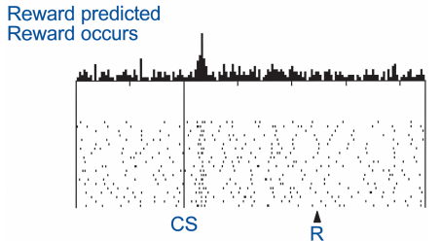
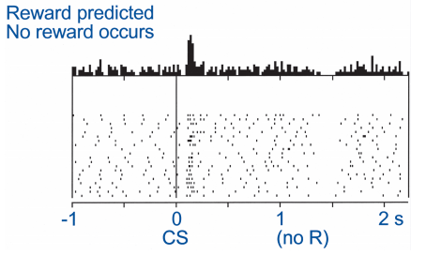
What does dopamine (DA) do?
Lots of things
Current behavior (performance)
Future behavior (learning)
Fast, phasic DA spikes in the striatum occur when participants experience reward (RPEs)
DA lesions leads to akinetic movements and the choice to not pursue rewards

Slide 4
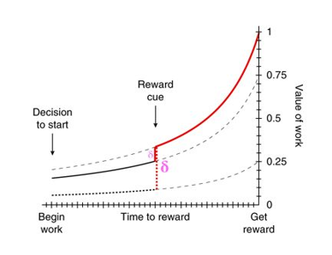
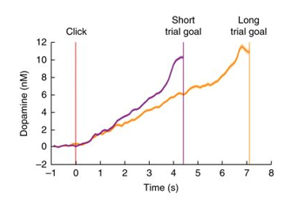
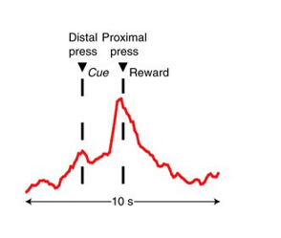
Striatal DA encodes the value of work and ramps up to an expected reward
Reflects state value of a reward
Encodes temporal discounting in instrumental cases
Notes:
Howe, M. W., Tierney, P. L., Sandberg, S. G., Phillips, P. E. & Graybiel, A. M. Prolonged dopamine signalling in striatum signals proximity and value of distant rewards. Nature 500, 575–579 (2013).
Wassum, K. M., Ostlund, S. B. & Maidment, N. T. Phasic mesolimbic dopamine signaling precedes and predicts performance of a self-initiated action sequence task. Biol. Psychiatry 71, 846–854 (2012).
Hamid, A. A. et al. Mesolimbic dopamine signals the value of work. Nat. Neurosci. 19, 117–126 (2016).
Only true in instrumental case

Slide 5

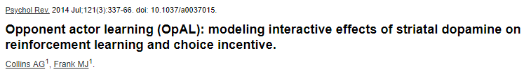
Implications of fluctuating DA?
Indiscriminately increasing vigor of any action
Modulates perceived rewards and/or perceived costs

Slide 6
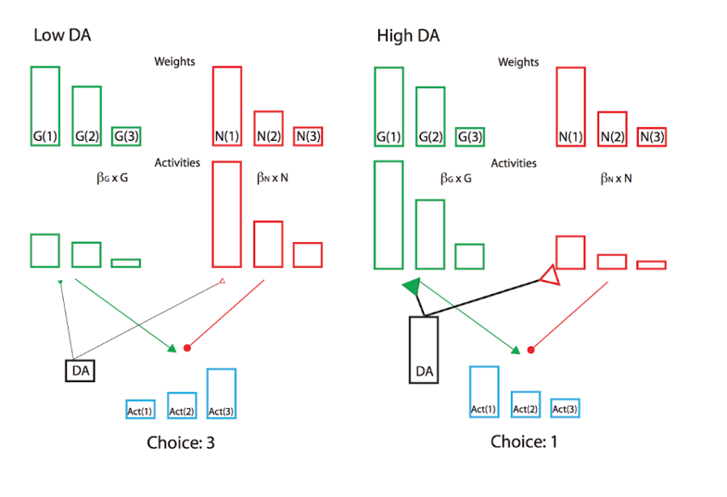
Do fluctuating levels of DA bias value perception?
At different levels of DA, participants may be perceiving value differently.
Specifically when experiencing high levels of DA, participants should focus on rewards.
i.e. participants should prefer risky gambles as the potential reward is higher

Slide 7
Do humans’ propensity to gamble vary as striatal DA changes (via proximity to reward)?

Slide 8
Motivation
Task
First order analyses and conditions analysis
Breakdown of participants
Conclusion and future directions

Slide 9
Task
Designed to elicit DA ramping in humans online via mTurk
Gamble?
Gamble?
Gamble?

Slide 10
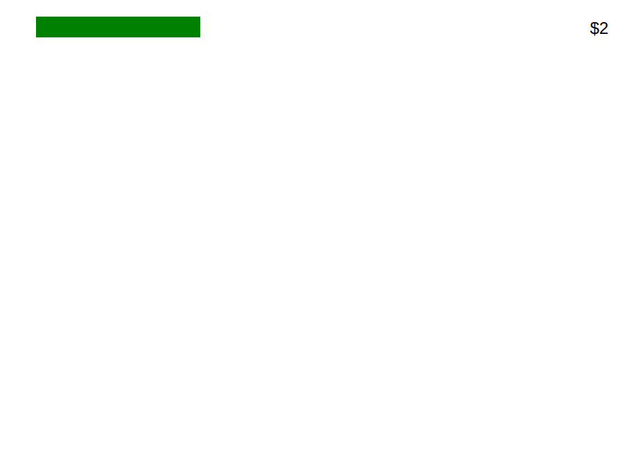
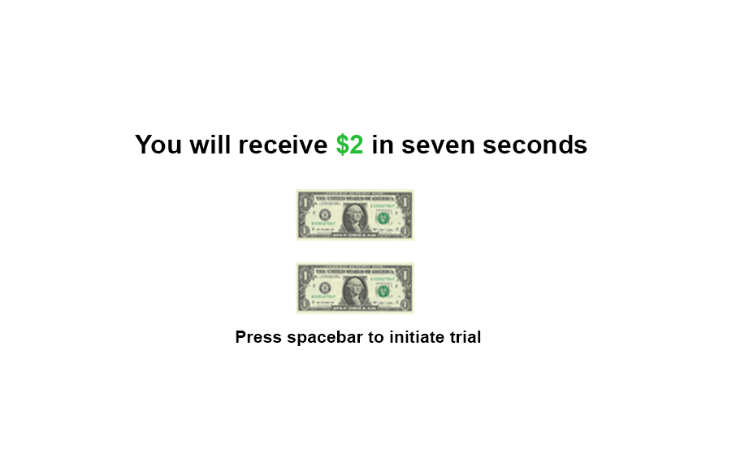
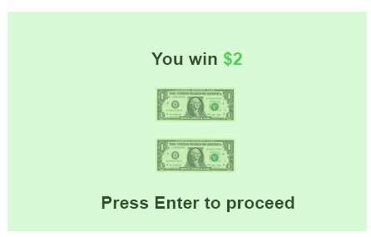

Slide 11

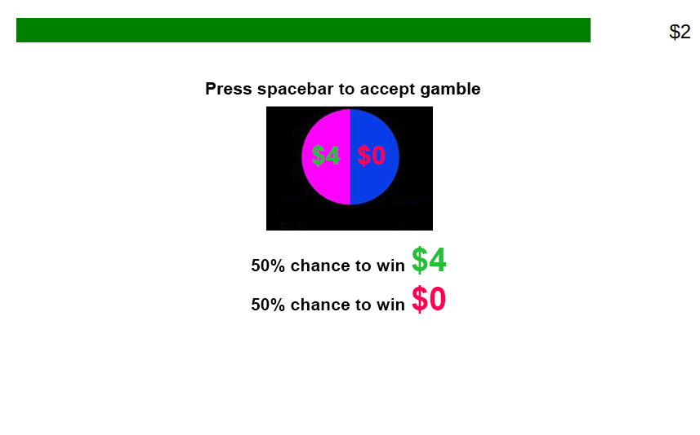
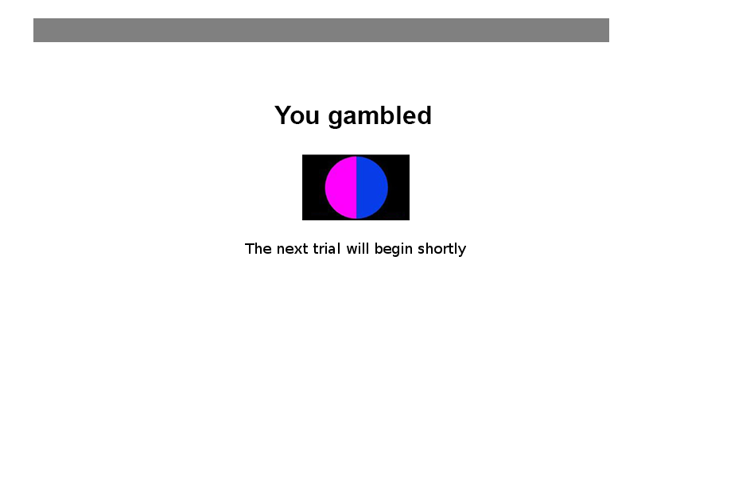

Slide 12
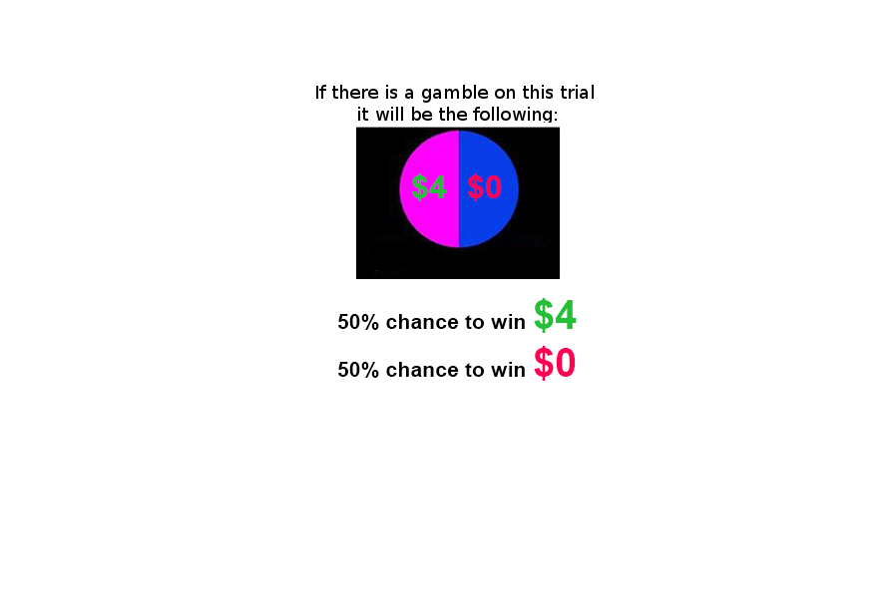
Current version

Slide 13
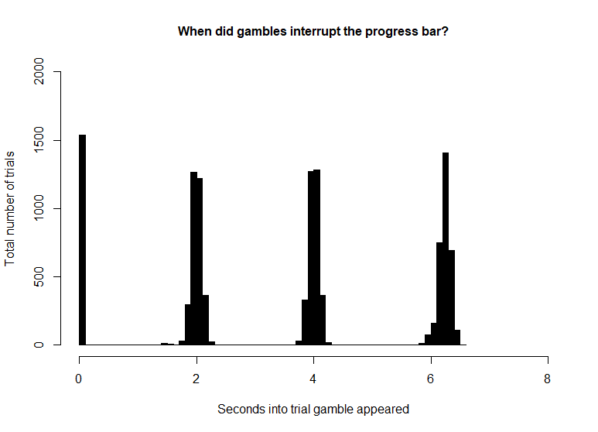
Current task specifications and participants
221 participants
18-40 years old
102 male 81 female, remaining declined to answer
133 trials. Option to gamble on 86.39% of trials.
Each trial has a magnitude and a value component.
6 catch trials.
Magnitude
Low
Trials that offer $1 or $2
Mid
Trials that offer $3 or $4
High
Trials that offer $5 or $6
Value
Low
Gambles that offer 1.5* guaranteed amount
Mid
Gambles that offer 2* guaranteed amount
High
Gambles that offer 3* guaranteed amount

Slide 14
Motivation
Task
First order analyses and conditions analysis
Breakdown of participants
Conclusion and future directions

Slide 15
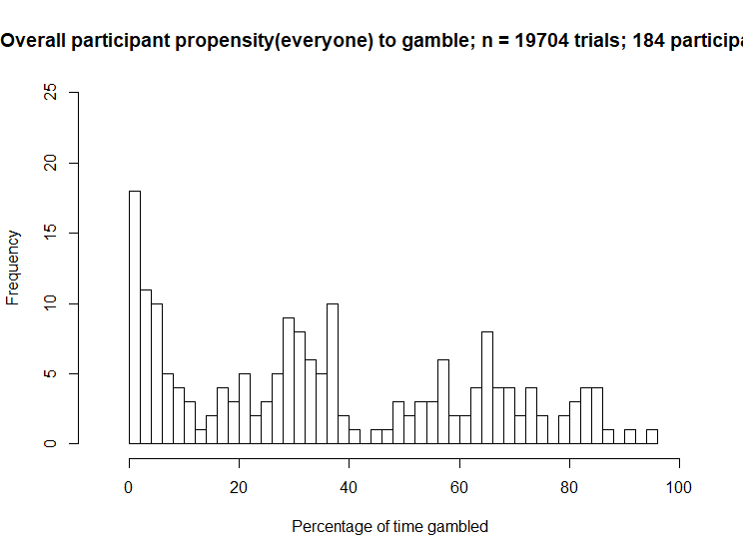
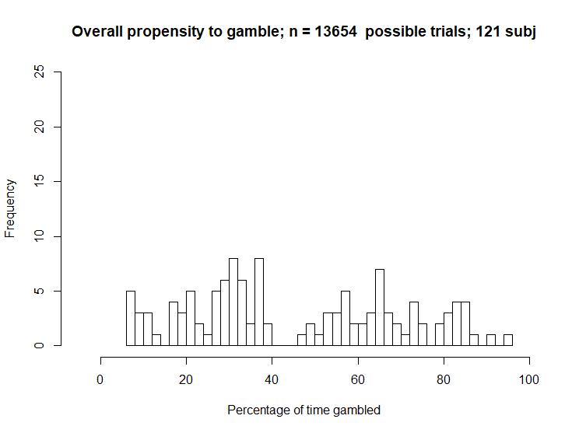
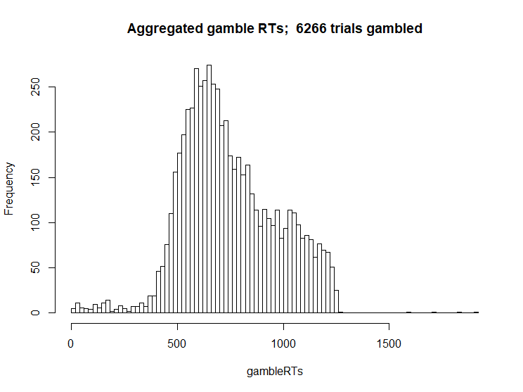
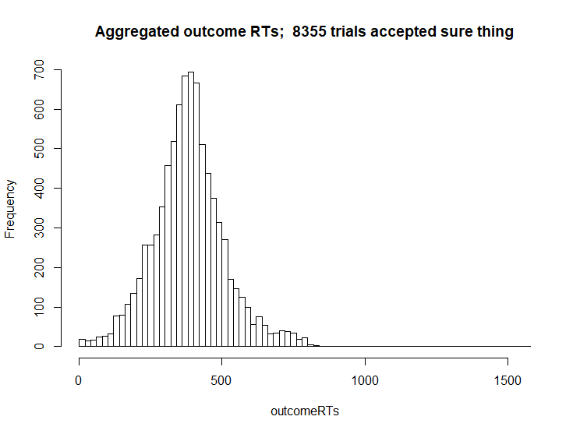
First order analyses

Slide 16
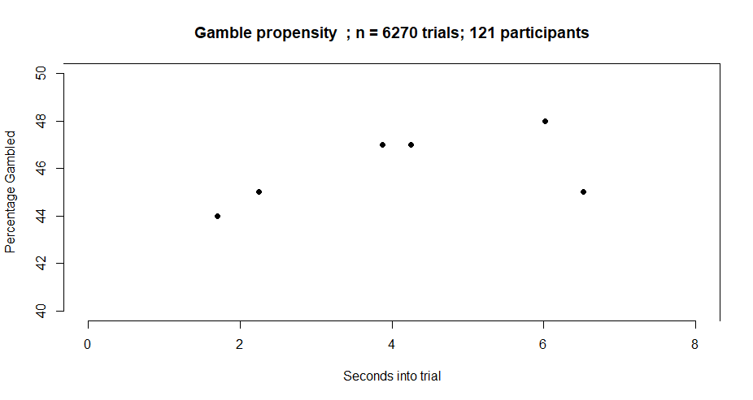
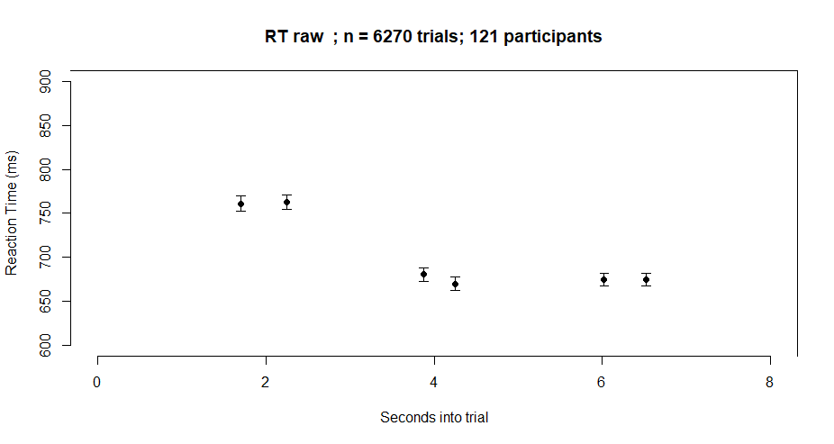
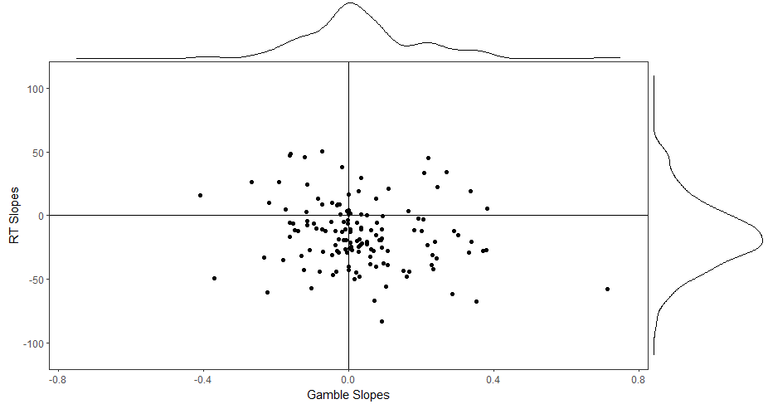
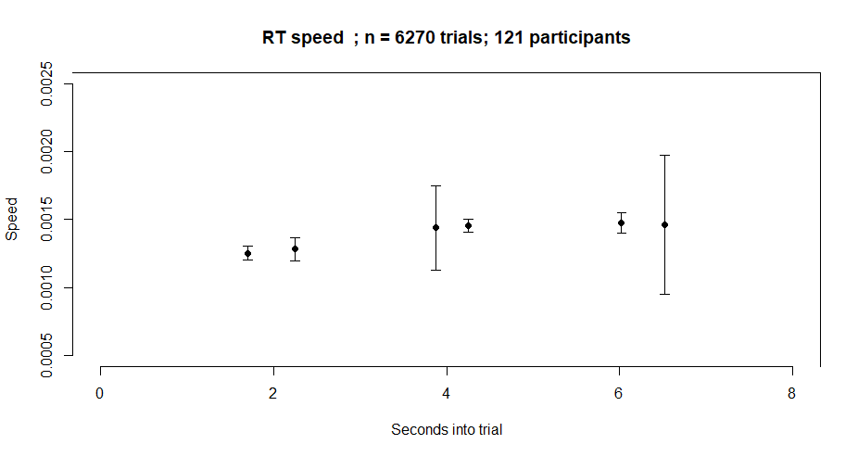

Slide 17
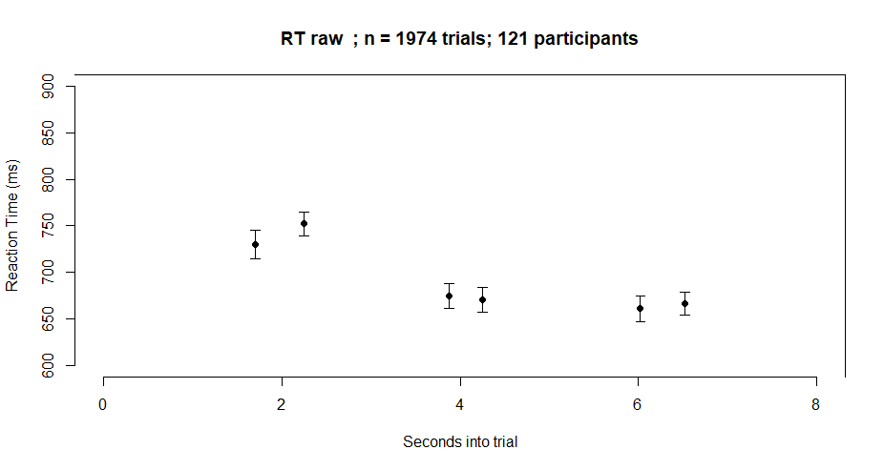
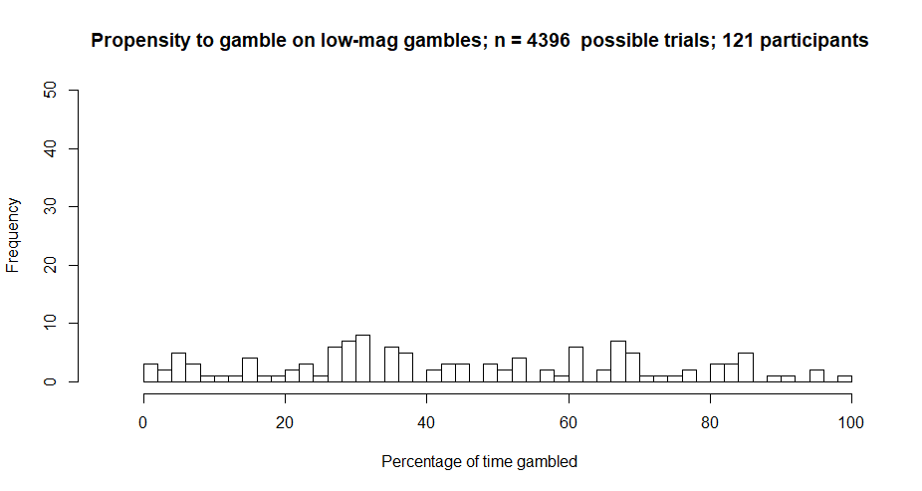
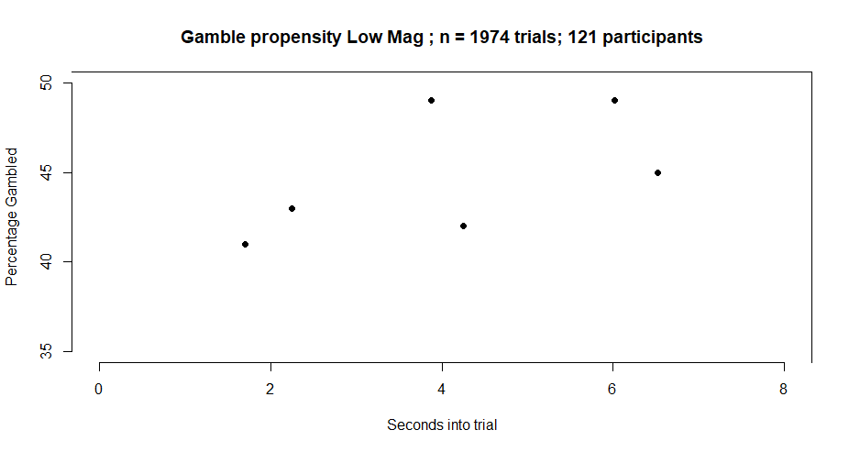
Low Mag

Slide 18
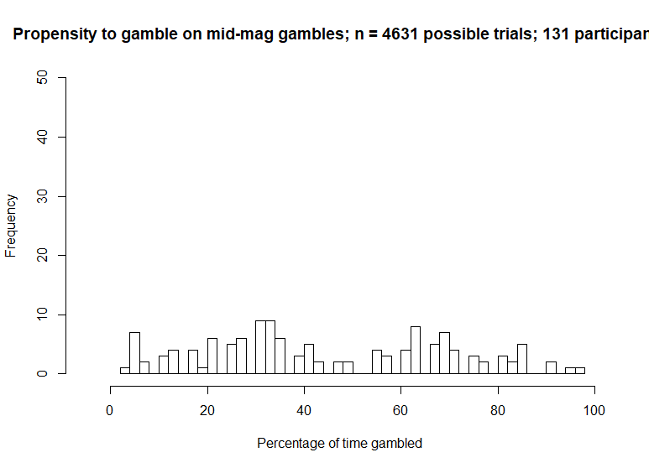
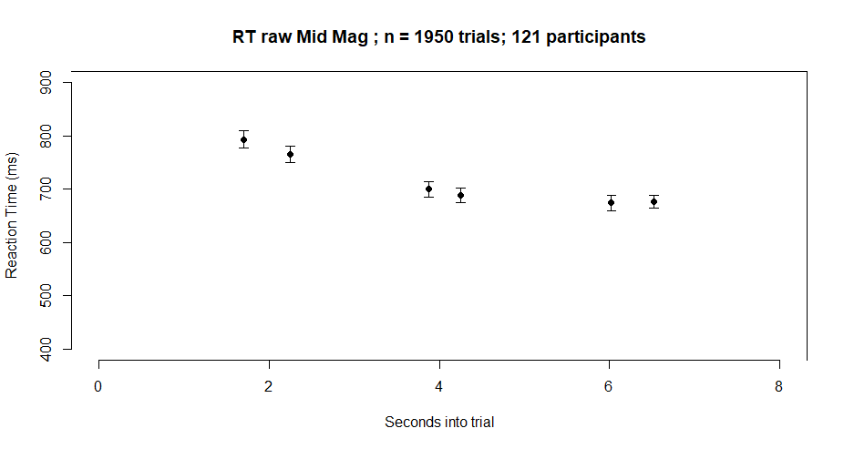
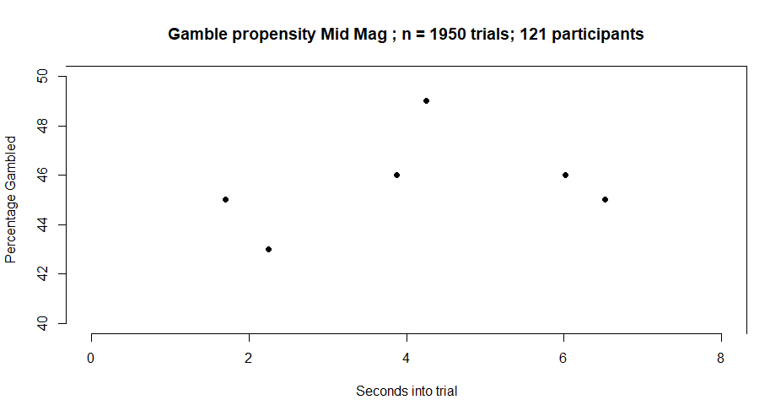
Mid Mag

Slide 19
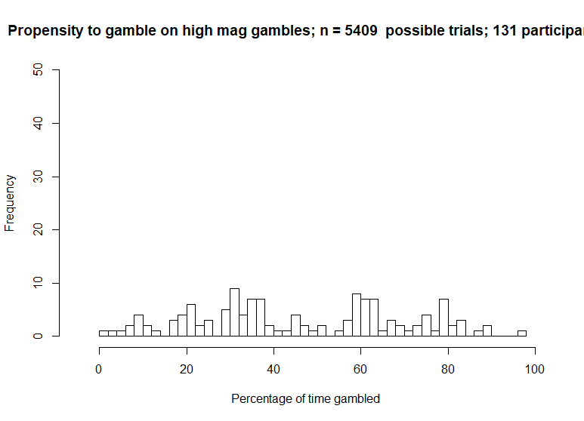
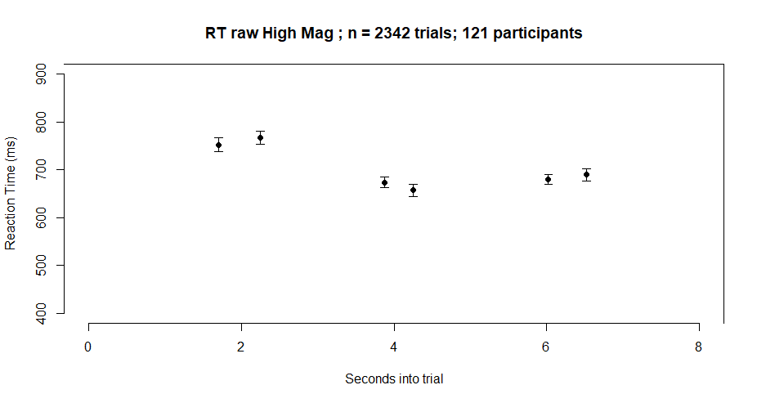
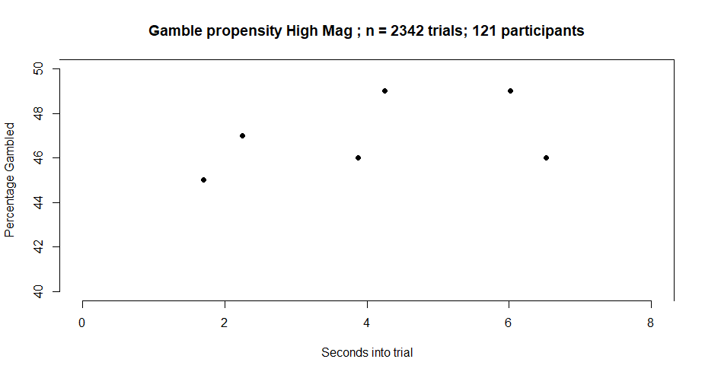
High Mag

Slide 20
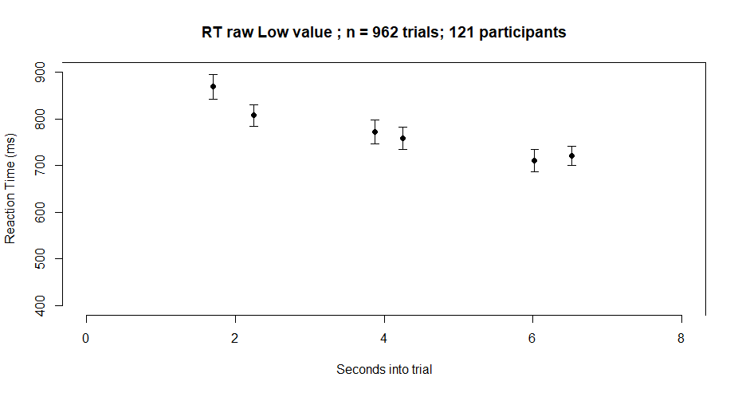
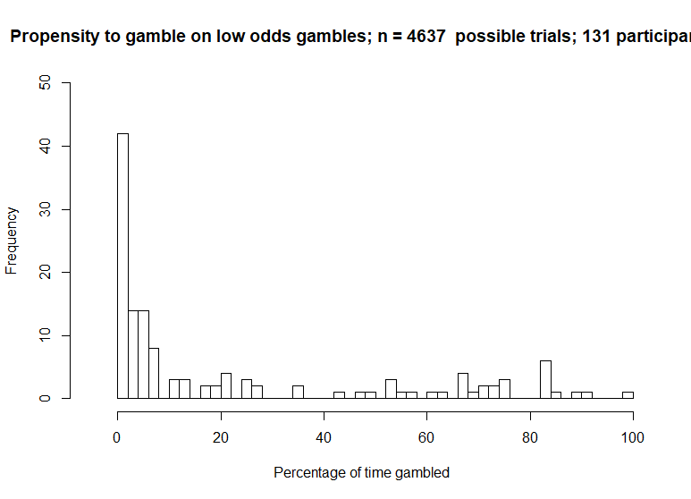
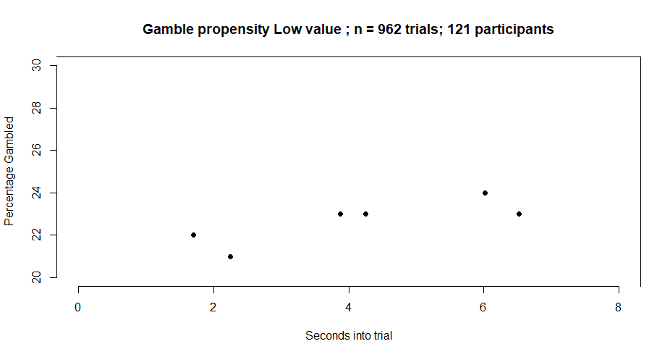
Low value (previously called odds)

Slide 21
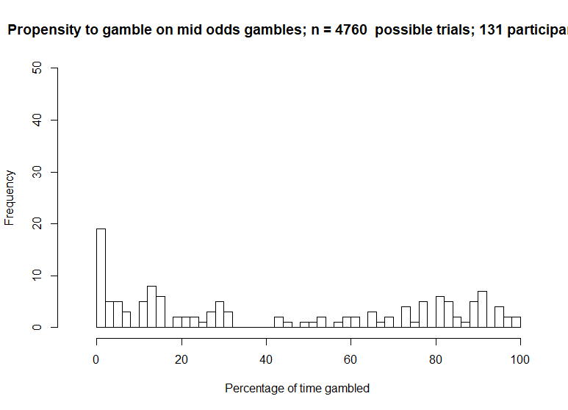

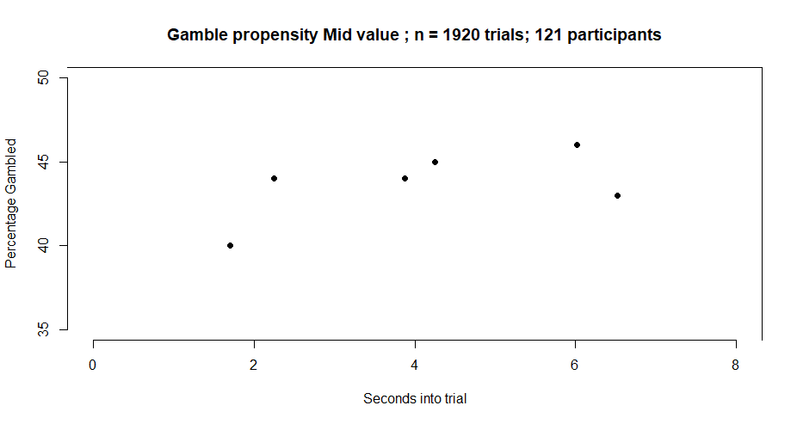
Mid value

Slide 22
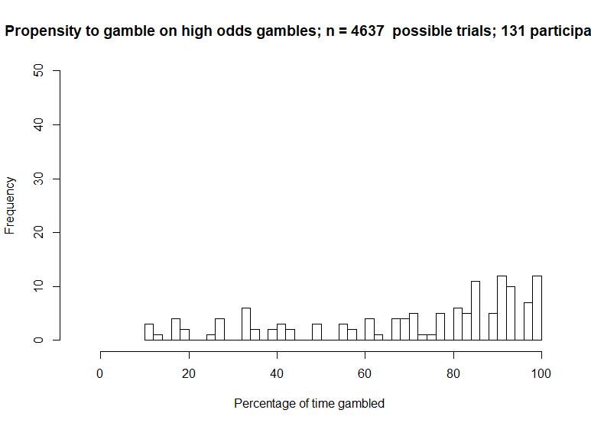
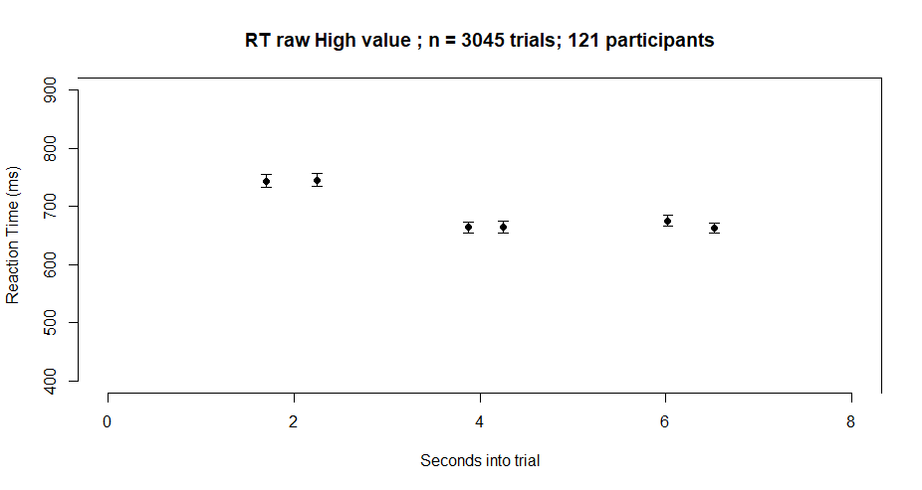
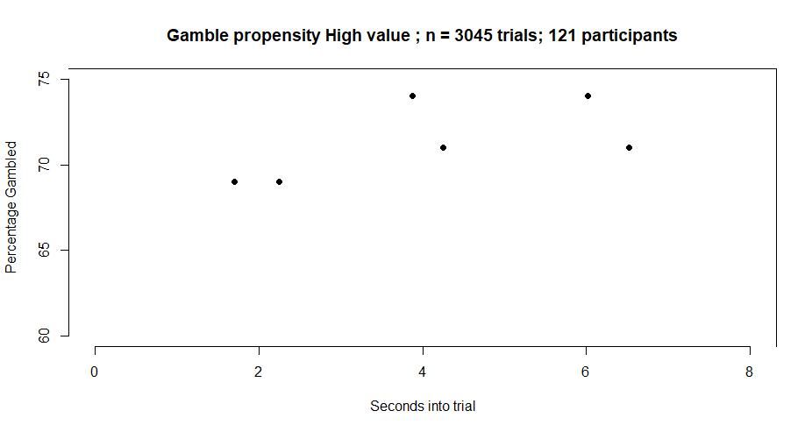
High value

Slide 23

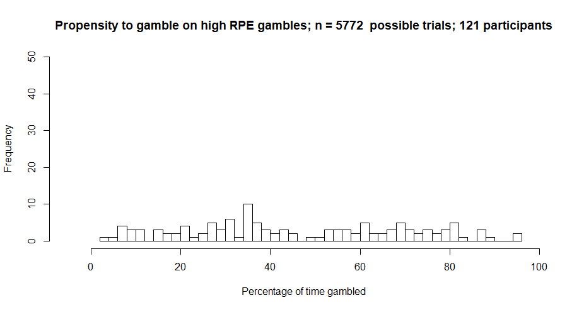
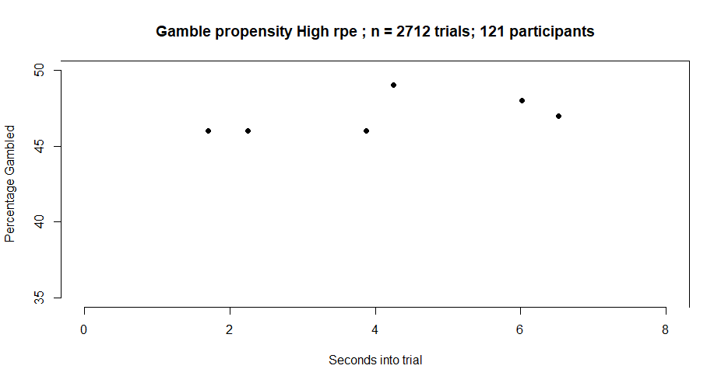
High RPE trials only

Slide 24

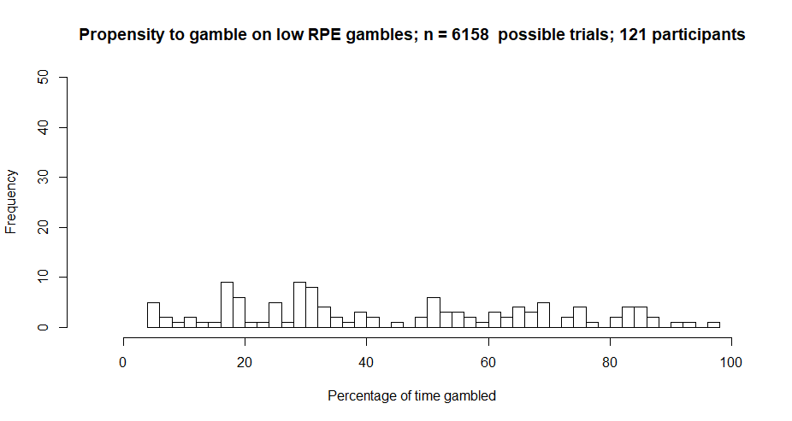
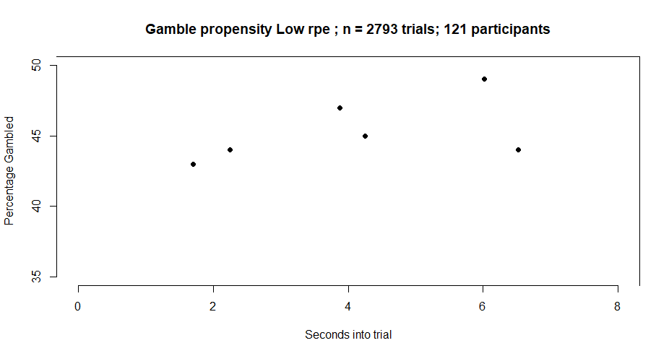
Low RPE trials only

Slide 25
Motivation
Task
First order analyses and conditions analysis
Breakdown of participants
Conclusion and future directions

Slide 27
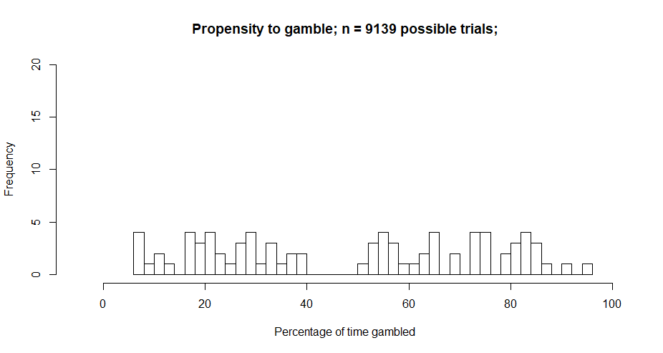
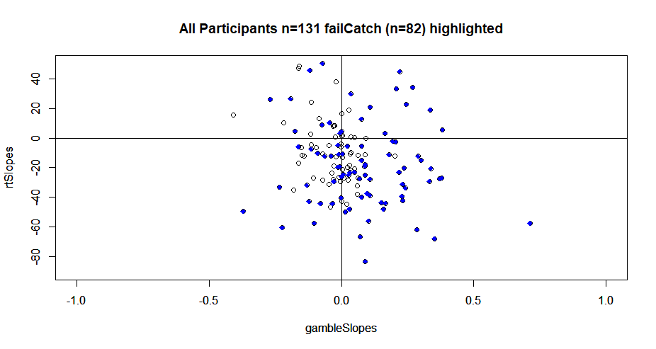
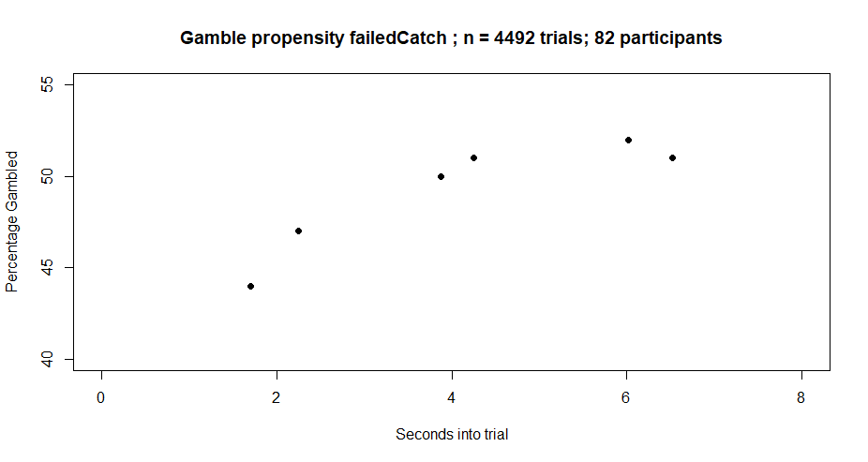
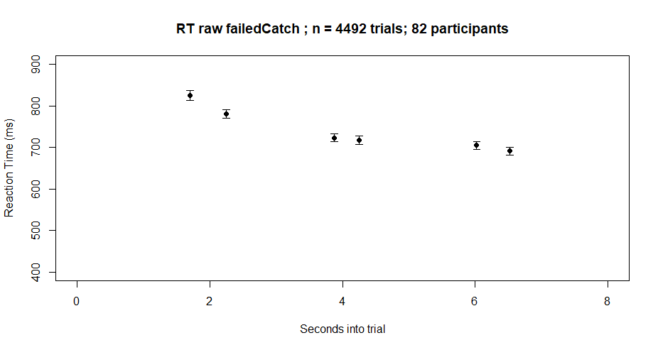
Participants who failed any number of catch trials (n=82)

Slide 28
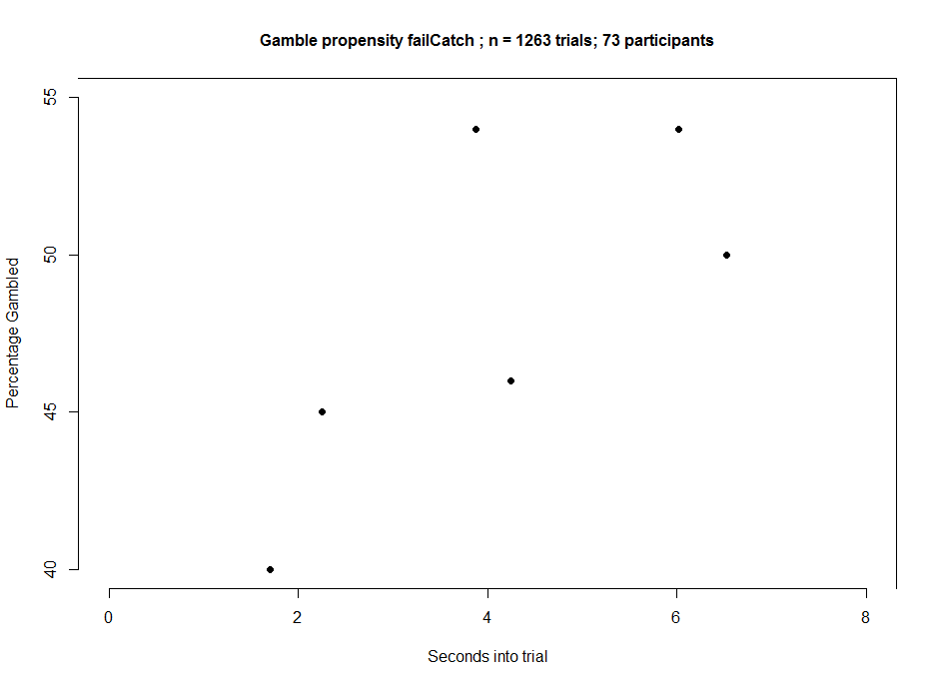
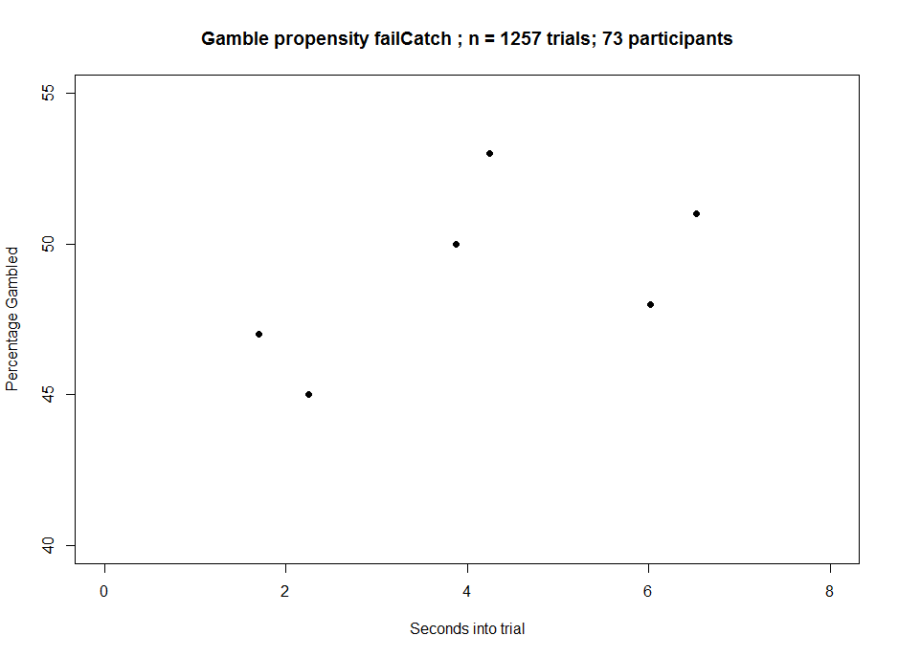
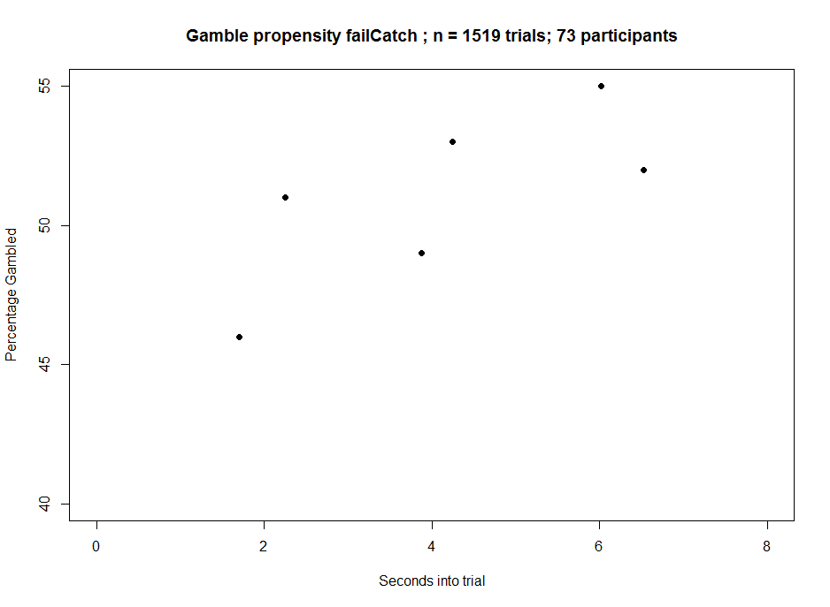



Magnitude
Low
Mid
High

Slide 29






Value
Low
Mid
High

Slide 30





Participants who showed downwards decreasing RT slope, p< .1 (n= 37)

Slide 31





Participants who showed gambleRamp p<.1 (n=18)

Slide 32






Upper quartile of logical gamblers split (n=36)
This plot shows only midValue trials
for logical gamblers

Slide 33






Participants who gambled more than 60% of time (n=45)
Participants who passed Catch

Slide 34
Motivation
Task
First order analyses and conditions analysis
Breakdown of participants
Conclusion and future directions

Slide 35
Summary
Overall, participants demonstrated an increase in gambling propensity (gambleRamp) and decreased RT as gambles interrupted later.
Both this decreasedRT effect and gambleRamp effect was strongest in particular subsets of participants, notably individuals who failed the catch trials.
Maybe the randomness in failCatch participants can hint at a subtle ramp

Slide 36
Future experiments
Collect version
Gamble is still previewed
Spacebar to gamble
C to collect either gamble or sure thing
Instrumental version
Gamble is no longer previewed
Progress bar stops during gamble, Y or N to accept/reject
Baratt Impulsiveness Test (BIT)
Notes:
Collect version is to not bias any participant towards a specific response.
Instrumental is to see if ramp affects value without any vigor

Slide 37

Acknowledgements
LNCC
Special thanks to Andrew, Carolyn, Dan, Andrea, Wasita, and Michael

Slide 38






Extra Plots

Slide 39





ACF constants for each participant

