Slide 1
Ramping risk-taking
Examining the dynamics of how a progressing value function changes gambling behavior in humans
Shenhav lab meeting 10.29.18

Slide 2
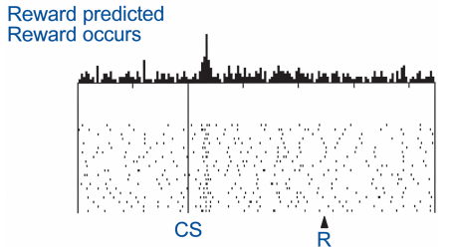
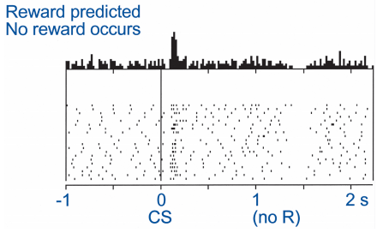
What does dopamine (DA) do?
Lots of things
Current behavior (performance)
Future behavior (learning)
Fast, phasic DA spikes in the striatum occur when participants experience reward (RPEs)
DA lesions leads to akinetic movements and the choice to not pursue rewards

Slide 3
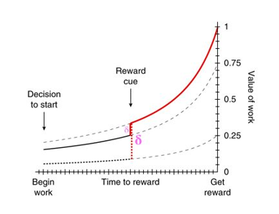
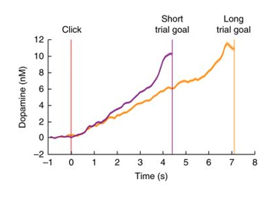
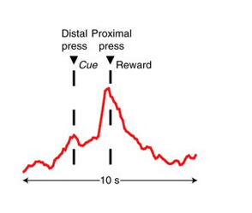
Striatal DA encodes the value of work and ramps up to an expected reward
Reflects state value of a reward
Encodes temporal discounting in instrumental cases
Notes:
Howe, M. W., Tierney, P. L., Sandberg, S. G., Phillips, P. E. & Graybiel, A. M. Prolonged dopamine signalling in striatum signals proximity and value of distant rewards. Nature 500, 575–579 (2013).
Wassum, K. M., Ostlund, S. B. & Maidment, N. T. Phasic mesolimbic dopamine signaling precedes and predicts performance of a self-initiated action sequence task. Biol. Psychiatry 71, 846–854 (2012).
Hamid, A. A. et al. Mesolimbic dopamine signals the value of work. Nat. Neurosci. 19, 117–126 (2016).
Only true in instrumental case

Slide 4

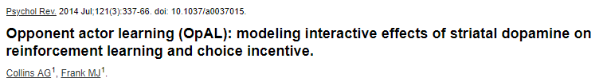
Implications of fluctuating DA?
Indiscriminately increasing vigor of any action
Modulates perceived rewards and/or perceived costs

Slide 5
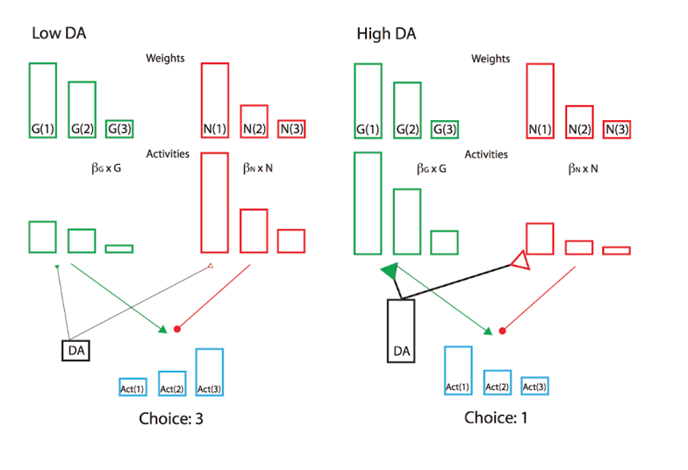
Do fluctuating levels of DA bias value perception?
At different levels of DA, participants may be perceiving value differently.
Specifically when experiencing high levels of DA, participants should focus on rewards.
i.e. participants should prefer risky gambles as the potential reward is higher

Slide 6
Do humans’ propensity to gamble vary as striatal DA changes (via proximity to reward)?

Slide 7
Task
Designed to elicit DA ramping in humans online via mTurk
Gamble?
Gamble?
Gamble?

Slide 8
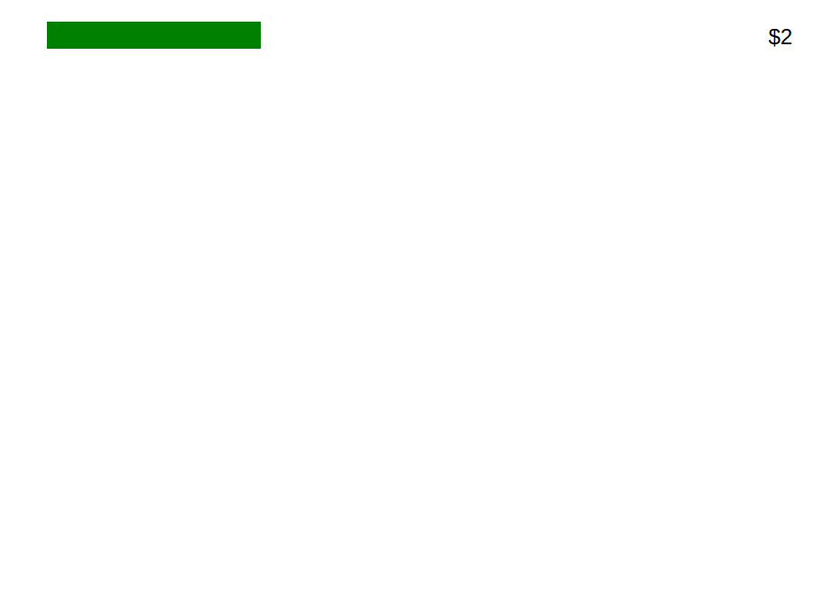
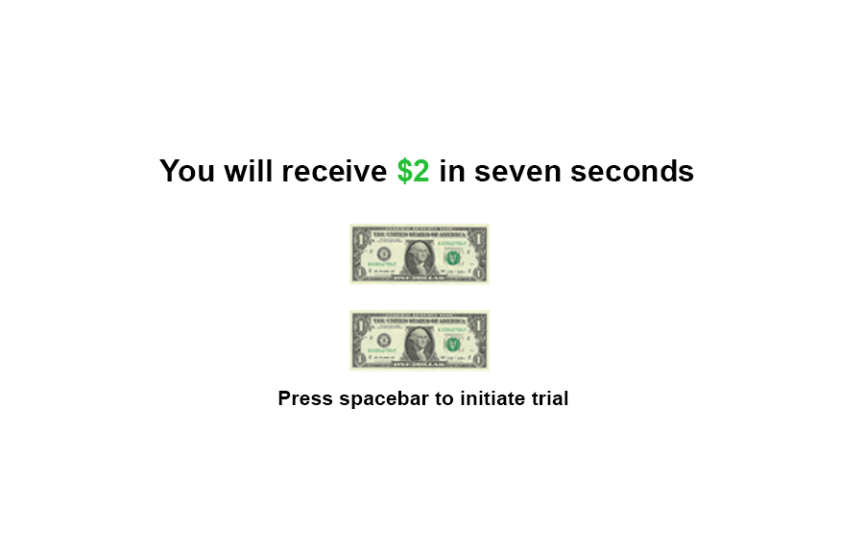
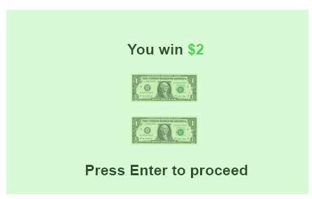

Slide 9
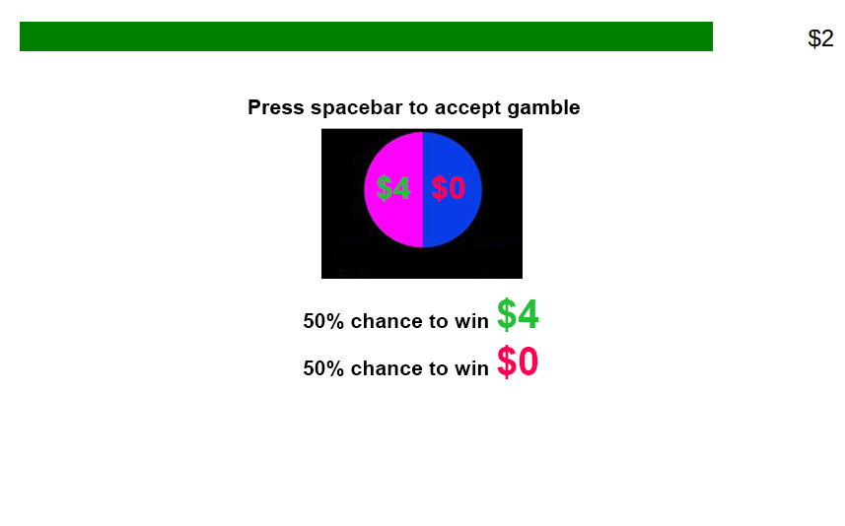

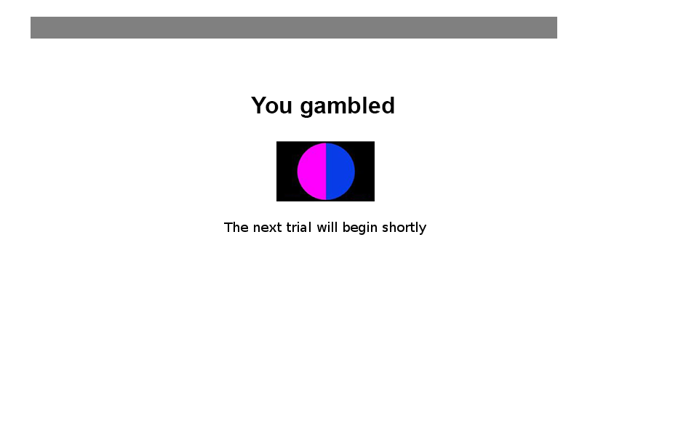

Slide 10
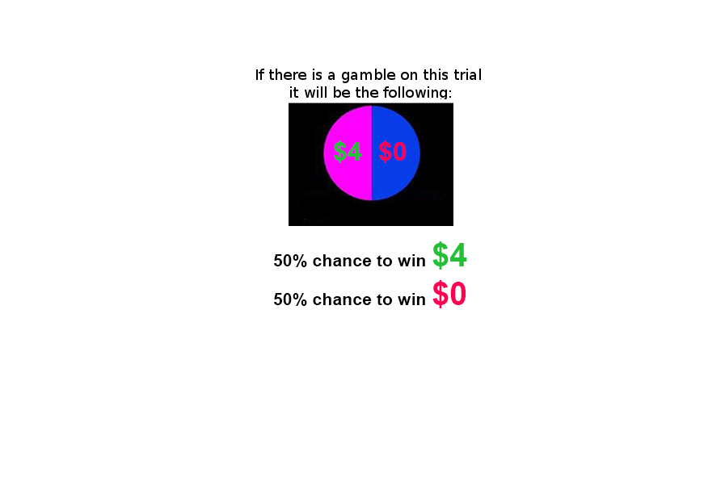
Current version

Slide 11
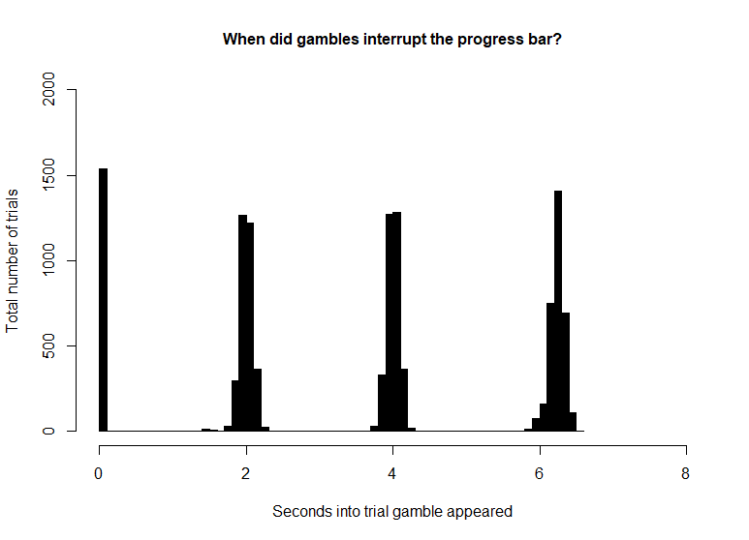
Current task specifications and participants
221 participants
18-40 years old
127 male 76 female
133 trials. Option to gamble on 86.39% of trials.
Each trial has a magnitude and a value component.
Value
Low
Gambles that offer 1.5* guaranteed amount
Mid
Gambles that offer 2* guaranteed amount
High
Gambles that offer 3* guaranteed amount
Magnitude
Low
Trials that offer $1 or $2
Mid
Trials that offer $3 or $4
High
Trials that offer $5 or $6

Slide 12
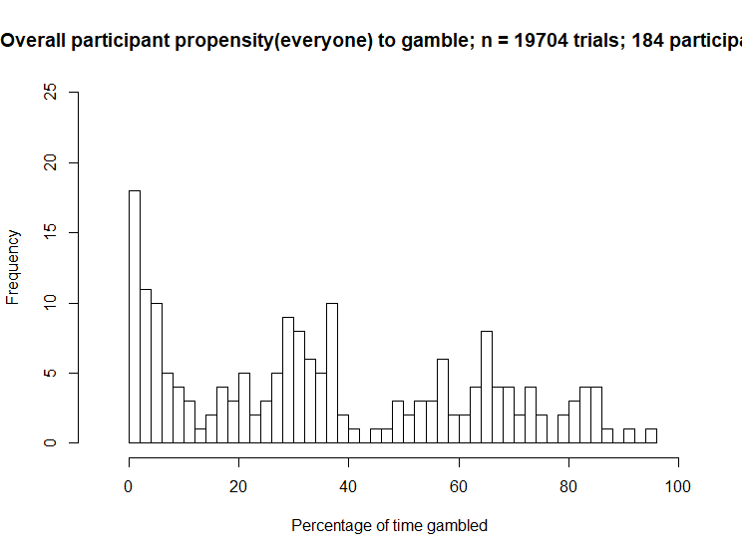
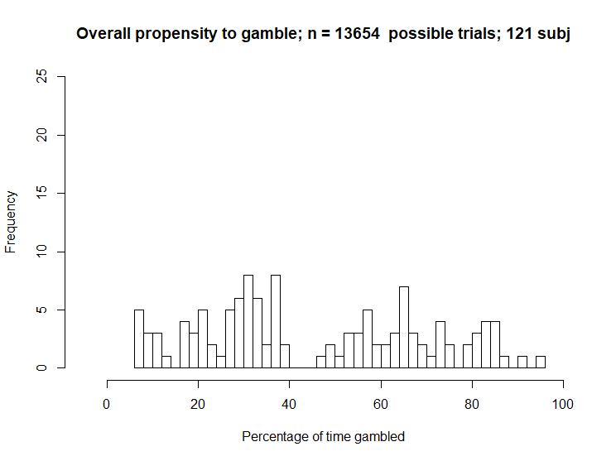
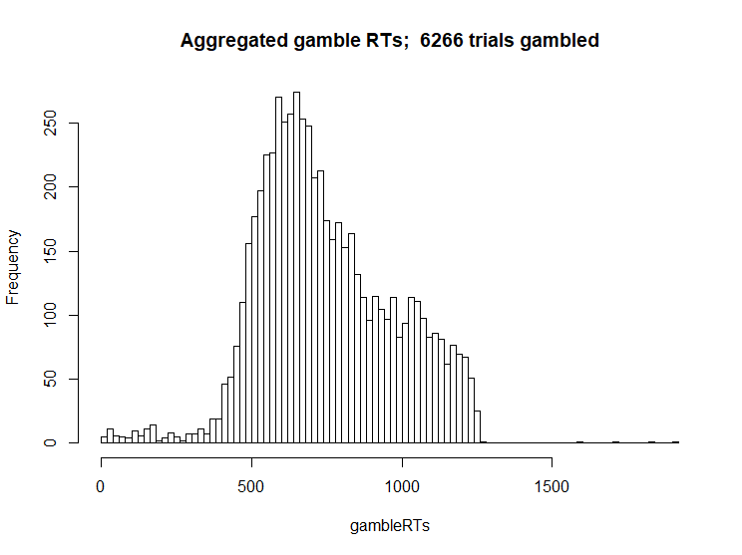
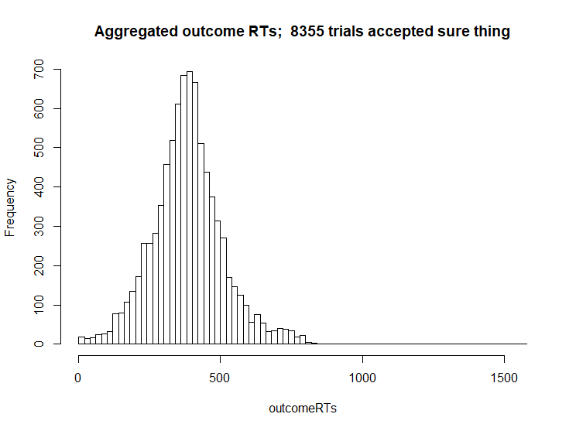
First order analyses

Slide 13
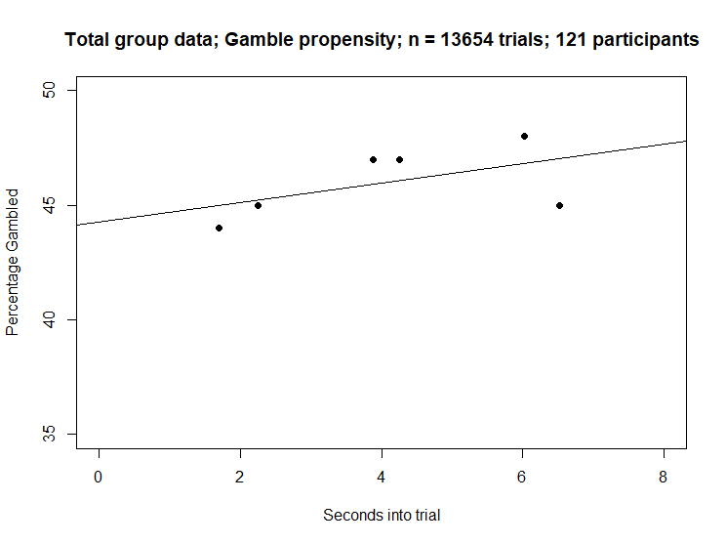
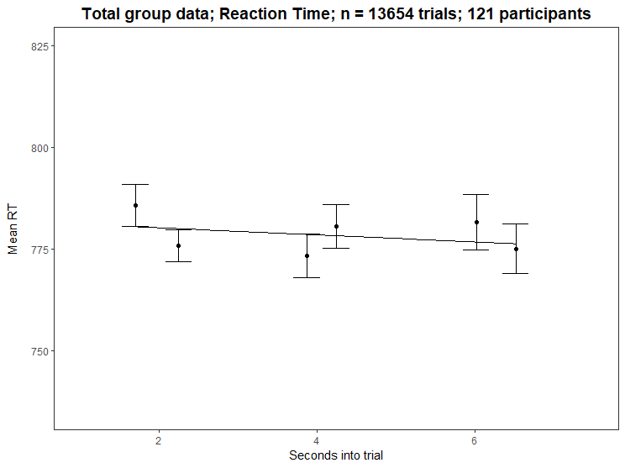
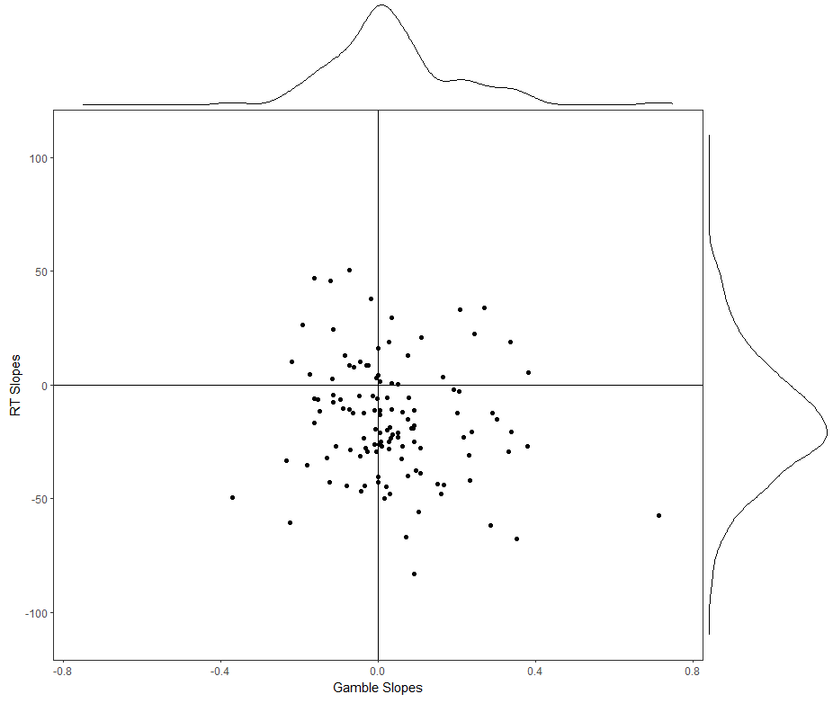

Slide 14
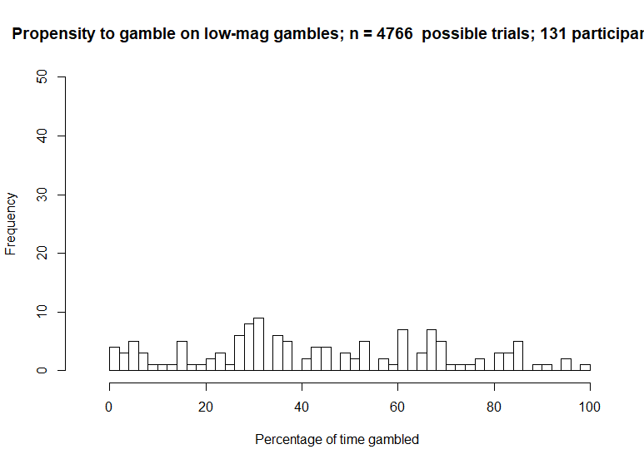
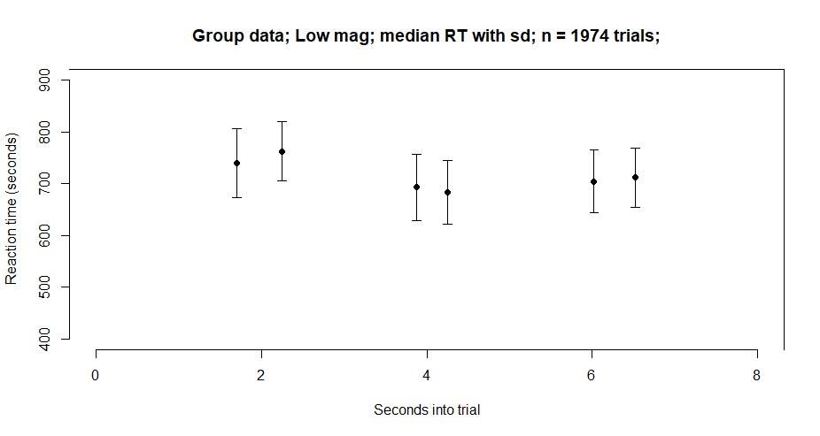
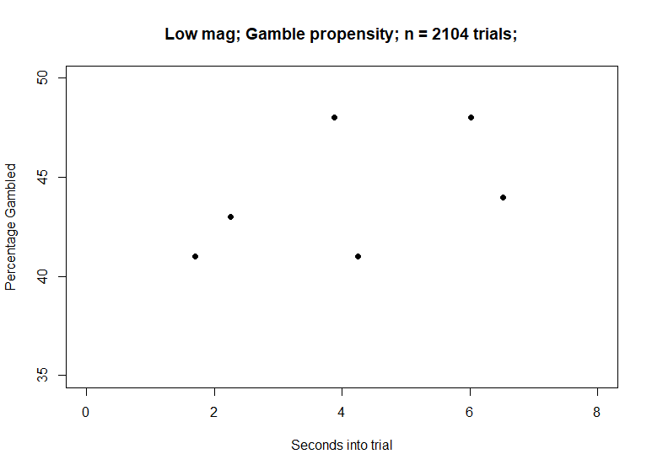
Low Mag

Slide 15

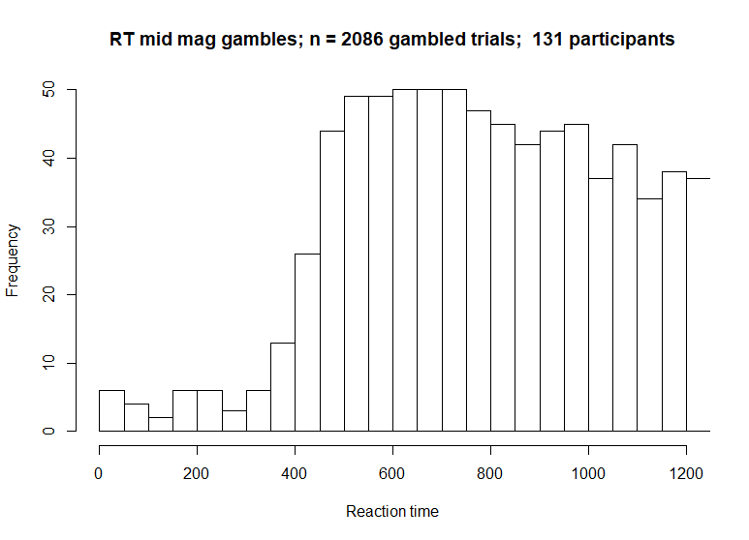
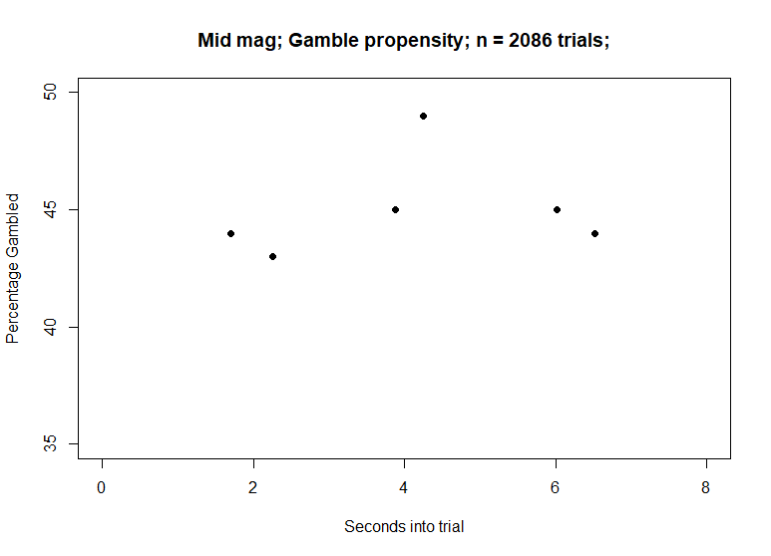
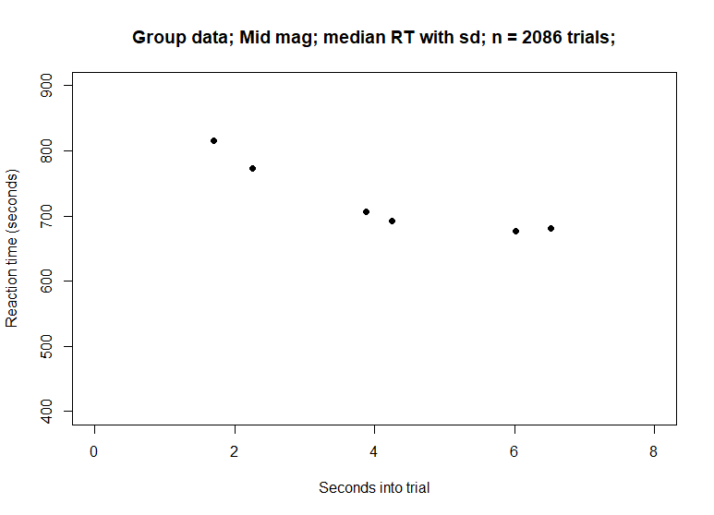
Mid Mag

Slide 16
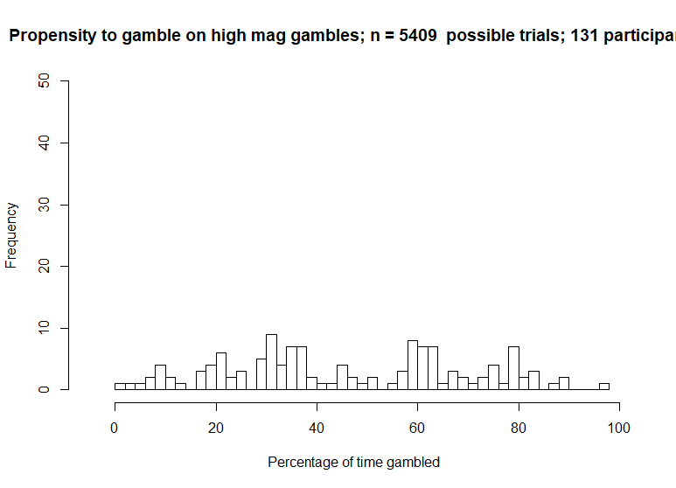
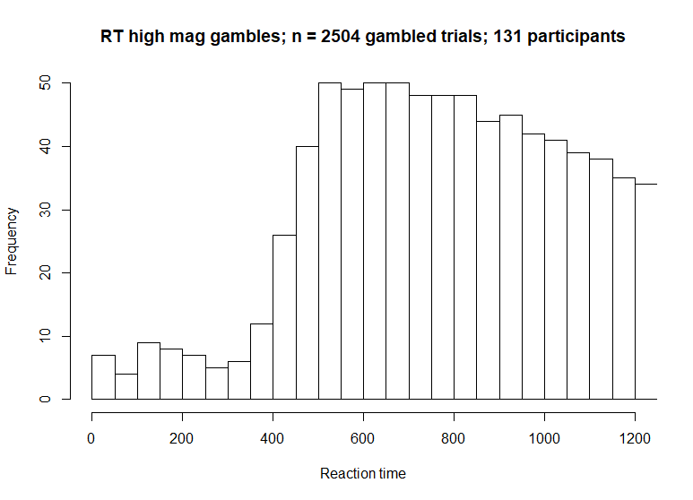
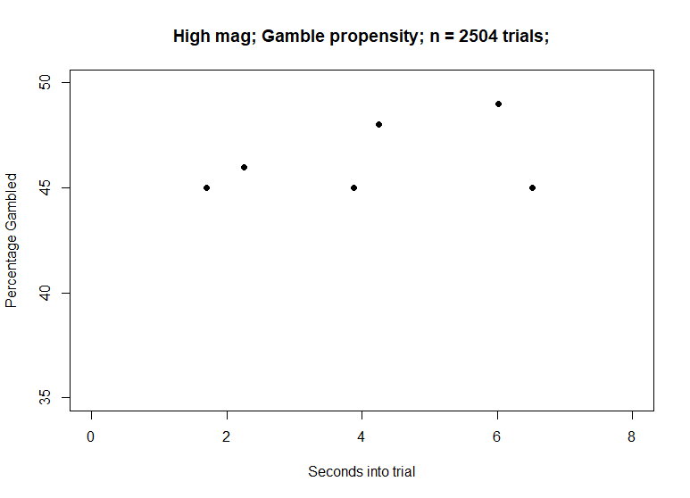
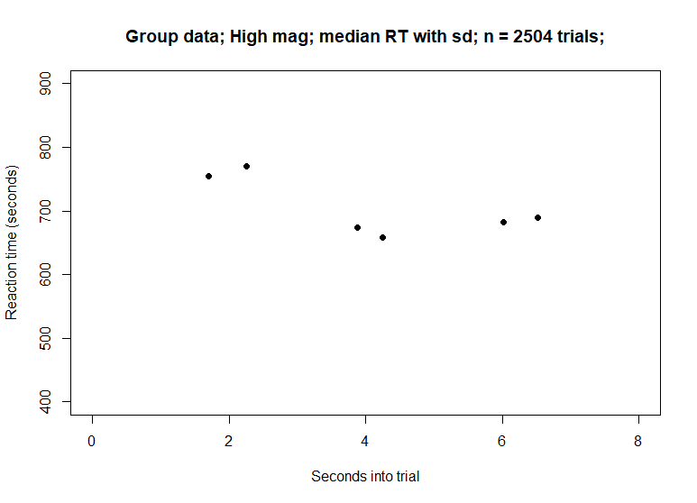
High Mag

Slide 17
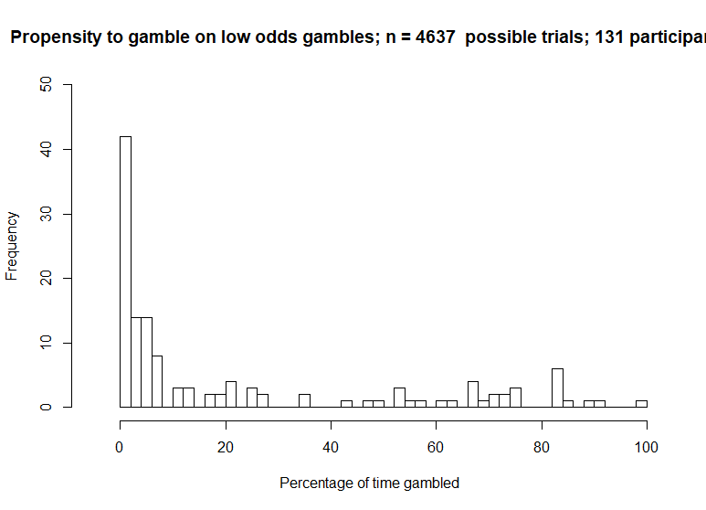
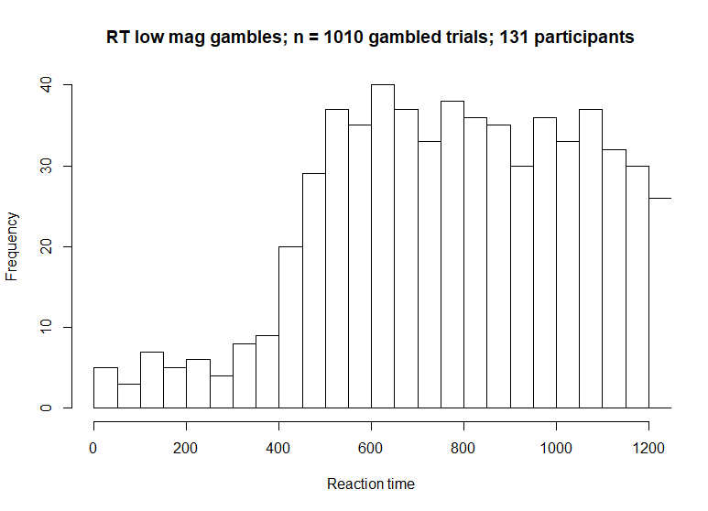
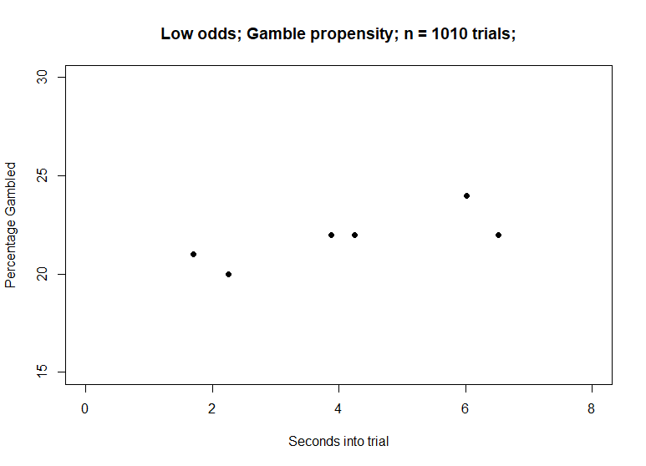
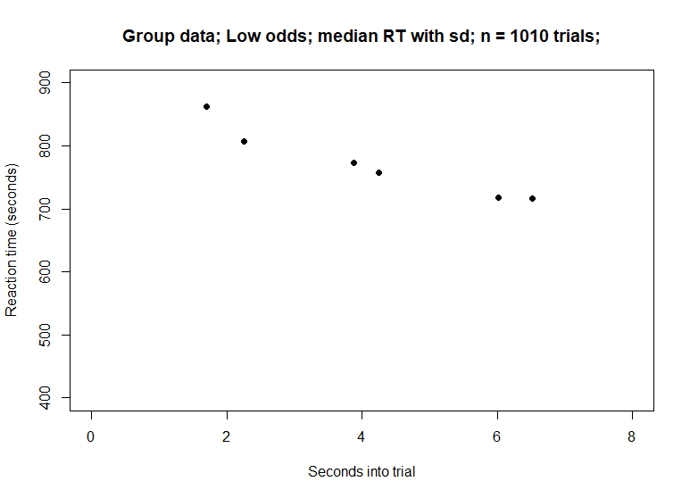
Low value (previously called odds)

Slide 18
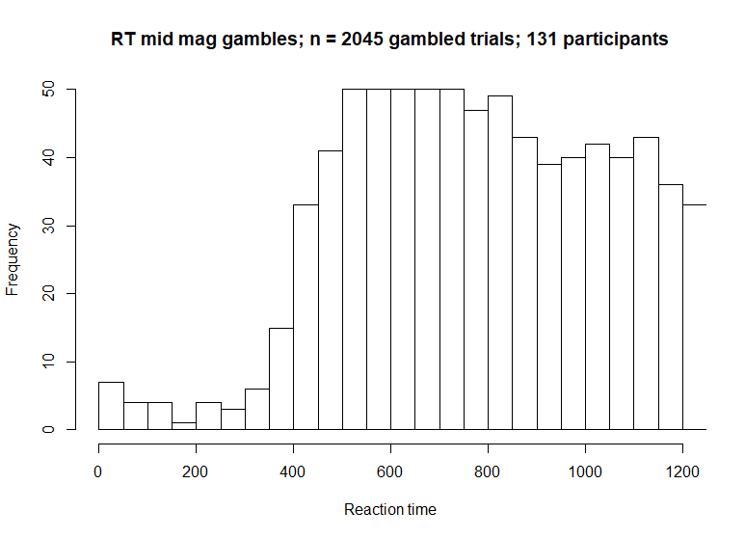
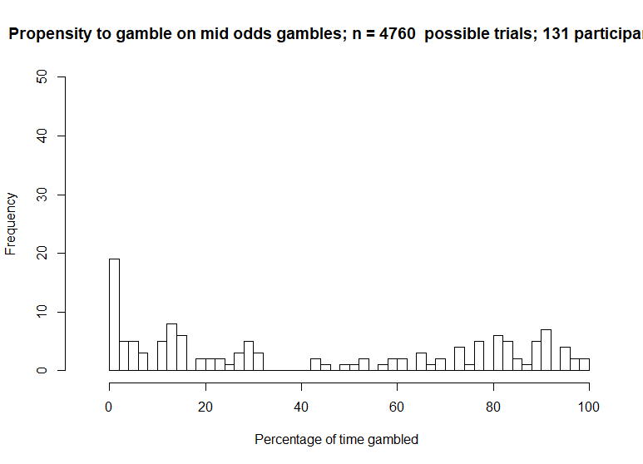
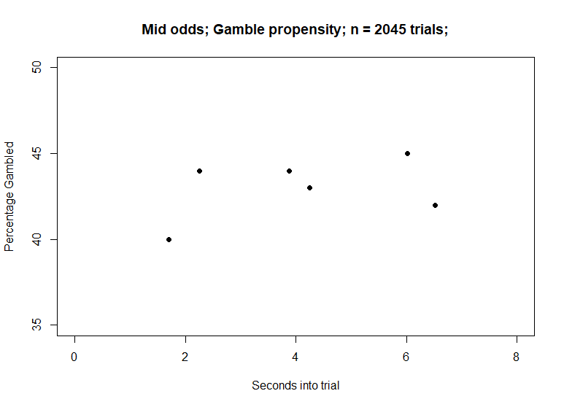
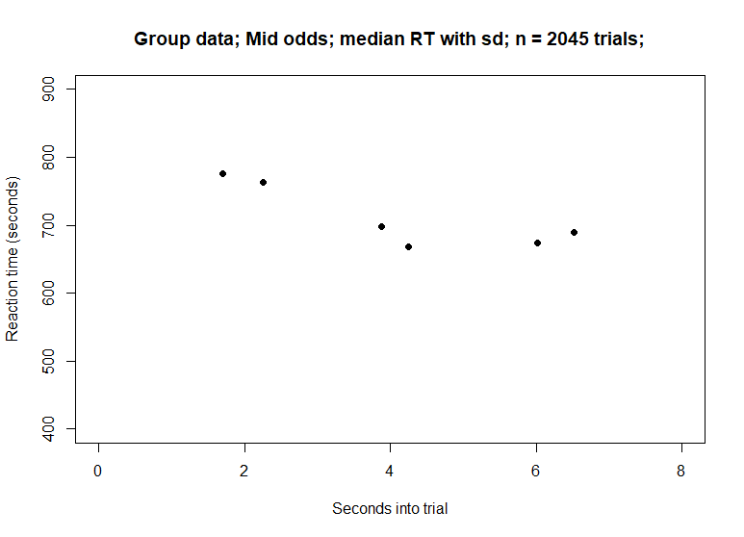
Mid value (odds)

Slide 19
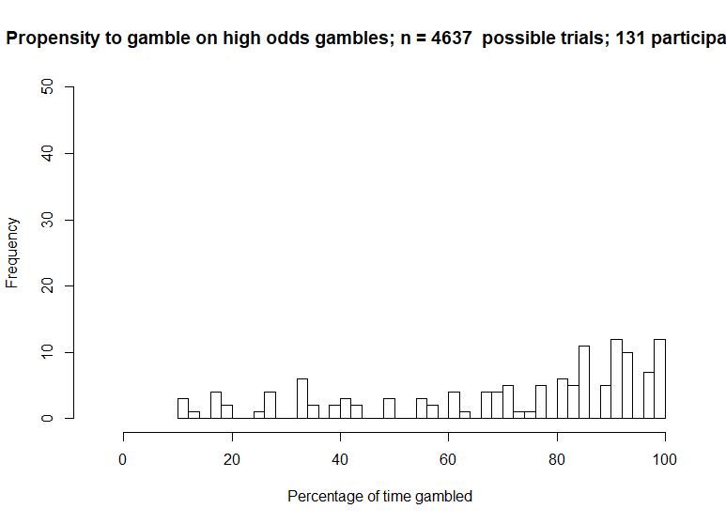
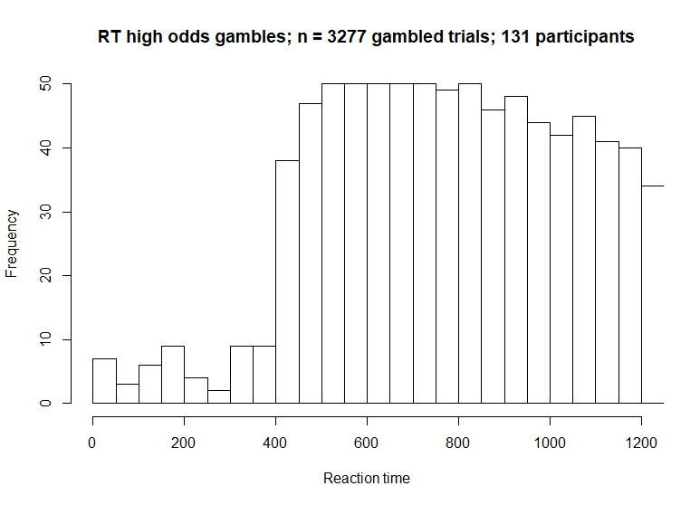
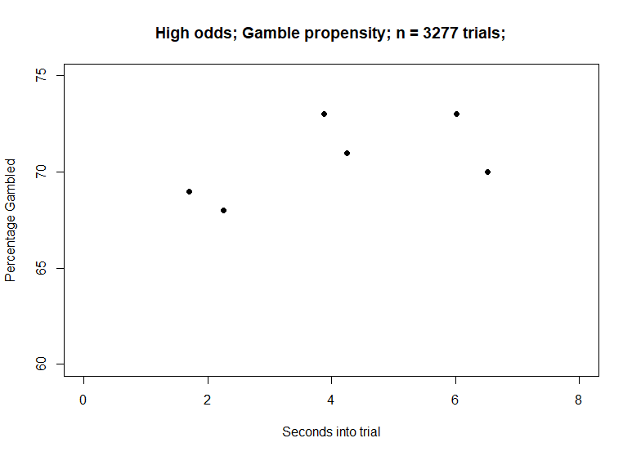

High odds

Slide 20
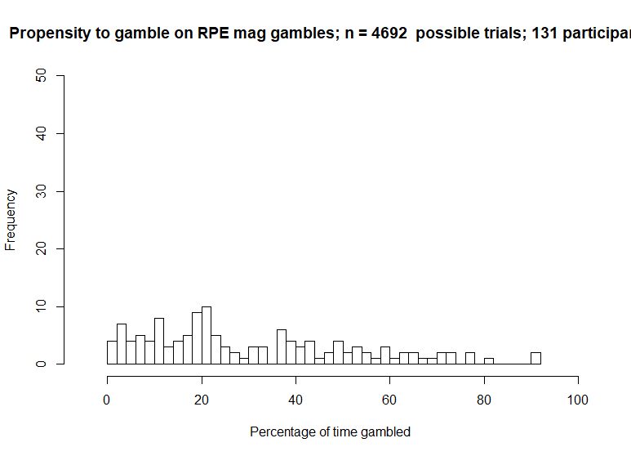
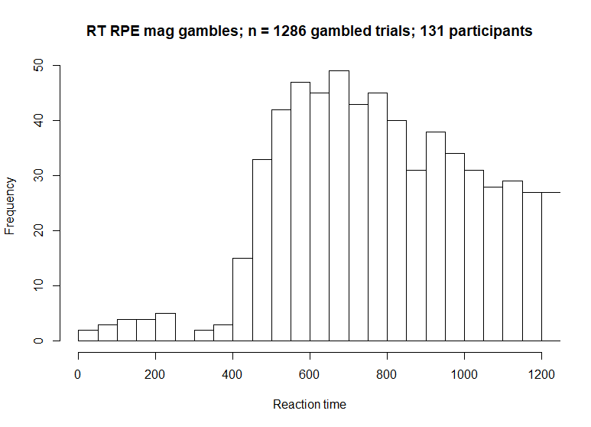
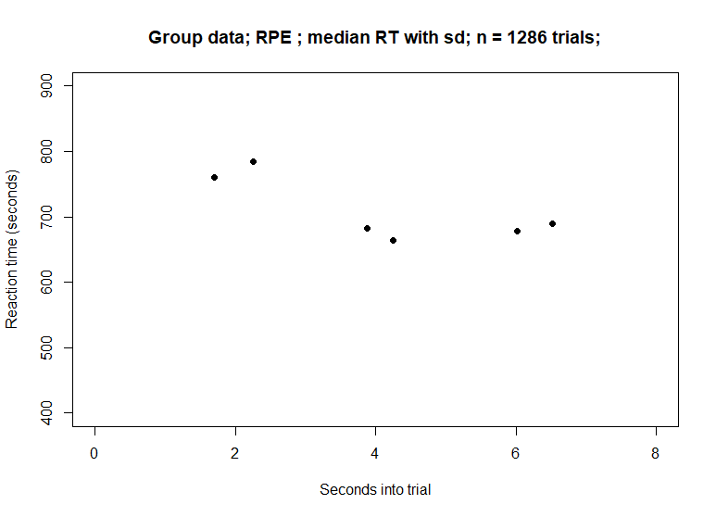
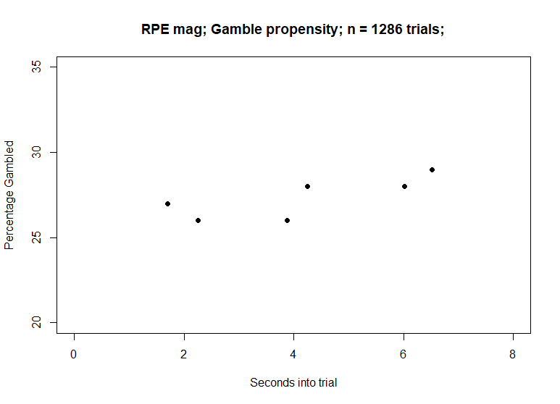
High RPE trials only

Slide 21
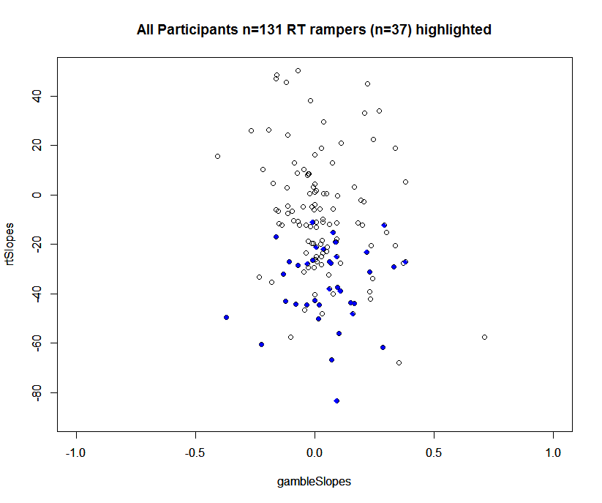
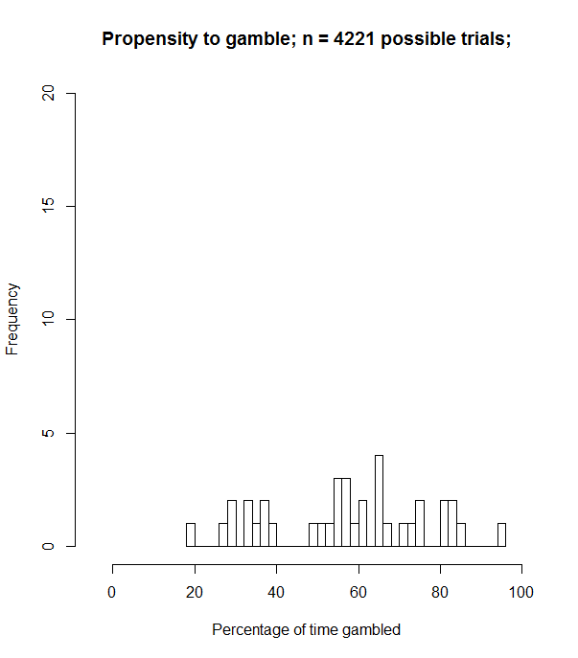
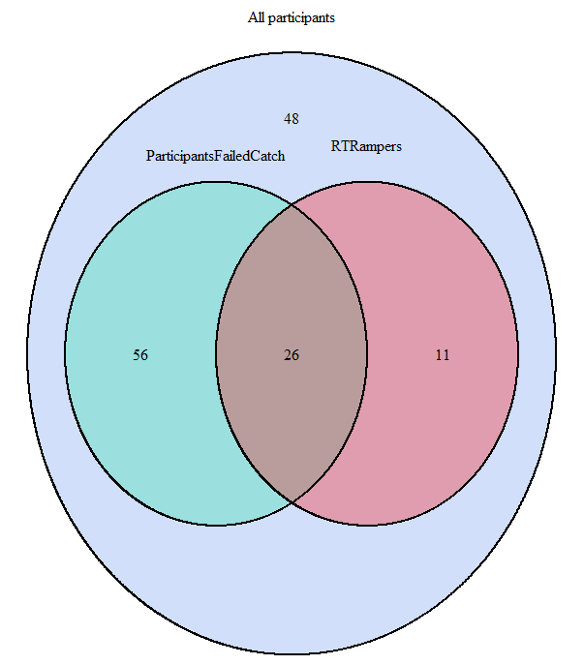
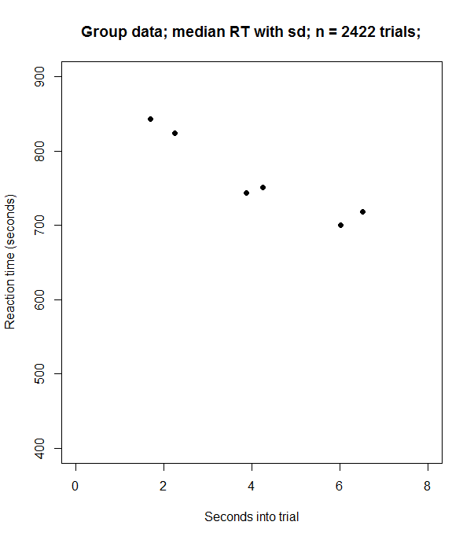

Participants who showed downwards decreasing RT slope, p< .1 (n= 37)

Slide 22





Participants who showed gambleRamp p<.1 (n=18)

Slide 23






Upper quartile of logical gamblers split (n=38)
This plot shows only midValue trials
for logical gamblers

Slide 24





Participants who gambled more than 60% of time (n=45)

