Slide 1
Studying dopamine: a risky proposal?
Exploring the dynamics of dopamine and ventral striatal activity
Borton lab meeting 12.7.18
Guillaume Pagnier

Slide 2
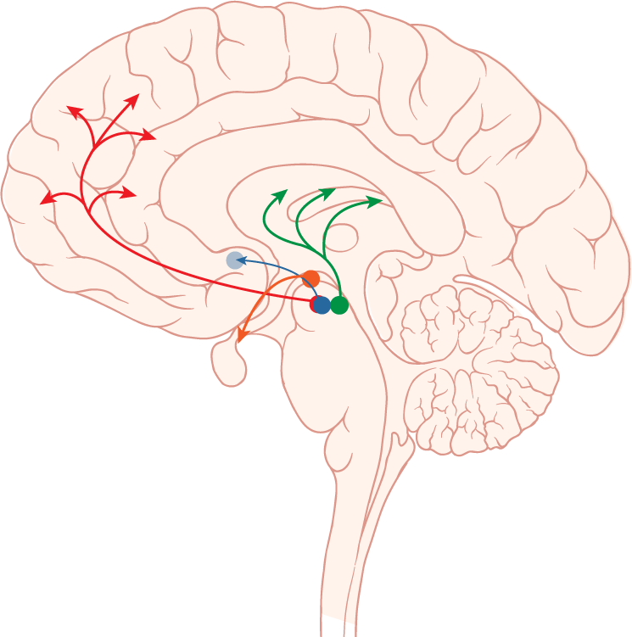
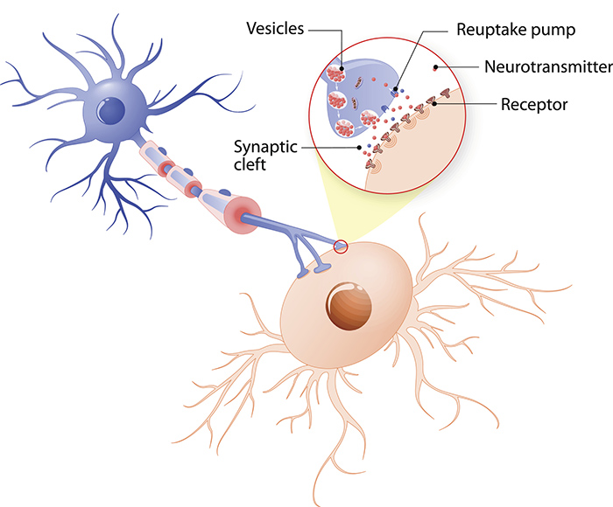
What is dopamine?
Neurotransmitter
Rest of Basal Ganglia (BG)
Dorsal Striatum
(Caudate and Putamen)
Ventral Striatum (NaC)
DA
DA
Striatum
SNpc
Ventral Tegmental Area (VTA)
Credit:Getty Images/iStockphoto
Notes:
DA-

Slide 3
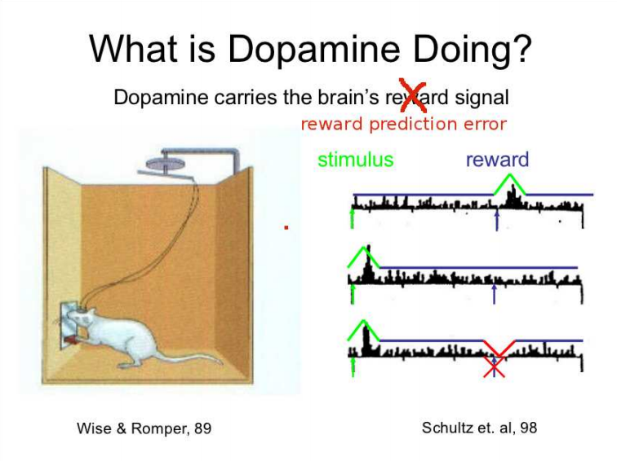
Credit:Michael Frank
Notes:
Similar to gambling via anticipation of reward though unsure about what gambling really does

Slide 4
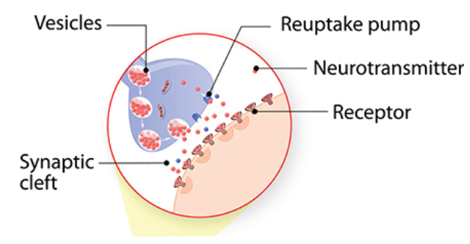
Exploiting dopamine via drugs
Notes:
Cocaine: blocks reuptake transmission. Physiologically addictive via fewer transporters
Gambling:

Slide 5
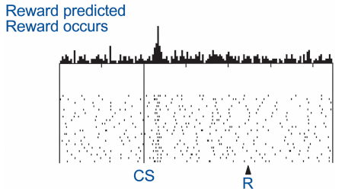
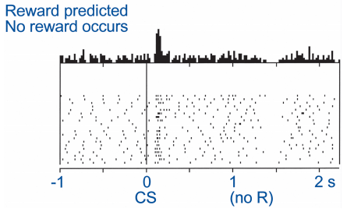
So, what does dopamine (DA) do?
Lots of things
Current behavior (performance)
Future behavior (learning)
RPEs guide learning
DA lesions leads to akinetic movements and the choice to not pursue rewards

Slide 6
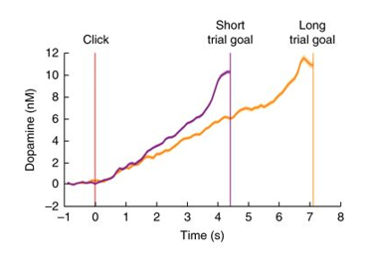
Striatal DA encodes the value of work and ramps up to an expected reward
Reflects state value of a reward
Notes:
Howe, M. W., Tierney, P. L., Sandberg, S. G., Phillips, P. E. & Graybiel, A. M. Prolonged dopamine signalling in striatum signals proximity and value of distant rewards. Nature 500, 575–579 (2013).
Wassum, K. M., Ostlund, S. B. & Maidment, N. T. Phasic mesolimbic dopamine signaling precedes and predicts performance of a self-initiated action sequence task. Biol. Psychiatry 71, 846–854 (2012).
Hamid, A. A. et al. Mesolimbic dopamine signals the value of work. Nat. Neurosci. 19, 117–126 (2016).
Only true in instrumental case

Slide 7
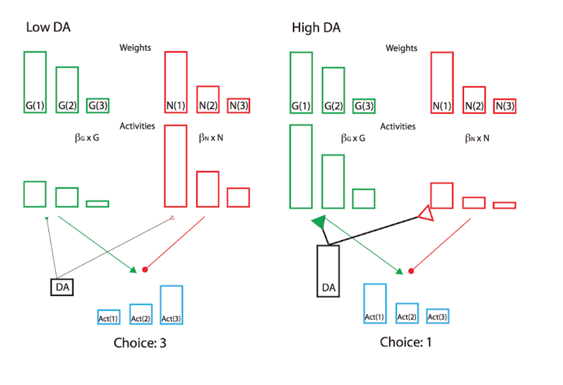
Do fluctuating levels of DA bias value perception?
At different levels of DA, participants may be perceiving value differently.
Specifically when experiencing high levels of DA, participants should focus on rewards.
i.e. participants should prefer risky gambles as the potential reward is higher

Slide 8
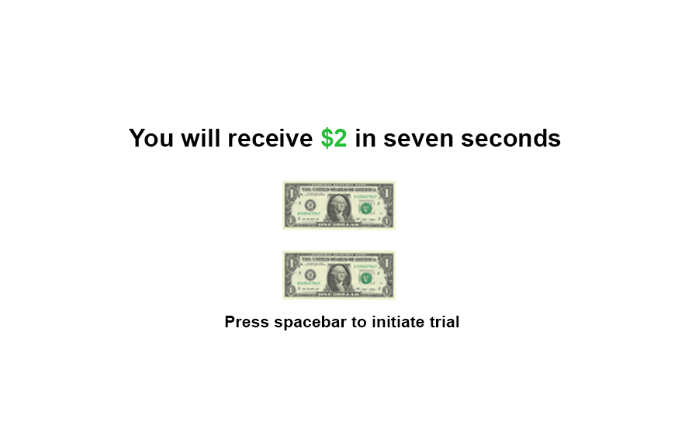
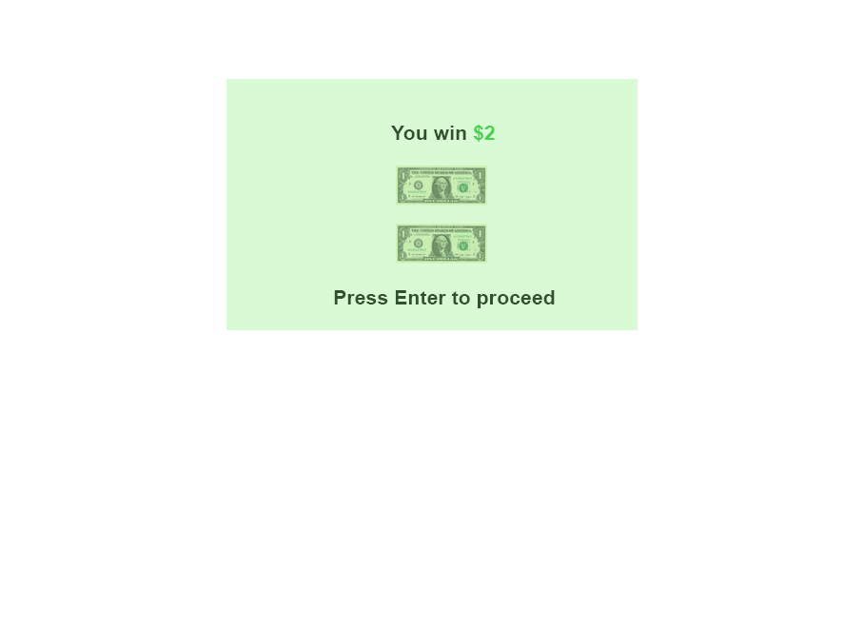
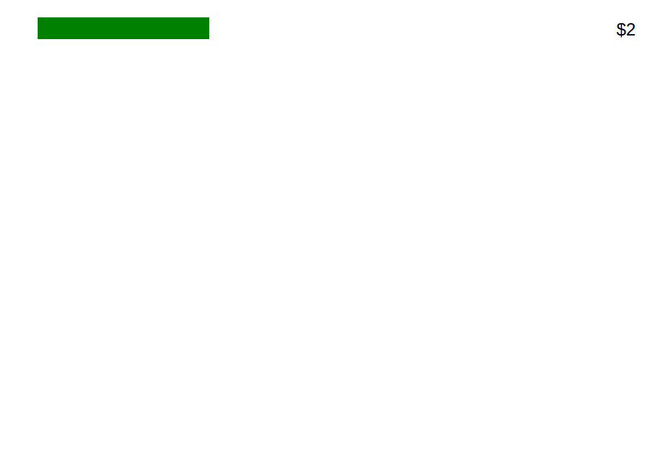
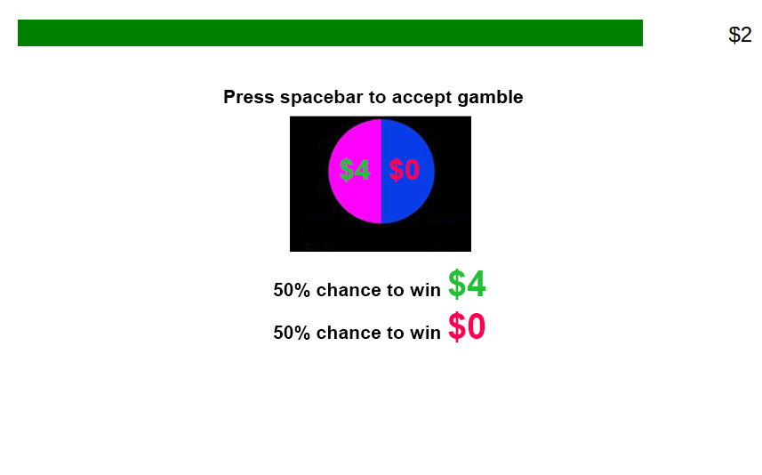
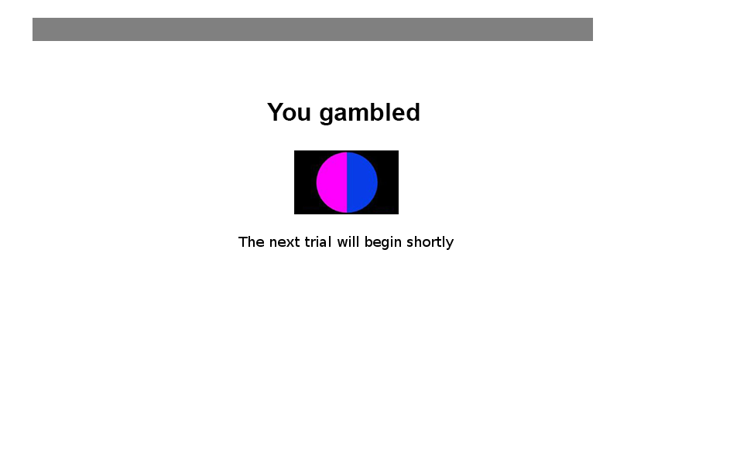

Slide 9
Task
Designed to elicit DA ramping in humans online via mTurk
Gamble?
Gamble?
Gamble?

Slide 11
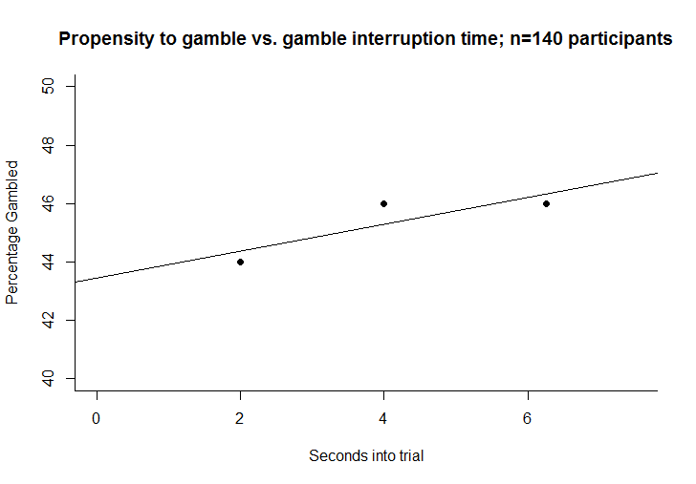
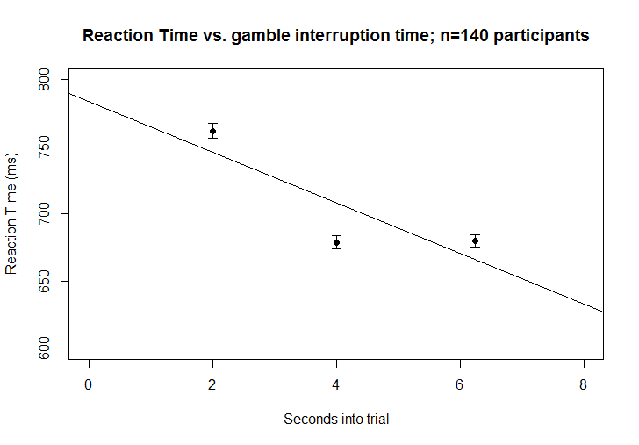
Gamble propensity vs. gamble interruption time
Reaction Time vs. gamble interruption time

Slide 12
DA affects choice behavior

Slide 13
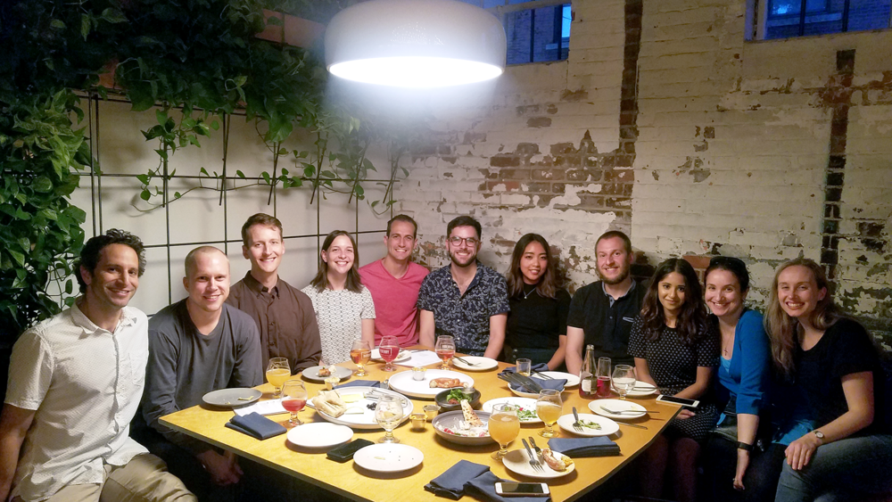
Acknowledgements
LNCC
Special thanks to Andrew, Carolyn, Dan, Andrea, Wasita, and Michael

Slide 14
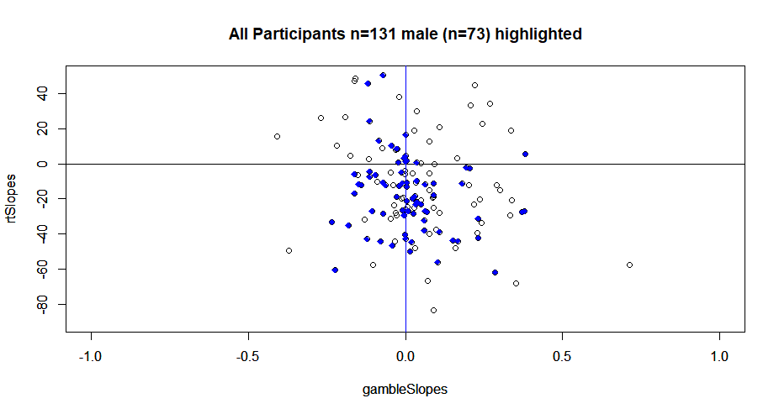
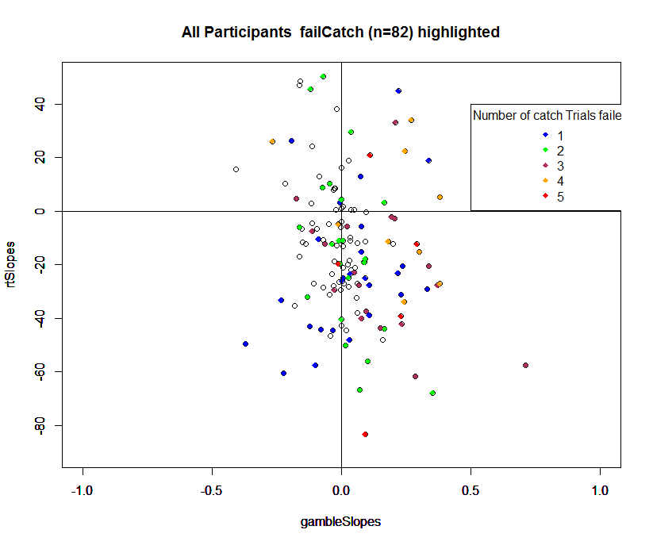
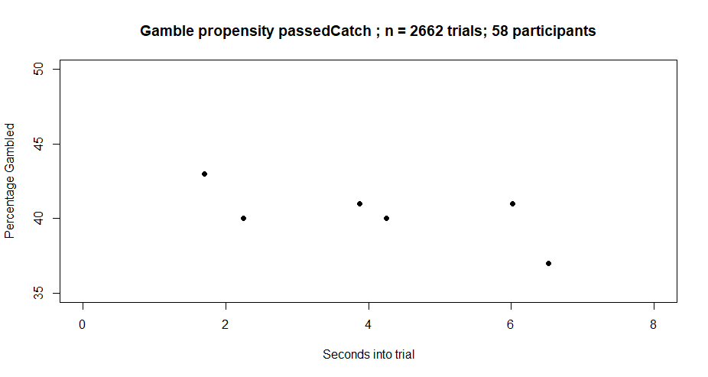
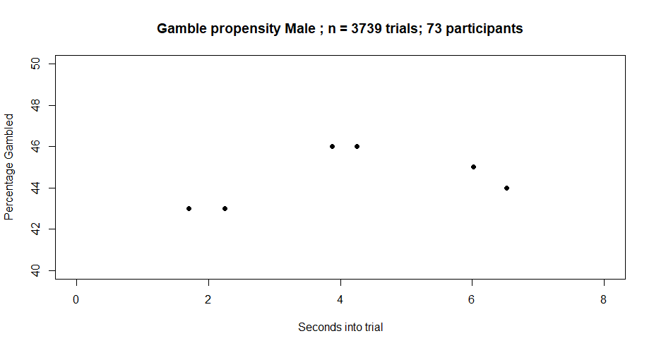
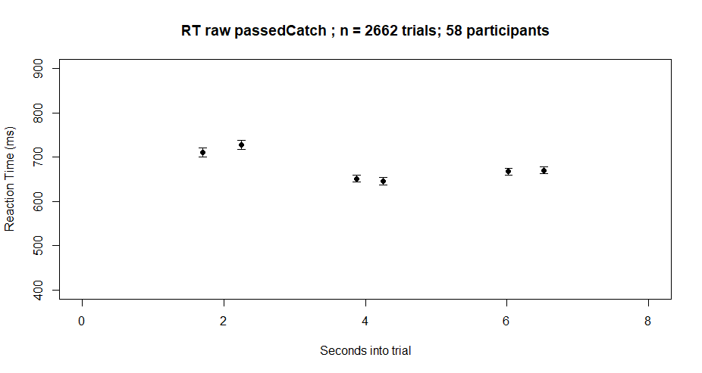
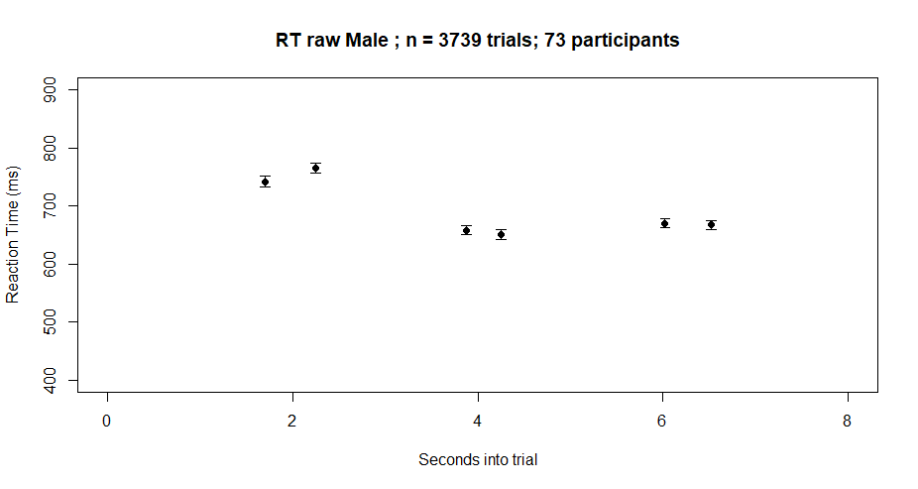
Extra Plots

Slide 15
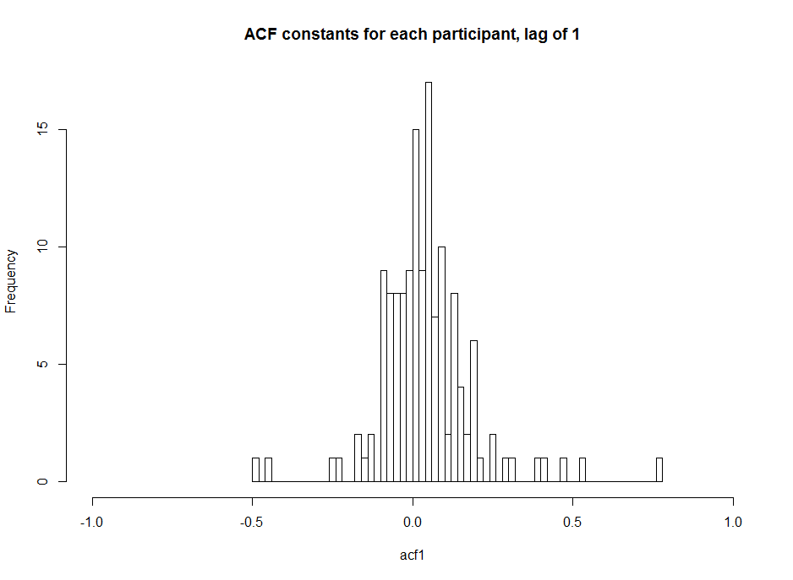
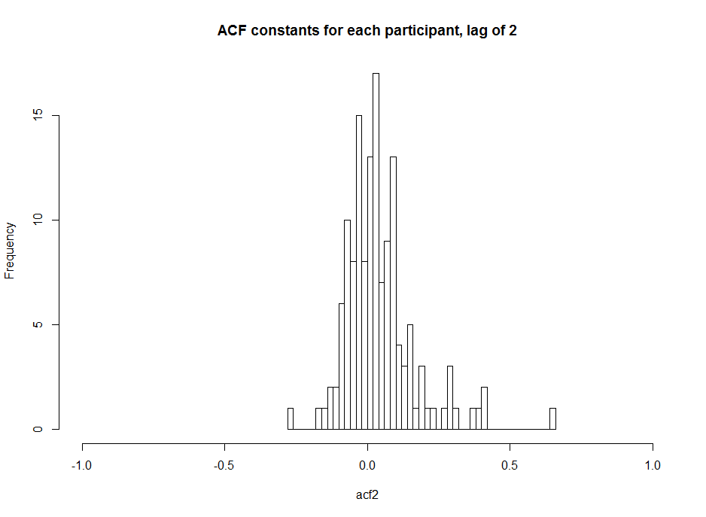
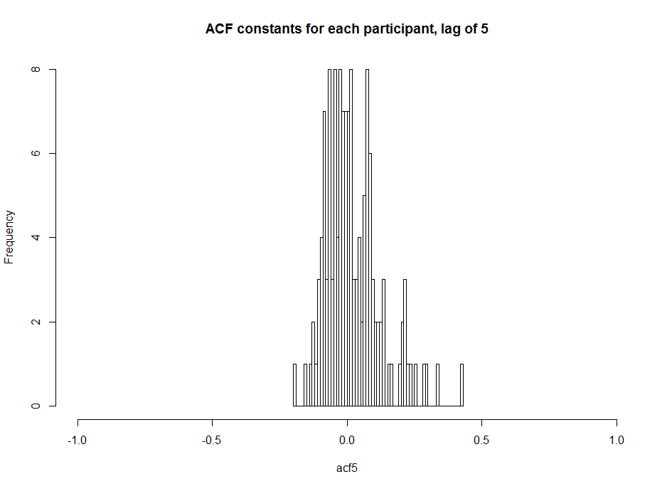
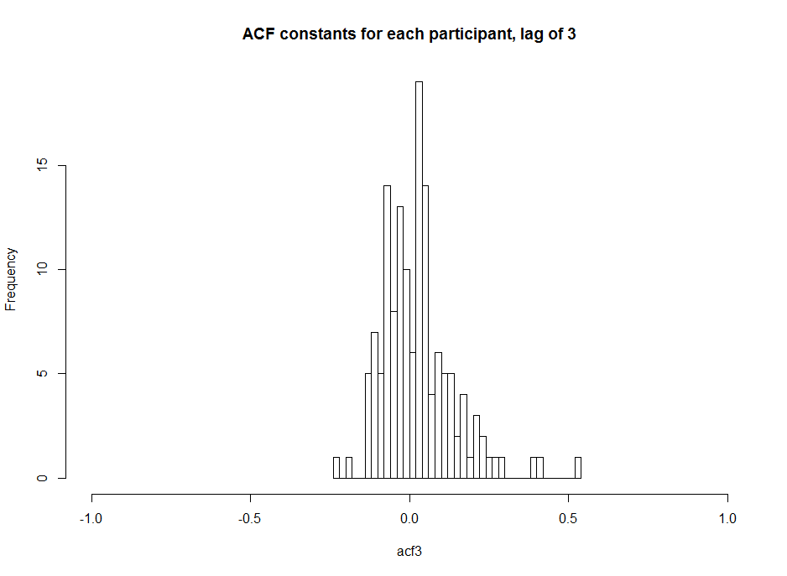
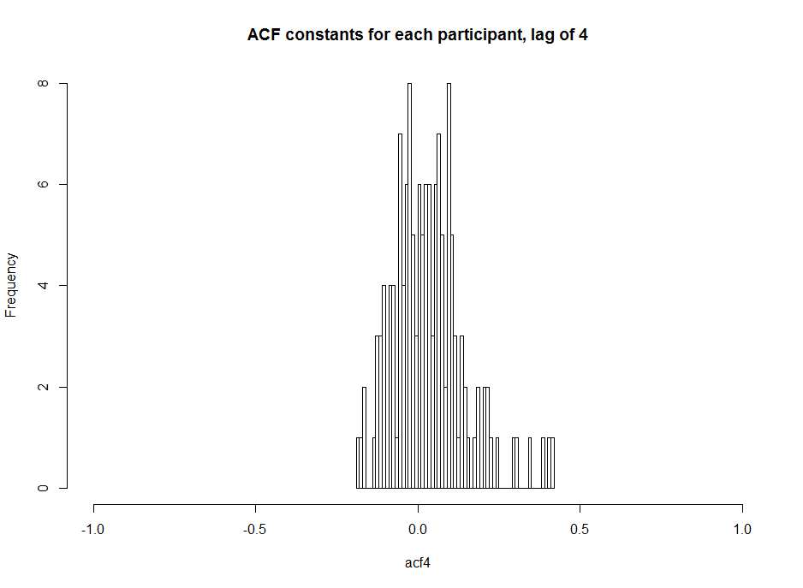
ACF constants for each participant

